Slide 1
EDRN Breast/GYN Collaborative Projects
Ongoing or Completed Projects
Protein and auto-antibodies in serum for early detection of triple negative breast cancer
Protein and auto-antibodies in serum for early detection of ovarian cancer
Tissue biomarkers in benign breast disease for risk of invasive breast cancer

Slide 2
EDRN Breast/GYN Collaborative Projects
Proposed Projects
Genomic signatures of ovarian cancer in cervico-vaginal fluid (CVF)
Combined blood and image biobank for early detection of breast cancer
Validation of blood-based markers for ER+ breast cancer
Validation of mammographic imaging markers specific to different breast cancer subtypes
Integration of imaging and blood based markers to improve breast cancer early detection

Slide 3
Proposed Breast Cancer Projects - Details
1. Phase 3 validation of blood-based markers for ER+ breast cancer
Analogous to previous triple-negative project
Could leverage both the EDRN reference set and our sets of preclinical samples
Clear potential clinical applications
2. Validation of mammographic imaging markers specific to different breast cancer subtypes
Could leverage existing sets of samples
Could guide clinical decision making
3. Integration of imaging and blood-based markers to improve breast cancer early detection
Could leverage existing sets of samples including both clinical and preclinical sets
Could guide clinical decision making

Slide 4
EDRN Ovarian Cancer Validation Project
TEAMS
BDL
Steven Skates | Michael Gillette
Eleftherios Diamandis | Vathany Kulasingam
Andy Godwin | Paul Engstrom
Nicole Urban | Chris Li
Josh LaBaer | Karen Anderson
Jeff Marks | Anna Lokshin
Zhen Zhang | Lori Sokoll
Karin Rodland | Tao Liu
David Camp
BDL
BDL
BDL
CEVC
CEVC
CEVC
BDL
BDL
CEVC
BDL
BRL
IAA
IAA

Slide 5
Ovarian Validation Study – Early Detection
Original design
150+ ovarian cancer candidates discovered in previous round of funding
Diamandis
Godwin
LaBaer
Li
Lokshin
Marks
Skates
Bioinformatics (in silico) mRNA filter
Accurate Inclusion
Mass Screening (empirical)
50 Candidates
25 SRM Assays
PNNL (BRL)
25 Bioplex Assays
JHU (BRL)
+ NAPPA (ASU)
Cases vs. Benigns at Diagnosis – rule out (FHCRC – CEVC)
Early Detection Biomarkers
25 candidates x Longitudinal ROCA samples

Slide 6
Top ranked Affy probes amongst 363 probes representing 153 protein candidates

Slide 7
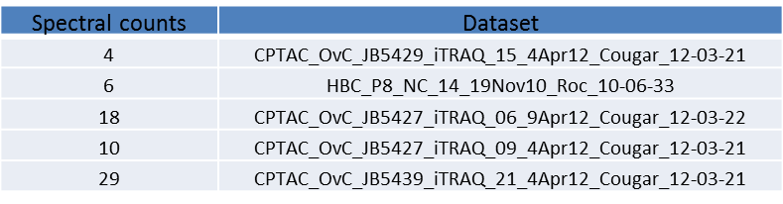
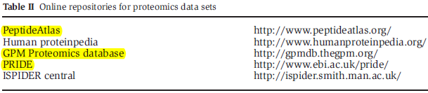

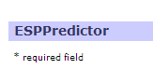
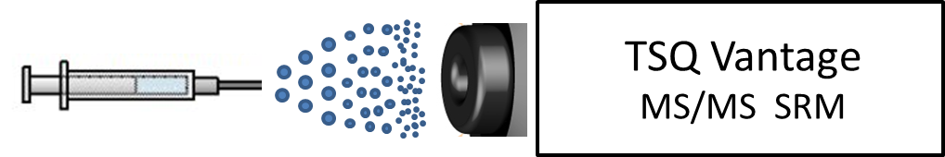
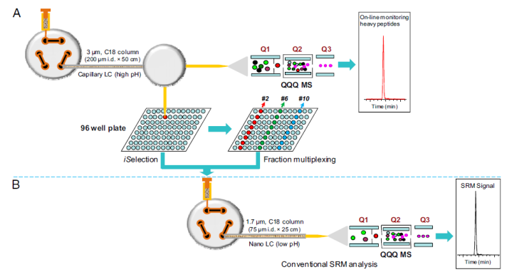
Procedure for Developing PRISM-SRM Assays
PNNL data
Online database
Prediction tools
Peptide selection:
Direct infusion
CE and transition optimization:
Scheduled SRM
LC-SRM:
PRISM SRM
PRISM-SRM:

Slide 8
Candidate biomarker list and PRISM-SRM analysis – Antibody Free!
13 of 16 target proteins detected using PRISM-SRM
Only 5 of 16 detected without PRISM
Data from analysis of 7 cases and 7controls provided by POCRC

Slide 12
ROCA Study – Longitudinal Biorepository
Johns Hopkins
Georgetown
Enrollment by
Study Site
Emory
FHCRC
Baylor
Duke/UNC
MD Anderson
UT San Antonio
Creighton
EDRN
John Stoddard
UT Southwestern
Magee
Dana-Farber
Patients: 3,780
MGH
UPenn
Alabama
Utah
Fox Chase
Colorado
UCI
Early Detection of Ovarian Cancer in Women at Increased Risk
Collaboration between CGN, GOG, SPORE, EDRN, & philanthropy

Slide 13
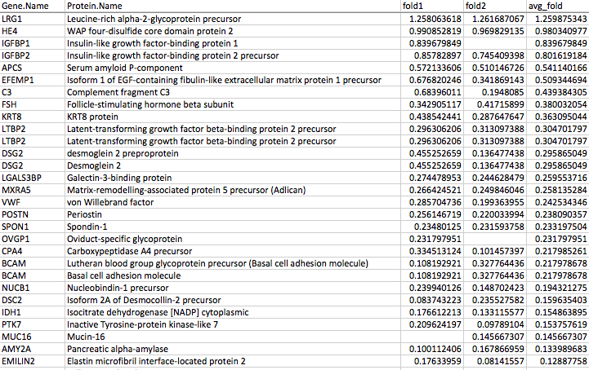
Broad Institute: Ranked AIMS results in pooled plasma by avg Fold Change

Slide 14
Ovarian Validation Study – Early Detection
Modified design
150+ ovarian cancer candidates discovered in previous round of funding
Diamandis
Godwin
LaBaer
Li
Lokshin
Marks
Skates
Bioinformatics (in silico) mRNA filter (Toronto)
Accurate Inclusion
Mass Screening (Broad)
50 SRM Assays
PNNL (BRL)
8 high throughput assays
JHU (BRL)
+ 3 NAPPA (ASU)
Cases vs. Benigns at Diagnosis – rule out (FHCRC – CEVC)
Early Detection Biomarkers
25 candidates x Longitudinal ROCA samples (MGH/Broad)

Slide 15
Final Steps
Expand to 100 serous cases vs. 100 serous controls
Measure in longitudinal samples e.g. CGN/SPORE/EDRN ROCA, other cohorts via JHU’s ELISAs.

