Slide 1
Fourth Annual US Japan Workshop on Cancer Biomarkers
EDRN lung collaborative group
“Non-invasive diagnosis of lung cancer in an epidemic of indeterminate pulmonary nodules”
March 7, 2017
Tempe Az

Slide 2
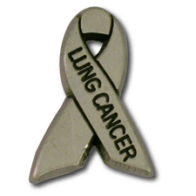
Lung Collaborative Group
Biomarker Development Laboratories
Avi Spira, Steve Dubinett, Marc Lenburg, Deni Aberle | BU, UCLA and Lahey Clinic
Louise Shaw | Wistar Institute
Jim Herman | U of Pittsburgh
Harvey Pass | NYU
Biomarker Reference Laboratory
Sanford Stass, Feng Jiang | University of Maryland
Clinical Validation Centers
Pierre Massion, Kim Sandler | Vanderilt
Bob Gillies, Matt Schabath | Moffitt CC
DMCC
Margaret Pepe, Jackie Dahlgren | Fred Hutchinson CC
Program Officers
Lynn Sorbara | NCI DCP
Karl Krueger | NCI DCP
Notes:
8 institutions, 6 BDLs, 2 CVCs, 2 BRLs.

Slide 3
5 pearls for Team Science
Relevant clinical questions, group decision
Careful design and power, support from DMCC
Shared biospecimens, clinical, imaging, biological with MTAs, IRBs, Databases VSIMS
Shared Data, publication policy
Collaboration with outside investigators via set-aside funds and associate memberships

Slide 4

The Challenges of Early Detection
Disease
non-measurable
Lung
nodules
Diagnosis
Recurrence
Behavior
BM of risk
Diagnostic
BM
BM of
Response
Screening programs
Therapeutics
Notes:
Window of

Slide 5
EDRN Lung collaborative group
1. Biomarker of risk
high risk individuals
CVC
3. Molecular & Imaging biomarker for IPNs
LTP2
Risk
Early
Diagnosis
Diagnosis
Progression
2. Biomarker of risk for
never smokers, early onset
disease and strong family history
4. Biomarker of Risk of
post-surgical progression
LTP3
5. Biomarker-based clinical trial

Slide 6
The Pursuit of Noninvasive Diagnosis of Lung Cancer
Risk assessment test
Risk assessment
Screening test
Early detection
Diagnostic test
Staging test
Prognostic test
Disease Management
Test predictive of response
Monitoring
Atwater Semin Respir Crit Care Med 2016
Notes:
Figure 1.

Slide 7
Biomarkers of early detection
Sullivan-Pepe, JNCI 2001- EDRN
Candidates | Phase 1 | Phase 2 | Phase 3 | Phase 4 | Phase 5
 | Discovery, Prediction | Assay validation | Retro-longitudinal | Prospective screening | Cancer Control
SERUM/PLASMA
MS profiling | x | x | x
Autoantibodies | x | x | x | x
Specific antigens /proteins | x | x | x
miRNA | x | x | x | x
DNA methylation Blood | x | x
Circulating Tumor cells | x
TUMOR/airway epith Preinvasive histo/cytology | x | x | x
DNA methylation | x | x | x
RNA airway signature | x | x | x | x
Proteomic profiling | x | x
Chromosome aberrations | x | x
SPUTUM/EBC
DNA Methylation Sputum | x | x | x
DNA CN -FISH | x | x
VOCs | x | x
Notes:
Phase 4 studies screen people and lead to diagnosis and treatment.
Phase 5 reduces the burden of cancer.
Not useful if not treatment, no change in outcomes, in picking up indolent cancers..

Slide 8
Criteria for clinical use of biomarkers
Cost & time
Cancer Control
Cost effectiveness
Adds value or change management
Reduces false positive
Causes a Stage shift
Validates in an Independent cohort
Innovation &
biology
Analytical Validation of the assay
Notes:
Level of evidence?? Proof that it works? Where do we set the bar?
Who is deciding for what is sufficient? Sleep studies and PFTs --better outcomes? Bronchoscopies on chronic cough?
Is clinical utility = cancer control (decrease mortality?

Slide 9
Existing repositories: Blood archives at Frederick
 | Set A | Set B | Set C
Collection | Prospectively collected |  | Prospective collection
SOP | No or not unique SOP |  | Unique SOP
Date | 2000-2005 |  | 2006-on
Clinical setting | Diagnosis | Screening | Diagnosis
Cases | 180 | 170 | 180
Controls | 180 | 250 | 180
Other ca | 75 |  | 75

Slide 10
EDRN Lung collaborative group
3. Molecular & Imaging biomarker for IPNs
LTP2
Risk
Early
Diagnosis
Diagnosis
Progression

Slide 11
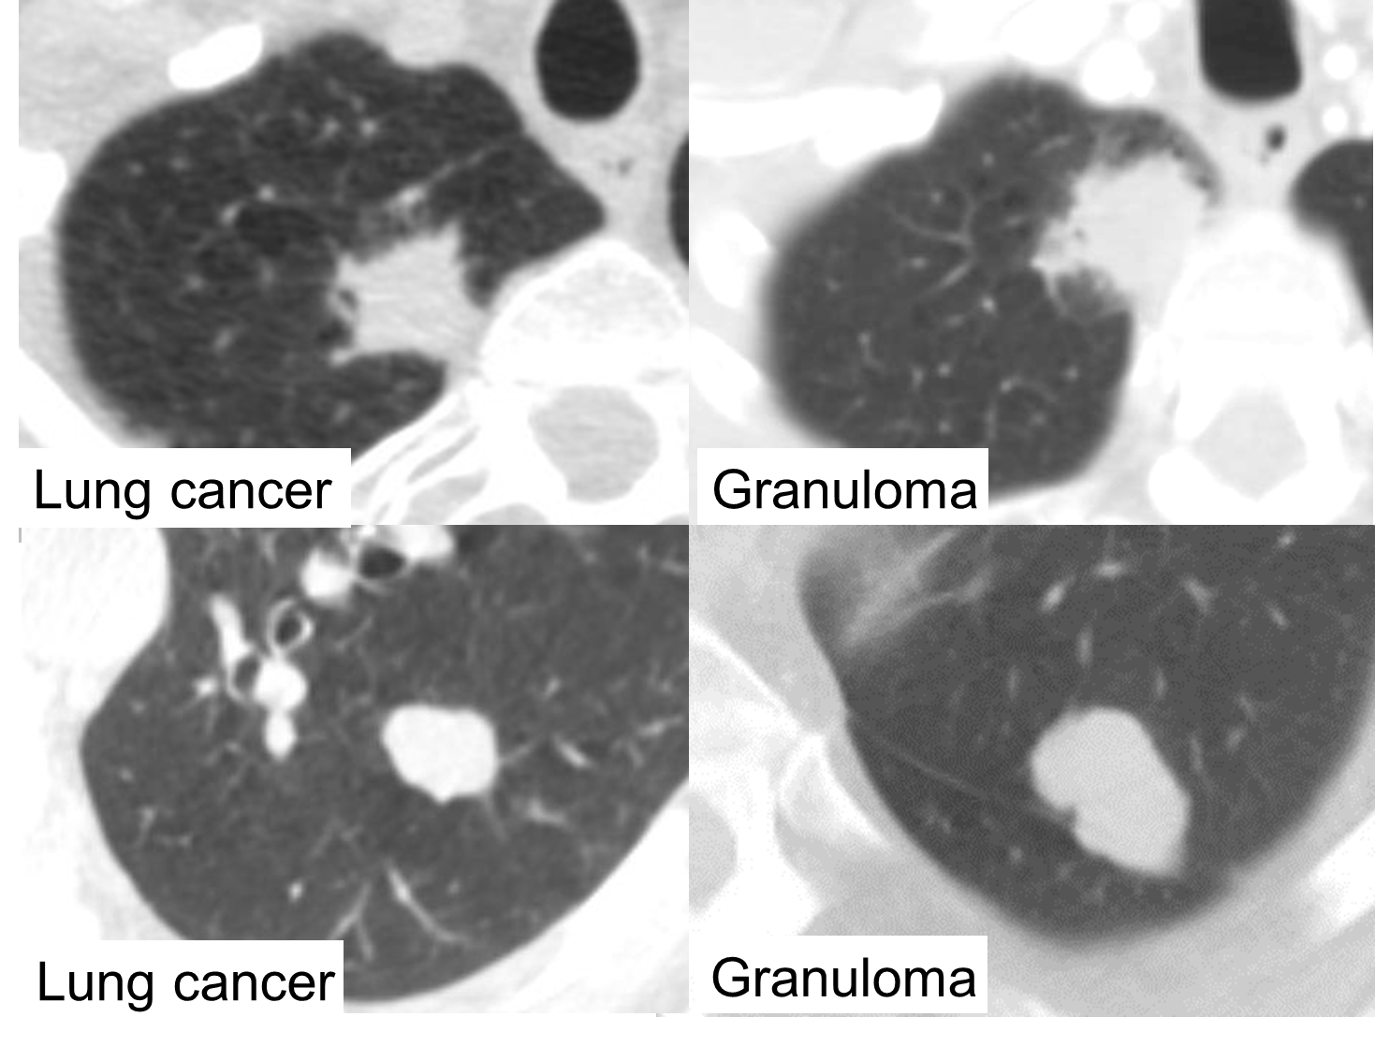
Clinical problem: Indeterminate pulmonary nodules
Courtesy
Dr. Ron Walker

Slide 12
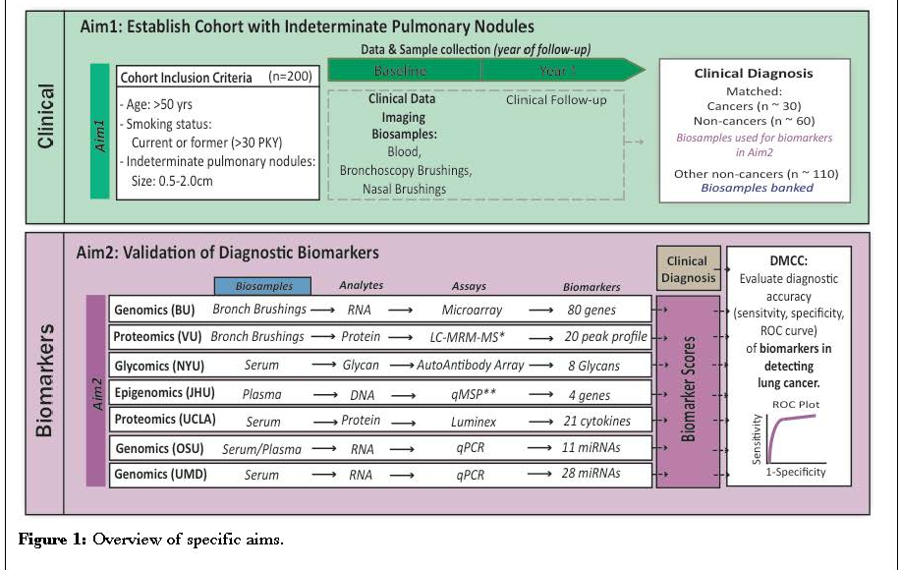
Lung collaborative project - LTP2

Slide 13
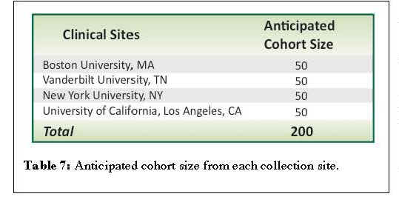
Participating collection sites

Slide 14
Existing repositories: LTP2- IPNs: n=200
Risk Factors Among LTP2 Participants
LC Dx
Other
(n=62)
(n=70)
Smoker:
Yes
62
70
Age:
mean
67.6
66.7
sd
8.7
8.4
Diameter mm:
mean
17.4
13.6
sd
5.4
4.5
Years Since Quitting:
mean
6.1
7.7
sd
10.9
11.7

Slide 15
EDRN Lung collaborative group
Risk
Early
Diagnosis
Diagnosis
Progression
4. Biomarker of Risk of
post-surgical progression
LTP3

Slide 16
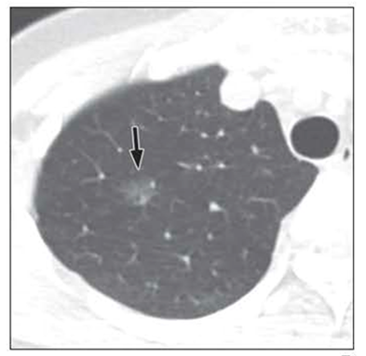
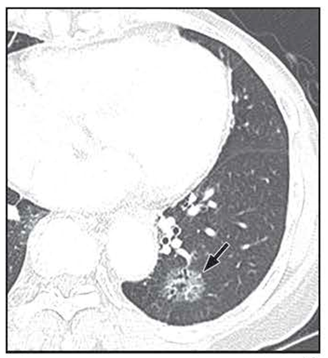
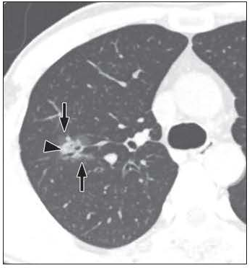
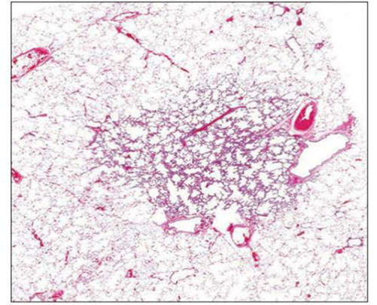
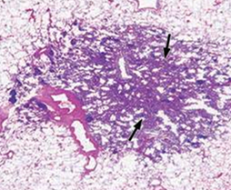
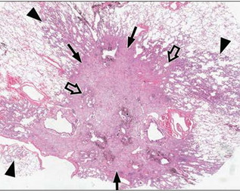
Clinical problem: Indolent vs Aggressive LC
A
C
E
B
D
F
AIS
MIA
ADC
Lee AJR 2014
Weichert COPM 2014

Slide 17
Existing repositories LTP3- Early LCs, n=180
All with plasma
178 with snap frozen matching lung from the same lobe

Slide 18
EDRN Lung collaborative group
1. Biomarker of risk
High risk individuals
CVC
Risk
Early
Diagnosis
Diagnosis
Progression

Slide 19
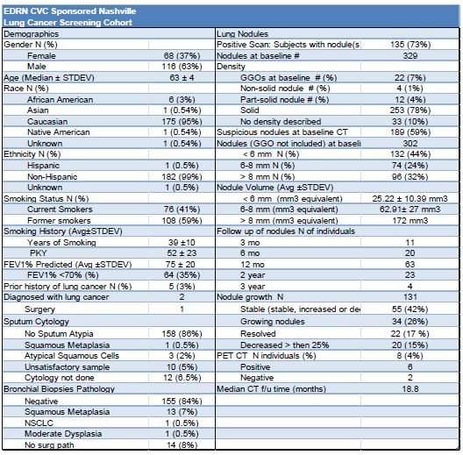
Existing repositories CVC Screening 235/480

Slide 20
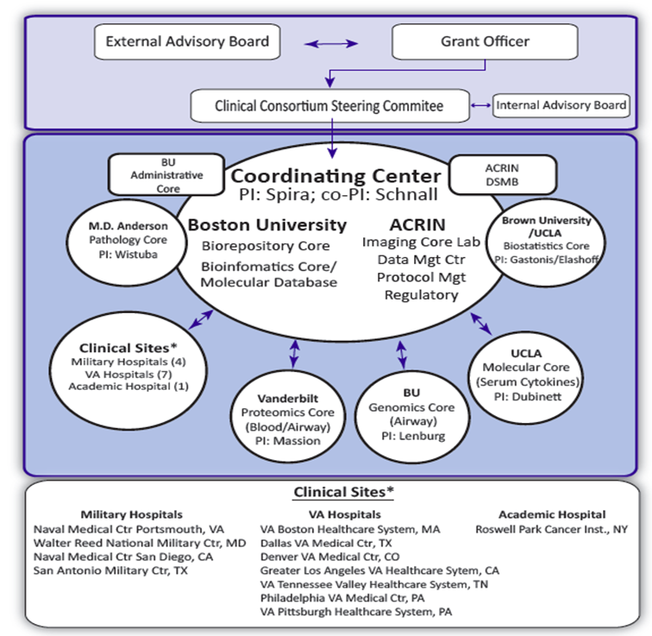
Existing repositories DECAMP
DECAMP (DoD) 2014
Lung nodule Study
n=337/500
Screening study
n= 417/800

Slide 21
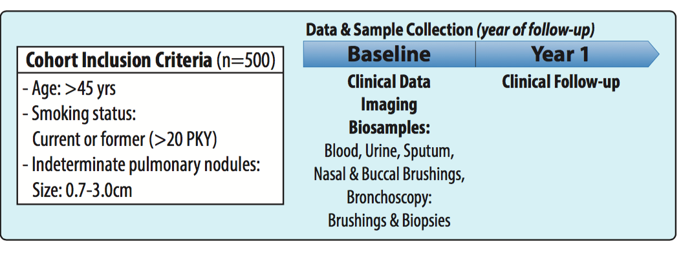
DECAMP1 (nodule) study design
Exclusions: prior history of lung cancer, pure GGO
Notes:
Considering the enrollment trend, we project subject recruitment will be completed by early 2017.

Slide 22
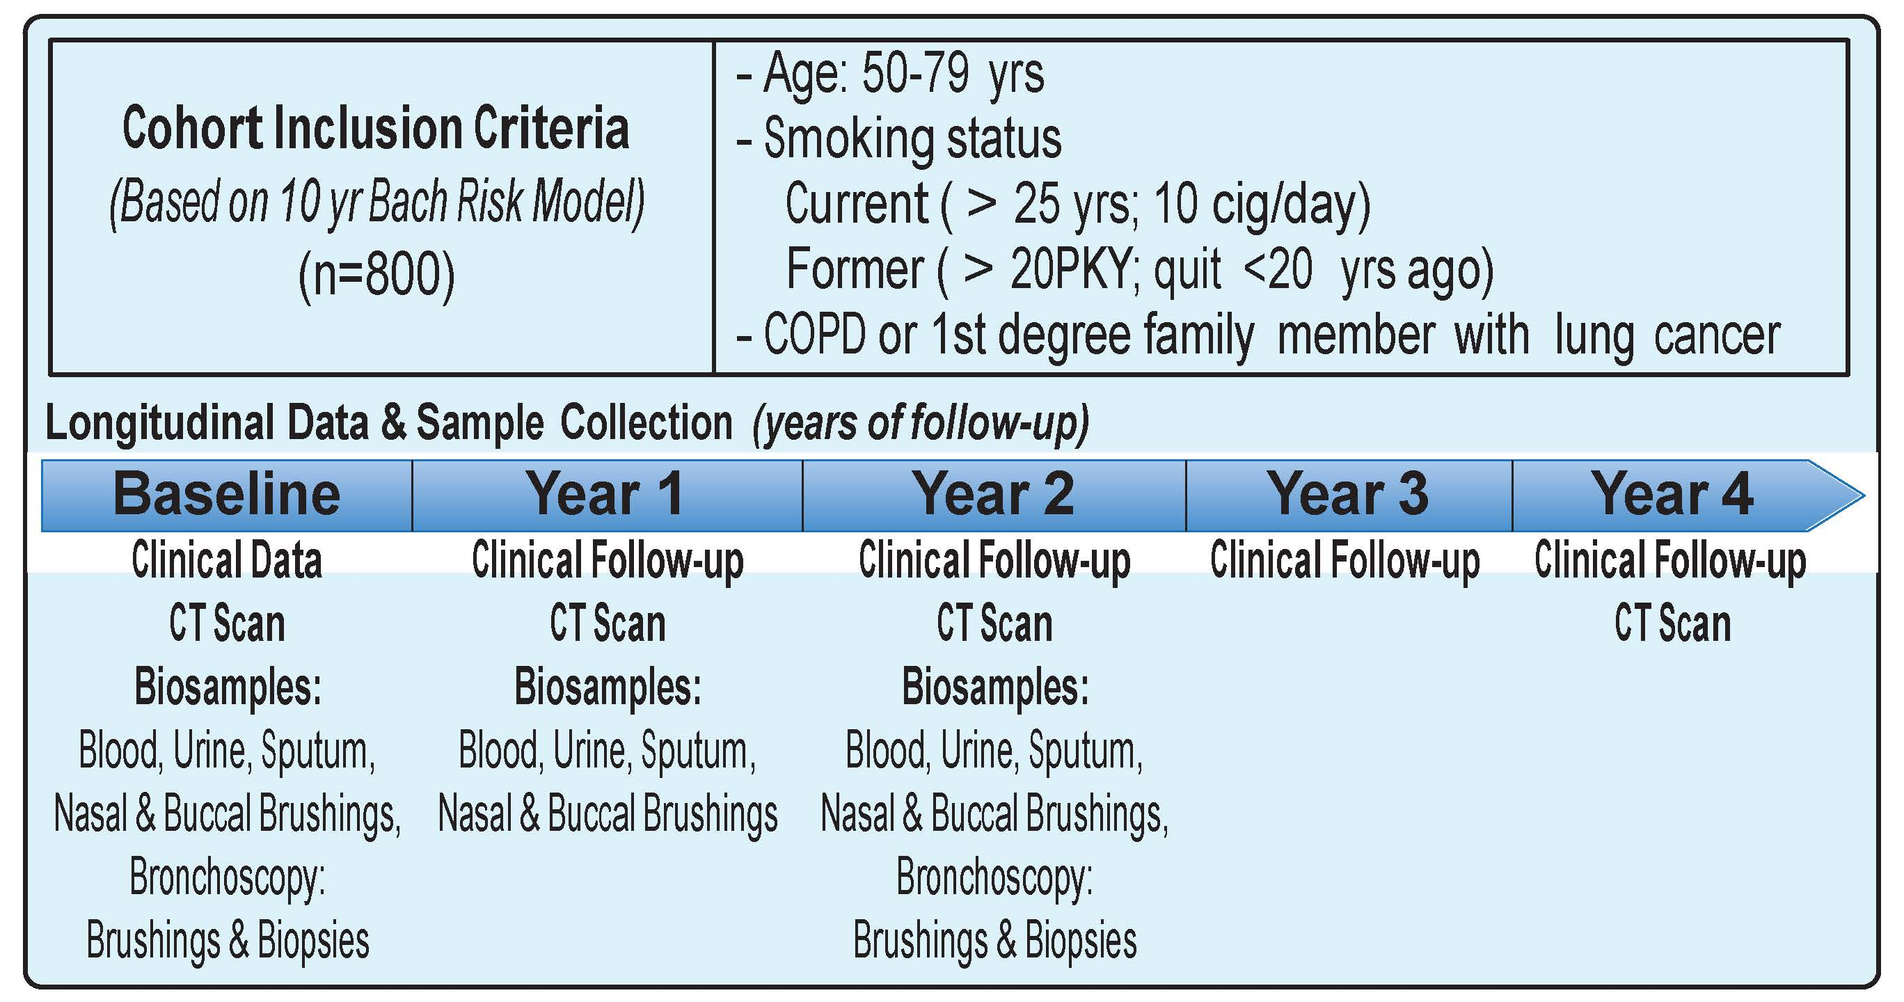
DECAMP2 (screening) study design

Slide 23
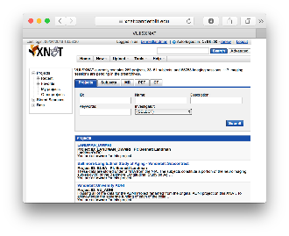
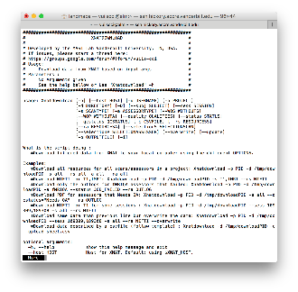
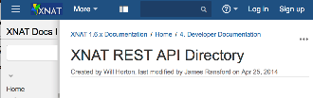

Vanderbilt Lung Imaging Repository
Medical image Analysis and Statistical Interpretation lab, Bennett Landman, PhD
Contributing Sites
Repository Users
External Programs
External Web Browser / Computer
External File System
External PACS
External XNAT
Web portal
Vanderbilt Lung Repository
Q/A and
De-identification
DAX/XNAT
Command line tools
DAX: Neuroimage. 2016 Jan 1;124(Pt B):1097-101. doi: 10.1016/j.neuroimage.2015.05.021.
XNAT: Neuroimage. 2016 Jan 1;124(Pt B):1093-6. doi: 10.1016/j.neuroimage.2015.06.076.
Software API
Image Processing
PACS or XNAT
Notes:
Vandy, Moffitt, Stanford, U Pen,

Slide 24
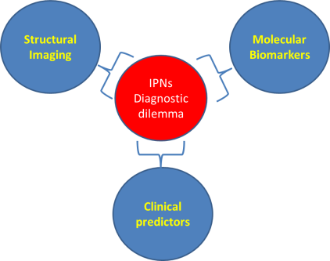
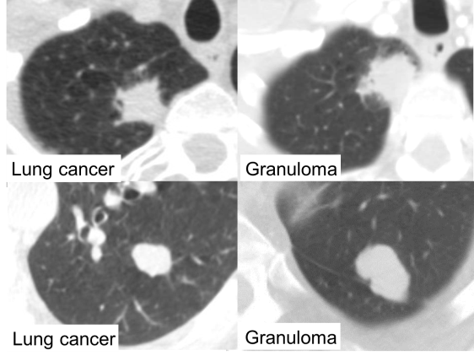
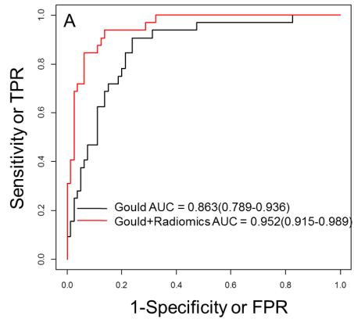
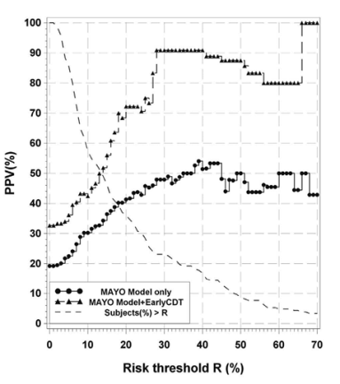
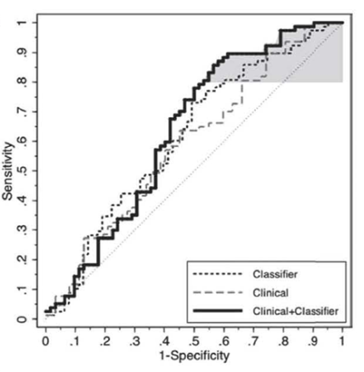
Non invasive diagnosis of Indeterminate Pulmonary Nodules
Radiomics
Oncimmune
Integrated Dx
Funding
UO1 CA186145 (CIB)
UO1 CA152662 (EDRN)
Publications
Liu, CCR 2016
Massion JTO 2016
Vachani JTO 2015
Deppen JAMA. 2014
Shared Resources
Proteomics core
Quantitative Sciences
Innovative Translational Research
Notes:
Figure 1. Added value of radiomics to the best current model for non-invasive diagnosis of cancer Gould in (A) training set (240 controls and 32 cancers) and (B) validation set (n=39 controls and 34 cancers) (AUC goes from 0.772 to 0.852). All AUCs reported are presented with bootstrap bias corrected 95%CI.
Figure 2. Plot of PPV (Positive Predictive Value) versus Risk Threshold for the MAYO model. Curves shown for the MAYO model only (black line with dots) and the MAYO model plus EarlyCDT-Lung (grey dashed line with triangles). Also shown is the plot of percentage of subjects with individual risk below the risk threshold on the x-axis (black dashed line). Adding EarlyCDT-Lung improves the PPV over the whole range. For a chosen risk threshold, a patient is risk-model positive if their calculated individual risk is greater than the threshold. [cohort, 4mm-20mm, n=208]. (Massion JTO 2016)
Figure 3. Incremental diagnostic value of the protein expression classifier to a clinical lung nodule prediction model. Shown are the respective ROC curves for the clinical model48 alone (grey dashed line), the protein expression classifier alone (black dashed line), and the model combining the protein expression classifier and the clinical modeln (solid line). Model performance for the clinical models was evaluated based on 1000 bootstrappings. Area under the ROC curve (AUC) and partial area under the curve (pAUC) at 80% sensitivity (shaded in grey) were calculated with bootstrap bias-corrected 95% confidence intervals (CI). (Vachani JTO 2015)

Slide 25
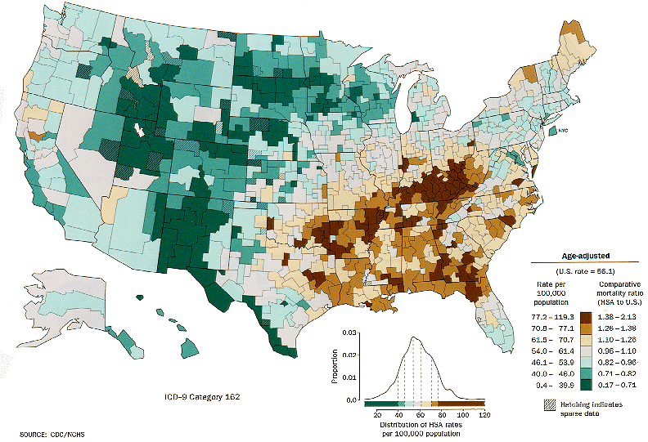
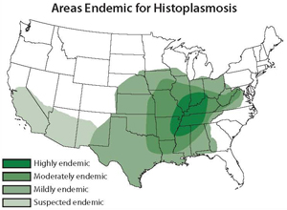
Lung cancer---- Histoplasmosis
Areas Endemic for Lung Cancer
Areas Endemic for Histoplasmosis
Eric Grogan and Karen Anderson

Slide 26
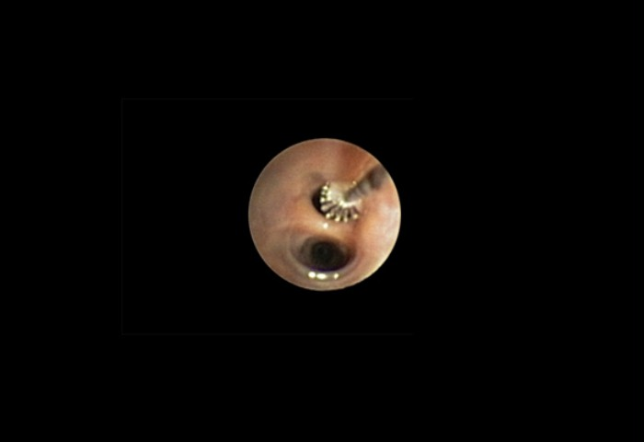
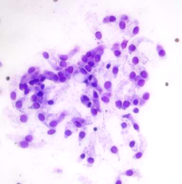
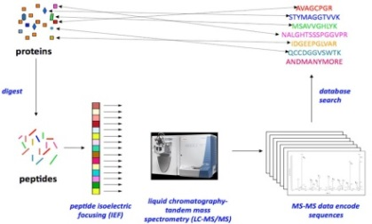
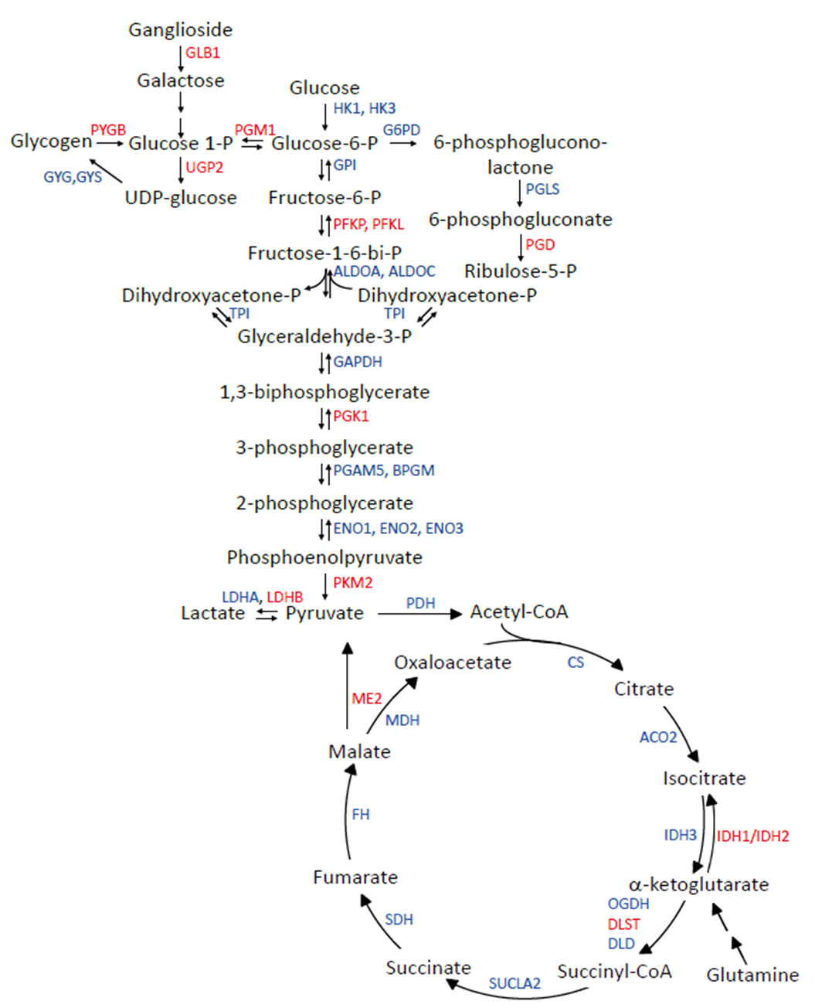
Proteomic analysis of bronchial epithelium in high risk individuals
In the high risk epithelium:
Carbohydrate metabolism reprogramming
Lipid metabolism reprogramming
Looking to test a Link between reprogramming and cancer dvpt
Shotgun proteomics
Rahman et al. JCI Insight. 2016
Funding
R01 CA 102353, EDRN CA152662
DoD W81XWH-11-2-0161

Slide 27
Point mutations detected in the normal airway epithelium of a patient with cancer
LUP405: Patient with tumors, germline and brush samples
Gene | Residue change | Protein position | T1 (AF%) | T2 (AF%) | Brush – Mutation calling without prior knowledge (AF%) | Brush – Reads seen with prior knowledge of tumor mutations | Reported in COSMIC
ZFHX4 | VAL>LEU | 2668/3617 | 1.70% | 9.84% | 0.80% | 29
UGT3A2 | none | 412/524 | 1.56% | 9.03% | 0.78% | 16
DCAF4L2 | none | 254/396 | 1.39% | 8.75% |  | 12
PTEN | ARG>GLN | 130/404 | 1.36% | 8.42% | 0.92% | 19 | Yes
LRFN5 | none | 154/720 | 0.96% | 8.02% | 1.28%
PEG3,ZIM2 | GLU>VAL | 1403/1589 | 1.59% | 7.67% | 1.33% | 38
ZFHX4 | GLN>LYS | 505/3617 | 1.29% | 7.61% | 1.12% | 41
TRIM58 | LEU>PHE | 306/487 | 1.78% | 7.47% | 1.46% | 30
ZNF831 | ASN>LYS | 1172/1678 | 0.99% | 7.29% | 1.24% | 35
APOB | SER>CYS | 3720/4564 | 0.85% | 6.94% | 0.70%
PAPPA2 | GLN>HIS | 384/1792 | 1.03% | 6.68% | 0.49% | 13
MKRN3 | GLY>TRP | 29/508 | 1.46% | 6.66% |  | 10
C1orf173 | ALA>GLY | 1022/1531 | 1.67% | 1.78% | 2.29% | 72
Massion, Diehn unpublished data
Notes:
Interpretation:
Similar mutations identified in the two tumor regions
Most tumor mutations identified in brush sample when calling without prior knowledge
Many reads supporting tumor mutations seen in brush sample when using more sensitive calling approach that uses prior knowledge of tumor mutations

Slide 28
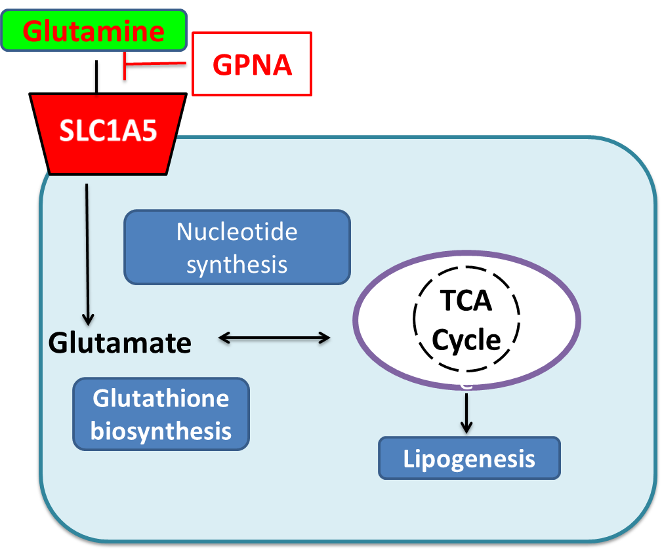
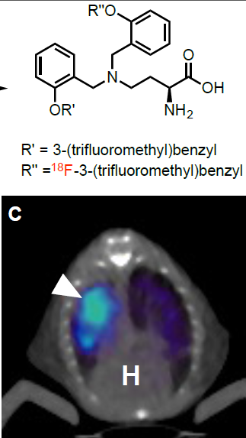
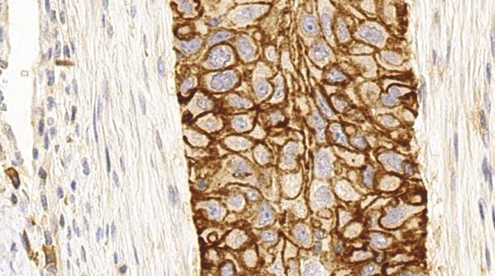
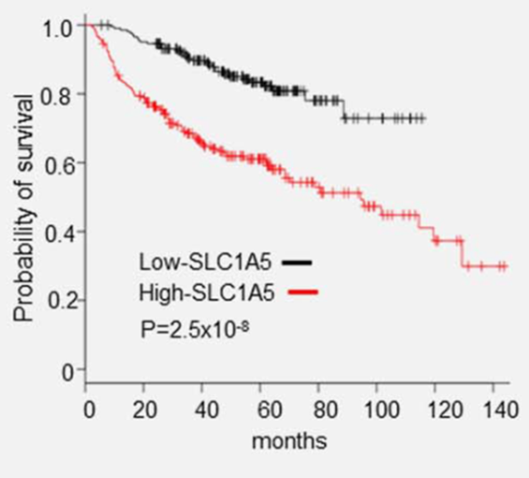
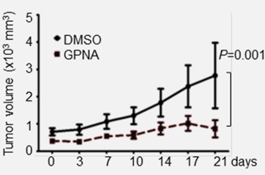
SLC1A5 and Glutamine metabolism in cancer
Funding
U01 CA186145
Publications
Hassanein CCR 2013
Hassanein Int J Cancer. 2015
Hassanein Mol Imaging Biol. 2016
Shared Resources
Genomic Sciences
Quantitative Sciences
VUIIS
Innovative Translational Research
Notes:
SLC1A5 is a Glutamine transporter, it is overexpressed in 70% of lung cancers and associated with poor survival. Its level of expression is correlated with response to Gln Transport inhibition. Inhibition of Gln transport related to SLC1A5 prevents mouse xenografts tumor growth. With Charles Manning we developed a SLC1A5 specific inhibitor that we are testing in preclinical models. We have already a path for IND and testing in humans during 2016.

Slide 29
Lung Collaborative Group
Biomarker Development Laboratories
Avi Spira, Steve Dubinett, Marc Lenburg, Deni Aberle | BU, UCLA and Lahey Clinic
Louise Shaw | Wistar Institute
Jim Herman | U of Pittsburgh
Harvey Pass | NYU
Biomarker Reference Laboratory
Sanford Stass, Feng Jiang | University of Maryland
Clinical Validation Centers
Pierre Massion, Kim Sandler | Vanderilt
Bob Gillies, Matt Schabath | Moffitt CC
DMCC
Margaret Pepe, Jackie Dahlgren | Fred Hutchinson CC
Program Officers
Lynn Sorbara | NCI DCP
Karl Krueger | NCI DCP
Notes:
8 institutions, 6 BDLs, 2 CVCs, 2 BRLs.

