Slide 1
Proteomic identification of potential biomarkers of thoracic tumors
Kiyoshi Yanagisawa
Division of Molecular Carcinogenesis,
Nagoya University Graduate School of Medicine
Notes:
Signature based biomarker

Slide 2
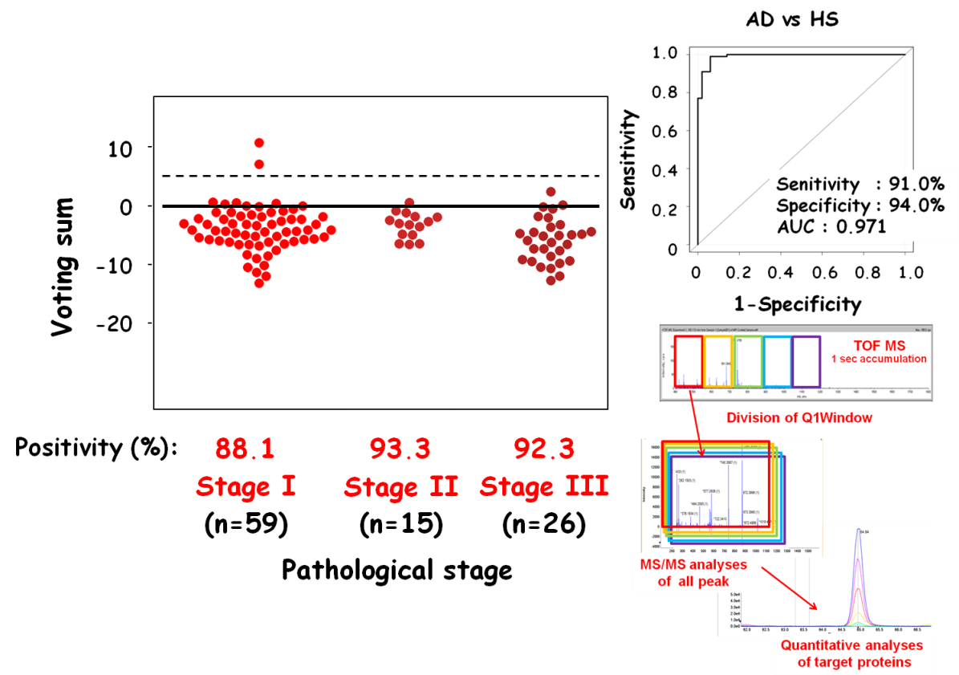
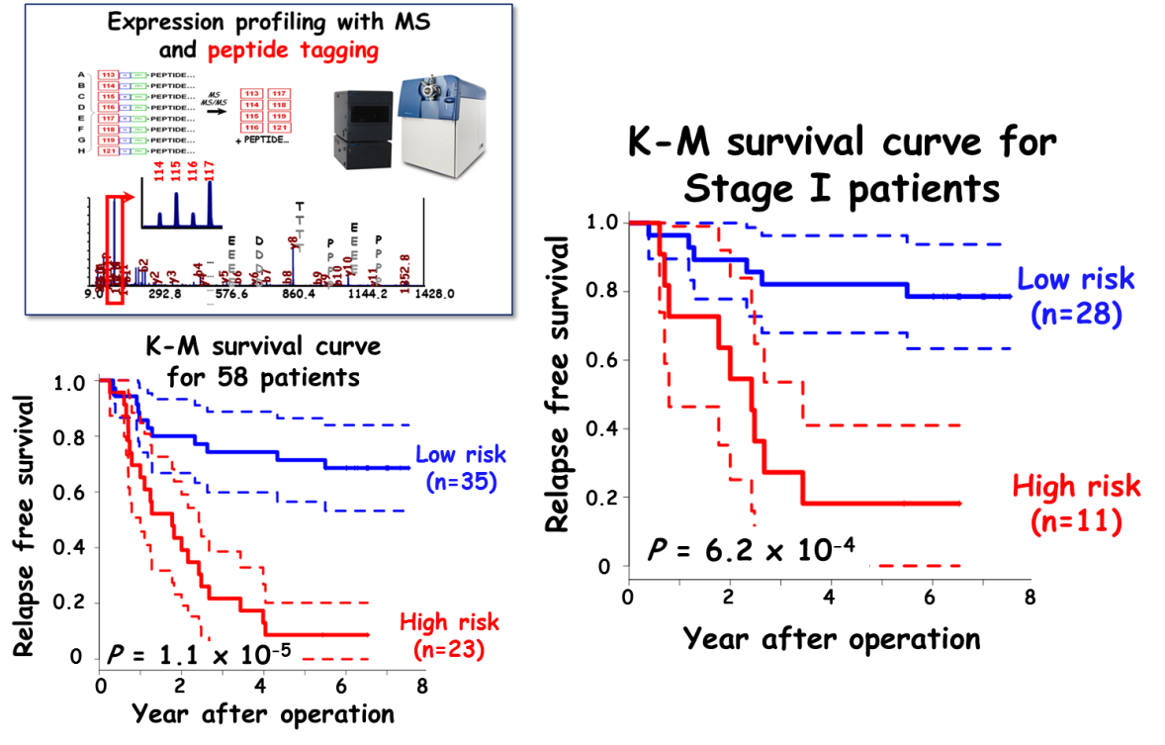
Today’s topics
Protein signature as prediction marker
Protein signature as serum marker
Notes:
Will allow us to realize personalized medicine for postoperative NSCLC
Employing bioinformatic approaches, we will construct classifier for early detection of NSCLC and PDAC
Clinical application of this marker help us to screen MPM patients efficiently in the clinical practice.
I hope these information help us to exchange technologies, information, and materals in the future.

Slide 3
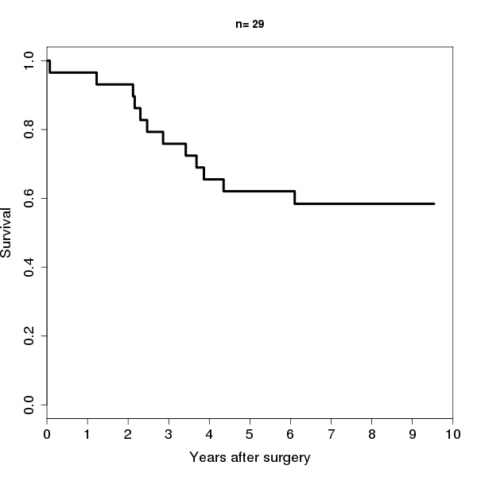
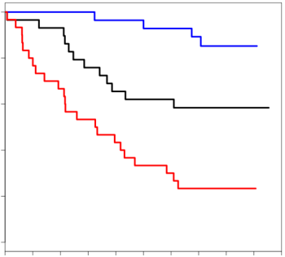
Postoperative treatment of lung cancer
Post operative prognosis of lung cancer
Postoperative prognosis
（ex. stage IB）
Metastases undetectable with current imaging
No Metastasis
Relapse after curative surgical treatment
“Observation”in US, Euro
1.0
0.8
0.6
Survival rate
Cured
Treated with unnecessary adjuvant chemo therapy in Japan
0.4
0.2
Die with relapse during follow up period
Unnecessary treatment with chemo reagents
0
0
2
4
6
8
10
Years
Accurate prediction of the risk of relapse
Residual tumor cells can be eliminated by adequate adjuvant chemo therapy
Observation without unnecessary adjuvant chemo therapy
Low risk patients
->“Observation”without unnecessary treatment
1.0
0.8
0.6
Survival rate
High risk patients
-> Adjuvant chemo therapy to eliminate residual tumor cells
0.4
Improvement of cure rate
0.2
0
0
2
4
6
8
10
Years
Notes:
This scheme shows current issues of post operative treatment.
After operation patients with metastasis
On the other hand patients without metastasis
Appropriately treat patients and it leads to improvement of cure rate

Slide 4
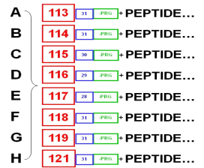
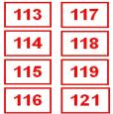

Exploration of proteomic signature to predict relapse free survival of NSCLC
Expression profiling with MS
and peptide tagging
Number of proteins identified: > 11,000
MS
MS/MS
+
PEPTIDE…
114
115
116
117
Variance and intensity: 2,000
T
T
T
T
E
E
E
E
D
D
D
D
E
E
E
E
P
P
P
P
…
…
…
…
y8
P
P
P
P
A
P
b2
b4
y10
q,H
72.1
b1
b7
b10
1352.8
45.1
y3
y5
b6
b8
y11
112.1
y2
y6
b9
74.1
142.1
T
L
y4
y9
39.0
9.0
292.8
576.6
860.4
1144.2
1428.0
Construction of NSCLC postoperative relapse free survival prediction model
AD
SQ
AdSq
LA
LCNEC
IA
21
4
2
1
0
Partial Cox regression
5-fold CV (repeats 1,000 times)
C-index
IB
19
8
1
2
0
IIA
3
0
0
1
0
IIB
7
5
0
6
0
IIIA
19
9
2
0
0
IIIB
5
1
0
2
1
72
25
5
12
1
/ 115
Notes:
We first explore proteomic signature that can predict relapse free survival of NSCLC.
To do it, We divided cohort into two.
One is used as training consisting of 115 patients for discovery and the other is used for test for confirmation
Here is patient characteristics of training cohort
From fundamental profile we selected 2000 according to variance and intensity.
Then we employed these strategies to construct prediction model of relapse free survival of NSCLC.

Slide 5
Construction of proteomic prediction of postoperative prognosis of NSCLC using the training set
Random 5-fold CV
(Select # of proteins for final model)
Number of proteins identified: > 11,000
CV training data
(N = 92)
CV test data
(N = 23)
C-index
Variance and intensity: 2,000
Filtering:
Univariate Cox regression
-> 100 proteins
Construction of NSCLC postoperative relapse free survival prediction model
Partial Cox regression
5-fold CV (repeats 1,000 times)
C-index
Partial Cox regression:
Model construction
CV repeats: 1000 times
Notes:
And all of these constructed models were applied to CV test cohort calculating C-index to evaluate prediction power.
These steps were repeated 1000 times.
Thus we evaluated prediction power with average c-index to determine optimal number of proteins for prediction of NSCLC relapse free survival .

Slide 6
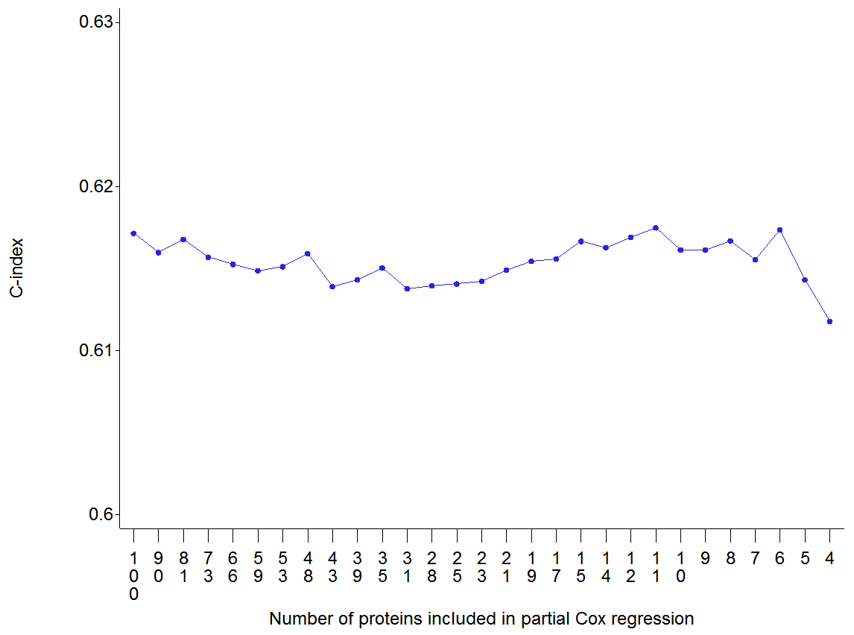
Construction of proteomic prediction of postoperative prognosis of NSCLC using the training set
Random 5-fold CV
(Select # of proteins for final model)
11 protein - relapse free survival prediction model
CV training data
(N = 92)
CV test data
(N = 23)
C-index
0.63
11
Filtering:
Univariate Cox regression
-> 100 proteins
0.62
Average C-index in CV test
0.61
Partial Cox regression:
Model construction
0.6
CV repeats: 1000 times
100
50
30
20
10
# of proteins in partial Cox regression
Notes:
This graph shows the average c-index in CV test cohort.
As we can see 11 protein model showed the highest c-index meaning prediction power of this model is better than the others.
Accordingly we decided to construct final prediction model with 11 proteins.

Slide 7
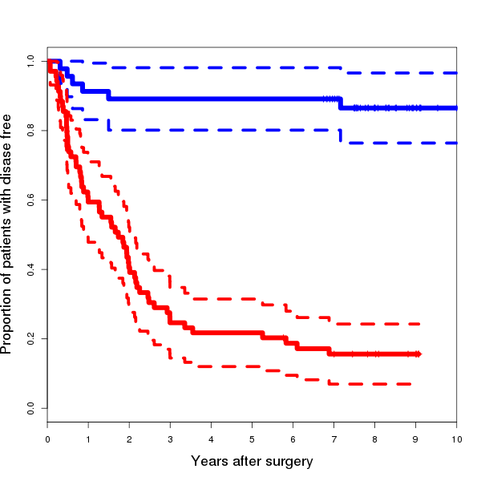
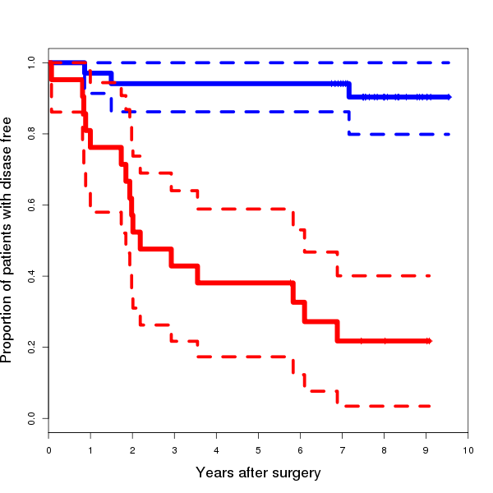
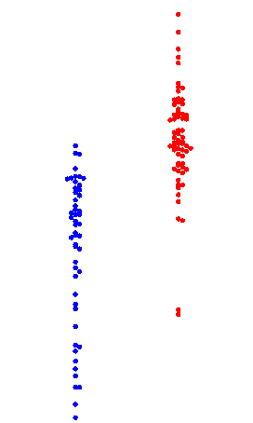
Proteomic prediction of postoperative prognosis of NSCLC using 11 biomarkers in the training set
Clinical
outcome
K-M survival curve for 115 patients
K-M survival curve for stage I patients
1.0
1.0
No relapse
(n=53)
Relapsed
(n=62)
0.8
0.8
Low risk
(n=46)
Low risk
(n=34)
0.6
0.6
Relapse free survival
Relapse free survival
Low risk
(n=46)
High risk
(n=69)
High risk
(n=21)
0.4
0.4
Proteomic Prediction
0.2
0.2
P = 6.8 x 10⁻⁹
P = 2.0 x 10⁻⁴
0
0
High risk
(n=69)
0
0
2
2
4
4
6
6
8
8
10
10
Year after operation
Year after operation
Notes:
Using constructed prediction model of NSCLC, we calculated risk score of entire patients in the training cohort and evaluate prediction power comparing with clinical outcome.
We found that most of patients in low risk group were alive for more than 5 years without any evidence of recurrence, while patients in high risk group experienced rec.
Next to evaluate prediction power of constructed proteomic classifier, we employed K-M survival curve.
As a result, significant differences in relapse free survival were observed between proteomic signature defined low and high risk group.
Interestingly, we selected stage I cases from the training cohort, and classified them according to proteomic signature.
As we can see, marked differences in relapse free survival were observed between low and high risk group.

Slide 8
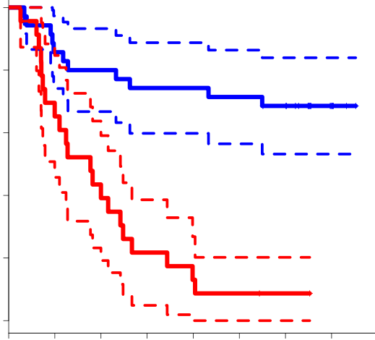
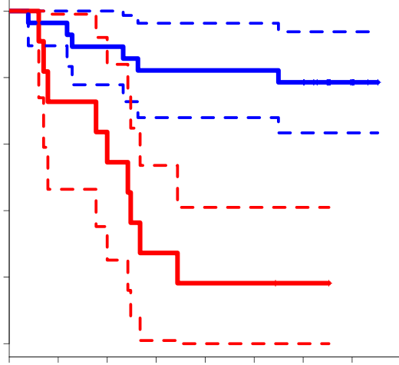
Proteomic prediction of postoperative prognosis of NSCLC using 11 biomarkers in the test set
K-M survival curve for 58 patients
1.0
K-M survival curve for Stage I patients
0.8
Low risk
(n=35)
0.6
1.0
Relapse free survival
Low risk
(n=28)
0.4
0.8
0.2
High risk
(n=23)
0.6
Relapse free survival
0
P = 1.1 x 10⁻⁵
0
2
4
6
8
0.4
Year after operation
High risk
(n=11)
AD
SQ
AdSq
LA
LCNEC
0.2
IA
17
1
2
0
0
P = 6.2 x 10⁻⁴
IB
10
6
1
3
1
0
IIA
2
0
0
0
0
0
2
4
6
8
IIB
2
0
0
1
0
Year after operation
IIIA
6
4
0
2
0
IIIB
0
2
0
0
0
35
13
3
6
1
/ 58
Notes:
After confirming prediction the power in the training cohort, it is necessary to validate it using independent test cohort.
So we applied the prediction model to independent 58 NSCLC patients.
As we can see prediction power was confirmed in the entire test set.
We discriminated shorter duration of relapse among stage I NSCLC patients.
Thus, our constructed prediction model is supposed to be robust and be applied to clinical practice of NSCLC.
This is one story

Slide 9
Postoperative treatment of lung cancer
Post operative prognosis of lung cancer
Postoperative prognosis
（ex. stage IB）
Metastases undetectable with current imaging
No Metastasis
Relapse after curative surgical treatment
“Observation”in US, Euro
1.0
0.8
0.6
Survival rate
Cured
Treated with unnecessary adjuvant chemo therapy in Japan
0.4
0.2
Die with relapse during follow up period
Unnecessary treatment with chemo reagents
0
0
2
4
6
8
10
Years
Accurate prediction of the risk of relapse
Residual tumor cells can be eliminated by adequate adjuvant chemo therapy
Observation without unnecessary adjuvant chemo therapy
Low risk patients
->“Observation”without unnecessary treatment
1.0
0.8
0.6
Survival rate
High risk patients
-> Adjuvant chemo therapy to eliminate residual tumor cells
0.4
Improvement of cure rate
0.2
0
0
2
4
6
8
10
Years
Notes:
High risk group need to be treated with adjuvant chemo therapy, however low risk group will be observed without therapy.

Slide 10
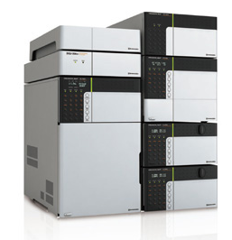
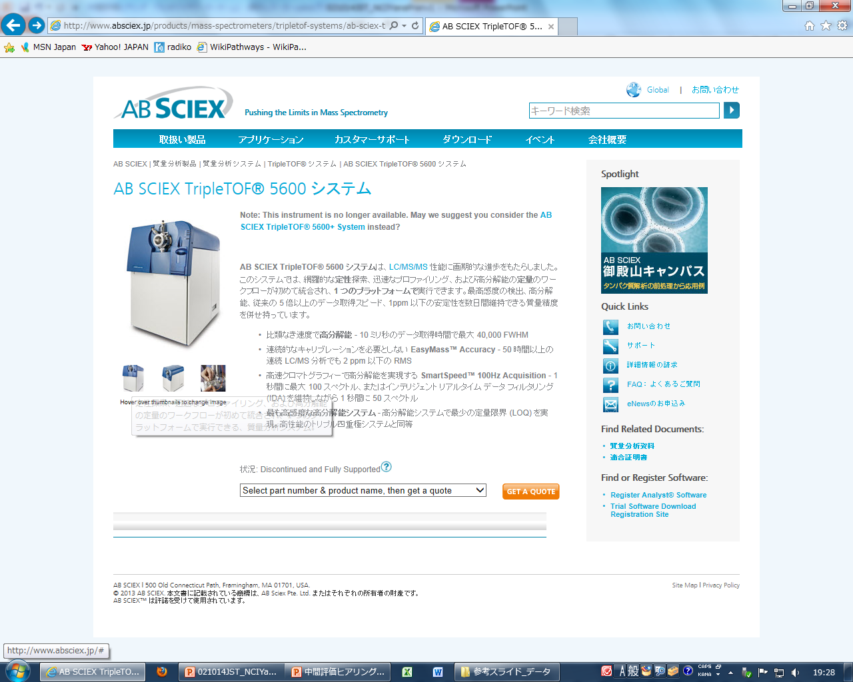
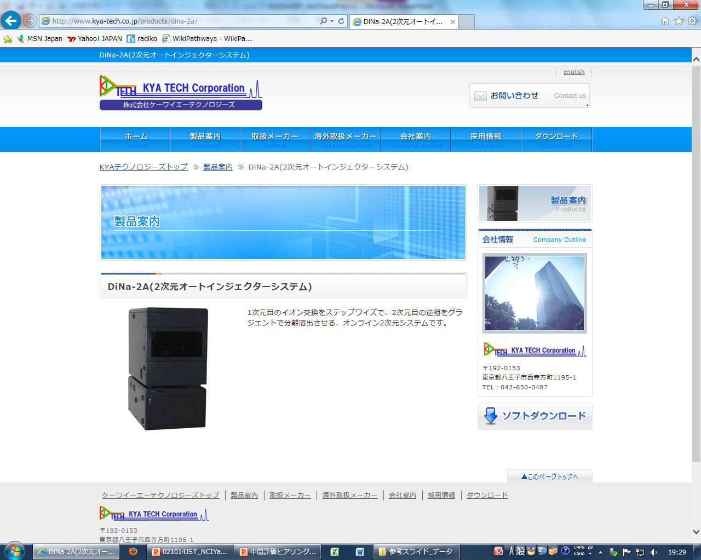
Proteomic discovery and verification of serum markers of LAD
Comprehensive proteomic data
of NSCLC tissues:
> 11,000 Proteins identified
Exploration of proteins in serum:
> 3,000 proteins identified
Expression profiling with MS
and peptide tagging
Pre-processing of Serum samples
MS
Reduction, Alkylation and Digestion
MS/MS
+
PEPTIDE…
114
115
116
117
Nano-LC separation and MS analyses
T
T
T
T
E
E
E
E
D
D
D
D
E
E
E
E
P
P
P
P
…
…
…
…
y8
P
P
P
P
A
P
b2
b4
y10
Abundant protein
depletion with HPLC
Protein identification
with Nano-LC-MSMS
q,H
72.1
b1
b7
b10
1352.8
45.1
y3
y5
b6
b8
y11
112.1
y2
y6
b9
74.1
142.1
T
L
y4
y9
39.0
9.0
292.8
576.6
860.4
1144.2
1428.0
Discovery of candidate proteins
thousands of proteins
comparison of up to 8 samples
relative quantification
Notes:
We next used this fundamental information to identify serum markers of NSCLC.
To accomplish this task, we explored proteins in serum employing various proteomic technologies such as HPLC, nano-LC, MS and so on.
So far we identified more than 3000 proteins in serum samples from NSCLC as well as HS.
We are in the middle of

Slide 11
Proteomic discovery and verification of serum markers of LAD
Comprehensive proteomic data
of NSCLC tissues:
> 11,000 Proteins identified
Exploration of proteins in serum:
> 3,000 proteins identified
345 overlapping proteins
Expression profiling with MS
and peptide tagging
Pre-processing of Serum samples
MS
Reduction, Alkylation and Digestion
MS/MS
+
PEPTIDE…
114
115
116
117
Nano-LC separation and MS analyses
T
T
T
T
E
E
E
E
D
D
D
D
E
E
E
E
P
P
P
P
…
…
…
…
y8
P
P
P
P
A
P
b2
b4
y10
Abundant protein
depletion with HPLC
Protein identification
with Nano-LC-MSMS
q,H
72.1
b1
b7
b10
1352.8
45.1
y3
y5
b6
b8
y11
112.1
y2
y6
b9
74.1
142.1
T
L
y4
y9
39.0
9.0
292.8
576.6
860.4
1144.2
1428.0
Discovery of candidate proteins
thousands of proteins
comparison of up to 8 samples
relative quantification
Notes:
Comparing these two profiles, we found that more than 300 proteins are overlapped between them.
Therefore we evaluated significance of these proteins as markers of NSCLC

Slide 12
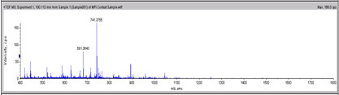
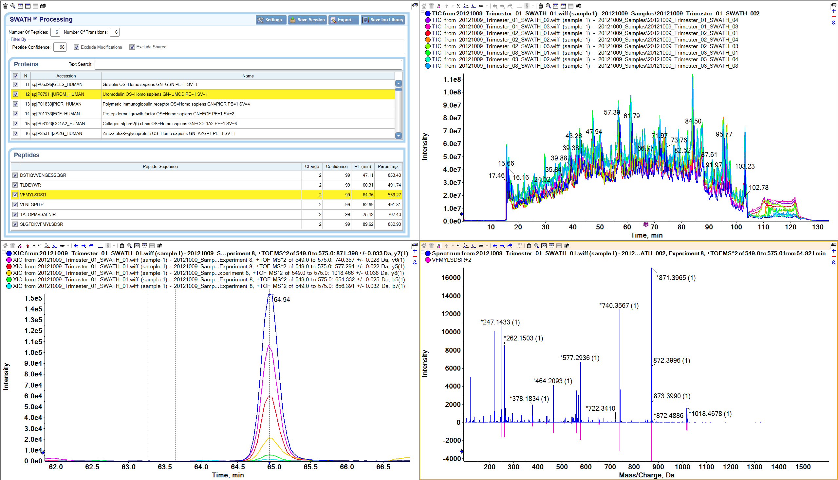
SWATH analyses for expression profiling of target proteins in LAD in the training set
LAD
HS
TOF MS
-Gender-
1 sec accumulation
Male
82
28
Female
68
22
Division of Q1Window
-Age-
Ave
66.0
66.4
Range
28-85
39-84
-pStage-
IA
58
IB
24
IIA
5
MS/MS analyses of all peak
IIB
18
IIIA
21
IIIB
19
IV
5
Quantitative analyses
of target proteins
150
50
Notes:
sequential window acquisition of all theoretical fragment-ion spectra

Slide 13
SWATH analyses for expression profiling of target proteins in LAD in the training set
Comprehensive proteomic data
of NSCLC tissues:
> 11,000 Proteins identified
Exploration of proteins in serum:
> 3,000 proteins identified
TOF MS
1 sec accumulation
345 overlapping proteins
Division of Q1Window
Representative candidates
P=2.29x10⁻⁷
P=7.44x10⁻³
P=2.32x10⁻⁷
P=3.71x10⁻³
6
3
6
6
4
2
4
4
MS/MS analyses of all peak
Relative ratio of expression
Relative ratio of expression
Relative ratio of expression
Relative ratio of expression
2
1
2
2
0
0
0
0
Quantitative analyses
of target proteins
HS
LAD
HS
LAD
HS
LAD
HS
LAD

Slide 14
Construction of prediction model for detection of lung adenocarcinoma using the training set
processed data
75 proteins-
LAD detection model
10-fold CV
(Select # of proteins for final model)
CV training data
CV validation data
Error rate
10,000
repeats
75
Ranking based on S2N value
Weighted voting
No. of proteins

Slide 15
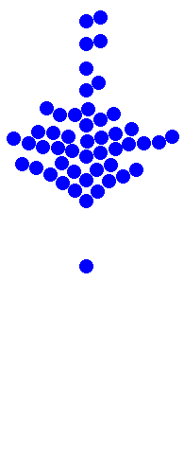
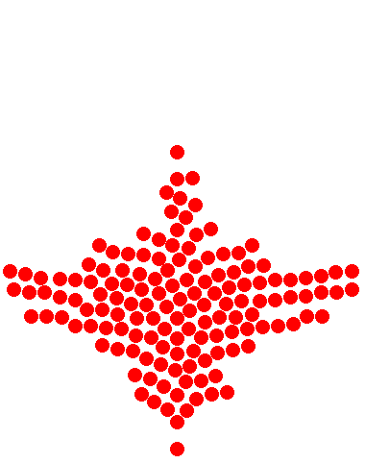
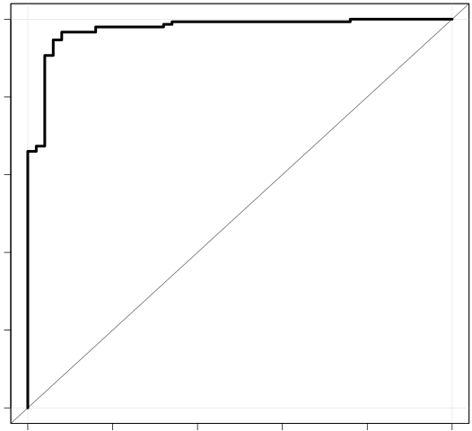
Evaluation of prediction model for detection of lung adenocarcinoma using the training dataset
***
AD vs HS
20
1.0
10
0.8
Voting sum
0.6
0
Sensitivity
-10
0.4
Senitivity : 96.0%
Specificity : 94.0%
AUC : 0.975
0.2
-20
0
Positivity (%):
6.0
96.0
0
0.2
0.4
0.6
0.8
1.0
HS
AD
1-Specificity
(n=50)
(n=150)
Clinical diagnosis

Slide 16
SWATH analyses for expression profiling of target proteins in LAD in the validation set
LAD
HS
TOF MS
1 sec accumulation
-Gender-
Male
52
28
Female
48
22
Division of Q1Window
-Age-
Ave
65.0
65.7
Range
39-85
42-82
-pStage-
IA
44
IB
15
IIA
6
MS/MS analyses of all peak
IIB
9
IIIA
15
IIIB
11
Quantitative analyses
of target proteins
100
50

Slide 17
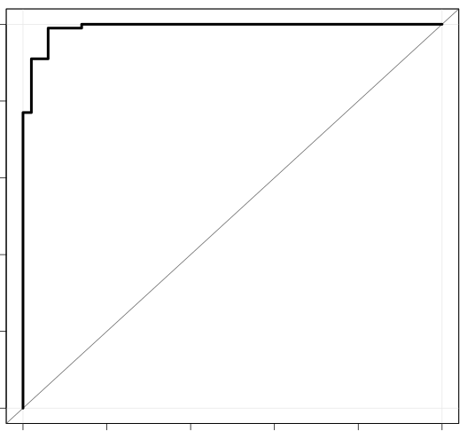
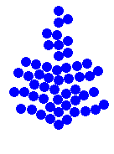
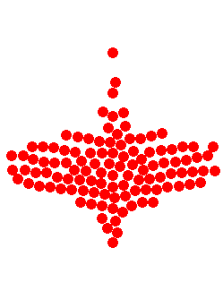
Validation of prediction model for detection of lung adenocarcinoma using the validation dataset
***
AD vs HS
20
1.0
10
0.8
Voting sum
0.6
0
Sensitivity
-10
0.4
Senitivity : 91.0%
Specificity : 94.0%
AUC : 0.971
0.2
-20
0
Positivity (%):
6.0
91.0
0
0.2
0.4
0.6
0.8
1.0
HS
AD
1-Specificity
(n=50)
(n=100)
Clinical diagnosis
Notes:
間質性肺炎 35 細菌性肺炎 １２

Slide 18
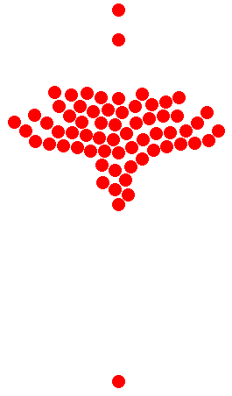


Validation of prediction model for detection of lung adenocarcinoma using the validation dataset
AD vs HS
10
1.0
0
0.8
Voting sum
0.6
-10
Sensitivity
-20
0.4
Senitivity : 91.0%
Specificity : 94.0%
AUC : 0.971
0.2
0
Positivity (%):
88.1
93.3
92.3
0
0.2
0.4
0.6
0.8
1.0
Stage I
Stage II
Stage III
1-Specificity
(n=59)
(n=15)
(n=26)
Pathological stage

Slide 19
Conclusions and future prospects
Protein classifier as prediction marker
Protein classifier as serum marker
Personalized therapy for postoperative NSCLC patients
Serum classifiers for early detection of LAD
Notes:
Potential signature based biomarkers
Will allow us to realize personalized medicine for postoperative NSCLC
Employing bioinformatic approaches, we will construct classifier for early detection of NSCLC
I hope these information help us to exchange technologies, information, and materals in the future.

Slide 20

Acknowledgments
Nagoya Univ. Grad. Sch. Med.
Division of Molecular Carcinogenesis,
Naoe Hotta
Keiko Kano
Takashi Takahashi
Nagoya Univ. Hospital
Thoracic Surgery,
Noriyasu Usami
Kohei Yokoi
Nagoya Univ. Hospital
Respiratory Medicine,
Masashi Kondo
Yoshinori Hasegawa
Nagoya Univ. Grad. Sch. Med.
Division of Molecular Carcinogenesis,
Masahiro Nakatochi
Akihiro Hirakawa
Aichi Cancer Center
Yasushi Yatabe
Tetsuya Mitsudomi
Notes:
That is my presentation.
Supervision of all projects

