Slide 1

Blood-based Tests for Early Detection of Pancreatic Cancer
Anirban Maitra, M.B.B.S.
Sheikh Ahmed Pancreatic Cancer Research Center
University of Texas MD Anderson Cancer Center
Houston, Texas

Slide 2
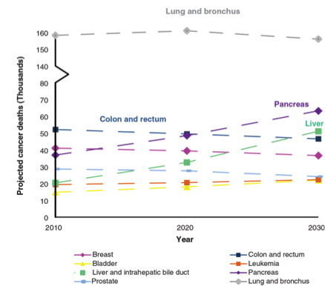
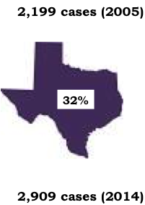

The Incidence of Pancreatic cancer is on the Rise
Rahib et al, 2014

Slide 3
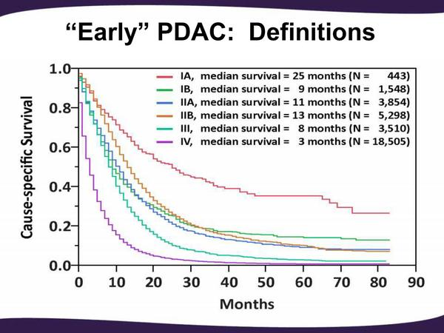
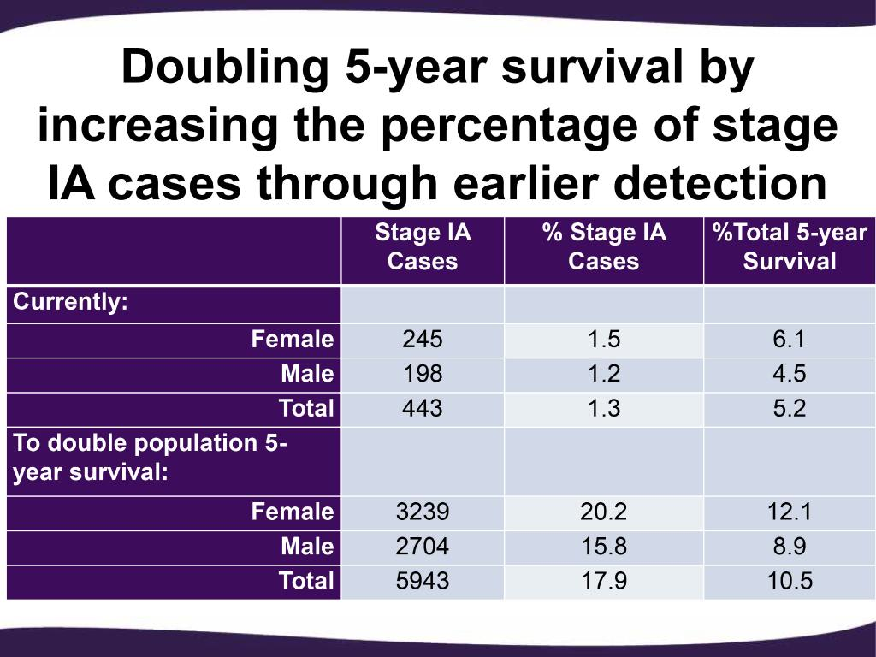
What would it take to “double” pancreatic cancer survival?
>10-fold increase in Stage 1A patients

Slide 4
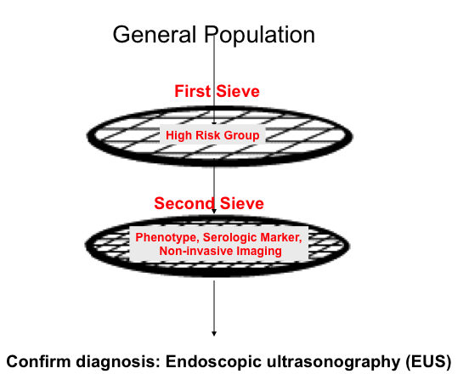
Early detection of pancreatic cancer requires defining whom to screen
No consensus or tools available currently
Define high risk groups for pancreatic cancer
Most likely a blood, urine or saliva-based test
Cannot be ivory tower assay
Familial pancreatic cancer
Pancreatic cysts
Adult new-onset diabetes

Slide 5

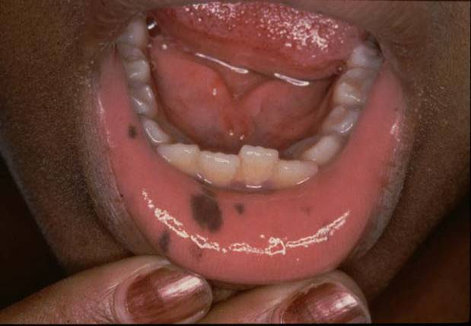
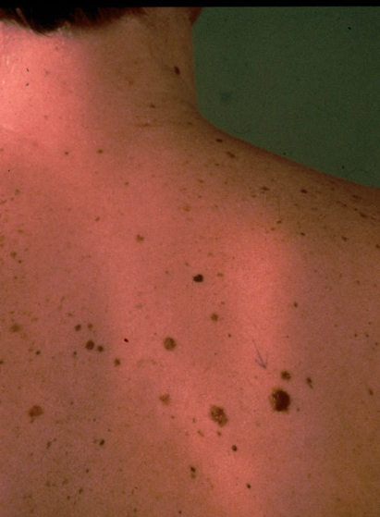
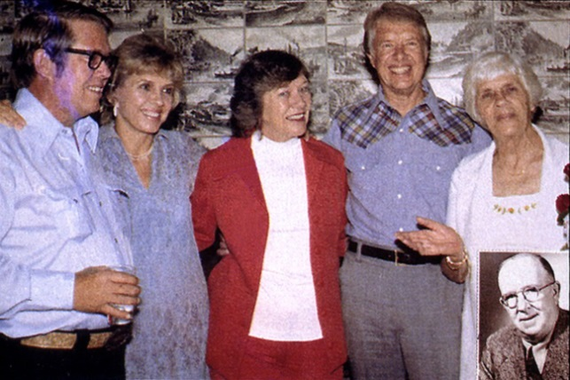
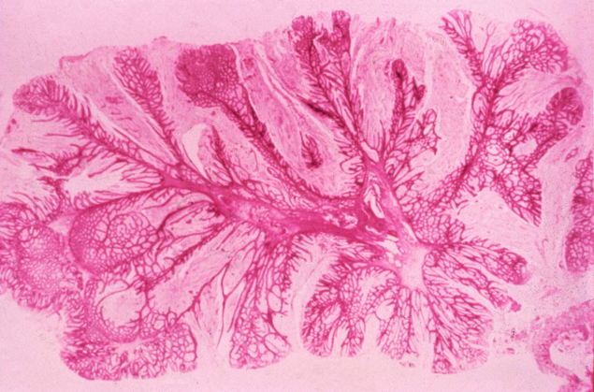
BRCA2 germline mutations
~5% of pancreatic cancers
Most common known familial pancreatic cancer gene
Founder mutation in Ashkenazi Jewish population
Peutz-Jeghers syndrome
5-10% - Positive
Family History
p16 germline mutations
“Familial Pancreatic Cancer”

Slide 6
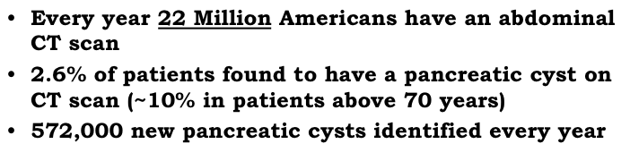

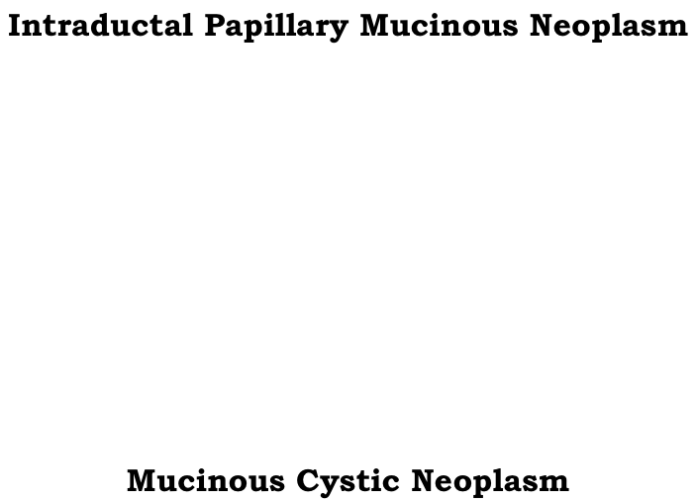
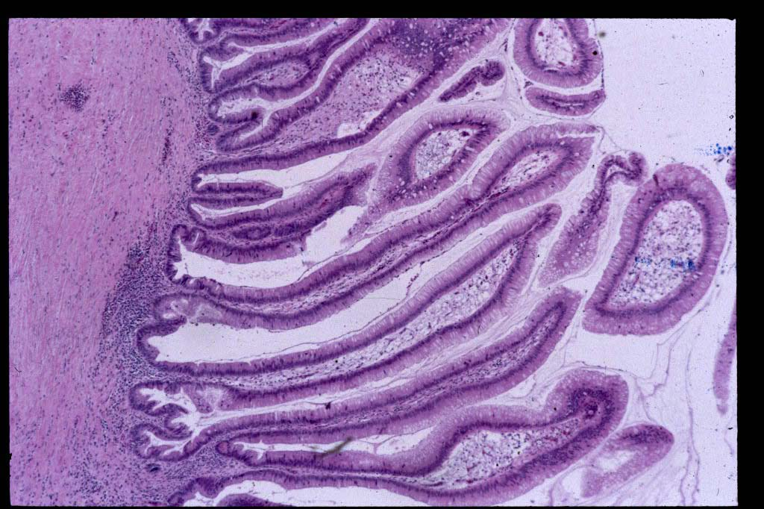
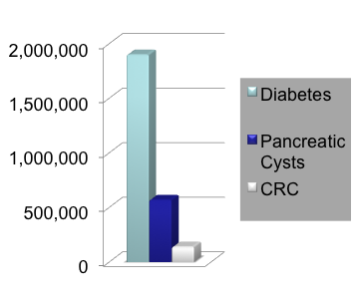
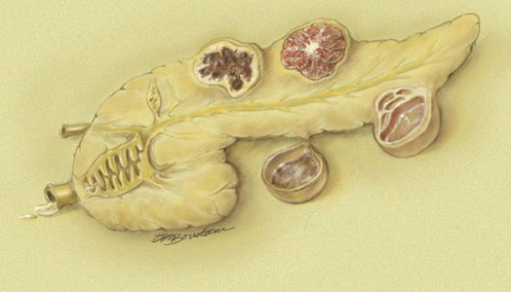
Pancreatic cysts

Slide 7
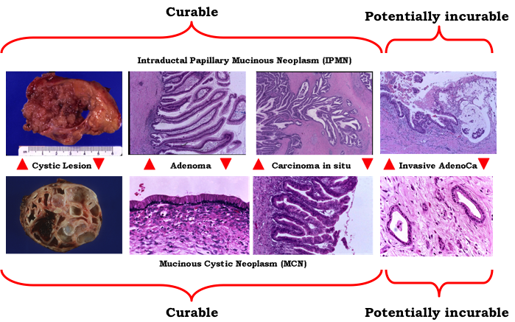
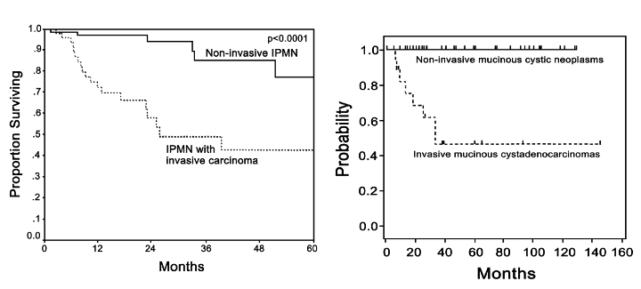
Natural history of cystic neoplasia in the pancreas
Caveat:
Vast majority (>90%) of mucinous cysts are not going to progress to pancreatic cancer
Challenge:
Identify the minority with aggressive biology using biomarkers that will predict which patients need surgery

Slide 8
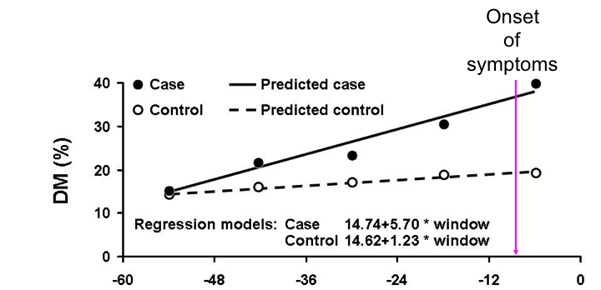
New-onset diabetes and pancreatic cancer
Diabetes as a biomarker for occult cancer
Between 25-50% of pancreatic cancer patients have new-onset diabetes as their first symptom
Can pre-date cancer diagnosis by 2 years
CHALLENGE: Only 1 in 100 NOD patients above 50 have an underlying pancreatic cancer
How do we find the needle in a haystack?

Slide 9
Consortium for the Study of Chronic Pancreatitis, Diabetes and Pancreatic Cancer (CPDPC)
NIDDK/NCI Consortium (U01 DK108328)
Mayo C
Ohio State U
U.Iowa
Kaiser F, UCSF
Indiana U
U.Pittsburgh
Stanford U.
Cedars Sinai LA
U.Florida
U.Texas - M.D. Anderson
Baylor U.
“NOD Cohort”

Slide 10
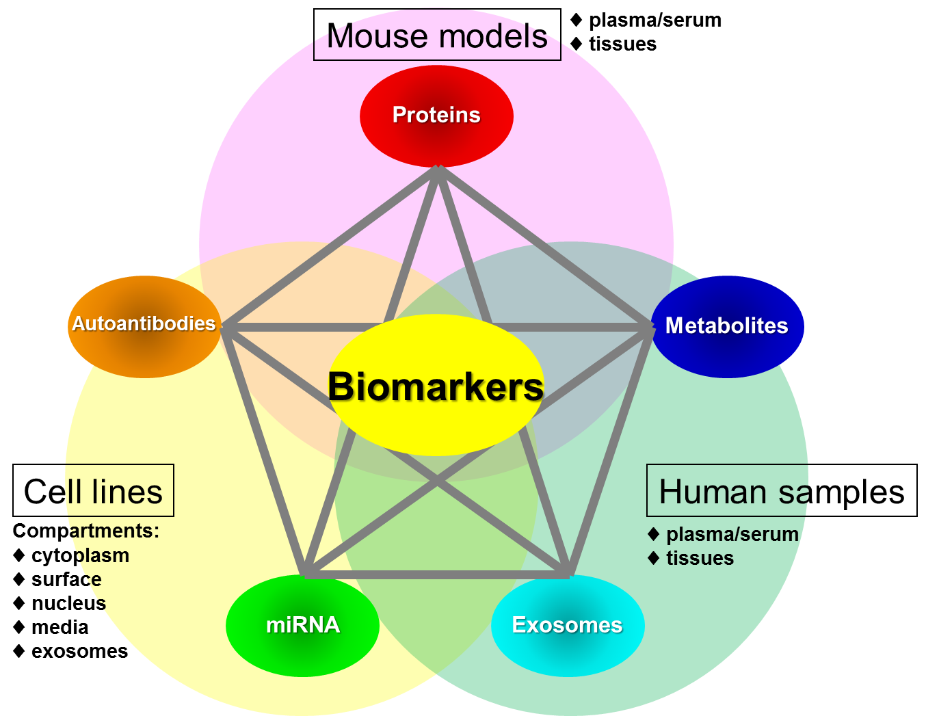
The Anderson strategy for blood based biomarker discovery
Capello & Hanash

Slide 11
In-depth Quantitative Profiling of Plasma Proteins
Cancer pool
Control pool
Immunodepletion
Capello & Hanash

Slide 12
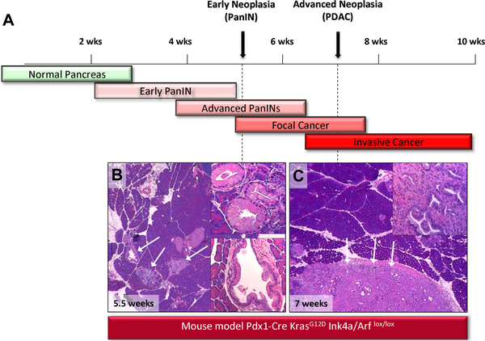
Plasma Protein Biomarker Candidates:
PDAC Mouse Model
Human Pre-Diagnostic Samples
CARET Cohort
Cases diagnosed with stage I-II PDAC within 1 year vs matched healthy controls
17 Protein Biomarker Candidates
+ CA19-9
Faca VM et al, Plos Med 2008
Capello M et al, JNCI 2017

Slide 13
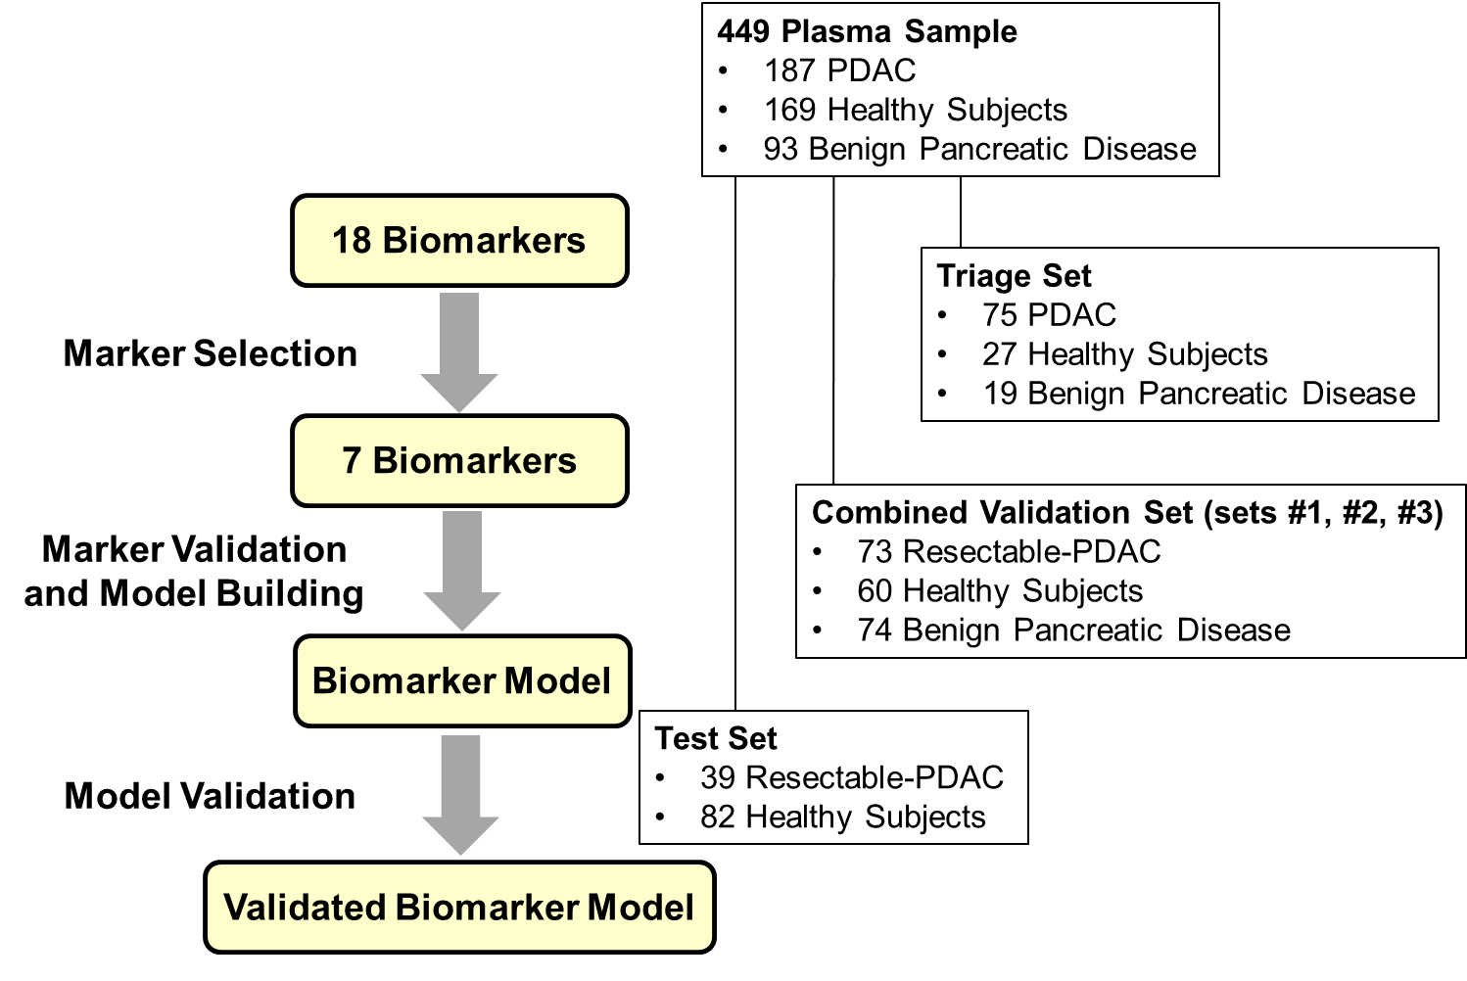
Sequential Validation Strategy
Capello M et al, JNCI 2017

Slide 14
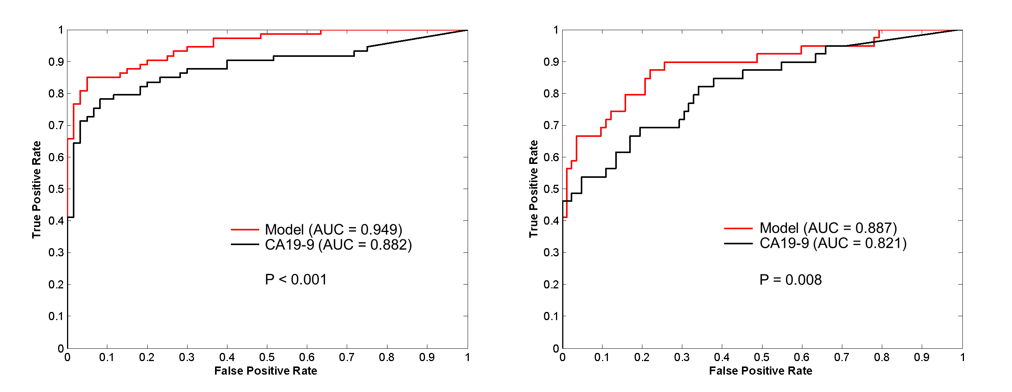
Biomarker Model Building and Validation
Combined Validation Set
Test Set
Model: TIMP1 + LRG1 + CA19-9
“Anchor Panel”
Capello M et al, JNCI 2017

Slide 15
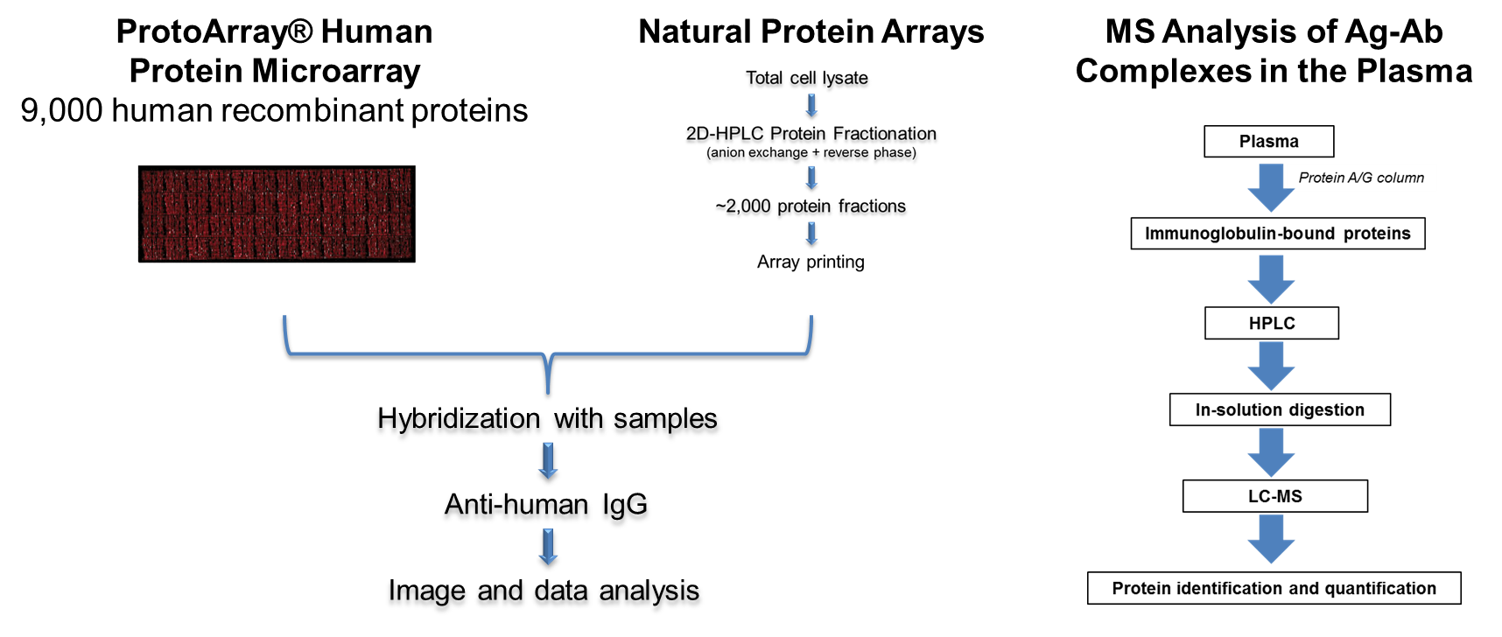
Tumor-Associated Antigen Candidates
Qiu J et al, JCO 2008; Ladd JJ et al, Cancer Res 2013; Katayama H et al, Cancer Res 2015

Slide 16
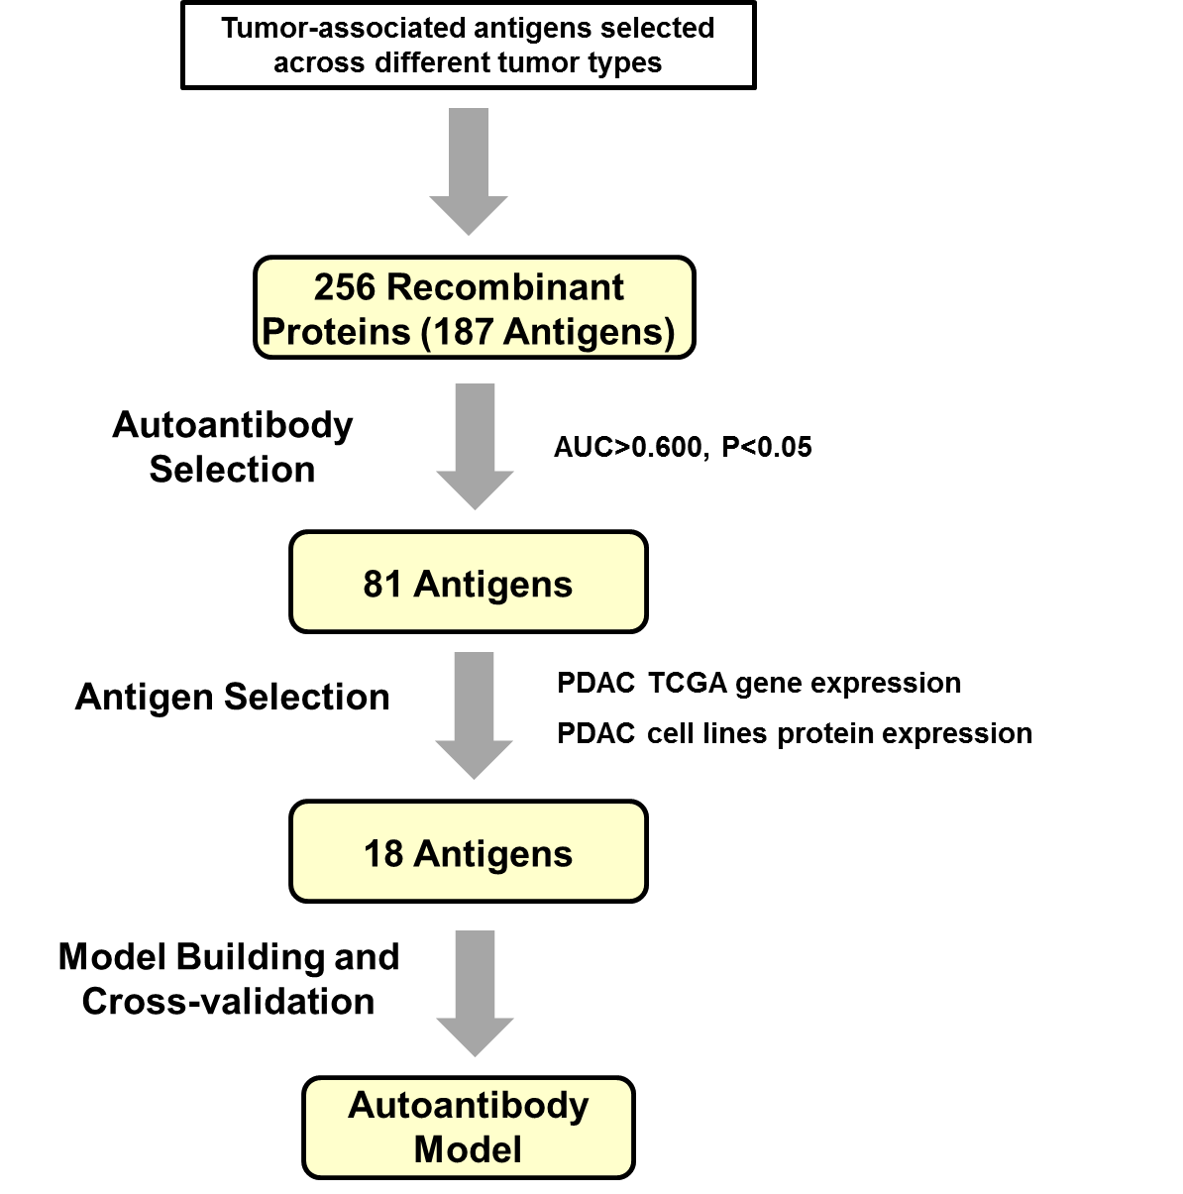
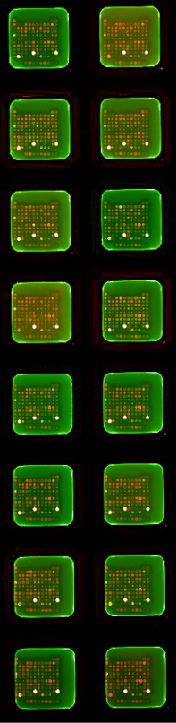
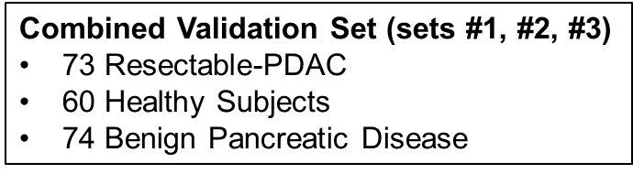
Autoantibody Biomarker Candidates
4 Autoantibodies
Capello & Hanash

Slide 17
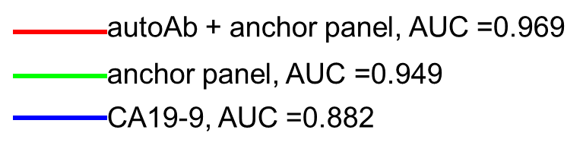
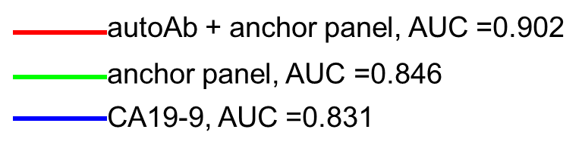
Protein and Autoantibody Biomarker Model
Resectable-PDAC vs
Benign Pancreatic Disease
Resectable-PDAC vs Healthy Controls
vs anchor panel P=0.043
vs anchor panel P=0.012
4 autoantibodies + anchor panel (TIMP1, LRG1 & CA19-9)

Slide 18
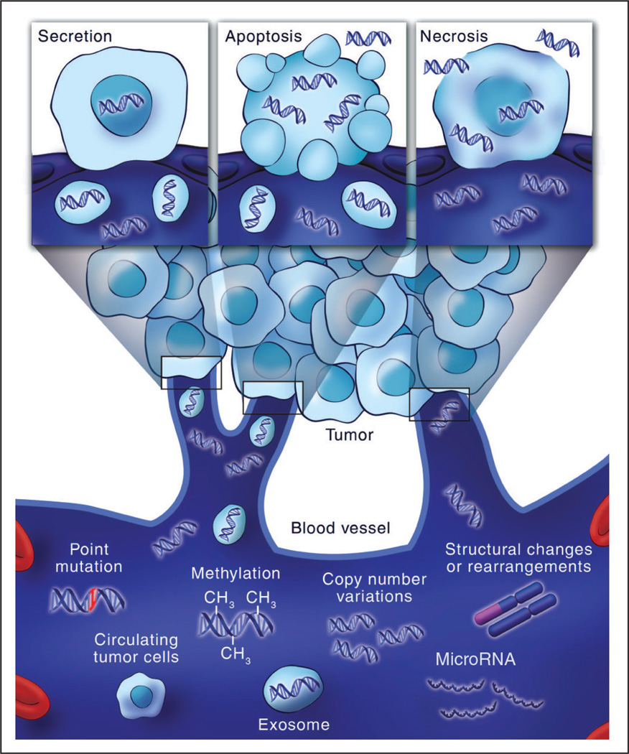
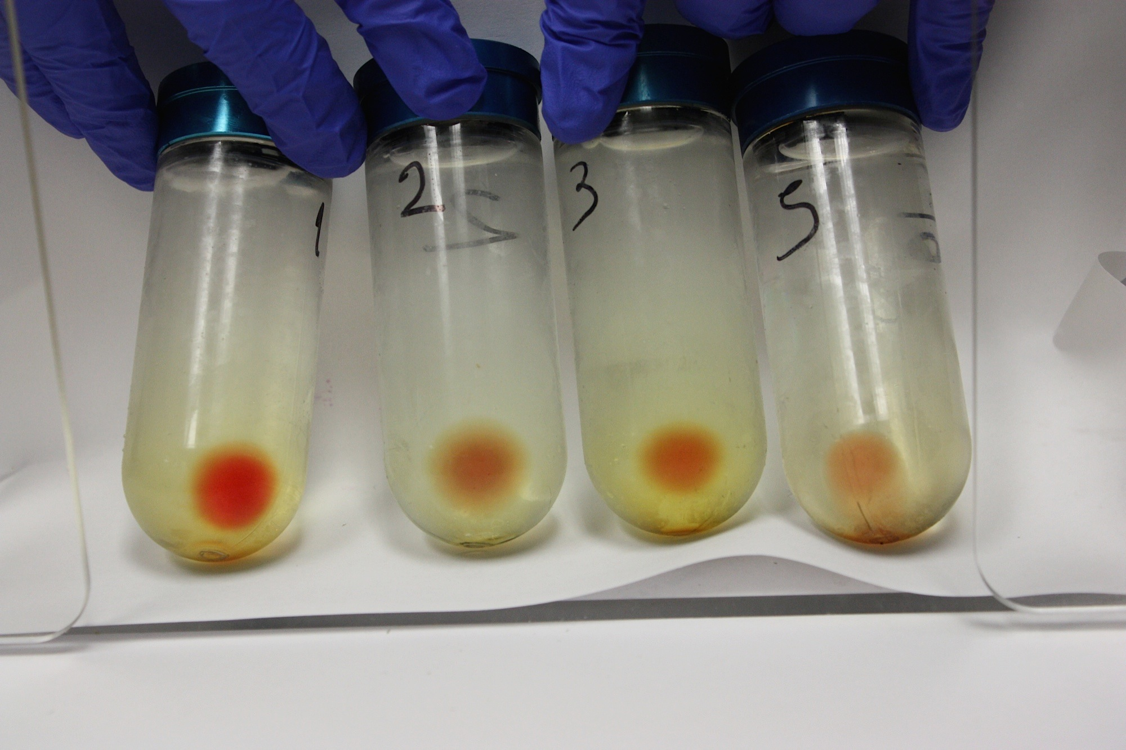
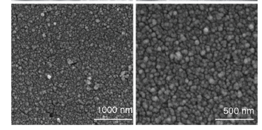
Next Steps: Integrating Genomic Markers

Slide 19
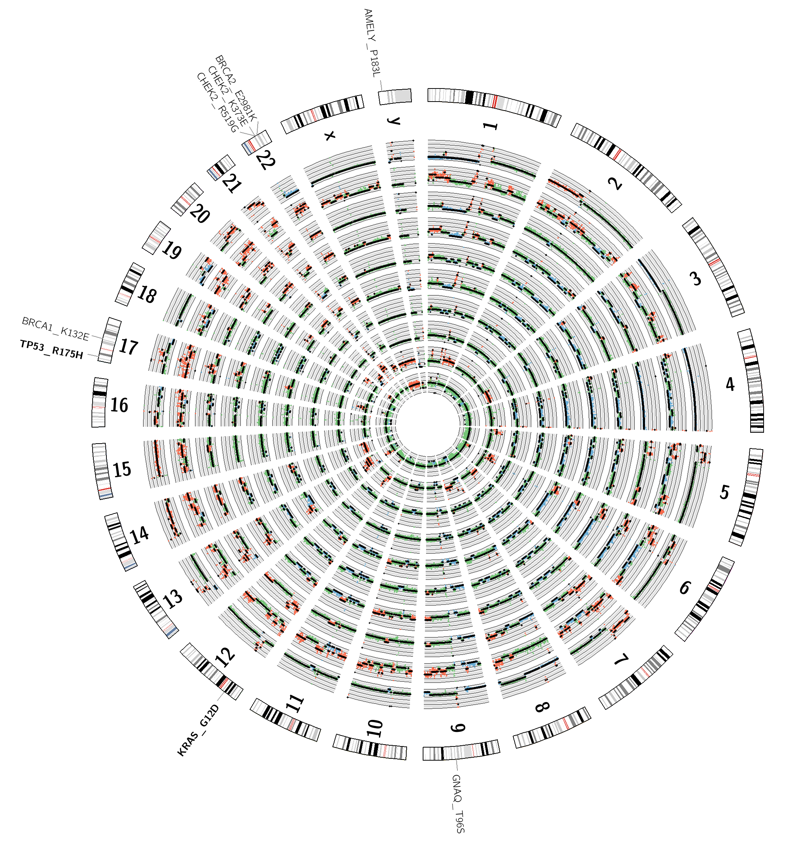
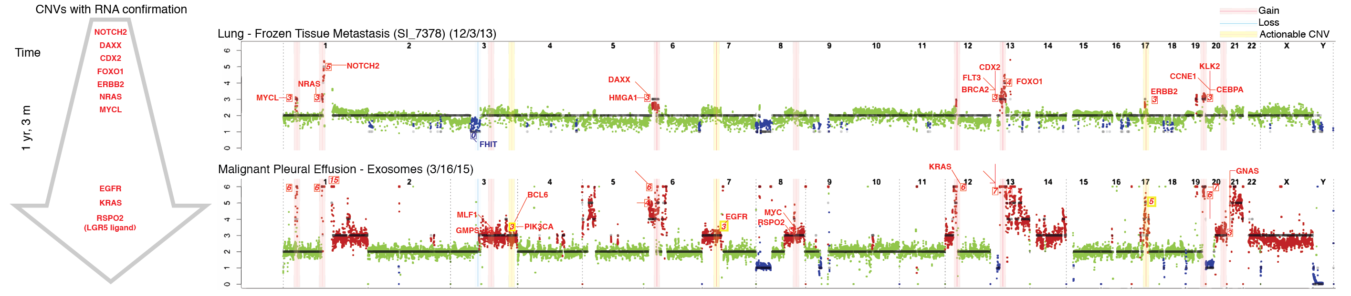
Liquid Biopsies can enable serial monitoring of genomic alterations during the course of therapy
San Lucas et al Ann Oncol 2016
Allenson et al Ann Oncol 2017

Slide 20
Preservation of RNA in shed exosomes allows for monitoring of expressed tumor antigens

Slide 21
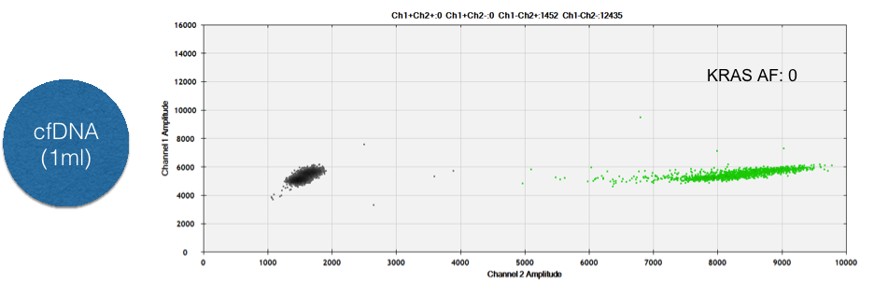
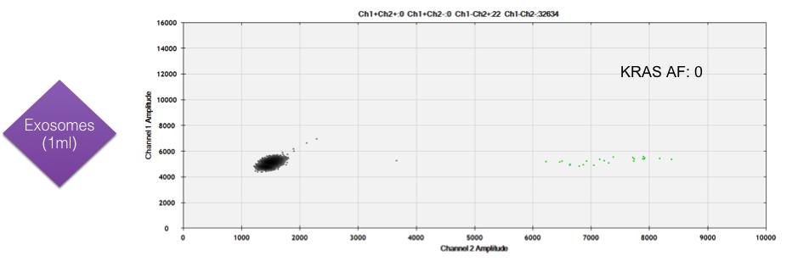
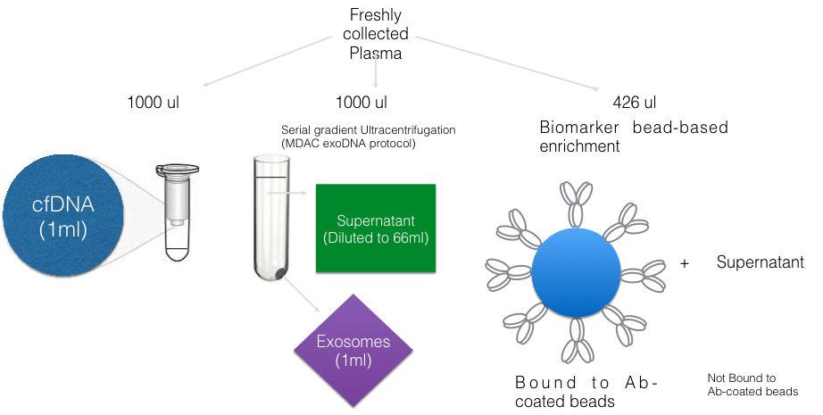
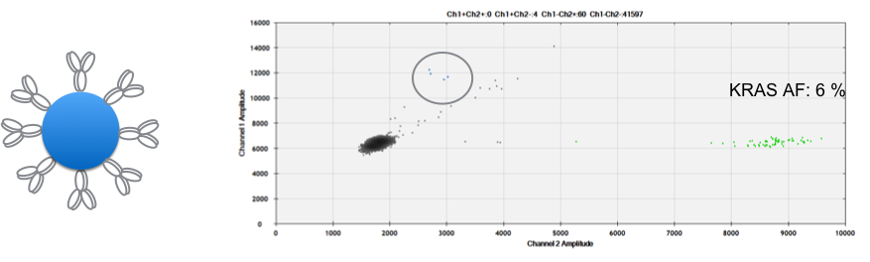
Isolating Cancer-specific exosomes (CSEs) can enhance diagnostic yield in low tumor burden settings

Slide 22
Plasma ExoDNA for Early Pancreatic Cancer Detection
Combine the high sensitivity of protein/autoantibody markers with the high specificity of genomic markers (mutant KRAS)

Slide 23
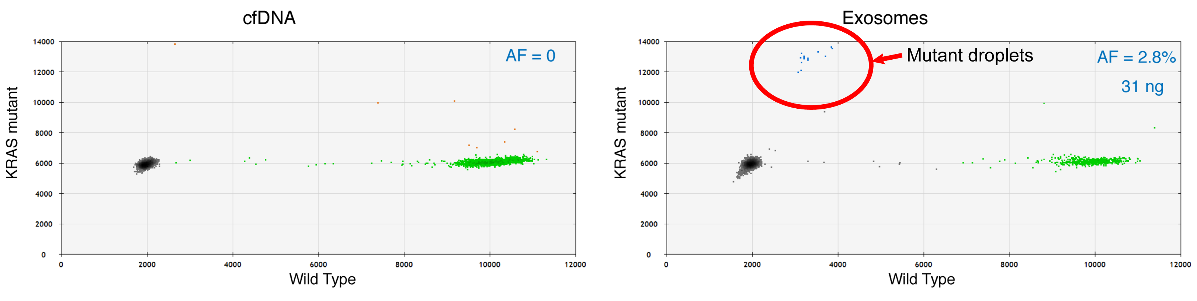
Urine ExoDNA for Early Pancreatic Cancer Detection
10/13 early stage PDAC
Mutant KRAS in UexoDNA
2/13 early stage PDAC
Mutant KRAS in UcfDNA

Slide 24
Acknowledgements
Sam Hanash
Michela Capello
Hector Alvarez
Mark Hurd
Sudhir Srivastava
JoAnn Rinaudo
NCI U01CA196403 (Overdiagnosis Consortium)
NCI U01CA200468 (EDRN CVC)
NCI/NIDDK U01DK108328 (CPDPC)

