Slide 1

Early Cancer Detection Through Autoantibody Discovery
- Proteomics to Clinic -
Joshua LaBaer, M.D., Ph.D.
Director, Virginia G. Piper Center for Personalized Diagnostics
Executive Director (interim), Biodesign Institute
Biodesign Institute, ASU
US Japan Workshop for Cancer Research • March 6, 2017 • Tempe, AZ

Slide 2

How will proteomics achieve impact?
By finding new→
  Biological discoveries
  Therapeutics
  Diagnostics

Slide 3
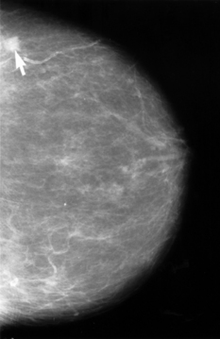
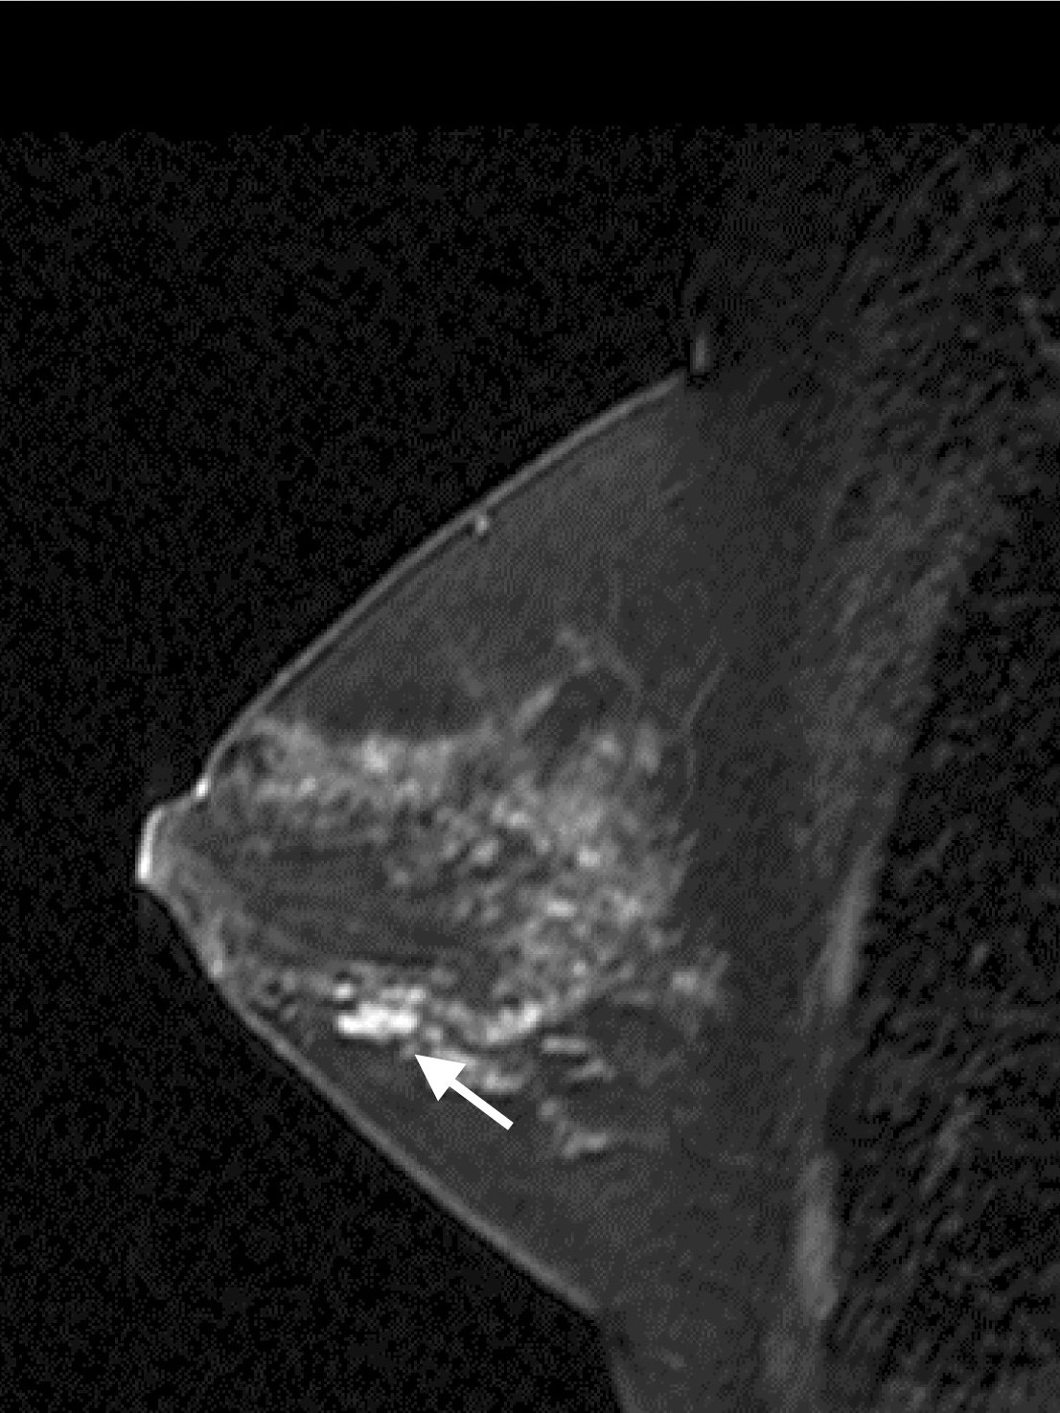
Early Detection of Breast Cancer
Stage | 5-year Relative Survival Rate
0 | 100%
I | 100%
IIA | 92%
IIB | 81%
IIIA | 67%
IIIB | 54%
IV | 20%
Annual Incidence:182,460
Annual Mortality: 40,480
Compliance with mammography varies
Dense breasts limit detection
Some subtypes occur as interval cancers
Access to mammography is not universal
Mammography:
Sensitivity: 75%
Specificity: 80-95%
MRI:
Sensitivity: 88%
Specificity: 67%

Slide 4

Autoantibodies and Cancer
Secretion
Cell Death
Immune
Tolerance
No Immune Response
Normal Cells
Normal Proteins
Secretion
Cell Death
Neoantigens
Autoantibodies to Tumor Antigens
Cancer Cells
Normal Proteins & Tumor Antigens
Amplify Signal
Persist after antigen gone
Occur early in disease
Very stable in serum sample
Well established chemistry – excellent detection reagents

Slide 5


Using Protein Microarrays to Identify Autoantigens
-High density protein microarrays-
Test sera
Compare Cases and Controls
Replicate microscopic arrays of candidate proteins
Identify which proteins are
specific to patient sera
Validation and Discovery in One Step

Slide 6
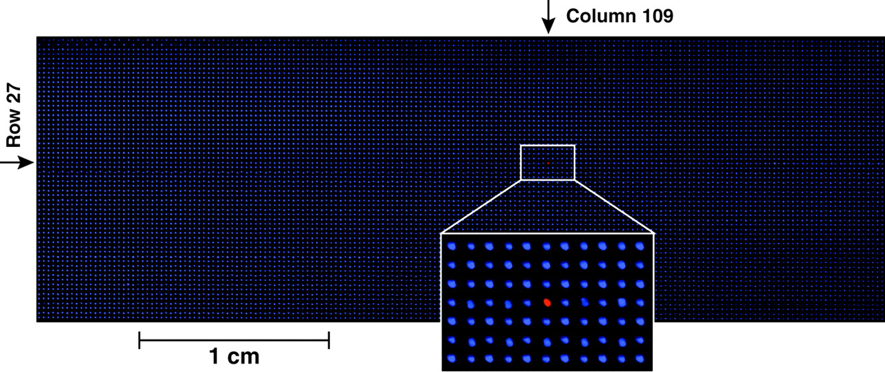
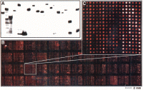
Printing Purified Proteins
MacBeath and Schreiber Science (289) 2000
Persistent Challenges:
Protein expression/purification needed
Array shelf life
Mammalian context
Zhu et al., Science (293) 2001

Slide 7

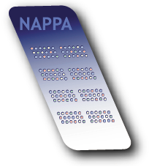
How NAPPA works…
1. Print genes
2. Express in situ & capture proteins
Y
Y
Y
Cell free expression of
target protein
Y
Y
Y
Science. 2004 Jul 2;305(5680):86-90

Slide 8
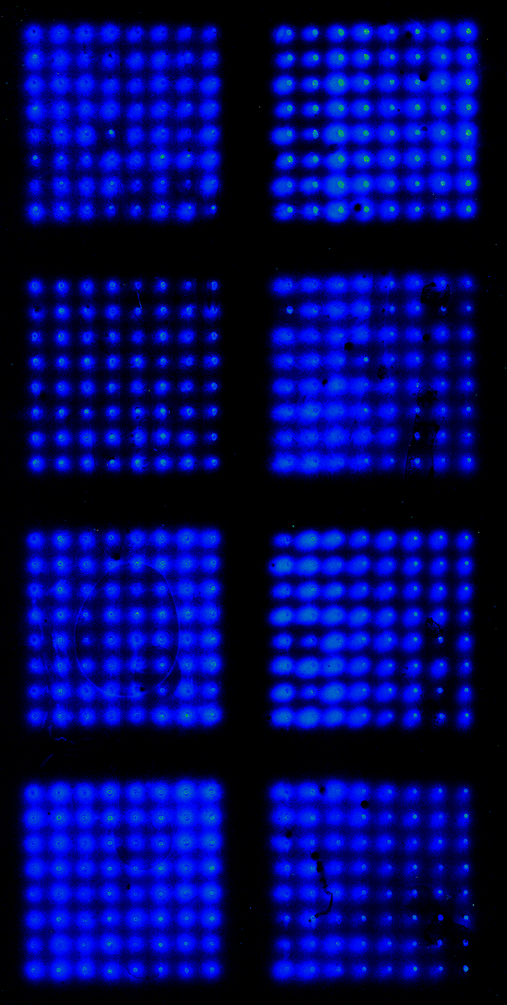
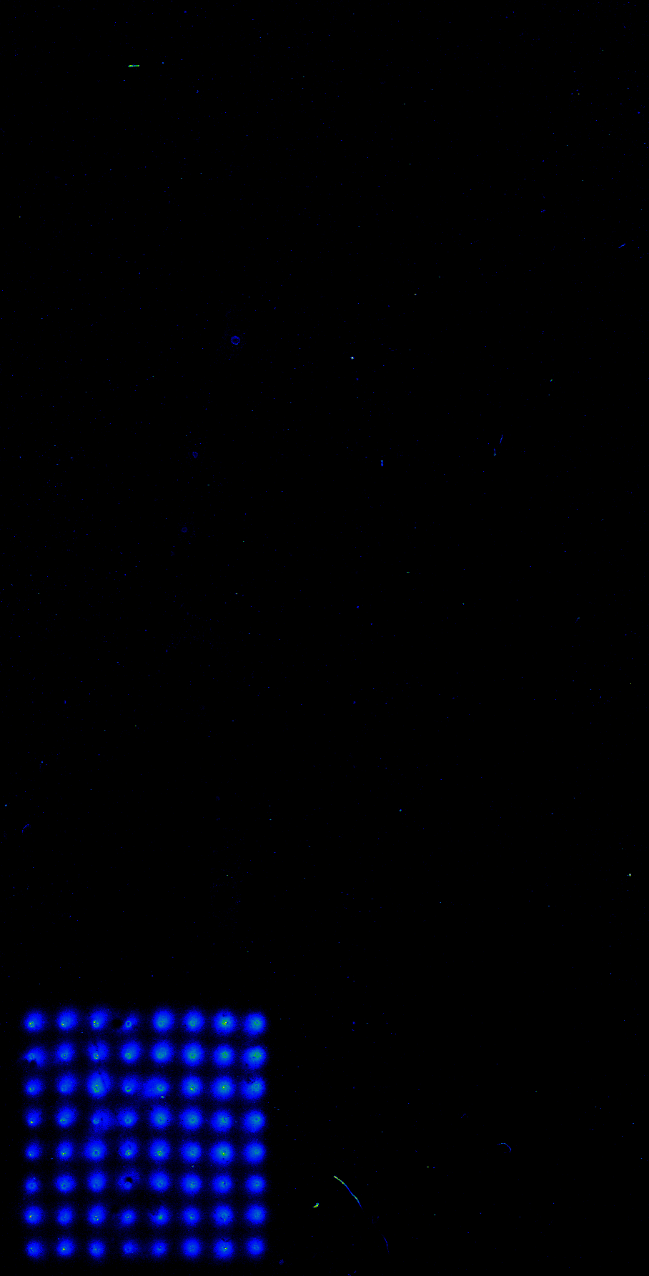
NAPPA
Protein Expression
Anti-GST
Anti-p21
Advantages:
No need to express and purify protein separately
Highly consistent protein levels
Human milieu → natural folding
Proteins just-in-time → shelf life not an issue
Access to all cloned cDNAs
Easy to produce custom arrays
Arrays stable on bench until activated
Cdk2
CDT1
Fos
Cdk4
Cdk6
Jun
p21
CycD1
p21
Niro Ramachandran
Notes:
So here what we have done is go right to a microscale and a density of 512 spots. We express 8 genes. We detect the expression of all 8 genes using an gst antibody. But in order to show you that we are detecting these proteins specifically we use protein specific antibodies such as p21, and here we identify only p21 of the 8 target genes, we can also use Jun and highlight Jun expression alone.

Slide 9
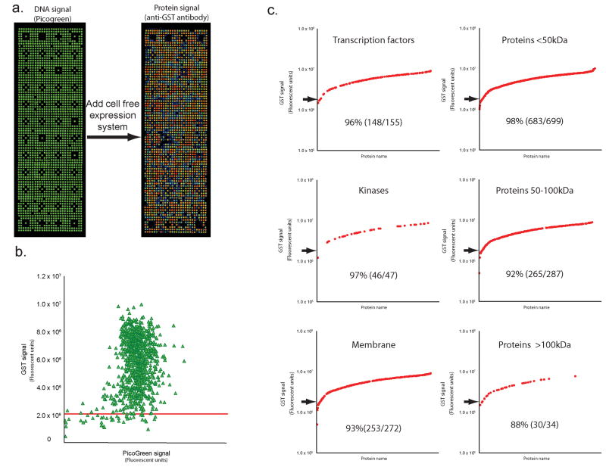
High-density NAPPA arrays
Different types
~1 log
Different sizes
~1 log
Nat Methods. 2008 Jun;5(6):535-8.

Slide 10
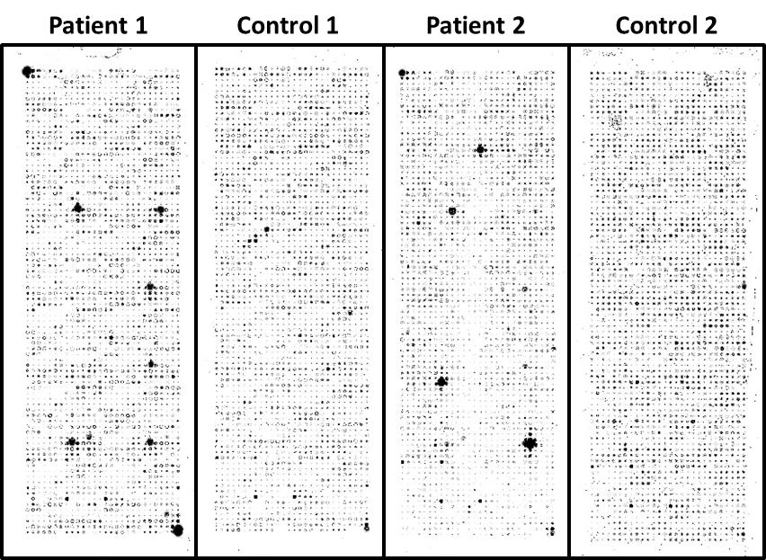
Images of plasma probed arrays

Slide 11
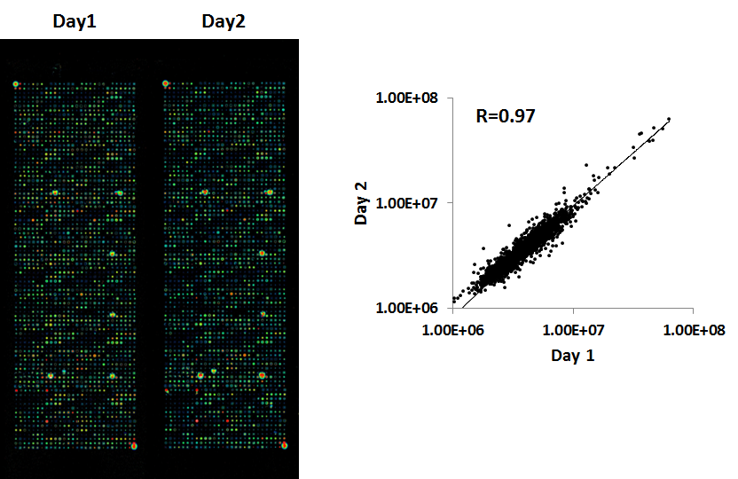
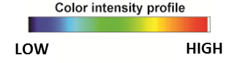
Screening Reproducibility
Jie Wang, Ji Qiu
Cancer Epidemiol Biomarkers Prev. 2015 Sep;24(9):1332-40

Slide 12
Three Phases of Screening
Antigens | Sensitivity (%)
BAT4 | 29.41
CTBP1 | 19.61
SF3A1 | 33.33
BDNF | 17.65
ZNF510 | 21.28
ATP6AP1 | 24
BMX | 13.73
UBAP1 | 13.73
RAC3 | 25.49
HOXD1 | 21.57
SOX2 | 15.56
GPR157 | 12
SLC33A1 | 18
C15orf48 | 11.76
ZMYM6 | 17.65
TRIM32 | 26
DBT | 21.57
CSNK1E | 31.37
MYOZ2 | 25.49
EIF3E | 21.57
PDCD6IP | 19.61
ATF3 | 17.65
TFCP2 | 23.53
SERPINH1 | 27.45
FRS3 | 39.22
RAB5A | 24
ALG10 | 15.69
SELL | 25
Phase 1:
Pre-screen
~5000 Ag’s
Routine mammography
53 cases/53 controls
Eliminate uninformative features
Diagnostic mammography
51 cases/39 controls
Benign breast disease
Diagnostic mammography
51 cases/38 controls
Benign breast disease
28 antigen panel selected
Phase 2:
Training
761 Ag’s
Phase 3:
Validation
(Blinded)
119 Ag’s
J Proteome Res. 2011 Jan 7;10(1):85-96

Slide 13
Translating Proteomic Discoveries
Biomarker Discovery
& Independent Verification
Optimize and Lockdown Assay
Clinical Validation
Optimization of individual assays improves performance considerably
Proteomics is ideal for discovery
Clinical grade tests require:
  Analytical chemistry
  Robust assays
  Quality assurance methods
Combine multiple assays to get an ideal panel
Improves both
  Sensitivity
  Specificity
For patient care we really care about
  NPV
  PPV

Slide 14


Slide 15
Early Detection of Breast Cancer
Based on two large, prospectively collected, randomized, blinded, multi-centered clinical trials;
Provista001 (NCT01839045)
Provista002 (NCT02078570)
Clinical Significance
Significantly reduce total number of biopsies and rate of false positives
PPV 26% (dense)/46% (fatty)
NPV >98% both groups
When combined with imaging – Improves the sensitivity of breast cancer detection (100% detection)
Improved cancer-to-biopsy yield
Accurately detects breast cancer irrespective of breast density
Notes:
Kinase array

Slide 16
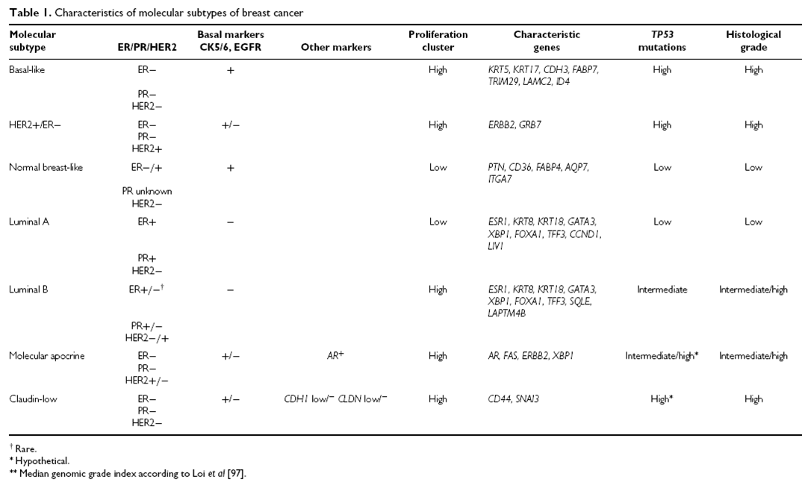
Breast Cancer is a heterogeneous disease
Britta, Weigelt et al. J Pathol 2010
Notes:
High TP53 mutation rate
More aggressive
High proliferation cluster
High histological grade

Slide 17
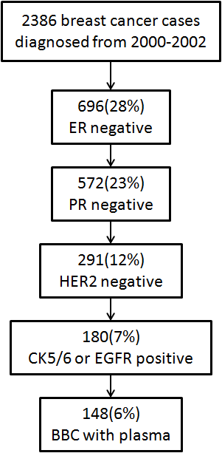
Study Population
Polish Breast Cancer Study
2000~2003 in Warsaw and Lodz, Poland
2386 BC cases + 2798 age and location matched controls
148 cases had Basal-like Breast Cancer(BBC) with plasma available
TMA: ER, PR, HER2 negative, CK5/6 or EGFR positive
Molecular profiling data
Jonine Figueroa
Notes:
BBC were classified based on TMA data

Slide 18
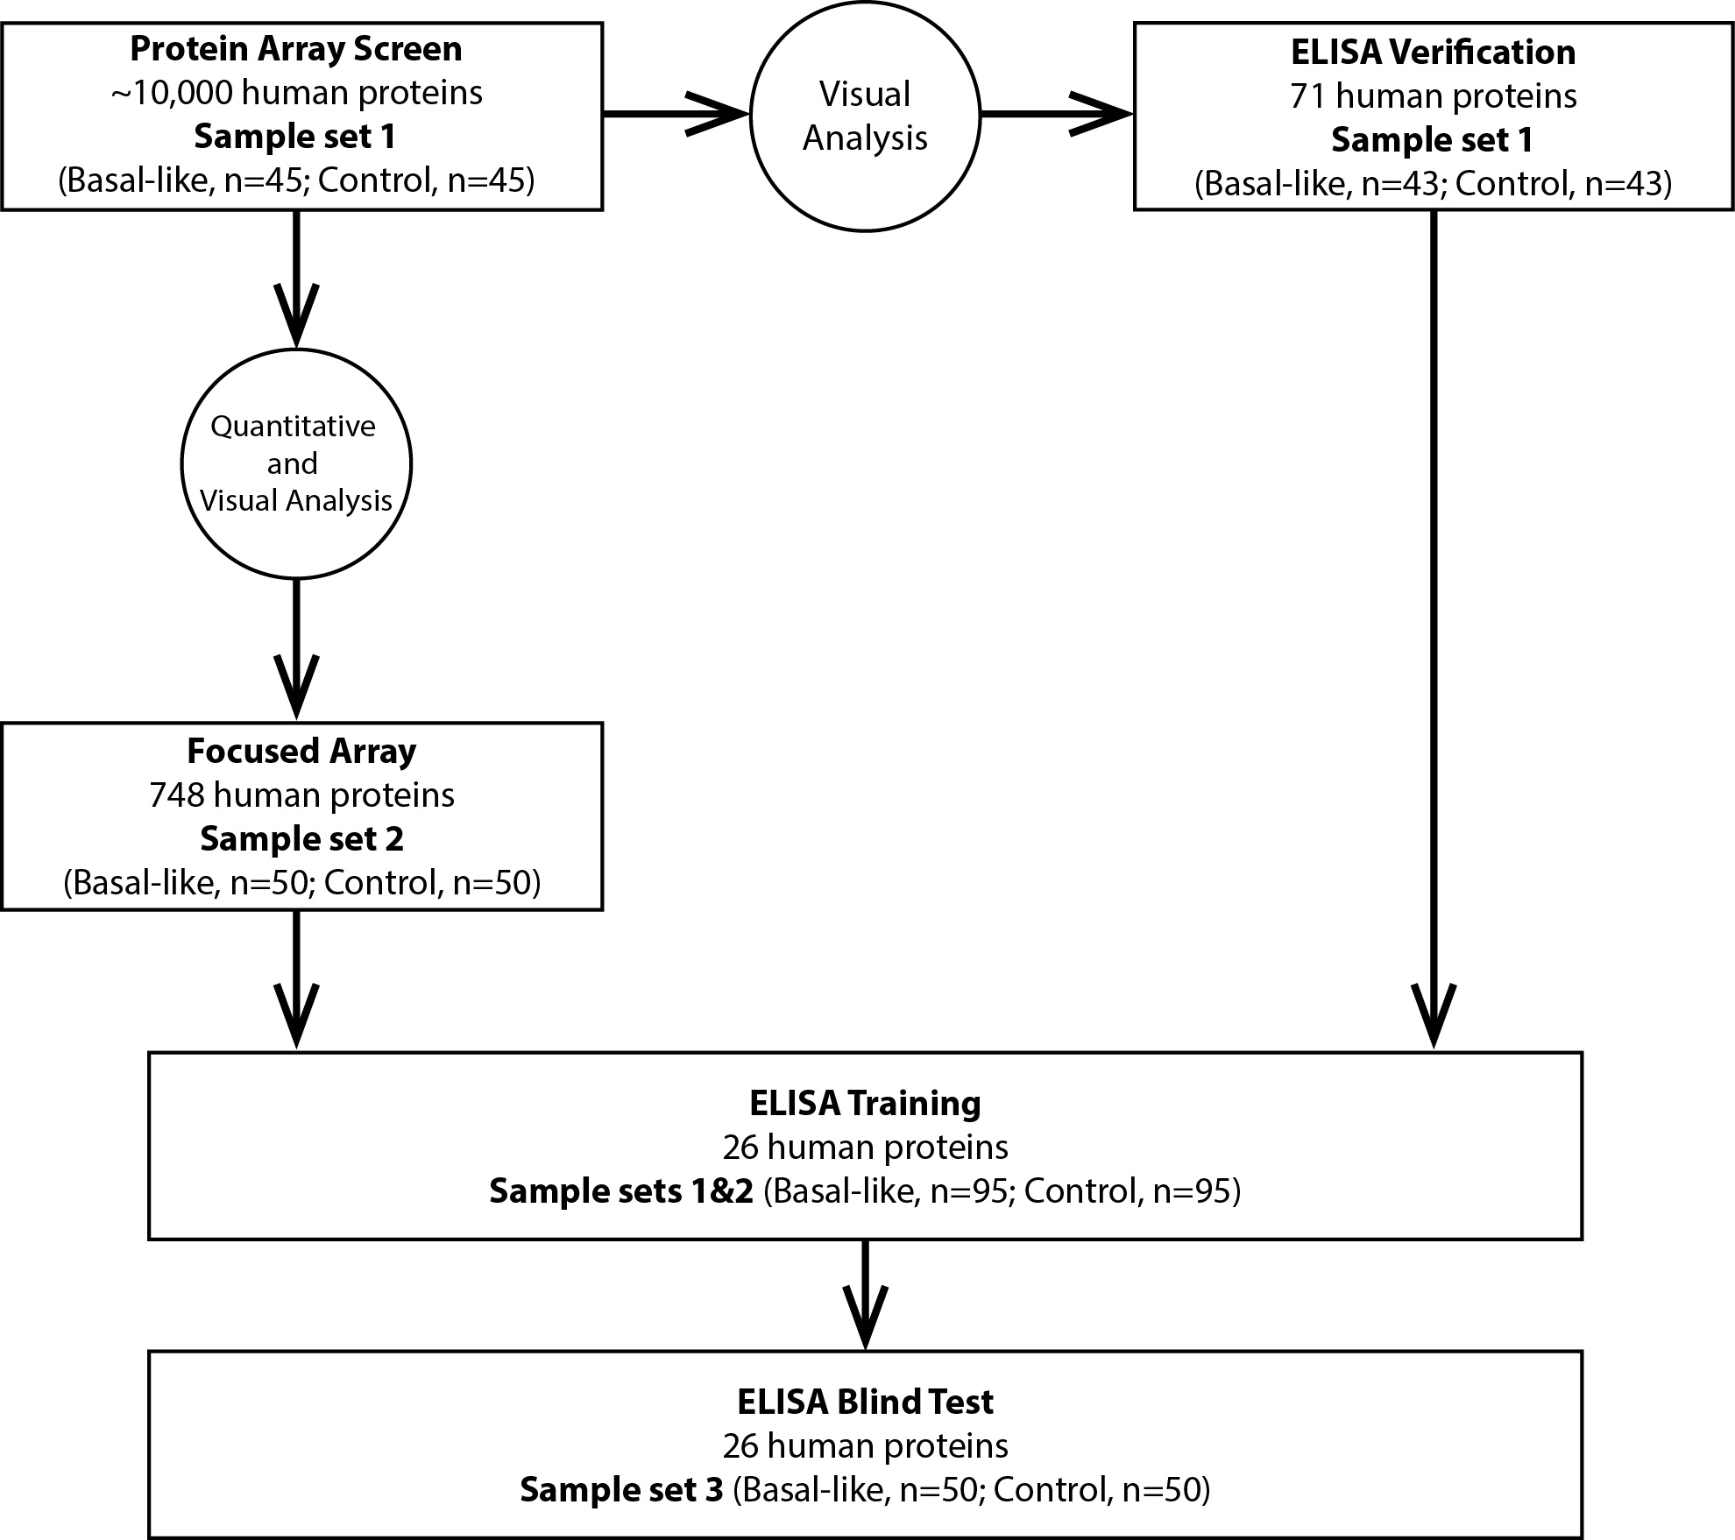
Screening Strategy

Slide 19
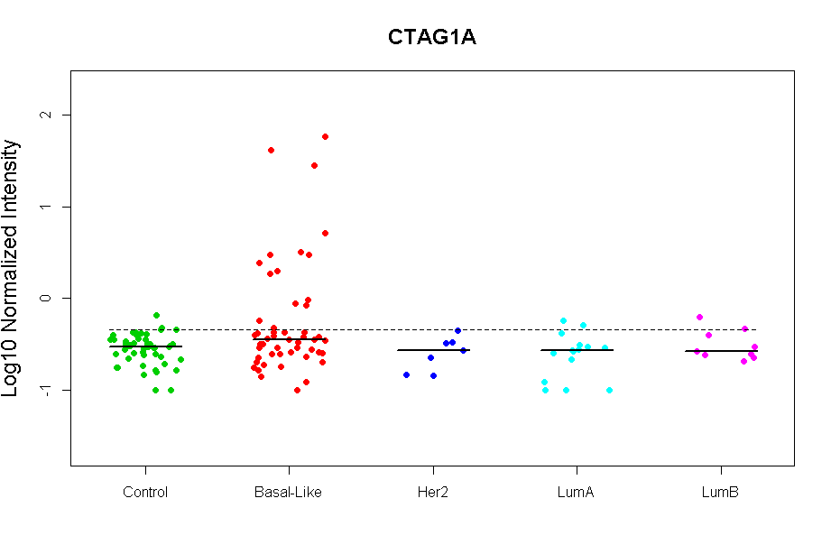
Cancer Epidemiol Biomarkers Prev. 2015 Sep;24(9):1332-40

Slide 20

A National Study for Blood Tests for TNBC cancers
FHCRC
PNNL
UCSF
FCCC
MSKCC
NCI
DUMC
ASU/Mayo
Vanderbilt
Karen Anderson

Slide 21
Biomarker Panel for Triple-Negative Breast Cancer
Autoantibodies to p53, CTAG1A, CTAG2 with CA 125
 | ROC (0.05) | p-value | 95% CI | AUC | p-value | t-test
TP53 CTAG1A CTAG2 PRoBE Combination | .133 .117 .233 .217 | .073 .159 .001 .004 | (0.05,0.22) (0.05,0.23) (0.12,0.33) (0.10,0.33) | .51 .54 .56 .56 | .848 .397 .196 .171 | .069 .048 .012 <.001
AUC 0.73
41% sensitivity at 95% specificity
Karen Anderson
Notes:
Associations of different TNBC subtypes. TNBC gene expression subtypes are associated with distinct molecular features. Luminal AR cancers are the most distinct TNBC subtypes associated with PIK3CA mutations and apocrine histology. The immunomodulatory subtype is likely composed of all other subtypes, with the gene expression consequences of lymphocytic infiltration dominating the gene expression subtyping. Although current data suggest that BRCA1 mutant TNBC cell lines fall in the basal-like 1 TNBC subtype, it is unclear if this association will also be seen in TNBC cancers. Subtypes of TNBC: BL1, basal-like 1; BL2, basal-like 2; IM, immunomodulatory; ML, mesenchymal-like; MSL, mesenchymal stem-like; LAR, luminal androgen receptor; AR, androgen receptor; path CR pathologic complete response.

Slide 22

The Future of Biomarkers –
Post Translational Modification
Ji Qiu
Kailash Karthekeyan

Slide 23
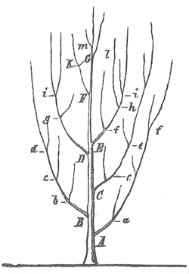
Post Translational Modification is Altered in Cancer – Simplistic Version
Healthy Cells
O-Glycosylated at specific residues
Complex branched structures
Protein X
Truncated sugar chains create neoantigenic sites
Newly modified amino acids create neoantigenic sites
Cancer Cells
O-Glycosylation is significantly truncated to a few residues
Increased promiscuity of where glycosylation occurs
Protein X
Opportunity to look for new autoantibodies

Slide 24





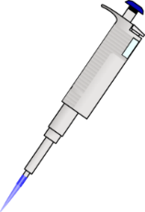


Contra capture protein array concept
Step 1: Print cDNA in PDMS wells
HeLa
lysate
Step 2: Fill PDMS wells with in vitro protein
expression mixture
Step 3: Seal PDMS wells with capture ligand coated slide
Mol Cell Proteomics. 2016 Jul;15(7):2324-37

Slide 25




Contra capture protein array concept
Step 4: Expressed proteins captured onto slide
Step 5: Remove capture slide and discard PDMS wells
Step 6: Prepare slide for PTM
Mol Cell Proteomics. 2016 Jul;15(7):2324-37

Slide 26
Contra capture protein array concept
Enzyme for PTM
Add
Step 7: Perform PTM on array
Analysis

Slide 27
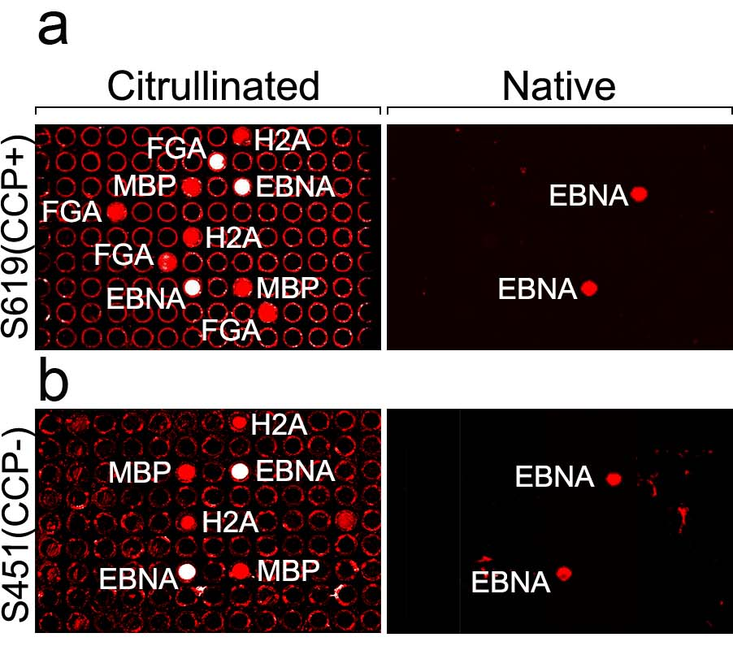
Specific serum reactivity to citrullinated proteins on contra capture protein arrays
Citrullination sensitive by clinical assay
NOT citrullination sensitive by clinical assay

Slide 28
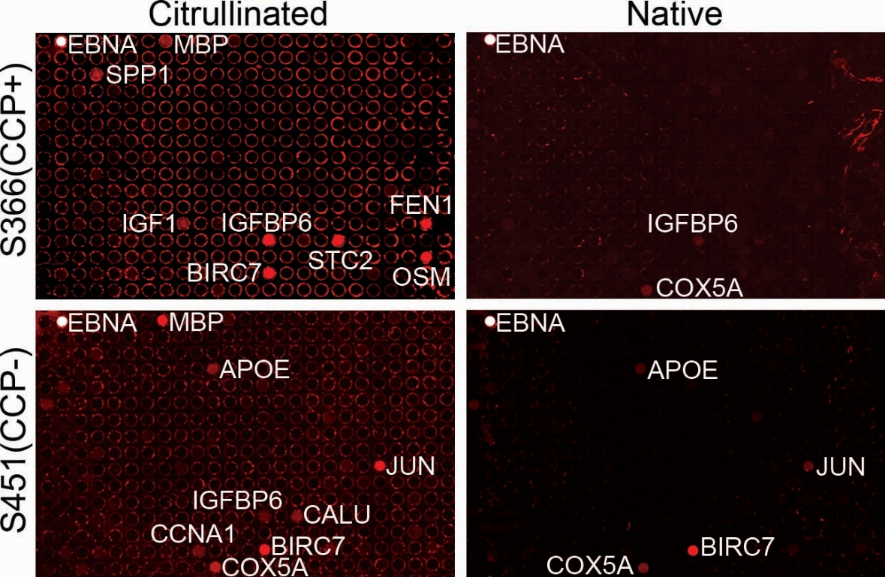
Identification of novel anti-citrullinated antigen antibodies in RA patients
190 genes printed
96 out of 190 were selected due to high/differential expression in RA synovial fluid
Rest are randomly selected genes from DNASU

Slide 29
Glycosylation-specific patient responses to tumor antigens

Slide 30
Translational Take Homes
Ensure robust and reproducible platform
Use an appropriate clinical design
Use strong biostatistics
Optimize assay
Combine assays as needed
Partner with careful diagnostics company
Prepare for a long process

Slide 31
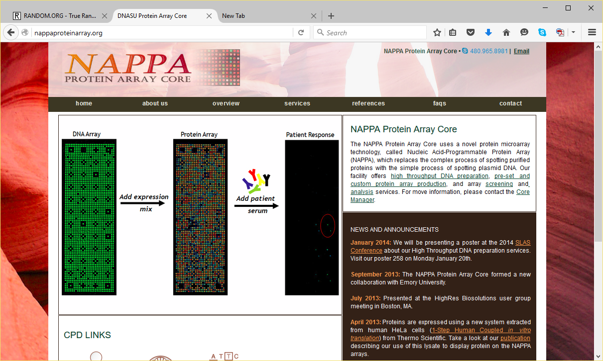
Non-profit Protein Microarray Core
nappaproteinarray.org

Slide 32


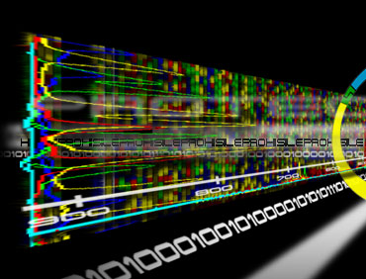
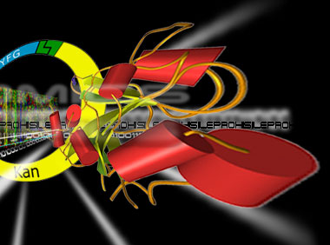



Collaborators
Funding
Microbiology
Breast Cancer/Ob Gyn
Steve Lory
Ed Ryan
John Mekalanos
EDRN
NIGMS - PSI
JDRF
BCRF
NIAID
NCI (Breast Cancer SPORE,
R01, IMAT)
NHGRI
Viginia G. Piper Foundation
Karen Anderson
Andy Godwin
Paul Engstrom
Steve Skates
Jeff Marks
Engineering
Dale Larson
Diabetes
Des Schatz
Mark Atkinson
Clive Wasserman

Slide 33
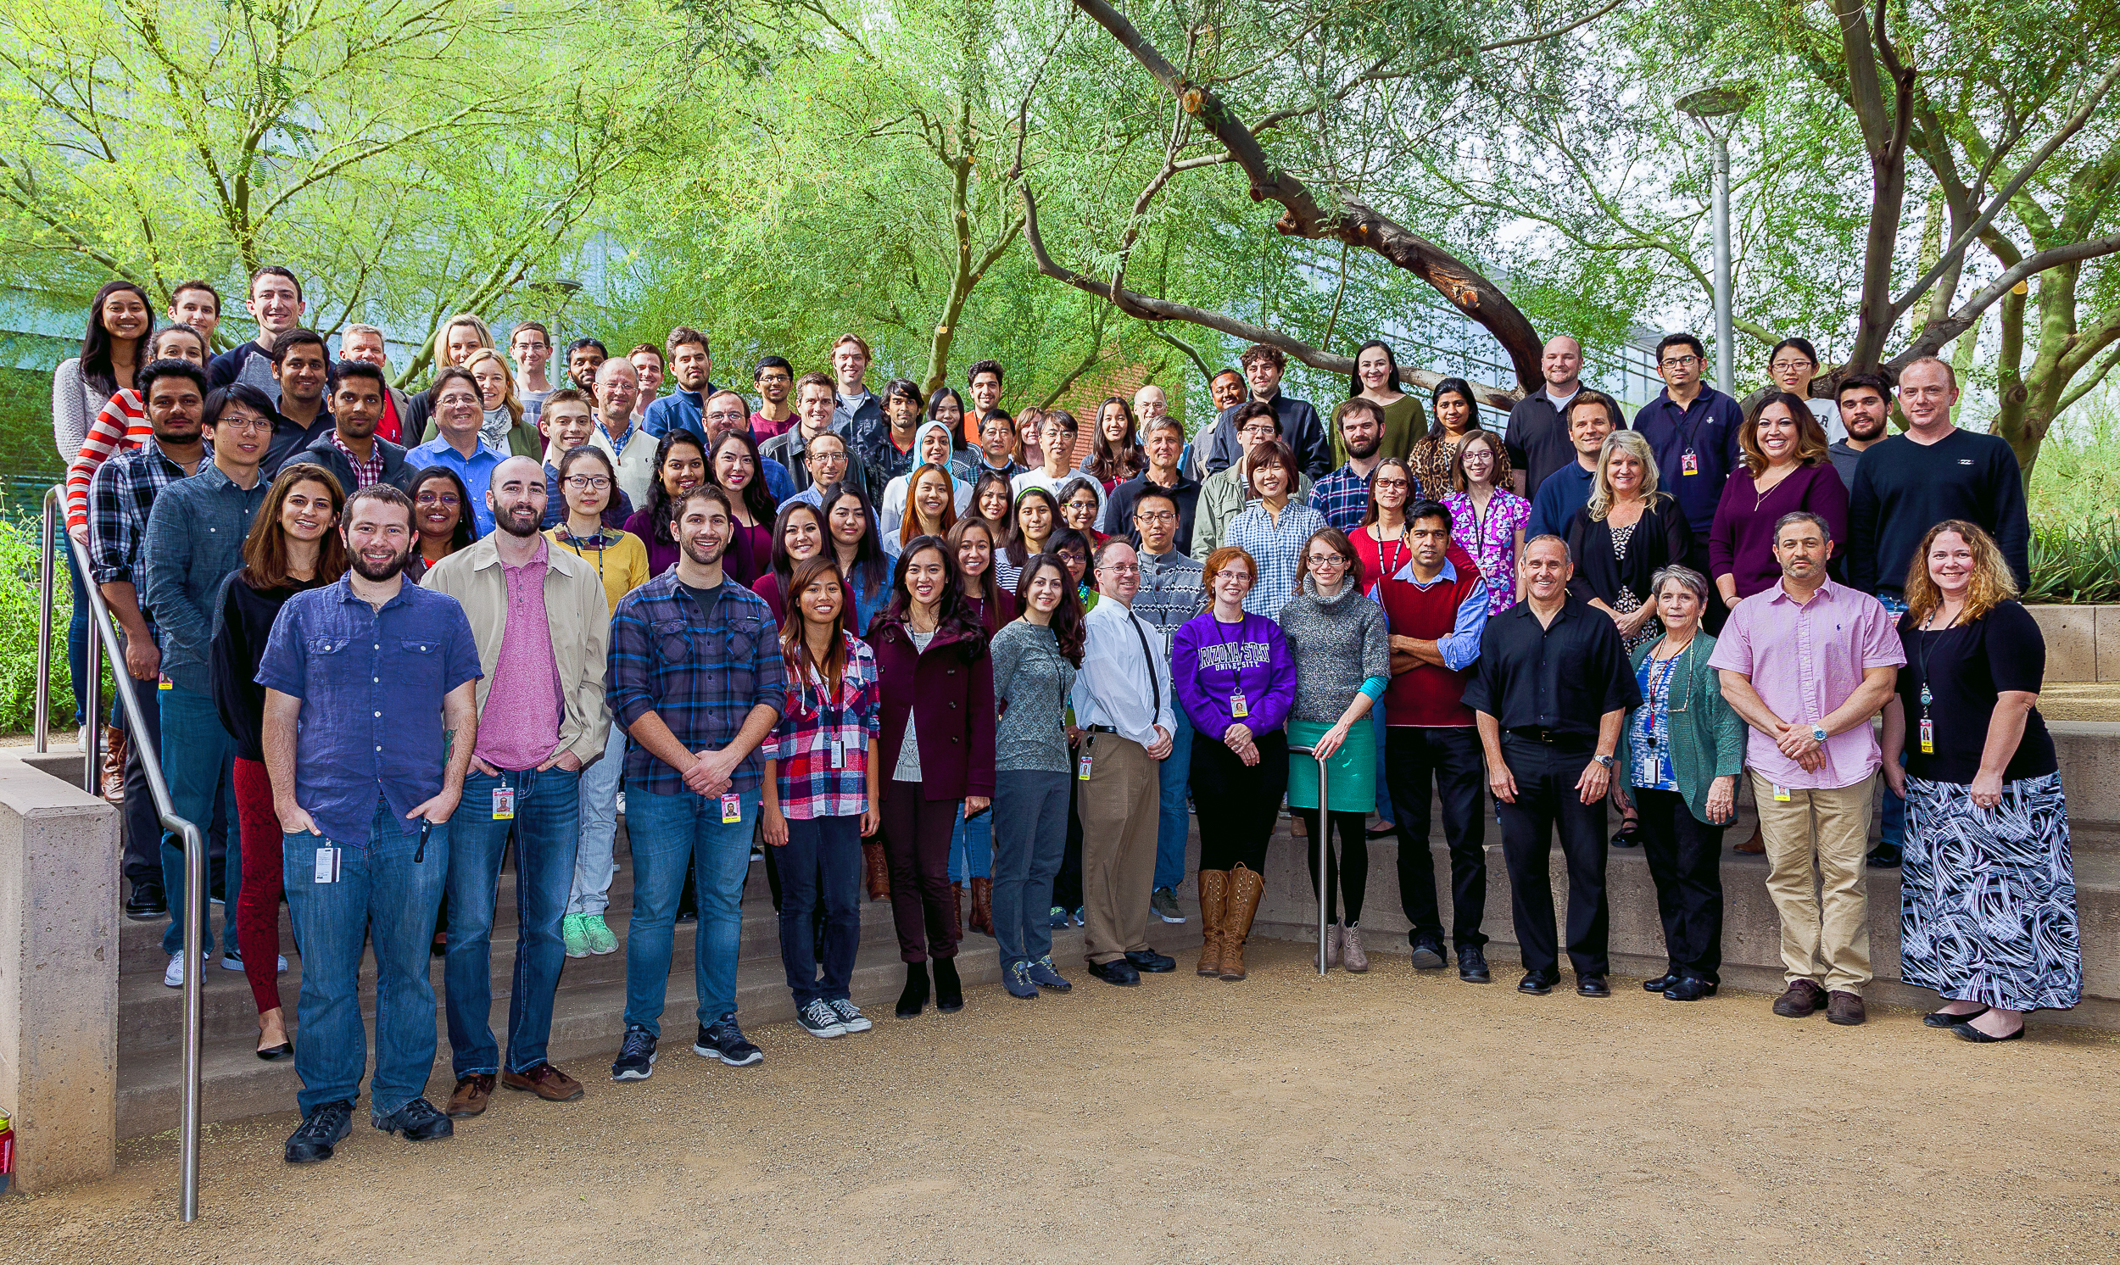
Thanks to the team that does the work!

