Slide 1
Mesothelioma, Buffy Coats, and Mononuclear Cells: Immunodiagnostics?
Harvey I. Pass MD
NYU Langone Medical Center

Slide 2
Disclosures
Grants: NCI EDRN,TCGA, DOD, Technion, CDC
Philanthropy: Rosenwald Foundation, Stephen A. Banner Lung Cancer Foundation, Belluck and Fox, Levi, Phillips and Konigsberg, Simmons Foundation, Baron and Budd, multiple patients who shall remain anonymous
Royalties: NCI cell lines
Industry: Fujirebio, 20/20 Gene, MesoScale Diagnostics, Cynvezio, Source MDX, Celera, OPKO, SomaLogic, Genentech, Integrated Diagnostics, Transgenomics, Rosetta Genomics, Calithera, Pinpoint Genomics, Cizzle, emeraldLogic, HTG
Patents (no money): Osteopontin for diagnosis and prognosis of MPM; fibulin 3 for diagnosis and prognosis of MPM; mir-29c* for prognosis of MPM; mir-31 for diagnosis of MPM, HMGB1 for diagnosis of MPM

Slide 3
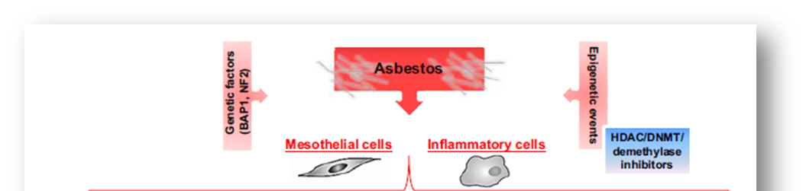
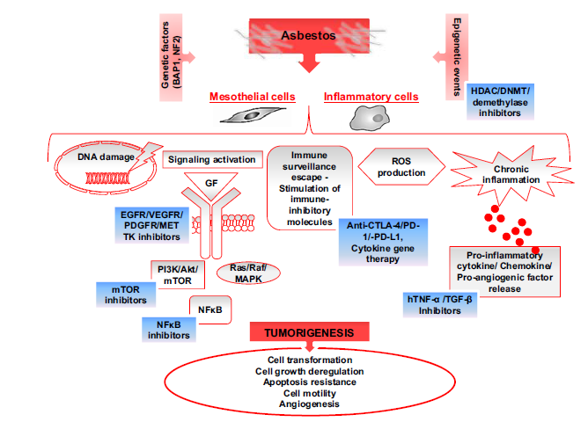
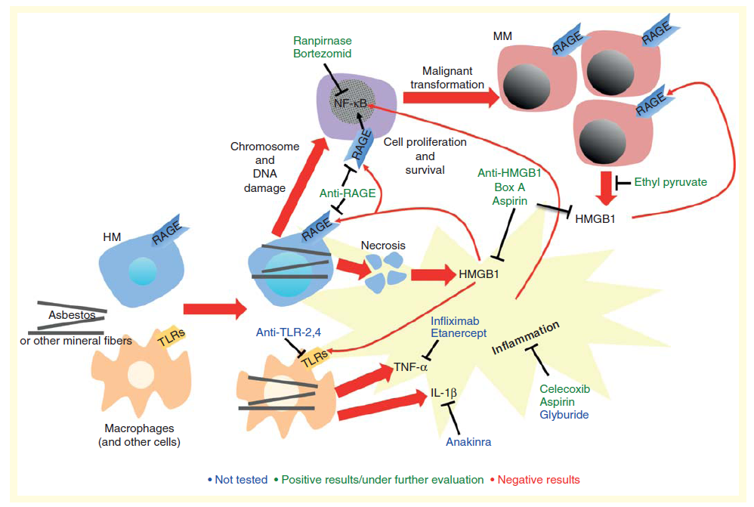
Targets for Mesothelioma? The Usual Suspects…
Actionable Mutations
Angiogenesis Inhibition
RTK inhibition
MSN Overexpression
Immune Suppression
Microenvironment

Slide 4
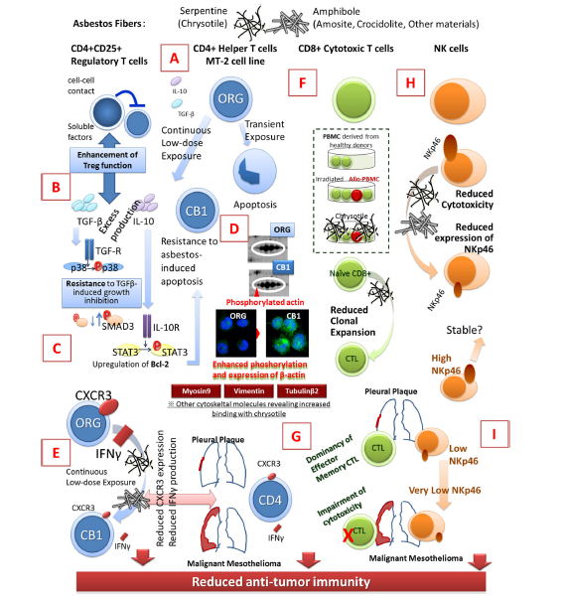
Notes:
Fig. 1 Schematic presentation showing the immunological effects of asbestos fibers on regulatory T cells, CD4+ helper T cells, CD8+ cytotoxic T and natural killer cells. ORG MT-2 original cell line, CB1 one of the sublines of the MT-2 cell line continuously exposed to chrysotile B asbestos, IL interleukin, TGF transforming growth factor, SMAD signal transducing adaptor proteins, STAT3 signal transducer and activator of transcription 3, R receptor, CXCR3 chemokine (C-XC motif) receptor 3, IFN interferon, CTL cytotoxic T lymphocyte, PBMC peripheral blood mononuclear cells, NK natural killer. a Excess production of IL-10 and TGF-b in MT-2 subline (CB1) continuously
exposed to asbestos, b resistance to TGF-b-induced growth inhibition in MT-2 subline (CB1), c acquisition of asbestos-induced apoptosis in MT-2 subline (CB1) via excess production of IL-10, phosphorylation of STAT3 subsequent overexpression of Bcl-2, d enhanced b-actin phosphorylation in MT-2 subline (CB1), e reduction of CXCR3 and IFN-c-producibility inMT-2 subline (CB1) meaning reduction of antitumor immunity, f reduction of CTL clonal expansion in co-culture with asbestos, g aberrant CTL population and function in patients with pleural plaque (PP) or malignant mesothelioma (MM), h decrease of NKp46 activating receptor by asbestos exposure in NK cells and i progressive reduction of NKp46 in patients with PP–MM

Slide 5
MPM Tumor Microenvironment Studies: Mainly Differences between MPMs
Author | Number MPM | T cells | Regulatory cells | Memory | B cells | Macrophages | Cytokine/ chemokine receptors | PD-L1 | PMN | Techniques | Findings
Anraku 2008 | 32 | Cd3,cd4,CD8 | Cd25, foxp3 | Cd45R0 |  |  |  |  |  | IHC | ↑CD8 ↑survival; ↑CD4 or CD25↓survival;↓cd450↓survival
Cornelissen 2014 | 16 | CD8 |  |  |  | CD68 total CD163 M2 |  |  |  | IHC | ↑CD163/CD68 Ratio ↓survival
Yamada 2010 | 44 | CD8 and HLA,CD5, CD56 NK |  |  |  |  |  |  |  | IHC | ↑CD8↑survival for EPP patients ↑CD4↑survival trend only ND CD56 NK
Ujiie 2015 | 230 | CD3, CD4, CD8 | FOXP3 | Cd45RO, | Cd20 | CD68,CD163 | IL-7R, IL12Rb2,CCR7,CXCL12, CxCR4 |  |  | IHC | ↑CD4↑survival;↑CD8 trend only; ↑CD20↑survival ↑IL7R↓survival ↑CD163/CD8 ratio↓survival ↓163/CD20 ratio ↑survival
Mansfield 2014 | 105 |  |  |  |  |  |  | PDL1 |  | IHC 5H1-A3 | PDL1 ↑40% total (epi, 33%;BMM,29%;SMM, 38%) ↑PDL1↓survival(5 vs 14 months)
Cedres 2015 | 119 |  |  |  |  |  |  | PDL1 |  | IHC E1L3N | PDL1↑ 37% nonepi;13%epi ↑PDL1↓survival (5 vs 16 months)
Combaz-Lair 2016 | 58 | CD3, CD8 |  |  |  |  | TLR3 | PDL1 and PD1 |  | IHC E1L3N, SP142, | PDL1 ↑29% total PDL1↑62% SMM;9% BMM;24% EMM PDL1↑staining in TILS from nonepi (10%) vs epi (4%) ↑PDL1↓survival seen only with SP142 clone TLR↑in all MPM
Awa d 2016 | 43 | CD3 , CD4,CD8 , CD56 | FOXP3, LAG-3 | CD45 | CD16 CD19 | CD33 | CD14 CD123 | CD279 (PD1), HLA-DR TIM-3 | CD66b | Flow of processed fresh tumor | PDL1 (+) vs PDL1 (-): ↑CD45, ↑CD3,↑CD8 ↑FOXP3 CD4+ Tregs ↑PD1/TIM3 on CD4 and CD8 cells Sarcomatoid and biphasic had higher levels of PDL-1, CD3, and PD1(+)Tim-3(+) CD8 cells
Khanna 2016 | 65 tumor/ 9 effusion | Cd3, CD8 |  |  |  | Cd14 |  | PDL1, PD1 |  | IHC/flow | Much higher levels of PDL1 positive T cells in the effusion vs blood; same for PD1

Slide 6
Specificity and Sensitivity of Blood Cellular Elements for Diagnosis of Mesothelioma
The microenvironment of the Buffy Coat
granulocytes, lymphocytes, macrophages, mast cells, eosinophils, dendritic cells, circulating tumor cells (either free or in microvesicles), along with platelets.
Further heterogeneity occurs even when sampling such a conglomeration of materials in that the relative proportions of the components described above may differ from specimen to specimen and experiment to experiment.

Slide 7
Blood Cells and Microenvironment
Previous efforts in non-MPM cancers
bead separation of individual components of the microenvironment.
lymphocytes or mononuclear cells, or even platelets, which could be studied for their unique RNA or proteomic expression.
Literature review reveals sparse information on analysis of the blood cellular fraction for the diagnosis of asbestos exposure or MPM
most studies performing in vitro effects of asbestos on mononuclear cell populations.
To our knowledge, large scale comparisons of immunogene expression from circulating blood fraction to separate healthy from asbestos exposed individuals, and from MPM patients have never been reported .
The complexity of such an investigation is amplified by the lack of well documented specimens and which genes to investigate.
These issues are minimized by our huge archive of matched buffy coat and PBMCs in MPM and control cohorts, and our expertise in the use of the Nanostring nCounter system.

Slide 8
Hypothesis
Cellular fractions of the blood may be educated/influenced by the presence of asbestos exposure, and the gene expression associated with these asbestos induced changes will differ from healthy non-asbestos exposed individuals.
Moreover, as an individual develops MPM, we hypothesize that the cellular fraction of blood will have a different profile than those only with asbestos exposure

Slide 9
Nanostring Immune-Oncology Panel
770 gene panel which measures gene expression of human immune response in all cancer types
Combines markers for 24 different immune cell types and populations including 109 genes to cell surface markers for 24 different immune cell types and populations, 30 common cancer antigens and genes that represent all categories of immune response including key checkpoint blockade genes.

Slide 10
Issues
What fraction?
Selective…..impossible
Heterogeneity
Buffy coat (BC), from EDTA plasma
white cell fraction which includes granulocytes as well as platelets;
despite SOPs for its processing, the removal of the buffy coat from the plasma interface is subject to human variation.
Peripheral blood mononuclear cells (PMBC),
harvested at the same time of the buffy coat using the BD CPT 32670 Ficoll separation tubes
monocytes, lymphocytes and platelets without granulocytes, and these are cryopreserved.
Whether immune-gene expression would be more sensitive and specific with or without granulocytes is unknown.
Therefore to decide which blood fraction is the ideal one for cohort differentiation would require preliminary investigations of matched both isolated fractions (PBMC and BC).

Slide 11
Population
51 archived, never used, BCs and matching PBMCs from venous samples of 17 MPM, 17 AE, and 17 healthy, non asbestos exposed (HR)
All cell pellets were thawed at 4ºC, and when liquid, were vortexed.
An aliquot of the stock was then removed for RNA extraction from the all 102 specimens.
These 102 samples were then processed with the nanostring platform, and data normalized for the experiment to all housekeeping genes.

Slide 12
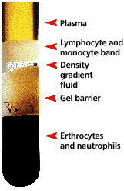
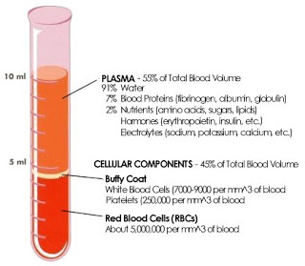
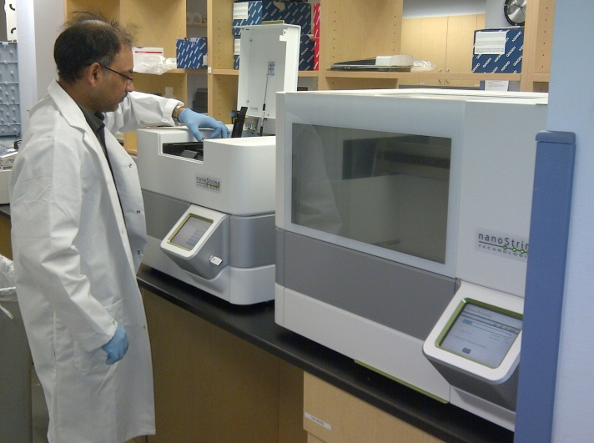
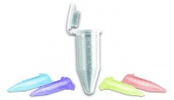
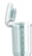

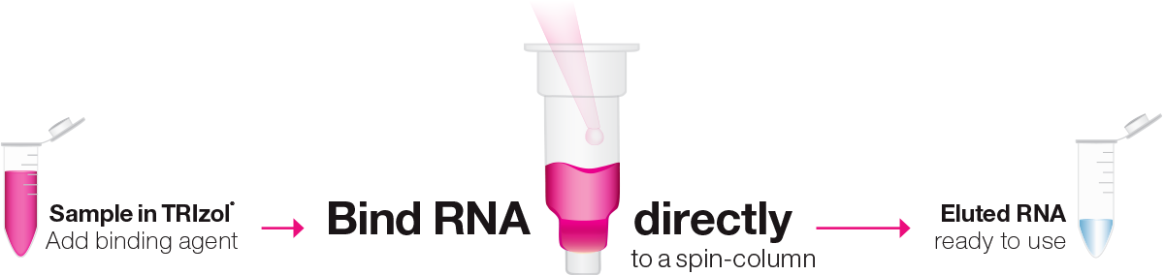


17 High Risk vs 17 AE vs 17 MPMs
CPT
EDTA
Freeze Pellet
Load Fluidics

Slide 13
Statistical Considerations
Two sample t-tests for each of 730 endogenous immune-genes was performed to detect differentially expressed genes.
The Bonferroni corrected p-value<0.05/730 = 6.85e-5 was used as the p-value threshold.
ROC curves for the top five genes were constructed, and these genes were then used for multi-variate logistic regression model.

Slide 14
Technical Reproducibility
Two different aliquots of the identical 14/17 Asbestos Exposed and 14/17 MPMs buffy coats were analyzed for gene expression by Nanostring on different days (30 days apart).
Repeat thaw, identical vortex, new RNA extraction
Run on new nanostring chips
Correlation of previous run with repeat run

Slide 15
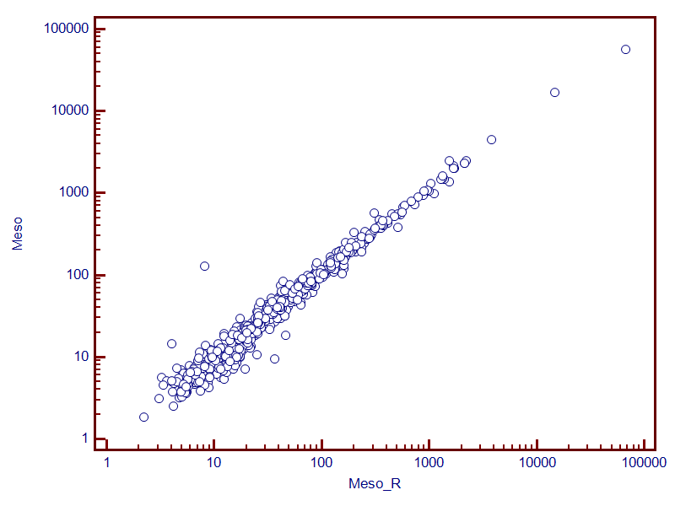
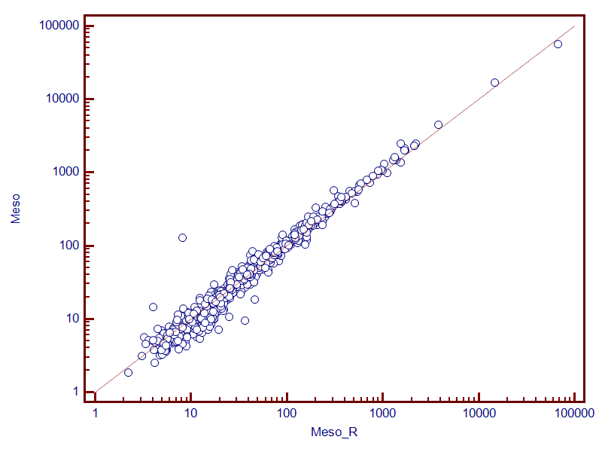
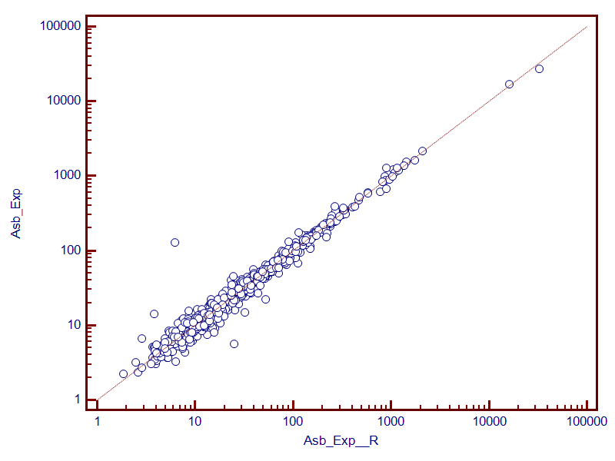
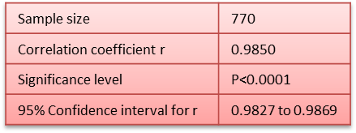
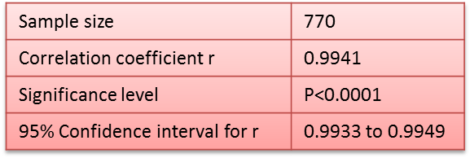
Sampling heterogeneity is not a problem
Excellent correlation between the two samples, whether AE or MPM was seen.
The same 6 genes were outliers for both AE and MPM which we believe are “lot” effect and were not any of the significant genes in our analysis.

Slide 16
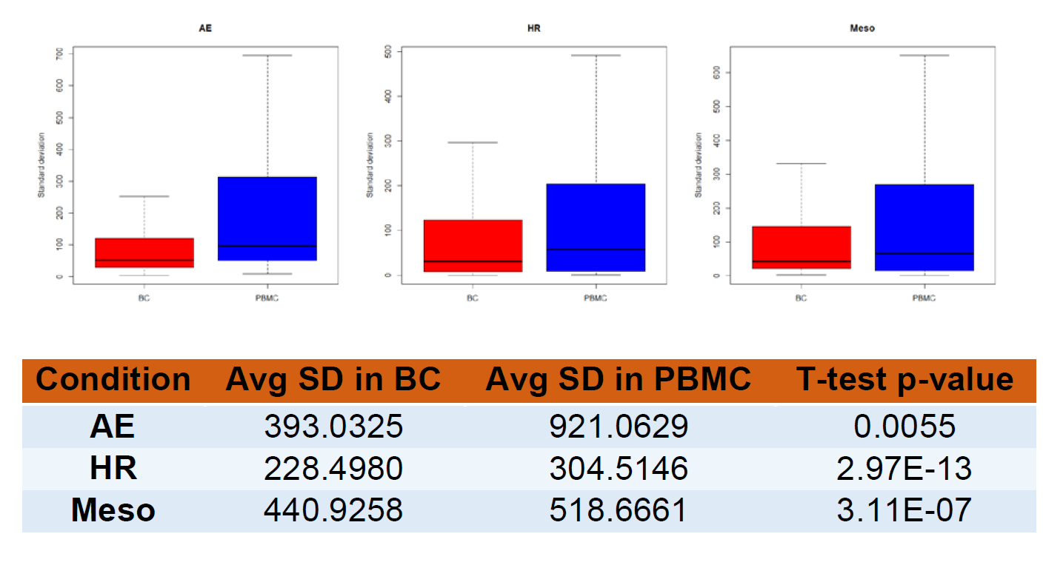
Which is less variable? BC or PBMC
For each of the 730 genes, we calculated the standard deviation (SD) across 17 samples in the same cohort. Smaller standard deviation would indicate less variability.
Then we compared the standard deviation of all genes between BC and PBMC.

Slide 17
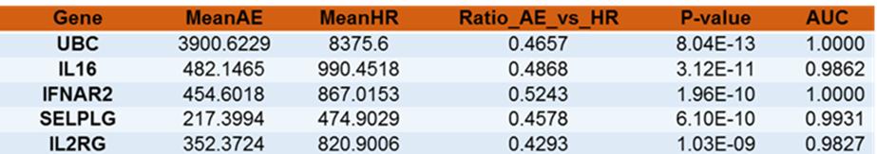
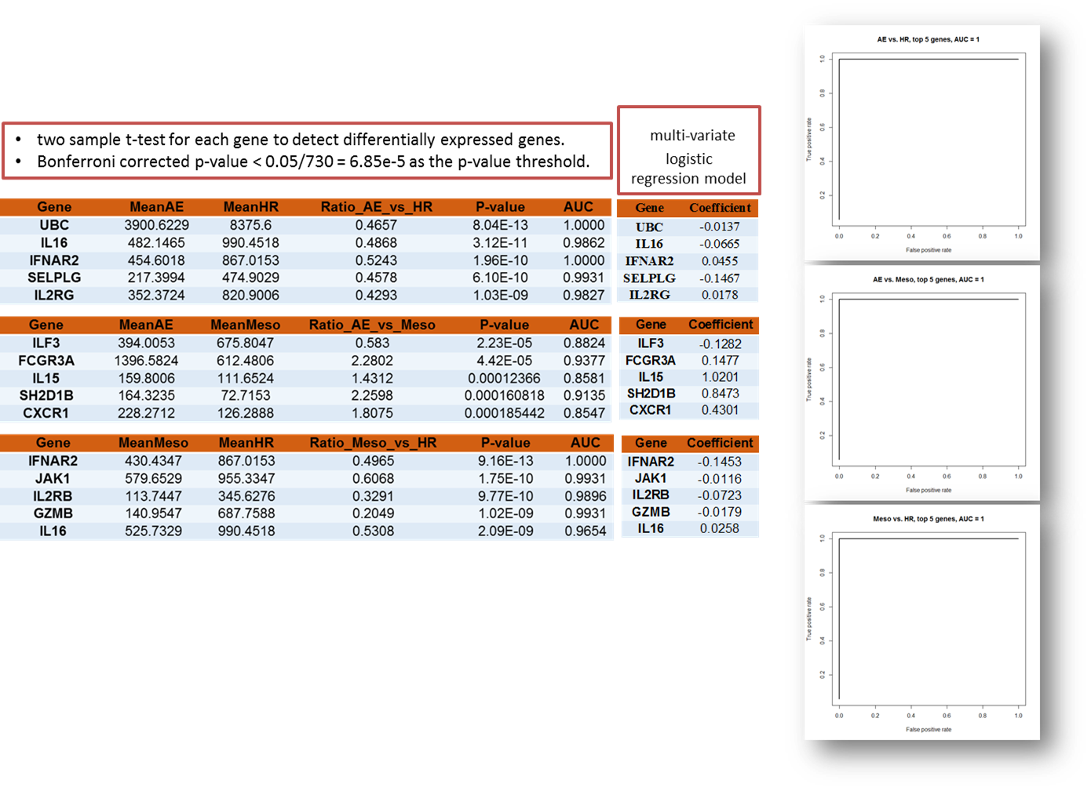
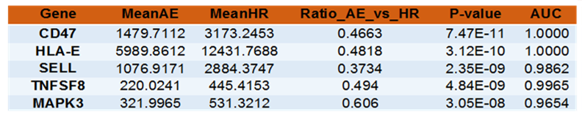
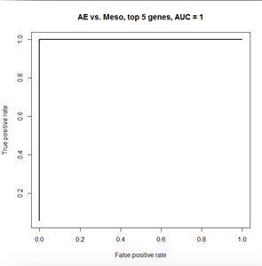
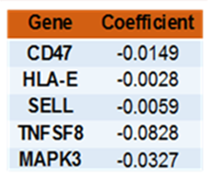
Buffy Coat
HMGB1: 2.16 FC MPM/AE, p=2.77E-09
Healthy Age and Tobacco Matched Cohort vs
Asbestos Exposed
PBMC
HMGB1: 1.20 FC MPM/AE, p=0.001

Slide 18
Healthy cohort vs Asbestos Exposed
Buffy Coat
PBMC
UBC
protein degradation, DNA repair, cell cycle regulation, kinase modification, endocytosis, and regulation of other cell signaling pathways
Interleukin-16
migration of CD4+ lymphocytes, monocytes, and eosinophils. Primes CD4+ T-cells for IL-2 and IL-15 responsiveness. Also induces T-lymphocyte expression of interleukin 2 receptor. Ligand for CD4
IFNAR2 (receptor for interferons alpha and beta)
Involved in IFN-mediated STAT1, STAT2 and STAT3 activation
Selectin P Ligand
critical role in leukocyte trafficking during inflammation by tethering of leukocytes to activated platelets or endothelial expressing selectins. 4 fold decrease in our mesotheliomas compared to normal mesothelium
Interleukin 2 Receptor Subunit Gamma
important signaling component of many interleukin receptors, including those of interleukin -2, -4, -7 and -21. 1.5 fold elevated in mesothelioma compared to normal mesothelium
CD47 expression
Used by cancers to evade immunological eradication, and has a role as a negative checkpoint for innate immunity and subsequent adaptive immunity. its overexpression is seen in our mesotheliomas 4.5 fold over normal mesothelium.
HLA-E
Associated with NK cells and is the ligand for NKG2A. HLAE is 2 fold upregulated in mesothelioma over normal mesothelium.
Selectin L
encodes a cell surface adhesion protein which mediates the adherence of lymphocytes to endothelial cells of high endothelial venules in peripheral lymph nodes.
TNFSF8
induces proliferation of T cells and also inhibits B cell Ig class production.
MAPK3
activated by upstream kinases, resulting in its translocation to the nucleus where it phosphorylates nuclear targets and regulates various cellular processes such as proliferation, differentiation, and cell cycle progression in response to a variety of extracellular signals

Slide 19
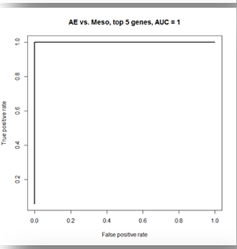
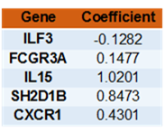
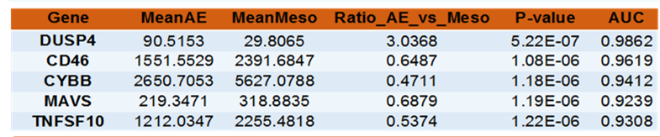


Buffy Coat
Asbestos Exposed
vs
Mesothelioma

Slide 20
Asbestos Exposed vs MPM
Buffy Coat
PBMC
ILF3
required for T-cell expression of interleukin 2. Can also regulate methyltransferase activity
FCGR3a
expressed on natural killer (NK) cells and involved in the removal of antigen-antibody complexes from the circulation, as well as other antibody-dependent responses including phagocytosis
IL15
regulates T and natural killer cell activation and proliferation, increase the expression of apoptosis inhibitor BCL2L1/BCL-x(L), possibly through the transcription activation activity of STAT6, and thus prevent apoptosis
SH2D1B
Plays a role in regulation of effector functions of natural killer (NK) cells
stimulates polarization of the microtubule-organizing center and cytotoxic granules toward the NK cell synapse. Negatively regulates CD40-induced cytokine production by dendritic cells by activation of the PI3K pathway
CXCR1
interleukin-8 receptor and along with IL-8 acts as a neutrophil chemotactic factor. Binding of IL-8 to the receptor causes activation of neutrophils.
Dusp4
involved in epithelial-to-mesenchymal transition (EMT) and stem cell (CSC) regulation
Increased DUSP4 expression in activated T cells in the elderly in part accounts for defective adaptive immune responses
negative effect on the expansion of antigen-specific B cells
CD46
a costimulatory molecule for T cells and drives T-cell to secrete anti-inflammatory cytokine IL-10, acquiring a so-called Type I regulatory phenotype (Tr1)
CYBB
Critical for ROS generation, specifically superoxide into phagosomes of immune cells.
Influences production of TAM
Mitochondrial Antiviral-Signaling Protein(MAVS)
required for activation of transcription factors which regulate expression of beta interferon and contributes to antiviral immunity
TNFSF10 (TRAIL)
Tumor necrosis factor-related, apoptosis-inducing ligand which induces cancer cell death through extrinsic apoptotic pathway, while sparing normal cells

Slide 21
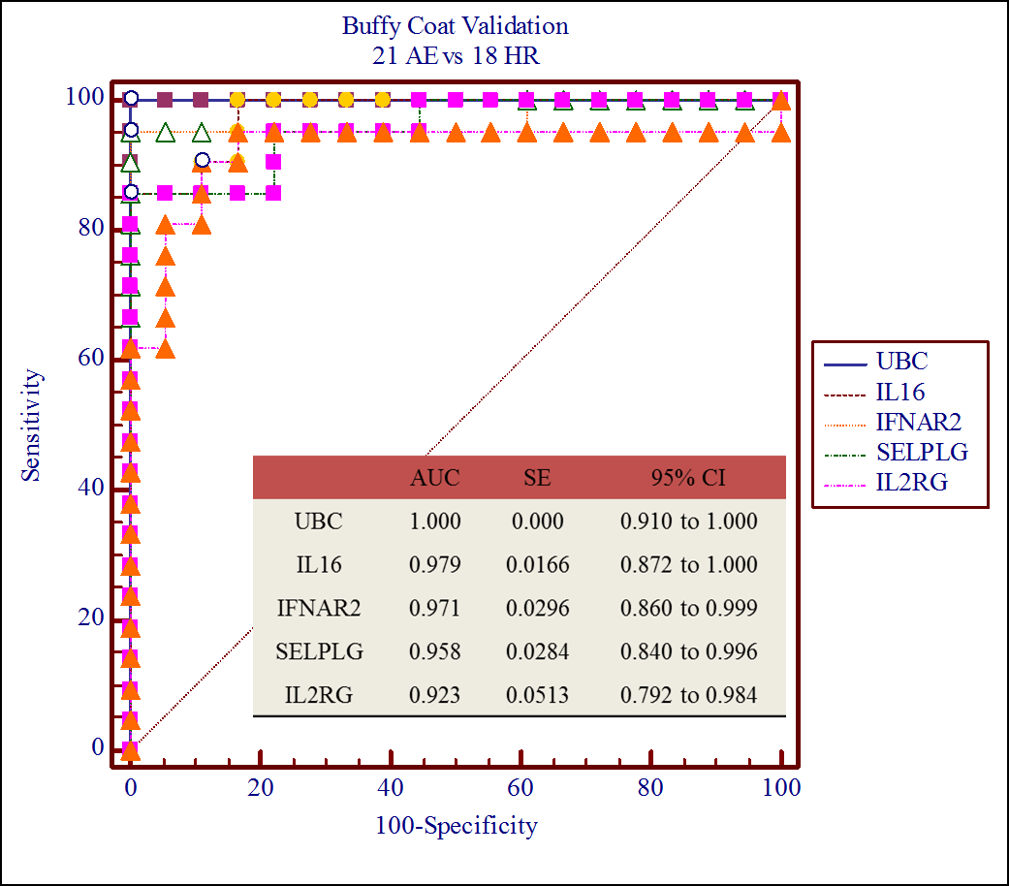
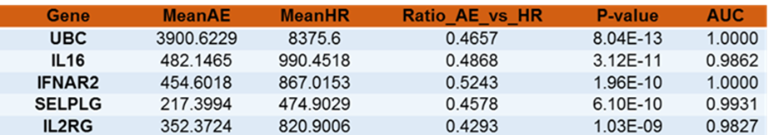
Validation: BC Asbestos Exposed vs Healthy Matched

Slide 22
Observations
A first series of discovery experiments reveals differences in the BC and PBMC fraction of AE, HR, and Mesothelioma patients
A profound decrease in immune effectors seems to occur with asbestos exposure
Further segregation of the components of the nanostring immune profiles is necessary to comment on specific immune effector cell type dysfunction.

Slide 23
Thanks to
Chandra Goparaju PhD
Judy Goldberg MS
Ki Prokrym BS
Brady Kwong BS

