Slide 1
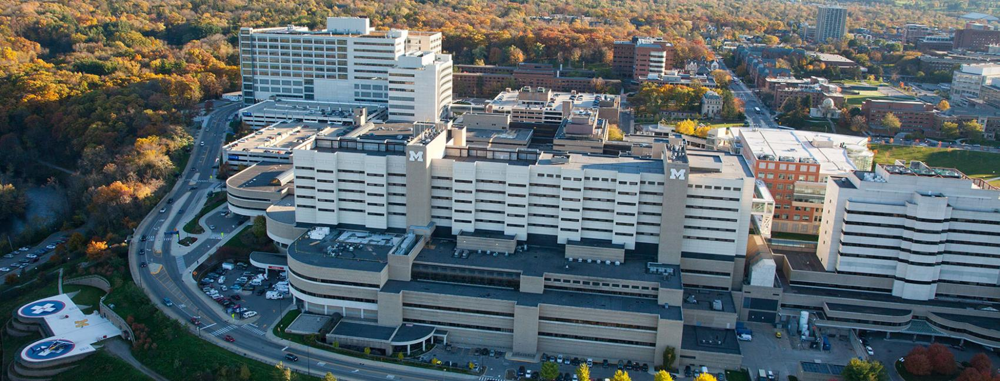

The Application of Integrative Sequencing for Precision Oncology
Arul M. Chinnaiyan, M.D., Ph.D.
American Cancer Society Research Professor
Howard Hughes Medical Institute

Slide 2
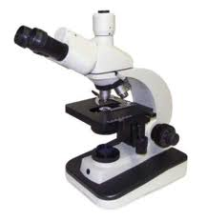
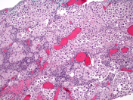

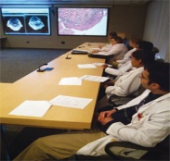

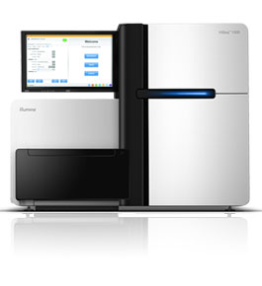
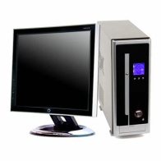

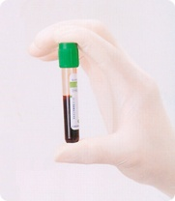





MiOncoSeq:
The Michigan Oncology Sequencing Program
Tumor Biopsy
Genetic Counselor
Sequencing Tumor Board
Precision Medicine
Tumor Board
Informed Consent
Genetic Counseling
Sequencing
Analysis
Actionable Results?
Incidental Results?
Buccal swab
or
Disclosure of Results
Blood
Roychowdhury et al Sci.Tran.Med. November 2011

Slide 3
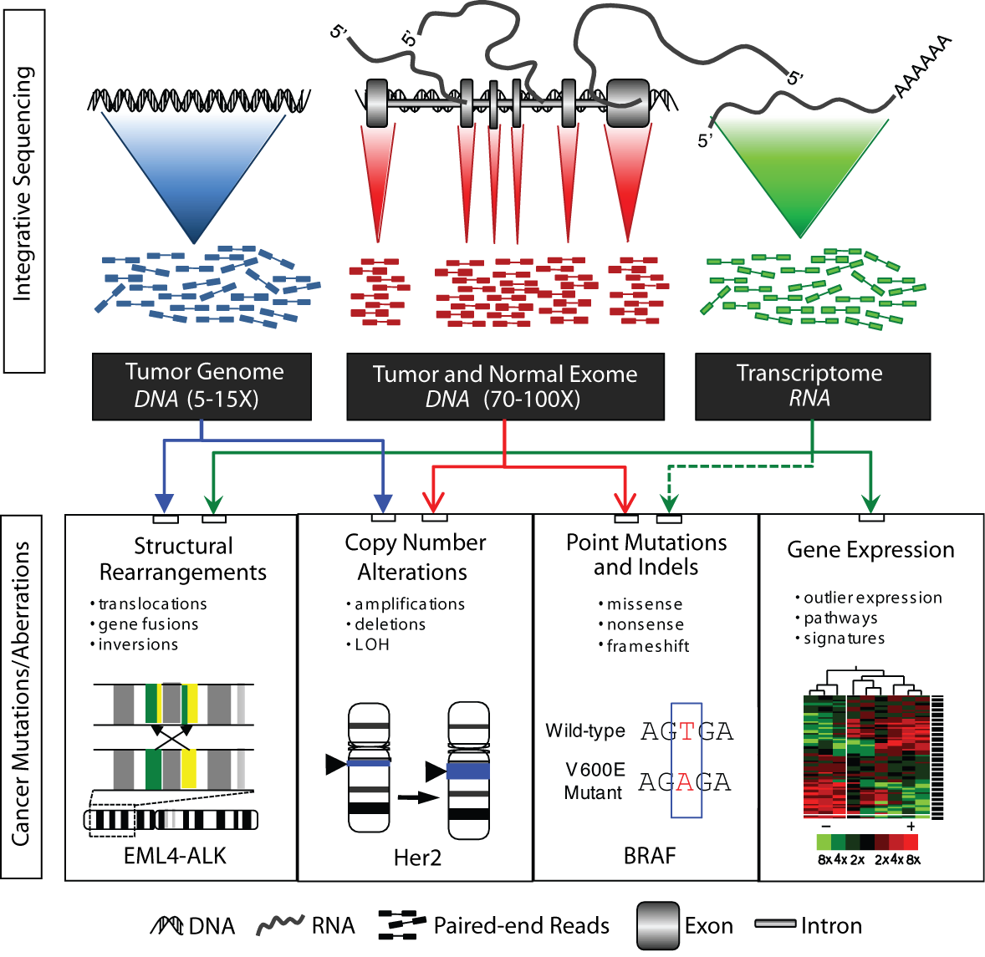
Integrative Clinical Sequencing
Roychowdhury et al, Science Translational Medicine 2011.

Slide 4
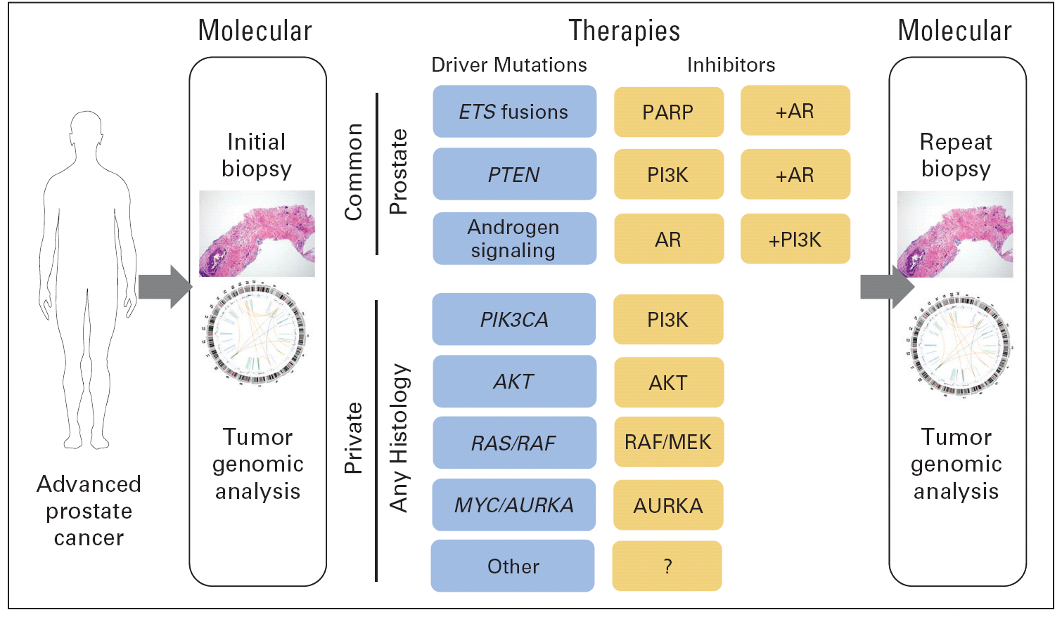
Towards Precision Medicine for Advanced Prostate Cancer
Roychowdhury and Chinnaiyan, JCO 2013

Slide 5
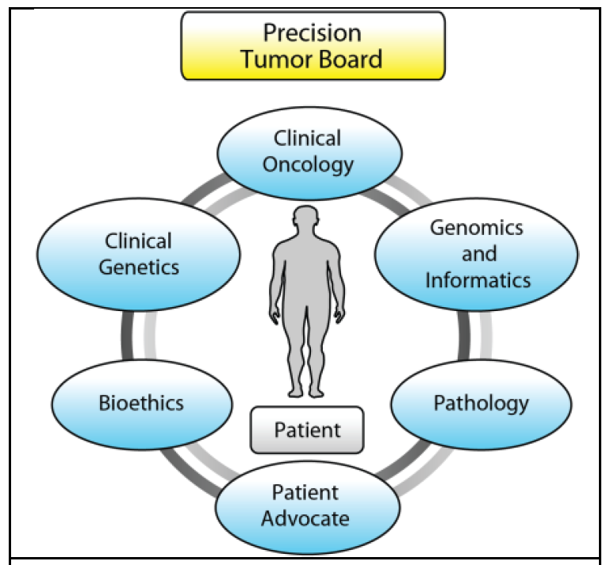
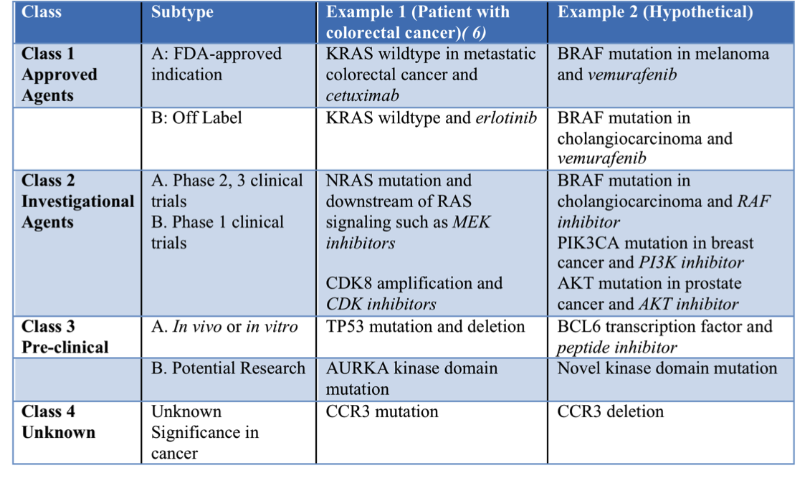

Multi-Disciplinary
Precision Medicine Tumor Board (PMTB)
Since 2011:
>100 PMTBs convened
8 patients presented on average
>1000 patients at PMTB

Slide 6
MI-Oncoseq Clinical Sequencing
N>2000 patients

Slide 7
MiOncoSeq
Clinical Sequencing Vignettes
NAB2-STAT6 is the pathognomonic driver fusion for Solitary Fibrous Tumors (SFTs)/hemangiopericytoma (Nature Genetics 2013a)
Pediatrics- MiOncoseq Program(JAMA 2015)
Rare, targetable FGFR kinase family fusions are found across a diverse array of tumor types (Cancer Discovery 2013)
ESR1 mutations are a common resistance mechanism in ER+ metastatic breast cancers treated with aromatase inhibitors (Nature Genetics, 2013b)

Slide 8
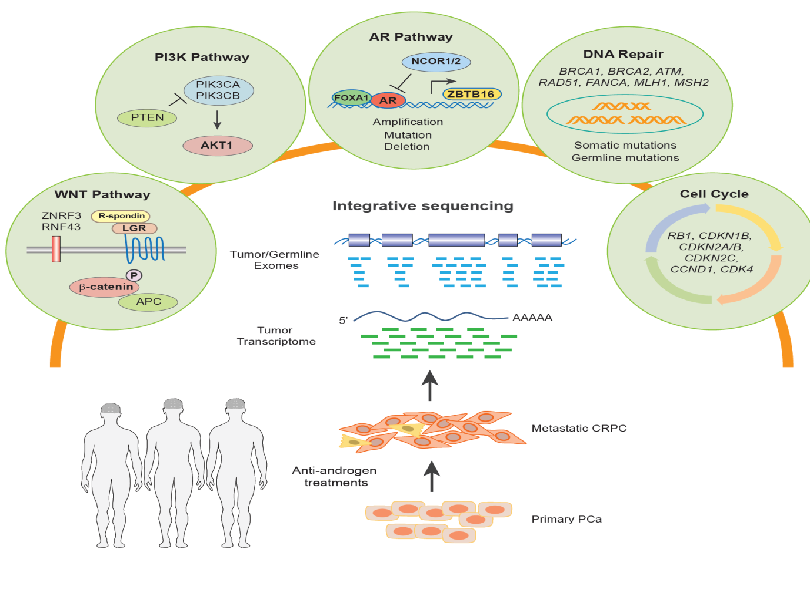
Integrative Clinical Sequencing of Metastatic Prostate Cancer

Slide 9





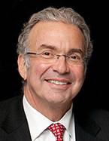


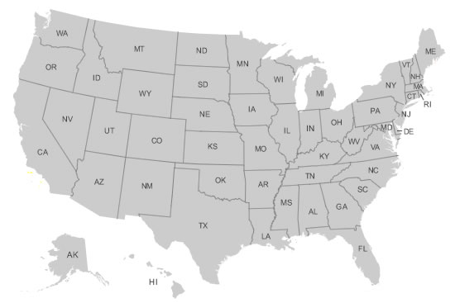





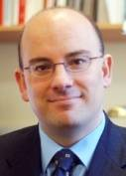






Peter Nelson, MD
Dream Team Principal
University of Washington /
Fred Hutchinson Cancer Research Center
Arul Chinnaiyan, MD, PhD
Dream Team Co-Leader
University of Michigan
Levi Garraway, MD, PhD
Dream Team Principal
The Broad Institute
Philip Kantoff, MD
Dream Team Principal
Dana Farber Cancer Institute
Mark Rubin, MD
Dream Team Principal
Weill Cornell
Johann de Bono, MD, PhD
Institute of Cancer Research/
Royal Marsden Hospital
Charles Sawyers, MD
Dream Team Co-Leader
Memorial Sloan Kettering Cancer Center
SU2C-PCF Prostate Dream Team Leaders and Principals

Slide 10












Schema of Project Work Flow
Clinical sites
Clinical data
integration
Pathology data
coordination
Sequencing
Data analysis
Data
visualization
Data portal
Precision medicine tumor boards

Slide 11
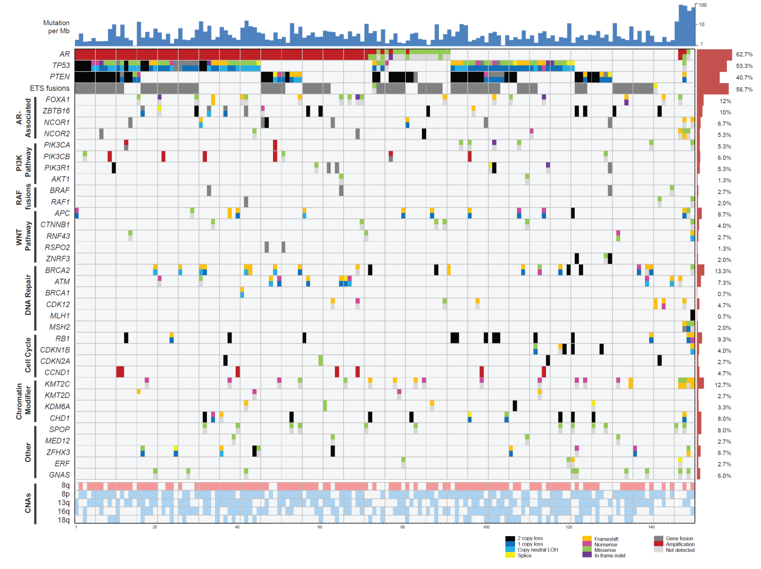
The Genomic Landscape of the SU2C-PCF mCRPC Cohort
Robinson et al, Cell 2015

Slide 12
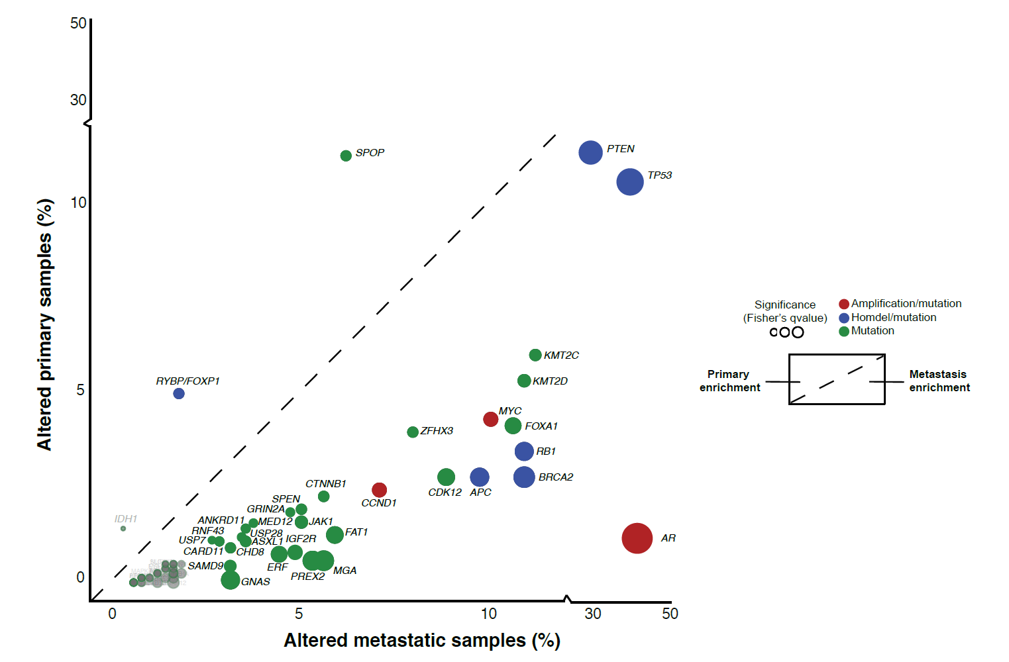
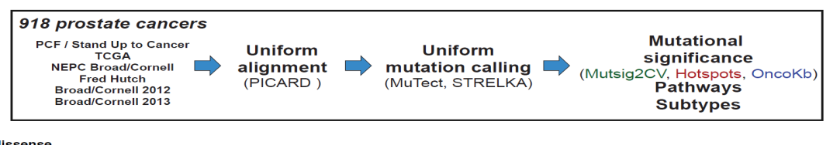
Enrichment of key driver mutations in metastatic prostate cancer relative to primary
Submitted,
Van Allen,
Shultz et al

Slide 13
DNA Repair Pathway Aberrations (23%)

Slide 14
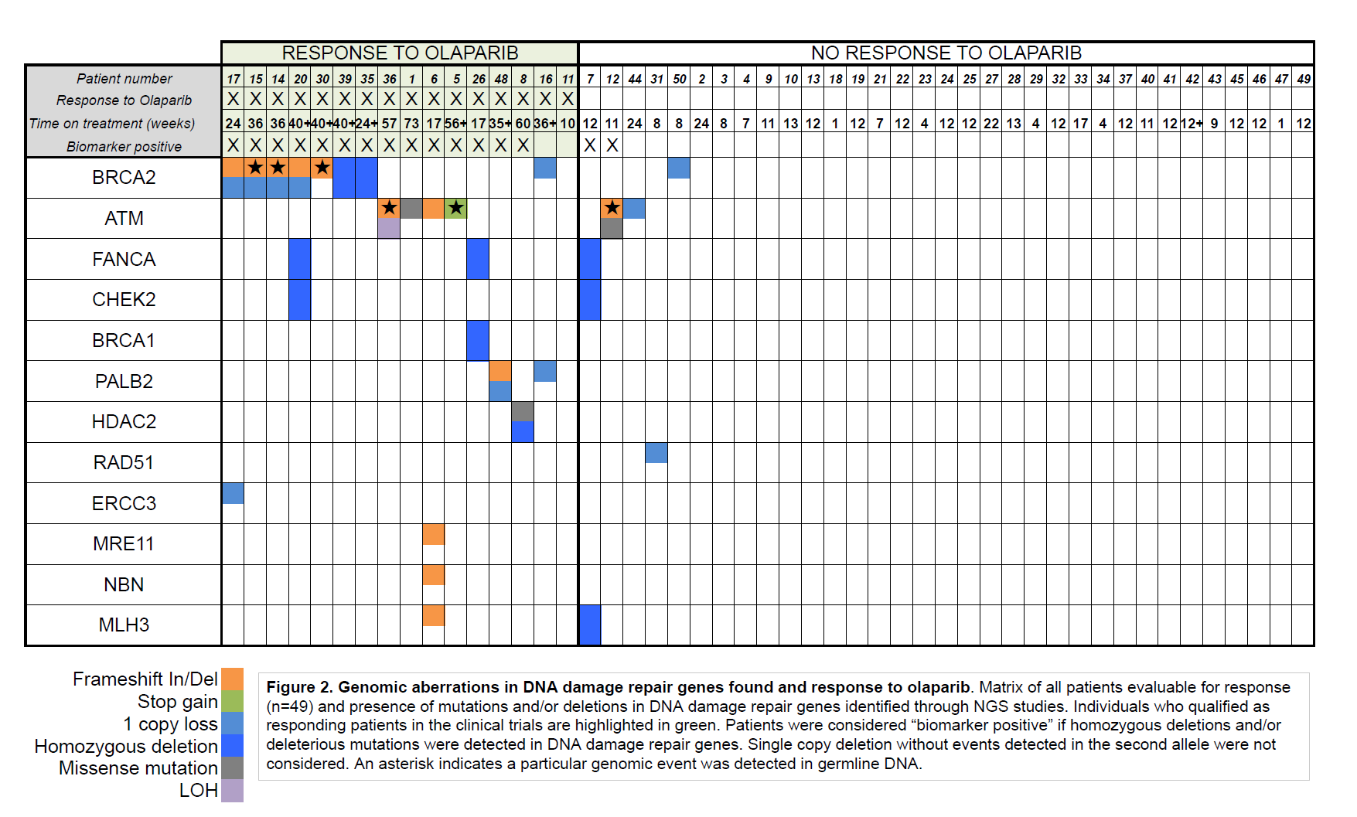
Advanced prostate cancer patients with DNA repair aberrations tend respond to PARP inhibitors
Johann de Bono, Mateo et al, TO-PARP study, NEJM 2015

Slide 15
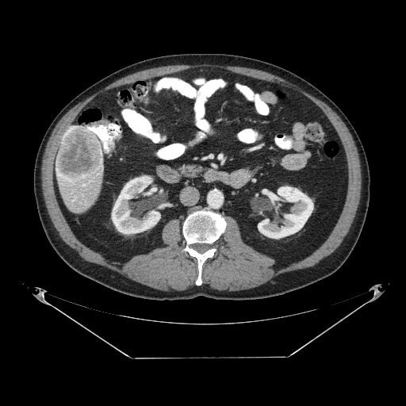
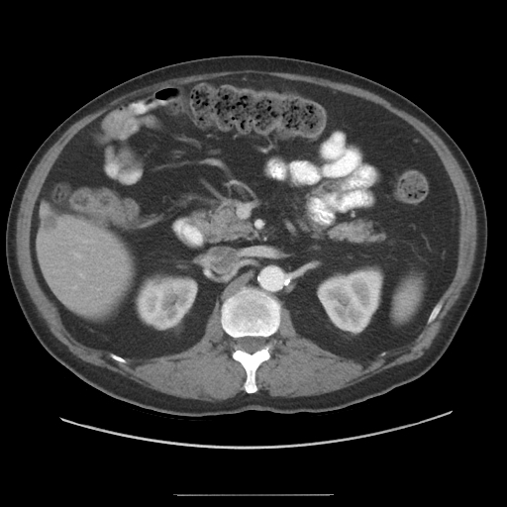
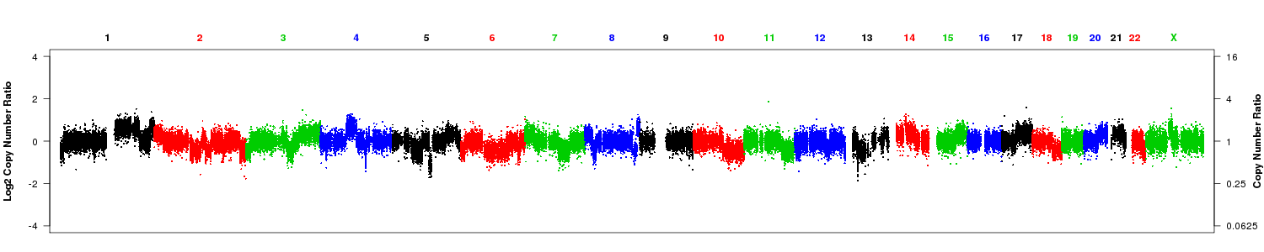
Exceptional Responder: CRPC patient with BRCA2 loss/AR amplification receiving ABT888 (PARPi) and abiraterone
chrX: copy gain of AR
PSA 127.9
PSA < 0.1 (Aug 2013 to present)
Maha Hussain et al, CTEP gene fusion study unpublished
chr13: BRCA2 homozygous deletion

Slide 16
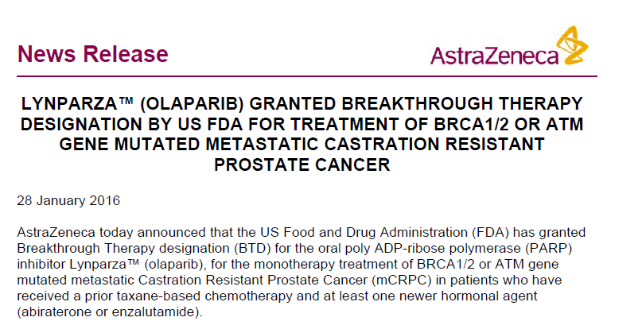

Slide 17
Germline DNA repair alterations across SU2C and extension cohorts
Case Series | n | Mutated | %
SU2C/PCF Discovery | 150 | 15 | 10.0%
SU2C/PCF Validation | 84 | 9 | 10.7%
MSKCC | 124 | 23 | 18.5%
Royal Marsden | 131 | 16 | 12.2%
University of Washington | 91 | 8 | 8.8%
Weill Cornell | 69 | 7 | 10.1%
University of Michigan | 43 | 4 | 9.3%
Combined | 692 | 82 | 11.8%
Pritchard et al, NEJM 2016

Slide 18
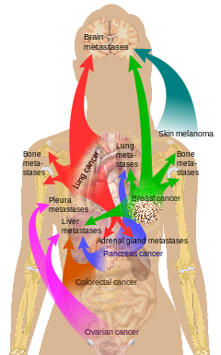
Integrative Clinical Sequencing of Metastatic Cancers
Manuscript submitted

Slide 19
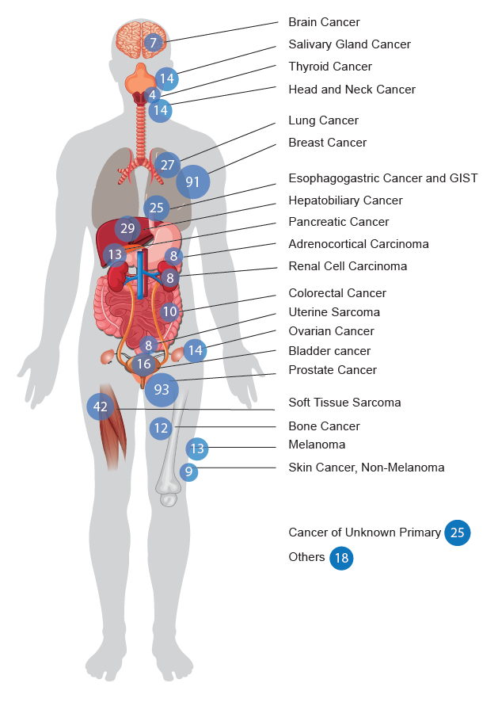
MET 500
Cancer Types
n=500 solid tumor metastases sequenced
(subset of CSER1 cohort)

Slide 20
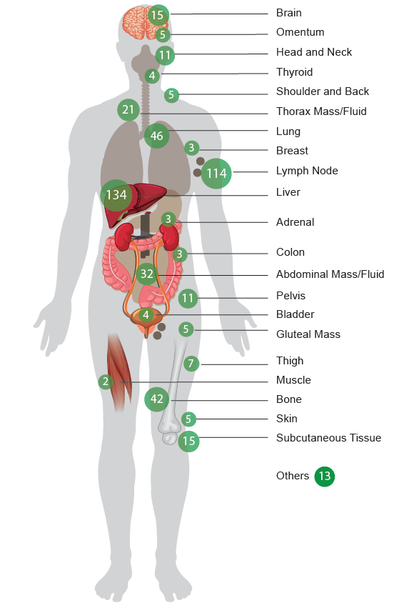
MET 500
Clinical Sites of Biopsy
n=500 solid tumor metastases sequenced
(subset of CSER1 cohort)

Slide 21
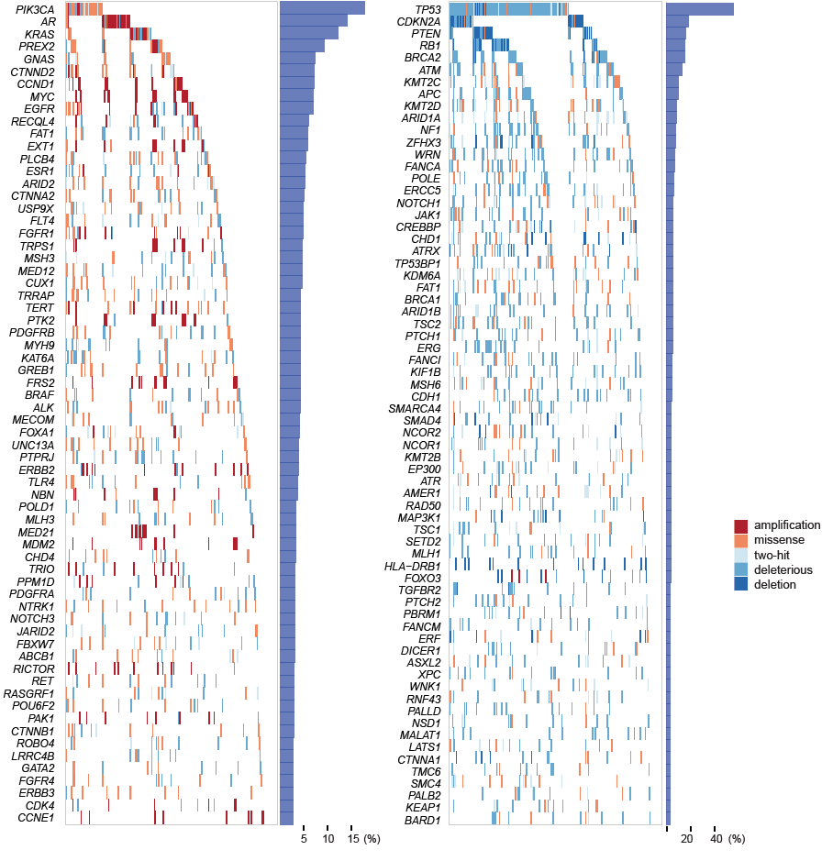
Landscape of Alterations in Metastatic Cancers

Slide 22
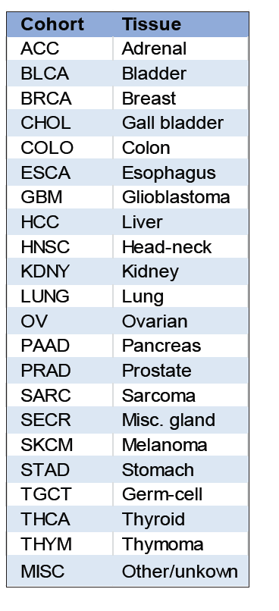
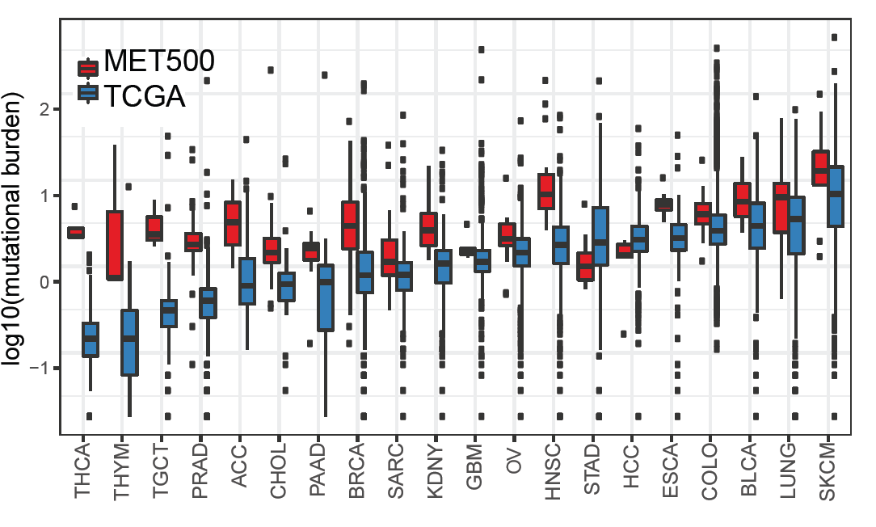
Mutational burden of metastatic cancer vs. clinically localized disease

Slide 23
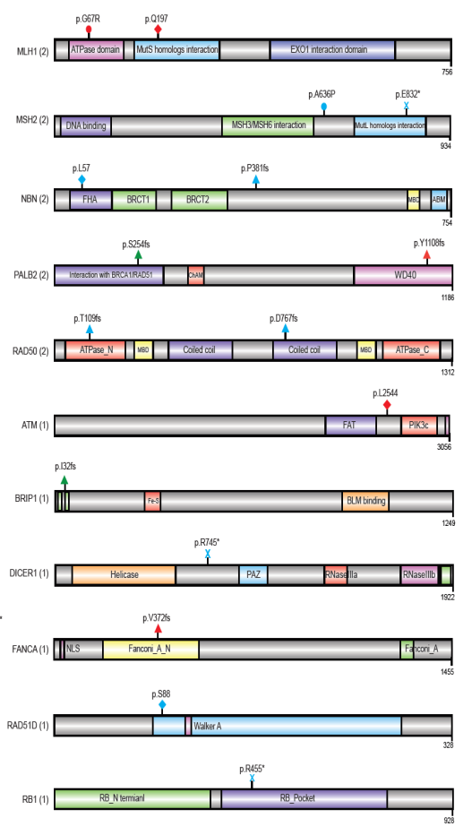
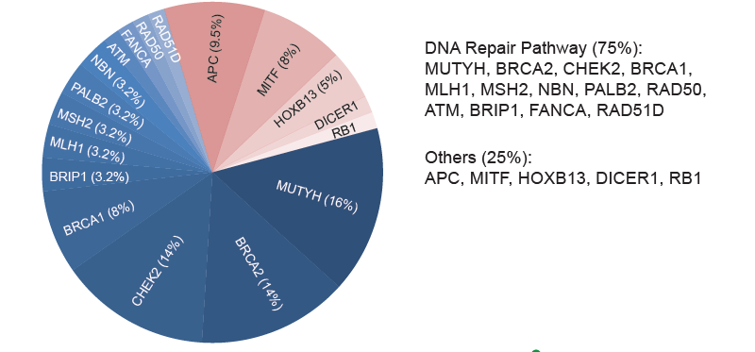
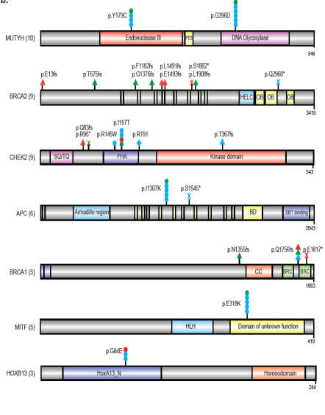

Germline Events in Metastatic Cancer
12.2% (62/500)

Slide 24
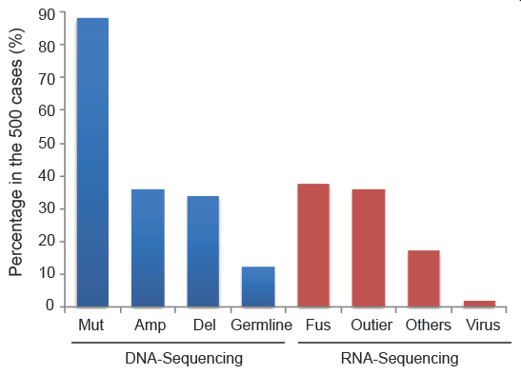
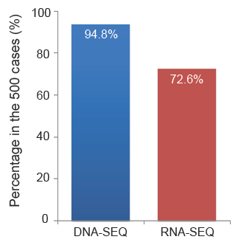
Classes of Clinically Relevant Alterations Identified by Integrative Sequencing
Bob Lonigro, Yi-Mi Wu, Pankaj Vats

Slide 25
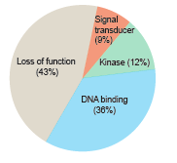
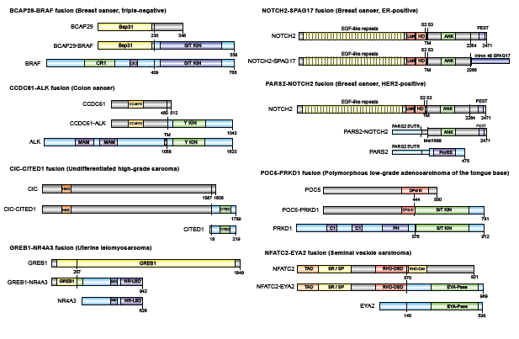
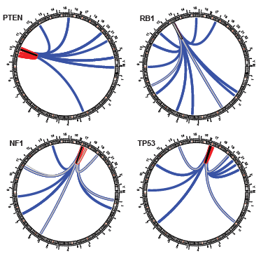
Importance of RNA-seq in the assessment of cancer patients

Slide 26
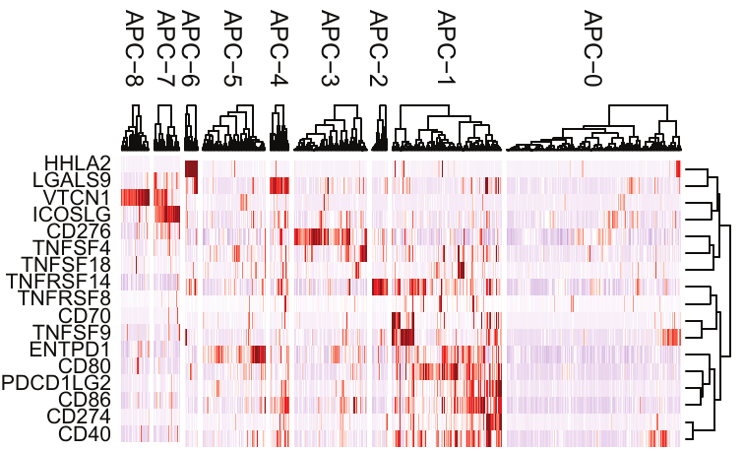
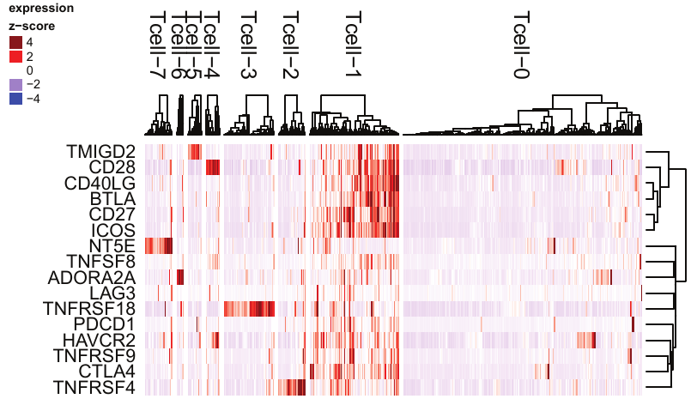
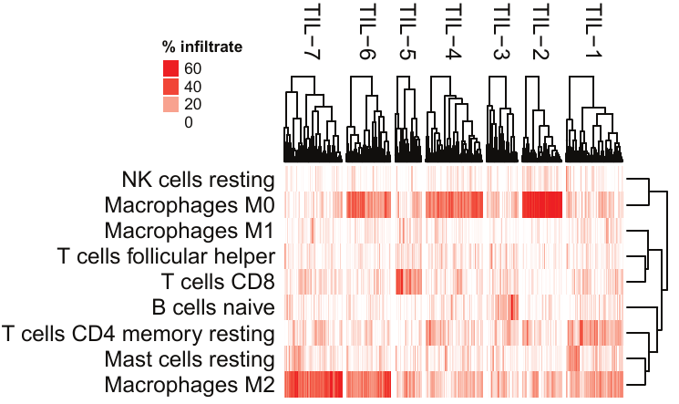
Immunophenotypes:
What types of cells are infiltrating the tumor?

Slide 27
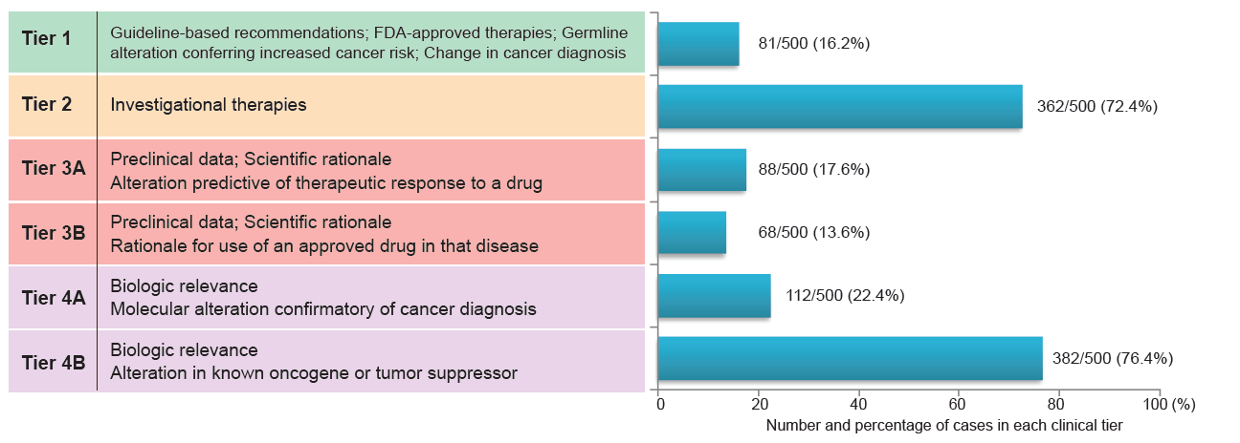
Clinical Tiering of Molecular Alterations in Metastatic Cancers
2700 Molecular alterations resulted in 2105 Tiered events.
Erin Cobain et al

Slide 28

Take Home Points…
It is possible to provide a relatively comprehensive mutational landscape to individual cancer patients (exome/transcriptome)
A variety of mutations types will need to be monitored including point mutations, indels, copy number alteration, gene fusions/translocations, germline, among others
RNA-seq will be an important complement to DNA-seq as it provides information with regards to gene fusions, outlier expression, pathway activation, viruses, and immune environment
Metastatic prostate cancer: >90% actionable pathways, ~25% harbor DNA repair gene defects, ~12% DNA repair related germline alterations
10-12% pathogenic germline alterations across cancers
Comprehensive sequencing approaches will better facilitate enrollment in Phase I/II clinical trials
May facilitate the move toward combination therapeutic regimens
Requires buy-in from a multi-disciplinary team of investigators including pathologists, genetic counselors, oncologists, radiologists, bioinformaticians, clinical geneticists, and bioethicists.

Slide 29




Acknowledgements
Bioethics
Scott Roberts
Ray De Vries
Brian Zikmund-Fisher
U of Michigan (MCTP)
Dan Robinson
Xuhong Cao
Yi-Mi Wu
Bob Lonigro
Pankaj Vats
Priya Kunju
Yu Ning
Fengyun Su
Rui Wang
Scott Tomlins
Chandan Kumar
Lynda Hodges
Erica Rabban
Fu-Zon Chung
Pallavi Mohapatra
Terry Barrette
Christine Brennan
Marcin Cieslik
Pediatrics Team
Rajen Mody
Kevin M. Frank
Patricia L. Robertson
Gregory Yanik
Aghiad Chamdin
James A. Connelly
Sung Choi
Andrew C. Harris
Carrie Kitko
Rama Jasty Rao
John E. Levine
Valerie P. Castle
Raymond J. Hutchinson
Jonathan R. Dillman
Raja M. Rabah
Genetics
Elena Stoffel
Jeff Innis
Michelle Gornick
Jessica Everett
Jessica Long
Victoria Raymond
Med Onc Team
Moshe Talpaz
Scott Schuetze
Rashmi Chugh
Dan Hayes
Jimmy Rae
Maha Hussain
Dave Smith
Ajjai Alva
Erin Cobain

Slide 30
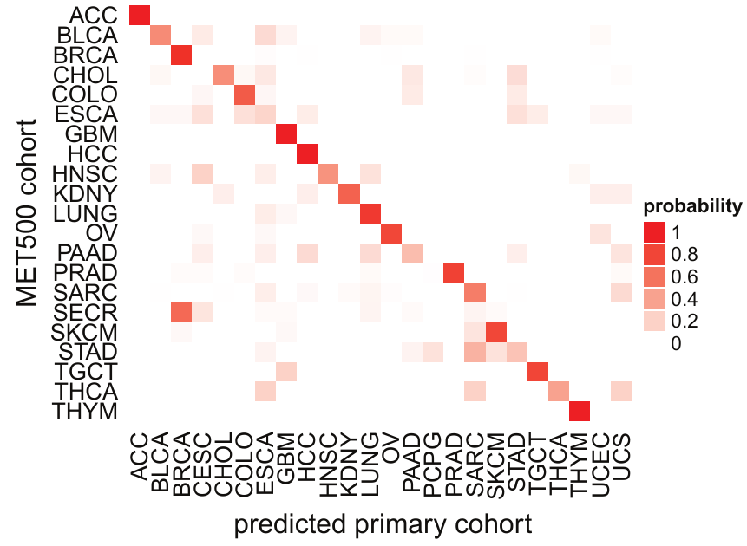
Prediction accuracy across metastatic cancer
Marcin Cieslik

Slide 31
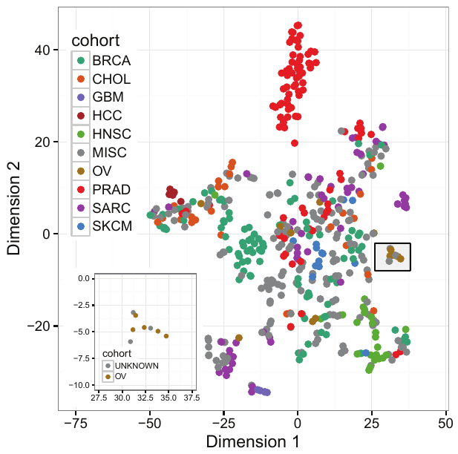
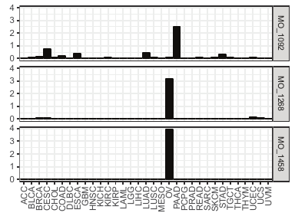
Cancer of Unknown Primary (CUP):
Ovarian and Pancreatobiliary
Marcin Cieslik

Slide 32
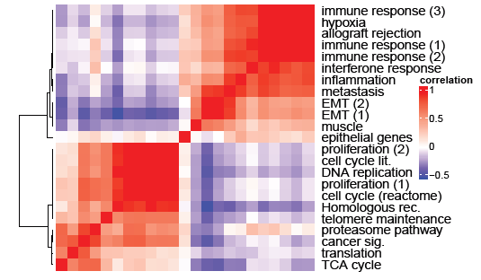
Transcriptional Networks in Metastatic Cancers: Proliferation vs. EMT

Slide 33
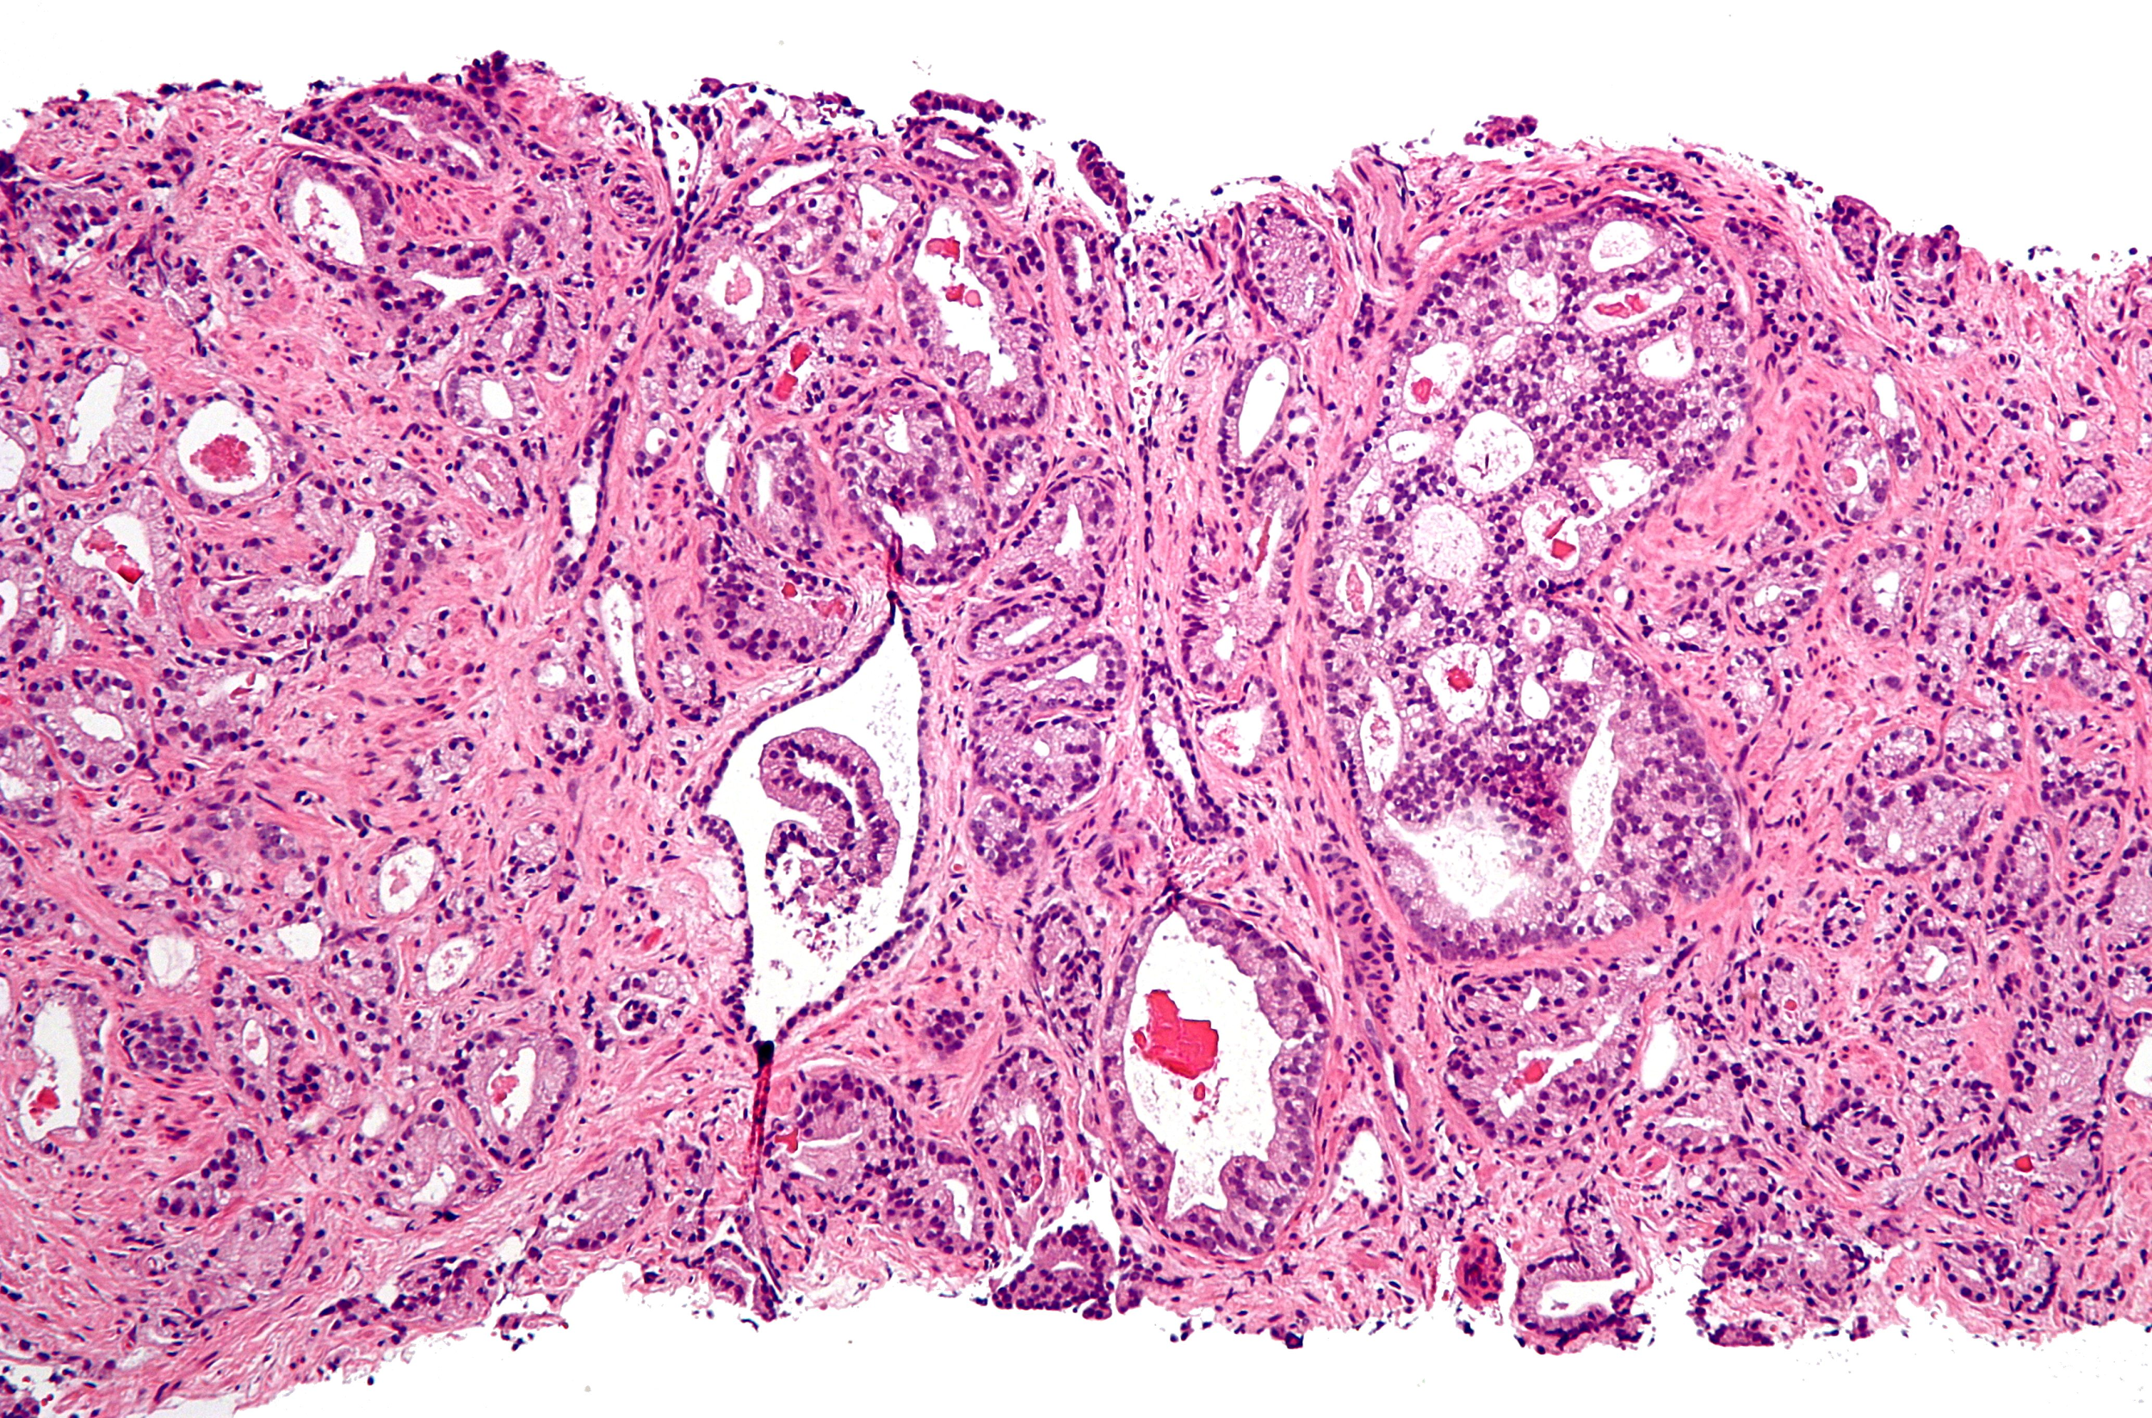
Immuno-oncology Applications of Integrative Clinical Sequencing
DNA
RNA
T-cell
pathology
mutation
expression
repertoire
IHC / H&E
neoantigen
immunotype
infiltration
PD-L1, MHC, T-cell, MΦ
Integrative Immune Profiling

Slide 34
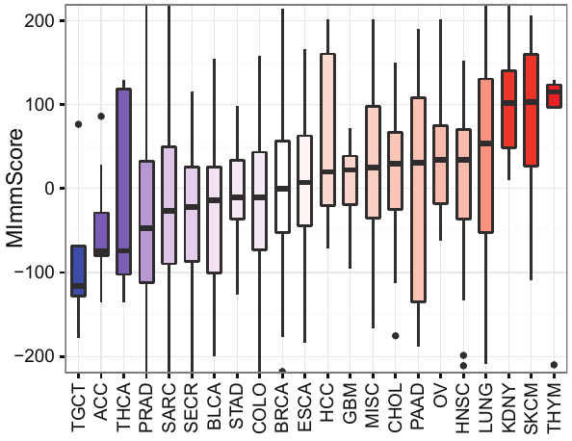
Magnitude of Immune Infiltration Across the MET500 Cohort
Marcin Cieslik

Slide 35
Immunophenotypes:
What types of cells are infiltrating the tumor?

Slide 36
Integrative Clinical Sequencing of Metastatic Prostate Cancer

Slide 37
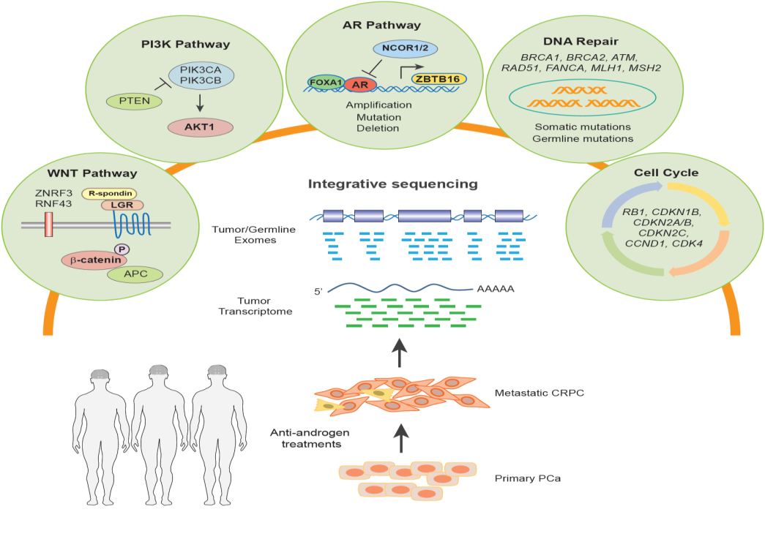
Highlights
Multi-institutional integrative clinical sequencing of mCRPC is feasible
~90% of mCRPC harbor clinically actionable molecular alterations
mCRPC harbors novel genomic alterations in PIK3CA/B, R-spondin, BRAF/RAF1, APC, β-catenin and ZBTB16/PLZF
>20% of mCRPC harbor DNA repair pathway aberrations (BRCA2, BRCA1, ATM and others)
8-10% harbor pathogenic germline findings

Slide 38
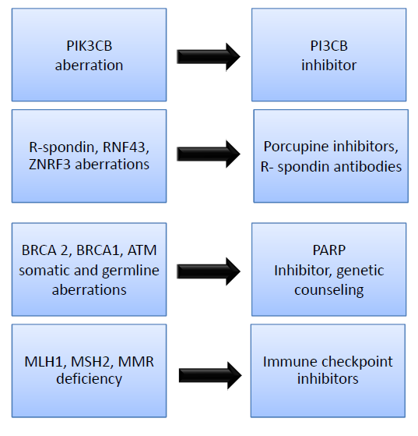
Summary: Actionable Mutations in mCRPC

Slide 39
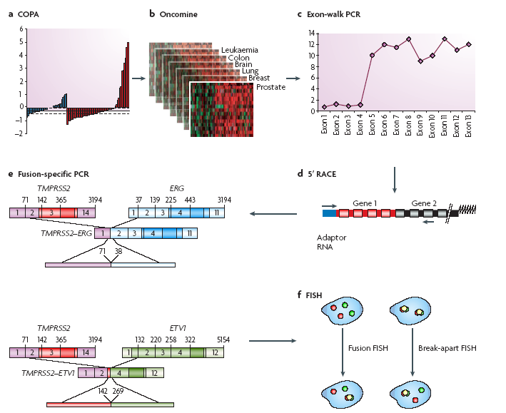

A Bioinformatics Approach Leads to the
Discovery of Gene Fusions in Prostate Cancer
Scott Tomlins
Kumar et al. Nature Cancer Reviews, 2008

