Slide 1

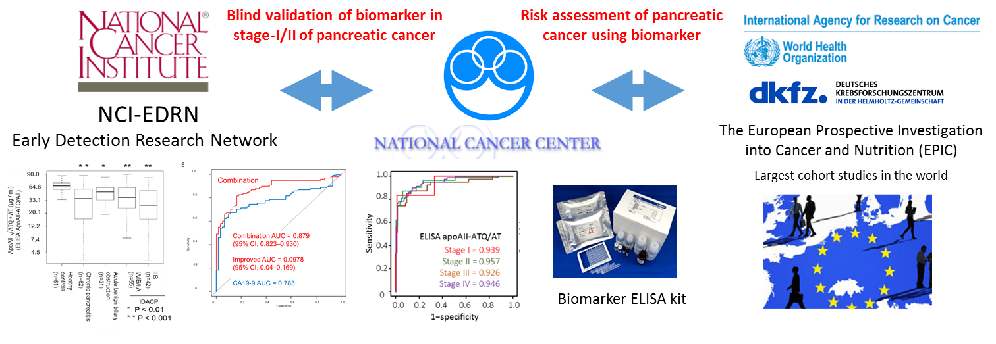
A plasma biomarker for the detection of early-stage pancreatic cancer and risk diseases for pancreatic malignancy using antibodies for apolipoprotein-A2 isoforms
Kazufumi Honda, D. D. s. and Ph. D.
National Cancer Center Research Institute
Notes:
Thank you very much for inviting me.
I am Honda from National Cancer Center.
Today, I would like to talk about a plasma biomarker for the detection of early-stage pancreatic cancer and risk diseases for pancreatic malignancy using antibodies for apolipoprotein A2 isoforms.

Slide 2

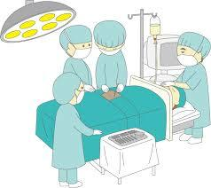

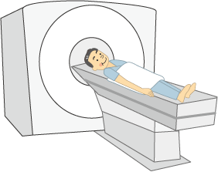
Unmet medical needs for early detection of pancreatic cancer
Minimally invasive examination for screening early stage and premalignant lesions due to pancreatic cancer.
2. Cost effective screening methods for detecting early stage pancreatic cancer
First screening
Second screening
Screening hospital
Enrichment of high risk individuals using a non-invasive biomarker
Early detection by invasive high resolution imaging
Reduction of mortality from pancreatic cancer by early treatment
5-Y survival rates of PDAC
(Japanese Association of Clinical Cancer Centers 2017)
Almost all patients with pancreatic cancer are at advanced stages
Increase the rate of 5-year OS by 41 times by early detection (stage-1 vs. stage-IV)
Stage-I; 45%
OS rate
Decreasing mortality from pancreatic cancer requires the development of screening methods for early stages of pancreatic cancer and its risk diseases such as IPMN, MCN, and pancreatitis.
Stage-II; 17%
Stage-IV; 1.1%
Stage-III; 6.6%
(years)
Notes:
This slide shows the unmet medical needs for early detection of pancreatic cancer.
One such need is a minimally invasive screening tool for detecting the early stage of pancreatic cancer and premalignant lesions.
Another need is cost effective screening methods for detecting the early stage of pancreatic cancer.
Such tools and methods will allow the development of efficient strategies for pancreatic cancer screening and are necessary for reducing mortality due to pancreatic cancer.
This scheme shows one screening strategy for pancreatic cancer.
Subjects at risk of pancreatic cancer are enriched using a blood test to detect pancreatic cancer or risk diseases, then risk subjects are enriched in a second screening using the blood biomarker and enhanced high resolution imaging.
Mortality due to pancreatic cancer is reduced by early treatment of pancreatic cancer and its risk diseases.

Slide 3
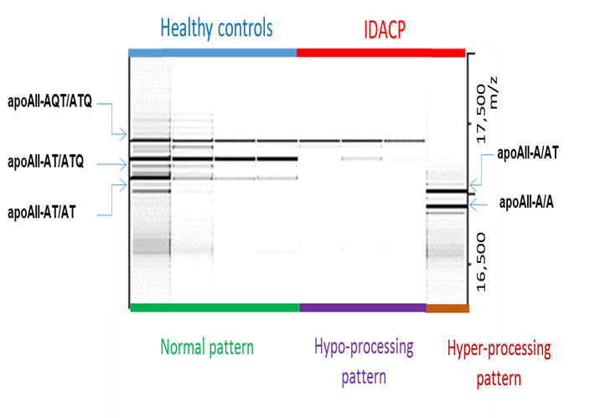
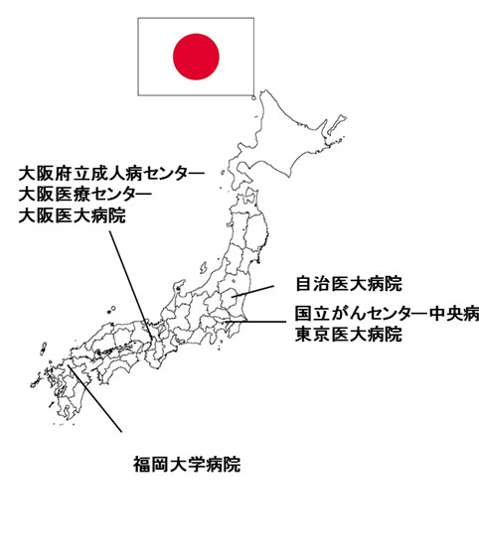
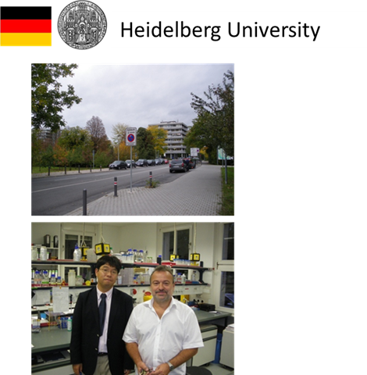
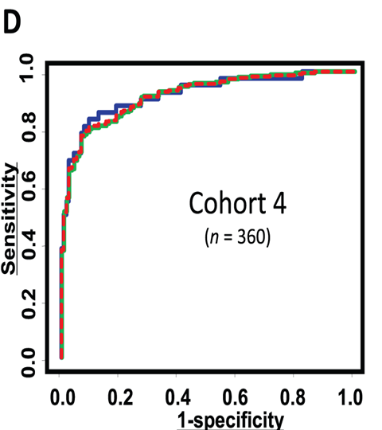

Apolipoprotein A2-isoforms (apoA2-i) in the circulating blood stream
Honda et al., Cancer Research 2005
Honda et al., PLOS ONE 2012
Notes:
We attempted to identify a blood biomarker for the efficient screening and early detection of pancreatic cancer using proteomics.
We identified one plasma molecule, an isoform of apolipoprotein A2, from the plasma proteomic profiles of pancreatic cancer patients.
Circulating apoA2 consists of 5 different isoforms.
Circulating apoA2 dimerizes, and the C-terminal ends of the apoA2 isoforms are different. The amino acids of apoA2 were cleaved from the C-terminal end. We named the cleaved dimeric products apoA2-ATQ/ATQ, apoA2-ATQ/AT, apoA2-AT/AT, apoA2-AT/A, and apoA2-A/A.
Because these isoforms have different molecular weights, the amount of each isoform in plasma can be measured using matrix-assisted laser desorption ionization–mass spectrometry, abbreviated MALDI–MS.
Our previous study demonstrated that apoA2-ATQ/AT is significantly reduced in the plasma of patients with pancreatic cancer in comparison with healthy controls.
We recently reported a multi-institutional analysis using mass spectrometry showing that apoA2 isoforms are an important biomarker for detecting early-stage pancreatic cancer.

Slide 4
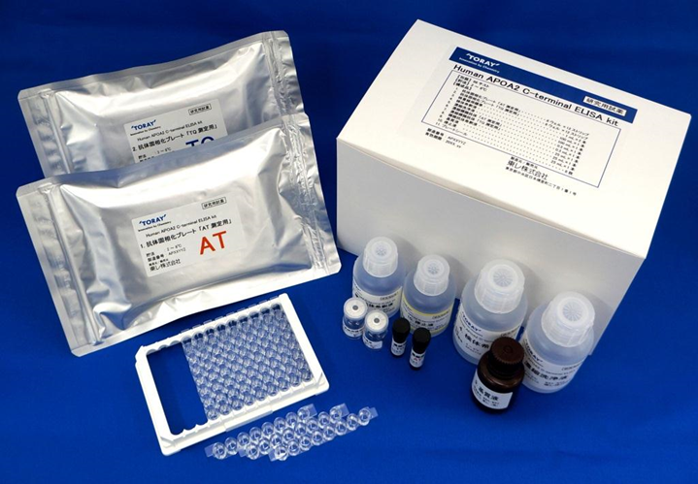
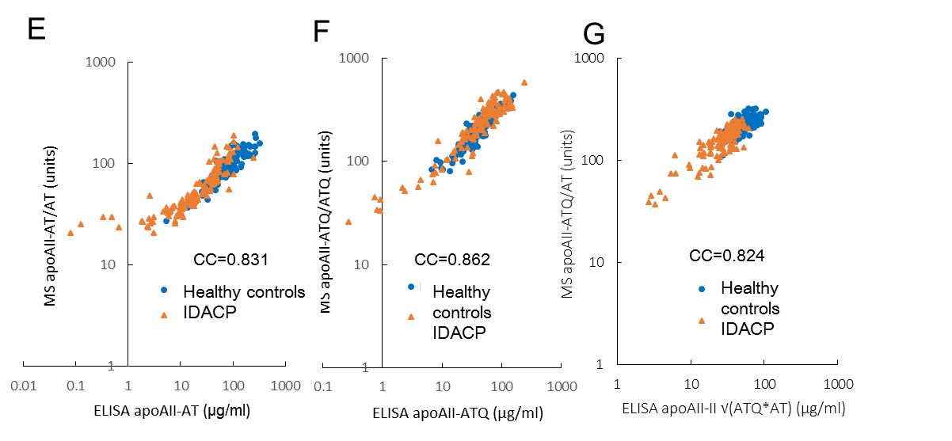
Sandwich ELISA kit with specific antibody for apoAII isoforms
A
ApoAII-ATQ-specific
antibody
(mouse monoclonal)
B
Pan-apoAII antibody
(mouse monoclonal)
A
T
Q
A
T
A
T
Q
A
T
ApoAII-AT-specific
antibody
(rabbit polyclonal)
Pan-apoAII antibody
(goat polyclonal)
Honda et al., Sci Rep. 2015
Notes:
In conjunction with a Japanese diagnostic company, we have developed ELISA kits to measure the concentration of apoA2 isoforms in the blood stream, thus allowing the easy clinical examination of apoA2 isoforms as an early detection biomarker for pancreatic cancer.
These schemes show the ELISA system for measuring apoA2 isoforms.
The results of mass spectrometry and ELISA provided high correlation coefficients.

Slide 5
Distribution of apoAII-ATQ/AT in early stages of invasive ductal adenocarcinoma of the pancreas (IDACP)
Jichi Medical University
National Cancer Center
Tokyo Medical University
National Osaka Hospital
Osaka Medical Center
Osaka Medical College
Fukuoka University
Honda et al., Sci Rep. 2015
Notes:
We analyzed the expression level of circulating apoA2 isoforms in the plasma of healthy controls and patients with pancreatic cancer collected from multiple institutions in Japan.
A statistically significant reduction in apoA2-ATQ/AT was found in all stages of pancreatic cancer in comparison with healthy controls.

Slide 6
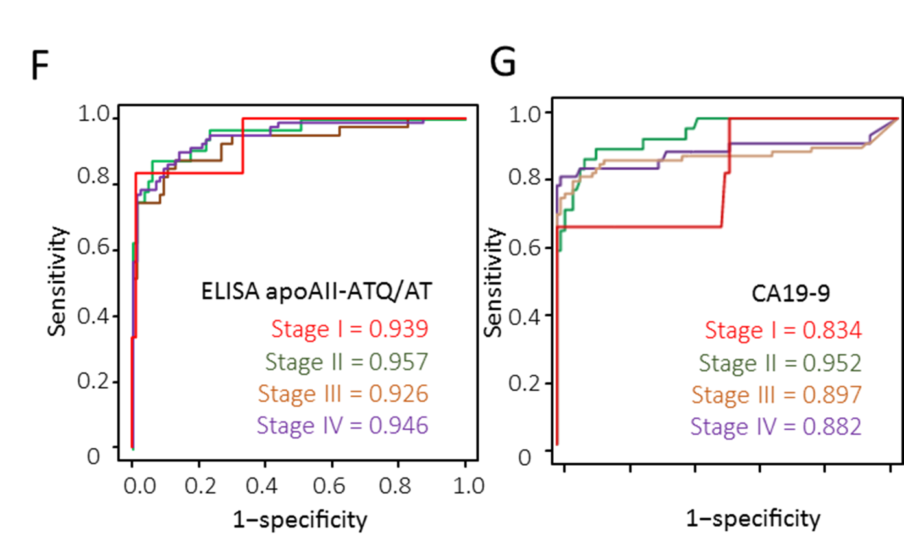
Comparison of ROC analysis between apoAII isoforms and CA19-9
Honda et al., Sci Rep. 2015
Notes:
ELISA of apoA2 isoforms revealed a statistically significant reduction in apoA2-ATQ/AT for all stages of pancreatic cancer.
AUC values of apoA2-ATQ/AT were greater than 0.93, including for stage-I and stage-II pancreatic cancer.
Moreover, the AUC values of apoA2-ATQ/AT were higher than the values of CA19-9 for all stages.

Slide 7
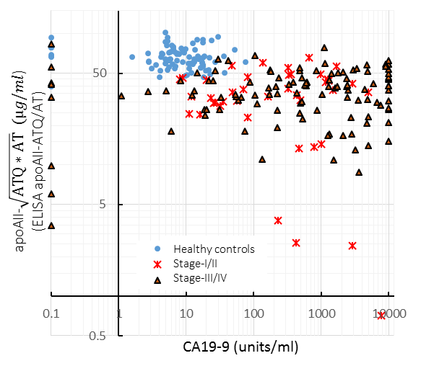
Combination analysis of apoAII-ATQ/AT and CA19-9
46 μg/ml
Final accuracy
Sensitivity 91.8%
Specificity 98.1%
Honda et al., Sci Rep. 2015
75 units/ml
Notes:
This slide shows a scatter graph for apoA2-ATQ/AT and CA19-9.
The X axis is the concentration of CA19-9, and the Y axis is the concentration of apoA2-ATQ/AT.
Blue dots indicate healthy controls, red crosses indicate patients with stage-I and stage-II pancreatic cancer, and orange triangles indicate patients with stage-III and stage-IV pancreatic cancer.
Combination analysis of apoA2-ATQ/AT and CA19-9 significantly improved diagnostic accuracy for detecting patients with pancreatic cancer.
The sensitivity and specificity of the combination analysis were 91.8% and 98.1%, respectively.
In particular, CA19-9 was not detected in some patients with stage-III and stage-IV pancreatic cancer. These stages of pancreatic cancer do not produce Lwise antigen. ApoA2 isoforms were detected in patients that tested negative for CA19-9.

Slide 8
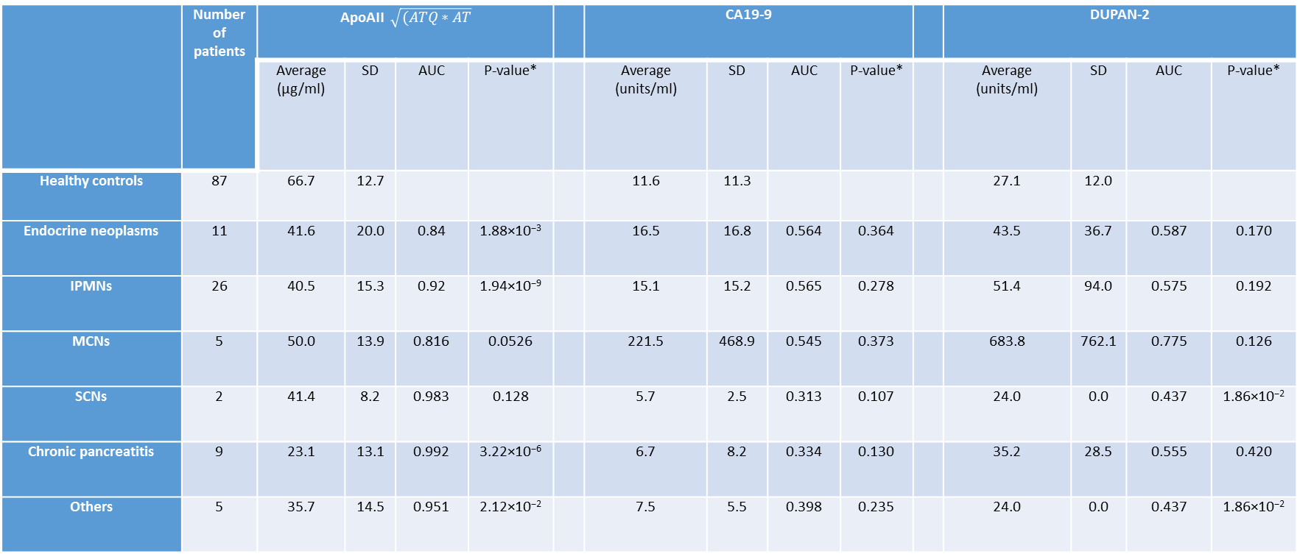
Determining the efficiency of apoA2-I as a risk marker for PDAC
Honda et al., Sci Rep. 2015
Notes:
Interestingly, apoA2-I can be used to detect not only early stages of pancreatic cancer, but also precancerous lesions of PDAC, such as IPMN and MCN, with very good AUC values.
For example, the AUC value of patients with IPMN compared to healthy subjects was 0.92, allowing patients with IPMN to be discriminated from healthy controls.

Slide 9


Blind validation of the diagnostic accuracy of ELISA for apoAII isoforms using a pancreatic reference set from NCI EDRN
NCC
Proposal for collaboration
MTA
NCI EDRN
NCI post results on Internet
Send reference set
After 1.5 years
Return results
Send final report
Send final report
Blind measurement
Data management center
Calculation of final diagnostic accuracy
Publication
Notes:
The clinical usefulness of the proposed method in a clinical setting was validated by NCI EDRN.
I was the PI of this study, NCI EDRN was the management office, and the data management center was the Fred Hutch Cancer Research Center.

Slide 10
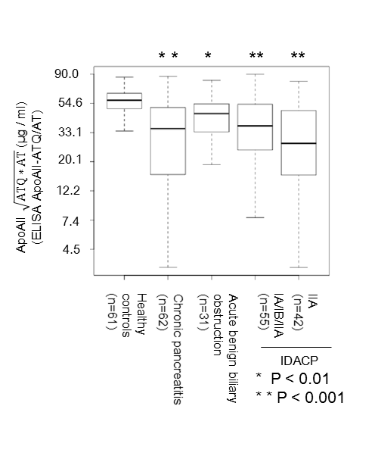
Results for pancreatic reference set from NCI EDRN
IIB
Honda et al., Sci Rep. 2015
Notes:
This slide shows the results for the pancreatic reference set from NCI EDRN.
A statistically significant reduction in apoA2-ATQ/AT was observed for patients with chronic pancreatitis, stage-IA/IB/IIA pancreatic cancer, and stage-IIB pancreatic cancer in comparison with healthy controls.
There were 61 healthy controls, 62 cases of chronic pancreatitis, 31 cases of acute benign biliary obstruction, and 97 cases of stage-I or stage-II pancreatic cancer.

Slide 11
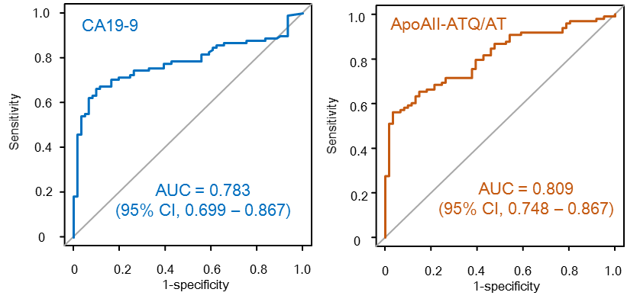
Results of ROC analyses of CA19-9 and apoAII isoforms
Honda et al., Sci Rep. 2015
Notes:
The AUC value of CA19-9 was 0.783 and could be used distinguish patients with stage-I and stage-II pancreatic cancer, whereas the AUC value of apoA2-ATQ/AT was 0.809.
Thus, the AUC value of apoA2-ATQ/AT was higher than that of CA19-9.

Slide 12
Combination analysis with apoAII isoforms and CA19-9
E
1.0
Combination
0.8
0.6
Sensitivity
Combination AUC = 0.879
(95% CI, 0.823–0.930)
Improved AUC = 0.0978
(95% CI, 0.04–0.169)
CA19-9 AUC = 0.783
0.4
0.2
0
0 0.2 0.4 0.6 0.8 1.0
1-specificity
Honda et al., Sci Rep. 2015
Notes:
This slide shows the results of ROC analysis with apoA2 isoforms and CA19-9.
Notably, combination analysis with CA19-9 and apoA2 isoforms significantly improved the AUC value of a single assay of CA19-9, from 0.783 to 0.879.
The AUC value increased by approximately 0.1. The 95% confidence interval of the improved AUC value ranged from 0.04 to 0.169, and was statistically significant.
Thus, the validation study conducted by NCI EDRN confirmed the diagnostic accuracy of our ELISA kit for apoA2 isoforms.

Slide 13
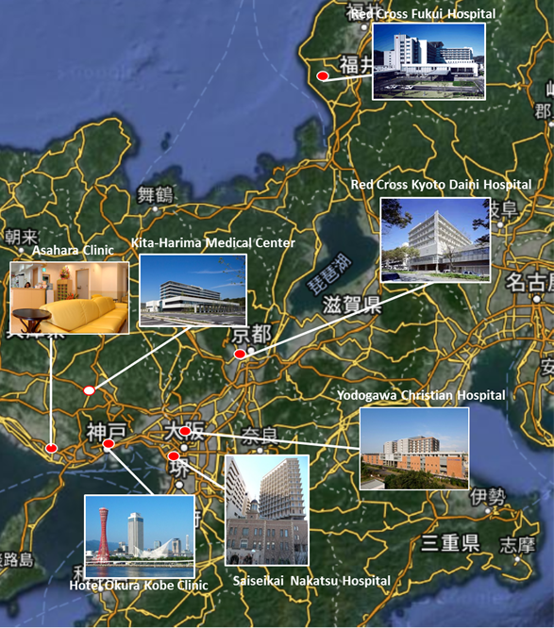
Experimental cancer screening for pancreatic cancer
Kobe University and NCC
Kobe Pancreatic Cancer Screening Network
Red Cross Fukui Hospital
Notes:
We recently organized the Kobe Pancreatic Cancer Screening Network to conduct a proof of concept study for pancreatic cancer screening using apoA2 isoforms as biomarkers. This network screened for early-stage pancreatic cancer and risk diseases of pancreatic malignancies using apoA2 isoforms with support from AMED.
This is a Japanese poster for recruiting patients for this screening.
Seven cancer screening centers in four prefectures are participating in the Kobe Pancreatic Cancer Screening Network.

Slide 14


The Kobe Pancreatic Cancer Screening Network
Development of an efficient screening method for pancreatic cancer
Blood collection
Return results to patients
Measure apoAII isoforms
Under cutoff
Recommendation for second screening with imaging
NCC
Report patient results
PMDA
Goal: enrolment of 5000–10000 cases
AMED Practical Research for Innovation Cancer Control （PI: Honda K.）
Notes:
The aim of this project is to develop an efficient method to screen for pancreatic cancer.
This slide shows a schematic of this clinical development.
First, patients were enrolled at the Kobe Pancreatic Cancer Screening Network. After obtaining informed consent, blood was collected from the enrolled patients. The plasma levels of apoA2 isoforms were measured using the apoA2 ELISA kit, and the results returned to the patients. A second screening with imaging was recommended for patients presenting abnormalities in the apoA2 isoform level.
The final diagnosis was reported to the patients. We would like to enroll between 5000 and 10000 cases in this project.
We would also like to identify the clinical profile of false-positive patients from these data.

Slide 15
Interim analysis of experimental pancreatic cancer screening by apoA2-i
Enrollment
N = 3610
Positive
N = 77
Imaging
N = 40
Any diseases of pancreas
N = 18
2016/11/8
6 screening centers
  PDAC n = 1
  PNET n = 1
  Pancreatic mass n = 3
  IPMN n = 6
  Pancreatic cyst n = 2
  AIP n = 1
  CP n = 1
  Early stage CP n = 3
2.1%
ApoA2 ATQ/AT > 35 μg/ml
52%
・Dynamic CT/ MRCP/ EUS
45%
EUS：Endoscopic Ultrasonography
PDAC：Pancreatic ductal adenocarcinoma
PNET：Pancreatic neuroendocrine tumor
IPMN：Intraductal mucinous neoplasm
AIP：Autoimmune pancreatitis
CP: Chronic pancreatitis
2017/2/26 Enrollment of 5000 subjects
Notes:
This slide shows the results of an interim analysis of pancreatic cancer screening using apoA2-I.
Subjects were enrolled from 6 screening centers and plasma apoA2-I levels were measured.
Forty of 70 positive subjects underwent Dynamic CT, MRCP, or EUS, and 18 subjects were diagnosed with pancreatic diseases:
one PDAC, one PNET, six IPMN, two with pancreatic cysts, one AIP, one chronic pancreatitis, and three early stage of CP.

Slide 16

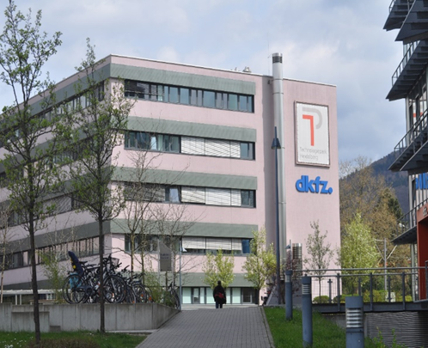
Blind validation of apoA2-I for blood samples before diagnosis of pancreatic cancer by The European Prospective Investigation into Cancer and Nutrition (EPIC) study
The EPIC study is one of the largest cohort studies in the world, with more than half a million (52,1000) participants recruited across 10 European countries and followed for almost 15 years.
Notes:
In addition, the risk of pancreatic cancer is being assessed through collaboration with a WHO IARC EPIC study.
The EPIC study is one of the largest cohort studies in the world, with more than half a million (521,000) participants recruited across 10 European countries and followed for almost 15 years.

Slide 17




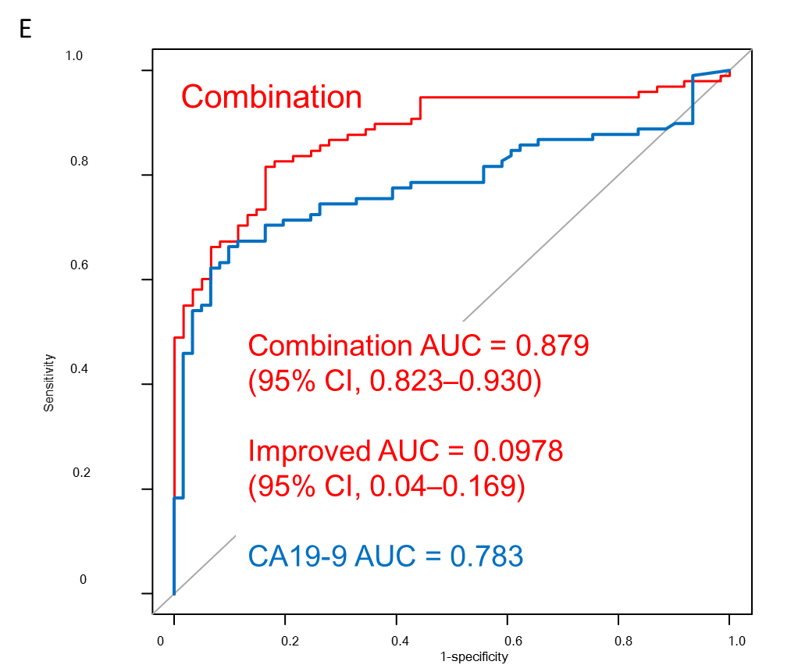
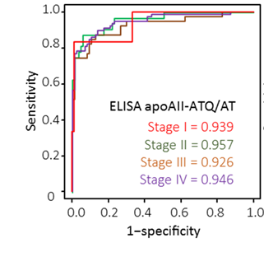
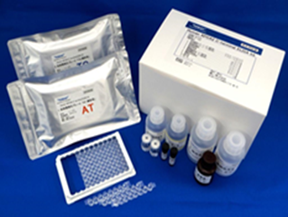

International collaboration for clinical development of an early detection biomarker for pancreatic cancer
Development of an efficient screening method for pancreatic cancer using a biomarker (apoA2-isoform)
First screening
Second screening
Screening hospital
Enrichment of high risk individuals using a non-invasive biomarker
Early detection by invasive high resolution imaging
Reduction of mortality from pancreatic cancer by early treatment
Blind validation of biomarker in stage-I/II pancreatic cancer
Risk assessment of pancreatic cancer using biomarker
NCI-EDRN
Early Detection Research Network
The European Prospective Investigation into Cancer and Nutrition (EPIC)
Largest cohort studiy in the world
Biomarker ELISA kit
Honda and Srivastava Biomarker Med. 2016
Notes:
This is the final slide. [There are two more slides]
We are developing an efficient screening method for pancreatic cancer by closely collaborating with NCI EDRN and WHO IARC to blindly validate the clinical usefulness of a biomarker to detect early stage pancreatic cancer and to assess the personal risk of pancreatic cancer.

Slide 18

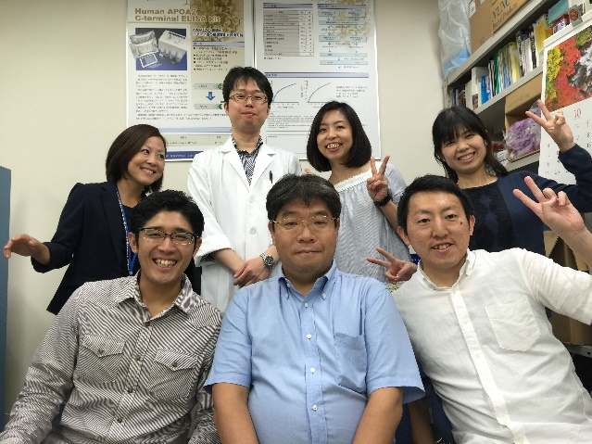










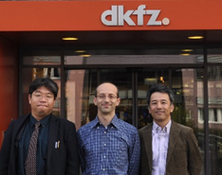


Acknowledgment
National Cancer Center Drs. N Miura, Y Watabe, Mori, Yoshimoto, Fujiwara, Shiraishi, Y Yamada, K Kato, Iwasa, Sakamoto, Shoji, Yamada, Takeuchi
Multi-institutional
Drs. S Nakamori, H Nagai, N Sata, T Ioka, A Tsuchida, Y Saito, Y Yasunami, M Shimahara, T Okusaka
University of Heidelberg
Dr. Klaus Felix, Prof. Markus W Bucher
NCI Early Detection Research Network (EDRN)
Dr. S Srivastava
Kobe University
Dr. Yoshida, Prof. Azuma
Dr. Kobayashi, Dr. Nishiumi
Tohoku University
Prof. Terasaki, Dr. Yoneyama
Kumamoto University
Prof. Ohtsuki
dkfz.
Prof. Kaaks, Dr. Canzian
大阪府立成人病センター
大阪医療センター
大阪医大病院
自治医大病院
国立がんセンター中央病院
東京医大病院
福岡大学病院
Keio University
Prof. Suematsu, Dr. Kabe
Toray
Dr. Kobayashi, Dr. Jung
Fred Hutch Cancer Center
Prof. Huang, MS Marsh
ＡＭＥＤ 革新がん 「膵がん検診の効率化を目指した血液バイオマーカーの実用化」（代表研究者 本田一文）、ＡＭＥＤ 創薬支援ネットワーク「進行卵巣がんの創薬」（代表研究者 本田一文）文科省科学研究費 基盤（B) (代表
本田一文）、挑戦的萌芽研究(代表 本田一文）、CREST （代表研究者 末松 誠先生, 加部泰明先生) (代表研究者 吉田 優先生）、次世代がん医療創生研究事業 （代表研究者 本田一文）
This work was supported by a grant from the Japan Agency for Medical Research and Development (AMED) Practical Research for Innovation Cancer, AMED P-CREATE, and AMED-CREST.
EDRN
Notes:
I appreciate the assistance of the many collaborators who worked with me on this project.
In particular, I received much support from doctors participating in the multi-institutional study, Dr. Srivastiva of NCI, Dr. Felix of Heidelberg University, and Dr. Yoshida and Professor Azuma of Kobe University.
This work was supported by the Japan Agency for Medical Research and Development (AMED) Practical Research for Innovation Cancer Control, P-direct, and AMED CREST.
Thank you very much.

Slide 19
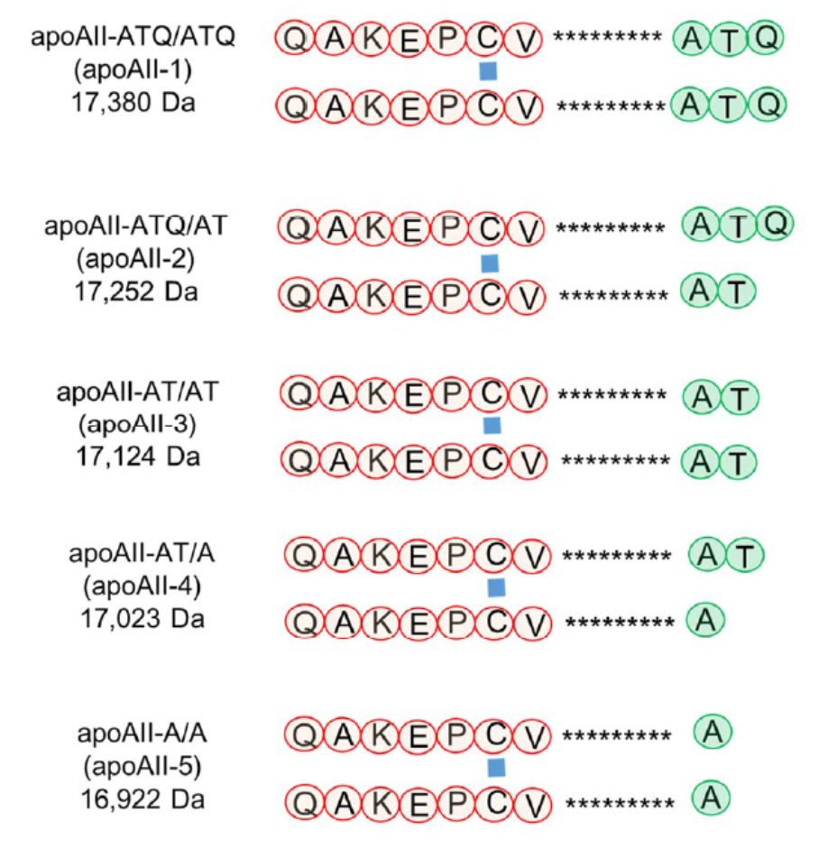

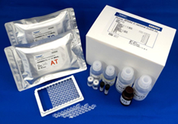
Plasma biomarker development for early detection of pancreatic cancer, a collaboration by NCI and NCC
Plasma biomarker for pancreatic cancer: apoA2 isoforms
Detection rate using apoA2-i for pancreatic cancer is higher than using CA19-9
Experimental pancreatic cancer screening of the general population using a biomarker in Japan
Development of diagnostic kit for early detection of pancreatic cancer
Blind validation of biomarker by NCI EDRN
Honda et al. Cancer Res, 2005.
Honda et al. Plos One, 2013.
Honda et al. Sci Rep. 2015.
Honda and Srivastava. Biomarker Med. 2016.
#4
Notes:
We have developed a plasma biomarker for the early detection of pancreatic cancer in collaboration with National Cancer Institute Early Detection Research Network.
We have identified a novel plasma biomarker for the early detection of pancreatic cancer using the proteomic profiles of patient plasma.
The AUC values obtained using this biomarker could distinguish patients with pancreatic cancer more accurately than the AUC values obtained using CA19-9, the current major biomarker for pancreatic cancer. These data were validated in a multi-institutional study in Japan.
The National Cancer Institute Early Detection Research Network NCI IDRN blindly validated the clinical utility of this new biomarker using a reference set of pancreatic cancer samples.
We have begun experimental pancreatic cancer screening of the general population using this biomarker, with the support of the AMED. [Why is this slide here, after the acknowledgments? It repeats what you’ve already said]

