Slide 1


AMED-ERDN Joint Workshop
Development of early diagnostic biomarker candidates
of lung cancer and pancreatic cancer
by the detection of cancer-derived protein fragments
in urine using the original MRM method
Tokyo
Masamitsu Nakazato
Division of Neurology, Respirology, Endocrinology and Metabolism,
Department of Internal Medicine, Faculty of Medicine,
University of Miyazaki
Miyazaki

Slide 2
Positive ratios of tumor markers
in early lung cancer and pancreatic cancer
tumor marker | cancer | positive ratio
CEA | Stage I lung cancer adenocarcinoma | 27%
SCC | squamous cell carcinoma | 27%
CYFRA 21-1 | squamous cell carcinoma | 43%
CA19-9 | resectable pancreatic cancer | 50%
Novel biomarkers for early detection of
lung cancer and pancreatic cancer have been required

Slide 3
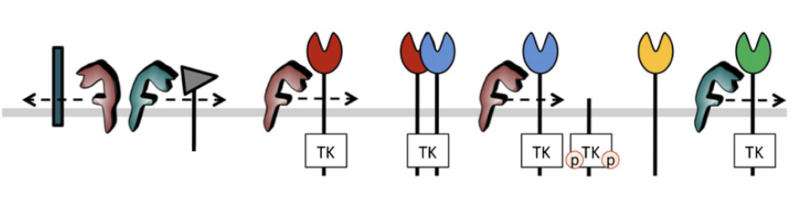
Proteolytic shedding in tumor progression
EGF
TGF-α
AR
BTC
HB-EGF
EPR
HB-EGF
BTC
EPR
Unknown
ligands
NRG1
NRG2
NRG1-4
BTC
AR
HB-EGF
EPR
Cell
adhesion
molecule
Pro-EGFR
ligands
TK
TK
TK
TK
P
TK
ADAM10
ADAM17
P
Her1/
EGFR
Her2
Her3
Her4
Migration/Invasion
Cell Proliferation/ Anti-apoptosis
Saftig P, Eur J Cell Biol 2011
３

Slide 4
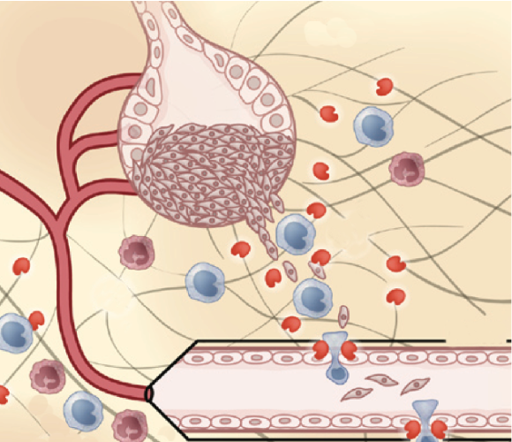
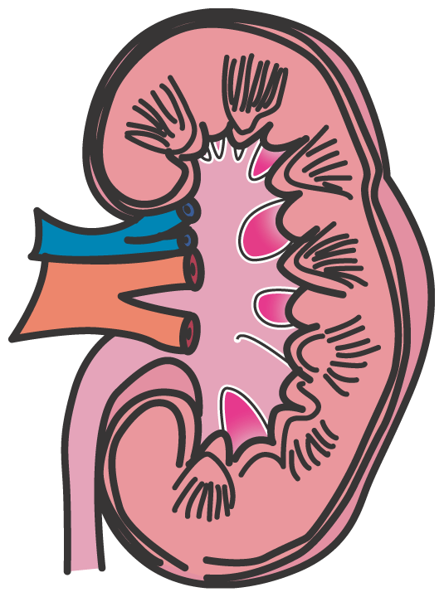
Detection of protein fragments in the urine
Tumor microenvironment
Glomerular
filtration
Shedding
products
Blood
excretion
into urine
z
Kessenbrock K, Cell 2010
Urine sample is suitable for detection of low molecular weight of
protein fragments, since high molecular weight of proteins are
not excreted into the urine.
We developed a comprehensive analysis method by the use of
iTRAQ-based and MRM-based quantifications of protein fragments excreted into the urine of cancer patients.

Slide 5
C-terminal cleavage sites of protein fragments
probed by ¹⁸O isotope labeling
H
H
H₂N
C
N
C
N
C
¹⁶O
H
¹⁶O
¹⁶O
¹⁶O
Trypsin digestion under the presence of
H₂¹⁸O-labeled water and H₂¹⁶O water
Tryptic peptides other than
the C-terminal peptide
C-terminal tryptic peptide
16
18
16
(H₂N
C
O
H)_{n}
(H₂N
C
O
H)_{n}
H₂N
C
O
H
16
O
16
O
16
O
５

Slide 6
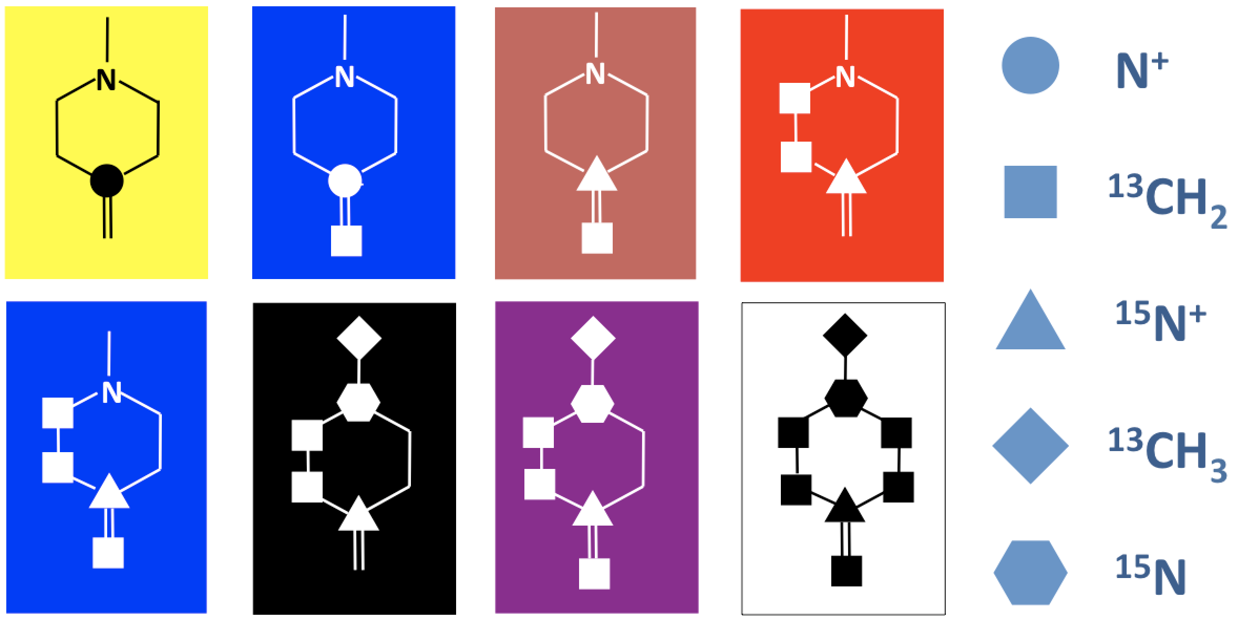
Comparative analysis of protein fragments in the urine
by iTRAQ method
Low molecular weight of protein fragments from 10 ml urine samples
Concentration and reductive alkylation
Trypsin digestion under the presence of ¹⁸O-labeled water
iTRAQ labeling
iTRAQ: isobaric tags for relative and absolute quantification
A
B
C
D
C
A:
Internal standard
B ~ H:
Samples
A
D
G
E
F
B
H
E
F
G
H
E
Analysis by nano-LC/MALDI-MS/MS
６

Slide 7
Identification of novel early diagnostic marker candidates of
lung adenocarcinoma in urine by iTRAQ analyses
Patent Application No. 2016-030267
Comprehensive analysis of protein fragments
stage I lung adenocarcinoma
healthy controls
n = 23
n = 25
Identification of 14,000 protein fragments
Selection of candidates based on the criterion of
ROC-AUC > 0.6 (higher than CEA)
We identified 11 novel early diagnostic
Marker candudates of lung adenocarcinoma
７

Slide 8
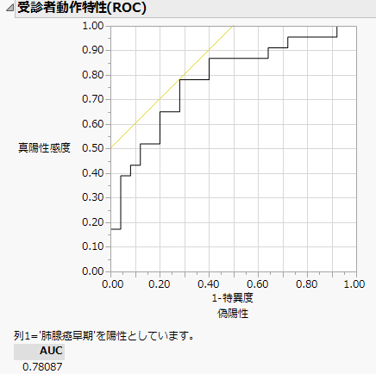
Protein X-Fragment-p12760
Patent Application No. 2016-030267
7
7
6
100
6
5
5
80
4
4
60
Sensitivity
: 78%
relative ratio to healthy controls
3
sensitivity (%)
3
Specificity
: 72%
40
2
cutoff
value
ROC-AUC
: 0.78
2
20
cutoff value
: 1.1
1.1
1
1.09
1
0
0
0
20
40
60
80
100
0
Healthy
controls
(n = 25)
Stage I lung
adenocarcinoma
(n = 23)
100−%specificity
８

Slide 9
Protein X
Domain A
Domain B
Domain C
p12760
p4252
p1001
p1004
IP
p571
p191
EL
EP
GG
DE
p166
GD
p987
DG
● A 352-amino acid protein secreted in the blood
● Proteolytically processed into three distinctly functioning domains
● The urine protein X level increases in prostatic cancer
Plasma level of immunoreactive Domain C increases in ovarian cancer
Devalieva K, Proteome Sci 2015
Matsuzaki H, J Clin Oncol 2005
９

Slide 10
Protein fragments identified in five cancers (ROC-AUC > 0.6)
~ common and different markers among types of cancer ~
Stage I Lung
adenocarcinoma
n = 23
Gastric
cancer
n = 30
Pancreatic
cancer
n = 35
Hepatocellular
carcinoma
n = 49
Cholangio-
carcinoma
n = 42
Protein X
Fragments
p191
p191
p191
p191
p304
p304
p304
p4252
p4252
p4252
p4252
p479
p479
p7667
p7667
p166
p166
p166
p571
p571
p571
p987, p1001, p175
p1004, p12760
Protein Y
Fragments
p14309
p14309
p14309
p10409
p10409
p8495
p1269
p1269
Protein Z
Fragment
p1275
Protein U
Fragments
p20858
p10234
Protein V
Fragments
p4581
p2767, p1021
Others
p6398,
p4626
p5080, p4616
p1323
p14161, p7142
p39, p179
７
p14594, p199

Slide 11
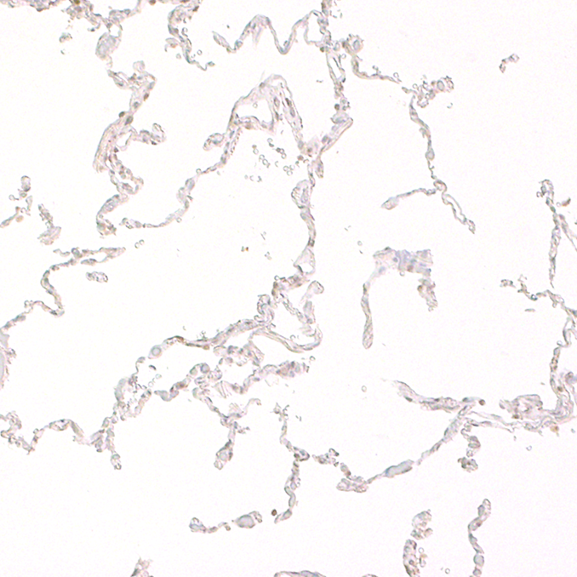
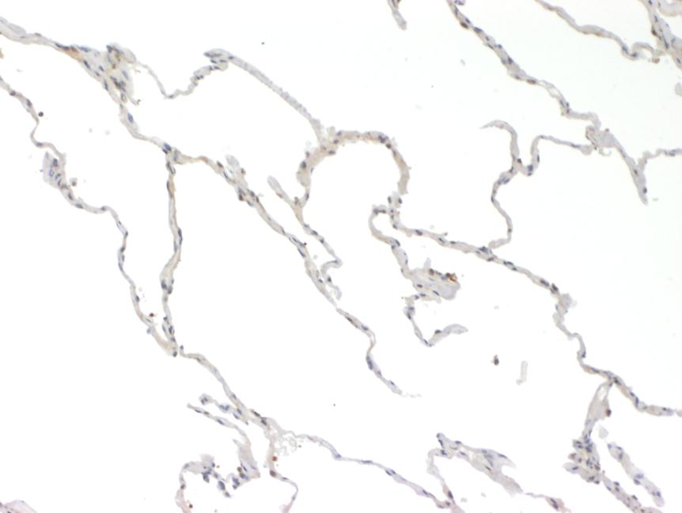
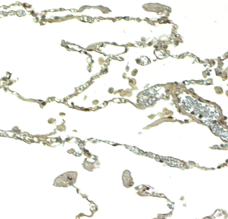
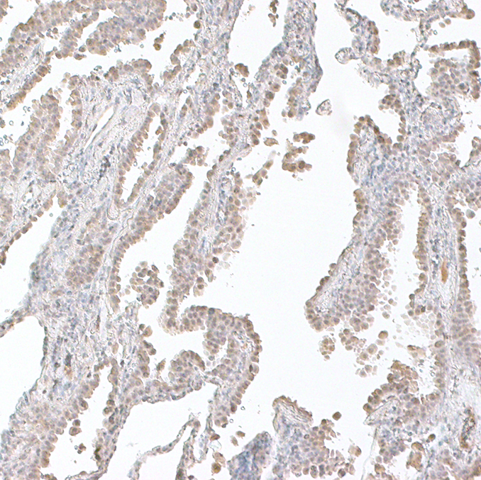
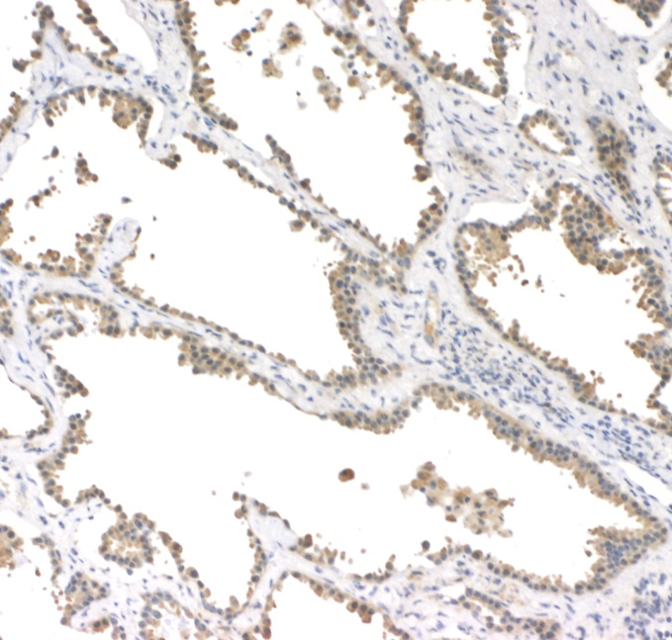
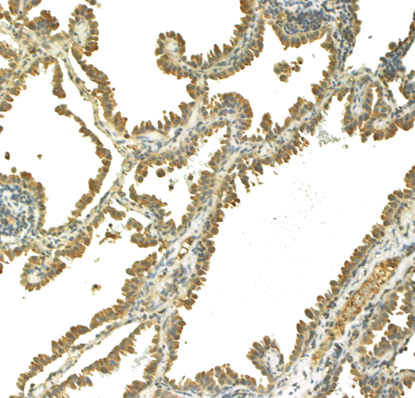
Robust expressions of protein X, Y, and V in lung adenocarcinoma
40
Protein X mRNA
30
Protein X
Protein V
20
Protein Y
Protein X/HPRT1
10
Non-tumor tissue
0
Normal
Lung
Lung
sq. ca.
Lung
adenoca.
(n = 19)
Lung adenoca.
Protein Y mRNA
1000
800
600
Protein Y/HPRT1
400
200
0
Normal
Lung
Lung
sq. ca.
Lung
adenoca.
(n = 19)
１１

Slide 12

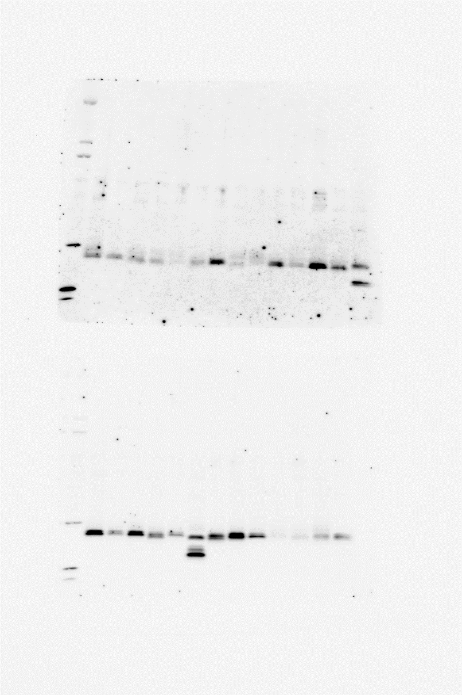
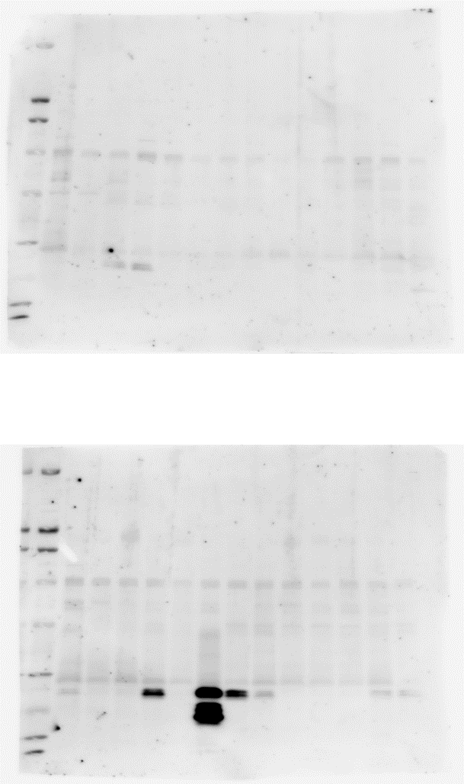
Expression of protein X and its fragment p4252 in lung adenocarcinoma
Domain C
Domain A
Domain C
Domain A
Domain B
Domain B
p12760
p4252
p4252
p1001
p1004
p571
p191
p166
p987
Protein X p4252- immunoreactivity
in lung adenocarcinoma
Urine
Healthy
controls
Lung
adenocarcinoma
Lung
Urine
①
②
③
④
⑤
⑥
⑦
75 kD
Anti-Protein X
C-terminus
70 kD
50 kD
Anti-Protein X
p4252
25 kD
25 kD
１２

Slide 13
Comparison of Protein X p571 and
CEA for detection of stage I lung adenocarcinoma
Patent Application No. 2016-030267
10
9
Positive rate
CEA
Protein X p571
: 28%
8
: 78%
ng/ml
CEA
p571
n = 14
6
Number of patients
10
5
4
8
4
2
2
2
1
6
3
0
5.0
−
+
−
+
4
cutoff
value
2
CEA
−
−
+
+
cutoff
value
p571
2
0.84
1
n = 11
n = 4
0
0
１３

Slide 14
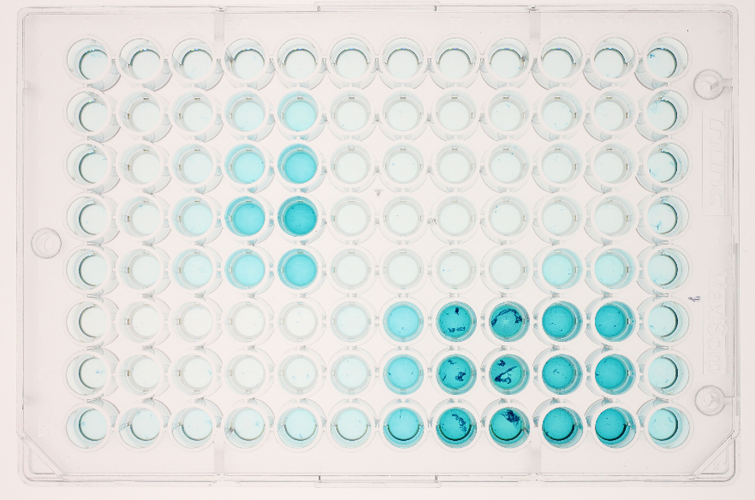
Development of ELISA kit for measurement of protein X-derived p4252
Protein X
Confidential
p4242
Anti-protein X-p4252 Ab
Anti-protein X-
C-terminus-Ab
p4252
C-terminus peptide
Urine of
healthy control
low
high
low
high
high
low
None
Absence of 1st Ab
x1,000
Purified
anti-p4252 Ab
x 200
x 40
Crude anti-p4252 Ab
x4,000
x1,000
Anti-protein X-
C-terminus Ab
x 200
x 40
１４

Slide 15
Identification of novel early diagnostic markers of lung
squamous cell carcinoma (Sq) in urine by iTRAQ analysis
14,000
protein fragments
Lung Sq
Healthy controls
Six novel early diagnostic marker candidates of lung Sq are identified
n = 29
n = 49
Selection based
on ROC-AUC > 0.8
Candidates |  | Sensitivity (%) | Specificity (%) | ROC-A UC
Protein L Fragment p7849 |  | 96.6 | 81.6 | 0.87
Protein B Fragment | p1278 | 69.0 | 89.8 | 0.80
Protein D Fragment | p2421 | 96.6 | 71.4 | 0.85
Protein K Fragment | p2268 | 96.6 | 73.4 | 0.83
Protein F Fragment | p340 | 75.9 | 81.7 | 0.87
Protein H Fragment | p528 | 96.6 | 67.4 | 0.81
１５

Slide 16
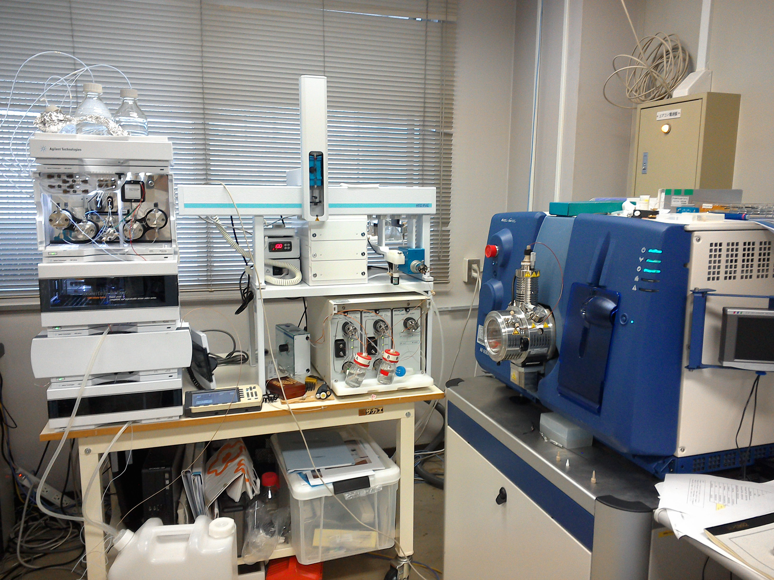
Quantitative analysis of the protein fragments in urine
by MRM (Multiple Reaction Monitoring) method
first mass
separation unit
collision
chamber
second mass
separation unit
q0
Q1
q2
Q3
Detector
Production
collision
LC
MS/MS
１６
QTRAP® 5500 LC/MS/MS system

Slide 17
Protein X and Y fragments of lung adenocarcinoma
in urine detected by MRM
Protein X-p175
Protein Y-p14309
0.10
0.05
0.08
0.04
0.06
0.03
ratio to internal control
ratio to internal control
0.04
0.02
0.02
0.01
0
0
Healthy
controls
(n = 28)
Stage I lung
adenocarcinoma
(n = 73)
Healthy
controls
(n = 28)
Stage I lung
adenocarcinoma
(n = 73)
Sensitivity
Specificity
ROC-AUC
: 84.7%
Sensitivity
Specificity
ROC-AUC
: 87.5%
: 71.5%
: 64.3%
: 0.84
: 0.79
１７

Slide 18
Identification of novel early diagnostic markers of
pancreatic cancer in urine by iTRAQ analysis
Selection based on
ROC-AUC > 0.8
Out of 14,000 protein fragments,
12 novel early
diagnostic markers are identified
Pancreatic cancer
Healthy controls
n = 23
n = 79
Protein W p1989
Protein V p2767
ROC-AUC: 0.83
ROC-AUC: 0.82
7.5
7.5
Healthy control
Resectable
Locally advanced
Distant metastasis
5
5
relative ratio to healthy controls
relative ratio to healthy controls
2.5
3.2
2.5
2.1
2.3
2.4
1.7
1.9
1
1
0
0
１８

Slide 19
Protein V fragments of pancreatic cancer
in urine detected by quantitative MRM analysis
Domain 1
Domain 2
Domain 3
Domain 4
p1021
Sensitivity: 86%, Specificity: 87%, ROC-AUC : 0.91
p2767
Sensitivity: 89%, Specificity: 77%, ROC-AUC： 0.88
p2767
p1021
10⁴
10⁶
10⁵
10³
760
10⁴
100
1077
ratio to internal control
10³
ratio to internal control
10²
100
10²
10
10
1
1
Healthy control
n = 48
Pancreatic
cancer
n = 35
Healthy control
n = 48
Pancreatic
cancer
n = 35
１９

Slide 20
Protein V-fragment p1021 in the urine is decreased
after pancreatic cancer resection (MRM analysis)
25
20
n = 8
15
ratio to internal control
10
5
0
Before surgery
One month
after surgery
２０

Slide 21
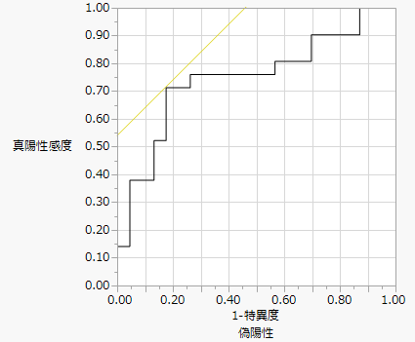
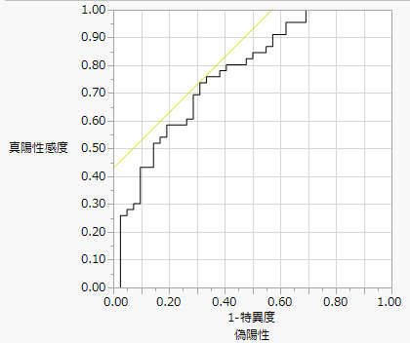
Validation of protein V fragment-p2767 in
stage I lung adenocarcinoma by MRM
Training set
（2 institutes）
Validation set
（4 institutes）
p2767 levels before and after stage I
lung cancer resection
Healthy control n = 23
Stage I lung adenoca. n = 21
Healthy control n = 42
Stage I lung adenoca. n = 46
100
100
1.5
n = 22
80
80
1
60
60
sensitivity (%)
40
sensitivity (%)
ratio to internal control
40
0.5
20
ROC-AUC:
0.75
20
ROC-AUC:
0.77
0
0
0
0
20
40
60
80
100
0
20
40
60
80
100
100−%specificity
100−%specificity
Before surgery
After
surgery
２１

Slide 22
Serum levels of protein V in stage I lung adenocarcinoma
μg/ml
P < 0.05
25
20
15
10
5
n = 13
n = 25
0
Healthy control
Stage I lung adenocarcinoma
２２

Slide 23
Ongoing prospective, multicenter studies to validate early diagnostic value of biomarkers for lung cancer and pancreatic cancer
Lung cancer
Development of ELISA kits for marker protein fragments in early lung adenocarcinoma
National Cancer
Center Hospital East
Osaka Univ.
Tottori Univ.
Prospective, multicenter validation
study of biomarkers for detection of
① stage I lung adenocarcinoma
② stage I lung squamous cell carcinoma
③ resectable pancreatic cancer
Tokushima Univ.
Miyazaki Univ.
Pancreatic cancer
National Cancer
Center Hospital East
Kyushu Univ.
Wakayama Medical Univ.
Miyazaki Univ.
２３

Slide 24

Summary
We established the comprehensive analysis method of iTRAQ-based and MRM-based quantifications of cancer-derived protein fragments excreted into the urine.
We identified novel diagnostic biomarker candidates for stage I lung
adenocarcinoma, pancreatic cancer, and several types of solid cancer.
Prospective, multicenter studies are now in progress to validate the
novel biomarkers identified in lung cancer and pancreatic cancer.
Normal Cell
excreted into urine
Cancer Cell
N
N
C
C
Cancer cells express larger amounts of several proteins and cleave their
fragments which are excreted in the urine.
２４

Slide 25
Collaborators
University of Miyazaki
Nobuhiro Matsumoto
Yasuji Arimura
Shigehisa Yanagi
Hironobu Tsubouchi
Laboratory of Protein Profiling and Functional Proteomics,
Institute for Protein Research, Osaka University
Toshifumi Takao
Nobuaki Okumura
Masafumi Fukuda

Slide 27
Summary
Collaborators
We established the comprehensive analysis method of iTRAQ-based and MRM-based quantifications of cancer-derived protein fragments excreted into the urine.
We identified novel diagnostic biomarkers for stage I lung
adenocarcinoma and pancreatic cancer.
We also identified multiple novel diagnostic markers in the urine for several types of solid cancer.
Prospective, multicenter studies are now in progress to validate the novel biomarkers identified in lung cancer and pancreatic cancer.
University of Miyazaki
Nobuhiro Matsumoto
Yasuji Arimura
Shigehisa Yanagi
Hironobu Tsubouchi
Normal Cell
Cancer Cell
Laboratory of Protein Profiling and Functional Proteomics,
Institute for Protein Research, Osaka University
excreted into urine
N
N
C
C
Toshifumi Takao
Nobuaki Okumura
Masafumi Fukuda
Cancer cells express larger amounts of several protein fragments compared to normal cells.

Slide 28

Expression of protein X and its fragment p4252 in cell lines of
lung adenocarcinoma and pancreatic cancer
Human bronchial
epithelial cell
BEAS-2B
Human lung
adenocarcinoma cell
HLC-1
Human pancreatic
cancer cell
T3M4
Anti-Protein X
p4252
Anti-Protein X
C-terminus
Bronchial epithelial cell
Lung adenoca.
Pancreatic ca.
ratio of
p4252/protein X
2
Protein X
5
p4252
5
1.6
4.0
3.9
1.5
4
3.8
4
1.1
3
3
Fold changes to BEAS-2B
Fold changes to BEAS-2B
ratio of p4252/ protein X
2.4
1
2
2
0.5
1
1
0
0
0

