Slide 1
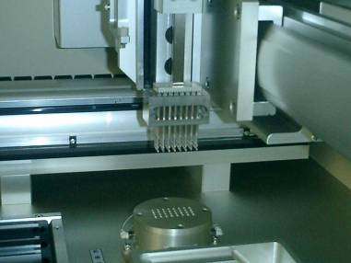
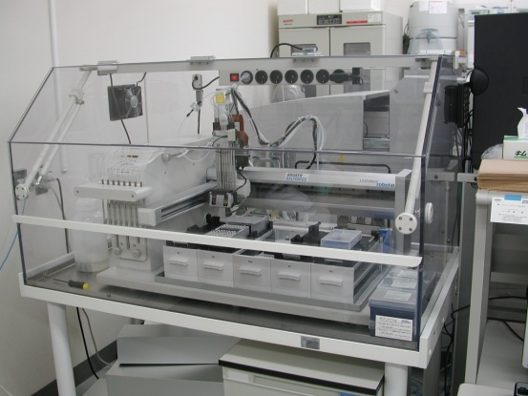
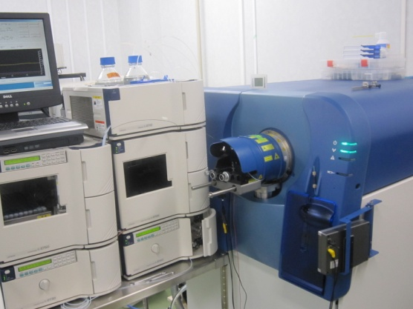
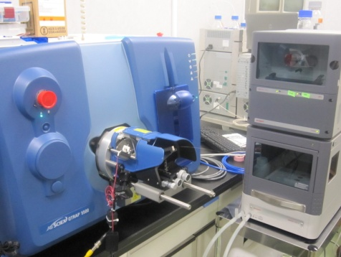
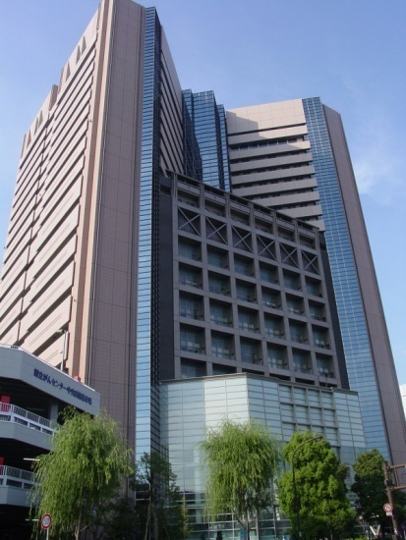
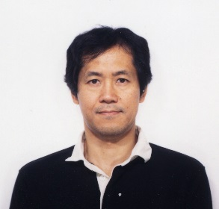

Early Detection of Lung Cancer
and Beyond
Tesshi Yamada, MD, PhD
National Cancer Center Research Institute, Tokyo, Japan
(March 6, 2017, Tempe, AZ)

Slide 2
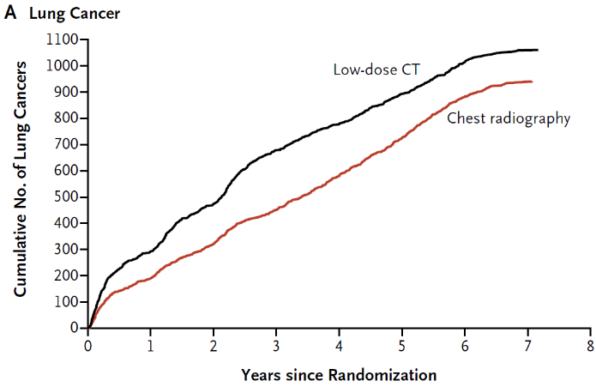
National Lung Screening Trial (NLST)
Low-dose CT Chest radiography
Notes:
The advent of low-dose computed tomography promises to contribute to the early detection of lung cancer.
A total of 51.8% of the lung cancer cases identified in the National Lung Screening Trial were stage IA.

Slide 3
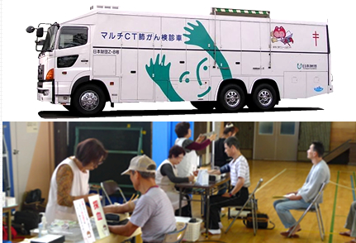
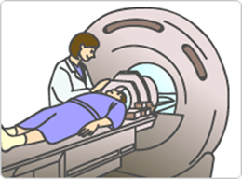
JECS study
CT scanners
Country | per Million | Total
Japan | 107.1 | 13,636
US | 41.0 | 13,065
Korea | 37.1
Germany | 35.3
France | 15.3
UK | 8.0
OECD (2016)

Slide 4
5-year survival rate of NSCLC
according to pStage
IA 83.9% (n = 4772)
IB 66.3% (n = 2629)
IIA 61.0% (n = 361)
IIB 47.4% (n = 1330)
IIIA 32.8% (n = 1862)
IIIB 29.6% (n = 1108)
IV 23.1% (n = 375)
Notes:
Early detection, however, does not necessarily mean the disease can be cured.
Here are data from a large-scale registry study in Japan. As you can see, the five-year survival for stage IA non-small cell lung cancer patients is just below 80%.

Slide 5
読売新聞（2016年12月2日）医療ルネッサンスNo.6446

Slide 6
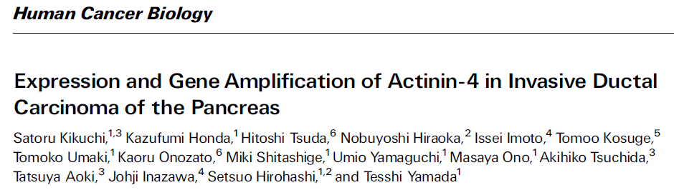
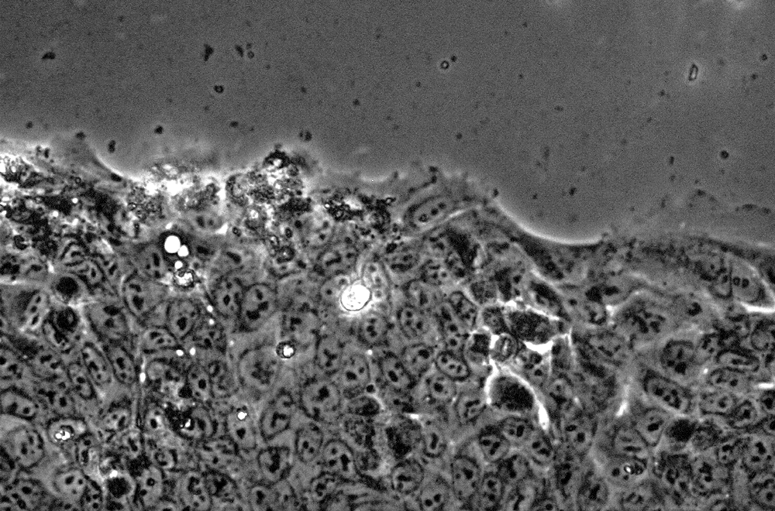
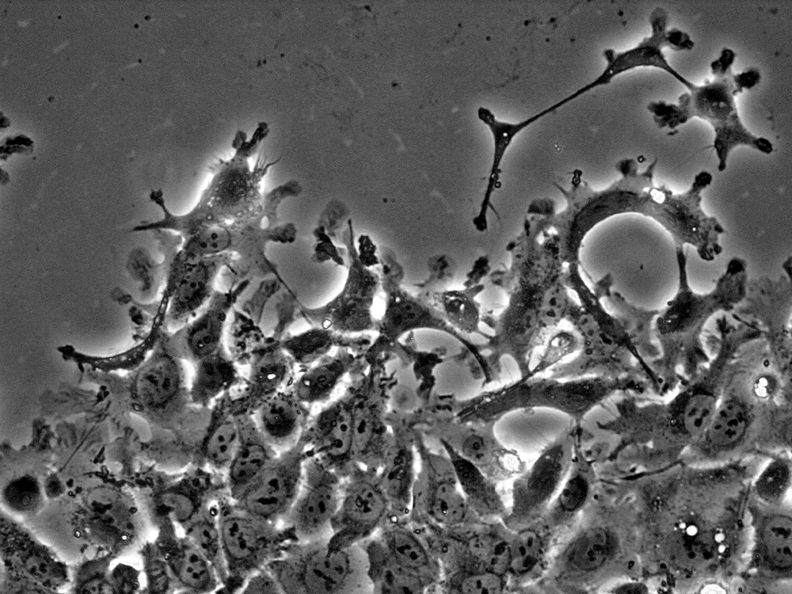
●Actinin-4 (ACTN4)
１） Originally identified in the NCC
２） Established biological function
V-15 (+) after 16hs
Actinin-4 (-) Actinin-4 (+)

Slide 7
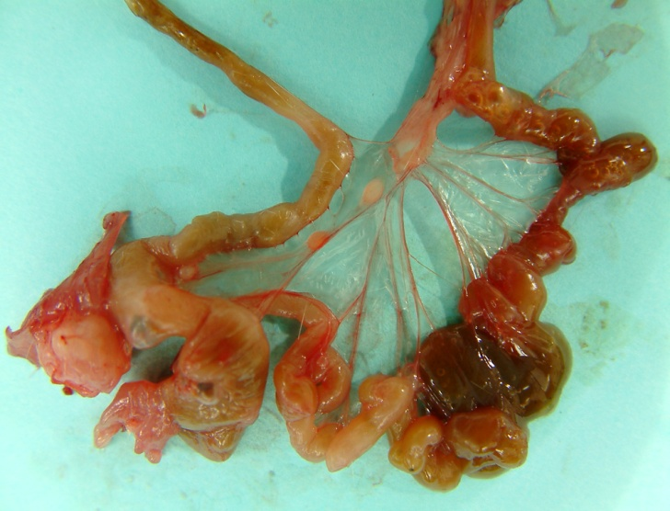

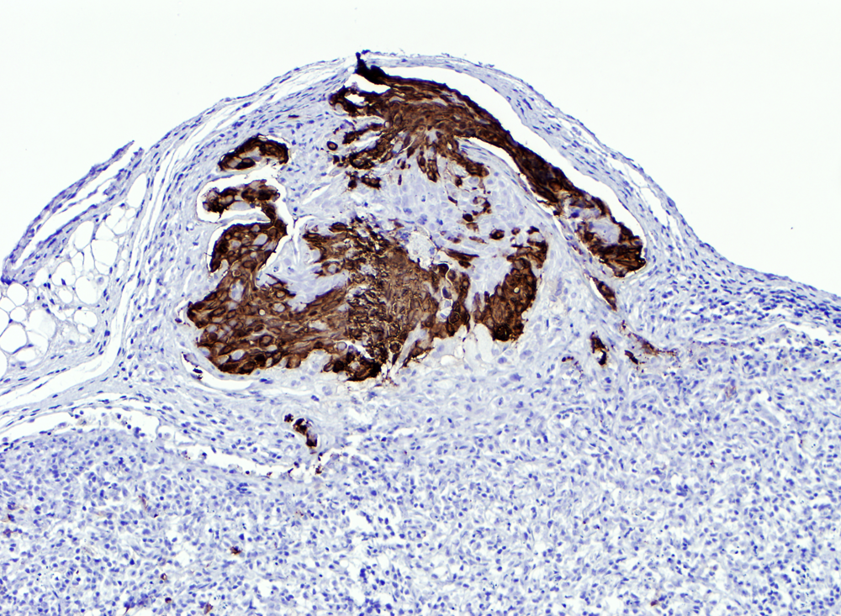
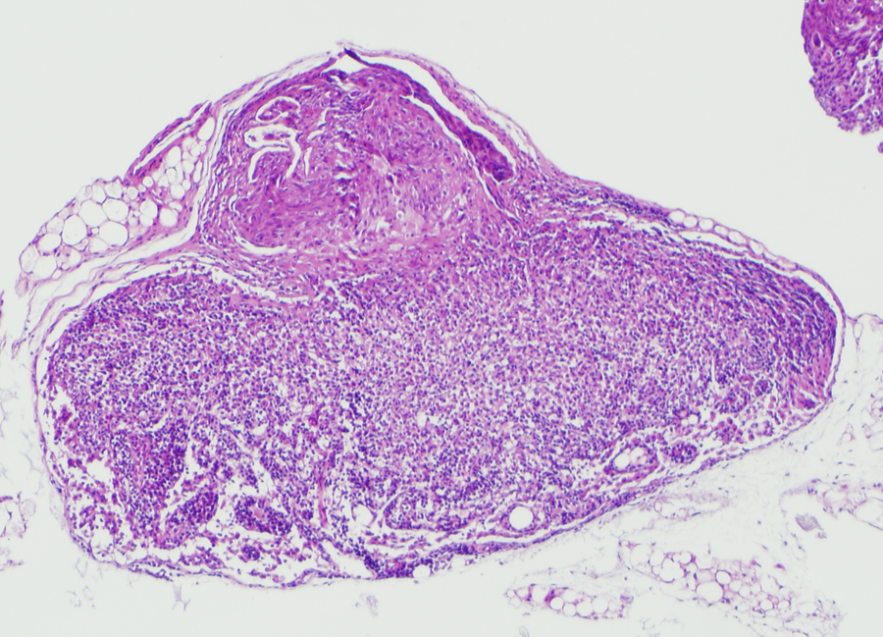
２） Established biological function
Actinin-4 promotes metastasis
ACTN４
L
L
L
P

Slide 8
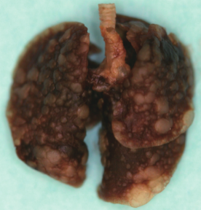
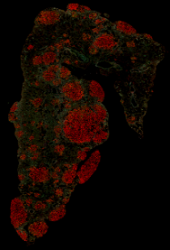
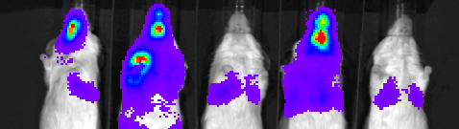
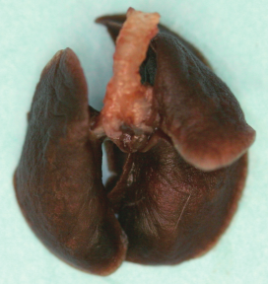
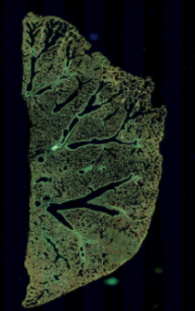
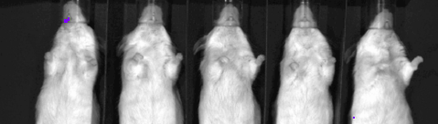
２） Established biological function
Inhibition of metastasis by lung cancer cells
with ACTN4 gene amplification
Control
shRNA to ACTN4
Notes:
In vivo bioluminescence imaging revealed that A549-luc-C8 cells formed marked metastases in the lungs and other organs following injection into the tail veins of immunodeficient mice,

Slide 9
３） Prognostic significance
Exceeds the standard TNM staging
Stage I (n=290)
Stage I (n=290)
100
100
80
FISH-negative
(n=267)
80
Stage IA
(n=184)
Stage IB
(n= 106)
60
60
Overall Survival (%)
FISH-positive
(n = 23)
Overall Survival (%)
40
40
20
20
0
P=1.70x10⁻¹⁰
0
P=6.99x10⁻⁵
0
20
40
60
80
100
120
140
0
20
40
60
80
100
120
140
Months
Months
5-yr OS rate (95% CI):
5-yr OS rate (95% CI):
FISH-negative
95% (82-98%)
FISH-positive
57% (39-84%)
Stage IA
97% (94-100%)
Stage IB
81% (72-90%)
Notes:
Its degree of discrimination exceeded that of the current standard TNM staging.

Slide 10
４） Multivariate analysis
Exceeds the standard TNM staging
Notes:
The hazard ratio for death in FISH-positive cases was ● 6.78 and ● clearly exceeded that of TNM staging.

Slide 11
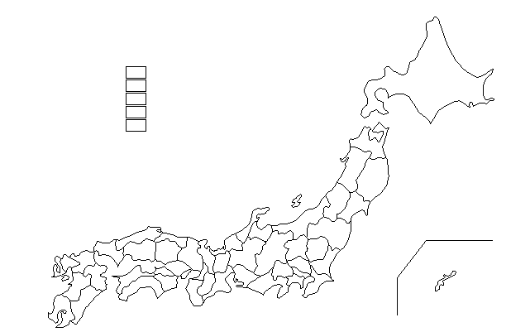
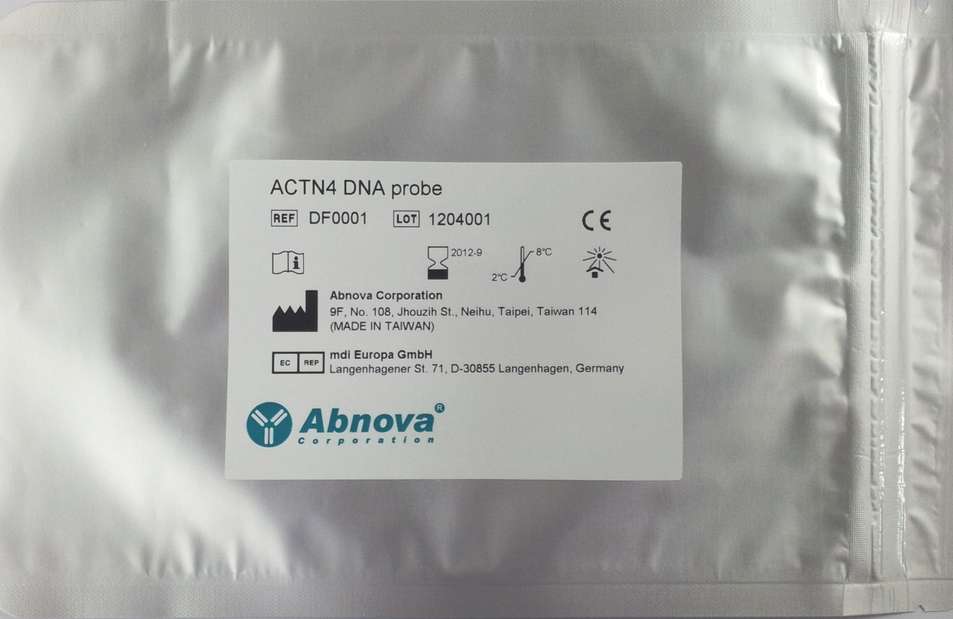
５） Independent validation
Discovery
Validation in 2 institutions
Training cohort
Tissue microarray (TMA)
543 cases (stages I-IV)
NCC Central Hospital
(1997-2009)
Cohort 1 (total 540 cases) :
372 cases (stage I)
168 cases (stage II or III)
NCC Central Hospital (1997-2001)
Cohort 2:
214 cases (stage I)
NCC Central Hospital (2001-2003)
NCC East Hospital
Cohort 3:
447 cases (stage I)
NCC East Hospital (1993-2005)
NCC Central Hospital
GMP-grade FISH probes
Total: 1201 cases
Notes:
The prognostic significance of ACTN gene amplification was further validated in 3 independent cohorts, totaling 1744 patients.

Slide 12
CTC (circulating tumor cells)
The process of metastasis
Metastasis
Primary tumor
Dissociate
Reconstitute
CTC

Slide 13

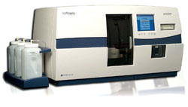

CTC (circulating tumor cells)
CytoQuest™ CR System

Slide 14
Detection of CTC (circulating tumor cells)
in surgical cases

Slide 15
CSC marker expression by CTC
Characterized by high tumorigenicity
Metastasis
X
Reconstitute
CSC

Slide 16
Involvement of Wnt signaling in CSCs
CD44
Lgr5/Gpr49

Slide 17
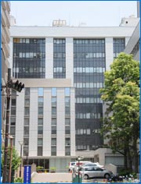
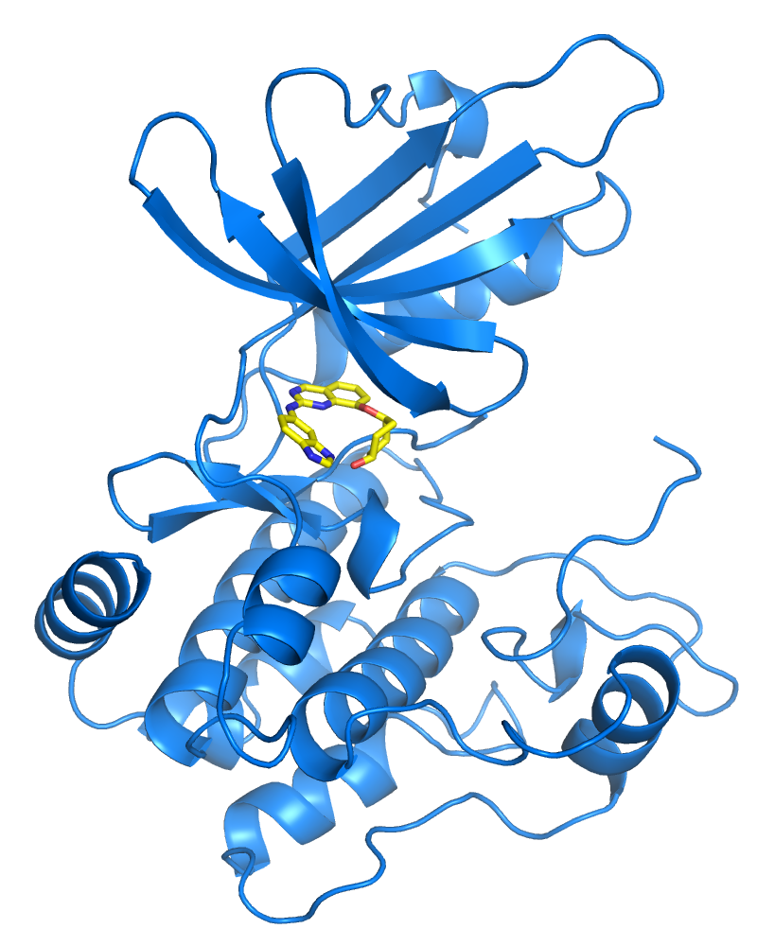


Development of an anti-Wnt therapeutics, NCB-0846
2008
2010
2013
Compound
screening
Compound
optimization
Target
discovery
Compound
screening
Compound
optimization
IC50 = 21 nM
Diastereomer
NCB-0846
ATP-binding
pocket
TNIK, Traf2 and Nck-interacting protein kinase

Slide 18
NCB-0846 targets cancer stem cells (CSCs)
● Suppression of CSC gene expression
● Reduction of CSCs
DMSO
NCB-0846
(1 μM)
NCB-0970
(1 μM)
● Suppression of tumorigenicity
CD24-Alexa 647
CD166-PE
(CD44, CD133, CD24, CD166)

Slide 19
Inactivation of actinin-4 by NCB-0846
DMSO NCB-0846 NCB-0970
(control) (diastereomer)
● Suppression of membrane ruffling
● Suppression of stress fiber formation
● Nuclear translocation of actinin-4

Slide 20
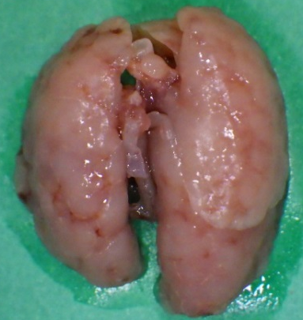
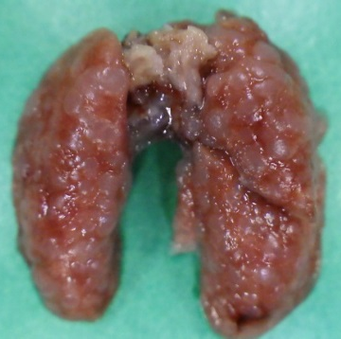
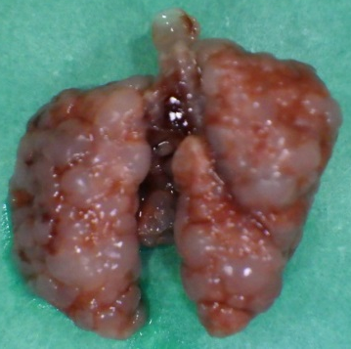
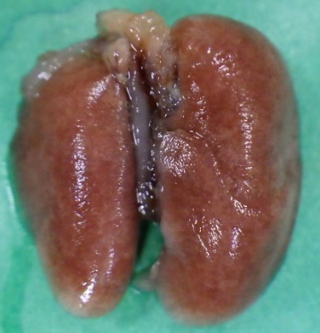
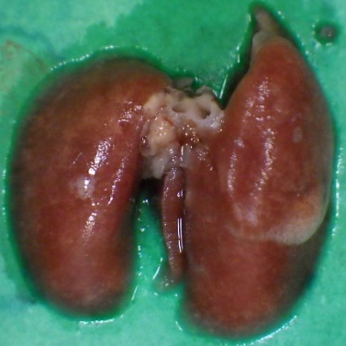
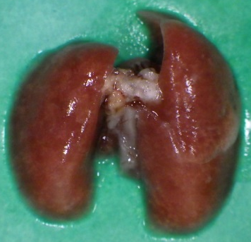
Suppression of metastasis
DMSO
(control)
NCB-0846

Slide 21
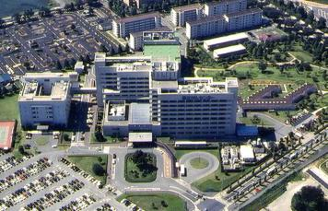

Development of NCB-0846
2008
2010
2013
2017
Target
discovery
Compound
screening
Compound
optimization
Preclinical
Phase I
Phase II/III

