Slide 1
Mass Spectrometry-based Targeted Quantification for Protein Biomarker Verification
Fourth Annual US Japan Workshop on Cancer Biomarkers in Collaboration with NCI Early Detection Research Network
Karin D. Rodland, Ph.D.
Chief Scientist for Biomedical Research, PNNL
Affiliate Professor, Cell, Developmental and Cancer Biology OHSU
March 6th, 2017

Slide 2
Translating Proteomic Discoveries to the Clinic: the Biomarker Problem
There is an unmet clinical need for biofluid biomarkers for early detection of ‘silent’ cancers, such as cancers of the ovary or pancreas
Multiple laboratories have been funded to identify potential biomarkers, generating long lists of candidates
  Discovery strategies have included transcriptome profiling, genome-level analyses, and proteomic studies
  There is a need to convert candidate lists to protein-based assays and prioritize for development of affinity reagents
Use of targeted proteomics can rapidly identify good-performing candidates without the need for affinity reagents
The Goal: Help Poor Performing Candidates Fail Quickly and Cheaply

Slide 3
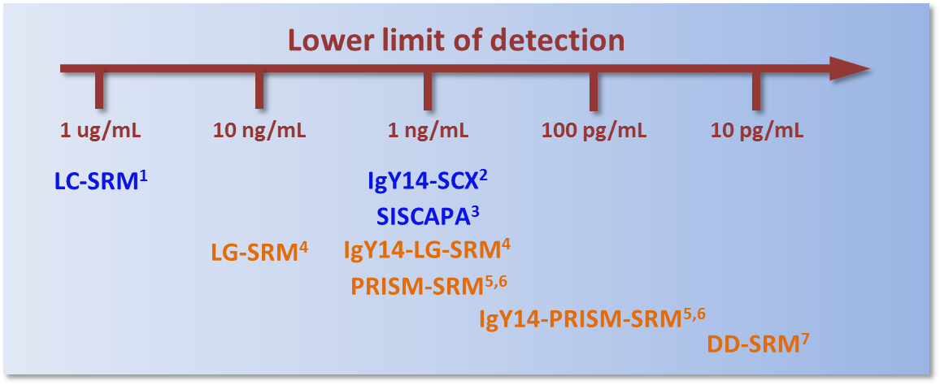
Targeted MS Assays (SRM) Increase Sensitivity and Provide Specificity
Using 10-200 µL of blood plasma or serum
Other platforms
PNNL platforms (Ab-independent)
¹Anderson et al., Mol Cell Proteomics. 2006, 5, 573-588
²Keshishian et al., Mol Cell Proteomics. 2007, 6, 2212-2229
³Whiteaker et al., Mol Cell Proteomics. 2012, 11, M111.015347
⁴Shi et al., Anal Chem. 2013, 85, 9196-9203
⁵Shi et al., Proc Natl Acad Sci. 2012, 109, 15395-15400
⁶Shi et al., J Proteome Res. 2013, 12, 3353-3361
⁷Nie et al., in preparation

Slide 4
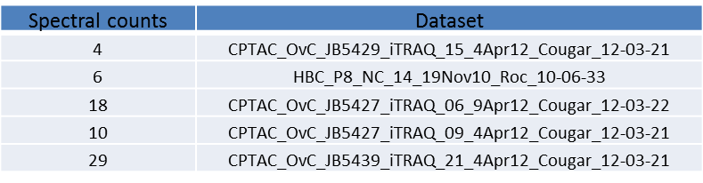
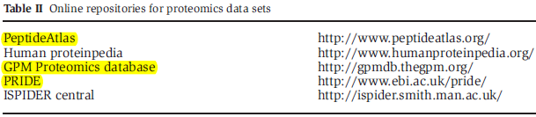

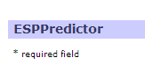
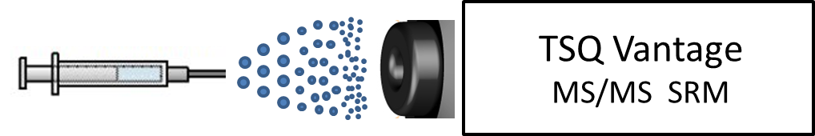
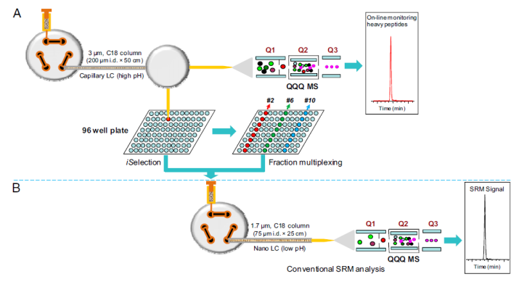
Procedure for Developing SRM Assays
PNNL data
Online database
Prediction tools
Peptide selection:
Direct infusion
CE and transition optimization:
Scheduled SRM
LC-SRM:
PRISM SRM
PRISM-SRM:

Slide 5
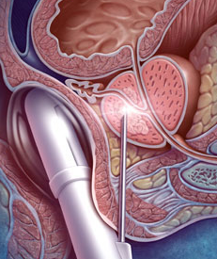


The Early Detection Problem in Prostate Cancer:
Discriminating Indolent from Aggressive Disease
How can one improve the ability of the PSA assay to distinguish between benign and aggressive disease?
  Free versus bound PSA
  PSA processing variants
What is the role of the TMPRSS2:ERG fusion in prostate cancer biology?
Can proteomics identify a panel of biomarkers with improved predictive ability?

Slide 6
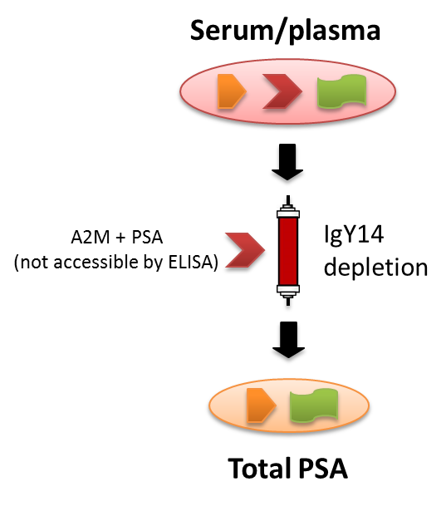
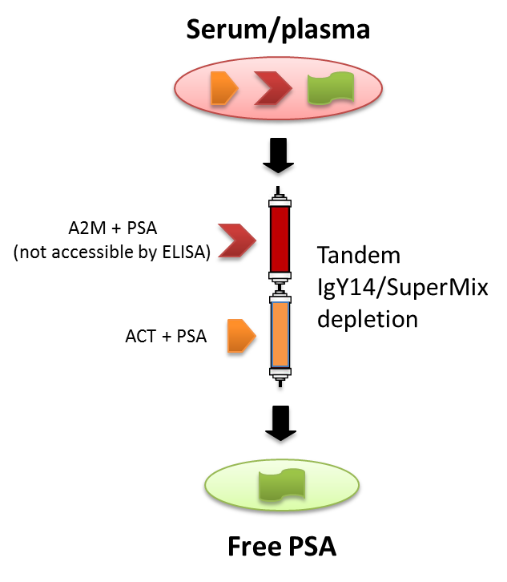
Analysis of Serum Total and Free PSA Using Immunoaffinity Depletion Coupled to LC-SRM
Low ng/mL levels were achieved for both total and free PSA analysis
Good correlation of SRM and immunoassay results of total PSA measurements for a set of 33 blinded clinical serum samples
PRISM SRM performed as well, in both sensitivity and accuracy, as a CLIA-approved ELISA for PSA
Liu et al. J Proteomics. 2012, 75, 4747-4757

Slide 7
Simultaneous Quantification of proPSA Isoforms in Prostate Patient Urine Using LG-SRM
PSA
(-2) proPSA
(-4) proPSA
(-5) proPSA
(-7) proPSA
Heavy (IS)
Light
Shi et al., unpublished results

Slide 8
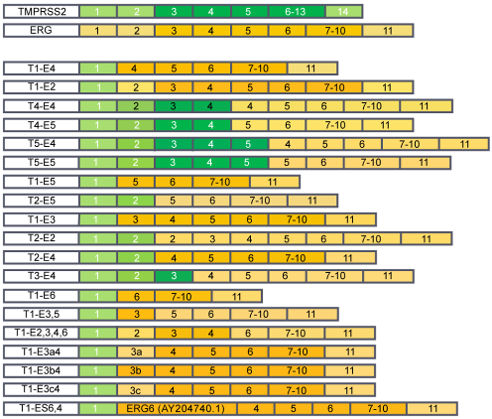
Identifying TMPRSS2:ERG fusions products
TMPRSS2:ERG fusion variants
Occurs in ~45% of prostate cancers
~100% specificity for prostate cancer
Current assays rely on PCR or FISH
Lack of good antibodies against ERG protein
John et al. J Cancer Sci Ther. 2012, 4: 94-101.
Notes:
Sets up the T2:ERG fusion protein as a target for SRM assays; illustrates multiplicity of possible isoforms

Slide 9
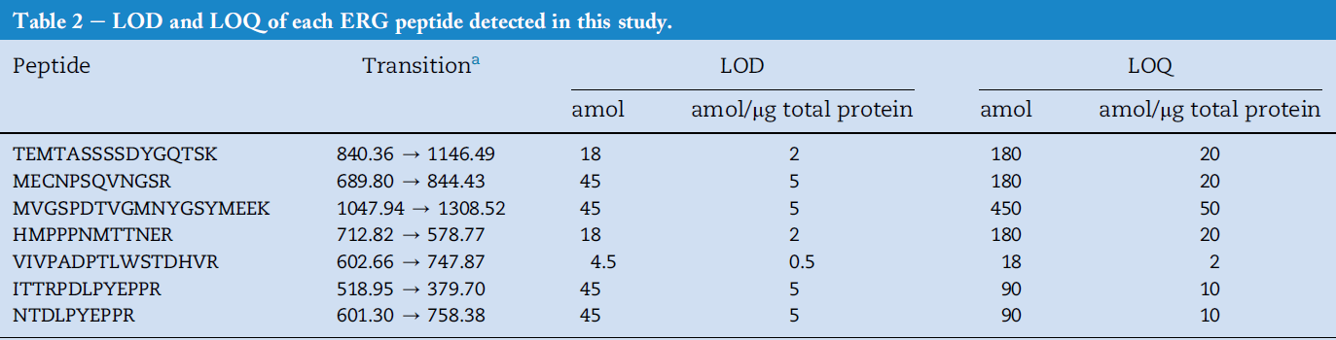
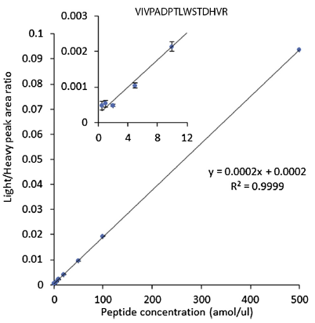
Sensitive Detection of TMPRSS2-ERG Fusion Protein Products Using PRISM-SRM
#
#
#
*
*
Range for LOD (0.5-5 amol/µg total protein) and LOQ (2-50 amol/µg total protein)
Three “shared” peptides as signature peptides for detection of T2ERG fusion
Highly correlated with T2ERG fusion status (in both patient tissues and cell lines)
For the first time, detection of two distinctive ERG protein isoforms simultaneously expressed in T2ERG-positive tissues
#
*
He et al., Mol Oncol. 2014, 8, 1169-1180

Slide 10
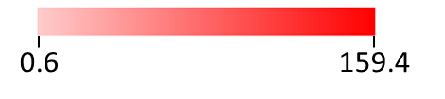
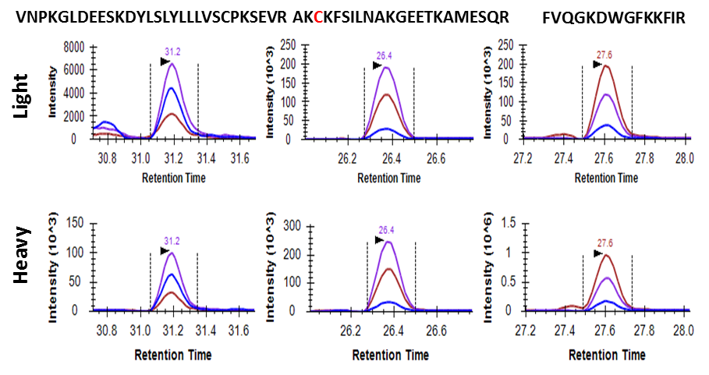
Identification of Specific SPOP Mutations:
SPOP Peptide | WT | Y87N | F102C | F133V
VNPKGLDEESKDYLSLYLLLVSCPKSEVR | 0.6 |  | 10.1 | 0.8
VNPKGLDEESKDYLSLNLLLVSCPKSEVR |  | 10.3
AKFKFSILNAKGEETKAMESQR | 1.2 | 26.1 |  | 1.9
AKCKFSILNAKGEETKAMESQR |  |  | 54.2
FVQGKDWGFKKFIR | 0.7 | 12 | 15.3
FVQGKDWGVKKFIR |  |  |  | 0.9
LADELGGLWENSR | 2.2 | 26.8 | 35.4 | 2.6
SLASAQCPFLGPPR | 10.8 | 122.4 | 159.4 | 13.0
Example: F102C mutation
fmol/µg of total protein
Applying PRISM-SRM assays to analyze HEK293 cells with the expression of WT and three most frequent SPOP mutations in prostate cancer led to confident detection of all three SPOP mutations in the positive cell lines, but not in the negative cell lines.
Wang et al., in preparation
Notes:
LOD for peptides: (in fmol/ug)
VNP wt : 0.4 mutant 0.2
AKF wt 0.5; mutant 0.5
FVQ wt 0.2 mutant 0.1
WT CONTROL PEPTIDES (selected for performance)
LADEL 0.05 SLAS 0.05

Slide 11
Demonstrated Capabilities of Targeted Proteomic Assays
Total and free PSA in plasma/serum and PSA & proPSA in urine
TMPRSS2:ERG fusion proteins in cells, tissues, urine, and urine sediment
ETV1 fusion in cells and tissues
SPOP mutations in cells and tissues
Liu et al. J Proteomics. 2012, 75, 4747-4757
He et al. Mol Oncol. 2014, 8, 1169-1180
He et al. J Transl Med. 2015, 13, 54

Slide 12
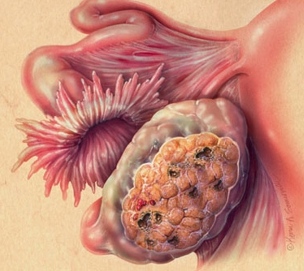
The Early Detection Problem in Ovarian Cancer
The Early Detection Problem:
5 year survival is 90-94% for Stage I-II 17-39% for Stage III-IV
BUT: only 20% of ovarian cancers are detected early, at Stage I-II
Ovarian Cancer is rare
Prevalence of 1 in 2500 imposes constraints on population-based screening
Need a positive predictive value (PPV) ~ 10% for a reasonable ratio of procedures (laparoscopy) to true positives
Requires high specificity and sensitivity
The current serum biomarker, CA125, had a PPV of ~6.5% in PLCO study

Slide 13
EDRN’s Ovarian Cancer Biomarker Validation Study
150+ ovarian cancer candidates from all Breast/Gyn EDRN sites
Diamandis
Godwin
LaBaer
Li
Lokshin
Marks
Skates
Bioinformatics (in silico) mRNA filter
61 Candidates
61 SRM Assays
PNNL (BRL)
Cases vs. Benign at Diagnosis – rule out
Early Detection Biomarkers
12 candidates x Longitudinal ROCA samples

Slide 14
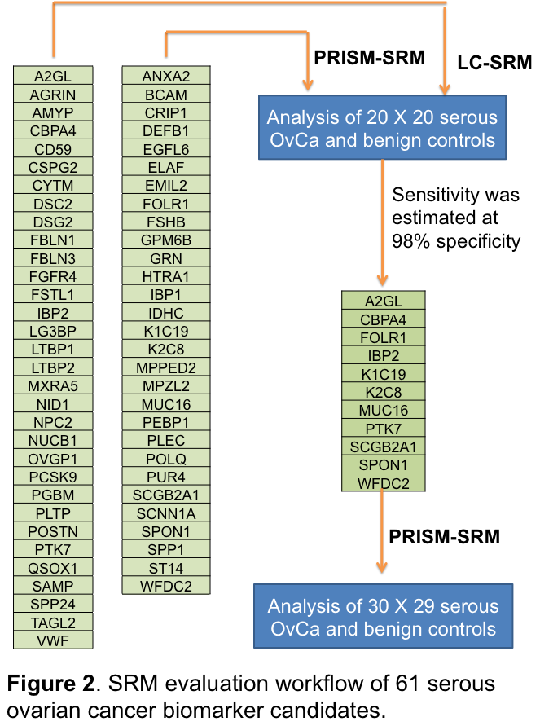
SRM evaluation of 61 candidate OvCa biomarkers
Candidate ovarian cancer biomarkers representing consensus of the ovarian cancer BDLs
Assay development
  PNNL developed multiplexed SRM assays for candidates lacking antibodies
SRM assays validated on EDRN Serum Set
  32 candidates validated by LC-SRM and 29 candidates by PRISM-SRM
  50 ovarian cancer cases and 50 matched controls
  Determined sensitivity at 98% specificity
A final set of 8 promising protein biomarker candidates submitted for Luminex analysis at JHU
K1C19
WFDC2
MUC16
A2GL
CBPA4
SPON1
FOLR1
K2C8
Notes:
32 detectable by LC-SRM
30 required PRISM-SRM

Slide 15
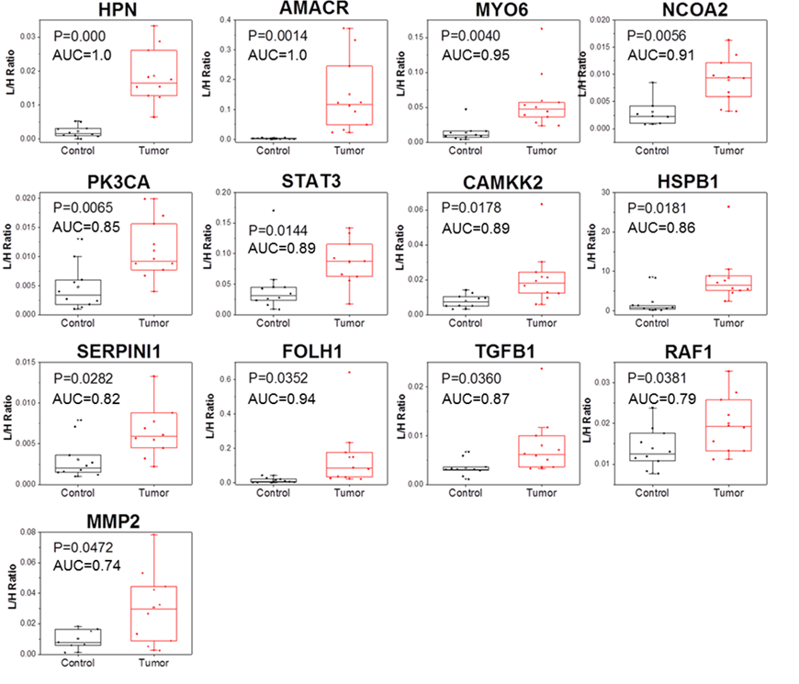
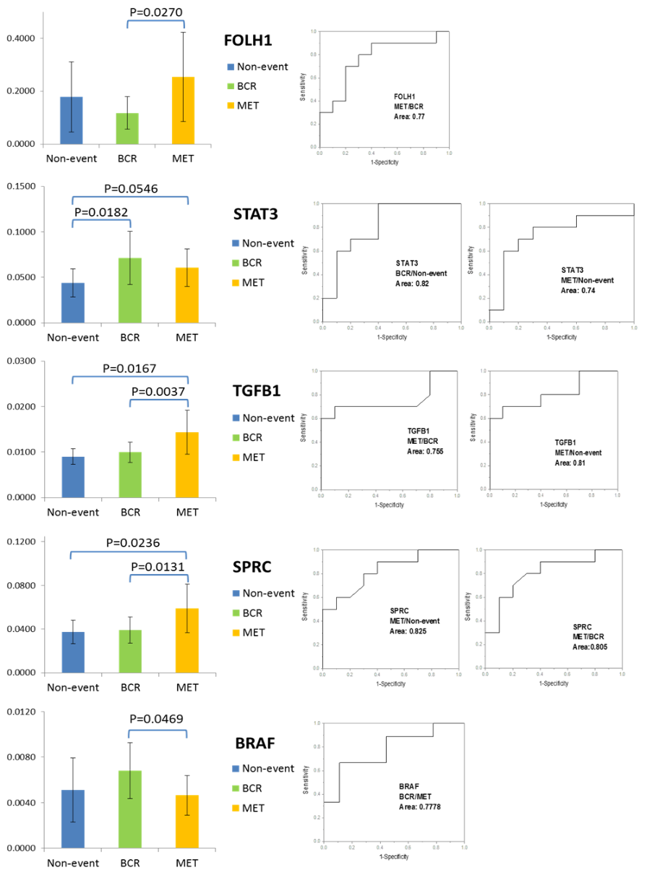
Multiplexed Analysis of 52 Biomarker Candidates for Progression in Prostate Tissues
Gleason 7-9 vs. BPH
BCR vs. Met vs. Non-event
42 out of 52 proteins were detected and compared in 10X10X10 FFPE samples
5 proteins showed promising results in the preliminary analysis

Slide 16
Conclusions
Large jump from intra-cellular transcriptome candidates to:
  Protein over-expression
  Secretion
  Over-expression in peripheral circulation
Genomics identifies Proteomics qualifies
Large attrition rate
  61 candidates, 50 failed >80% attrition rate
Impossible to predict from mRNA level, requires proteomics

Slide 17
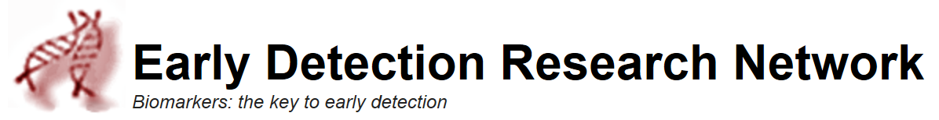


Acknowledgements
PNNL Integrative Omics group
Tao Liu (Co-PI)
Jintang He, Hui Wang, Yuqian Gao
Tom Fillmore, Athena Schepmoes
Tujin Shi, Wei-Jun Qian
Richard Smith
David Camp (retired)
Funding Support
IAA-ACN15006-001
Collaborators
Shiv Srivastava (CPDR)
Ian Thompson (UTHSCSA)
Arul Chinnaiyan, John Wei (UMich)
Mark Rubin (Cornell)
Alvin Liu (UW)
Daniel Chan, Zhen Zhang (JHMI)
U24-CA-160019
P41GM103493

Slide 18
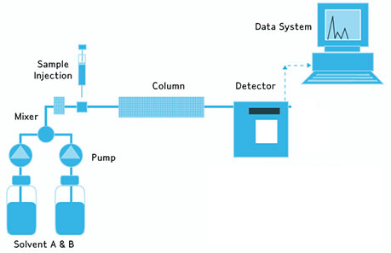
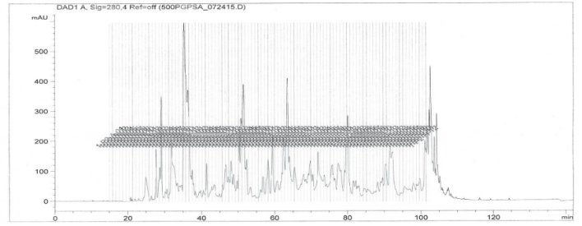
Pushing the Limits of Sensitivity: Deep Dive SRM
Loading:
200 uL plasma/serum
1-5 mg tissue/cell lysate
Low pH RPLC
4.6 X 250 mm
increased sample loading
concentrated target peptides
reduced interference
ultrahigh sensitivity
high reproducibility
high recovery
High pH cRPLC
Low pH cRPLC
Nie et al., in preparation

Slide 19
Detection of Four Cytokines by DD-SRM in Non-depleted Serum from Healthy Individuals
17.0 pg/mL
21.9 pg/mL
The protein concentrations listed are from other reports, measured by ELISA
7.2 pg/mL
7.3 pg/mL
Nie et al., in preparation

Slide 20
Detection of Low-abundance Cellular Proteins by DD-SRM in Ovarian Tumor Tissue
tissue sample loading amount: 1 mg
~20 copies/cell

Slide 21
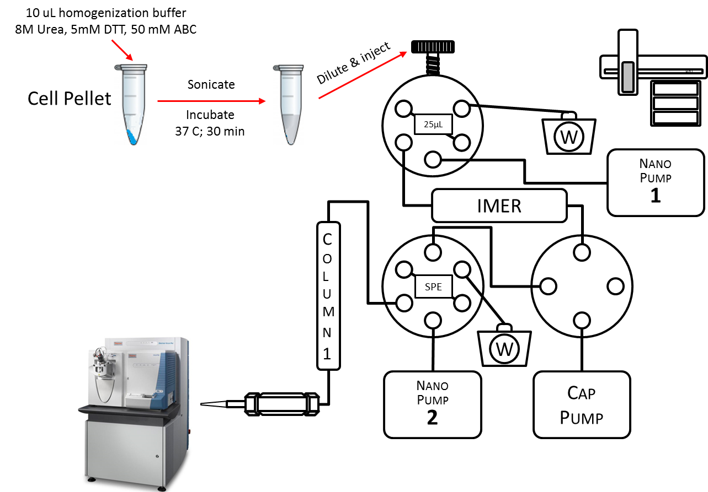
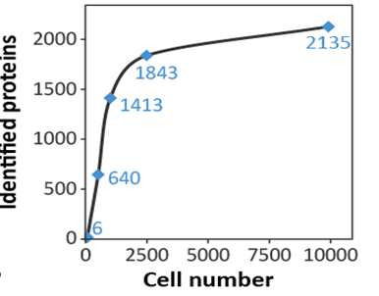
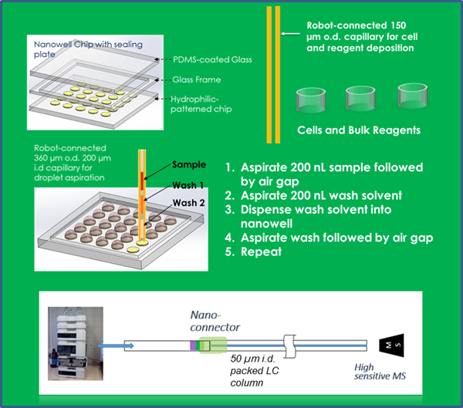
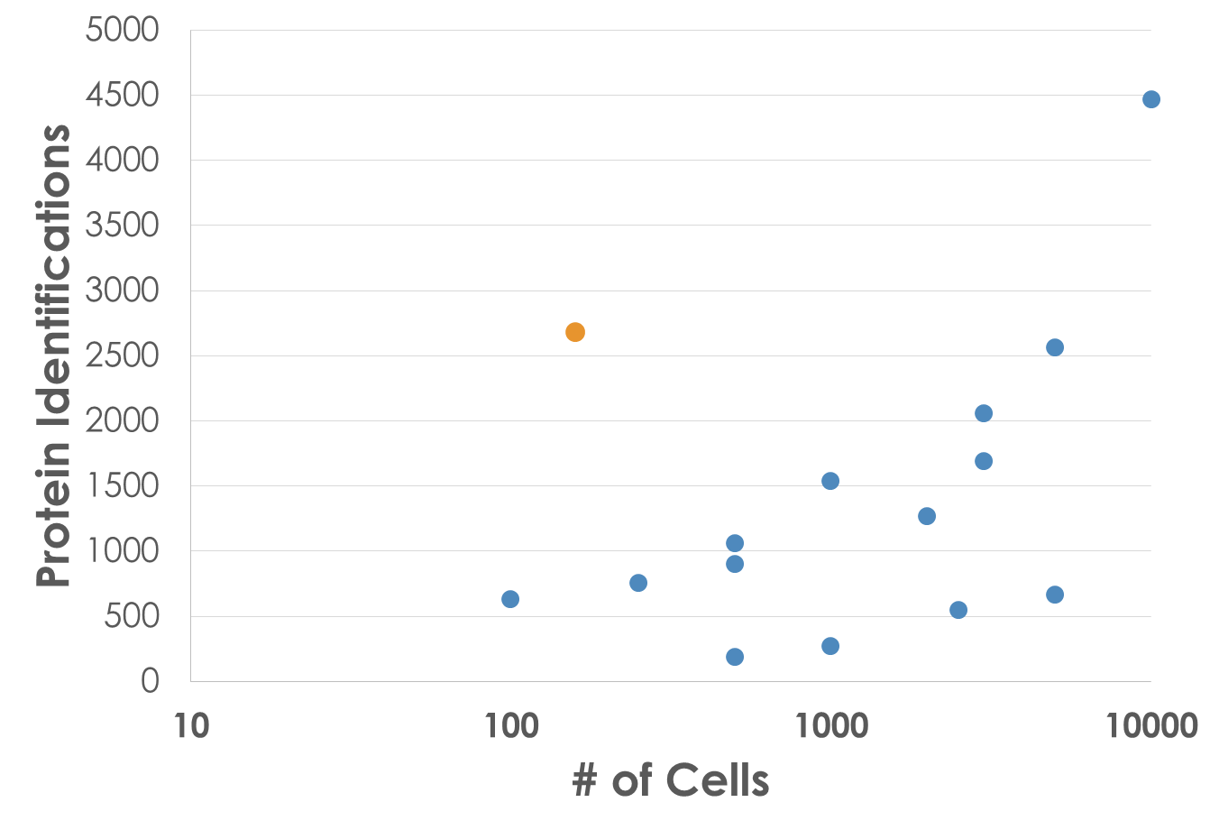
For Small Samples: ‘Nano’ Sample Processing
SNaPP
Huang et al., Endocrinology. 2016, 157, 1307-1314
Piehowski et al., unpublished
Nanowell
Nanowell
Zhu et al., Anal Chem. 2013, 85, 6723-6731
Zhu et al., unpublished results

