Slide 1

Expanding Global Problem of Liver Cancer
John D. Groopman
Anna M. Baetjer Professor Environmental Health Sciences
Johns Hopkins Bloomberg School of Public Health
Associate Director for Population Sciences
Sidney Kimmel Comprehensive Cancer Center
Johns Hopkins School of Medicine

Slide 2
Epidemiology of Liver Cancer: Present and Future Predictions

Slide 3
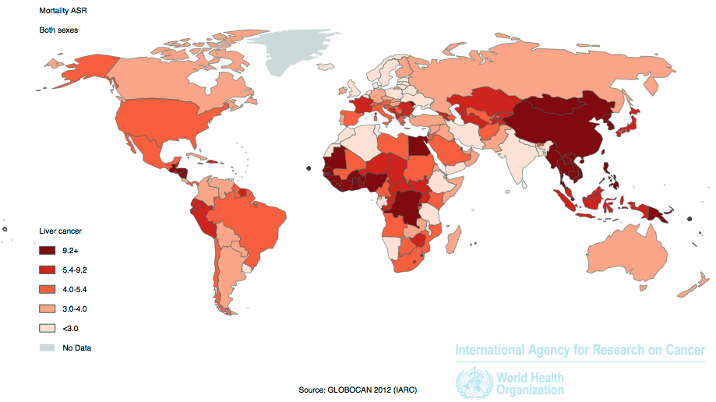
Liver Cancer Mortality
Liver cancer is the 2nd leading cause of global cancer death;
most before age 50; 9.1% of total (2012)
>80% of HCC occurs in the developing world
~500 million HBV carriers worldwide
~160 million HCV infected people worldwide
~100 million liver cancer deaths in 21st century
etiology of 90-95% of liver cancer now known,
but exposures are changing, e.g. fatty liver disease
ANIMAL MODELS
HUMAN STUDIES
Determine relation of
biomarker to disease
outcome
Cross-Sectional
Longitudinal studies of
biomarkers
Modulation of
biomarker in disease
prevention studies
Case-Control
Cohort
Clinical Trials
VALIDATED
BIOMARKERS
746,000 deaths in 2012 (WHO)
[Baltimore 2012 population 621,342]

Slide 4
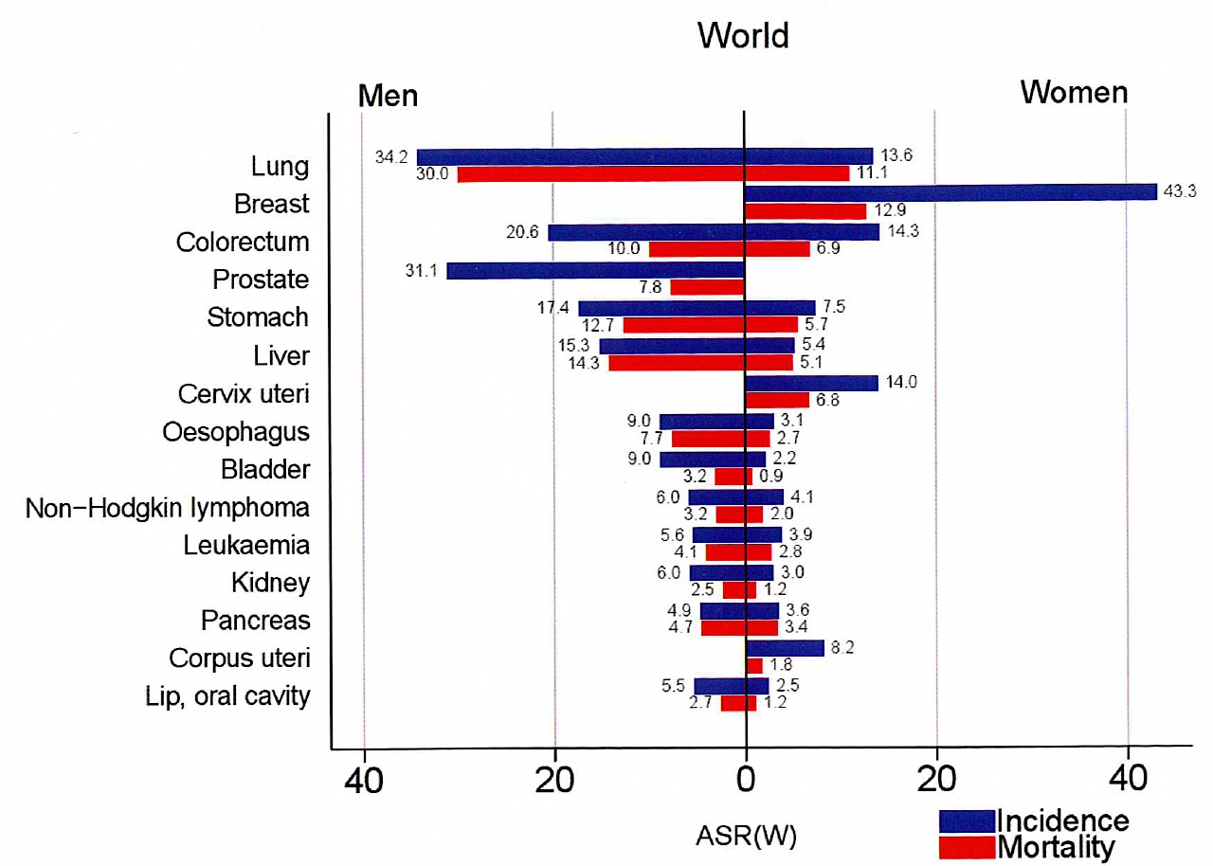
World Cancer Impact
World Cancer Report, 2014

Slide 5
Morbidity and Mortality for Liver Cancer
World Cancer Report 2014, IARC

Slide 6
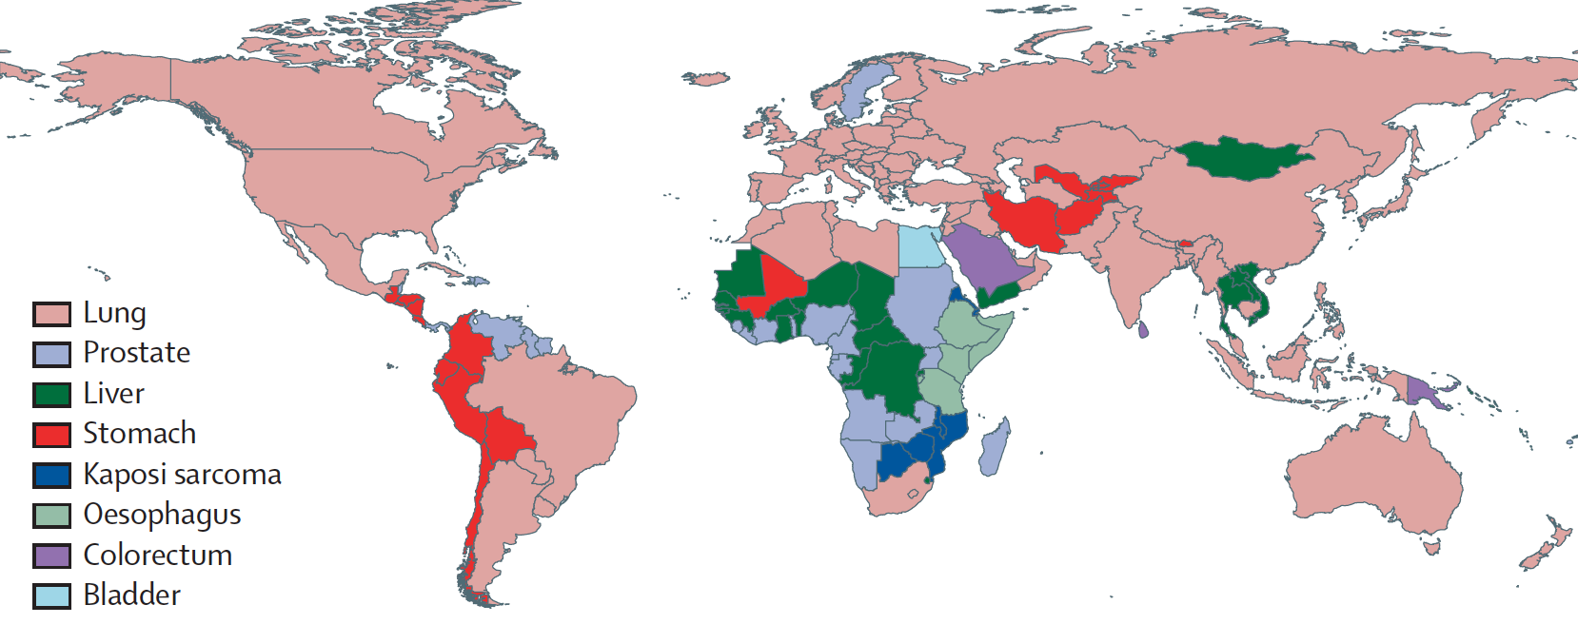
Leading Cancer Mortality in Men: Initiated between 1965-1985
Bray et al. Lancet Oncology, 2012

Slide 7
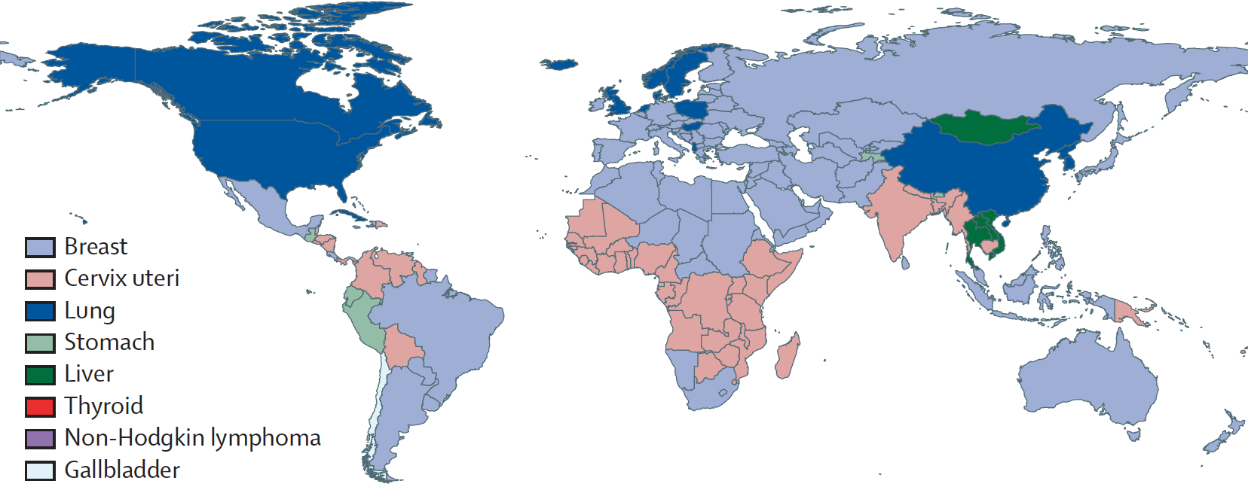
Leading Cancer Mortality in Women Initiated between 1965-1985
Bray et al. Lancet Oncology, 2012

Slide 8
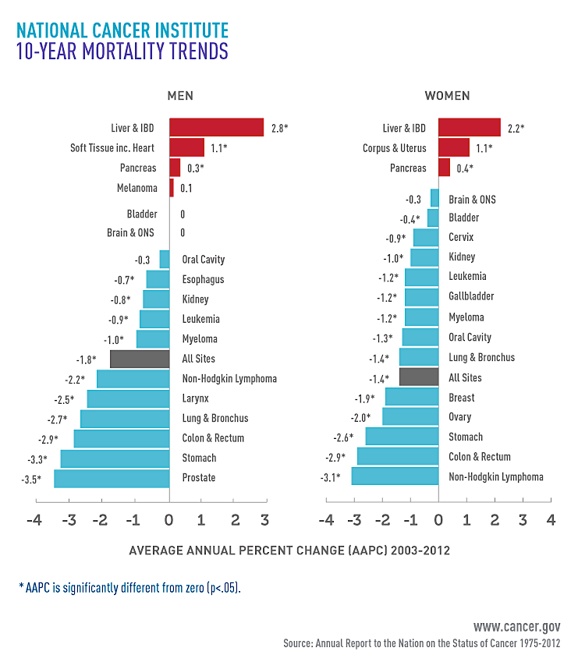

Slide 9
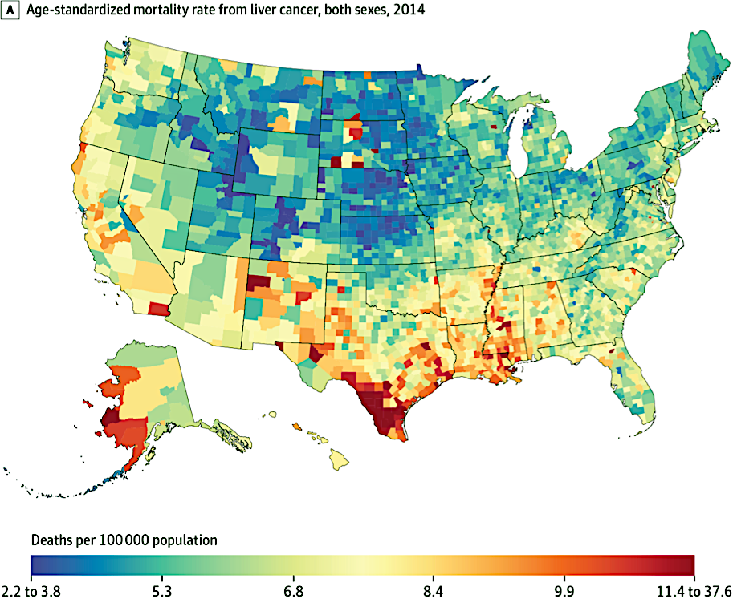
Age-standardized Mortality Rate from Liver Cancer, Both Sexes, 2014
Baltimore City ranks 15th highest liver cancer
of 3141 counties
JAMA. 2017;317(4):388-406. doi:10.1001/jama.2016.20324

Slide 10
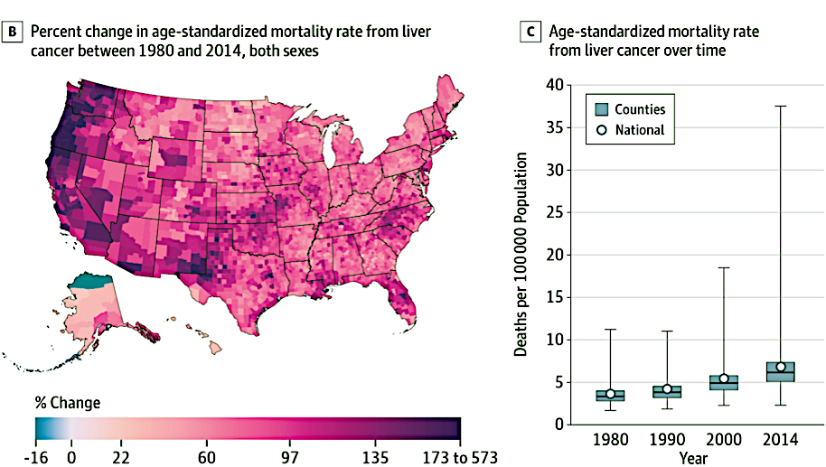
Percent Change in Mortality Rate from Liver Cancer, Both Sexes, 1980 to 2014
JAMA. 2017;317(4):388-406. doi:10.1001/jama.2016.20324

Slide 11
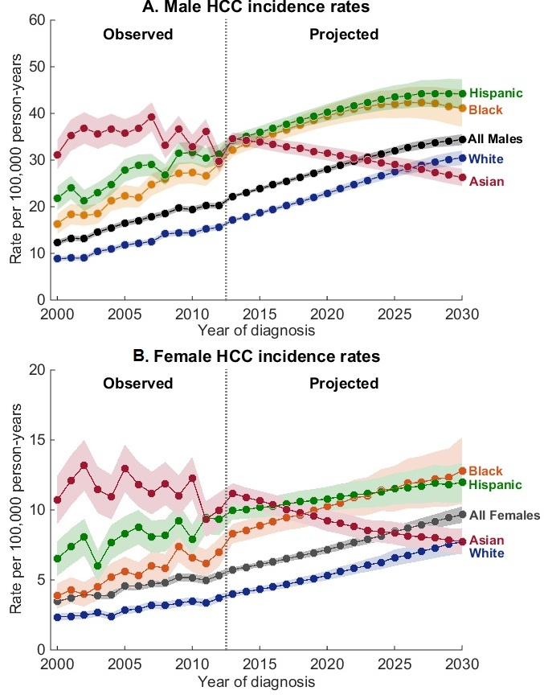
Petrick et al. JCO, 2016

Slide 12
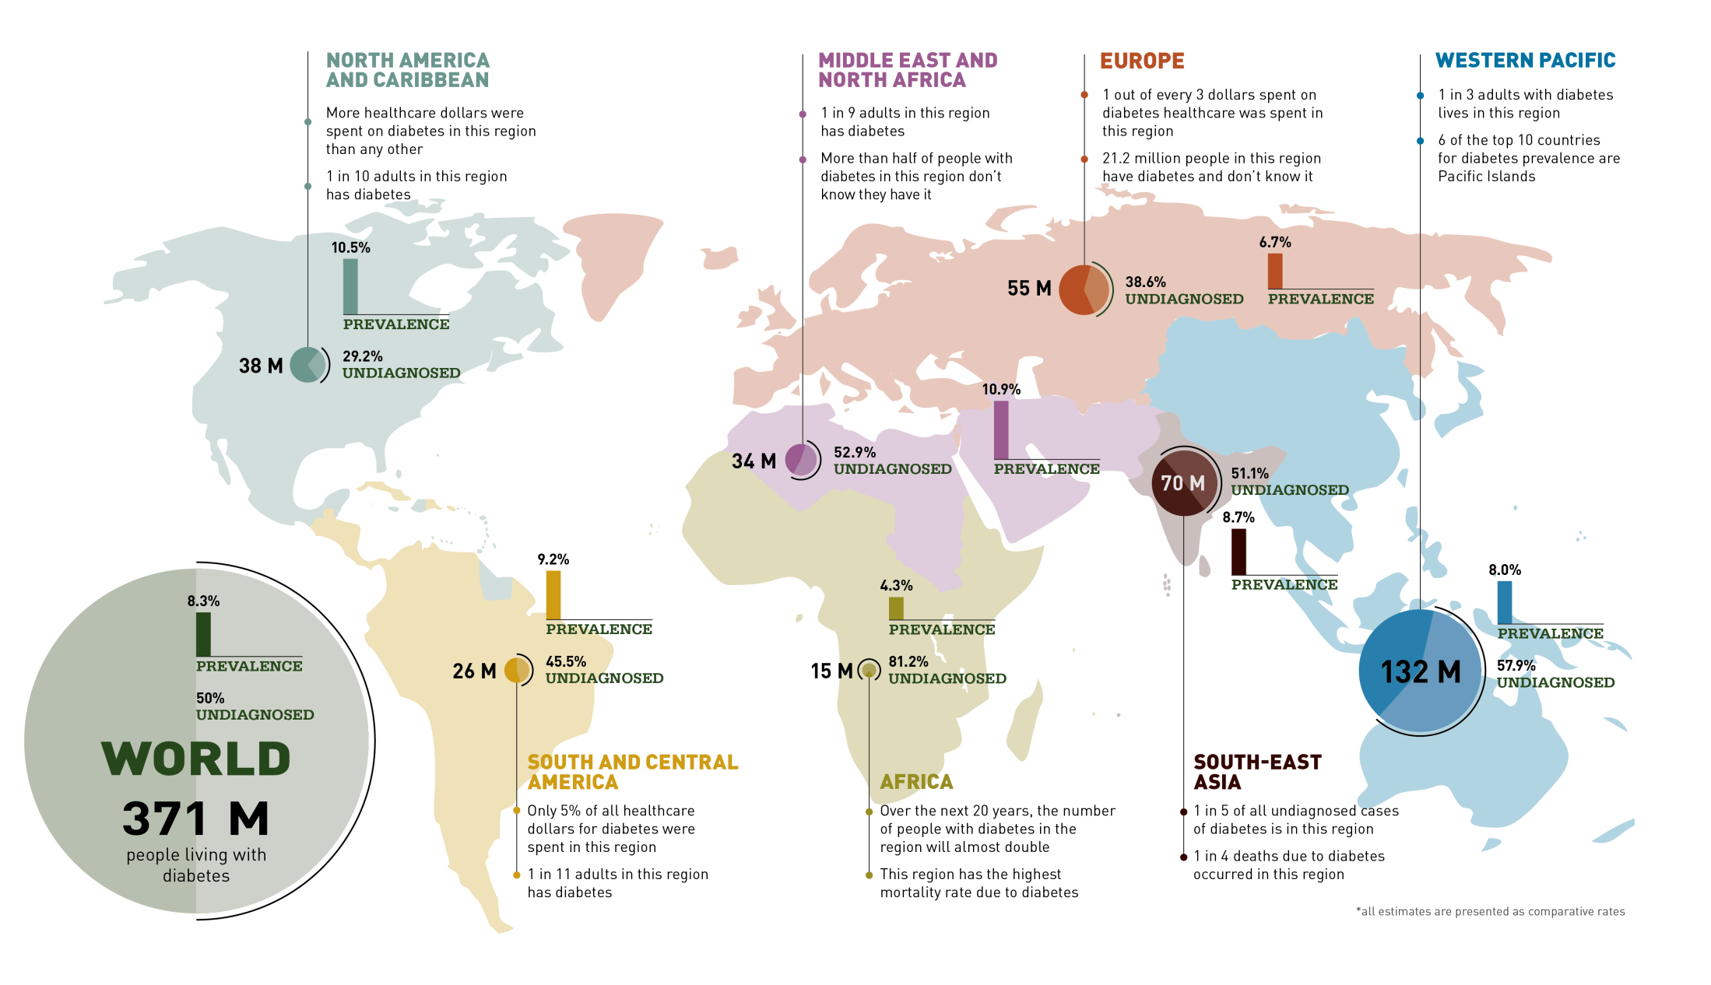
Global Burden of Diabetes
Thailand : type 2 Diabetes : 9.8% (InterAsia Study)
International Diabetes Foundation Atlas 5th Edition 2012

Slide 13
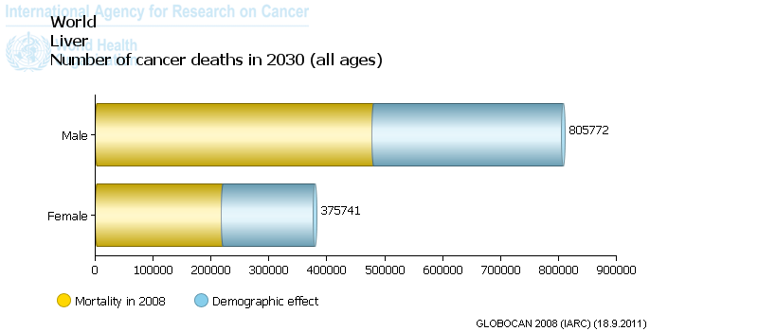
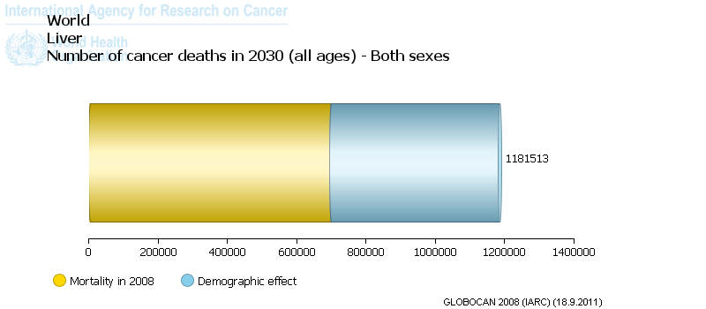

Slide 14
Etiology of Human Liver Cancer HBV HCV aflatoxins emerging factors: NAFLD, T2D, NASH

Slide 15
Recent Advances Using NexGen Sequencing: Biological Assay to Evaluate Environmental Mutagens

Slide 16
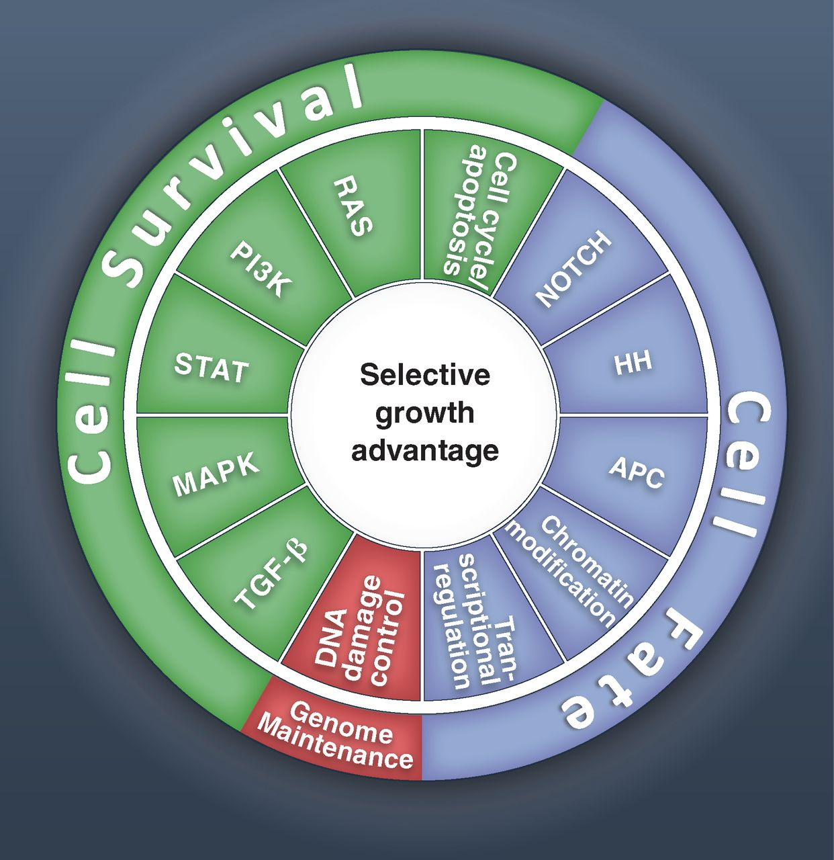

125 Mutated Driver Genes
61 Driver genes
55 Driver genes
~25000 tumors
sequenced
9 Driver genes
B Vogelstein et al. Science 2013;339:1546-1558
Published by AAAS
B Vogelstein et al. Science 2013;339:1546-1558
Notes:
Cancer cell signaling pathways and the cellular processes they regulate. All of the driver genes listed in table S2 can be classified into one or more of 12 pathways (middle ring) that confer a selective growth advantage (inner circle; see main text). These pathways can themselves be further organized into three core cellular processes (outer ring). The publications on which this figure is based are provided in table S5.

Slide 17
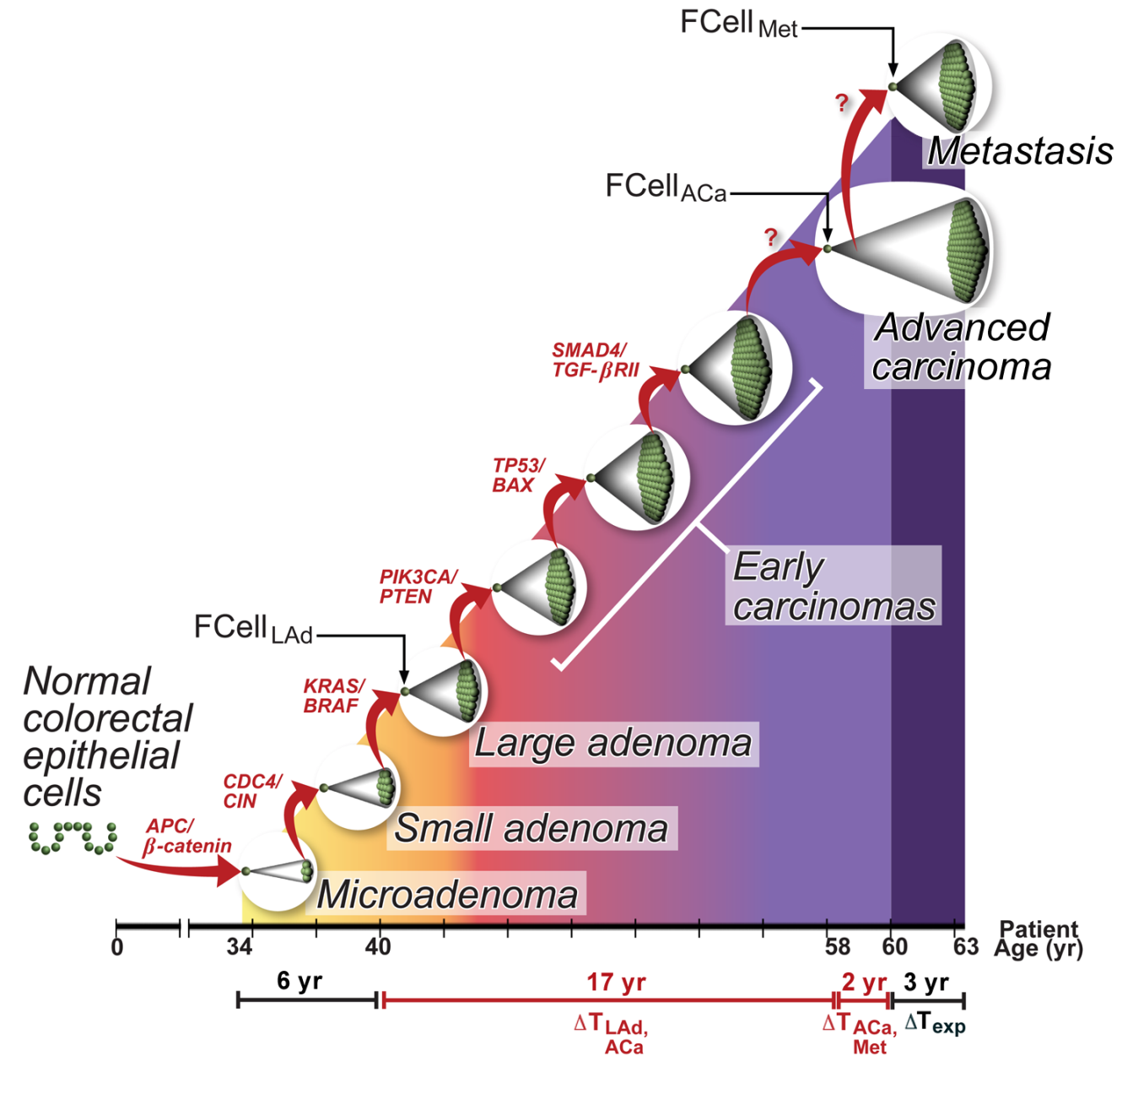
Tumor Evolution: Cancers of 2050 Already Initiated
t = 30 years: 90% prior to Dx
Therapy
Prevention
B. Vogelstein, 2011
Notes:
All the mutations are present in more advanced cancers

Slide 18
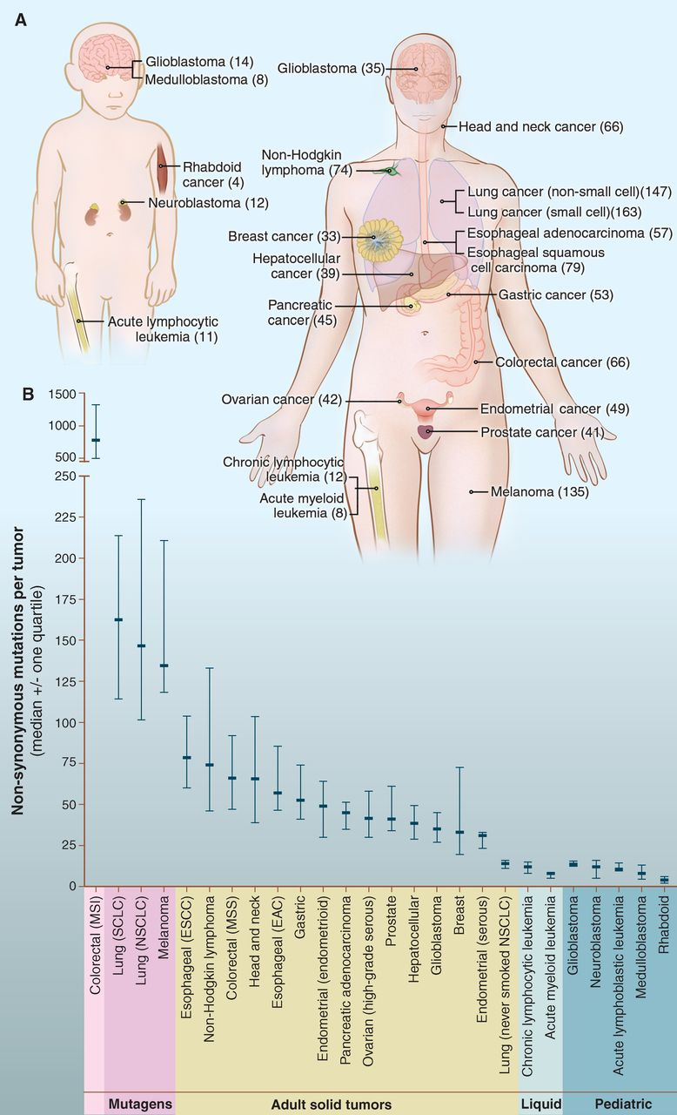
Somatic mutations in human cancers, detected by genome-wide sequencing studies.
Vogelstein et al. Science 2013;339:1546.
Notes:
Number of somatic mutations in representative human cancers, detected by genome-wide sequencing studies. (A) The genomes of a diverse group of adult (right) and pediatric (left) cancers have been analyzed. Numbers in parentheses indicate the median number of nonsynonymous mutations per tumor. (B) The median number of nonsynonymous mutations per tumor in a variety of tumor types. Horizontal bars indicate the 25 and 75% quartiles. MSI, microsatellite instability; SCLC, small cell lung cancers; NSCLC, non–small cell lung cancers; ESCC, esophageal squamous cell carcinomas; MSS, microsatellite stable; EAC, esophageal adenocarcinomas. The published data on which this figure is based are provided in table S1C.

Slide 19
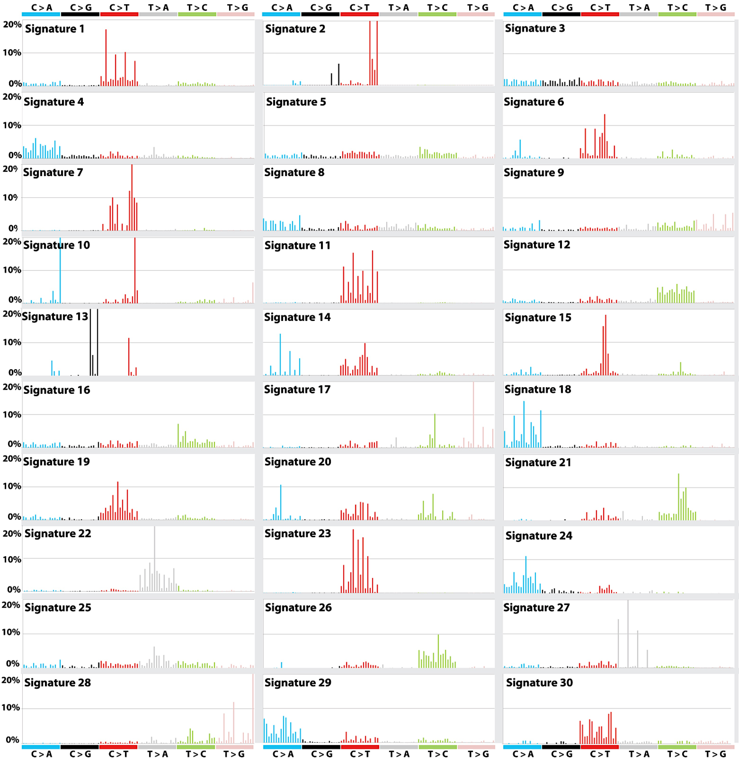
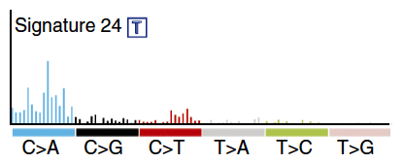
C:G → A:T
Our earlier work showed that aflatoxin adducts cause G → T mutations
MS 24. Nat Genet 47: 505-511, 2015.

Slide 20
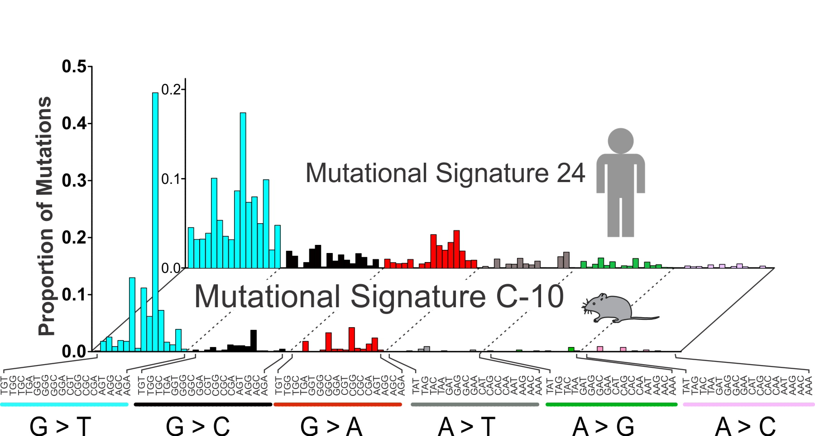
Mutational Signature of Aflatoxin (front) is Similar to Human Liver Cancer (back)
Sequencing technique is 10³-10⁴ x more error-free than current methods
Human cancer takes 20-30 years to develop
This signature is a biomarker we can use to develop disease prevention strategies and to guide environmental cleanup
MS 24. Nat Genet 47: 505-511, 2015.

Slide 21
Future Challenges: Not prioritized

Slide 22
Future Challenge 1
Morbidity and mortality is still almost 1:1.
Over the next 20 years more people will be diagnosed and managed with multiple chronic diseases, e.g. the cancer survivor with T2D, CVD, etc.
Our experimental studies lack the models needed to explore these mechanistic interactions.
The API population have been most greatly affected by early life infection with HBV that is now mitigated with immunization.

Slide 23
Future Challenge 2
Increasing fatty liver disease (NASH, NAFLD, ALD) are now creating the chronic inflammatory state that had been a hallmark of HBV infection.
HCV infections have greater control and cure breakthroughs.
Alcohol use is likely increasing in certain demographic groups, particularly veterans, in the US.

