Slide 1
The sTRA Glycan, a New Serological and Cellular Biomarker for Pancreatic Cancer
Brian B. Haab, PhD
Van Andel Institute
Fourth Annual US Japan Workshop on Cancer Biomarkers
March 6, 2017
Notes:
New biomarker both in blood and tissue
In identifies a separate subpopulation of cancer cells

Slide 2
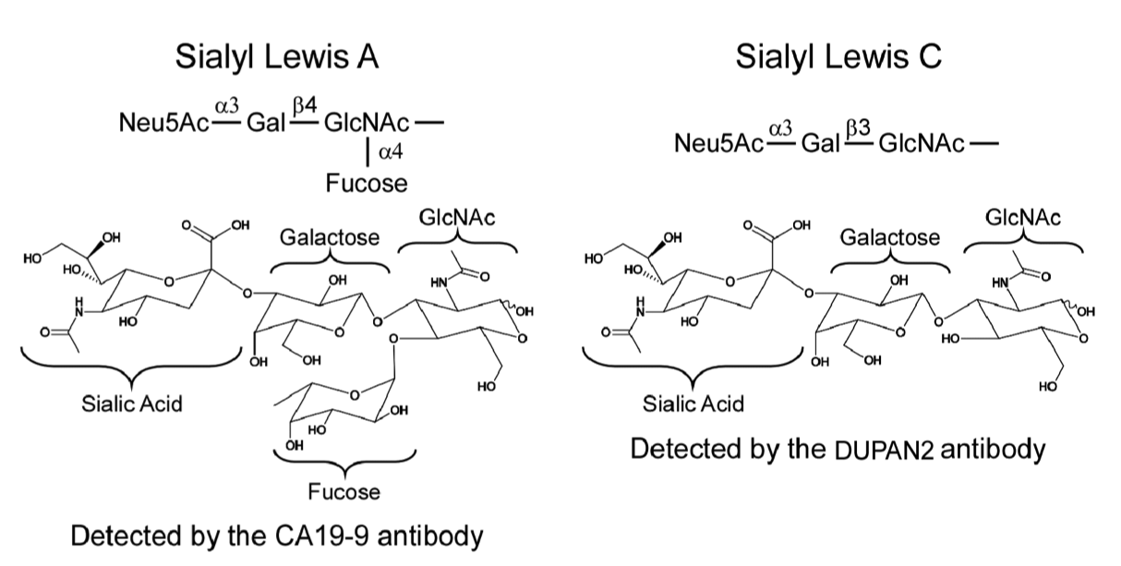
The CA19-9 antigen
New biomarker: sTRA
Detected by the TRA-1-60 mAb
After sialidase treatment
Detected by the CA19-9 antibody
Notes:
In approaching this problem, start with this marker
It has biological function, as do related structures
It is detected by an antibody. Perhaps related structures occur. Such structures would not be detected by the antibody

Slide 3
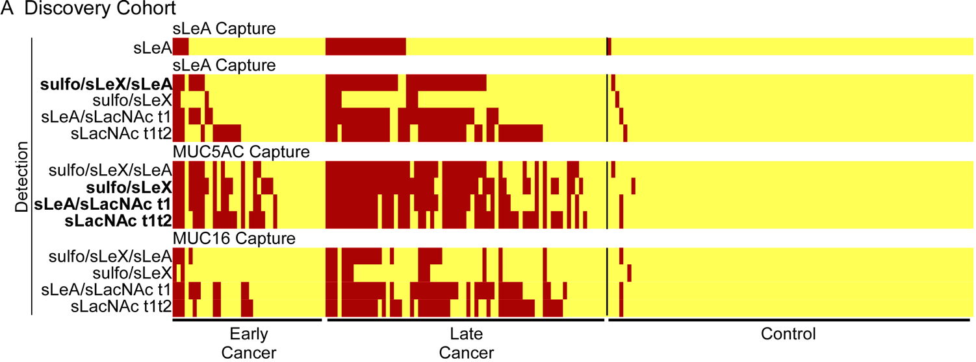
sTRA and CA19-9 are elevated in distinct subgroups
CA19-9
sTRA
Combined Cohorts
Three-marker panel: 85% sensitivity and 90% specificity
CA19-9: 54% sensitivity and 86% specificity
Notes:
We used a high-specificity threshold and saw elevations in CA19-9-low
Rates were similar in early-stage
A panel performed with 85% accuracy

Slide 4
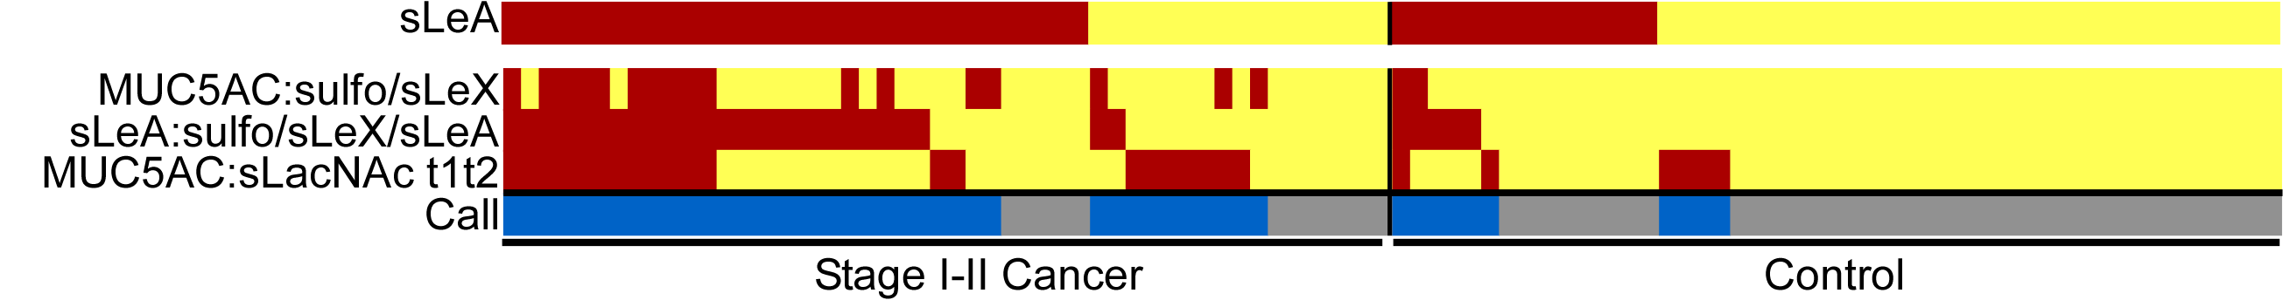
Blinded Set: Stage I/II cancer vs. benign controls
CA19-9
MUC5AC:sLeX
CA19-9:E-selectin
MUC5AC:sTRA
Call
CA19-9: 66% sensitivity, 72% specificity
Panel: 80% sensitivity, 84% specificity
Notes:
This is the toughest comparison, and was blinded

Slide 5
Performance as a Serological Biomarker
sTRA performs similarly to CA19-9 as an individual biomarker
sTRA is elevated independently of CA19-9
A 3-marker panel performed better than CA19-9 in 3 sample sets
Are cancers that produce sTRA a different subtype than those that produce CA19-9?

Slide 6
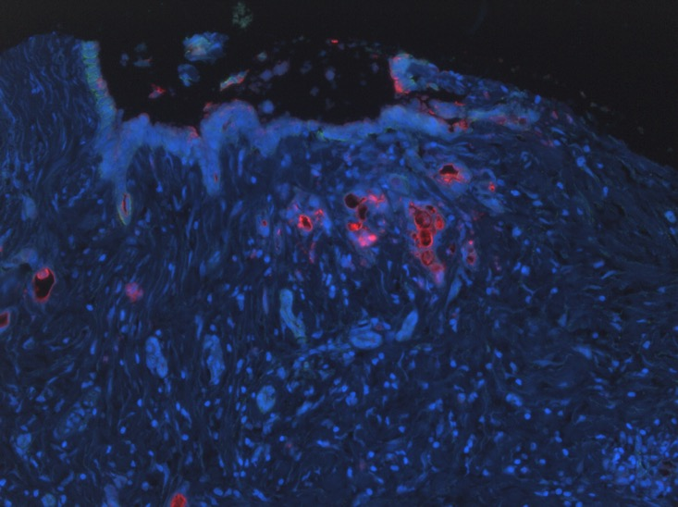
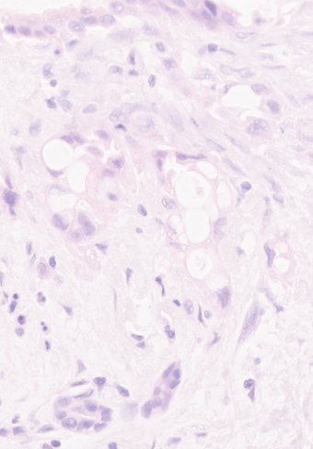
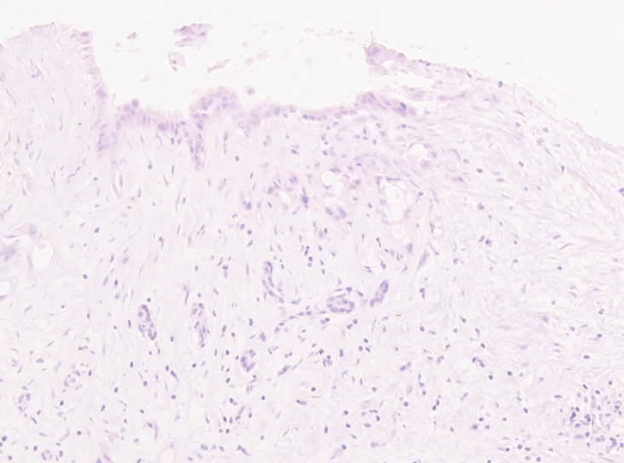
Red: CA19-9
Red: sTRA

Slide 7
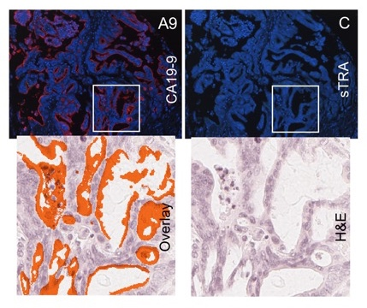
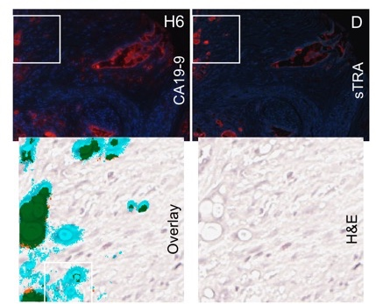
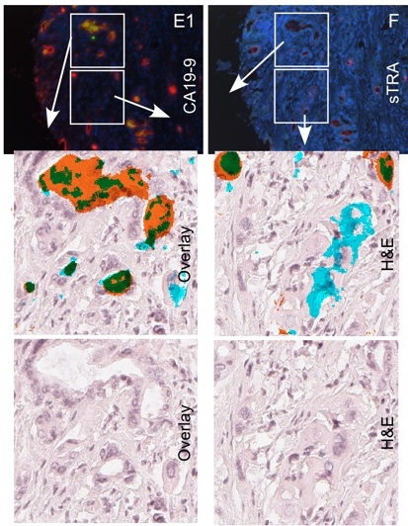
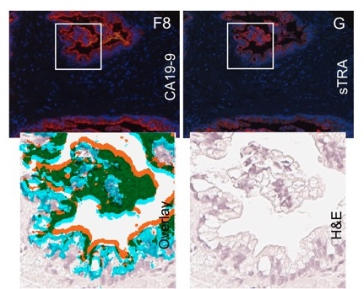

Slide 8
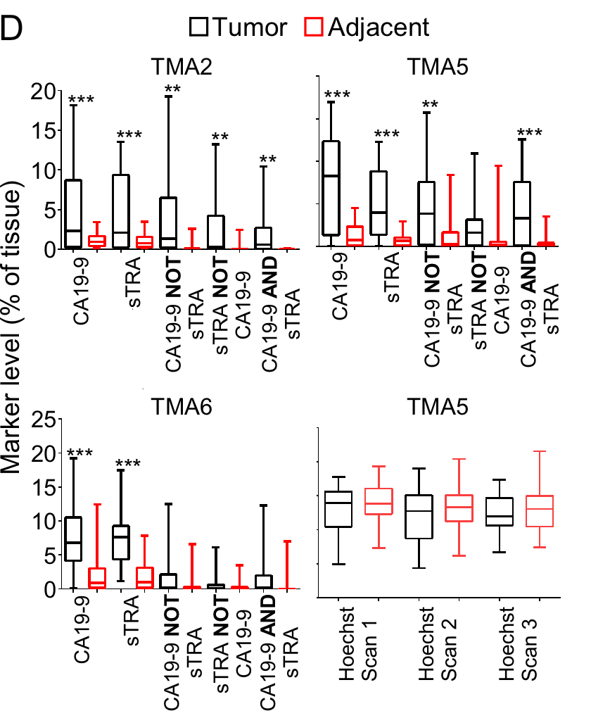
Elevations in Tumors Relative to Adjacent Tissue

Slide 9
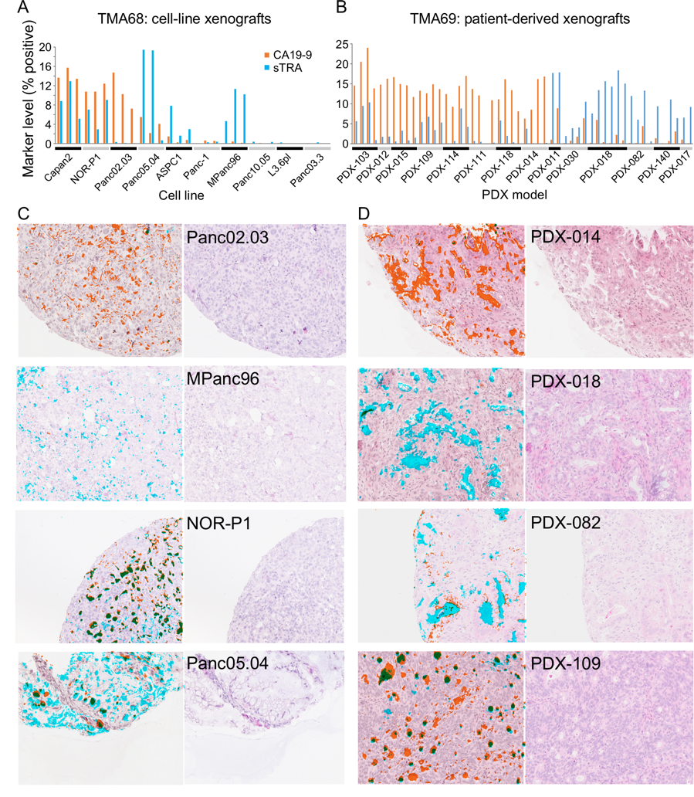
Patterns Same in Xenografts

Slide 10
Additional Findings
CA19-9/sTRA pattern predicts short time-to-progression with 90% sensitivity and 80% specificity
Associated with lymph node and liver metastasis

Slide 11
Performance as a Cellular Biomarker
Cancer cells can be subtyped by CA19-9 and sTRA expression
Evidence of sTRA contribution to high growth/invasion and recurrence
Ongoing:
Further testing prediction of outcome and metastasis
Invasion and drug-response studies

Slide 12
Thanks To:
Daniel Barnett, BS
Ying Liu, PhD
Katie Partyka, BS
Peter Hsueh, BS
Luke Wisniewski, BS
Huiyuan Tang, PhD
Bryan Reatini, BS
Elliot Ensink, BS
Randall Brand, MD – University of Pittsburgh Medical Center (UPMC)
Aatur Singhi, MD – UPMC
Herbert Zeh, MD – UPMC
Ying Huang, PhD – Fred Hutchinson Cancer Research Center
Peter Allen, MD – Memorial Sloan Kettering Cancer Center
Richard Drake, PhD – Medical University of South Carolina
Galen Hostetter, MD
David Monsma, PhD
VARI Biospecimen and Pathology Core
NCI – Early Detection Research Network
NCI – Alliance of Glycobiologists for Cancer Detection

Slide 13
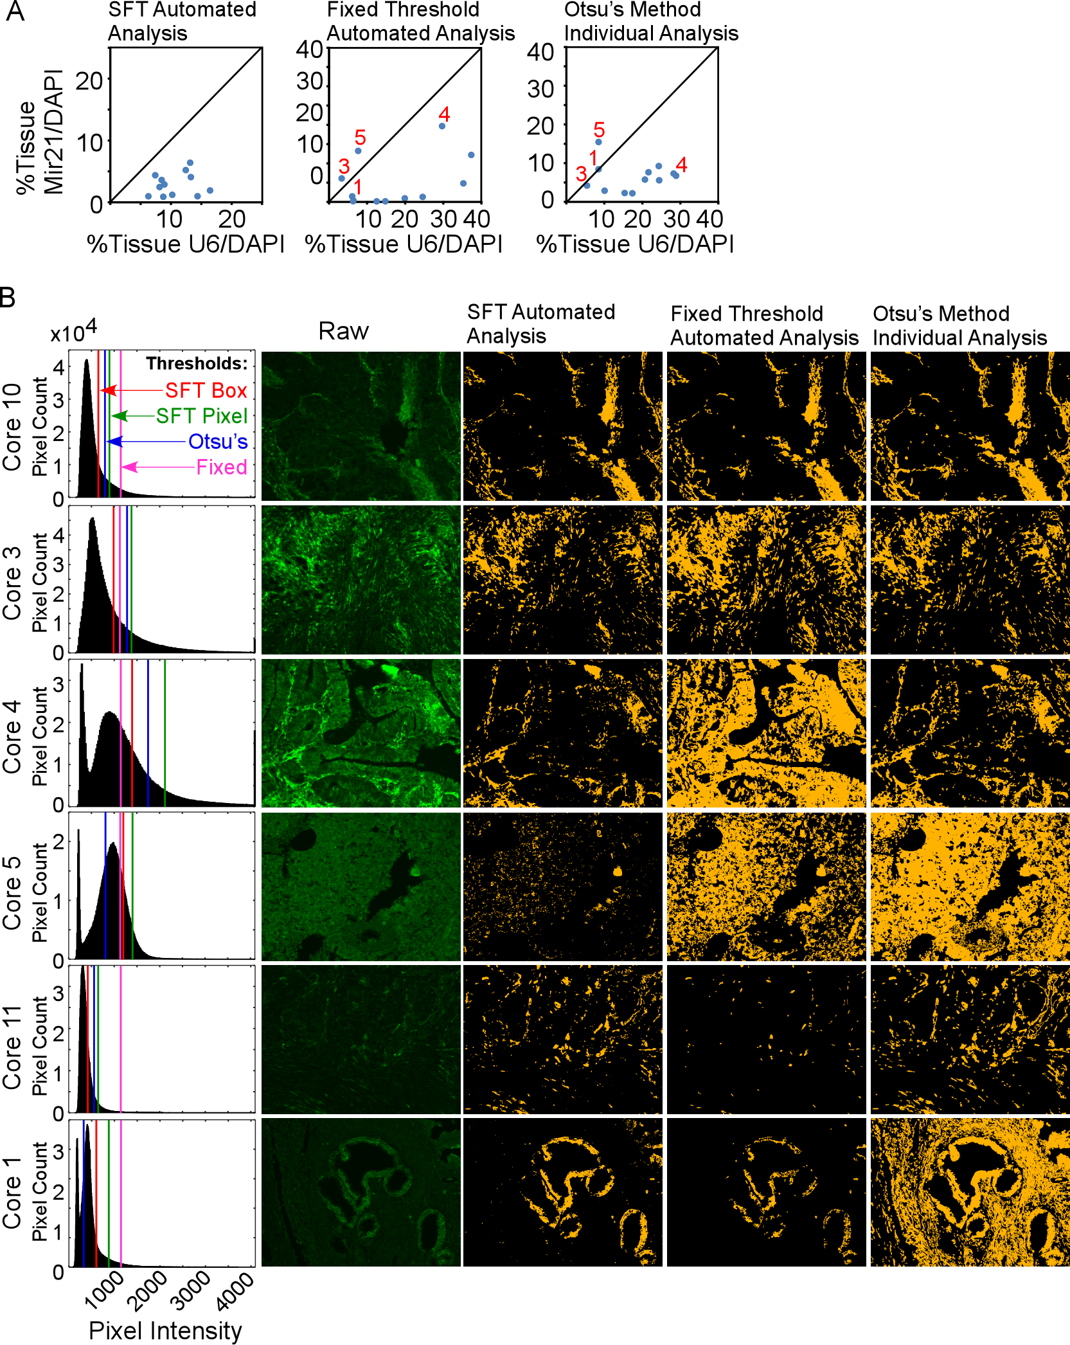
Automated Image Analysis

Slide 14
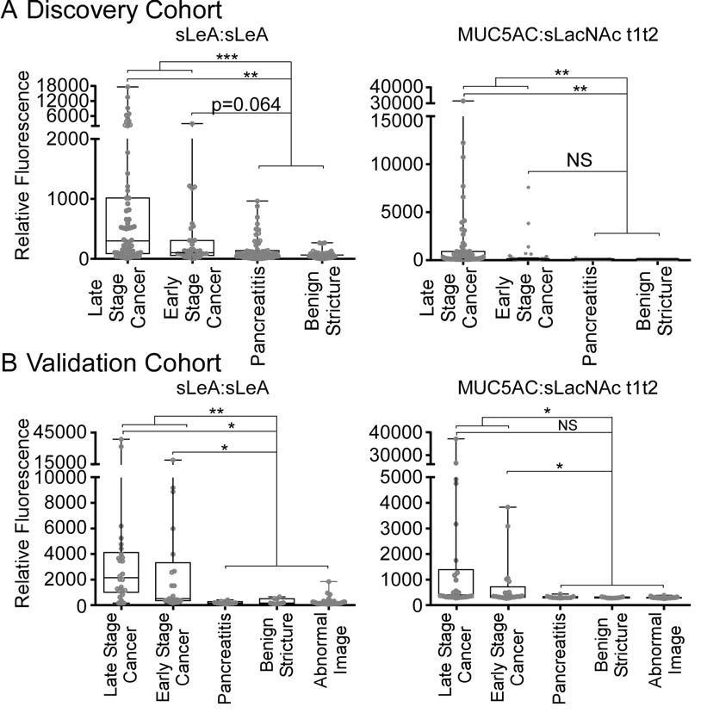
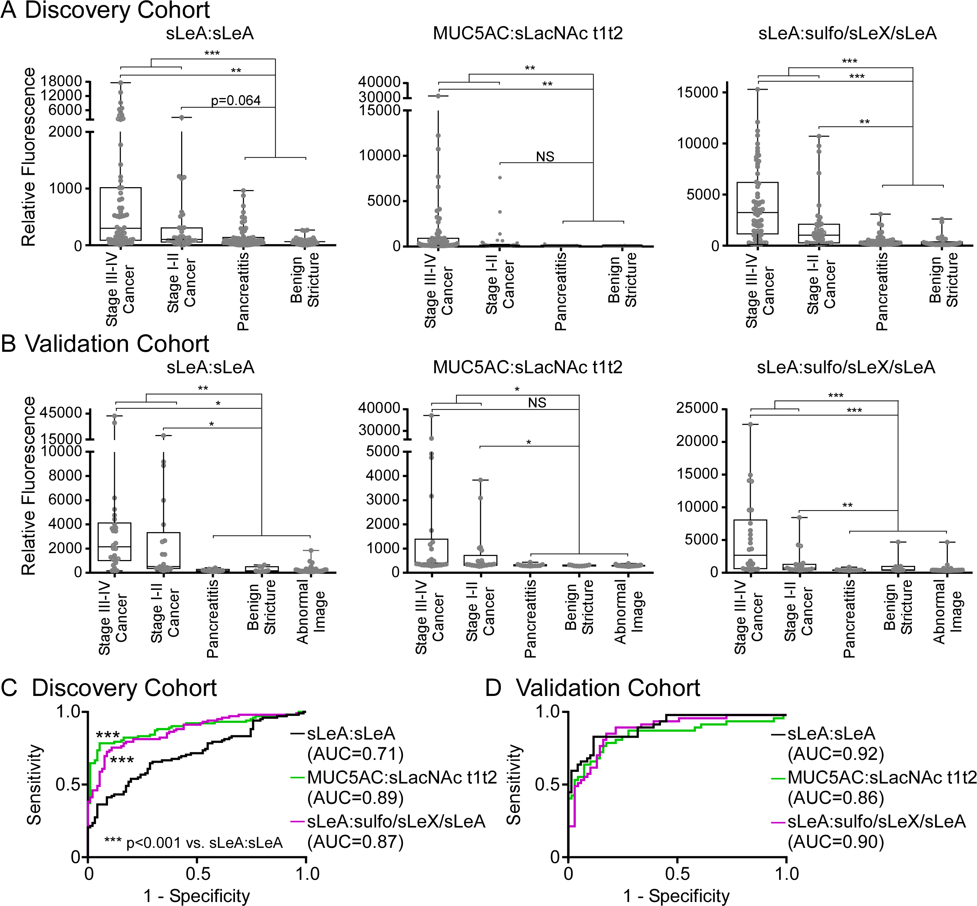
sTRA performs similarly to CA19-9 as an individual biomarker
CA19-9
sTRA
Notes:
As individual markers, they were on par with CA19-9.
But are they simply overlapping? Can they add value?

Slide 15
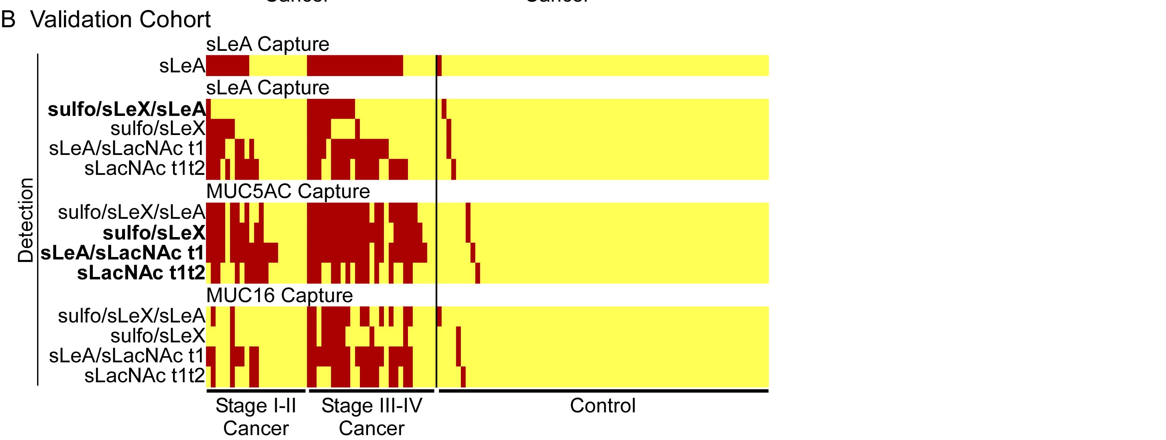
Similar Patterns in Second Set
Combined Cohorts
Three-marker panel: 85% sensitivity and 90% specificity
CA19-9: 54% sensitivity and 86% specificity
Notes:
Same patterns in the second set

Slide 16
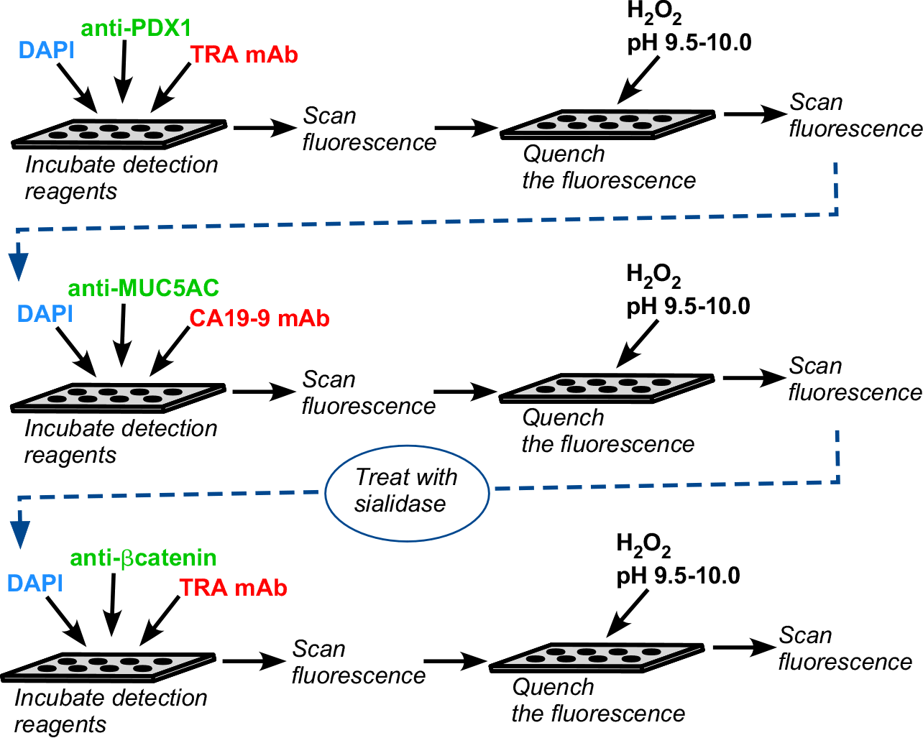
Multi-marker staining of FFPE tissue
Finish with H&E stain

Slide 17
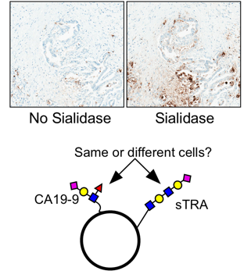
Presence in Cancer Tissue
TRA
sTRA

Slide 18
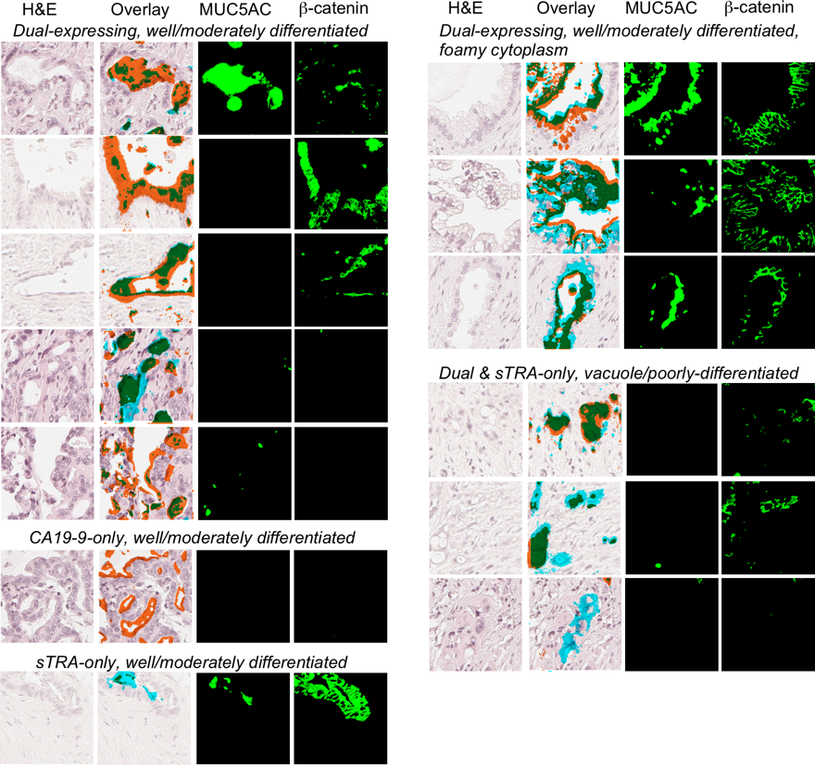

Slide 19
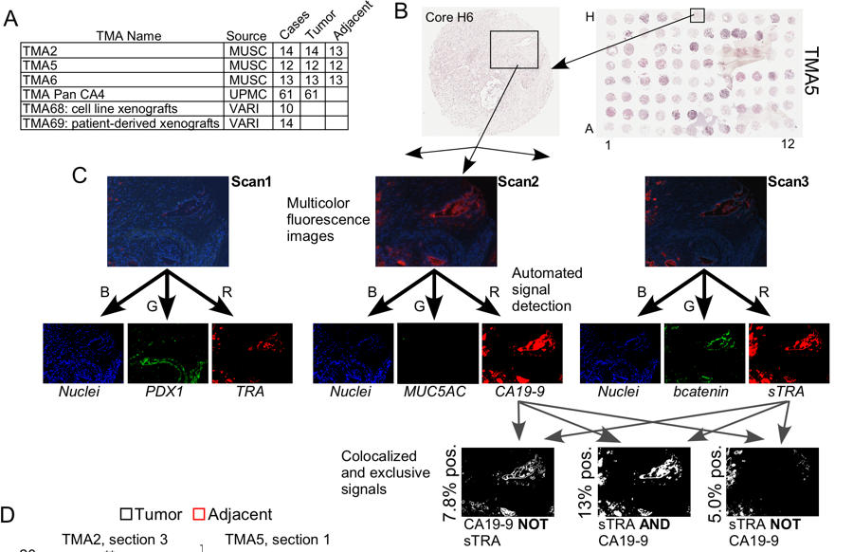
Analysis of Tissue Microarrays

