Slide 1
Ovarian Cancer Team Projects
Current and Proposed
Current
Validation study for serum protein biomarkers for early detection of OC
(PI: Skates)
Proposed Team Projects
Serum Autoantibodies as early detection for OC (PI: Bast)
Genomic markers in Cervico-Vaginal Fluid (CVF) for early detection of OC in high risk patients (PI: Shih)

Slide 2
Ovarian Validation Study – Early Detection
Modified design
150+ ovarian cancer candidates discovered in previous round of funding
Diamandis
Godwin
LaBaer
Li
Lokshin
Marks
Skates
Bioinformatics (in silico) mRNA filter (Toronto)
Accurate Inclusion
Mass Screening (Broad)
50 SRM Assays
PNNL (BRL)
8 high throughput assays
JHU (BRL)
+ 3 NAPPA (ASU)
Cases vs. Benigns at Diagnosis – rule out (FHCRC – CEVC)
Early Detection Biomarkers
5- 11 candidates x Longitudinal ROCA samples (MGH/Broad)

Slide 3
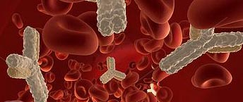
Circulating Autoantibody Biomarkers for Early Detection of Ovarian Cancer
This TEAM project proposes a study from autoantibody candidate biomarkers by EDRN investigators
Robert Bast, Karen Lu (MDACC)
Karen Anderson (ASU)
Charles Drescher (FHCRC)
Steven Skates (MGH)
Zhen Zhang (JHMI)
Notes:
Default title slide layout for Basic presentations
Enter copy in the content placeholders (default formatting shown on example slide above)
Another image may be substituted
To change image:
Delete existing image
Drag a new image into the picture placeholder or select the image placeholder and under the Insert tab, select Pictures and upload your photo

Slide 4
A study on the early detection of Ovarian Cancer (OC) with candidate autoantibody markers identified in previous and ongoing EDRN research that demonstrate signal in at least early phase II studies.
Clinical Aim: Early detection of OC using a regular blood test
Target Population(s): Normal risk postmenopausal women

Slide 5
Biospecimen Sources:
Samples obtained at diagnosis and matched controls (Bast, Drescher)
Longitudinal preclinical samples from local ovarian cancer screening trials (NROSS, Ovarian Cancer Early Detection Program (OCEDP)
Preclinical samples from large cohort studies (WHI, PLCO, UKCTOCS)
Biomarker Candidates:
Anderson (ASU) – 16 candidates
Drescher (FHCRC) – 5 candidates currently with 25 total expected by year 2
Bast (MDACC) – 4 candidates currently with 10 total expected by years 2-3.
Notes:
Title and Content layout
Always enter text or content in the programmed placeholders
Main content placeholder programmed for up to four levels of text
Each text level has preset font size, line spacing, bullets and indent
To get to next level, hit Increase List Level button in Paragraph section of Home tab and enter copy
To go back to previous level, hit Decrease List Level button in Paragraph section of Home Tab and enter copy
Don’t manually apply bullets or use the tab button

Slide 6
Milestones:
1) Assemble the necessary serum specimens.
2) Complete a panel of potential AAb biomarkers.
3) Estimate the markers’ potential for early detection, as measured by sensitivity up to one year prior to diagnosis at a given high specificity, individually and in combination.
4) Place promising assays on a standard platform.
5) Develop a new algorithm that includes CA125 and multiple AAb biomarkers.

Slide 7
Optimal approach to CVF collection to maximize nucleic acid and protein detection
Application for EDRN set aside funds by Ie-Ming Shih (JHU), Michael Birrer (MGH) and Charles Drescher (FHCRC).

Slide 8
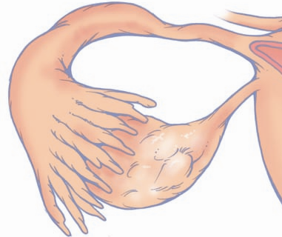
Tubal origin of HG serous carcinoma
Serous tubal intraepithelial carcinoma (STIC)
STIC cells exfoliate and disseminate before they become invasive
p53
HG
Fallopian tube
STIC
Fimbriated ends

Slide 9
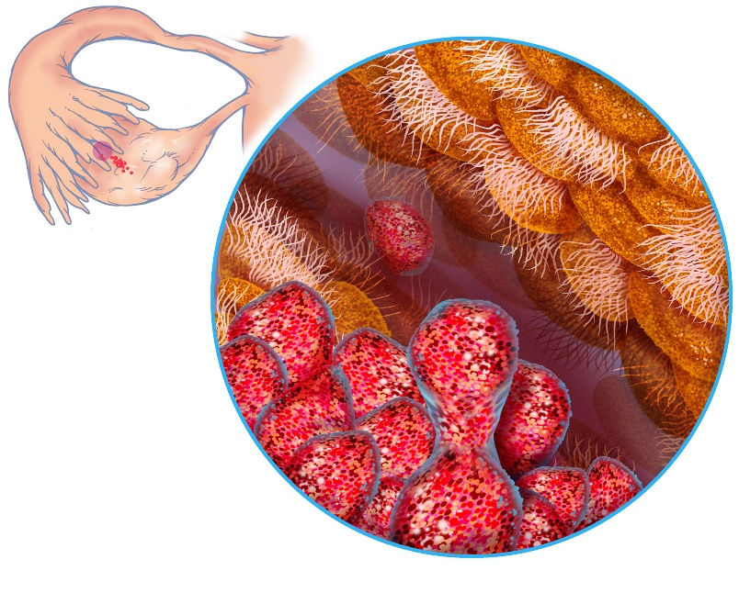
Fallopian tube epithelium as the cell of origin in many of ovarian high-grade serous carcinomas

Slide 10
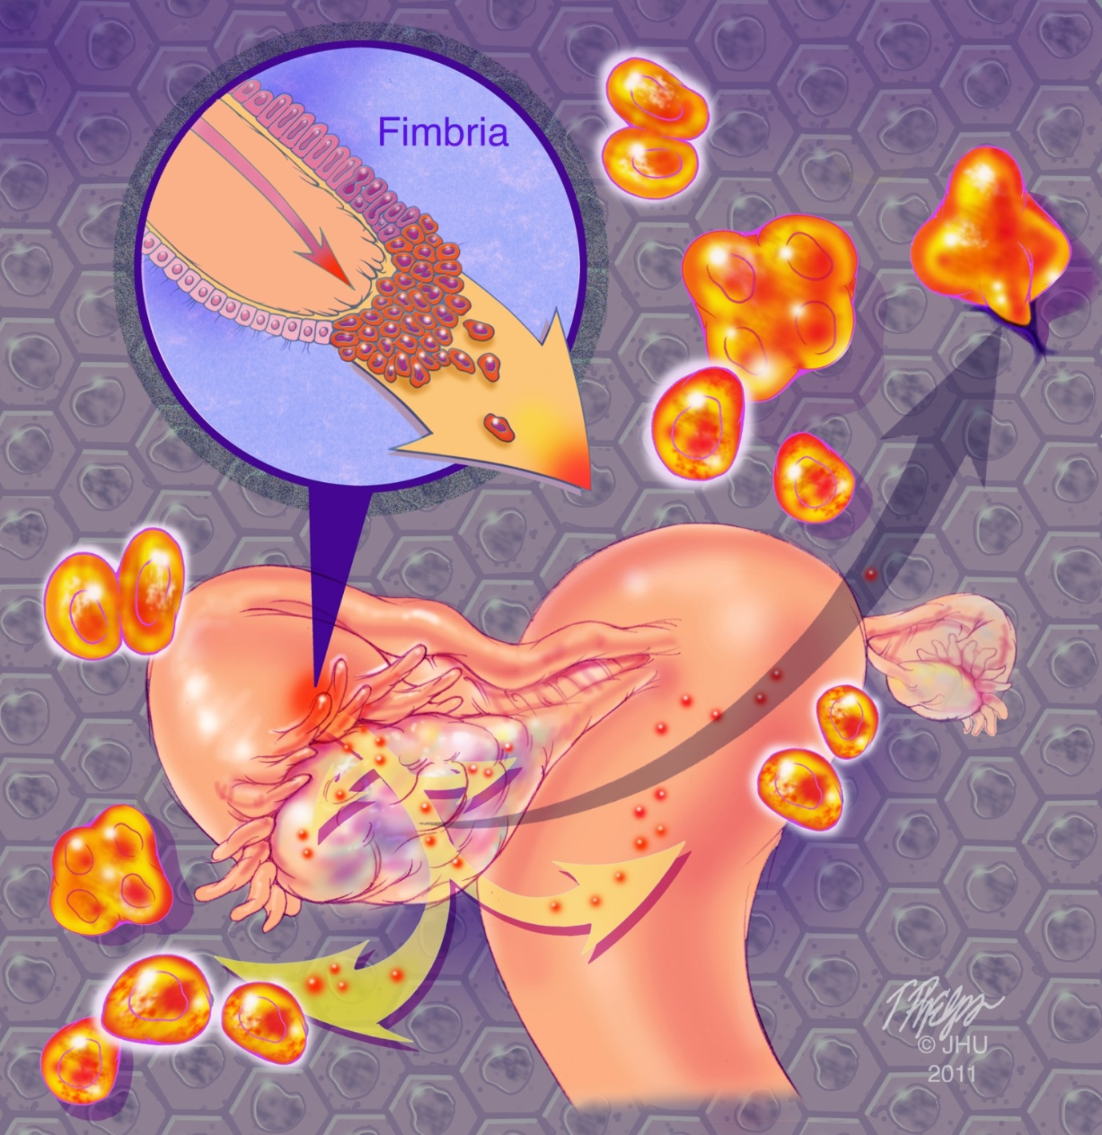
Tubal origin of HG serous carcinoma

Slide 11
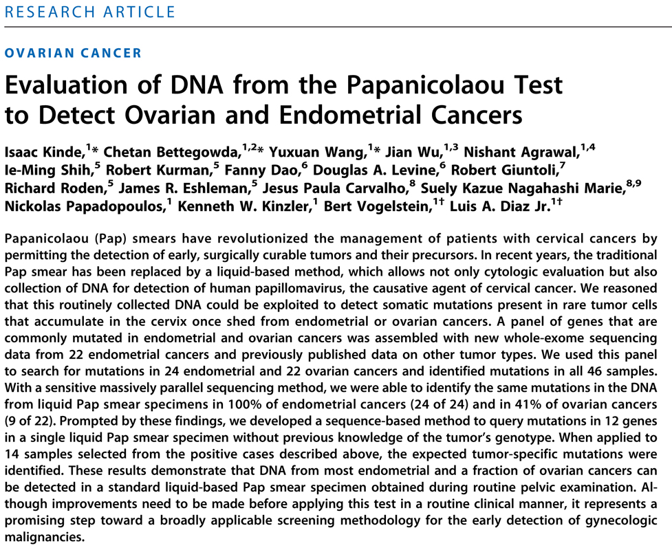
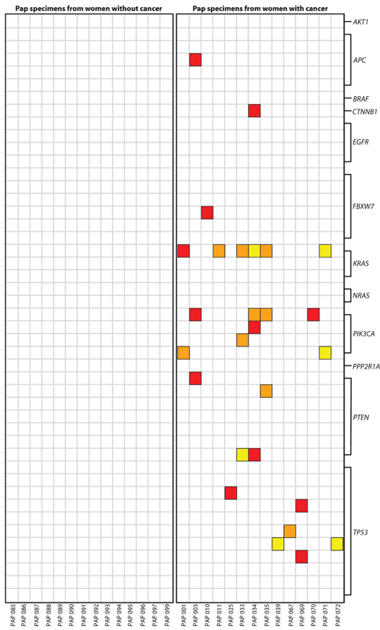
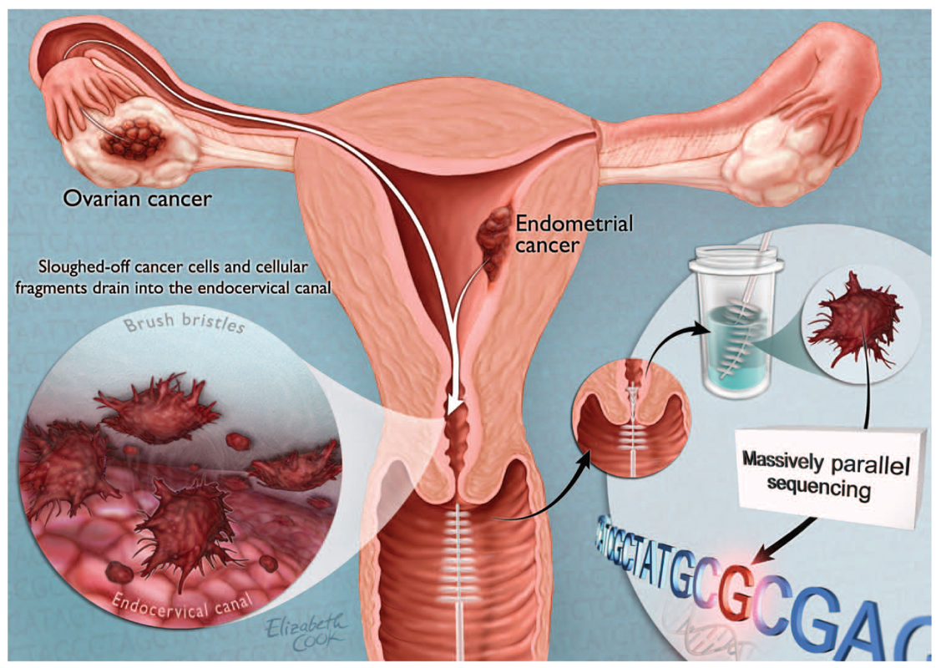
Sci Transl Med. 2013 Jan 9;5(167):167
DNA from most endometrial and a fraction of ovarian cancers can be detected in a standard liquid-based Pap smear specimen obtained during routine pelvic examination
PapGene Test
cancer
cases
No
cancer
Sci Transl Med. 2014

Slide 12
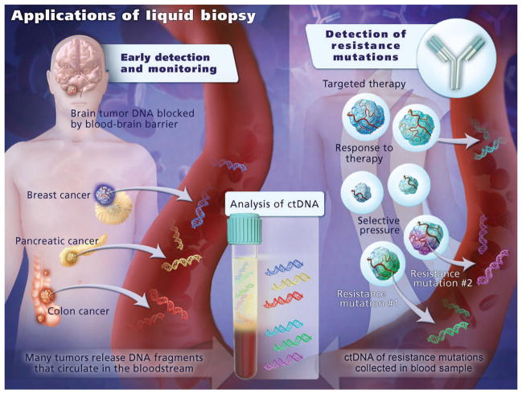
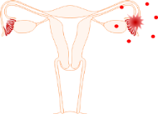
Circulating tumor cfDNA in plasma
Sci Transl Med. 2014

Slide 13
Lists the top 8 protein candidates, for which we will assay the CVF samples
SYMBOL | Ensembl ID | Uniprot ID | Gene Name | Commericial sources of ELISA kit
ATAD3A | ENSG00000197785 | Q9NVI7 | ATPase family, AAA domain containing 3A | MYBioSource Inc.
EPPK1 | ENSG00000261150 | P58107 | epiplakin 1 | MYBioSource Inc.
LEMD2 | ENSG00000161904 | Q8NC56 | LEM domain containing 2 | MYBioSource Inc.
LMNB2 | ENSG00000176619 | Q03252 | lamin B2 | BioMatik and other 4
PAK2 | ENSG00000180370 | Q13177 | p21 (RAC1) activated kinase 2 | BioMatik and other 6
TM9SF4 | ENSG00000101337 | Q92544 | transmembrane 9 superfamily member 4 | MYBioSource
UGGT1 | ENSG00000136731 | Q9NYU2 | UDP-glucose glycoprotein glucosyltransferase 1 | LifeSpan BioSciences and other 3
VWA1 | ENSG00000179403 | Q6PCB0 | von Willebrand factor A domain containing 1 | MYBioSource

Slide 14
Directions (Need Your Advice)
Sample collection of CVF
Biomarkers of ”ovarian” cancer precursors (collaboration with DoD ovarian cancer consortium)

Slide 15
CRITIQUE – All questions addressable
Reviewer #1
Timeline
Pooled samples for the initial screen
PLCO as a backup for the WHI and UKCTOCS is problematic as these samples may have systematic differences
Incorporation of other EDRN biomarkers
Reviewer #2
How many of the samples are premenopausal?
Are preoperative samples obtained under anesthesia?
Were all NROSS patients diagnosed by the algorithm?

Slide 16
CRITIQUE
Reviewer #2 (Continued)
POCRC blinding
Will a 10-fold improvement in specificity be observed with TVS in CA125 negative as well as CA125 positive cases?
The site of specimens (MDACC, FHCRC) should be a covariate.
Sensitivity will be determined at 95% and 98% for cases and benign disease controls individually or combined?
Reviewer #3
No concerns.

Slide 17
Specific Aims of the Team Project
Aim 1. Determine the optimal way(s) to collect CVF samples for genetic and proteomic analysis
compare the performance of the two collection methods. The parameters to be determined include DNA and protein quantity and quality (integrity).
determine how long we can store the CVF samples at room temperature.
determine if the collecting device itself will make a difference in CVF collection-conventional “cytobrush” vs. “broom-like device.
Aim 2. Collect plasma/serum samples and PBMC from the same patients for detection of ctDNA
Aim 3. Determine the feasibility by using targeted protein assays in CVF for the protein biomarkers identified by CPTAC/EDRN projects
To determine the quantity and quality of proteins found in CVF fluids collected by different methods. ThinPrep samples, SurePath samples, Stored Tampon samples, Fresh Tampon samples
ELISA assay will be performed for a limited number of protein biomarkers that have been found to be specifically expressed in ovarian cancer cells, yet barely detectable in corresponding normal tissues.

Slide 18
Reviewer 1
Overall, the goals of this study are difficult to evaluate. The first, and primary goal appears to be a technical approach to optimizing yield and stability of sample CVF prep, in particular for protein detection. There have been prior studies, some of which have been supported by EDRN, designed to develop protocols for protein isolation of CVF, so it is not clear what additional value the proposal adds to the current state.
The goal is to timely evaluate the new opportunities for obtaining additional CVF sources, (SurePath samples) and their compatibility with the assays proposed. The aims and tasks in this team project have not been proposed in the original proposal. The results from this study will add significant value to our assays, ensure the quality control of specimens due to sample sharing among different institutions and allow us to proceed this study and make progress.
Second, the rationale for studying the proteins in the CVF is not provided; there is limited preliminary data to support the detection in locoregional fluid.
The rationale is based on the hypothesis that protein biomarkers would be more abundant than genomic markers. We will start assessing whether we can detect proteins and their quality and quantity after we secure sample collection part.
Third, the support of the MGH/FHCRC is not committed at the time of the submission and needs to be clarified prior to approval. In addition, the potential overlap between this set aside proposal and the existing funding provided to the ovarian CVCs to provide samples needs to be addressed.
Both institutions are committed. There is no overlapping of the scope.

Slide 19
Reviewer 2
Aim 1 is an appropriate pursuit.
Thank you.
Aim 2 is not really an aim – it’s just a collection. I'm curious as to why Streck tubes are not being employed as that would reduce the need for prompt processing, which could be a serious barrier to wider spread translation of these sampling modalities.
Cell-Free DNA BCT tubes will be used.
Aim 3 is also a reasonable pursuit.
Thank you.
There is no analytic plan included for any of the aims and no justification that the planned sample size is sufficient.
Justification will be done by consulting with experts including Mark and Zhen. The sample size justification would also consider the budget available.
Budget justification: The justification indicates that the JHU site is under-budgeted for collection. At the same time, the majority of the budget is devoted to a postdoc and not to collection. This does not make sense. Either the justification or the budget needs to be changed.
This is an issue from realistic perspective. Due to the budget, we are figuring our the sufficient resource for sample collection (research coordination, patient consent, etc.).

Slide 20
Reviewer 3
Aim 1. A good study design for this comparison would be one where both ThinPrep and SurePath samples are obtained from the same individual in order to remove individual-level variability. It is important that Dr. Shih describes in better detail the manner of sample collection. I note that there is no power calculation provided nor specification of the statistical test. Sample pooling will give limited power for distinguishing trend over time from random variability in assay measurements. CVF by cytobrush and broom-like device are from the same women?
We have tried to sample both from the same women but it turns out not to be feasible according to our participating gynecologists. The manner of sample collection has been further detailed. Power calculation has been added after consulting with experts.
Aim 2. is better described. However, it is not stated what is the expected sample size for this project?
It has been described after consulting with experts (Mark and Zhen).
Aim 3. Subaim 1, the statistical test planned and its power is important to describe. Is there any possible confounding between contributing site and type of sample (e.g., ThinPrep vs. SurePath)? For subaim 2, there is no description of the number of samples, their type, and the characteristics of the samples.
The sample size and power have been described after consulting with experts (Mark and Zhen). The confounding factors between sites and types of samples will be determined in this team project.

Slide 21
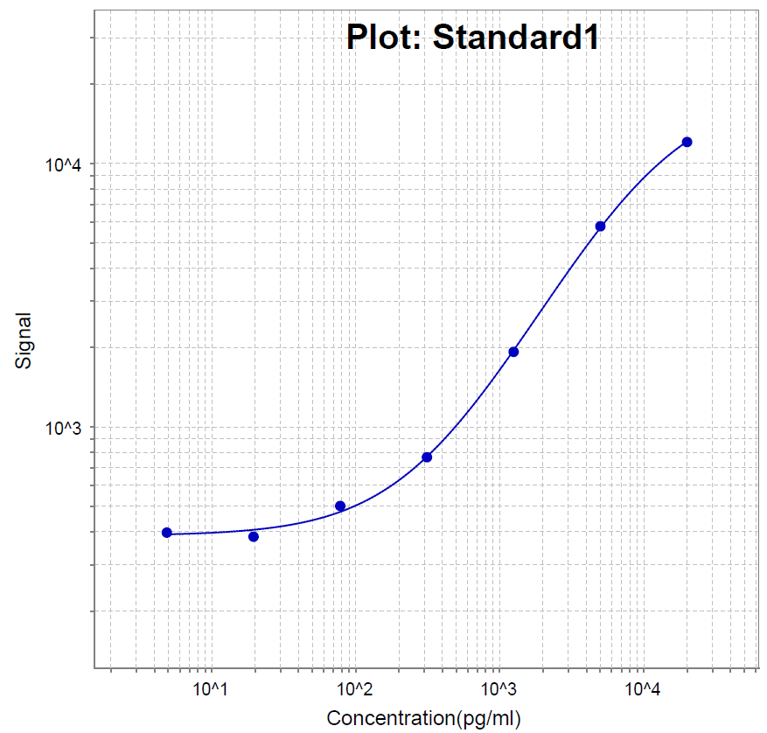
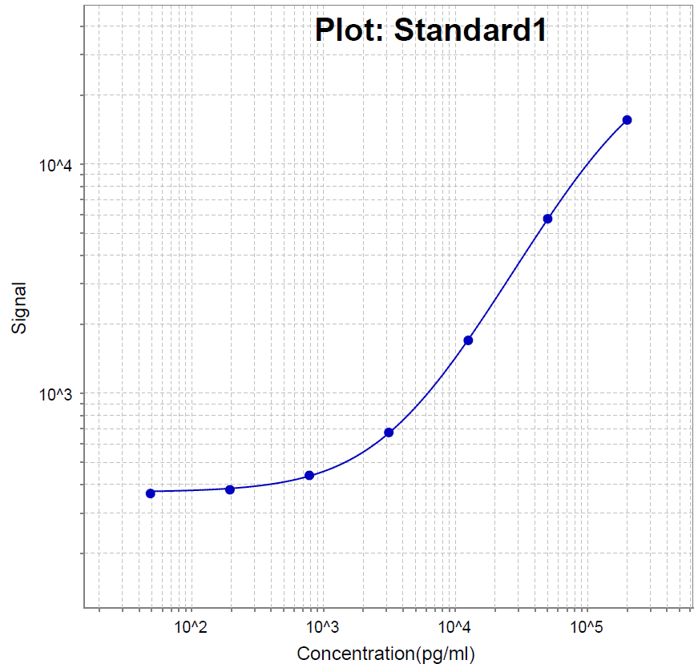
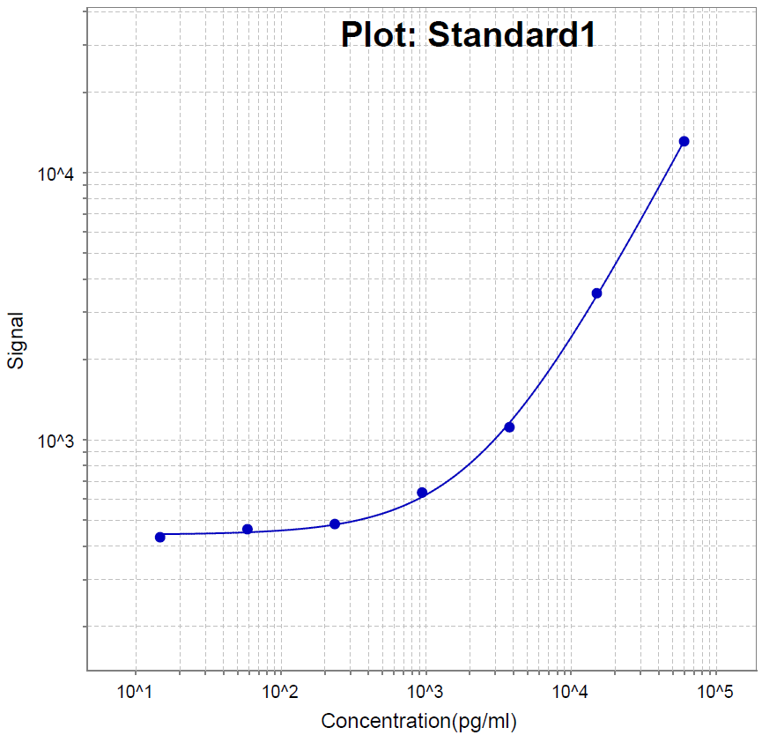
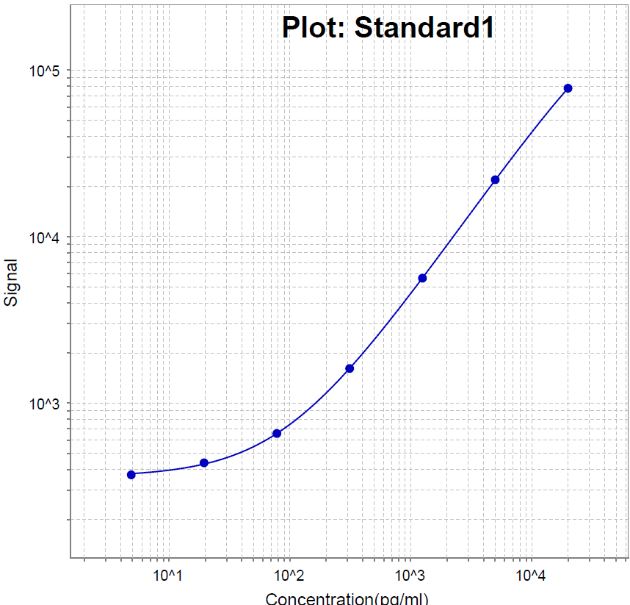
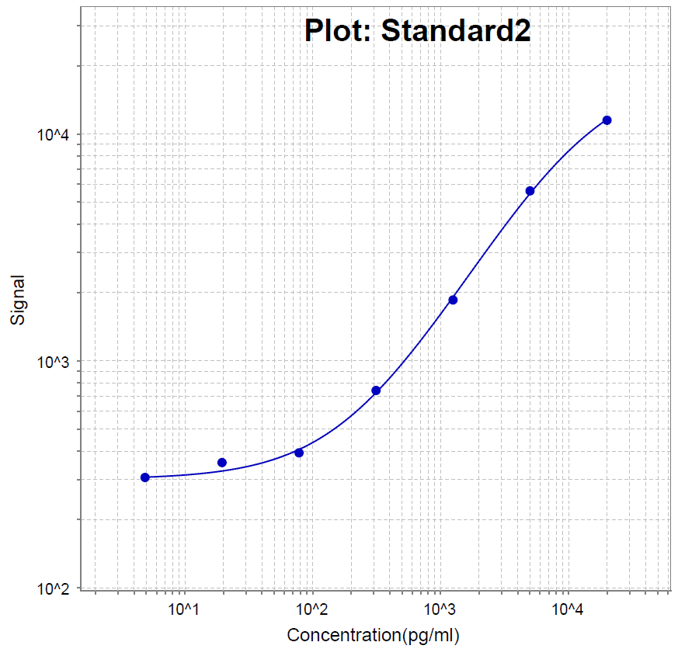
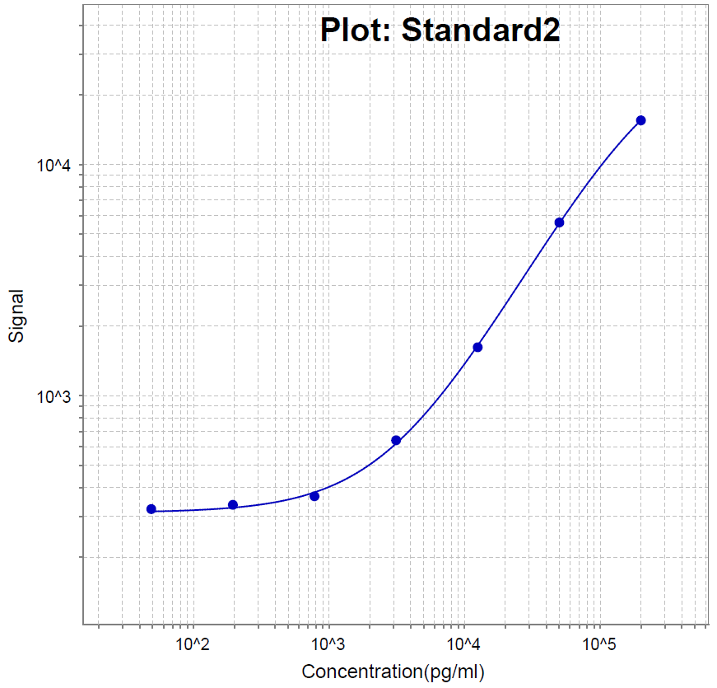

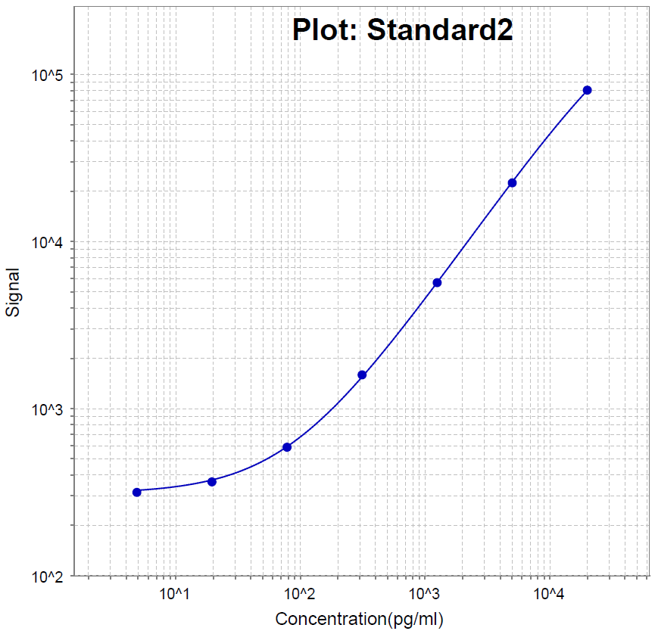
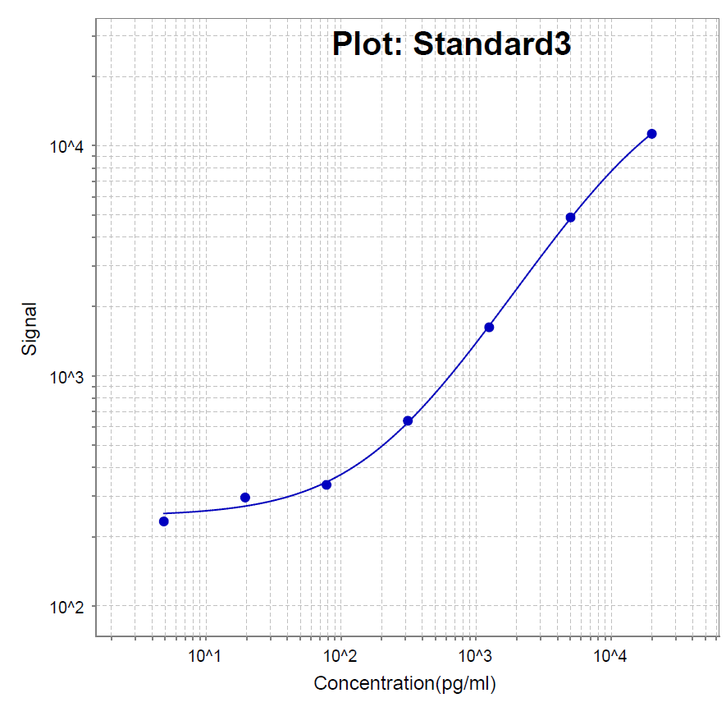
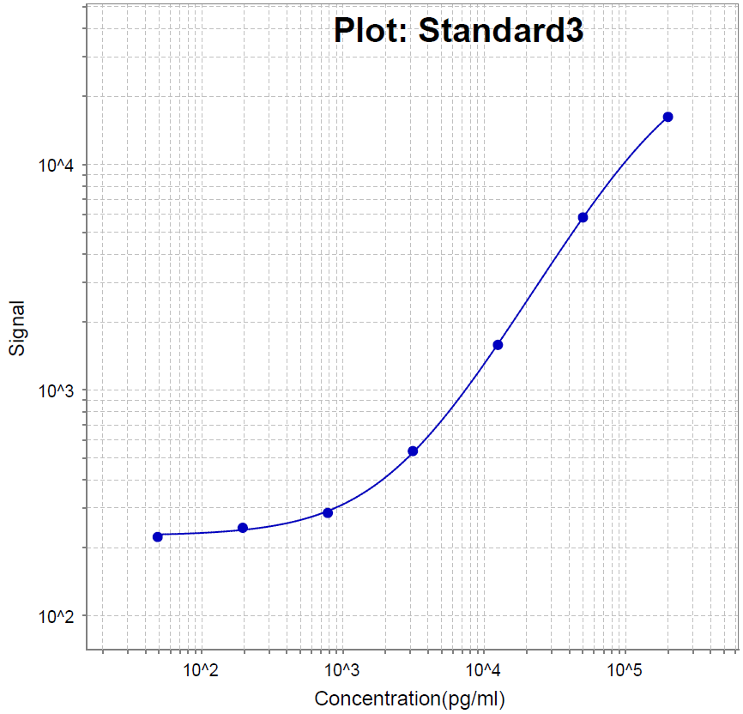
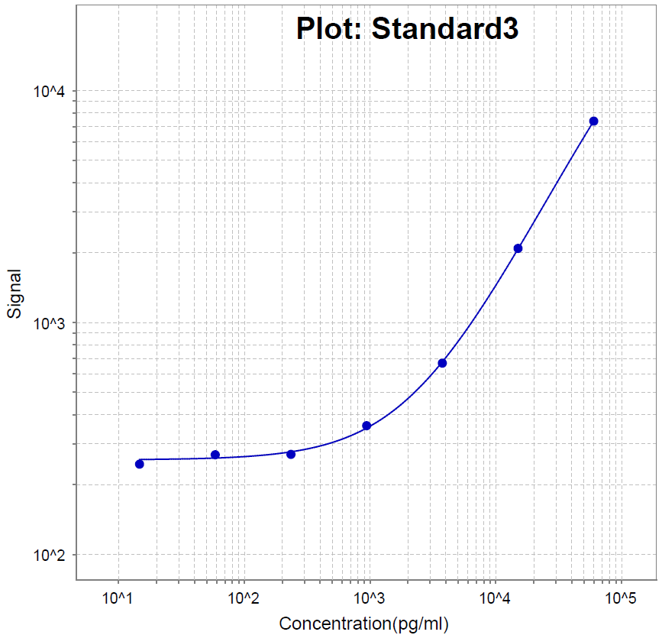
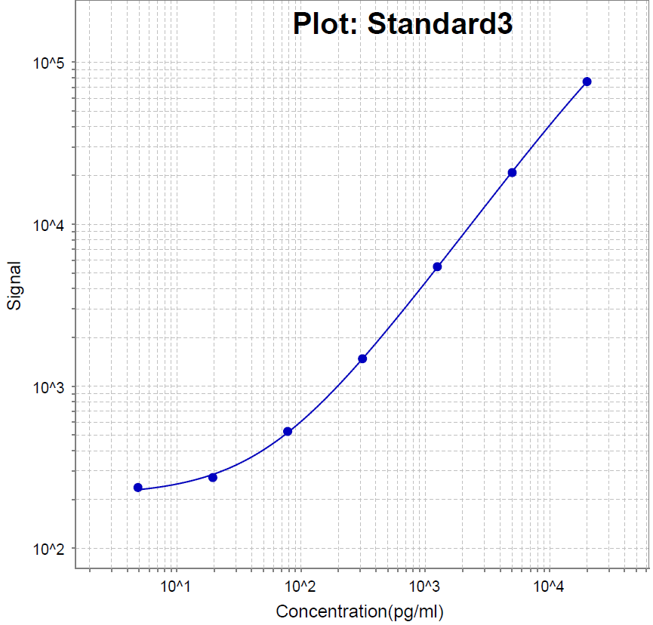
4-Plex
CA125
HE4
SPON1
FOLR1

Slide 22
JHU BRL
CA125
HE4
LRG1
CPA4
FOLR1
SPON1
KRT8, KRT19
– mostly complete

Slide 23
Validation pipeline for OC biomarkers
Evaluate specificity, early signal and assay CV using individual and pooled diagnostic samples from EDRN Reference
95 healthy controls
20 control pools; 12 case pools
Candidate Markers from all laboratories
Evaluate performance in large Phase II validation study
400 OC cases
200 each benign tumor and healthy controls
All targets passing EDRN reference set filters
Early Phase III Validation in pre-clinical samples from local screening studies
xx OC cases
xx OC controls
Top 5-10 targets and biomarker panel identified in Phase II study
Phase III Validation using samples from WHI/ UKCTOCS
XXX samples
Biomarkers and panels demonstrating lead time of at least 1 year in early phase III studies

Slide 24
Approach:
Develop MagPlex Luminex assays for promising autoantibodies
Evaluate specificity of candidate biomarkers in the EDRN reference set; Evaluate candidates in the combined MDACC/FHCRC sample set
Rank candidates based on their sensitivity at 95% and 98% specificity in the combined MDACC/FHCRC sample set at the time of conventional diagnosis
Develop a biomarker panel based on the statistical analysis of the MDACC/FHCRC sample sets
Perform subgroup analysis on high- and low-grade serous, clear cell, mucinous and endometrioid cancers and borderline ovarian tumors

Slide 25
Approach Continued…
Evaluate performance of top markers and biomarker panel in pre-clinical samples from participants in local ovarian cancer screening trials as prelude to requesting samples for large population-based cohort studies or ovarian cancer screening trials
Develop a standard multi-plex platform assay with Zhen Zhang at JHMI
Rank candidates based on assay performance in 100 serum biospecimens from ovarian cancer cases in the WHI observational study diagnosed within one year of second sample and in samples from controls, or samples obtained at diagnosis from EDRN groups
Validate candidates based on assay performance with 1500 serial preclinical samples and 5-fold controls from the UKCTOCS

Slide 26
Candidates for Early Detection of Ovarian Cancer
Will be Considered Validated If:
Clinical sensitivity is achieved (5% or greater) at 98% specificity at least 1 year prior to clinical detection
OR
There is improved performance of a combined biomarker panel
Algorithm
Steve Skates will develop a ROCA-like algorithm with the validated antibodies and CA125 and other EDRN biomarkers to be validated

