Slide 1

ctDNA and Methylation in
Early Detection and Monitoring
Of CRC
EDRN Colon Group Collaborative Project
Robert E. Schoen, MD, MPH
University of Pittsburgh

Slide 2
Status Quo
A blood test for CRC screening would increase compliance and enhance options for testing
Septin 9, a marker of aberrant methylation is an approved blood test, but has limited sensitivity
ctDNA, products of apoptotic cell turnover, are small fragments of nucleic acid that could also serve as markers for early detection
Markers of aberrantly methylated genes may also be informative
Better means of monitoring patients for CRC recurrence are needed

Slide 3
Rationale
ctDNA and aberrantly methylated genes are not mutually exclusive and may be complementary
Evaluation should occur in samples of plasma collected simultaneously and processed similarly
These markers could also have utility in monitoring CRC

Slide 4
Aims of our Future Set Aside Project
AIM 1. ctDNA and aberrantly methylated genes can be used together as a primary screening modality for detection of colorectal cancer.
AIM 2. ctDNA levels and aberrantly methylated genes can be used for monitoring of CRC patients with regional metastatic disease (stage III).
Aim 3: ctDNA levels and aberrantly methylated genes are dynamic and will quantitatively change with surgical resection.

Slide 5
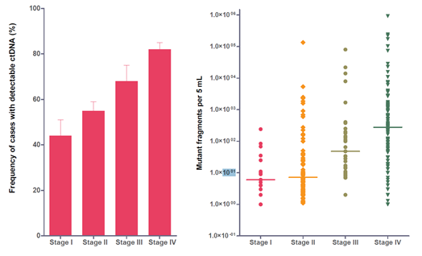
ctDNA in CRC by Cancer Stage
Bettegowda et al. Sci Transl Med. 2014 Feb 19;6(224):224ra24.
Notes:
(A) Fraction of patients with detectable ctDNA (colorectal, gastroesophageal, pancreatic, and breast cancers).(B) Quantification of mutant fragments in cancer cases categorized by stage. Error bars represent SEM.
Levels of ctDNA correlate with stage.
Among subjects with metastatic CRC, the number of mutant fragments ranged from 100,000 to 1 per 5 ml of plasma.

Slide 6
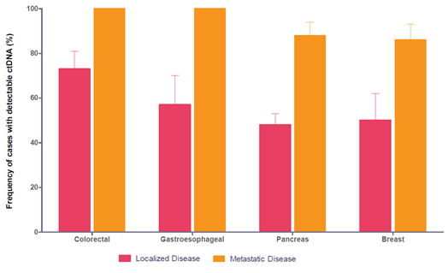
ctDNA: Localized vs. Advanced Cancer
Localized disease 73%
Bettegowda et al. Sci Transl Med. 2014 Feb 19;6(224):224ra24.
Notes:
Fraction of patients with detectable ctDNA in localized (stages I to III) and metastatic (stage IV) colorectal, gastroesophageal, pancreatic, and breast cancers.
73% of subjects with localized CRC had detectable ctDNA

Slide 7
Methylated Vimentin vs. CEA in Detection of CRC by Stage

Slide 8




ctDNA Detects Minimal Residual Disease and Predicts Recurrence in Stage II Colon Cancer
Jeanne Tie, Yuxuan Wang, Cristian Tomasetti, Lu Li, Simeon Springer, Isaac Kinde, Natalie Silliman, Mark Tacey, Hui-Li Wong, Michael Christie, Suzanne Kosmider, Iain Skinner, Rachel Wong, Malcolm Steel, Ben Tran, Jayesh Desai, Ian Jones, Andrew Haydon, Theresa Hayes, Tim J. Price, Robert L. Strausberg, Luis A. Diaz Jr., Nickolas Papadopoulos, Kenneth W. Kinzler, Bert Vogelstein and Peter Gibbs
Tie. Science Translational Medicine 2016

Slide 9
ctDNA in Stage II-CRC
N=250, post-op and serial plasma
23% adj chemo Rx at clinician direction
Targeted 15 genes using safe-SeqS
20/231 +ctDNA post op (9 p53, 8 APC, 3 KRAS)
Median f/u 27 mo
34 (14.8%) radiologic recurrence
27/178 (15%) no chemo Rx
7/52 (13%) with chemo Rx
Tie, Science Trans Med 2016

Slide 10
ctDNA in Stage II-Results
No Chemo
+ctDNA ↓↓ Recurrence free survival (RFS): HR=18
ctDNA helpful in both low and high risk by clinical pathologic characteristics
CEA did not predict RFS

Slide 11
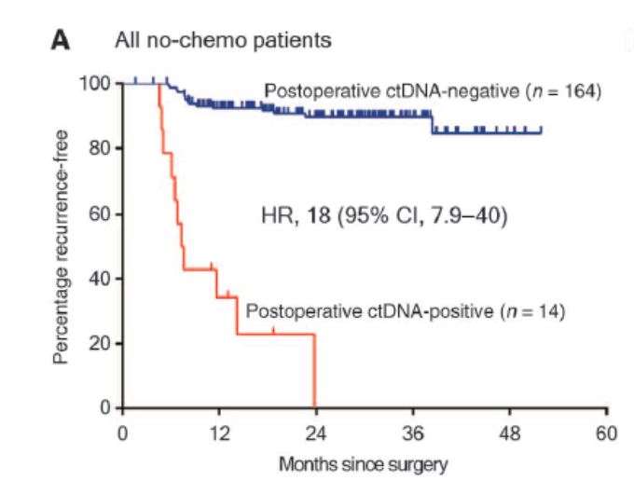

Recurrence Free Survival (RFS) in patients
not treated with adjuvant chemotherapy
Jeanne Tie et al., Sci Transl Med 2016;8:346ra92
Notes:
RFS in patients not treated with adjuvant chemotherapy. (A) Kaplan-Meier estimates of RFS for all patients not treated with adjuvant chemotherapy, stratified by postoperative ctDNA status. (B) Kaplan-Meier estimates of RFS in the same patients, stratified by clinicopathologic characteristics. (C) Kaplan-Meier estimates of RFS stratified by postoperative ctDNA status in patients with low-risk clinicopathologic characteristics. (D) Kaplan-Meier estimates of RFS stratified by postoperative ctDNA status in patients with high-risk clinicopathologic characteristics. The high-risk group is defined as those having mismatch repair–proficient (pMMR) tumors with at least one of the following poor prognostic features: T4, LN yield <12, LVI, and poor tumor differentiation. The low-risk group is defined as those with no poor prognostic features.

Slide 12
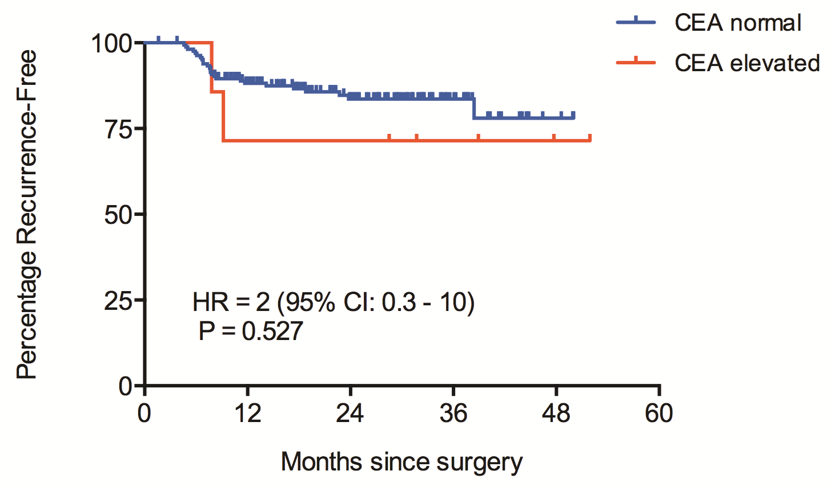
Recurrence Free Survival (RFS) in patients
not treated with adjuvant chemotherapy by CEA level

Slide 13
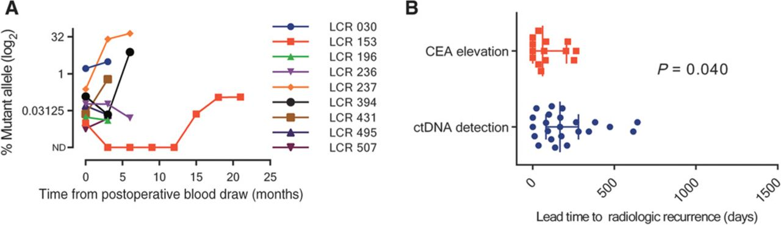
Serial ctDNA status up to radiological recurrence
ctDNA levels in patients not treated with chemo with positive ctDNA post op up to time of radiologic recurrence (N=9)
Lead time to radiologic recurrence for ctDNA and CEA
Notes:
Serial ctDNA status up to radiological recurrence. (A) Serial ctDNA measurements up to the time of radiological recurrence for the nine patients who were not treated with adjuvant chemotherapy and who were ctDNA-positive postoperatively. (B) Scatter plot of the lead time to radiological recurrence for ctDNA detection and CEA elevation, with the error bars representing the median and IQR.

Slide 14
Conclusions
ctDNA is a marker for recurrence in patients with stage II CRC
ctDNA findings discriminate within clinicopathologic subgroups

Slide 15
Aim 1 – Evaluation ctDNA
and Aberrant Methlylation
in Stage III and IV
ctDNA evaluated via SafeSeqs sequencing using panel of mutations (61 amplicons in 16 genes – 1999 positions
Panel of methylation markers, EVL, NTRK3, VIM and others via NGS
40 CRC and 40 controls

Slide 16
Aim 2 – Evaluation in Stage III Patients
Undergoing Monitoring for Recurrence
Assess ctDNA and methylation as prognostic markers for disease-free and overall survival
Use ctDNA results as basis for selection: Assess 15 patients who begin ctDNA negative and recur, and 10 patients who begin as ctDNA positive
Isolate tumor DNA from blocks to correlate to plasma findings

Slide 17
Aim 3 – Evaluate Dynamic Change in
ctDNA and Methylation with Surgery
Evaluate 15 patients pre and post surgery for change in ctDNA and methylation markers
Know ctDNA decreases post-op, but hasn’t been tested formally with markers of aberrant methylation

Slide 18
End Result
Assess ctDNA and aberrantly methylated genes for screening and monitoring of CRC
Evaluation will occur in equal volume of plasma collected similarly

Slide 20
Advanced Adenomas
Defined as adenomas ≥ 1cm, tubulovillous or villous histology, or HGD
Higher likelihood of harboring CRC
Subjects with them have higher likelihood of developing CRC
Most important precursor of CRC to detect
Non-invasive markers such as FIT, s-DNA limited sensitivity for AA

Slide 21
Advanced Adenoma
Supplement Rationale
Using BEAMing (2005) could only detect 1/11 patients with an advanced adenoma
Issue has not been evaluated using current technology of ctDNA

Slide 22
AA Supplement
15 pre-colonoscopy subjects with Advanced adenoma and ≥ 8 ml plasma
41 pre-surgical subjects with Advanced adenoma and ≥ 8 ml plasma
Readying these for evaluation

Slide 24
ctDNA Detects Minimal Residual Disease and Predicts Recurrence in Stage II Colon Cancer
Jeanne Tie, Yuxuan Wang, Cristian Tomasetti, Lu Li, Simeon Springer, Isaac Kinde, Natalie Silliman, Mark Tacey, Hui-Li Wong, Michael Christie, Suzanne Kosmider, Iain Skinner, Rachel Wong, Malcolm Steel, Ben Tran, Jayesh Desai, Ian Jones, Andrew Haydon, Theresa Hayes, Tim J. Price, Robert L. Strausberg, Luis A. Diaz Jr., Nickolas Papadopoulos, Kenneth W. Kinzler, Bert Vogelstein and Peter Gibbs
Tie. Science Translational Medicine 2016

Slide 25
Collection of clinical samples and follow-up data
250 patients with Stage II colon cancer
Ineligible
N=19
Tumor Tissue
N=231
4-10 weeks post-op blood samples (N=231)
Use of adjuvant chemo at clinician’s discretion
Chemo (N=57)
No Chemo (N=79)
Target sequencing of 15 genes
3-monthly follow-up blood draw in a subset of patients (N=167)
Clinical f/u q3 months
CT q6months
Mutations identified in tumors (N=230)
- ctDNA quantification
- CEA analysis
N=230
Final N=230
Recurrence = 34
No Recurrence = 196

Slide 26
ctDNA in Stage II-CRC
N=250, post-op and serial plasma
23% adj chemo Rx at clinician direction
Targeted 15 genes using safe-SeqS
20/231 +ctDNA post op (9 p53, 8 APC, 3 KRAS)
Median f/u 27 mo
34 (14.8%) radiologic recurrence
27/178 (15%) no chemo Rx
7/52 (13%) with chemo Rx
Tie, Science Trans Med 2016

Slide 27
ctDNA in Stage II-Results
No Chemo
+ctDNA ↓↓ Recurrence free survival (RFS): HR=18
ctDNA helpful in both low and high risk by clinical pathologic characteristics
CEA did not predict RFS

Slide 28
Recurrence Free Survival (RFS) in patients
not treated with adjuvant chemotherapy
Jeanne Tie et al., Sci Transl Med 2016;8:346ra92
Notes:
RFS in patients not treated with adjuvant chemotherapy. (A) Kaplan-Meier estimates of RFS for all patients not treated with adjuvant chemotherapy, stratified by postoperative ctDNA status. (B) Kaplan-Meier estimates of RFS in the same patients, stratified by clinicopathologic characteristics. (C) Kaplan-Meier estimates of RFS stratified by postoperative ctDNA status in patients with low-risk clinicopathologic characteristics. (D) Kaplan-Meier estimates of RFS stratified by postoperative ctDNA status in patients with high-risk clinicopathologic characteristics. The high-risk group is defined as those having mismatch repair–proficient (pMMR) tumors with at least one of the following poor prognostic features: T4, LN yield <12, LVI, and poor tumor differentiation. The low-risk group is defined as those with no poor prognostic features.

Slide 29
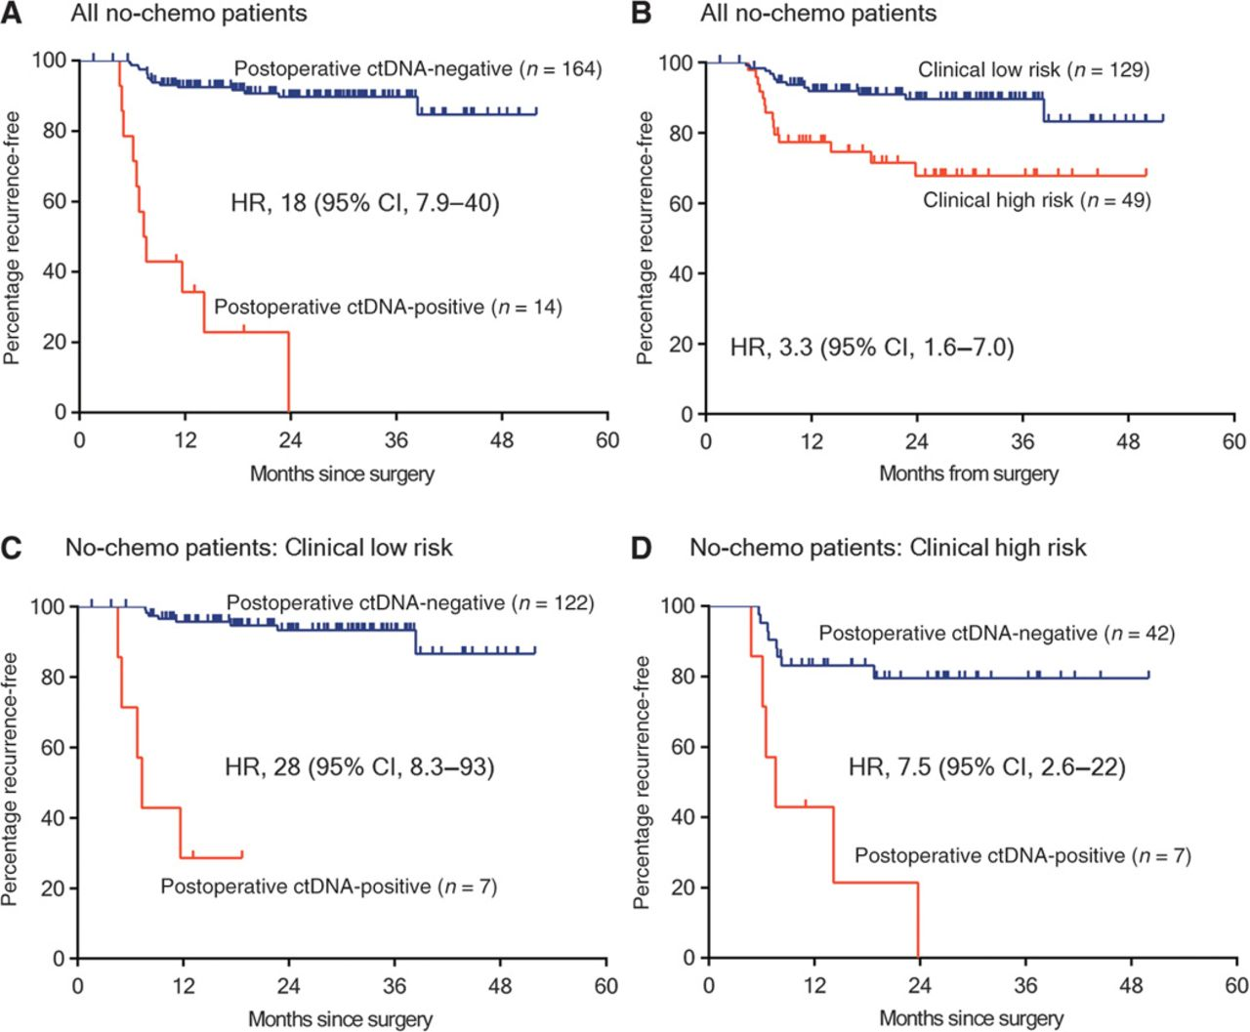
Recurrence Free Survival (RFS) in patients
not treated with adjuvant chemotherapy
Jeanne Tie et al., Sci Transl Med 2016;8:346ra92
Notes:
RFS in patients not treated with adjuvant chemotherapy. (A) Kaplan-Meier estimates of RFS for all patients not treated with adjuvant chemotherapy, stratified by postoperative ctDNA status. (B) Kaplan-Meier estimates of RFS in the same patients, stratified by clinicopathologic characteristics. (C) Kaplan-Meier estimates of RFS stratified by postoperative ctDNA status in patients with low-risk clinicopathologic characteristics. (D) Kaplan-Meier estimates of RFS stratified by postoperative ctDNA status in patients with high-risk clinicopathologic characteristics. The high-risk group is defined as those having mismatch repair–proficient (pMMR) tumors with at least one of the following poor prognostic features: T4, LN yield <12, LVI, and poor tumor differentiation. The low-risk group is defined as those with no poor prognostic features.

Slide 30
Recurrence Free Survival (RFS) in patients
not treated with adjuvant chemotherapy by CEA level

Slide 31
ctDNA in Stage II-Results
Post chemo +ctDNA: worse RFS: HR=11
Radiologic recurrence: +ct DNA (23/27) vs. CEA (11/27) – 85% vs. 41% (p=.002)
Time from detection to recurrence (ctDNA 167 days vs. CEA 61 days), p=.04

Slide 32
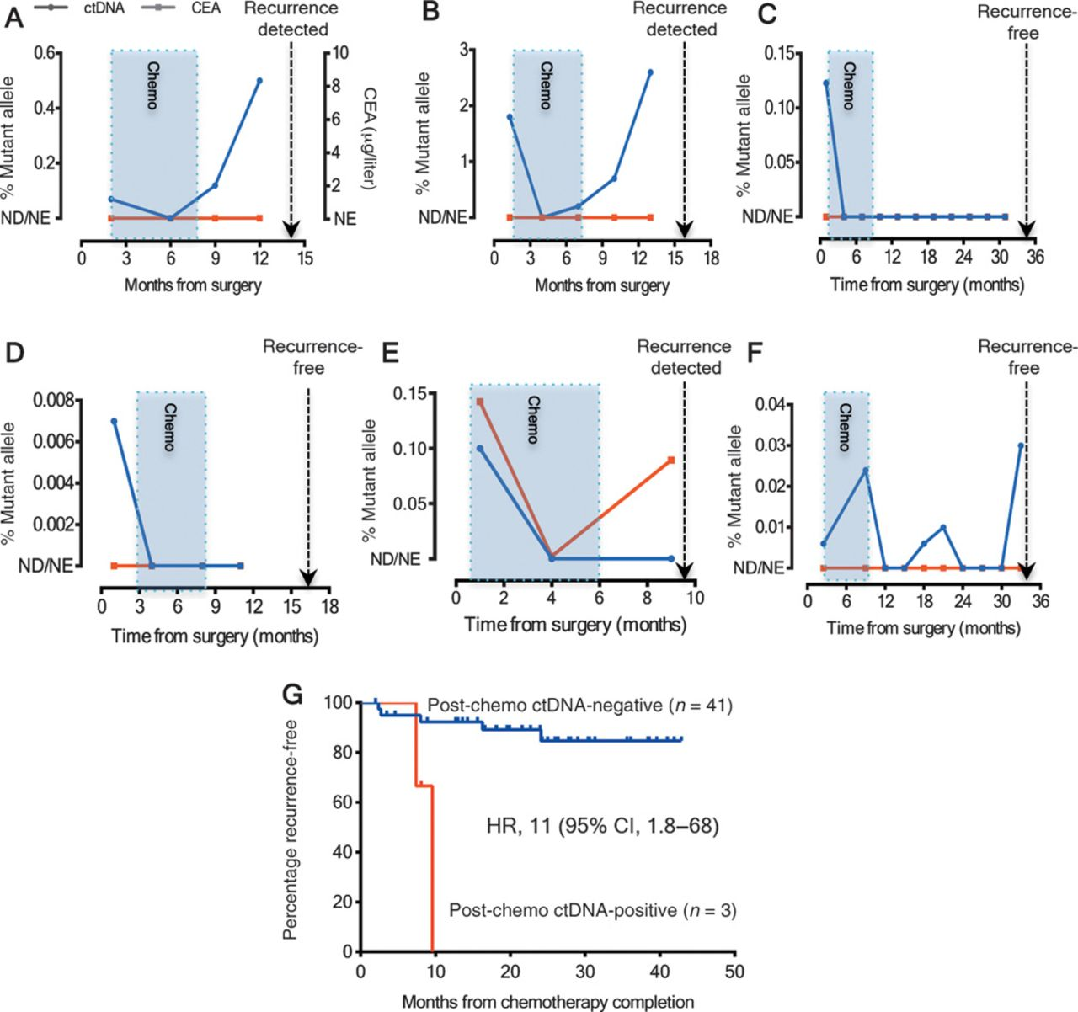
ctDNA status and RFS after adjuvant chemotherapy
Notes:
ctDNA status before, during, and after adjuvant chemotherapy. (A to F) ctDNA concentrations (% mutant alleles) for the six patients with positive postoperative ctDNA who subsequently received adjuvant chemotherapy. The blue shaded box indicates the period during which adjuvant chemotherapy was administered. The dotted line indicates the time of radiologic recurrence or last follow-up (if recurrence-free). The ctDNA status of patients represented in (A) and (B) initially became negative, then became positive again at the completion of adjuvant chemotherapy; both patients subsequently suffered a radiologic recurrence. Note that CEAs were not elevated in either patient at any time point. (C to F) Four patients whose ctDNA became negative after completion of chemotherapy. Three of these patients (patients C, D, and F) remained radiologic recurrence-free at their last follow-up visit. (G) Kaplan-Meier estimates of RFS according to post-chemotherapy ctDNA status in patients treated with adjuvant chemotherapy. ND, not detected; NE, not elevated.

Slide 33
Serial ctDNA status up to radiological recurrence
ctDNA levels in patients not treated with chemo with positive ctDNA post op up time of radiologic recurrence (N=9)
Lead time to radiologic recurrence for ctDNA and CEA
Notes:
Serial ctDNA status up to radiological recurrence. (A) Serial ctDNA measurements up to the time of radiological recurrence for the nine patients who were not treated with adjuvant chemotherapy and who were ctDNA-positive postoperatively. (B) Scatter plot of the lead time to radiological recurrence for ctDNA detection and CEA elevation, with the error bars representing the median and IQR.

Slide 34
ctDNA status before, during, and after adjuvant chemotherapy
with positive post op ctDNA (N=6)
3 of 4 patients whose ctDNA became negative post chemo remained recurrence free
Notes:
ctDNA status before, during, and after adjuvant chemotherapy. (A to F) ctDNA concentrations (% mutant alleles) for the six patients with positive postoperative ctDNA who subsequently received adjuvant chemotherapy. The blue shaded box indicates the period during which adjuvant chemotherapy was administered. The dotted line indicates the time of radiologic recurrence or last follow-up (if recurrence-free). The ctDNA status of patients represented in (A) and (B) initially became negative, then became positive again at the completion of adjuvant chemotherapy; both patients subsequently suffered a radiologic recurrence. Note that CEAs were not elevated in either patient at any time point. (C to F) Four patients whose ctDNA became negative after completion of chemotherapy. Three of these patients (patients C, D, and F) remained radiologic recurrence-free at their last follow-up visit. (G) Kaplan-Meier estimates of RFS according to post-chemotherapy ctDNA status in patients treated with adjuvant chemotherapy. ND, not detected; NE, not elevated.

Slide 35
ctDNA in Stage II CRC - Conclusions
Sensitivity (+ ctDNA) of predicting recurrence at 36 months is 48%
97% of subjects who did not recur had negative ctDNA post op
+ ctDNA high risk radiologic recurrence w/o chemo (none at 3 yrs by KM)
- ctDNA low risk radiologic recurrence w/o chemo (90% RFS at 3 yrs)
Personalized approach to patient management with ct DNA
ct DNA “better” than CEA

Slide 36
Conclusions
ctDNA is a marker for recurrence in patients with stage II CRC
ctDNA findings discriminate within clinicopathologic subgroups

