Slide 1
Pancreatic Cancer Team Project:
Biomarker Comparison/Combination
Comparison of candidate biomarkers from the EDRN and elsewhere
Samples from the two CVCs
Resectable cancer vs. benign diseases
Best performers will move to Reference Set
Successful markers in the Reference Set will be further tested in prediagnostic and diagnostic samples

Slide 2
Overview
Assemble set, send aliquots immediately to the three initial sites
  Send to other sites for testing when ready
Each site runs assays blinded, sends data to DMCC
  DMCC will have evaluated preliminary data to ensure each marker panel meets minimum criteria
DMCC analyzes data to compare biomarkers and evaluate combined markers
  Target criteria set to optimize either sensitivity or specificity
Promising panels will be run on the reference set
Panels meeting targets in the reference set will be further tested in prediagnostic samples – potential collaboration with Japan group

Slide 3

CVC Resources
Diagnosis | UPMC | UNMC
Pancreatic Adenocarcinoma (total) | 1,657 | 304
Stage I | 82 | 6
Stage IIA | 234 | 18
Stage IIB | 498 | 46
Stage III | 223 | 21
Stage IV | 515 | 42
Unknown | 105 | 171
Pancreatic Neuroendocrine Tumors | 216 | 15
Ampullary Tumors | 44 | 6
Intraductal Papillary Mucinous Neoplasms: surgical | 111
Intraductal Papillary Mucinous Neoplasms: clinical | 849
Mucinous Cystic Neoplasms: Surgical | 21
Mucinous Cystic Neoplasms: Clinical | 35
Solid Pseudopapillary Neoplasms | 7
Serous Cystadenomas: | 112 | 1
Pseudocysts | 156
Chronic Pancreatitis | 323 | 13
Acute Pancreatitis | 235 | 10
Benign Biliary Obstruction | 141
Healthy Controls | 87 | 104
Abnormal imaging test of pancreas with normal pancreatic EUS | 122
Abnormal imaging test of pancreas with benign finding | 146
Also have samples from rapid autopsies (UNMC)

Slide 4
Samples
Existing samples from the UPMC and MDACC Clinical Validation Centers
Cases: resectable pancreatic cancer, mostly PDAC but including other types
  Secondary analysis: new-onset diabetes
Controls: any benign condition of the pancreas, focus on chronic pancreatitis and biliary obstruction
~100 cases, ~100 controls

Slide 5
Target Performance
Clinical application both for diagnosis and screening
  Screening would be within new-onset diabetes
Two targets: one to optimize sensitivity, one to optimize specificity

Slide 6
Biomarkers
UNMC, Dr. Surinder Batra: MUC5AC and MUC5AC glycoforms
MDACC, Drs. Samir Hanash and Anirban Maitra: protein and autoantibody panel
VARI, Dr. Brian Haab: glycan and mucin glycoform panel
UPMC, Dr. Anna Lokshin: protein panel using Luminex

Slide 7
Panel 1
UNMC, Dr. Surinder Batra: MUC5AC and MUC5AC glycoforms

Slide 8
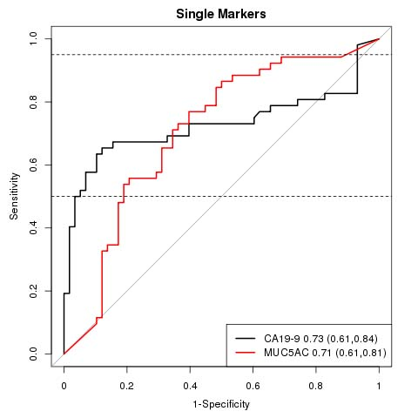
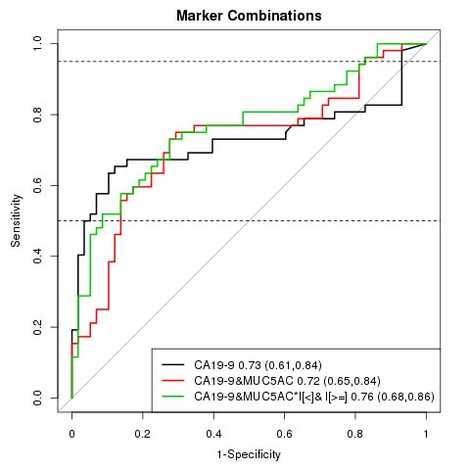
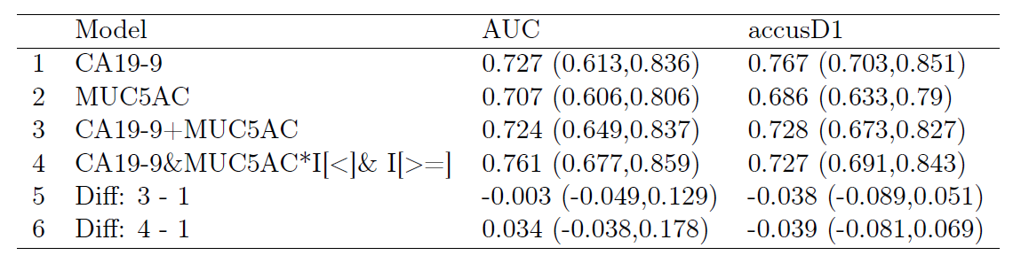

STAGE IA/IB/IIA FROM HEALTHY CONTROL GROUPS
0.73 TO 0.76
MUC5AC marginally improved the diagnostic efficacy of CA19.9 for differentiating HC from stage 1A/1B/IIA
Notes:
Because MUC5AC was measured with an upper limit, an additional model, labelelled CA19-19 +
MUC5AC I[MUC5AC < 20; 000] + I[MUC5AC 20; 000] was analysed and reported. It is based
on using values of MUC5AC for observations in which the value was below the upper limit and a
simple indicator for observations with value above the measurement threshold. The two coefficients
(for the continuous measured term and the indicator) are referred to as mkrLow and mkrHigh,
respectively.
In all models, the biomarkers are included on the log-scale. Any included adjustment covariates
are left on their natural scale (not log-transformed). For example, a model including one biomarker,
BMKR1, and adjusting for age would have linear predictor: 0 + 1 (log(BMKR1)) + 2 AGE.
For brevity, labels for models and coefficients do not reflect the log transformation.

Slide 9
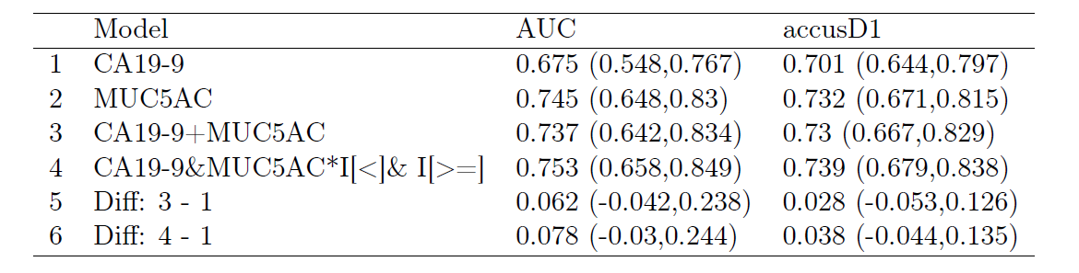
STAGE IA/IB/IIA VS CHRONIC PANCREATITIS
0.67 TO 0.75
MUC5AC PERFORMED BETTER THAN CA19.9 IN DIFFERENTATING CHRONIC PANCREATITIS CASES FROM CA19.9 THAT WAS USED AT ITS OPTIMAL CUT-OFF

Slide 10
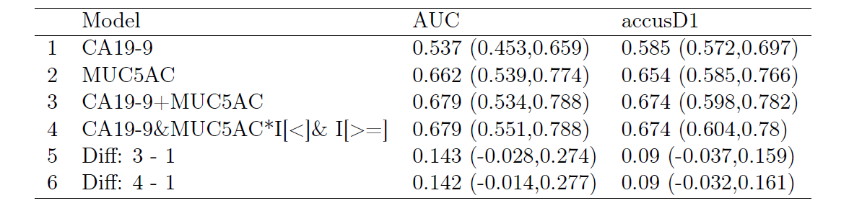
STAGE IA/IB/IIA VS ACUTE BILIARY OBSTRUCTIONS
0.54 TO 0.68
MUC5AC HAS HIGH DIAGNOSTIC POTENTIAL IN ACUTE BILIARY OBSTRUCTION CASES AND COMBINATION PERFORMED MUCH BETTER THAN CA19.9 ALONE
Notes:
DIFFERENCES DID NOT REACH SIGNIFICANCE DUE TOLOW SAMPLE NUMBER

Slide 11
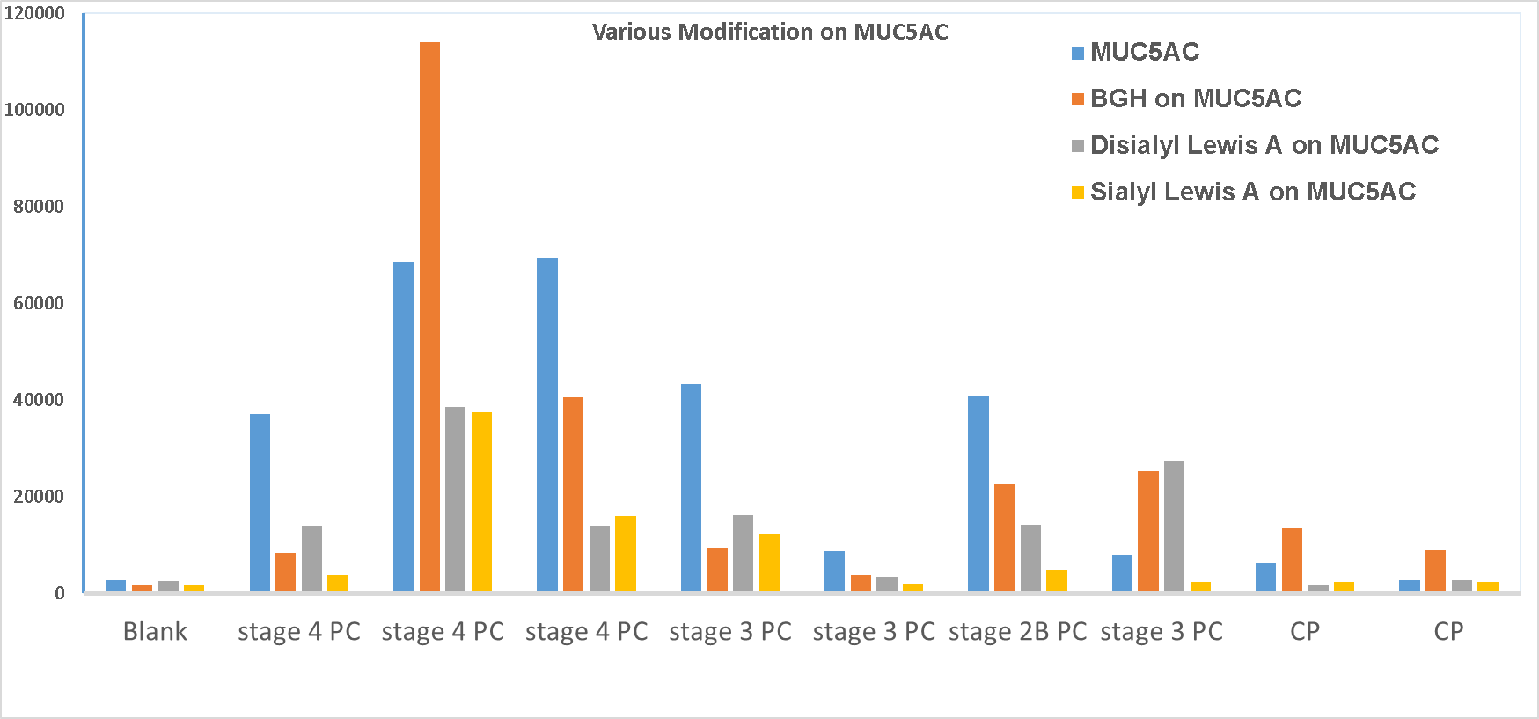
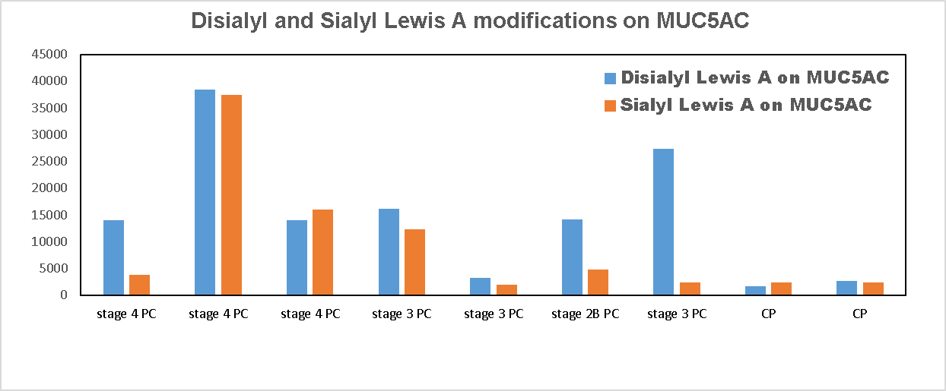
Assessment of Glycan Alterations on MUC5AC
MUC5AC expresses CA19.9 and Blood Group H antigen

Slide 12
Panel 2
MDACC, Drs. Samir Hanash and Anirban Maitra: protein and autoantibody panel

Slide 13
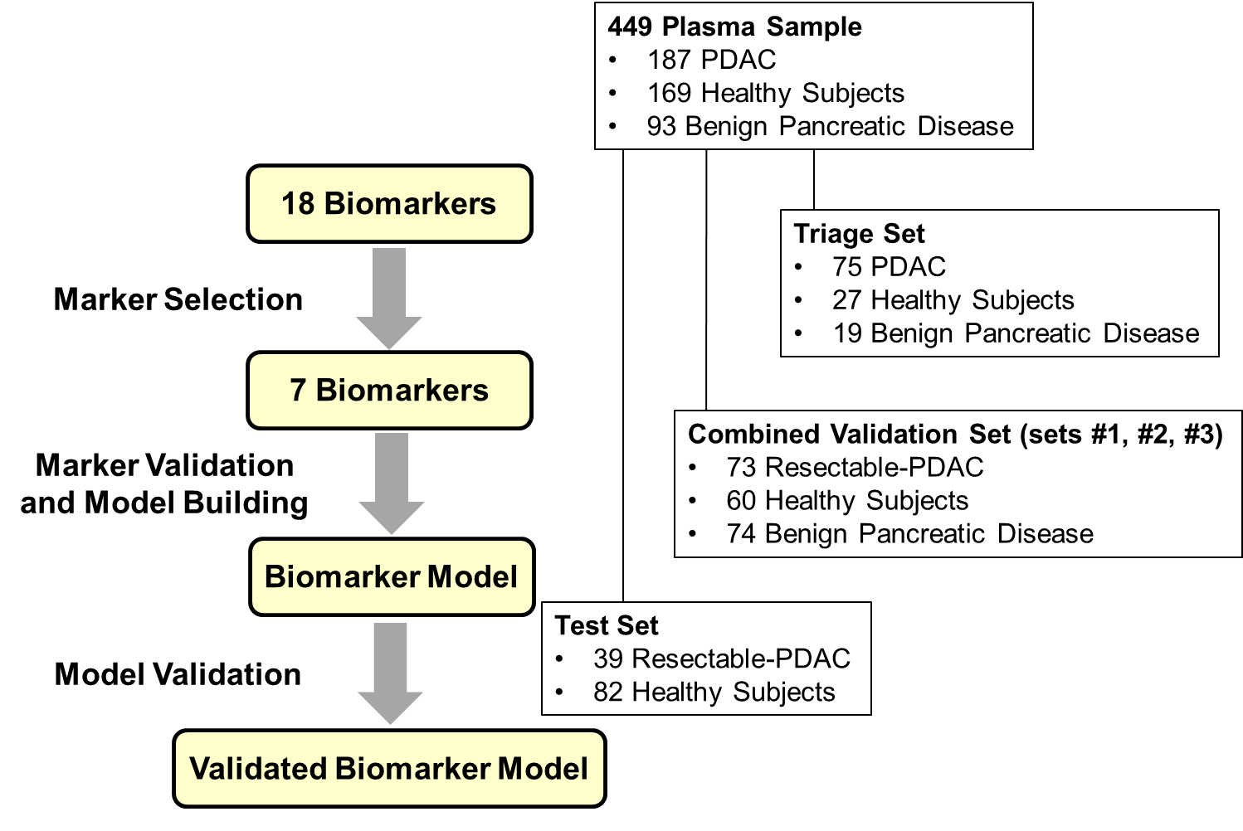
Sequential Validation Strategy
Capello M et al, JNCI 2017

Slide 14
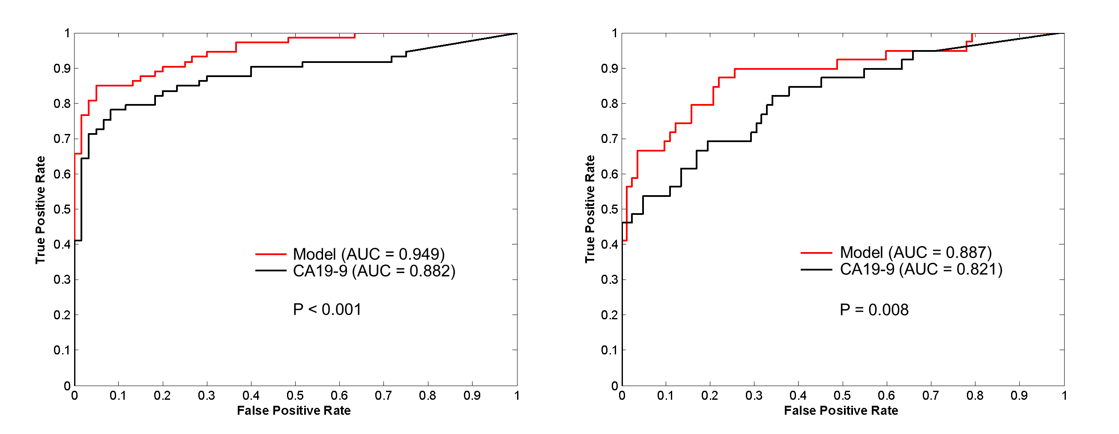
Biomarker Model Building and Validation
Combined Validation Set
Test Set
Model: TIMP1 + LRG1 + CA19-9
Resectable-PDAC vs Healthy Controls
Capello M et al, JNCI 2017

Slide 15
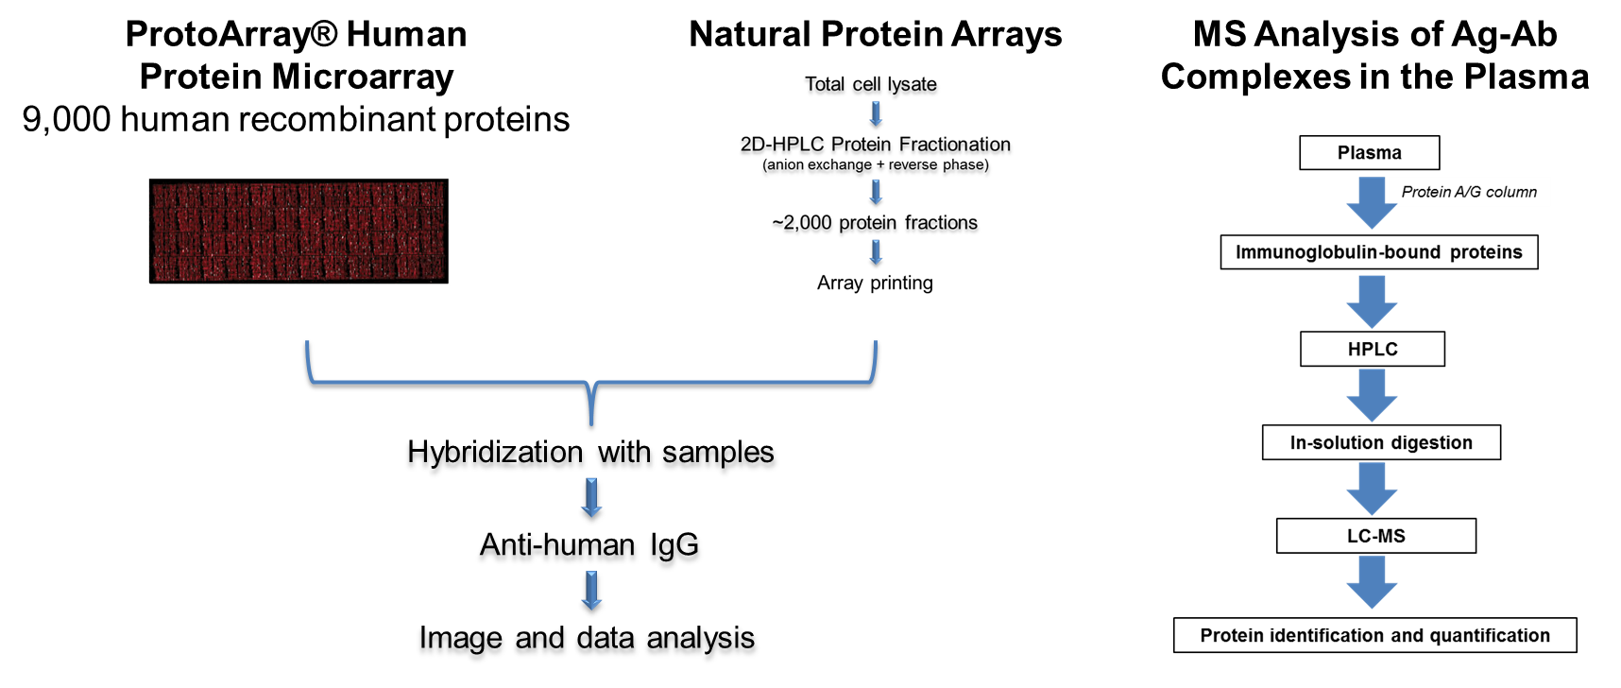
Tumor-Associated Antigen Candidates
Qiu J et al, JCO 2008; Ladd JJ et al, Cancer Res 2013; Katayama H et al, Cancer Res 2015

Slide 16
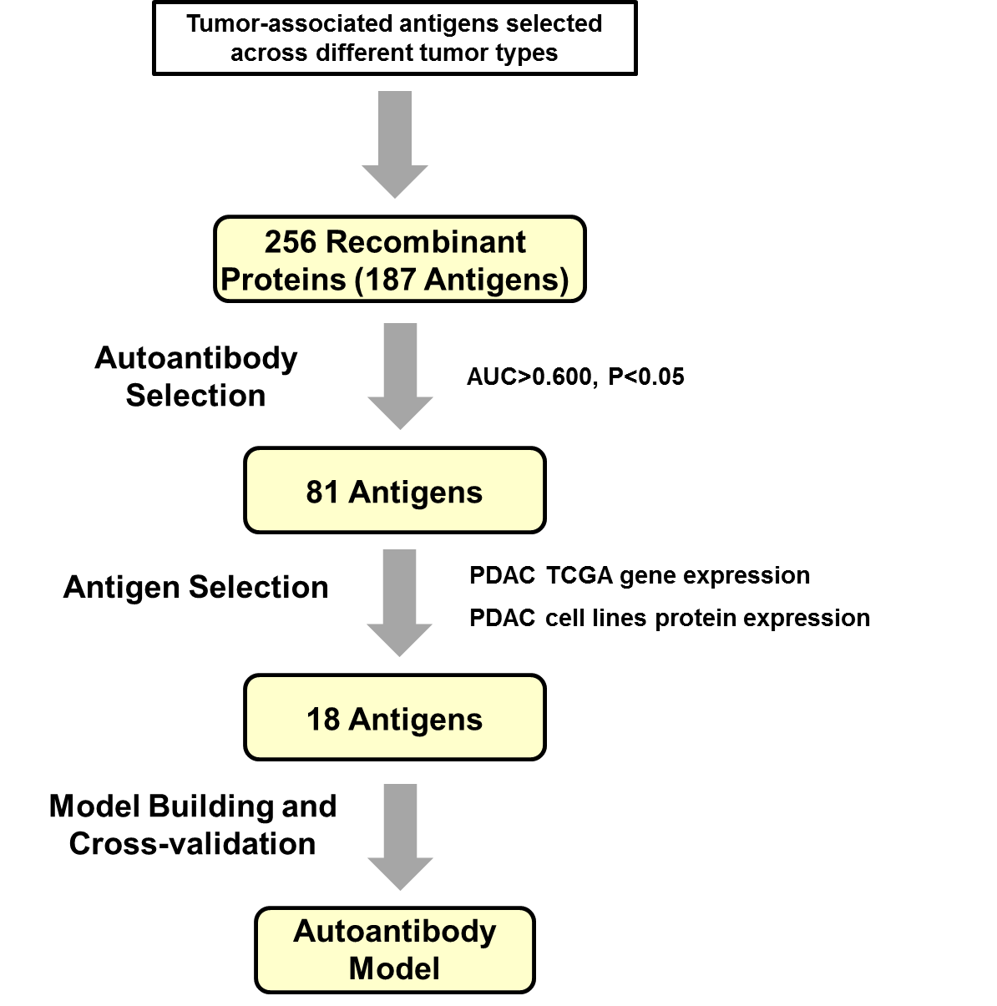
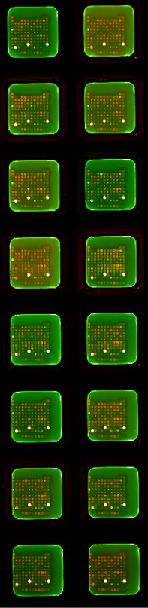
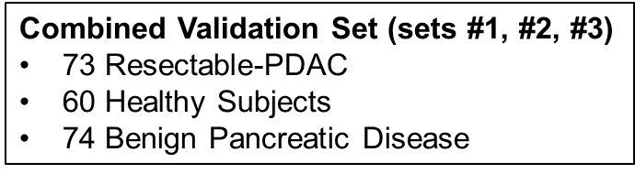
Autoantibody Biomarker Candidates

Slide 17
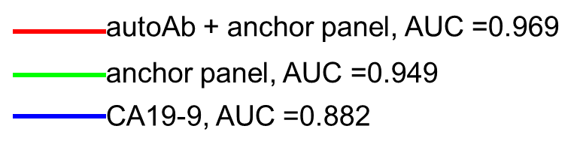
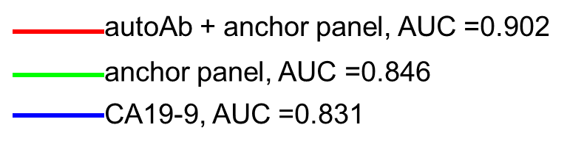
Protein and Autoantibody Biomarker Model
Resectable-PDAC vs
Benign Pancreatic Disease
Resectable-PDAC vs Healthy Controls
vs anchor panel P=0.043
vs anchor panel P=0.012
4 autoantibodies + anchor panel (TIMP1, LRG1 & CA19-9)

Slide 18
Panel 3
VARI, Dr. Brian Haab: glycan and mucin glycoform panel

Slide 19
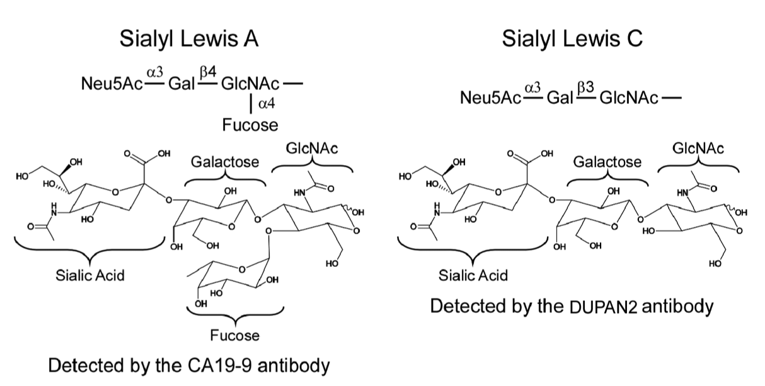
The CA19-9 antigen
New biomarker: sTRA
Detected by the TRA-1-60 mAb
After sialidase treatment
Detected by the CA19-9 antibody
Notes:
In approaching this problem, start with this marker
It has biological function, as do related structures
It is detected by an antibody. Perhaps related structures occur. Such structures would not be detected by the antibody

Slide 20
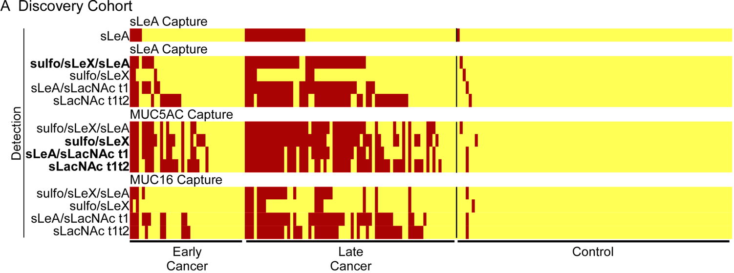
sTRA and CA19-9 are elevated in distinct subgroups
CA19-9
sTRA glycoform
of MUC5AC
*
*
*
Combined Cohorts
Three-marker panel: 85% sensitivity and 90% specificity
CA19-9: 54% sensitivity and 86% specificity
Notes:
We used a high-specificity threshold and saw elevations in CA19-9-low
Rates were similar in early-stage
A panel performed with 85% accuracy

Slide 21
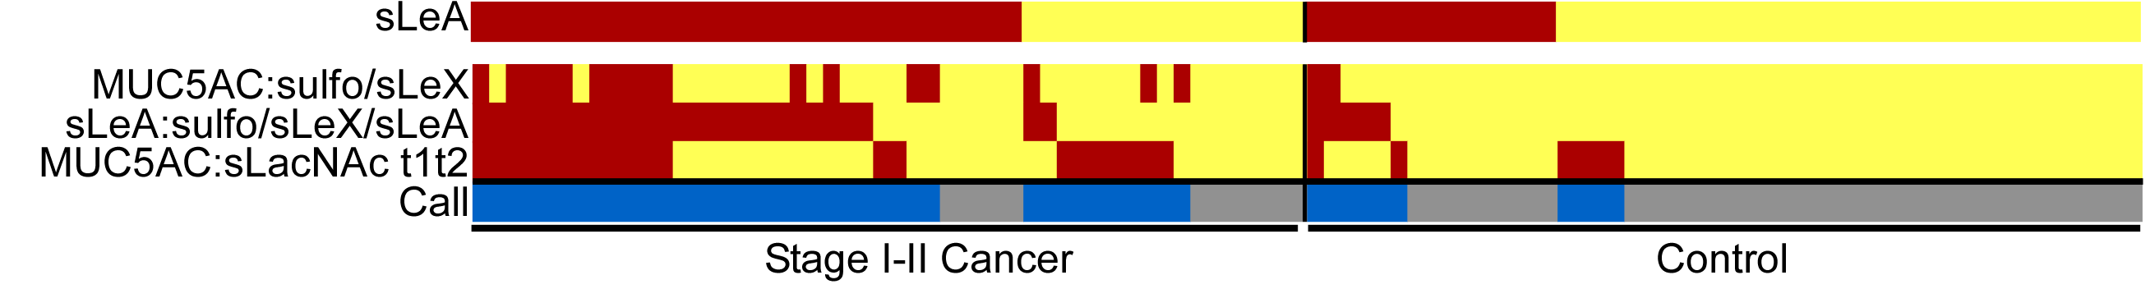
Blinded Set:
Stage I/II cancer vs. benign controls
CA19-9
MUC5AC:sLeX
CA19-9:E-selectin
MUC5AC:sTRA
Call
CA19-9: 66% sensitivity, 72% specificity
Panel: 80% sensitivity, 84% specificity
Notes:
This is the toughest comparison, and was blinded

Slide 22
Glycan/Glycoform Panel Performance Summary
sTRA performs similarly to CA19-9 as an individual biomarker
sTRA is elevated independently of CA19-9
A 3-marker panel performed better than CA19-9 in 3 sample sets
Are cancers that produce sTRA a different subtype than those that produce CA19-9?

Slide 23
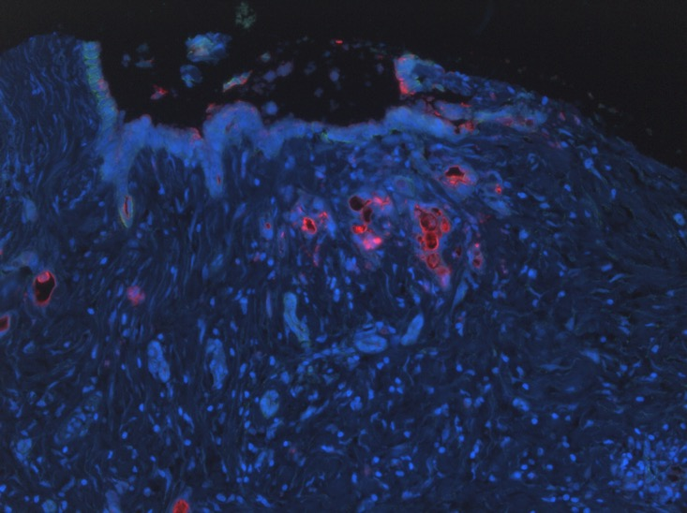
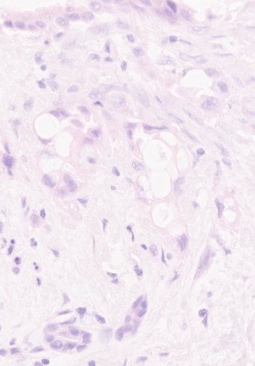
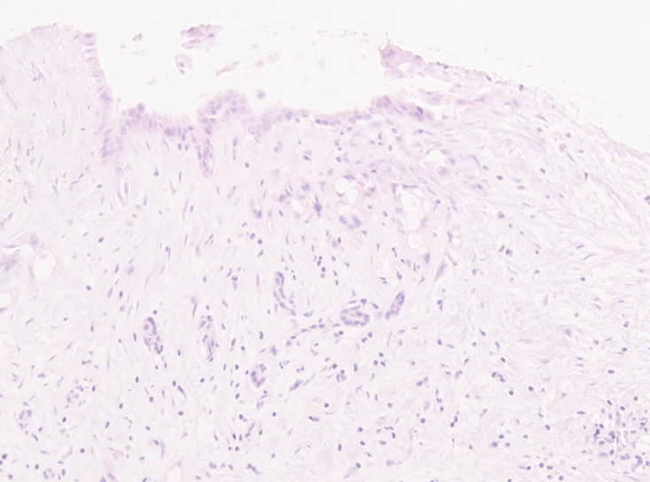
Red: CA19-9
Red: sTRA

Slide 24
