Slide 1
Lung collaborative group projects
LTP2
LTP3
LTP4 Preinvasive Lung Cancer Atlas
Considerations for future projects
Clinical trial biomarker driven diagnosis of IPNs.

Slide 2
Lung Team Project #2 Non invasive diagnosis of indeterminate pulmonary nodules
Lead: Avi Spira, MD

Slide 3
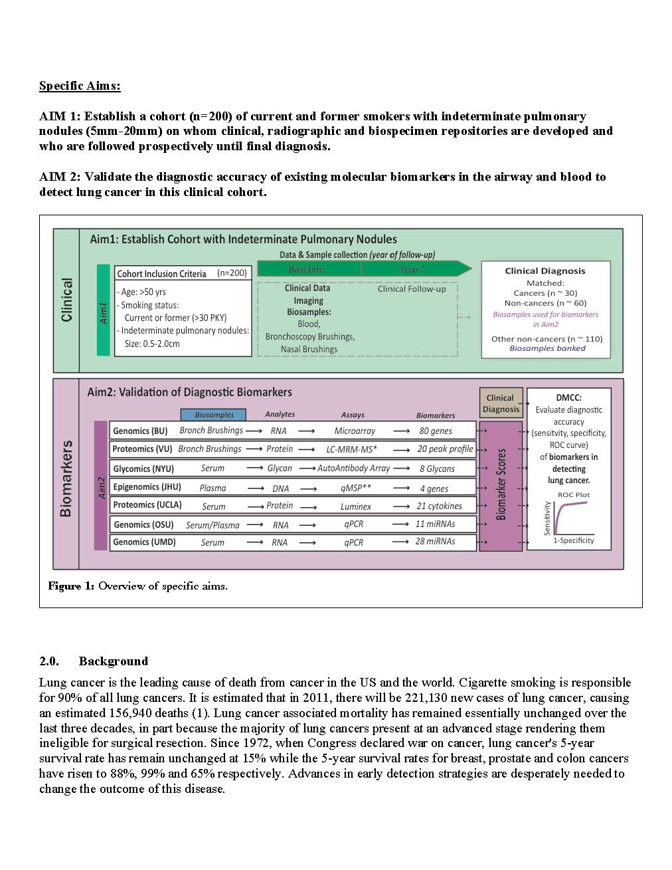
Lung collaborative project - LTP2
132/200 patients enrolled

Slide 4
Existing repositories: LTP2- IPNs n=132/200
Risk Factors Among LTP2 Participants
LC Dx
Other
(n=62)
(n=70)
Smoker:
Yes
62
70
Age:
mean
67.6
66.7
sd
8.7
8.4
Diameter mm:
mean
17.4
13.6
sd
5.4
4.5
Years Since Quitting:
mean
6.1
7.7
sd
10.9
11.7

Slide 5
Information for Final Dx – By Site
Notes:
Avi added Lahey
Jim Tsay at NYU
UCLA at the VA Igor
Wash u Uken
Herman David Wilson
Moffitt Lung cancer screening.

Slide 6
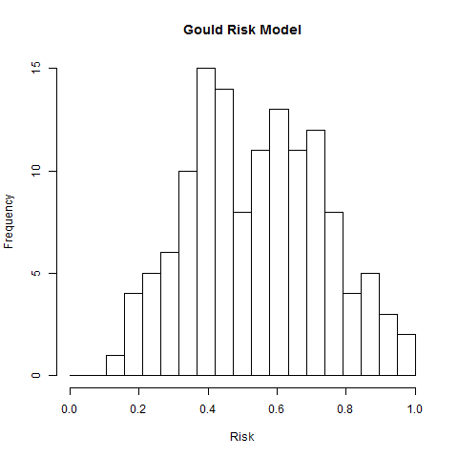
Gould Model
Prevalence of malignant SPN in Gould model development: 54%
*Chest v.131 (2007)

Slide 7
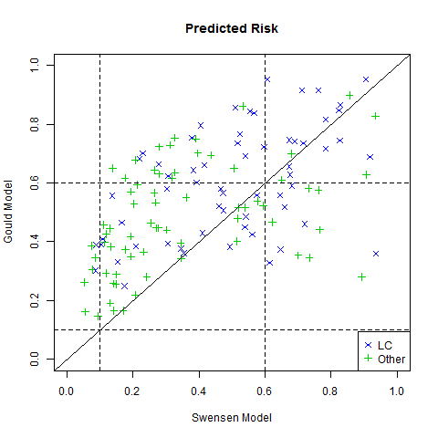
Comparison of Risk Scores

Slide 8
Key points of discussion moving forward.
Adjudicating committee Form: Spira, Schabath, Aberle, Massion
Reminder Form from VISMs at 24 mo follow up
Timing nodule ID from baseline CT down to 6 mo. since first CT.
For multiple nodules we will adjudicating the larger nodule.
Risk of study participants. 42-54% predicted risk across models. Prevalence of lung cancer is 47%. A
Add sites. Moffitt, U of Pittsburgh.
Time line: completion of accrual within 18 months.

Slide 9
Lung collaborative project - LTP2: Biomarkers

Slide 10
Lung Team Project #3 Biomarkers for Predicting Progression in Patients with Clinical Stage I Lung Cancer
Lead : Harvey Pass, MD

Slide 11
LTP3

Slide 12
LTP3

Slide 13
LTP3
AUC 71%

Slide 14
Survival

Slide 18
LTP3 Recurrence

Slide 19
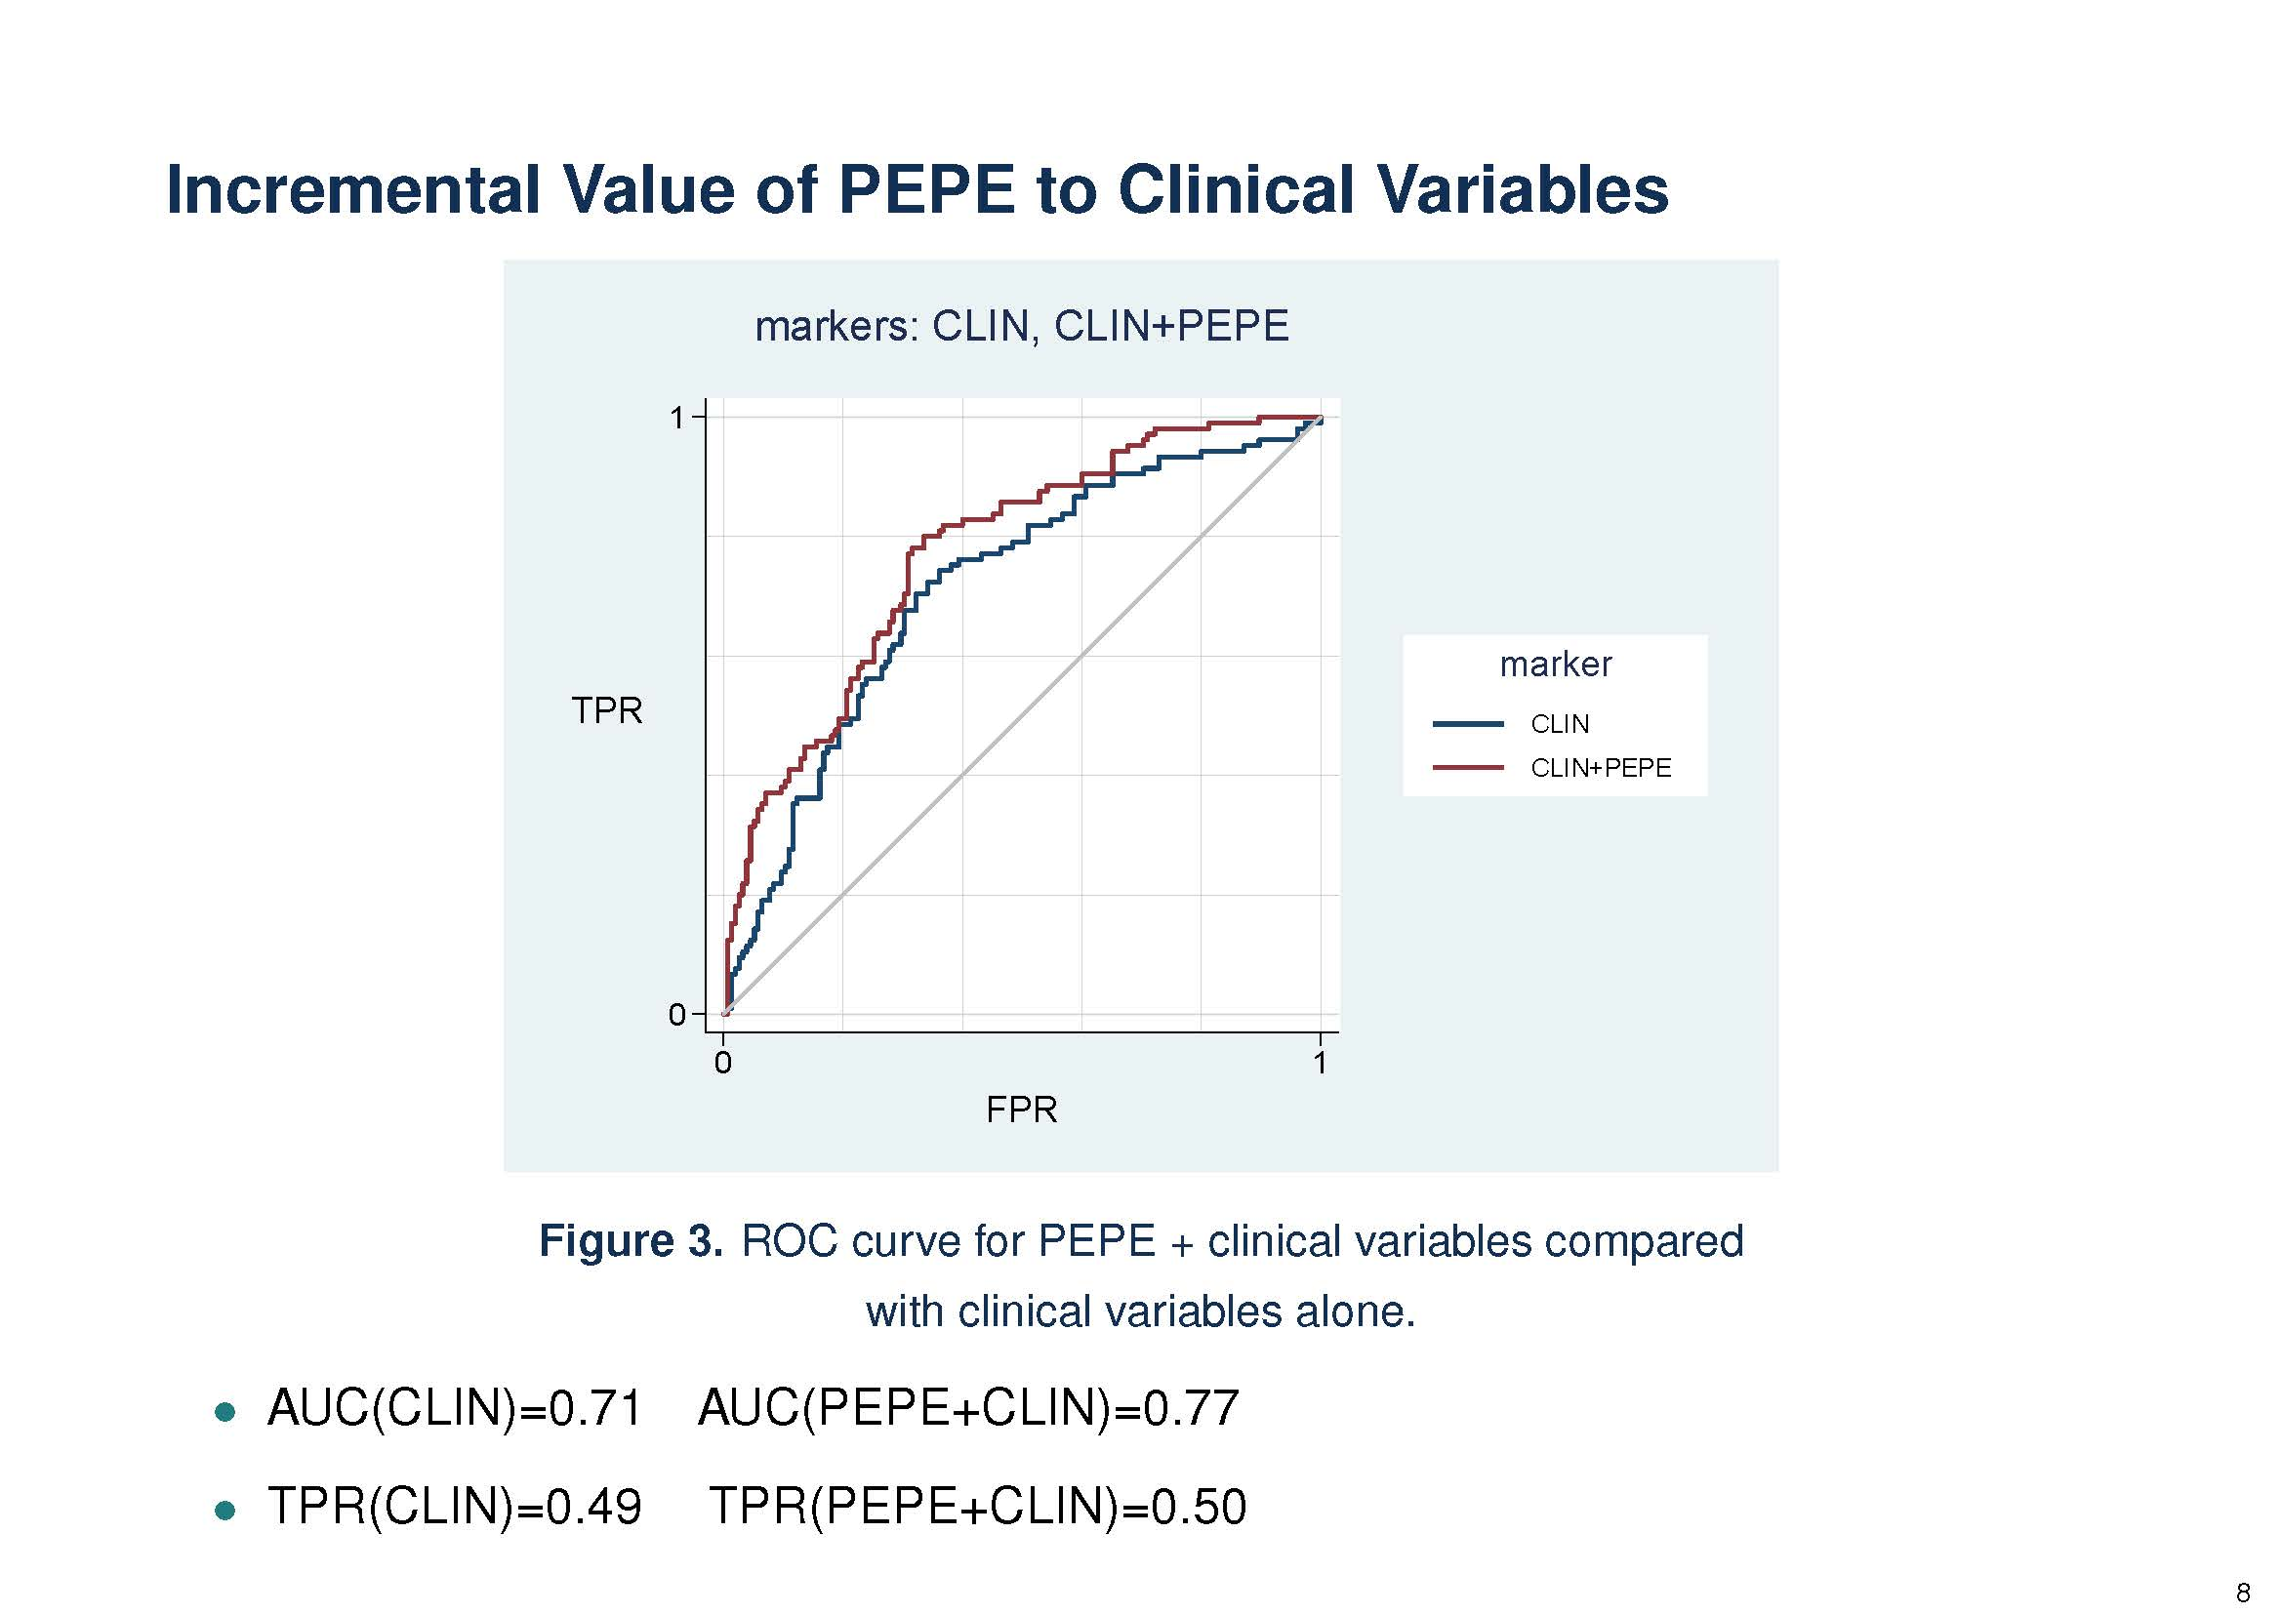
LTP3 Simulation exercise for SS calculation

Slide 20
LTP3 Discussion
Will need biomarkers with AUC greater than 0.6 in order to build on the Clinical AUC
Decided to have patients who are pathologic Stage I only who may not be 5 years mature
Will increase the number of at risk individuals for recurrence
Will need biomarkers with AUC greater than 0.6 in order to build on the Clinical AUC
Biomarkers of recurrence within our Lung Collaborative group and
Integration of biomarkers being tested in the MCL consortium

Slide 21
Lung Team Project 4– Preinvasive lesions ATLAS (Possible core funds request)
Discovery biomarkers predictive of disease development
Specimens:
Bronchial dysplasia (bronchoscopy or surgical), and
Ground glass opacities, atypical alveolar dysplasia or adenocarcinoma in situ
Assemble a list of specimens available with careful annotation
Leverage funding form Moonshot initiative

Slide 22
Lung Team Project 5– Risk assessment -- Future considerations
Improving on who is the best population to screen for lung cancer?
Identify individuals at high risk based on EHR.
Integrate Biomarkers :
Structural Imaging biomarker
SNVs- CNVs
Autoantibody biomarker
Clinical information from a synthetic derivative of EHR

Slide 23
Future considerations
?? Screening population: never smokers.
?? Clinical trial biomarker driven diagnosis of IPNs.

