Slide 1

High-density Antibody Arrays as Proteomic, Glycomic and Autoantibody Discovery Tools
Paul Lampe
FHCRC CVC

Slide 2
Our attempts to make biomarker development more effective
Screen appropriate samples (i.e., if early detection is goal use pre-dx)
Use assay with enough throughput to be able to run hundreds of samples
Screening through multiple sets reduces false positives
Only with validated markers spend the time to make more robust assays

Slide 3
Antibody Arrays
Pros:
High affinity (up to 10⁻¹¹)
Results directly translatable
High density arraying can be performed
Low amount of sample (50µl plasma)
High number of assays/sample
Post-translational modifications
pg sensitivity

Slide 4
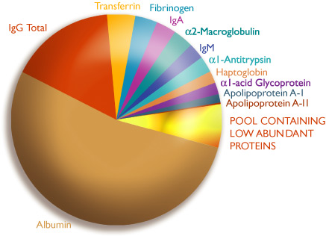
Affinity and Biomarker Concentration
Proteins in serum/plasma
>10,000 proteins

Slide 5
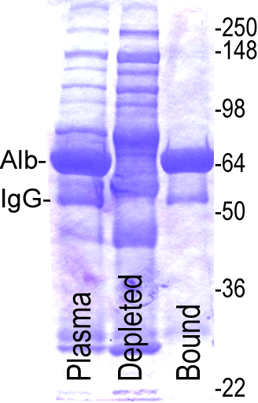
Abundant protein removal
Sigma ProtIA column (~65%)
Benefits
Lower affinity antibodies work
better
Less dye utilized by abundant
proteins

Slide 6

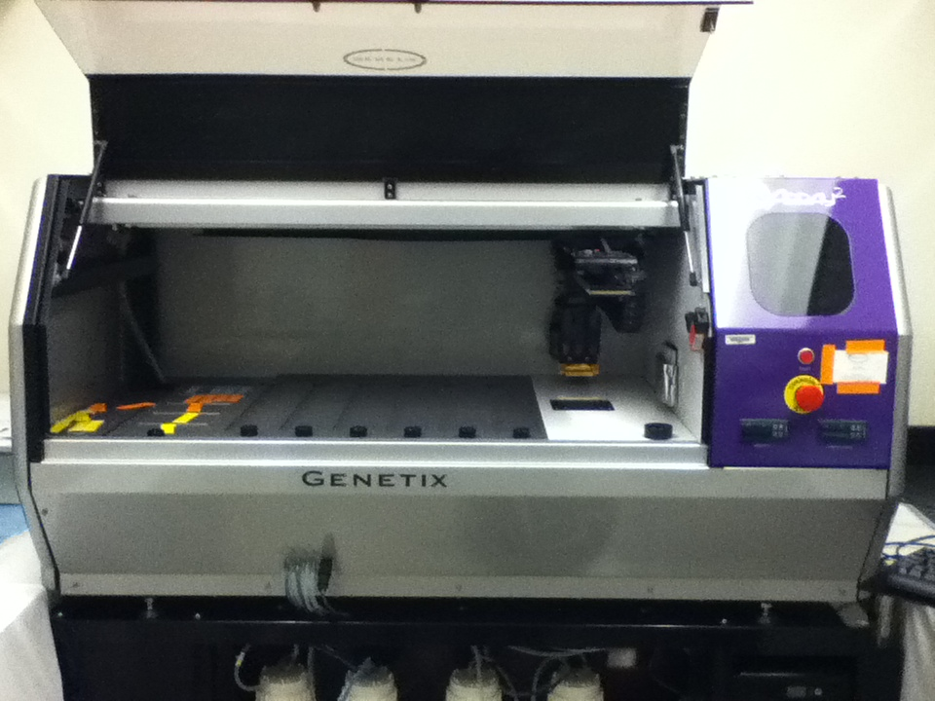
High density antibody array
Antibodies printed on NHS-ester reactive 3-D thin film surface slides (Nexterion slide H)
3,600 spots in triplicate = 10,800 spots
Targeting >2,100 different proteins.
~1,100 proteins detected by more than one antibody (different epitopes, phosphorylation, etc.)
Select antibodies to array based on preliminary data, the literature and availability of large libraries of antibodies.
Triplicates
1 BLOCK (15x15 = 225 spots)
1 slide contains 48 blocks
225x48=10800 spots/3=3600
24 or 48/day
2 arrays/slide
- 15x15x16=3600 spots/3=1200
- 48 or 96/day
14 arrays/slide
- 21x21=441 spots/3=147
- 168/day

Slide 7
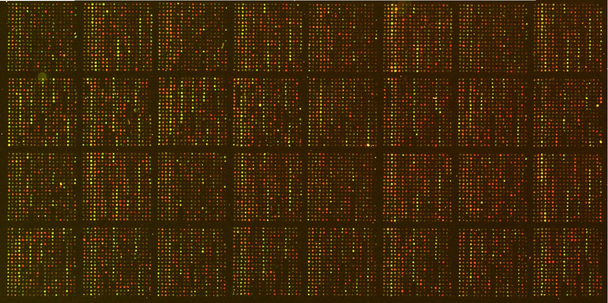
Array Image
3600 Abs spotted in triplicate, including
antibody controls, buffer controls

Slide 8
Antibody Arrays
Affinity purification platform for 3600, 1200 or 147 proteins
Proteomic
Glycomic
Autoantibody complex with antigen

Slide 9
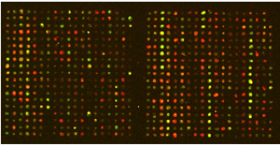
Proteomic analysis method utilizing our array
430200
430200
Antibodies covalently linked
to array surface
(high density: 3600 in triplicate)
Samples are incubated on antibody array
WASH
Proteins in sample
A
C
IgG
430200
B
Alb
Unbound proteins are washed away
Prot IA
Array is scanned
A
C
B
A
Cy5 Label
B
C
A
C
Cy3 labeled reference protein
B
Samples
(body fluids or tissue proteins)

Slide 10
Glycoproteomic analysis method utilizing our array
430200
430200
Antibodies covalently linked
to array surface
(high density: 3600 in triplicate)
Samples are incubated on antibody array
Glyco-proteome
430200
Protein
Protein
Protein
Unbound proteins are washed away
Glycans on proteins
R
Anti-Sialyl Le^{A}- Cy dyes
R
Sialyl Le^{A}
Mannose type
glycan
NeuAc
GlcNAc
Fuc
430200
Gal
Man
Only sialyl Le^{A} glycan bearing proteins are detected with fluorescently labeled anti-sialyl Le^{A}
Samples
(body fluids or tissue proteins)

Slide 11
Autoantibody-autoantigen analysis method utilizing our array
430200
430200
Antibodies covalently linked
to array surface
(high density: 3600 in triplicate)
Samples are incubated on antibody array
Free plasma proteins
430200
Unbound proteins, free IgG, IgMs are washed away
Abundant IgGs, IgMs
Fluorescently labeled
anti-human IgM
AutoAb-Antigen IgG Complex
Fluorescently labeled
anti-human IgG
AutoAb-Antigen IgM Complex
430200
Only AutoAg-AutoAb complexes are detected with fluorescently labeled anti-human IgG or IgM secondary antibodies
Samples
(body fluids or tissue proteins)

Slide 12
Colon Cancer Sample Sets
Early discovery in pre-Dx samples in Lampe and Hanash labs – populate array
Cardiovascular Health Study (CHS) pre-diagnostic samples (<3 years from Dx)
EDRN collaborative grp project (GLNE7)
UMN colonoscopy study
Japanese sera samples
EDRN sample set 2 from Dean
Danish plasma samples (Hans J. Nielsen)
WHI plasma samples
New collaborative group project (FIT+/-)

Slide 13
Discovery - CHS Prediagnostic
(79 cases vs 79 controls)
Confirmation - EDRN Diagnostic
(120 cases vs 60 controls)
(61)
(●: 78)
(1)
(○: 4)
-Log₁₀(p)
p≤0.015
-Log₁₀(p)
(1294)
(1535)
(6)
(23)
Coef
Coef
Expression in cases:
● Increased (p≤0.015, AUC>0.60)
- Decreased (p≤ 0.015, AUC>0.60)
x Insignificant (p ≤ 0.015)
Expression in cases:
● Increased (p<0.05, AUC≥0.60)
○ Increased (p<0.05, AUC<0.60)
- Decreased (p<0.05)
x Insignificant (p>0.05)

Slide 15

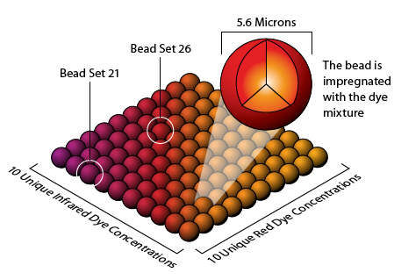
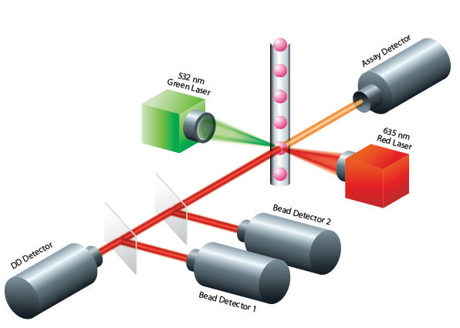
Transfer to quantitative, high-throughput multiplex technique: Luminex
Bead-based technology
Suitable for multiplexing
Antibody-based assay
  Directly translate from microarray platform

Slide 16
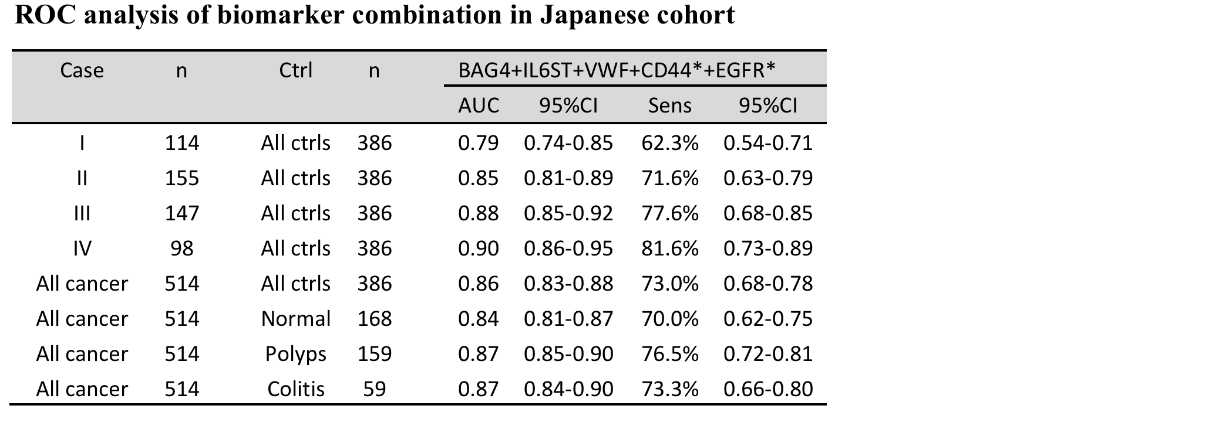
Sera: 514 cases, 386 controls (168 normal, 159 low risk polyps, 59 UC)

Slide 17
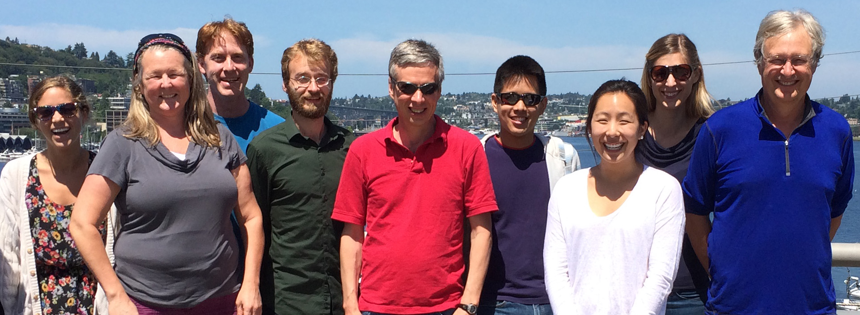
Lampe Lab Members:
Jon Ladd*
Lucrecia Márquez-Rosado
Joell Solan
Clay Dunn
Edward Lo
Kristy Lastwica
Carly Garrison
Jung-Hyun Rho*
Collaborators:
Chris Li, Chuck Drescher
Hans Jørgen Nielsen
Sam Hanash
Dean Brenner
Other GI collaborative group
Funding: EDRN, CVC: CA152637, BDL CA152746

