Slide 1
Integrating HuProt Array PTM Activity Profiling with MS Proteomic Analysis for Biomarker/Target Discovery
Zhen Zhang, PhD
Center for Biomarker Discovery and Translation
Johns Hopkins Medical Institutions
EDRN SC Meeting, 3/7-9/2017

Slide 2
Proteomic characterization of TCGA ovarian HGSC
JHU: (n = 122)
  66 HR deficient –somatic or germ line BRCA1/2 mutation, PTEN loss or BRCA1 methylation; >1.5 yr time-to-death/follow-up
  56 no HR deficiency; < 2.5 yr time-to-death/follow-up (2 samples had a mutation in other genes associated with HRD, one each in ATM and PALB2).
PNNL: (n=84, 32 overlap with JHU)
  Survival (OS < 3 yrs vs. > 5 yrs)
Sample contamination & Available tumor tissue volume.
All but five tumors had somatic TP53 mutations (excluded in final data analysis).

Slide 3
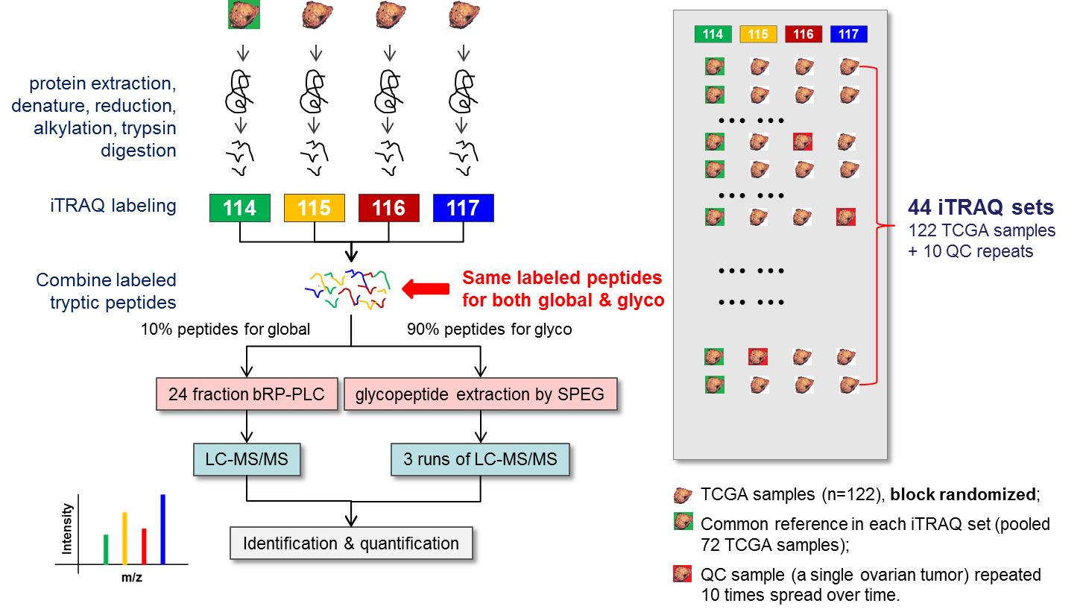
iTRAQ analysis experimental design

Slide 4
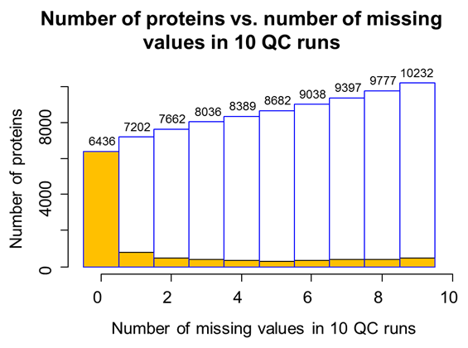
Reproducibility in protein coverage

Slide 5
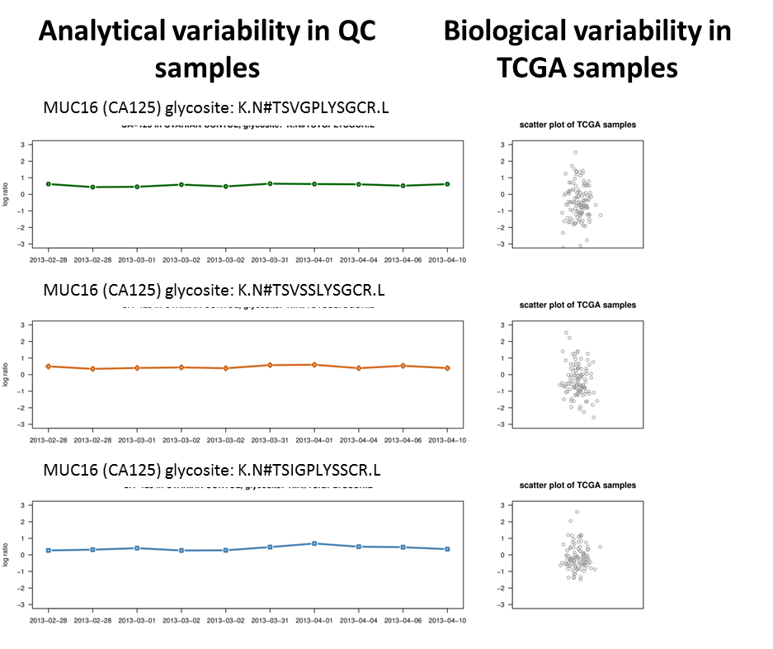
Reproducibility in quantitation (analytical precision)
Glycosites of MUC16 (CA125)

Slide 6
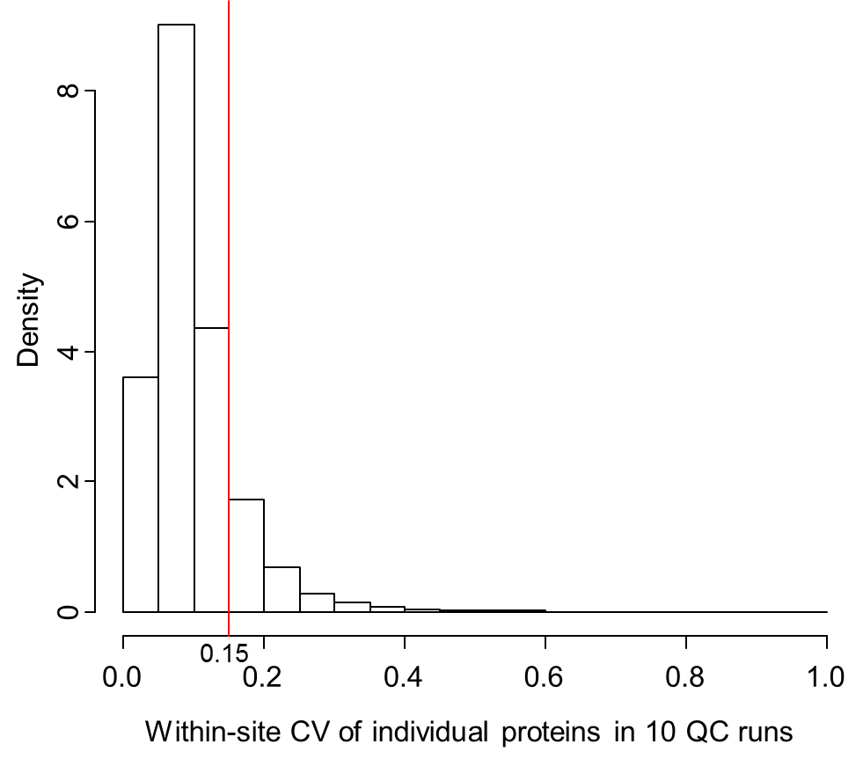
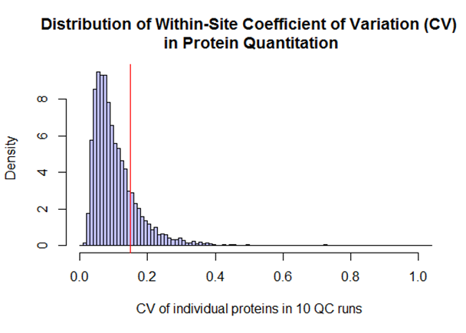
More formal characterization of analytical precision: within site-CV
Proteins with no missing values in the 10 QC runs (n = 6,436) were used in the estimation. Among them, 84.8% (n = 5,463) had a within-site CV < 15%
7202 proteins that were identified and quantified in at least 9 of the 10 repeats. Among them, 81.4% of these proteins had a CV < 15%

Slide 7
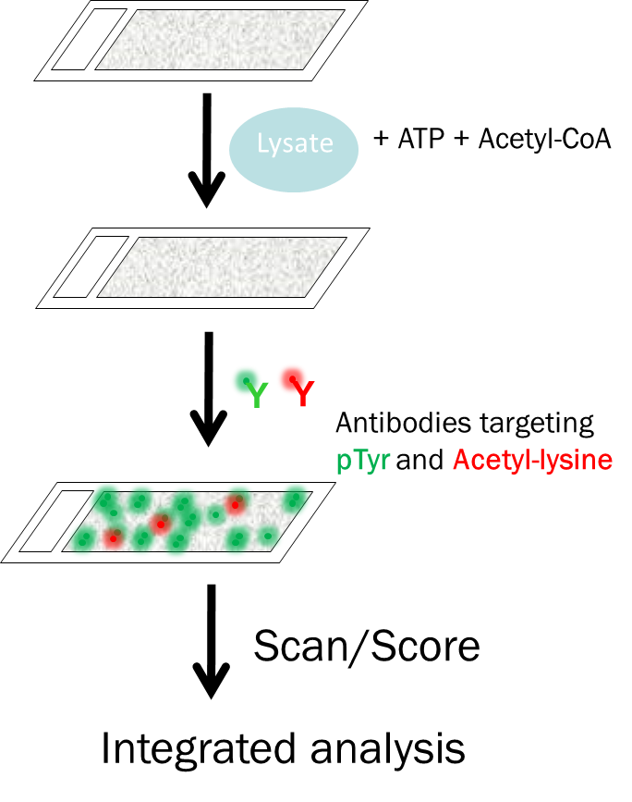
Activity-based Tyr phosphorylation and acetylation analysis (H Zhu)
102 TCGA samples (reduced from original 122 due to specimen volume restriction);
Tyrosine phosphorylation and acetylations;
Proteins interrogated: 18432;
Unique annotated proteins: 12322
Construction of human activity-based phosphorylation networks. Mol Syst Biol 2013; 9:655.

Slide 8
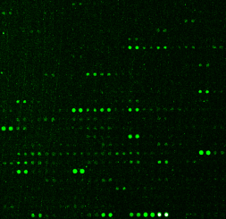
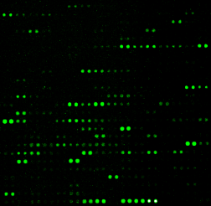
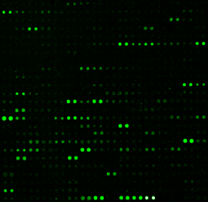
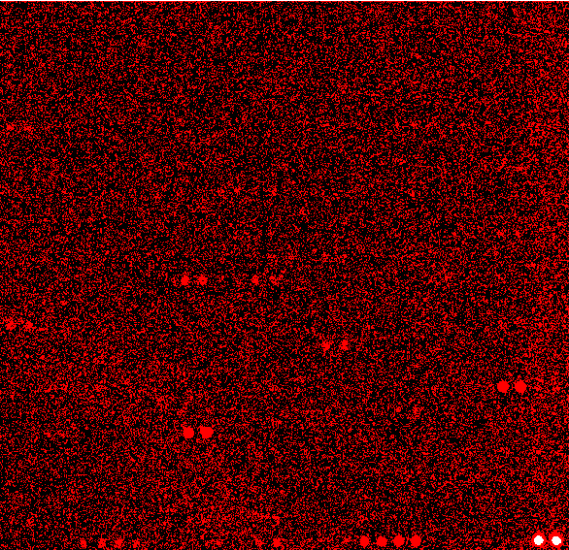
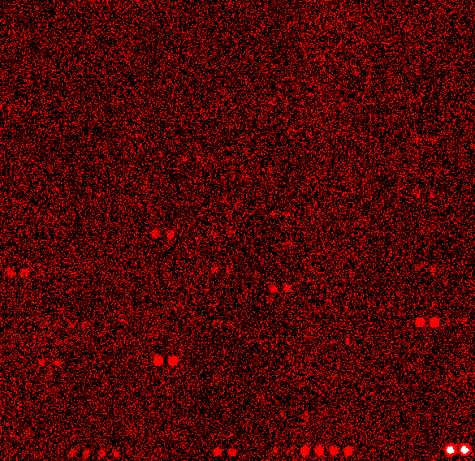
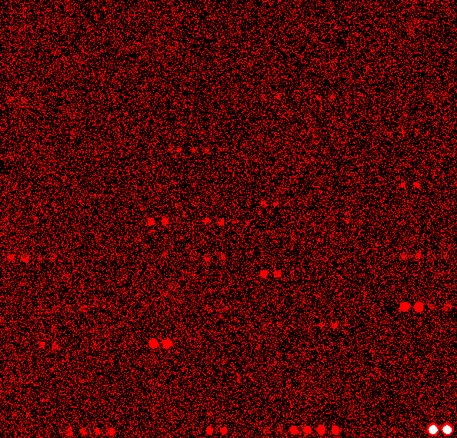
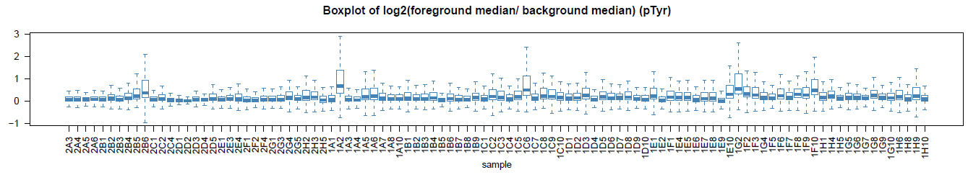
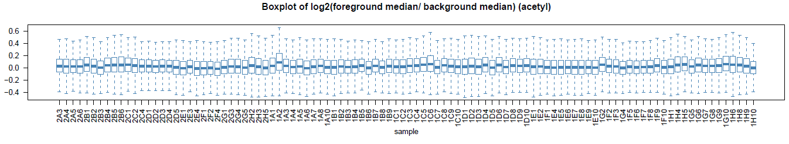
Multiolexed PTM activity profiling using HuProt
(H Zhu)
Negative control
Epoxy130427111
Sample #1H1
Epoxy130427112
Sample #1H4
Epoxy130427113
CFL1
KIA0174
PAIP2
Anti-pTyr
MKNK2
FGFR
VPS37B
DNTT
PTGIS
Anti-Kac
LRRC46
LOC285401
AMD1
Notes:
MKNK2 phosphorylates the eukaryotic initiation factor 4E (eIF4E), thus playing important roles in the initiation of mRNA translation, oncogenic transformation and malignant cell proliferation.
AMD1 encodes an important intermediate enzyme in polyamine biosynthesis, essential for cellular proliferation and tumor promotion.

Slide 9
Number of Positive Proteins Identified with pTyr and Kac Modification
932
2144
723
135

Slide 10
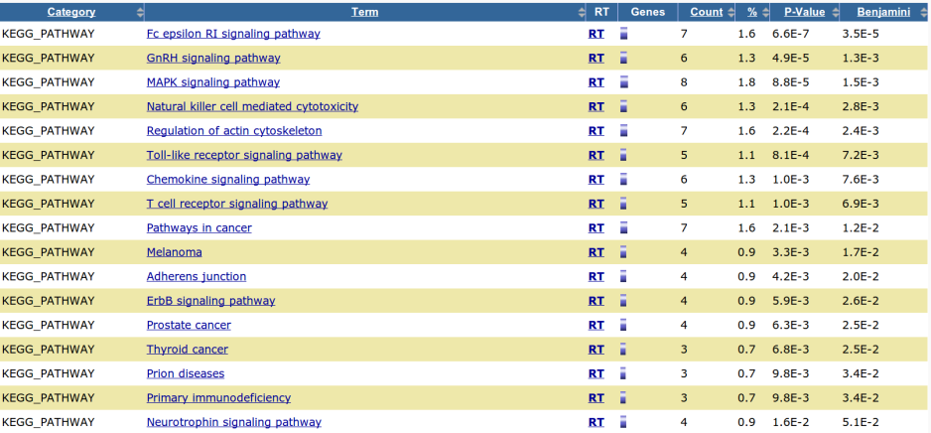
KEGG Pathway Enrichment of Tyrosine Kinases detected in JHU array data and PNNL LC-MS/MS data

Slide 11
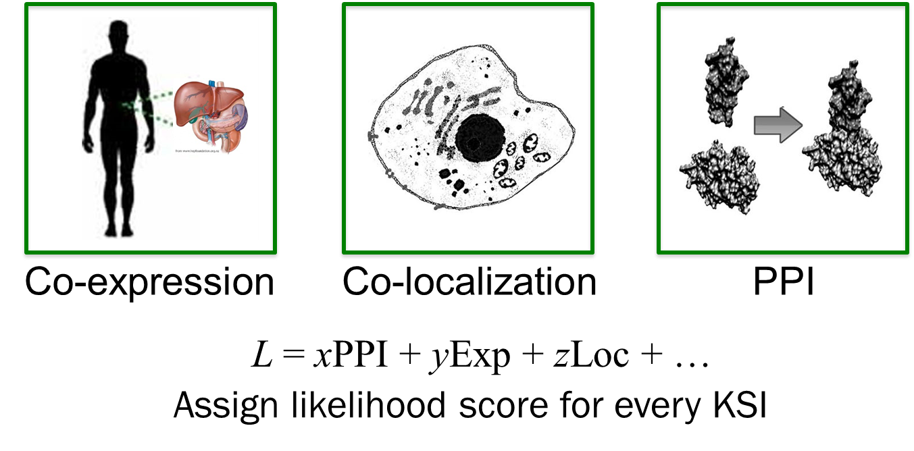
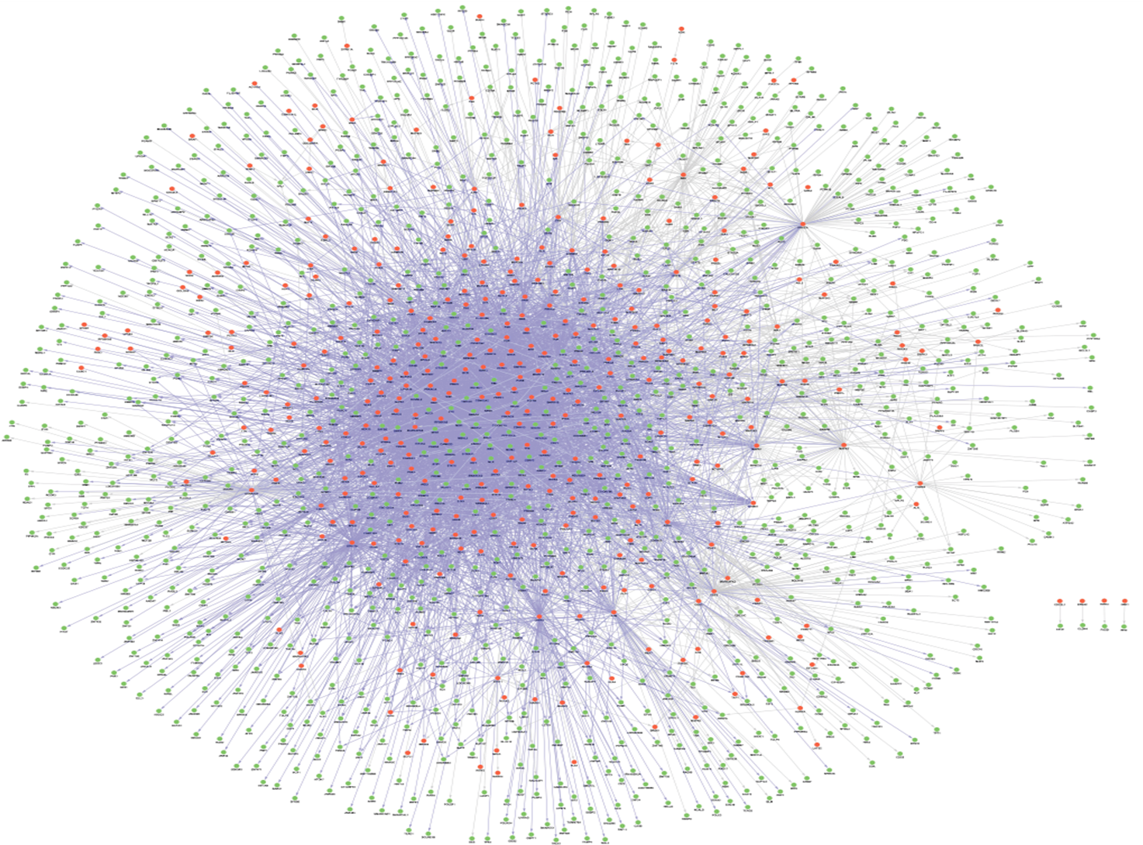
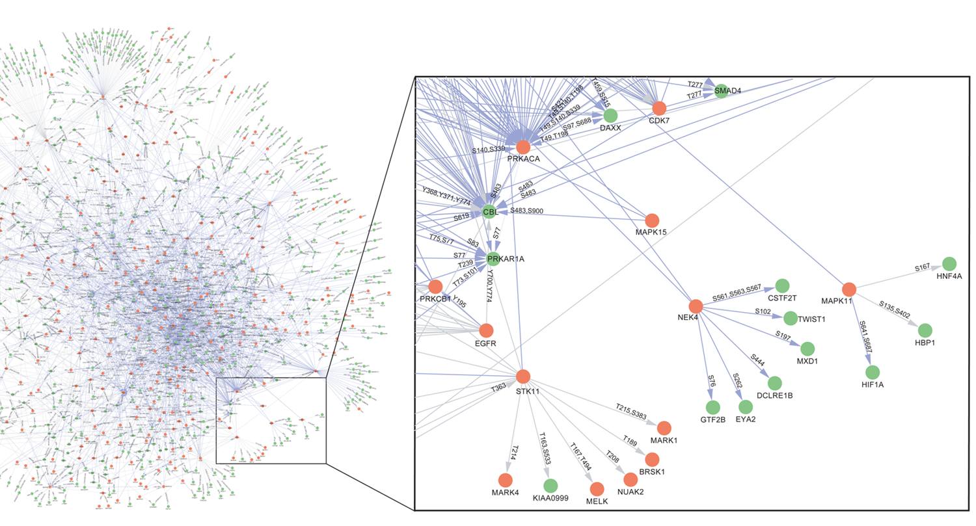
Construction of Hi-Res KSR Map (Newman, R., et al.)

Slide 12
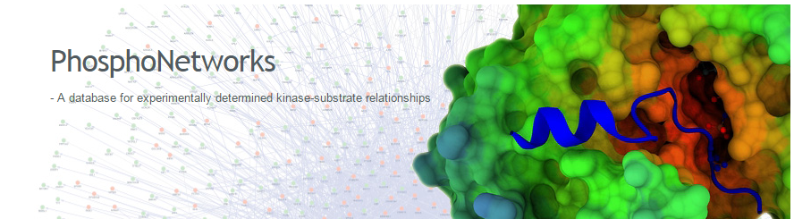
Tyrosine phosphorylation kinase-substrate network
Kinase-substrate network was derived from
1. Newman, R., Hu, J., Rho, H., Xie, Z., et al, “Construction of Human Activity-Based Phosphorylation Networks”. Mol Syst Biol. 9:655.(2013)
2. Hu, J., Rho H., Newman, R., Zhang, J., Zhu, H., Qian, J. “ PhosphoNetworks: A Database for Human Phosphorylation Networks”. Bioinformatics. 30:1. (2014)

Slide 13
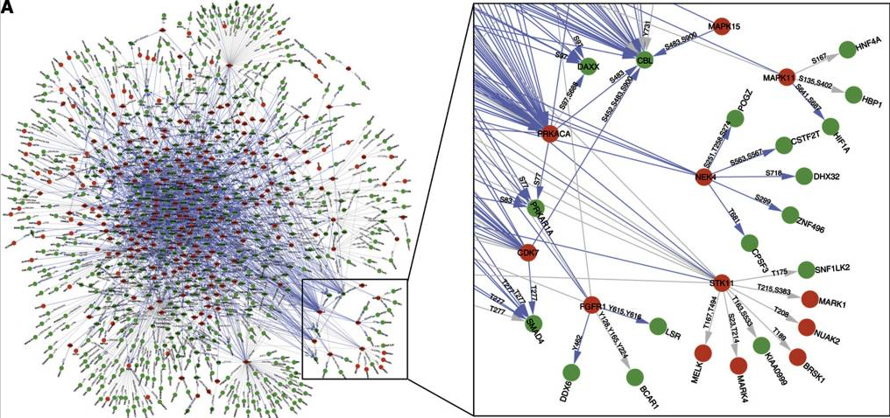
Integrated MS/Array Tyr phosphorylation activity analysis
S_{a}
K₁
K₁
S_{c}
Construction of human activity-based phosphorylation networks. Mol Syst Biol 2013; 9:655.
51 pTyr kinases, 133 substrates
256 Kinase-substrate relationships (KSRs)
116 substrates in pTyr array data
35 pTyr kinases (genes) detected in global LC-MS/MS data.
190 KSRs assessed.
MS global protein profile
HuProt array pTyr substrate activity profile

Slide 14
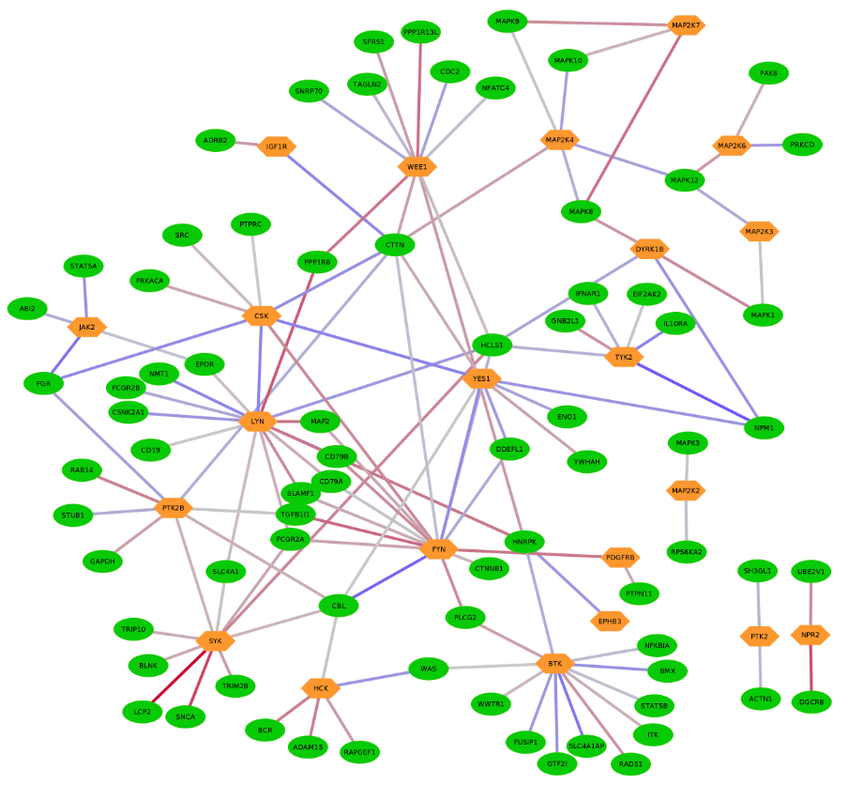
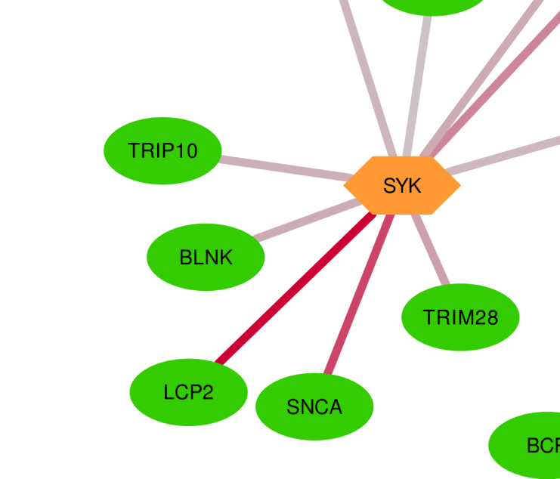
Phosphorylation activities assessed by Kinase-pTyr substrate activity correlation

Slide 15
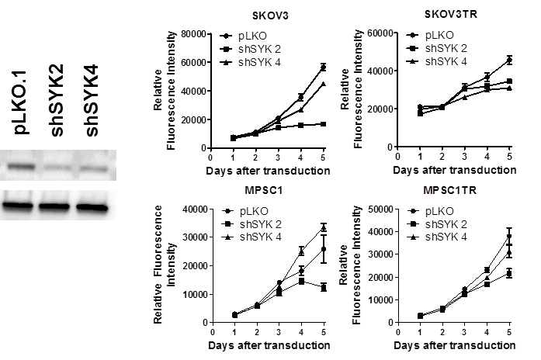
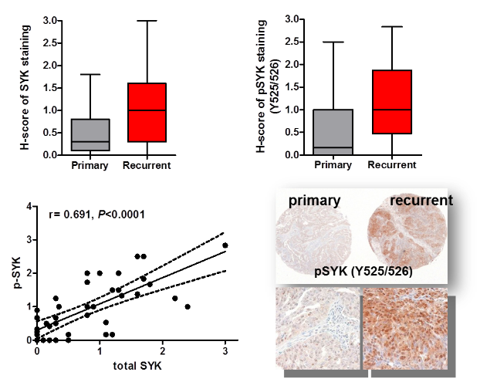
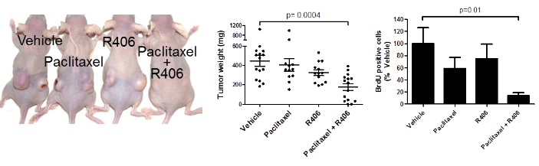
Concurrent research on SYK/pSYK at JHU (Ie-Ming Shih, Akhilesh Pandey)
SYK and pSYK expression is higher in recurrent ovarian cancer.
SYK knockdown and inhibition reduce ovarian cancer cell growth.
SYK inhibitor and paclitaxel combination produces synergistic response.

Slide 16
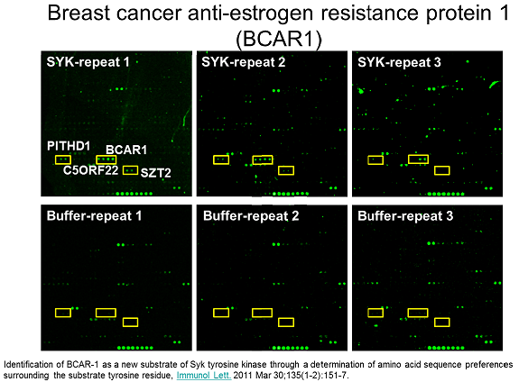

SYK assay on chips
PTP treatment
SYK in kinase buffer
Cy3-antipTyr
Y
Scan/Score
Substrates identification

Slide 17
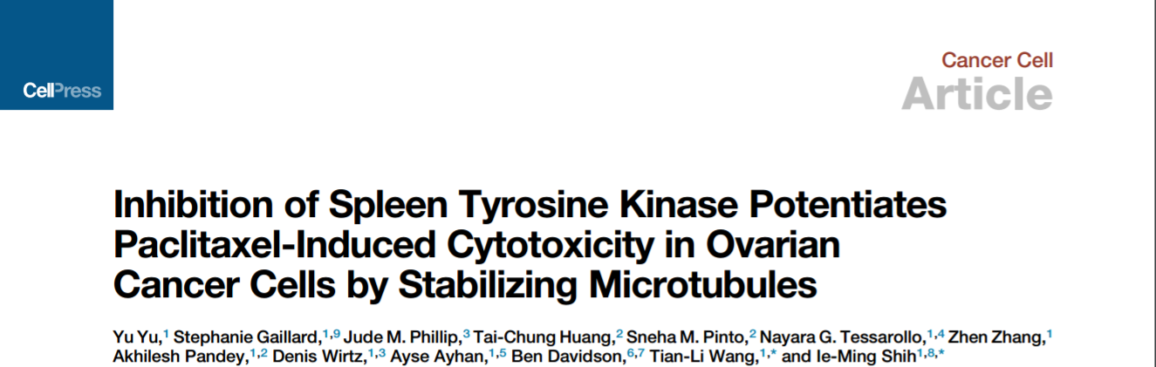
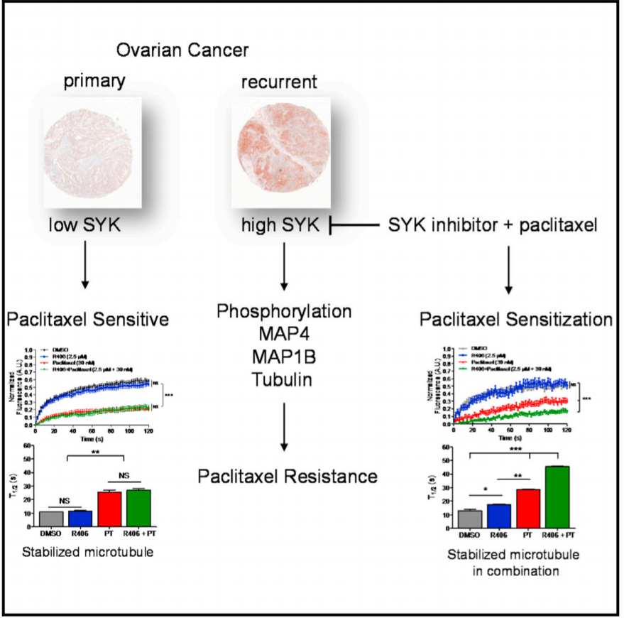
SYK is overexpressed in recurrent post-chemotherapy ovarian cancers
Inhibition of SYK synergistically enhances sensitivity to paclitaxel in tumor cells
SYK inhibition stabilizes microtubule in the presence of paclitaxel
Tubulin and MAPs are SYK substrates that may contribute to paclitaxel resistance

Slide 18
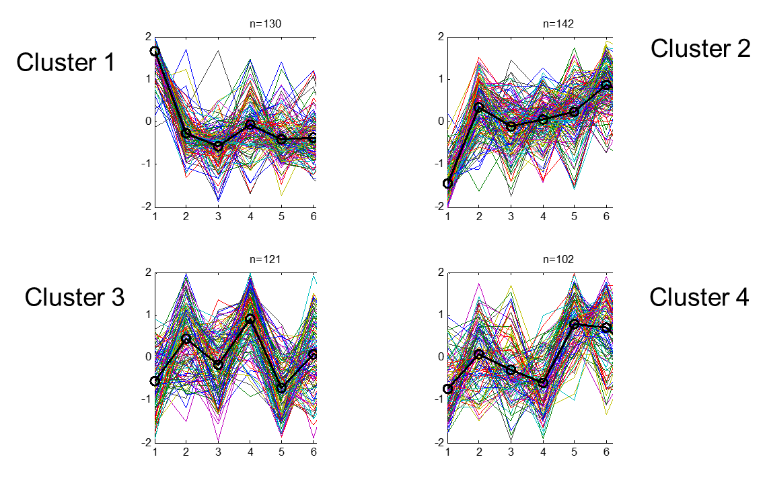
K-means clustering of temporal expression patterns
R406: 30min, 1h, 2h, 4h, 6h, 24h; Control: 2h; 24h.
3 STD as threshold to call positives in tyrosine phosphorylated proteins.
# of positive proteins in all samples: 495
30m 1h 2h 4h 6h 24h
30m 1h 2h 4h 6h 24h
30m 1h 2h 4h 6h 24h
30m 1h 2h 4h 6h 24h
Notes:
Red – high, Green – Low, Black – No change

Slide 19
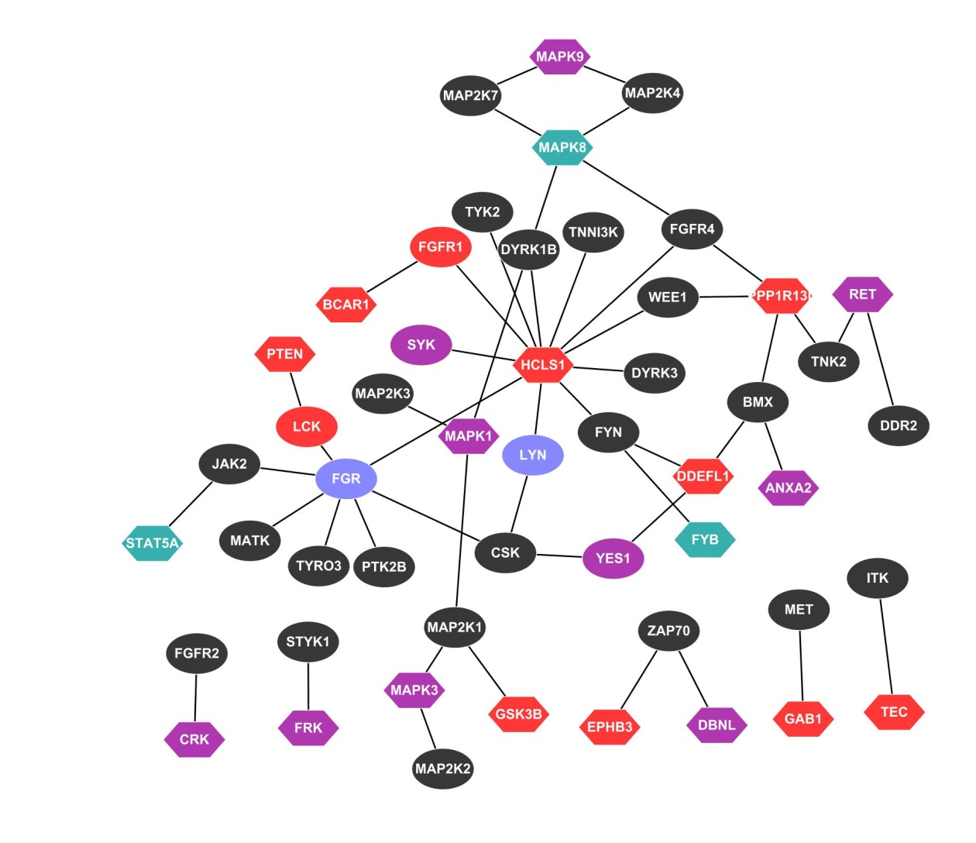
Kinase-substrate network
HIPK3
LASP1
Overlapped with label-free MS method
Kinase
Substrate
No cluster (kinase)
Cluster 1
Cluster 2
Cluster 3
Cluster 4

Slide 20
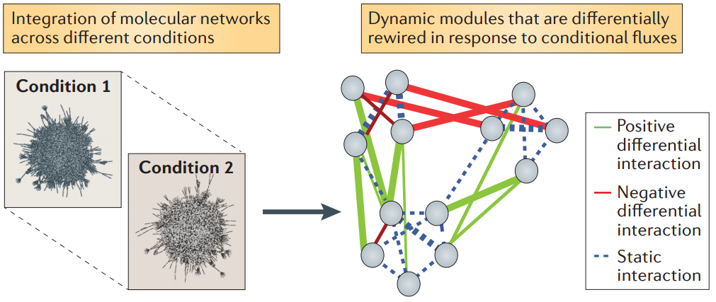
Differential dependency network (DDN) analysis search for phenotype-dependent connections
Reviewed in K. Mitra, et al., “Integrative approaches for finding modular structure in biological networks”, Nature Reviews Genetics 14:719-732, 2013
B. Zhang, et al., “Differential dependency network analysis to identify condition-specific topological changes in biological networks,” Bioinformatics, 25(4):526-532, 2009.
B. Zhang, et al., “DDN: a caBIG analytical tool for differential network analysis,” Bioinformatics, 27(7):1036-1038, 2011.
B. Zhang, Yue Wang, “Learning structural changes of Gaussian graphical models in controlled experiments”, in UAI 2010, Avalon, CA: 701-708, July 2010.

Slide 21
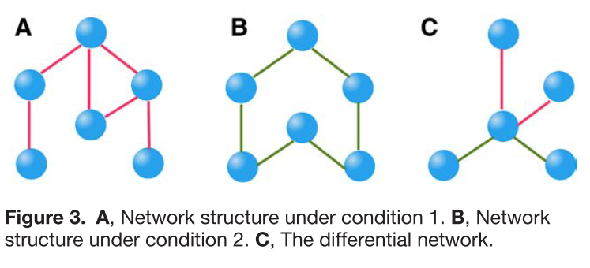
Sub-DDNs

Slide 22
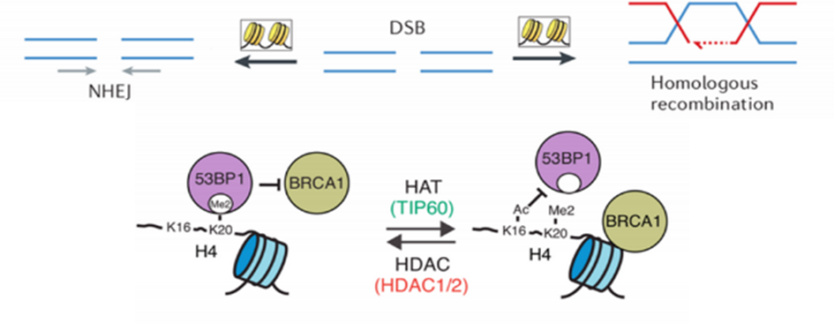
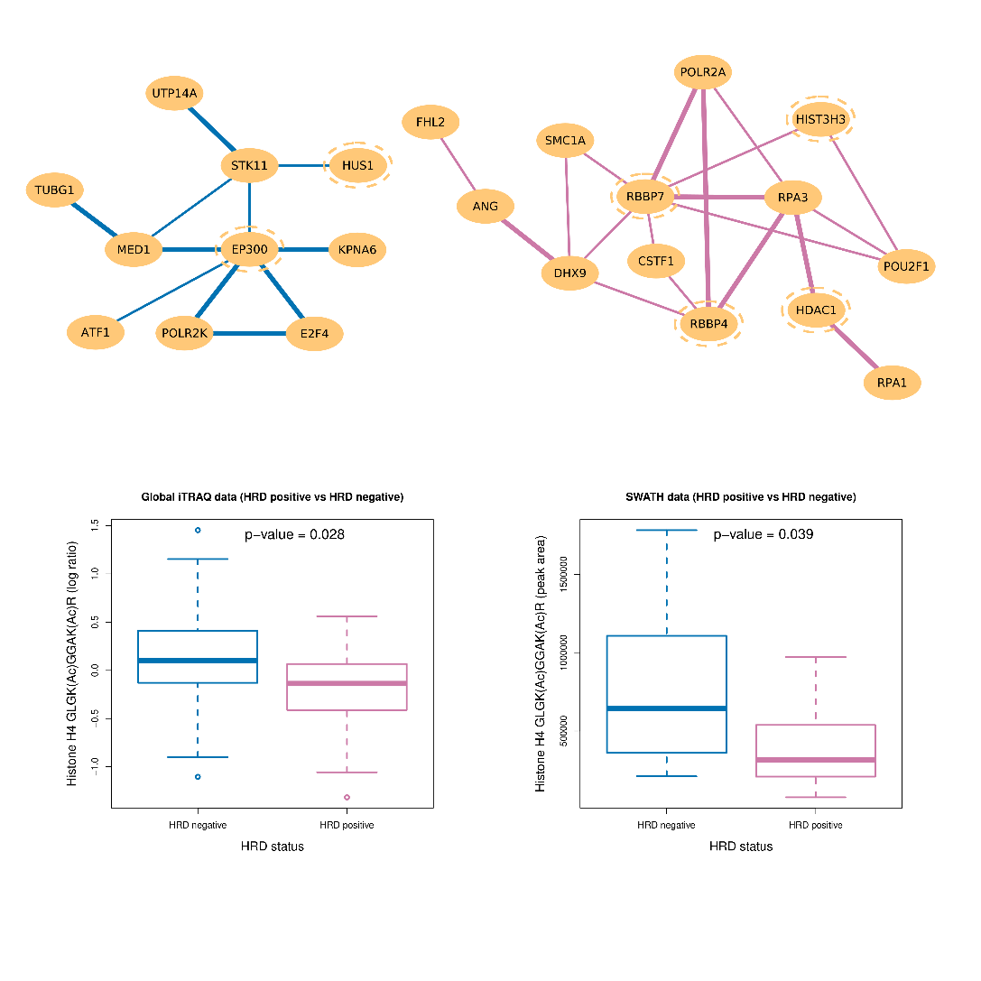
Differential acetylation of K12 and K16 between HRD and non-HRD

Slide 23
Summary
Integration of three types of data helps to identify phenotype dependent tyrosine phosphorylation:
  LC-MS/MS protein profiling (global/PTM) data,
  HuProt Array pTyr activity profiling data,
  KSR map data.
SYK kinome as an example.
Differential dependency network analysis of such data from populations or temporal experiments for biomarker/target discovery.

Slide 24
Acknowledgement
JHU:
  Ie-Ming Shih, Tian-Li Wang, Yu Yu,
  Lijun Chen, Stefani Thomas, Hui Zhang, Jian-Ying Zhou, Shisheng Sun,, Punit Shah, Paul Aiyetan, Yuan Tian, Caitlin Choi, Lori Sokoll, Leslie Cope, Akhilesh Pandey, Daniel W Chan
  Heng Zhu, Guang Song, Qifeng Song
  Bai Zhang, Li Chen.
JHU CPTAC Team:
  Yue Wang (VT), Douglas A Levine (MSKCC/NYU).
PNNL CPTAC Team: Tao Liu, Samuel H Payne,, Jason E McDermott, Vladislav A Petyuk, …, Richard D Smith, Karin D Rodland.
CPTAC investigators.

Slide 25
Supports
U24CA160036 (Z.Z., H.Z., D.W.C., A.P. and I.-M.S.), Leidos subcontract 14XS035 (Z.Z.), RO1CA103937 (I.-M.S.), W81XWH-11-2- 0230/OC100517 (I.-M.S.), RO1CA148826 (T.-L.W.), R21CA187512 (T.-L.W.), R01CA174388 (D.W.), U54CA143868 (D.W.), Conquer Cancer Foundation 2011 Young Investigator Award (S.G.), HERA OSB Grant from the HERA Women’s Cancer Foundation (Y.Y.), and Ovarian Cancer Research Fund 292512 (Y.Y.)

