Slide 1

Early Diagnosis of NSCLC From Gene Expression in Peripheral Blood: PBMC vs. PAXgene for sample Collection Microarrays to Nanostring for Commercialization Quant-Seq to Replace Microarrays for Discovery
Pros and Cons of PBMC as clinical samples.
PAXgene whole blood RNA as a PBMC alternative.
Microarrays as a biomarker discovery tool.
Nanostring as a biomarker commercialization platform
Quant-seq as an inexpensive alternative to microarrays as a discovery platform
EDRN 3/2017

Slide 2
Time To PBMC Isolation And RNA Extraction Has Global Effects On Gene Expression
Collection and Storage of Human Blood Cells for mRNA Expression Profiling: A 15-Month Stability Study
Jean-Brice Marteau, et alst DOI: 10.1373/clinchem.2005
“TTo guarantee optimal conditions, samples reach our laboratory for processing after a transportation time of <2 h at 4 °C. Indeed, gene expression was shown to change 2 h after blood collection (13), probably because of significant stress responses or possible contact activation of cells in the collection tubes . These findings underscore the extreme sensitivity of blood cells to ex vivo handling. “
Expression levels for many genes in human peripheral blood cells are highly sensitive to ex vivo incubation: Baechler et al Genes and Immunity (2004).
Holland NT, Smith MT, Eskenazi B, Bastaki M. Biological sample collection and processing for molecular epidemiological studies [Review]. Mutat Res 2003;543:217-234.
Pahl A, Brune K. Stabilization of gene expression profiles in blood after phlebotomy [Technical Brief]. Clin Chem 2002;48:2251-2253
Tanner MA, Berk LS, Felten DL, Blidy AD, Bit SL, Ruff DW. Substantial changes in gene expression level due to the storage temperature and storage duration of human whole blood. Clin Lab Haematol 2002;24:337-
EDRN 3/2017

Slide 3
PCA based on 614 significant fc>1.5 genes between pre and post treatment samples
CPT processed
next day
“Effects on metabolic studies are significantly greater.”

Slide 4
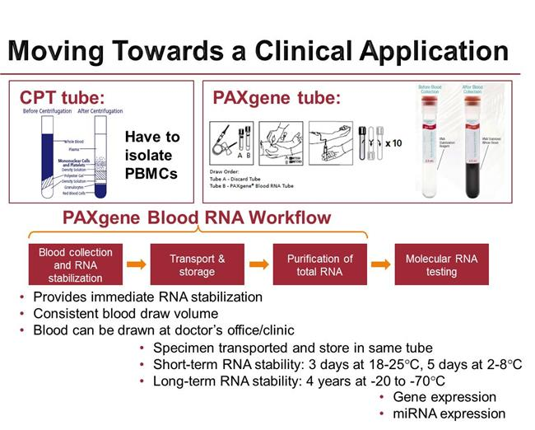
Sample Collection Systems
EDRN 10/19 /2016
Notes:
RNA isolation to preserve both mRNA and miRNAs

Slide 5
Early Microarrays Could Not Use RNA From Whole Blood
Affy Arrays, cDNA arrays on glass or filters
Globin Reduction Kits were marginally effective and added complexity.
Illumina Gene Expression Arrays. {Kuhn K, et al. Genome Res , 2004, vol. 14)
Our first lung biomarker study was based on 240 RNA samples from PBMC collected at University of Pennsylvania and processed within 2 hrs of the bleed. This limited sample collection from other sites.
PAXgene changed that. The sample was small (2.5mls) and collection was simple. It facilitated recruitment of new collaborators and in particular, made community hospitals accessible.
Bill Rom at NYU who agreed to collect PAXgene samples from the individuals in their LDCT lung screening program. He collected~2500 samples over 5 years
EDRN 3/2017

Slide 6
Differences CPT vs PAX RNA
Of 16319 probes detected>2x background, on the Illumina arrays, we identified :
1427 probes with FC>1.5 (more expressed in PAX), with 226 genes only in PAX
719 with FC<-1.5 (less expressed in PAX), with 47 genes not detected in PAX
Functions of 1427 underexpressed in CPT genes

Slide 7
CPT vs PAX
47 genes unexpressed in PAX compared to CPT
Functional categories of all 719 genes less expressed in PAX are on the right: ribosome, mitochondria, splicing.
PBMC express a STRESS signature not present in PAX samples

Slide 8
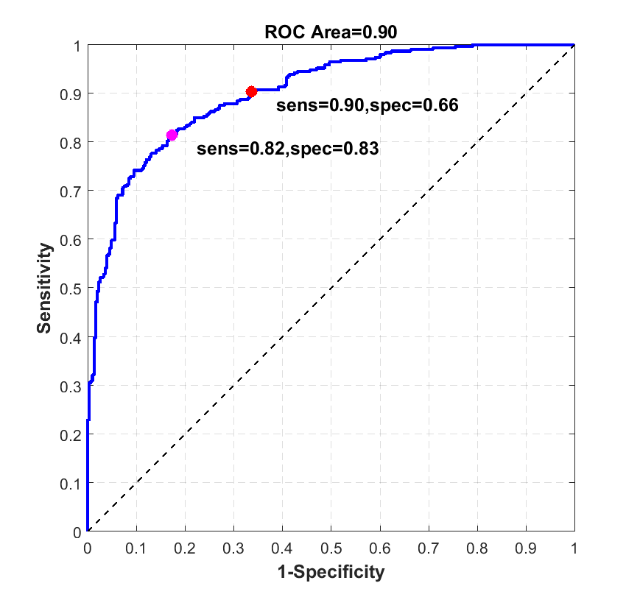
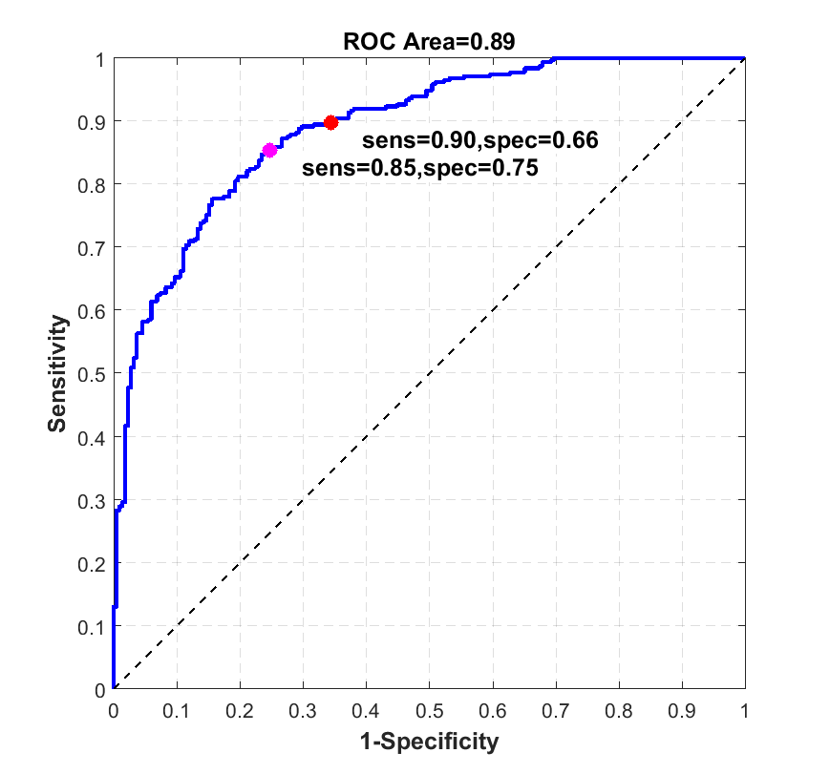
Overall Classification Performance
Cancer (314) vs. Benign Nodules (218) & Smokers W/O Nodules (88)
Cancer(314) vs. Benign Nodules(218)
All Illumina probes expressed at three times background (n=8900) were used as features for classification.
Notes:
Using all the genes from microarrays only
10 fold cross validation with 10 resamplings
Similar accuracy for general (vs nodule+disease) (total n=620) or nodule-specific (vs nodule only) (total n=532) classification

Slide 9
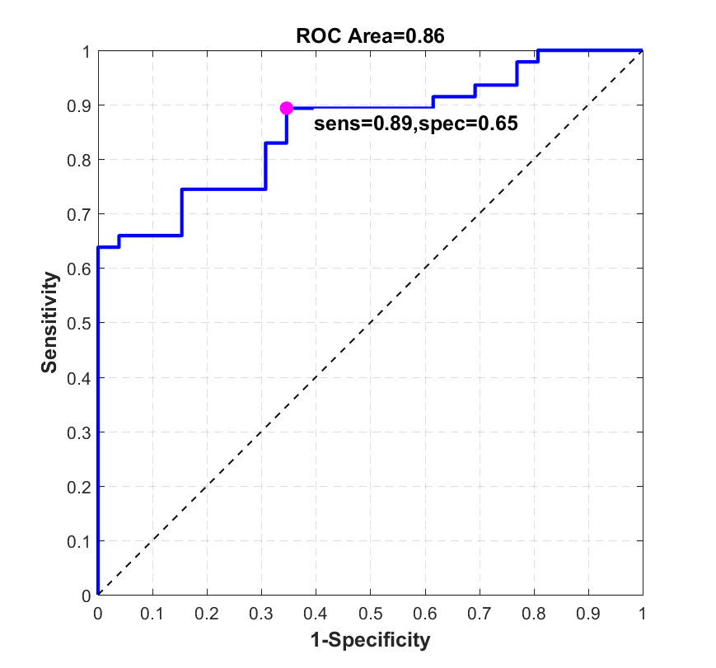
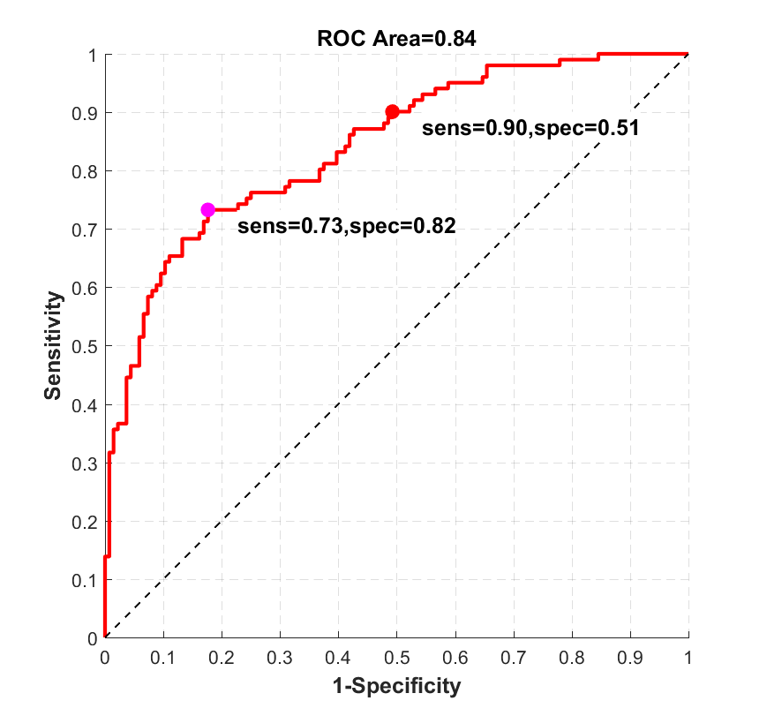
Distinguishing Cancers And Benign Nodules ≥ 8 Mm.
Genes were ranked by support vector machine recursive feature elimination (SVM-RFE)
Considered cancers and benign nodules ≥ 8 mm.
Training Set (75%): 145 cancers & 73 nodules
Median cancer size = 25 mm
Median nodule size = 12 mm
300 genes selected by SVM-RFE
Testing Set (25%): 47 cancer samples and 26 nodule samples
Median cancer size = 25 mm
Median nodule size = 12 mm
LEFT: Performance resulting from applying 300 gene classifier to testing set. RIGHT: Performance with 100 genes

Slide 10
Moving From The Microarray Discovery Platform To Platforms With Potential Clinical Applications
Custom Microarrays, PCR Arrays, Nanostring
Custom Illumina microarrays: familiar work horse, reagent batch effects had to be accounted for in large studies, technically demanding, likely to be discontinued.
Custom ABI PCR-Arrays: Sensitive, advertised ability to measure mRNA and miRNAs but not easily together, expensive, not being widely adapted, also found large reagent batch effects.
Custom Nanostring: No enzymatic reactions, simple easily applied technology, can detect mRNAs, miRNAs alone or combined, already FDA approved for the Prosigna breast cancer prognostic test.
May loose low expressors
Need more data on technical stability
EDRN 3/2017

Slide 11
1 count 1 transcript
INDEX
mRNA etc
EDRN 3/2017

Slide 12
3 Step process
Hybridization NanoString’s Technology employs two ~50 base probes per mRNA that hybridize in solution. The Reporter Probe carries the signal; the Capture Probe allows the complex to be immobilized for data collection.
Purify and Immobilize: Automated Prep Station After hybridization, the excess probes are removed and the probe/target complexes aligned and immobilized in the nCounter Cartridge.
Count Molecules Sample Cartridges are placed in the Digital Analyzer for data collection. Color codes in probe indexes are counted and tabulated for each target molecule.

Slide 13
Positives: Potential Negatives
No enzymes required to perform assay
No amplification
Minimal hands on required
Fully-automated system
Exceptionally easy-to-use
Multiplex hundreds of gene targets (800) in a single reaction
High sensitivity (< 1 copy per cell)
As low as 100ng of total RNA
Built in positive and negative controls
EDRN 3/2017

Slide 14
Plots of raw counts for each each sample vs. another sample with the same loading. Control probes are excluded
Replicates of each loading amount are highly correlated

Slide 15
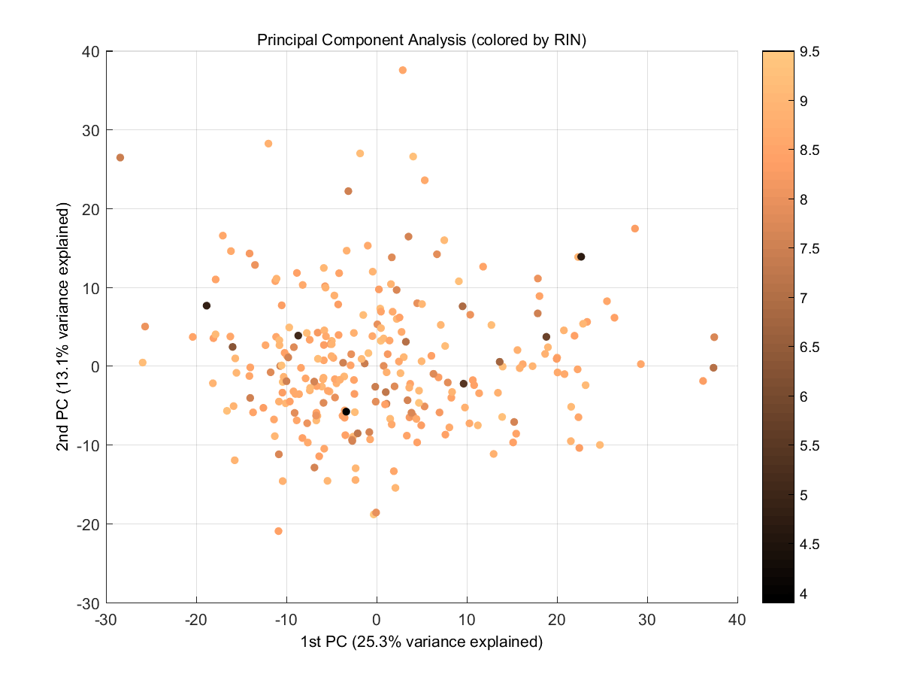
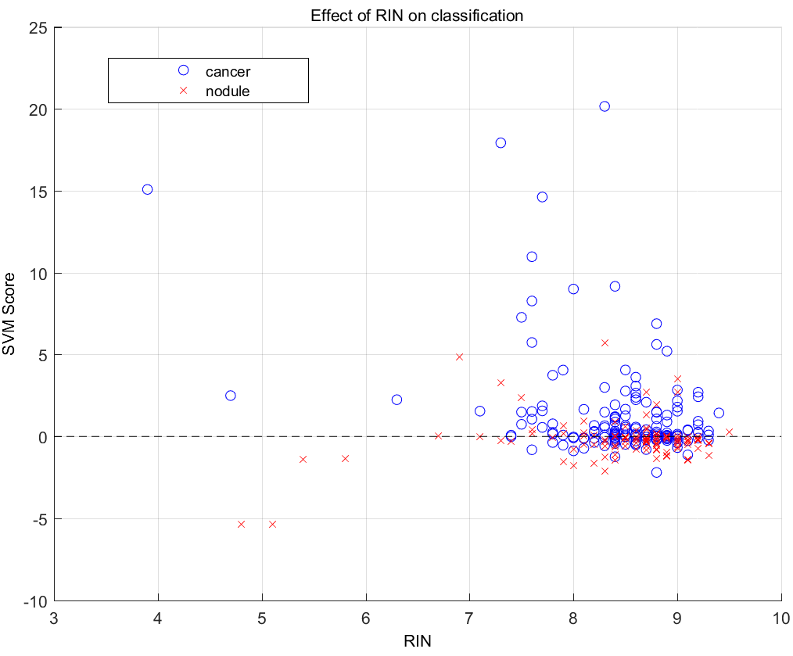
Effect of RIN
Each Sample is colored by its RNA integrity Number (RIN). Samples with lower RIN (darker) have similar gene expression to the samples with higher RIN and are distributed uniformly throughout the cloud of samples by PCA.
RIN does not have any effect on classification. Samples with low RINs were correctly classified by SVM.
EDRN 3/2017

Slide 16
Can increase low signals by Increasing FOV
EDRN 3/2017

Slide 17
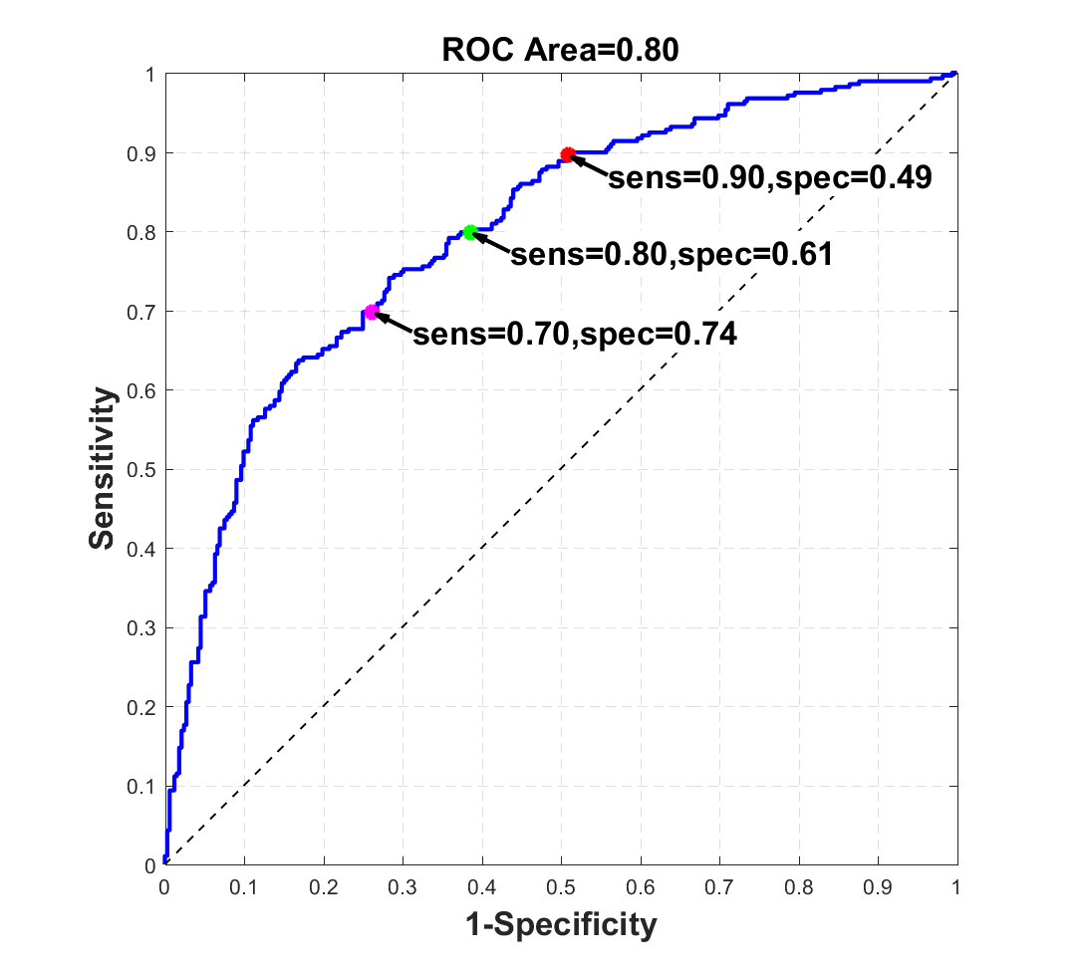
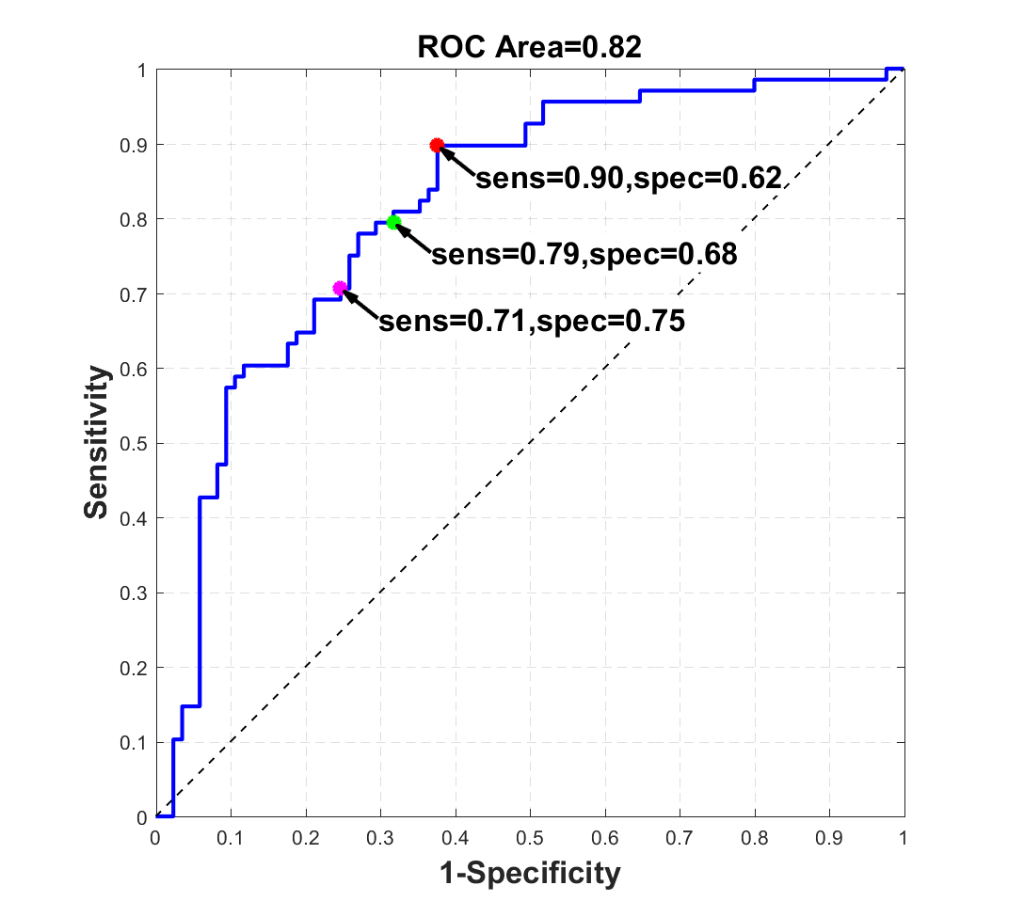
Performance of Biomarkers Selected on Microarrays on a Custom Nanostring Panel
All Probes
Top 100 Genes
Top 100 Genes selected from training set by SVM-RFE (75% of data) and applied to independent test set (25% of data)
10-Fold CV SVM of 610 Samples
Cancers n=278, Nodules n=332

Slide 18
Replacing Replacing Microarrays With The Lexogen 3’ Quantseq
QuantSeq generates strand-specific next-generation sequencing libraries close to the 3′ end of polyadenylated RNAs. Only one fragment per transcript is generated, directly linking the number of reads for a gene to its expression. You are essentially counting transcripts.
Can highly multiplex- >96 samples per lane-we do 40 samples per Next-seq lane (>400 million reads).
Analysis significantly simpler, faster and cheaper
COMPARING MICROARRAYS AND QUANTSEQ
Paxgene RNA from 6 patients was assayed on Illumina HT12v4 microarrays and Quantseq 3’ RNA-seq
AD – 3 adenocarcinoma patients
NOD– 3 patients with benign lung nodules
Notes:
QuantSeq reduces data analysis time and enables a higher level of multiplexing per run. QuantSeq is the RNA sample preparation method for accurate and affordable gene expression measurement.

Slide 19
SEQUENCING
Sample name | Total reads | Aligned hg38 | % | Transcriptome reads
NOD.1 | 9,227,508 | 7336501 | 80% | 5.7M
NOD.2 | 8,161,049 | 7101063 | 87% | 5.5M
NOD.3 | 9,113,302 | 8187030 | 90% | 6.3M
AD.1 | 8,087,350 | 6912613 | 85% | 4.9M
AD.2 | 8,668,370 | 7985752 | 92% | 6.1M
AD.3 | 10,859,647 | 9323112 | 86% | 7.0M
avg | 9,019,538 | 7,807,679 | 87% | 5.9M
Average run for quantseq requires only ~10M reads per sample (compared to 30-40M for conventional RNA-seq)
Paxgene (and PBMC as well) usually produce only ~50% of reads aligned against exons with a lot of signal coming from introns.
5M reads aligned against transcriptome per sample is our current target at Wistar Genomics/Bioinformatics
It is possible to increase the signal by resequencing existing library

Slide 20
NUMBERS
Microarrays
47,324 transcripts
Quantseq
45,968 genes
All Entrez genes
19,667
genes
Detection pv < | N transcripts | N Entrez
any | 47,323 | 30,500
0.05 | 22,456 | 16,234
0.01 | 16,568 | 12,532
0.001 | 13,027 | 10,246
Counts at least | N genes | N Entrez
any | 45,947 | 23,954
1 | 22,921 | 16,433
5 | 15,728 | 13,008
10 | 13,354 | 11,489
50 | 7,252 | 6,673
100 | 4,586 | 4,328
30,500
genes
23,869
genes
Detected Entrez genes
12,419
Genes
p<0.05
10,803
Genes
count≥10
Avg absolute expression
9,421
genes
AD/NOD difference
Notes:
Microarrays and Quantseq has the same approximate number of features for classification
But many of microarrays probes link to the same gene and not always distinguish isoforms well
So Quantseq has potentially more independent features for classification
While it is hard to tell the best threshold for calling the gene expressed, Quantseq has an advantage of sequencing with various depth to detect low expressers if needed
Correlation for expression and difference are not great, but well within expected between platforms. Both correlations are better than average between biological replicates (3 AD/NOD replicates – average R=0.24)

Slide 21
Other cutoffs
Microarrays
47,324 transcripts
Quantseq
45,968 genes
All Entrez genes
19,667
genes
Detection pv < | N transcripts | N Entrez
any | 47,323 | 30,500
0.05 | 22,456 | 16,234
0.01 | 16,568 | 12,532
0.001 | 13,027 | 10,246
Counts at least | N genes | N Entrez
any | 45,947 | 23,954
1 | 22,921 | 16,433
5 | 15,728 | 13,008
10 | 13,354 | 11,489
50 | 7,252 | 6,673
100 | 4,586 | 4,328
30,500
genes
23,869
genes
Detected Entrez genes
12,419
Genes
p<0.05
11,974
Genes
count≥5
10,218
genes
8,660
Genes
p<0.001
6,425
Genes
count≥50
5,254
genes
Notes:
Microarrays and Quantseq has the same approximate number of features for classification
But many of microarrays probes link to the same gene and not always distinguish isoforms well
So Quantseq has potentially more independent features for classification
While it is hard to tell the best threshold for calling the gene expressed, Quantseq has an advantage of sequencing with various depth to detect low expressers if needed
Correlation is better than average between biological replicates (R=0.24)

Slide 22
Acknowledgements
Michael Showe
Sonali Majumder
Andrew Kossenkov, Noor Dawany
Showe Lab
Celia Chang
Sandy Widura
Genomics
Andrew Kossenkov
Priyankara Wickramasinghe
Rehman Qureshi
Bioinformatics
NYU: William Rom, James Tsay, Harvey Pass
HFGCCC: * Thomas Bauer, Brian Nam
Temple U: Gerard Criner
UPenn: Anil Vachani
Roswell Park: Sai Yendamuri
Collection sites
*also collecting PBMC
Project Support: PA DOH Tobacco Settlement CURE Funds, EDRN BDL grant, SRA from Oncocyte
EDRN 3/7/2017
Notes:
Helen F. Graham Cancer Center at Christianna, Hospital DE.

