Slide 1


Targeted DNA and RNA Sequencing to Understand Cancer Development and Detection
Scott A. Tomlins M.D., Ph.D.
Assistant Professor of Pathology and Urology
Michigan Center for Translational Pathology Department of Pathology
University of Michigan Medical School
March 9, 2017

Slide 2
Disclosure Information
I have the following financial relationships to disclose:
The University of Michigan has been issued a patent on ETS gene fusions on which I am a co-inventor.
The diagnostic field of use has been licensed to Hologic/Gen-Probe, Inc., which has sublicensed rights to Roche/Ventana Medical Systems
Consultant for and honoraria from Roche/Ventana Medical Systems, Almac Diagnostics, Jansenn, AbbVie, Astellas/Medivation and Sanofi
Sponsored research agreement with and travel support from with Compendia Biosciences/Life Technologies/ThermoFisher Scientific
Sponsored research agreement with Astellas and GenomeDX
Co-founder, consultant for and equity holder in Strata Oncology

Slide 3
Premis
Comprehensive profiling of 100s-1000s of cancer tissue samples enables identification of smaller sets of genes for targeted DNA/RNA assessment
Pan-cancer/Cancer specific
Enables high throughput, inexpensive profiling
Compatible with minute FFPE specimens

Slide 4
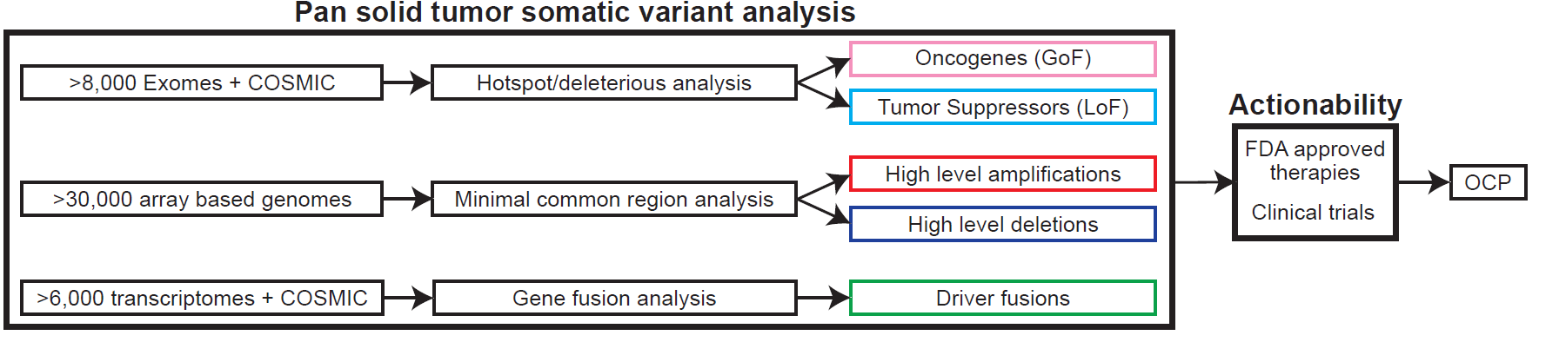
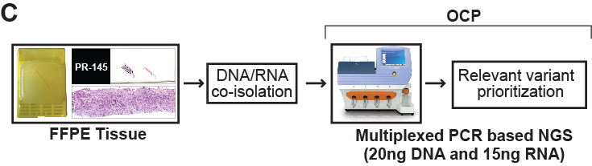
A scalable NGS system for solid tumors
Potential
Actionability
Panel being used in MATCH trial
Hovelson, McDaniel, Cani et al. Neoplasia 2015

Slide 5

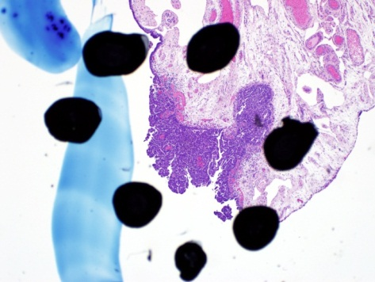
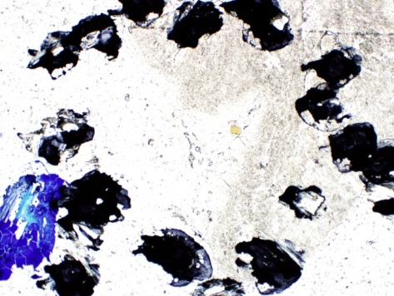
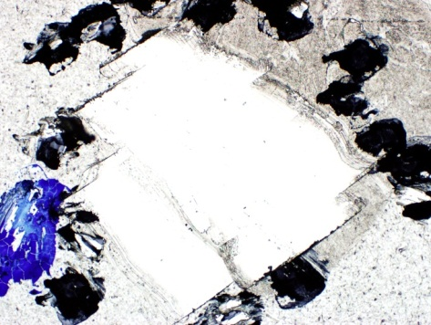
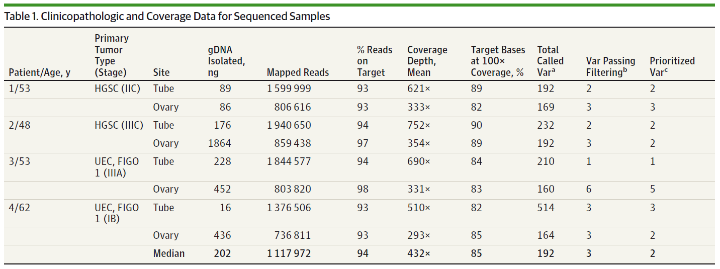

Slide 6
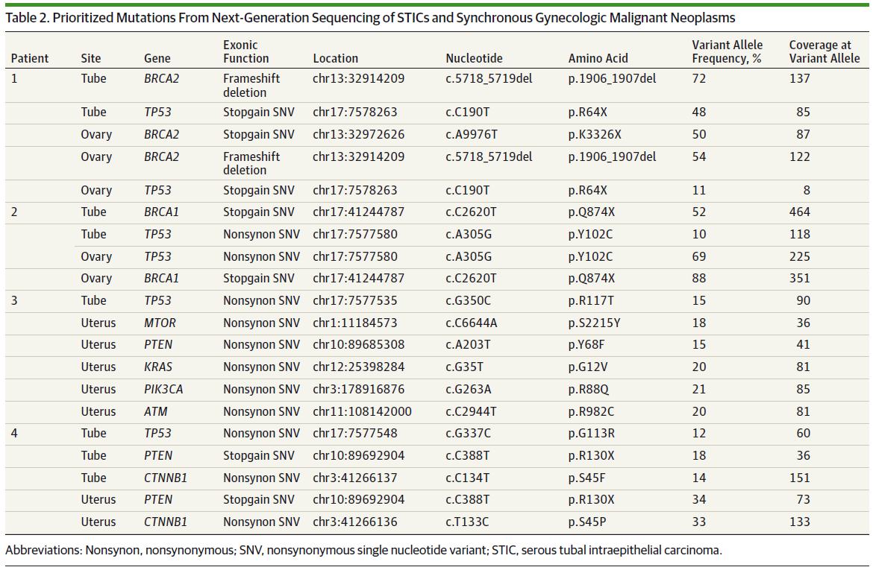

Slide 7
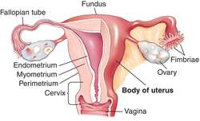
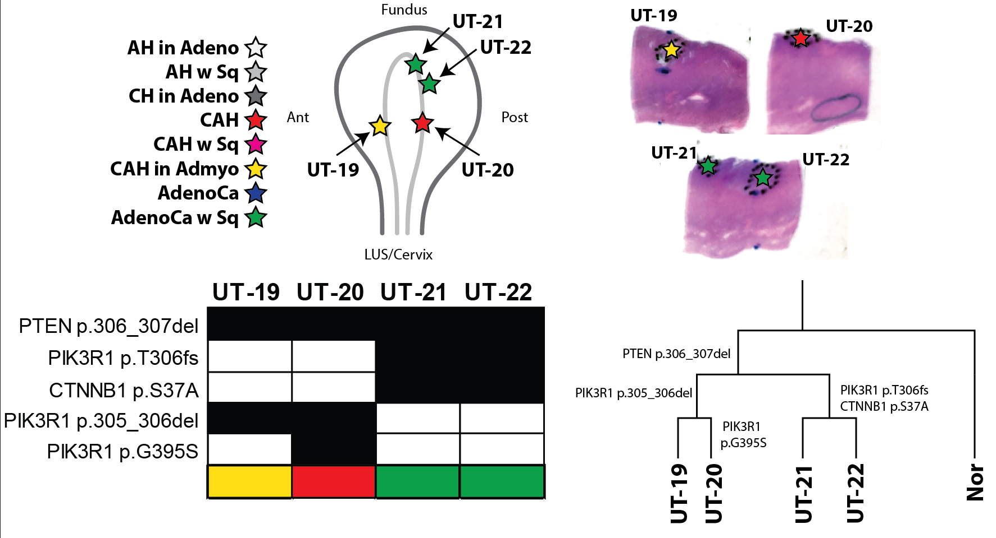
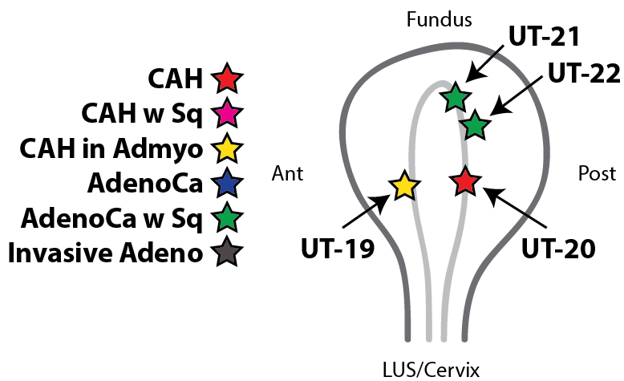
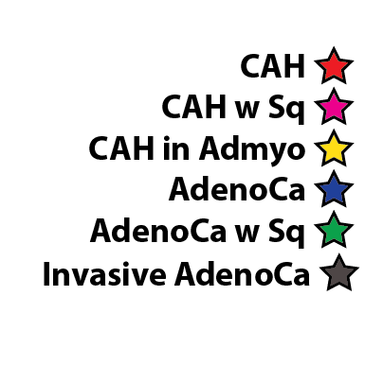
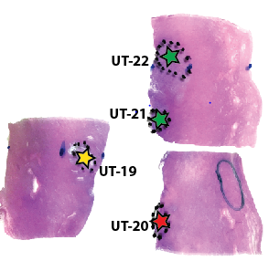
Case 1

Slide 8
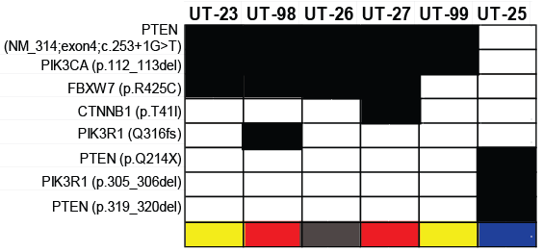
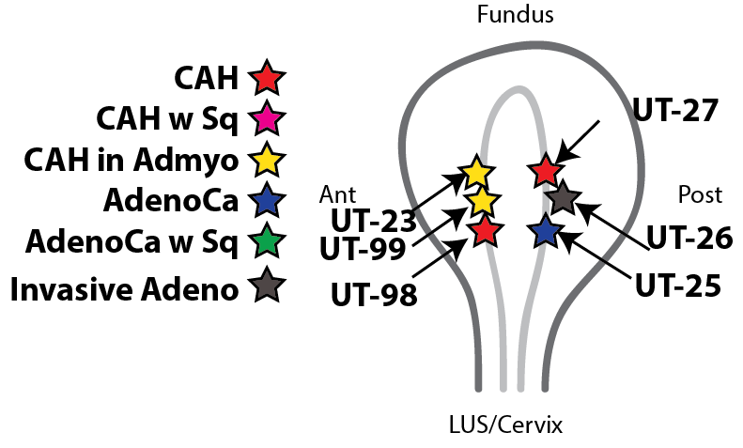
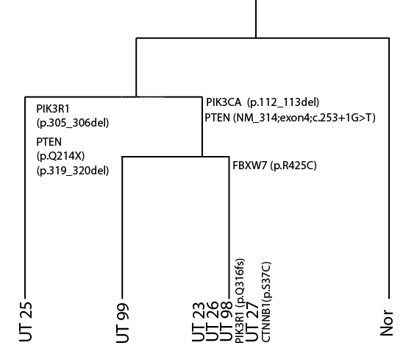
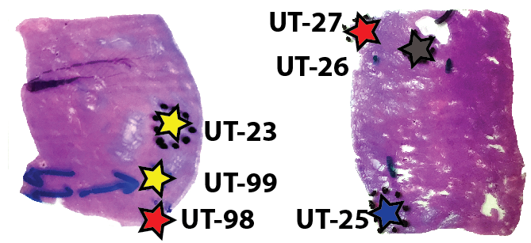
Case 2
Notes:
CAH- complex atypical hyperplasia

Slide 9
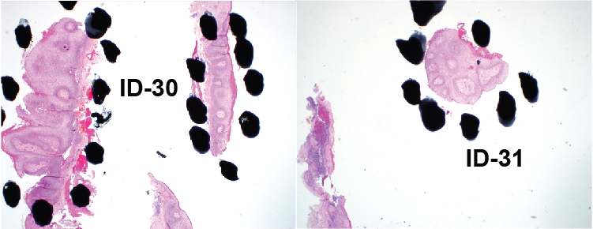
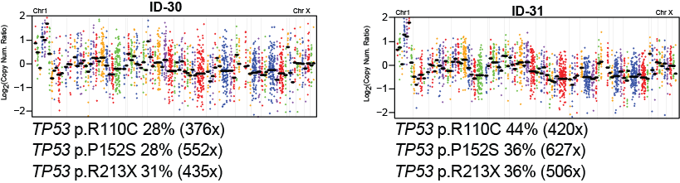
Skin SCCa in situ

Slide 10
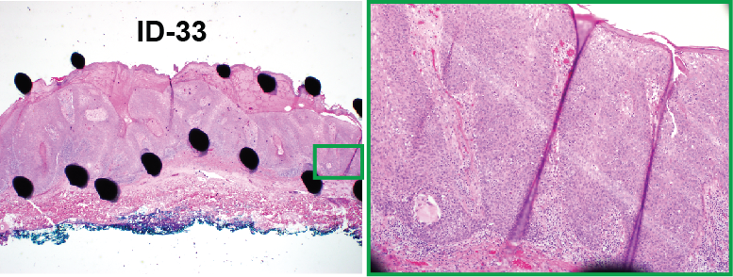
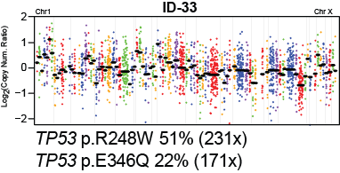
Skin SCCa in situ

Slide 11

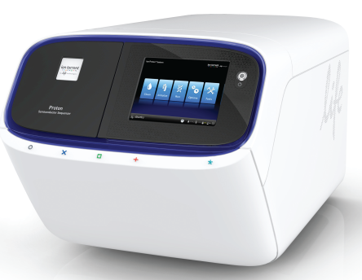
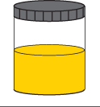
Multiplex RNAseq vs. qRT-PCR
Ampliseq RNA
(RT, multiplex PCR,
ligate adaptors/barcode)
Isolate RNA
(and DNA)
NGS
Potential advantages
<1-10ng FFPE or urine RNA vs. >>10ng qRT-PCR for many targets
Multiplexing is easier by sequencing than most qRT-PCR
Digital data (sequence information)
Notes:
More recently, we have been developing disease specific targeted RNAseq approaches combining gene fusion, gene expression, and expressed variant detection

Slide 12
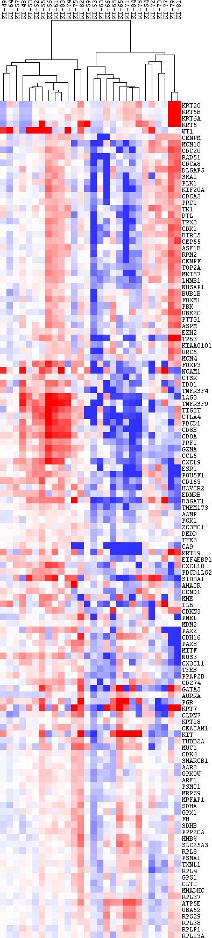

CK20, CK5/6
Proliferation
CD8A, PRF1, GZMA, CTLA4
PAX2/8
Unchanged (FH, SDHB, HK genes)

Slide 13
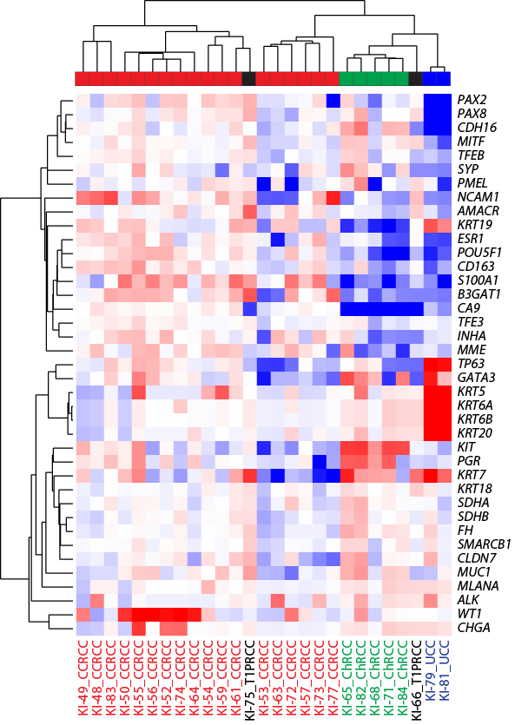

Slide 14
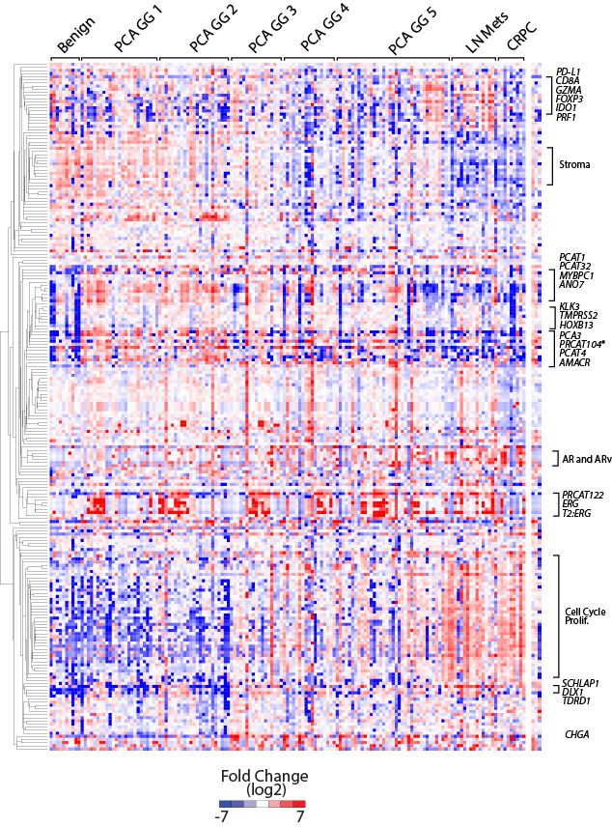
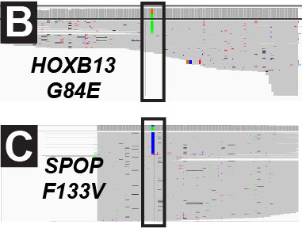
PCa Panel
306 transcript targeted RNAseq assay
Decipher
Oncotype DX
Prolaris (CCP)
Diagnostic genes
Subtyping genes (all ETS fusions)
AR splice variants
NePC genes
lncRNAs
Expressed mutations
Notes:
Supported by PCF, we have developed a 306 transcript targeted RNAseq assay for prostate cancer. This assay measures prostate cancer relevent gene expression, expressed variants and gene fusions. This includes known prognostic signatures, diagnostic and subtyping genes, AR splice variants, neuroendocrine subtyping genes, link RNAs, all known ETS and RAS/RAF gene fusions, as well as expressed mutations (e.g. SPOP) and germline variants (HOXB13 G84E). This PCF sponsored work led to a U01 EDRN co-PI grant for Dr. Tomlins (with Arul Chinnaiyan) to refine and use this approach for tissue based risk stratification and urine based early detection.

Slide 15
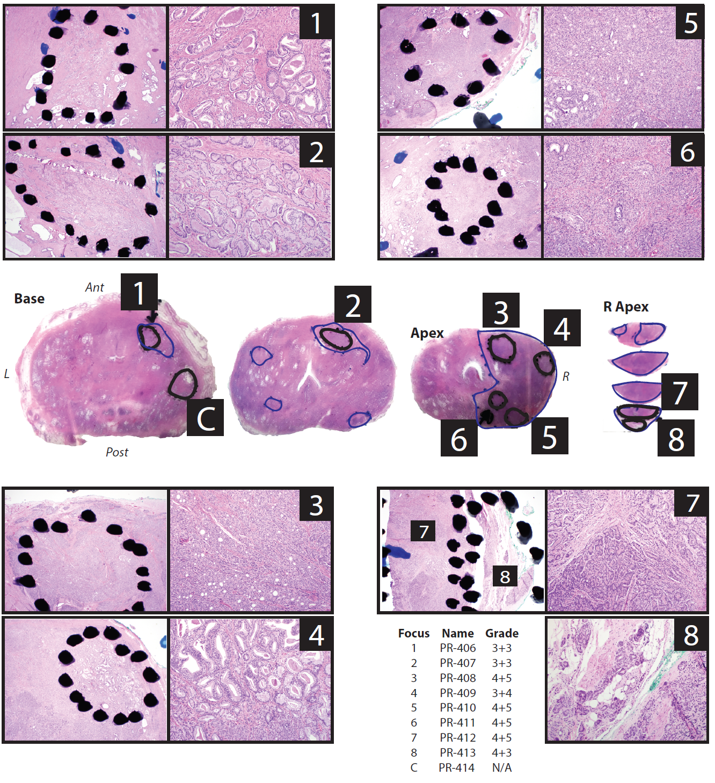

Slide 16
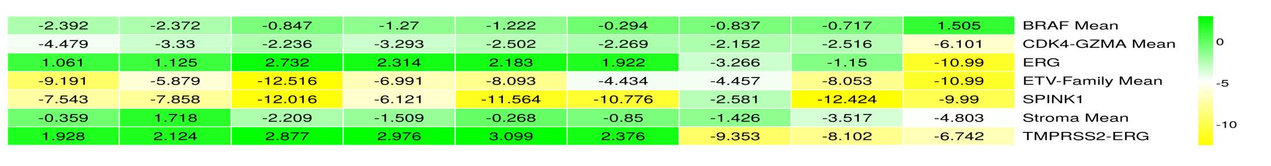
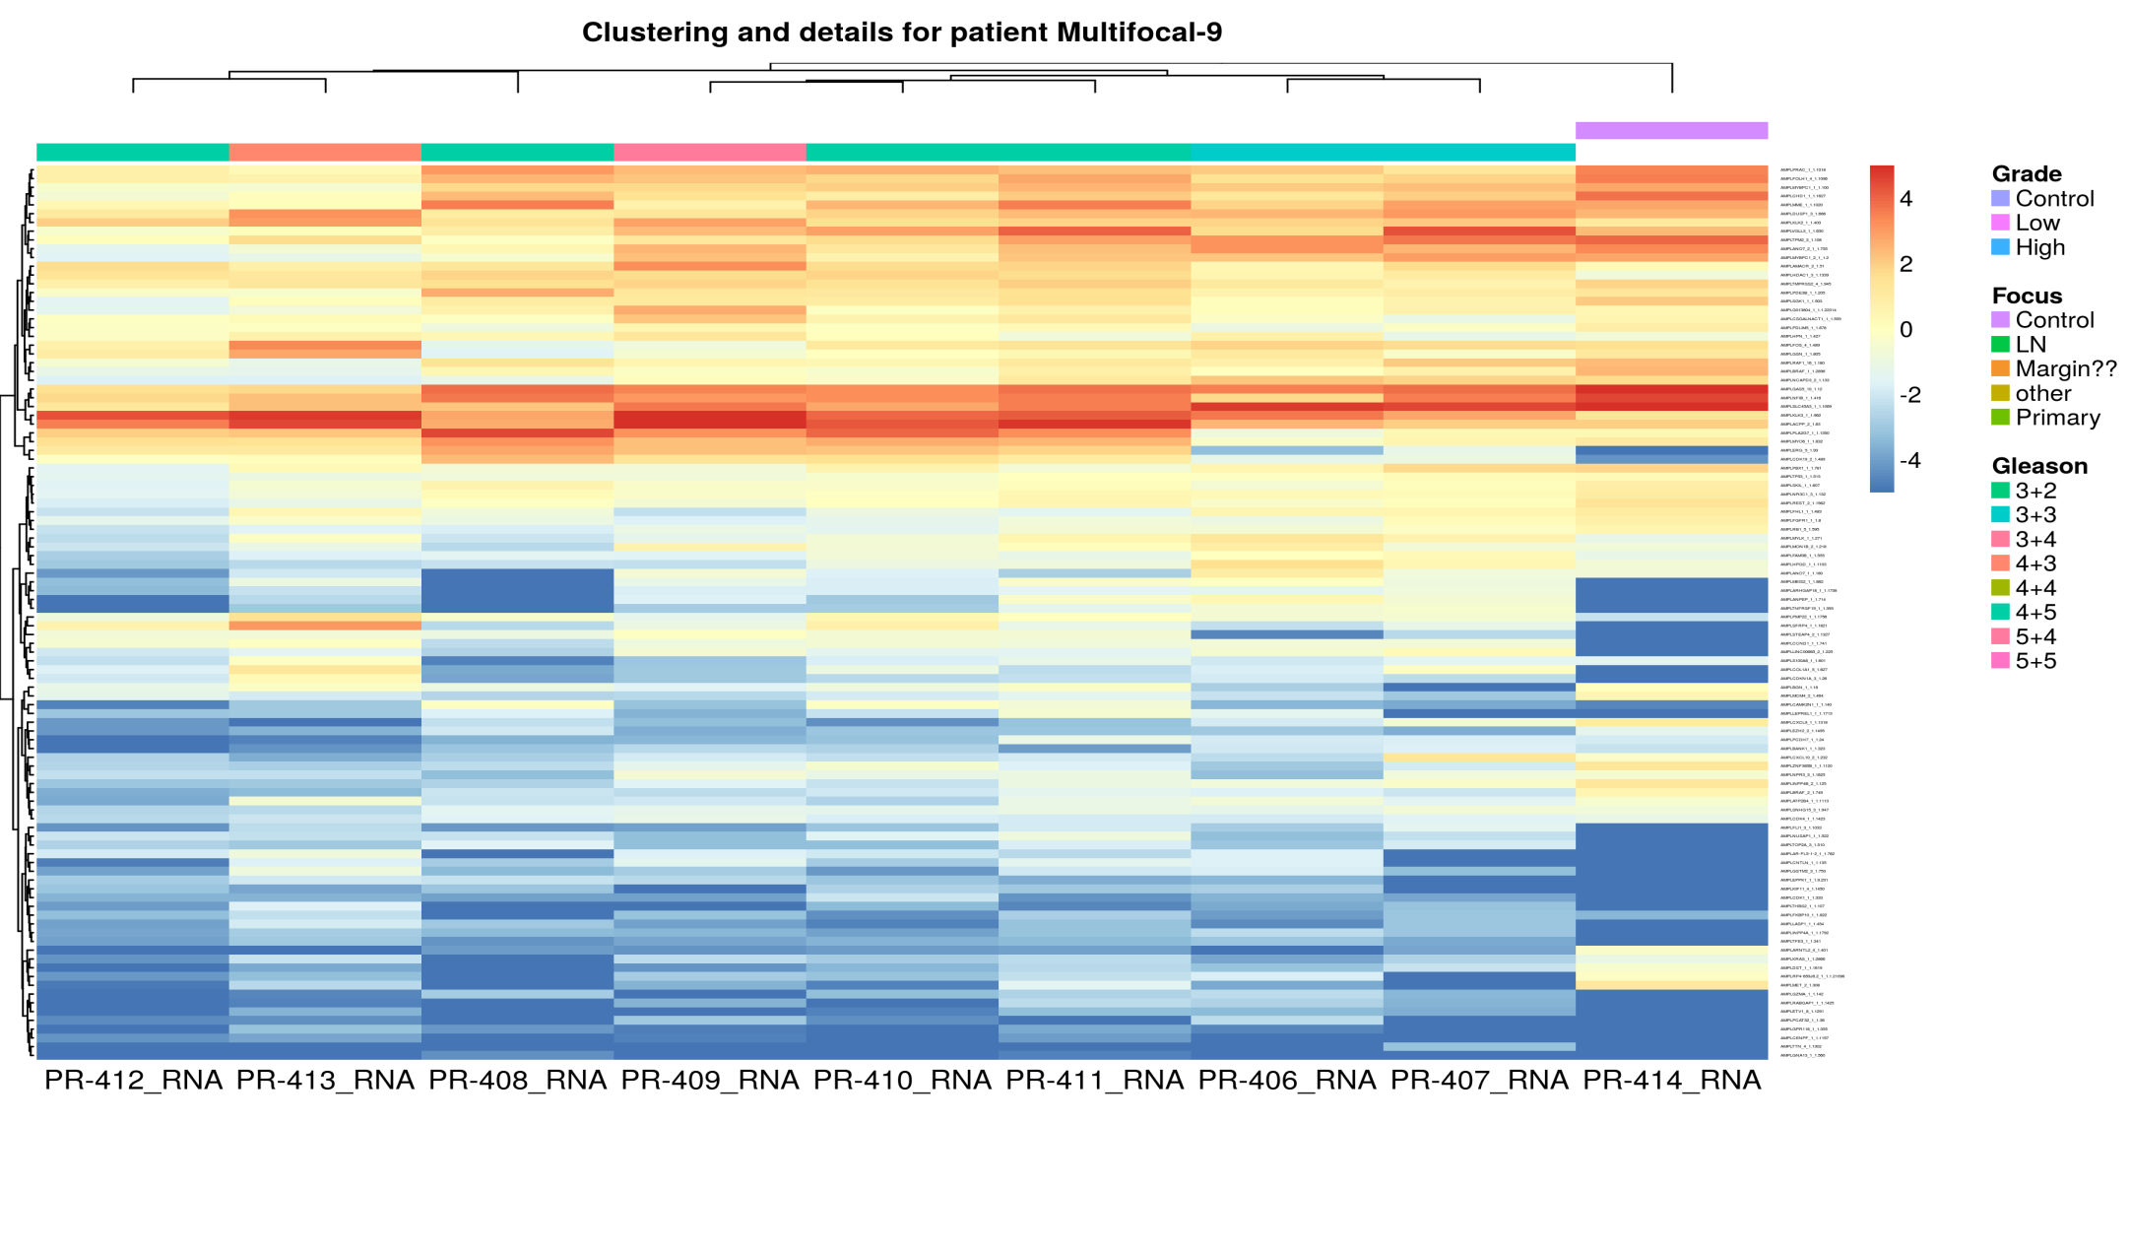
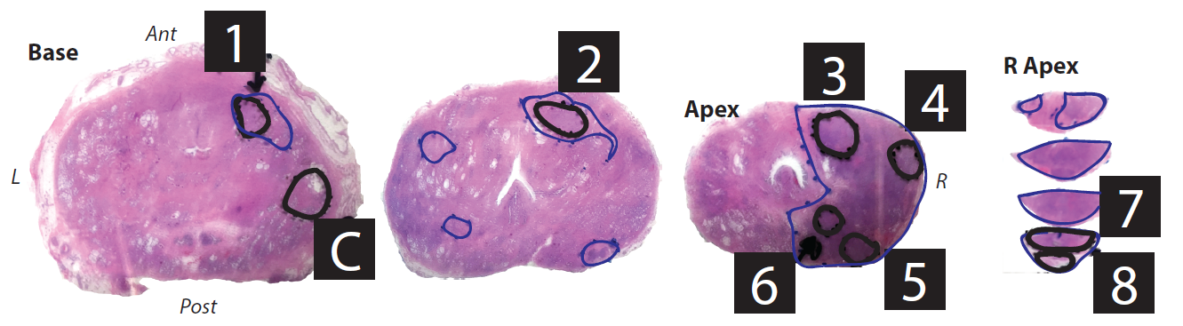
High Grade
Low Grade
7
8
3
4
5
6
1
2
C

Slide 17
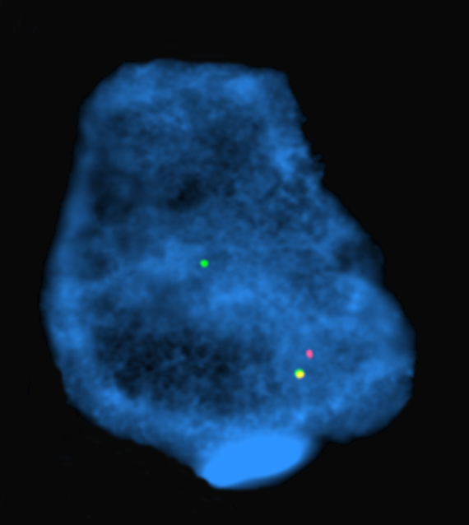







Acknowledgements
Tomlins Lab
UMHS (MCTP)
Pete Nelson (FHCRC)
Karen Knudsen (TJU )
Seth Sadis (ThermoFisher)
Ryan Dittamore (Epic Biosciences) Gert Attard (Royal Marsden)
Leonard Marks (UCLA)
Jiaoti Huang (UCLA/Duke)
Romain Mathieu (Med. Univ. of Vienna)
Martin Susani (Med. Univ. of Vienna)
Nathalie Rioux-Leclercq (Rennes Hospital)
Shahrokh Shariat (Med. Univ. of Vienna
ThermoFisher Ampliseq R&D Team
Rubicon Genomics
Collaborators
Daniel Hovelson
Andi Cani
Andrew McDaniel
Kei Omata
Albert Liu
Lorena Lazo de la Vega
Komal Kunder
Jeremy Kaplan
Moloy Goswami
Lucy Wang
Kelly Vandenberg
Michaela Haller
Anmol Amin
Venkata Yadati
Samantha Rahrig
Jarred Bratley
Venkata Yadati
Anmol Amin
Sharath Anand
Travis Weiss
Sherin John
Bhavneet Singh
Rishika Ramireddy
Catherine Grasso (UW)
Michael Quist
Arul Chinnaiyan
Todd Morgan
Kathy Cooney
Javed Siddiqui
Muneesh Tewari
Felix Feng
Maha Hussain
Xuhong Cao
Rajesh Rao
Dan Hayes
Rohit Mehra
Ganesh Palapattu
Simpa Salam
James Tracy

Slide 18
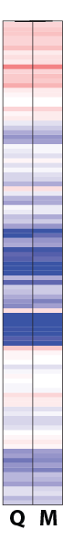
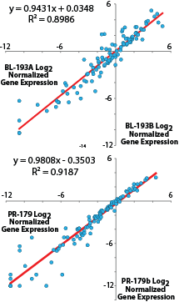
Bladder cancer targeted RNAseq panel
109 Target genes
normalized
to 7 housekeeping genes
Warrick et al. Virchows Archiv. 2015

Slide 19
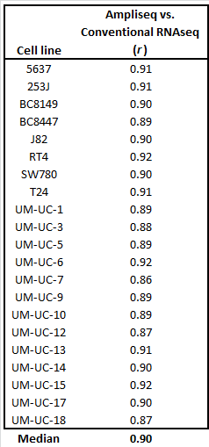
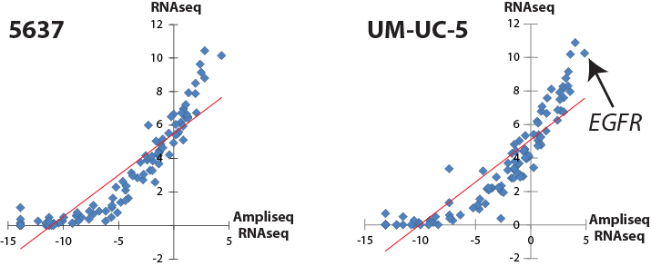
Correlation vs. RNAseq
21 bladder cancer cell lines
Bladder cancer targeted RNAseq panel
109 target genes, 7 housekeeping
Standard Illumina RNAseq (UMHS core)

