Slide 1

Modeling Prostate Specific Antigen (PSA) Kinetics in Prostate Cancer Active Surveillance
September 14, 2017
Yingye Zheng
On behalf of PASS study
Notes:
Work we did in PASS on in the setting of AS.

Slide 2
PSA in Prostate Cancer Active Surveillance
AS: a preferred strategy for low-risk disease
Variations in implementation
  Enrollment, followup intervals and trigger for intervention
  AS protocols are based on re-biopsy and repeated PSA
Question: How to collect and interpret serial PSA data optimally in the AS setting?
  Implication in biomarker studies
Notes:
For patients diagnosed with Pca, AS has become a preferred , due to prolonged natural history and indolent nature of the disease.
Popularity
AS are ; in most centers, psa is collected quarterly, with the goal of identifying men with a rapid PSA rise that may signify aggressive disease;

Slide 3
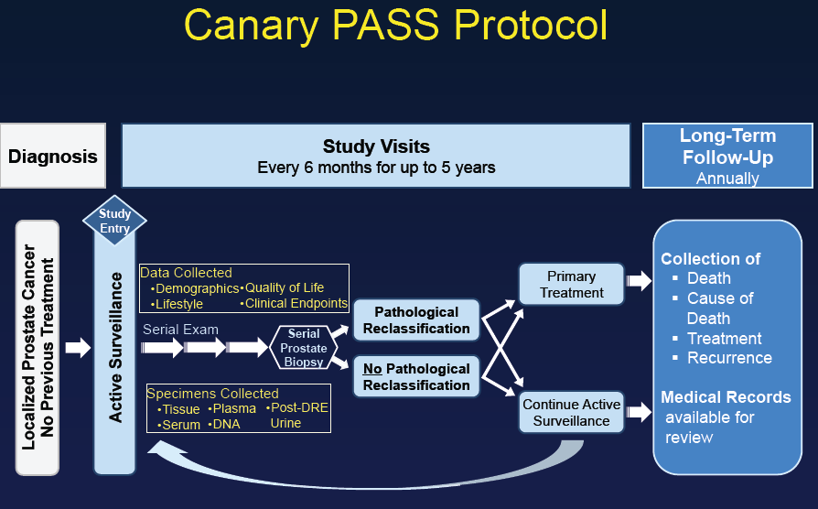
Canary Prostate Cancer Surveillance Study (PASS)
Notes:
PASS) is a multicenter, prospective cohort which enrolls men fwho are diagnosed with L pca opt for active surveillance at nine North American centers.
Under PASS protocol, clinic visits occur every 6 months, biopsies are performed first between 6 and 12 months after diagnosis, 24 month after diagnosis and then every 2 years. PSA is measured every 3 months

Slide 4
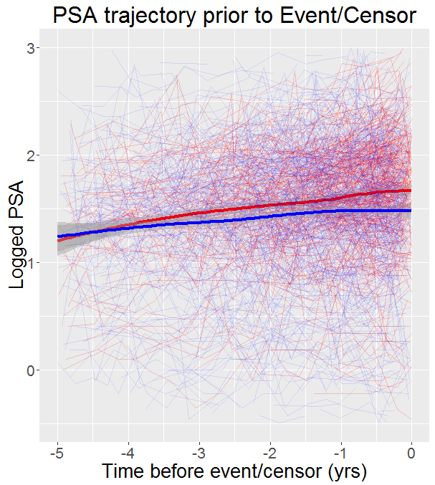
Changes of PSA Over Time in PASS
Red: event
Blue: Non-event
Notes:
There seems to be some elevation of PSA for relassifiers in particularly two years prior to events, compared to these without an events.

Slide 5
Research Questions
  Does change in PSA predict time to outcome?
    Reclassification: an increase in Gleason grade, or tumor volume.
  Determine the extent to which PSA kinetics might facilitate improved decision-making for men on surveillance
    Is there a lower threshold for PSAv, where most participants can move to watchful waiting?
    Is there an upper threshold, where most participants will need treatment?

Slide 6
Statistical Models
  To study longitudinal PSA measurements as predictors of reclassification, a two-stage procedure was used in the statistical modeling
    I: Derived features from longitudinal data (e.g., PSA kinetic parameters), which we treated like a putative biomarker
    II: Partly conditional Regression models with longitudinal features (e.g., PSAk) as predictors, predicting the residual time at a landmark time.
    Zheng & Heagerty 2004, Marziaz et al., 2017

Slide 7
I. Deriving PSA Kinetics

Slide 8
PSA in Pca Active Surveillance
Mixed messages:
  Many studies have not looked at PSA kinetics in Active Surveillance (AS)
    PSA screening
    Biochemical Recurrence
  Some studies have found PSA velocity and PSA doubling time to be significant in AS*, while others have not^
    Significant predictor vs. improving model accuracy
  * Al Otaibi (2008); Bul (2012); Khatami (2006); Klotz (2010); Kotb (2011); Ng (2008); Zhang (2006)
  ^ Iremashvili—weak association (2012); Ross (2010); Whitson (2011)
Notes:
PSA screening studies: Pearson 1994, Morrell 1995, Carter 1992, Carter 2006, Eggener 2007, Pinsky 2007, Punglia 2007
PASS originally use PSA dt < 36 months, however dropped due to few patients met the criteria

Slide 9
PSA kinetics in the PCa Literature
  PSA velocity (PSAv): rate of rise in PSA
    Simple calculations: slope between two points, or slope from linear regression
    Robust calculations: linear mixed models, joint modeling
      Thompson (2006): 20 definitions for evaluating PSAv
  PSA Doubling Time:
    months it would take for PSA to increase two-fold.
    Calculated from PSA velocity
    If negative PSAv, will need to consider categorizing PSAdt
  There are many different ways to measure PSA kinetics—give quite divergent results
Notes:
How to measure PSA change over time, kinetics? Can be measured with velocity or DT. DT

Slide 10
PSA velocity calculation in PASS
  Simple PSAv (PSAvS):
    Used all available PSAs prior to time of interest. At least 2 PSAs required.
    If 2 PSA measurements: change in PSA / change in time
    If 3+ PSA measurements: slope from linear reg. model
  Restricted Simple PSAv (PSAvRS):
    Used 2 PSAs closest to and prior time of interest
    Change in PSA / change in time
    Short term changes, independent of enrollment length

Slide 11
PSA velocity calculation
  BLUP PSAv (PSAvBLUP):
    For a new patient with repeated PSA measured up to s_{ij}, Best Linear Unbiased Predictors (BLUPs), with
    at each time s_{ij} was calculated using only past and current PSA measurements PSA(s₀, …, s_{ij})
  BLUP PSAv Restricted (PSAvBLUP_R):
    Similar to PSAvBLUP, limited to PSA measurements within 2 years prior of time point
Notes:
Modeling approach: measured with error, attenuate the effect and impact its predictive performance. linear mixed effect model, which allows individual specific baseline and rate of change, while borrowing information on the general trend from the AS cohort. With the BLUP, derive a fitted value that is less prone to the measurement error, the PSAv from BLUP, also reflect both general trend and individual measurement ..,

Slide 12
II. Predicting Outcome with longitudinal PSA Kinetics

Slide 13
Modeling Longitudinal Data

Slide 14
Statistical Models
  For time-varying PSA within subject: Cox PH model
    Outcome was time from each PSA measurement to grade and/or tumor volume reclassification, or censor
    Logged measurement time s as predictor
    with robust variance estimates
  Covariates:
    Dx PSA, measurement time s, PSAv at s
    Dx age, prostate size, prior biopsy (most recent percent of biopsy cores involved, history of any negative biopsy)

Slide 15
Subject Inclusions
  Data were from the 2016 PASS data freeze, and the following exclusions were applied:
# Participants | Condition
1278 | Feb 2016 data freeze*
-4 | Treatment within 6 months of diagnosis
-5 | ≥ 10 years between BL and Dx
-10 | no Dx Gleason score available or 4+3 at Dx
-107 | no surveillance biopsy
-51 | cores ratio >=34% at Dx
-193 | 5ARI user
-2 | Insufficient PSA data
906 | remaining
* Includes LTFU PSAs from 94 subjects who continued AS

Slide 16
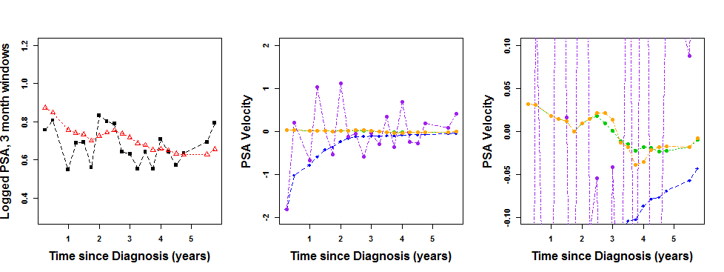
Example Participant 1, measurements every 3 months
Legend:
Black: observed PSA (log transformed)
Red: fitted PSA (from linear mixed model)
Blue: Simple PSA velocity (PSAvS)
purple: Restricted Simple PSA velocity (PSAvRS)
green: BLUP PSA velocity (PSAvBLUP)
orange: BLUP PSA velocity restricted (PSAvBLUP_R)
Notes:
3 month and 6 month windows since diagnosis were considered. For 2 or more PSAs that occurred in a window, the average of natural logged values was calculated. PSA kinetic variables were based on non-window averaged PSA. The nearest and prior PSA kinetic value was taken for each 3 month/6 month window.

Slide 17
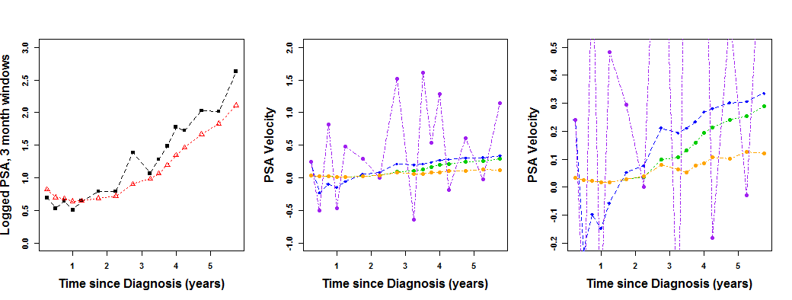
Example Participant 3, with high PSAvBLUP, grade + volume event, measurements every 3 months
Legend:
Black: observed PSA (log transformed)
Red: fitted PSA (from linear mixed model)
Blue: Simple PSA velocity (PSAvS)
purple: Restricted Simple PSA velocity (PSAvRS)
green: BLUP PSA velocity (PSAvBLUP)
orange: BLUP PSA velocity restricted (PSAvBLUP_R)
Notes:
3 month and 6 month windows since diagnosis were considered. For 2 or more PSAs that occurred in a window, the average of natural logged values was calculated. PSA kinetic variables were based on non-window averaged PSA. The nearest and prior PSA kinetic value was taken for each 3 month/6 month window.

Slide 18
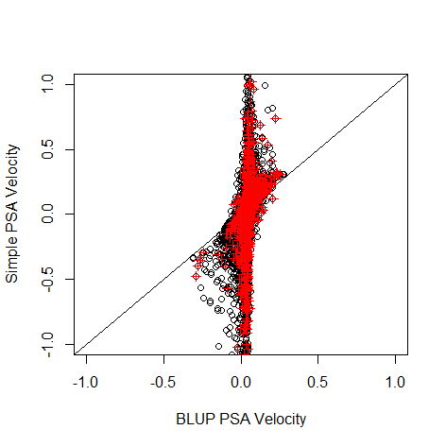
PSAvS vs PSAvBLUP
Red: event
Black: Non-event
Notes:
Note that PSAvBLUP is pulling values to 0, which is what we would expect.

Slide 19
Results from Cox models
Variable | PSAvS model |  | PSAvRS model |  | PSAvBLUP model |  | Model contains all PSAv
 | HR | P-value | HR | P-value | HR | P-value | HR | P-value
 | [95% CI] |  | [95% CI]^ |  | [95% CI]^ |  | [95% CI]^
Dx PSA | 1.75 (1.34, 2.29) | <.0001 | 1.73 (1.33, 2.25) | <.0001 | 1.77 (1.34, 2.34) | <.0001 | 1.79 (1.35, 2.37) | <0.001
PSAkS (0.10 increase) | 1.08 (1.02, 1.14) | 0.004 |  |  |  |  | 1.00 (1.00,1.00) | 0.208
PSAkRS (0.10 increase) |  |  | 1.01 (1.00, 1.02) | 0.11 |  |  | 1.00 (1.00,1.00) | 0.247
PSAk (0.10 increase) |  |  |  |  | 1.53 (1.19, 1.98) | 0.001 | 1.51 (1.17, 1.95) | 0.001
ª Model adjusted for age at diagnosis and prostate size, both of which were significant.

Slide 20
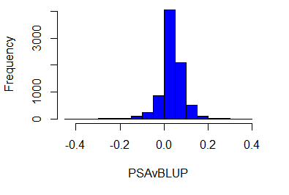
PSAvBLUP extremes
1st percentile= -0.13
99th percentile= 0.17
17 participants had at least 2 PSAvBLUPs > 0.17
11/17 (65%) of these participants had an event.
10 participants had at least 2 PSAvBLUPs < -0.15
9/10 (90%) of these participants did not have an event.
Notes:
These results indicate that NPV will likely be better than PPV based on PSA velocity in PASS.

Slide 21
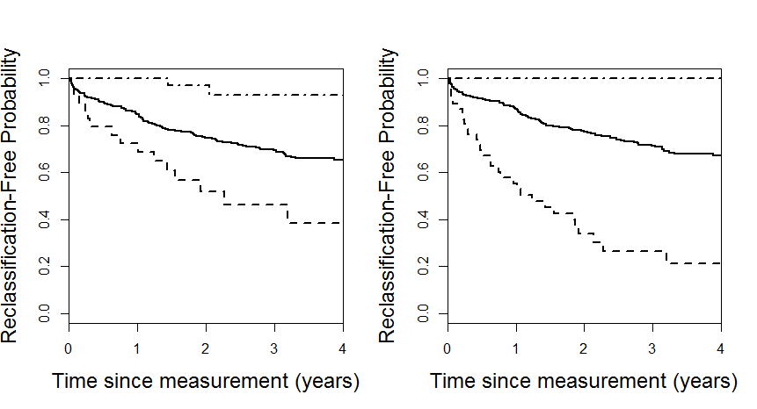
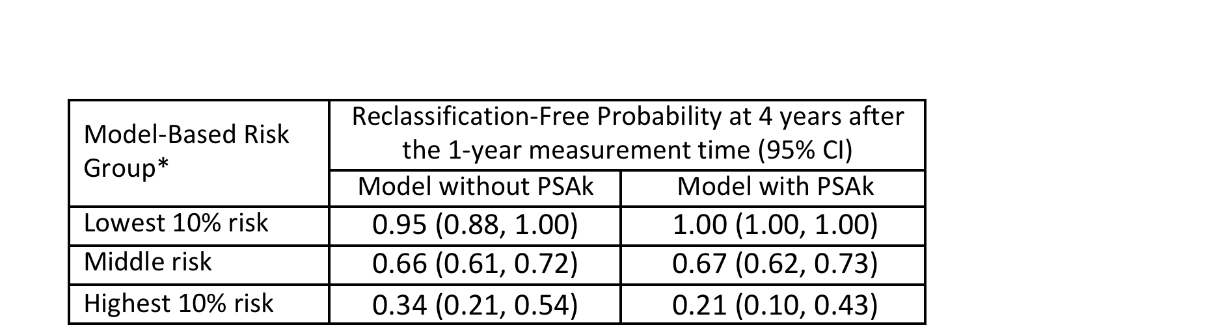
Notes:
when subgroups of low-, middle- and high-risk for reclassification were identified based on models with and without PSAk at a measurement time of 1 year after diagnosis, the inclusion of PSAk was better able to distinguish extreme subgroups of individuals (10% of the cohort each) with low and high event rates in the years after the prediction was made. The reclassification-free probability based on the KM estimator in the low risk group at 4 years after the 1-year measurement time was 1.00

Slide 22
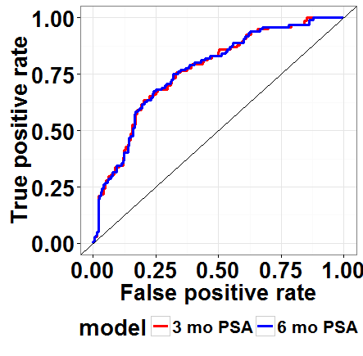
ROC Curve Analysis
ROC Curves from Cox PH model with diagnostic PSA plus PSAk using 3 or 6 month PSAs, prediction of reclassification event at 3 years since diagnosis. Prediction was made from 1 year after diagnosis.
Notes:
including PSAk in predicting 3 year reclassification outcomes from a measurement time of 1 year after diagnosis was 0.79

Slide 23
Summary
  Does PSAv predict time to reclassification (grade/tumor volume) in PASS?
    Yes, with adequate measurement
    Issues with compliance
  Determine the extent to which PSA kinetics might facilitate improved decision-making for men on surveillance for low-risk prostate cancer
    need to combine with other clinical variables (and novel biomarkers) for decision making

Slide 24
Acknowledgment
Anna Faino
Lisa Newcomb
Dan Lin
Matt Cooperberg
Jim Brooks
Other PASS investigators

Slide 25
Participant Characteristics
 | All Participants, n=906 | Event Participants, n=325 | Censor Participants, n=581 | P-value*
Time to event/censor since Dx, in years Range Median [IQR] | 0.2 – 12.2 2.9 [1.5, 4.9] | 0.2 – 8.8 1.8 [1.0, 3.1] | 0.3 – 12.2 3.9 [2.3, 5.4] | <.0001
Dx PSA, median [IQR] | 4.8 [3.6, 6.3] | 4.9 [4.0, 6.3] | 4.7 [3.5, 6.3] | 0.009
Prostate size, median [IQR] | 39.8 [30.0, 54.2] | 35.5 [26.8, 46.3] | 43.9 [31.7, 57.9] | <.0001
Dx PSA density, median [IQR] | 0.11 [0.08, 0.16] | 0.13 [0.10, 0.18] | 0.10 [0.07, 0.14] | <.0001
Dx cores ratio, median [IQR]^ | 8.3 [8.3, 16.7] | 16.7 [8.3, 18.8] | 8.3 [8.3, 16.7] | <.0001
Dx age, median [IQR] | 62 [57, 67] | 63 [58, 67] | 62 [57, 67] | 0.08
* P-value from 2 sample t-test for continuous variables, and for Chi Square test for categorical variables. For time to event/censor, PSA density and PSAvDx, p-value from Wilcoxon test.
^ 55 participants are missing diagnostic cores ratio. At least 6 cores were required. Cores ratio at diagnosis was imputed as (1/total number of cores) if at least 6 cores were taken and the next surveillance biopsy was negative. P-value corresponds to Wilcoxon test.

Slide 26
Participant Characteristics, cont.
 | All Participants, n=906 | Event Participants, n=325 | Censor Participants, n=581 | P-value*
# Surv. Bx prior to event/censor ,n(%) None 1 2 3+ | 261 (29) 268 (30) 226 (25) 151 (17) | 184 (57) 80 (25) 40 (12) 21 (6) | 77 (13) 188 (32) 186 (32) 130 (22) | <.0001
# Neg. Surv. Bx prior to event/censor, n(%) None 1 2+ | 537 (59) 223 (25) 146 (16) | 280 (86) 36 (11) 9 (3) | 257 (44) 187 (32) 137 (24) | <.0001
Dx CAPRA score, n(%)~ 0 1 2 3+ | 31 (4) 528 (64) 213 (26) 58 (7) | 9 (3) 190 (64) 79 (26) 21 (7) | 22 (4) 338 (64) 134 (25) 37 (7) | 0.86
* P-value from 2 sample t-test for continuous variables, and for Chi Square test for categorical variables. For time to event/censor, PSA density and PSAvDx, p-value from Wilcoxon test.
~ 71 participants are missing PSAvDx. 76 subjects are missing CAPRA score at diagnosis.

