Slide 1
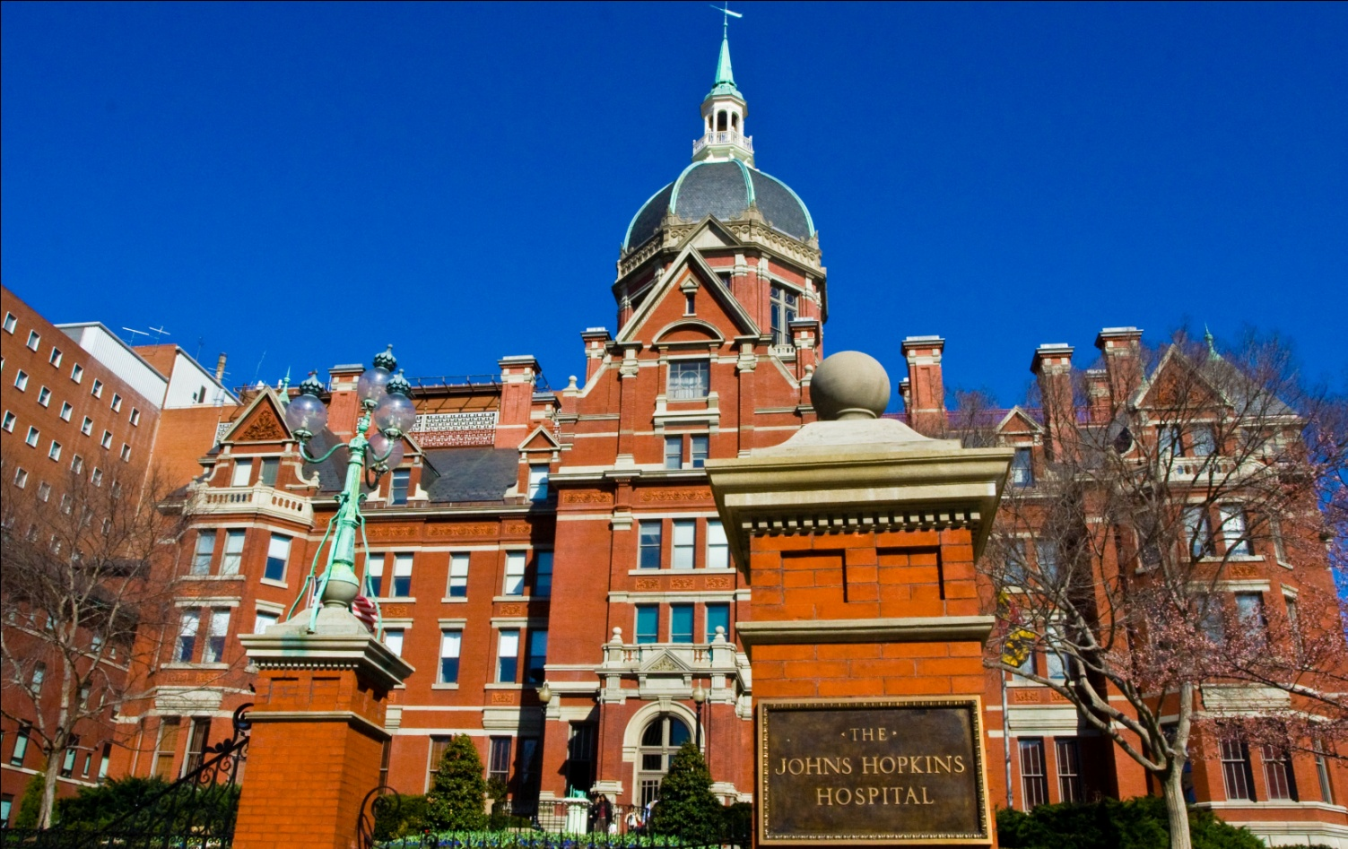


An Update on ctDNA as a
Cancer Biomarker
Ken Kinzler, Nicholas Papadopoulos, Brenda Diergaarde, Dan Normolle, Robert E. Schoen

Slide 2
ctDNA
As cancer cells turn over, release DNA into circulation, urine or stool
Detecting Mutant DNA – somatic mutations within driver genes that are responsible for clonal growth
Exquisite specificity – normal cells do not clonally expand, rarely harbor these somatic mutations, and not in this concentration

Slide 3
Challenges
Technical: Can we develop tests of sufficient specificity and sensitivity?
Biological:
1) Are there detectable amounts of DNA from neoplastic cells present in the biological fluid (some tumors don’t release)?
2) Somatic mutations vary - panel
3) Mutations not specific to one cancer

Slide 4
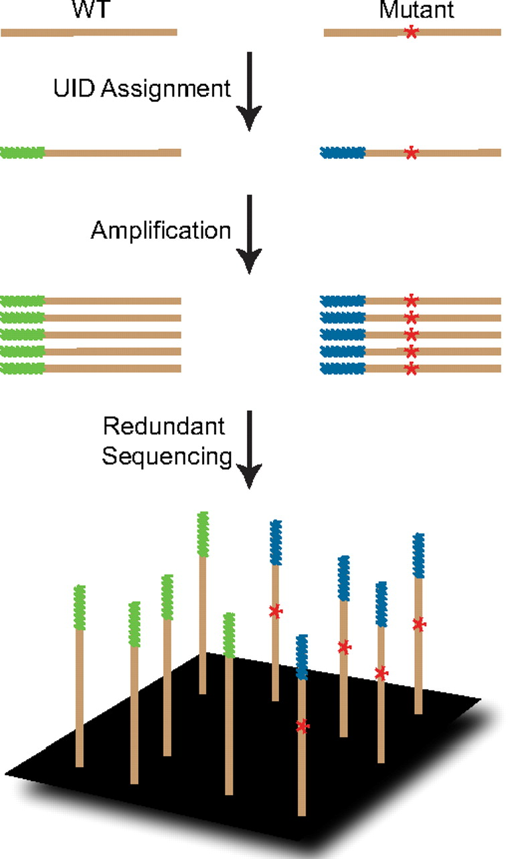
Safe-SeqS
Safe
Sequencing
System
Method for detection and quantification of rare mutations
Kinde I et al. PNAS 108:9530-9535, 2011

Slide 5
SafeSeqS
Assignment of unique ID (UiD) to each template molecule
Amplification of each UiD template molecule to create UiD families
Redundant sequencing to amplify: PCR fragments with same UiD are truly mutant if 95% contain identical mutation

Slide 6
Essential elements of Safe-SeqS
Sequencing or Replication Error
vs. Legitimate
Change
*
This strategy can decrease error rates by 70-fold
*
Kinde I et al. PNAS 2011;108:9530-9535

Slide 7
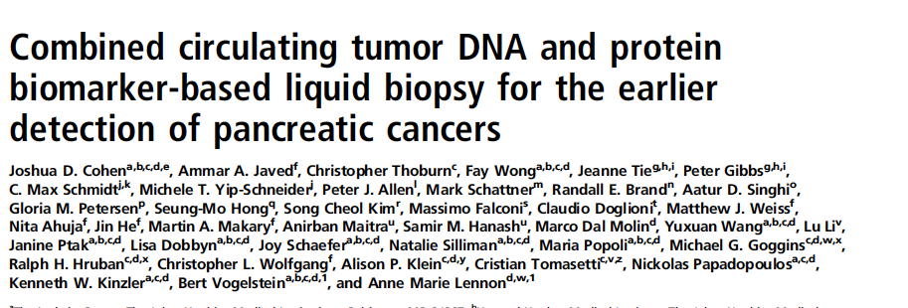
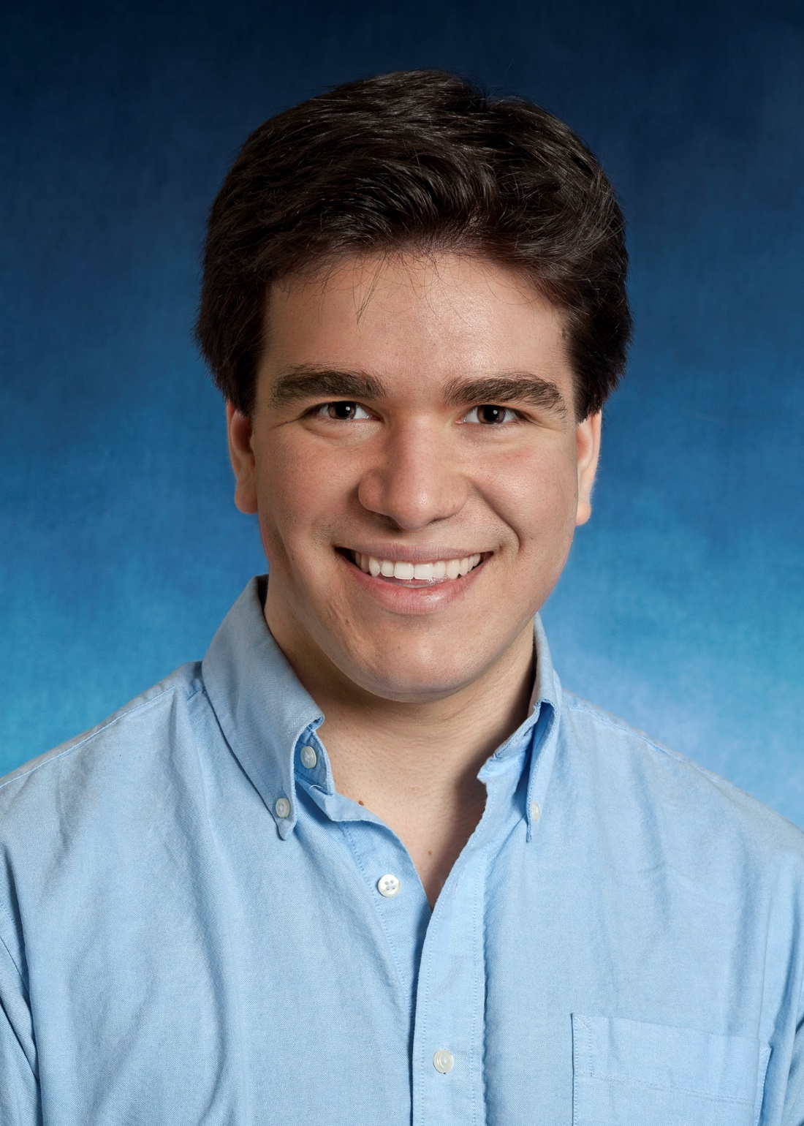
Cohen. PNAS 2017

Slide 8
ctDNA KRAS + Protein for Detection
of Pancreatic Ductal AdenoCA
221 pancreatic CA – all M0 (surgically resectable) (Stage I-II)
Tumor size median, 3.0cm IQR (2.4-3.8); 24 ≤ 1.5 cm
Positive nodes N=170 (76.9%)
182 controls
Cohen. PNAS 2017

Slide 9
KRAS Detection
Safe-SeqS – can detect 1 mutant/10,000 molecules
Codon 12 and 61 mutations
Detected mutant KRAS 66/221 (30%)
N=62 (codon 12) N=4 (codon 61)
ctDNA positivity correlated with stage, more frequent in large tumors

Slide 10
Mutant Templates
# of mutant templates calculated from mutant allele fraction and DNA concentration
15/66 (23%) <2 mutant templates/ml plasma
Avg 9.4/ml plasma
Only 1/221 normals had mutant KRAS
Concordant mutation found in 50/50 cancers tested

Slide 11
Protein Markers
Evaluated long list proteins – 5 promising
Prolactin – found to be elevated if blood drawn after anesthesia eliminated
CA 19-9 – threshold of 100 u/ml – zero positive for healthy controls
CEA, HGF, OPN – used threshold 10% higher than maximum in 273 normals – 100% specificity

Slide 12
Failed Protein Markers
AFP
CA15-3
Leptin
IL6
CA-125
NSE
OPG
TIMP-1
IL-8
sFas
Basic FGF2
CYFRA21-1
HE4
TGF-α
GDF15
DKK1
TIMP-2
Mesothelin
Midkine
Kallikrein6
CD44
AXL tyr kin
sHER2
sEGFR
suPAR
sPECAM1

Slide 13
Combination Assay
Sensitivity: 141/221; (64%, 95 CI 57-70) Specificity: 1/182; (99.5%)

Slide 14
Alone
KRAS = 30%
CA19-9 = 49%
Others = 18%
Uniquely
KRAS = 10%
CA19-9 = 22%
Others = 4%

Slide 15
N=
12
17
22
170
221

Slide 17
Combination Assay
Combination assay sensitivity: 141/221 (64%, 95 CI 57-70)
Positive assay associated with ↓’d survival – independent of clinico-path results – HR 1.76
27/40 (60%) patients with no symptoms were detected, of whom 19/27 (70%) w/o recurrence at 12 mo f/u

Slide 18
Summary: Pancreatic Adeno CA
KRAS gene mutation and protein biomarkers N=221 CA’s, 182 controls
KRAS mutant ctDNA in plasma – 66/221 (30%) – 100% concordance w/tumor
Add 4 proteins (CEA, CA 19-9, HGF, OPN) sensitivity to 64%
Only 1/182 controls was positive – 99.5% specificity
High thresholds to avoid decreasing specificity

Slide 19
Mega Study
1600 cancers, 800 controls
ctDNA Assay with 61 amplicons, evaluating spectrum of mutations in genes across cancers – agnostic screening assay
Combined with proteins to increase sensitivity and site identification

Slide 20
CRC Cohort
409 stage I-IV CRC patients, all with matched tumor
71 stage I
186 stage II
121 stage III
31 stage IV
Average age 64 (range: 22-93)

Slide 21
ctDNA + protein
I
IV

Slide 24
ctDNA for Monitoring

Slide 25
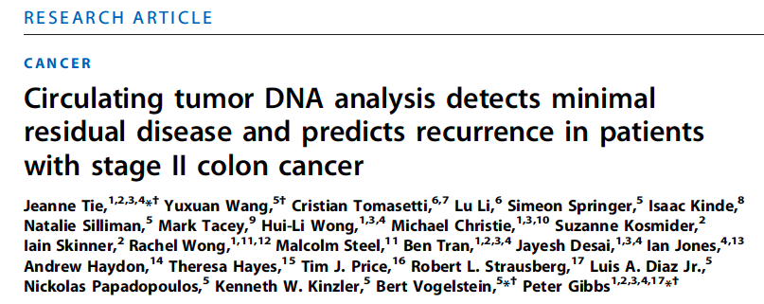
Sci Transl Med. 2016 Jul 6;8(346):346ra92
ASCO Annual Meeting, 2016, Abstract 3511

Slide 26
ctDNA in Stage II CRC
N=250, post-op and serial plasma
23% adj chemo Rx at clinician direction
Targeted 15 genes using safe-SeqS
20/231 +ctDNA post op (9 p53, 8 APC, 3 KRAS)
Median f/u 27 mo
34 (14.8%) radiologic recurrence
27/178 (15%) no chemo Rx
7/52 (13%) with chemo Rx
Tie, Science Trans Med 2016

Slide 27
ctDNA in Stage II - Results
No Chemo
+ctDNA ↓↓ Recurrence free survival (RFS): HR=18
ctDNA helpful in both low and high risk by clinical pathologic characteristics
CEA did not predict RFS

Slide 28
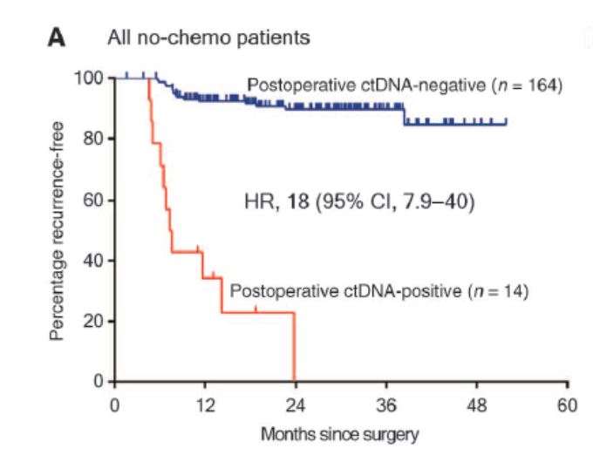

Recurrence Free Survival (RFS) in patients
not treated with adjuvant chemotherapy
Jeanne Tie et al., Sci Transl Med 2016;8:346ra92
Notes:
RFS in patients not treated with adjuvant chemotherapy. (A) Kaplan-Meier estimates of RFS for all patients not treated with adjuvant chemotherapy, stratified by postoperative ctDNA status. (B) Kaplan-Meier estimates of RFS in the same patients, stratified by clinicopathologic characteristics. (C) Kaplan-Meier estimates of RFS stratified by postoperative ctDNA status in patients with low-risk clinicopathologic characteristics. (D) Kaplan-Meier estimates of RFS stratified by postoperative ctDNA status in patients with high-risk clinicopathologic characteristics. The high-risk group is defined as those having mismatch repair–proficient (pMMR) tumors with at least one of the following poor prognostic features: T4, LN yield <12, LVI, and poor tumor differentiation. The low-risk group is defined as those with no poor prognostic features.

Slide 29
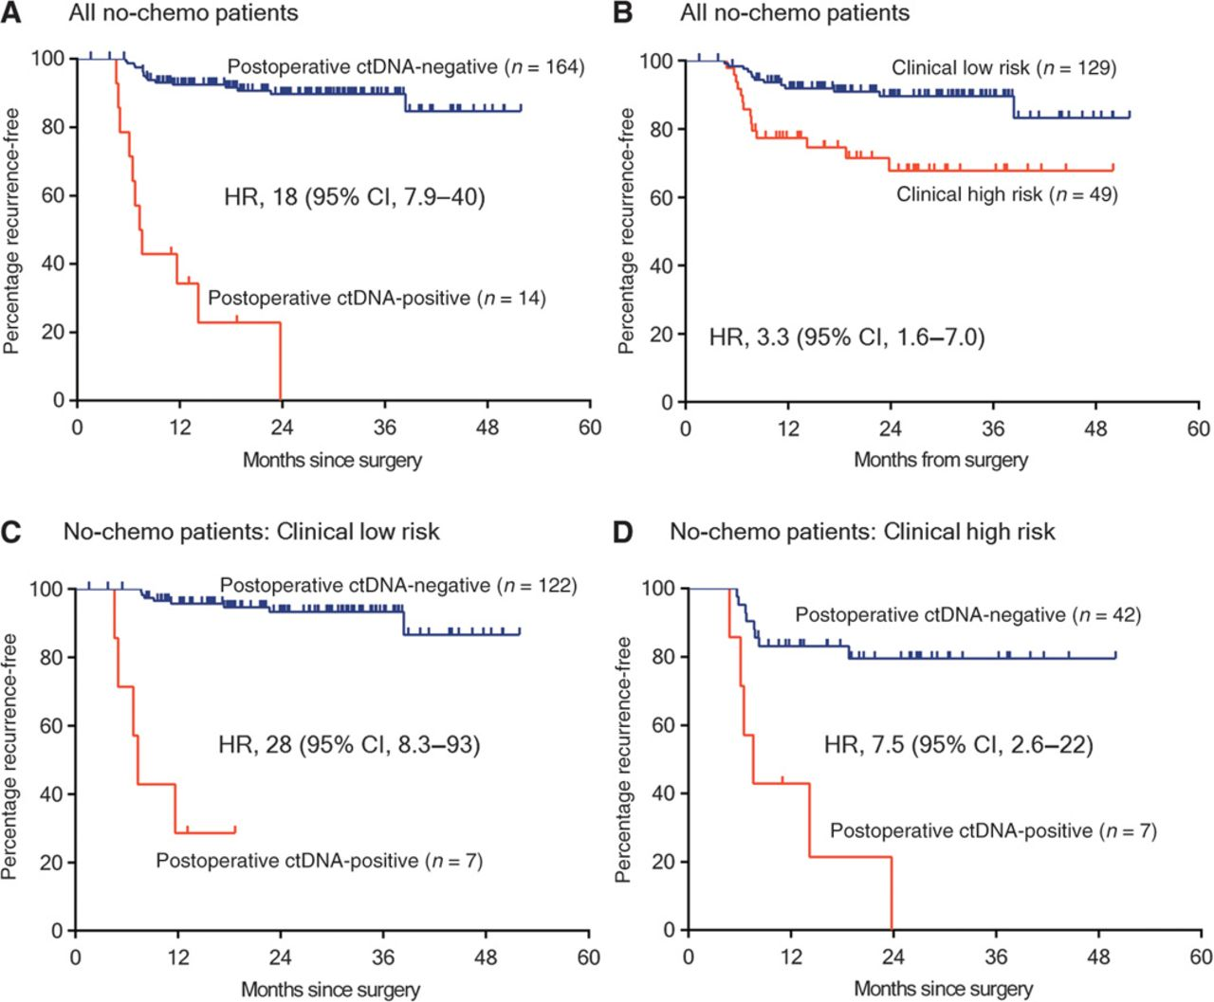
Recurrence Free Survival (RFS) in patients
not treated with adjuvant chemotherapy
Jeanne Tie et al., Sci Transl Med 2016;8:346ra92
Notes:
RFS in patients not treated with adjuvant chemotherapy. (A) Kaplan-Meier estimates of RFS for all patients not treated with adjuvant chemotherapy, stratified by postoperative ctDNA status. (B) Kaplan-Meier estimates of RFS in the same patients, stratified by clinicopathologic characteristics. (C) Kaplan-Meier estimates of RFS stratified by postoperative ctDNA status in patients with low-risk clinicopathologic characteristics. (D) Kaplan-Meier estimates of RFS stratified by postoperative ctDNA status in patients with high-risk clinicopathologic characteristics. The high-risk group is defined as those having mismatch repair–proficient (pMMR) tumors with at least one of the following poor prognostic features: T4, LN yield <12, LVI, and poor tumor differentiation. The low-risk group is defined as those with no poor prognostic features.

Slide 30
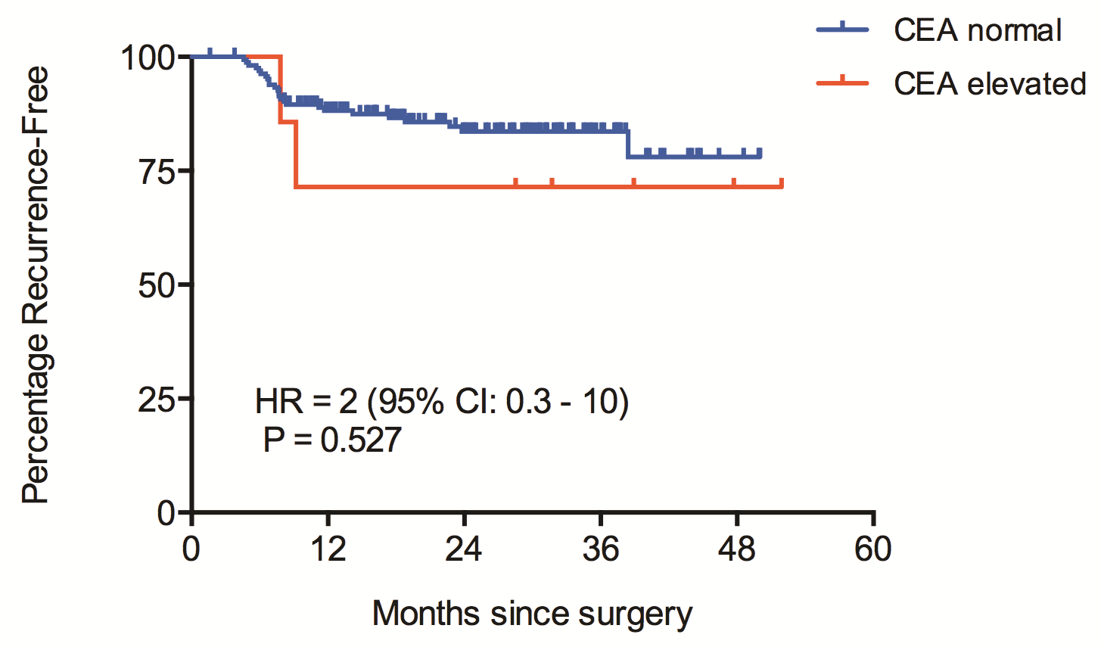
Recurrence Free Survival (RFS) in patients
not treated with adjuvant chemotherapy by CEA level

Slide 31
Serial ctDNA: Patients Treated with Chemotherapy
Last
Follow-Up
Last
Follow-Up
Chemo
Chemo
Chemo
Responder
Recurrence
Detected
Recurrence
Detected
Chemo
Chemo
Chemo
Non-Responder

Slide 32
Conclusions
ctDNA is a marker for recurrence in patients with stage II CRC
ctDNA findings discriminate within clinicopathologic subgroups

Slide 33
“DYNAMIC” Study
Circulating Tumour DNA Analysis Informing Adjuvant Chemotherapy in Stage II Colon Cancer

Slide 34
“DYNAMIC” Study
Study Design
Randomised multi-centre biomarker-driven adjuvant treatment study
Primary end-points
Number of patients treated with adjuvant chemotherapy
Recurrence-free survival

Slide 35
DYNAMIC
Study
Stage II Colon Cancer (n = 450)
Post-op ctDNA
2:1 Randomization
Stratification: T-stage, Type of hospital (metro vs regional)
Arm A
Biomarker Driven Group
(n = 300)
Arm B*
Standard Management Group
(n = 150)
Post-op ctDNA
Positive
Post-op ctDNA
Negative
Adjuvant chemo
No adjuvant chemo
Monthly ctDNA during chemo
Follow-Up for Recurrence and Survival
*Blinded to ctDNA results

Slide 36
Aims: EDRN Renewal
Can ctDNA be used as a primary screening modality?
Test panel of mutations (PlasmaSeq)
Can ctDNA in Stage III CRC be used as predictor of disease free and overall survival?
Compare CEA to ctDNA
Evaluate ctDNA as prognostic marker

