Slide 1

Urinary RNA, Serum Biomarkers, and
Axumin PET Imaging:
A Trifecta to Better Detect Aggressive Prostate Cancer
Martin G. Sanda, M.D.
PI, Emory-Harvard-University of Washington EDRN CVC
Professor and Chairman, Department of Urology
Emory University School of Medicine & Winship Cancer Institute
EDRN Steering Committee Meeting
September 12, 2017

Slide 2
Serum Biomarkers, Urinary RNA, Imaging to Better Detect Aggressive Prostate Cancer
Serum
  Prostate Health Index: phi (D Chan, L Sokoll et al)
Urinary RNA
  PCA3 (J Wei et al)
  TMPRSS2:Erg (S Tomlins, A Chinnayian et al)
  Multiplex urinary RNA (K Pellegrini et al)
Combining Urinary RNA and Serum Biomarkers
  Serum phi and urinary PCA3 (E Huang et al)
Imaging
  Mets: Axumin-PET(D Schuster, M Alemozaffar et al)

Slide 3
Serum: Prostate Health Index (phi)
  Phi = [-2]pro-PSA / free PSA * √ total PSA
  Less impact of prostate size/BPH (than total PSA)
Complementary Collaboration between NCI & Industry:
EDRN Studies
  Retrospective prediction of biopsy (Sokoll et al J Urology 2008)
  Prospective validation (Sokoll et al Ca Epi Bio Prev 2011)
  Gleason score 7+ on initial biopsy (de la Calle 2015)
Beckman pivotal trial
  Catalona et al J Urology 2011
  Improved accuracy over PSA and %free PSA
  Any Prostate Ca on Initial or Repeat Biopsy
Notes:
-The Prostate Health Index (PHI) is a mathematical formula that was developed by Beckman Coulter
comprising of total PSA, [-2]proPSA and fPSA. And Because of the combination, Phi is more stable against variations in prostate size/benign hyperplasia as compared to total serum PSA.
-Both free PSA which is an unbound form of PSA and [-2]proPSA which is an isoforms of free PSA has been shown to increase specificity in prostate cancer detection.
-Phi is currently FDA approved and commercially available for clinical assay awaiting for reimbursement code/policy.
-In a 2011 landmark study, Phi was not only shown to detect prostate cancer with increased accuracy over PSA and percent free PSA, But also was positively associated with Gleason score on biopsy.
-However, this and most of the other studies were evaluated in mixed setting of initial as well as the repeat prostate biopsies.
-Moreover, the only study that described Phi performance initial biopsy population, did not evaluated Phi's ability to separate aggressive prostate cancer from indolent and results were not independent of total PSA.

Slide 4
Prostate Health Index (phi) to
Detect Aggressive Prostate Cancer: Results
PHI specificity for aggressive Pca higher than PSA, %free PSA
Using PHI ≥ 24 to select men for biopsy can:
  Avoid unnecessary biopsies in 36% of biopsy candidates
  Avoid over-detection of Gleason 6 cancer in 26%
Parameter | Sensitivity | Specificity
Development Cohort
Phi >24 | 96% | 35%
PSA > 2.5 | 96% | 17%
%free PSA < 26% | 95% | 20%
Validation Cohort
Phi >24 | 92% | 30%
PSA > 2.5 | 98% | 18%
%free PSA < 26% | 95% | 15%
Notes:
In conclusion, prostate health index can improve the detection of aggressive prostate cancer in initial biopsy population with a higher specificity than either total serum PSA or % free PSA alone.
And Phi score at an optimal threshold of 24 or more, can reduce unnecessary biopsy and over diagnosis of indolent disease in same population.

Slide 5
Serum Biomarkers: Prostate Health Index (phi)
Current Status:
FDA-approved, commercially available clinical assay
Awaiting CMS reimbursement code/policy (in process)
Clinical adoption underway - slowly
Notes:
-The Prostate Health Index (PHI) is a mathematical formula that was developed by Beckman Coulter
comprising of total PSA, [-2]proPSA and fPSA. And Because of the combination, Phi is more stable against variations in prostate size/benign hyperplasia as compared to total serum PSA.
-Both free PSA which is an unbound form of PSA and [-2]proPSA which is an isoforms of free PSA has been shown to increase specificity in prostate cancer detection.
-Phi is currently FDA approved and commercially available for clinical assay awaiting for reimbursement code/policy.
-In a 2011 landmark study, Phi was not only shown to detect prostate cancer with increased accuracy over PSA and percent free PSA, But also was positively associated with Gleason score on biopsy.
-However, this and most of the other studies were evaluated in mixed setting of initial as well as the repeat prostate biopsies.
-Moreover, the only study that described Phi performance initial biopsy population, did not evaluated Phi's ability to separate aggressive prostate cancer from indolent and results were not independent of total PSA.

Slide 6
Serum Biomarkers, Urinary RNA, Imaging to Better Detect Aggressive Prostate Cancer
Serum
  Prostate Health Index: phi (D Chan, L Sokoll et al)
Urinary RNA
  PCA3 (J Wei et al)
  TMPRSS2:Erg (S Tomlins, A Chinnayian et al)
  Multiplex urinary RNA (K Pellegrini et al)
Combining Urinary RNA and Serum Biomarkers
  Serum phi and urinary PCA3 (E Huang et al)
Imaging
  Mets: Axumin-PET(D Schuster, M Alemozaffar et al)

Slide 7
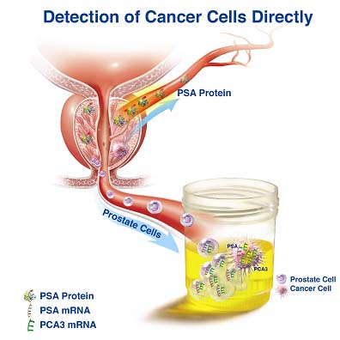
Urinary RNA: PCA3
J Wei et al, EDRN PCA3 Validation Trial, J Clin Onc 2014
DD3: a non-coding RNA associated with PCA tissue (Bussemakers et al 1999)
Detected in post-DRE urine sediment (Hessels et al 2003)
Adopted to clinical grade assays in post-DRE whole urine (Genprobe/ Hologics)
FDA approval to select men for repeat prostate biopsy (2012)

Slide 8
Urinary RNA Testing to Refine Prostate Ca Detection
TMPRSS2:ERG (A Chinnayian, University of Michigan BDL)
  Gene rearrangement (deletion or translocation) in ~ half of prostate cancers (Tomlins et al, Science, 2005)
  TMPRSS2-Erg RNA detected in post-DRE urine sediment by RT-PCR (Laxman et al 2006)
  Possible combination with PCA3 suggested (Hessels et al 2007)

Slide 9
Urinary T2:Erg and PCA3 RNA Testing to Refine Prostate Cancer Detection
M Sanda et al JAMA Oncology 2017
Study Objectives
  To determine if combined T2:erg and PCA3 RNA assay can improve specificity for detecting ‘aggressive’ PCA (Prostate biopsy Gleason score > 7)
    Reduce unnecessary biopsy and ‘over-diagnosis’ of cancers with Gleason score = 6
  To model the lifetime cost impact if urinary T2:Erg and PCA3 was used to identify men for prostate biopsy

Slide 10
Urinary T2:Erg and PCA3 RNA Testing to Refine Prostate Cancer Detection
Enrollment
Development Cohort: 3 Sites N = 516
Validation Cohort: 10 Sites (EDRN PCA3 Trial Group) N = 561
Collect Post-DRE Urine;
Assay T2:Erg and PCA3
Prostate Biopsy
Benign
Prostate
Cancer
Analysis:
Specificity for Gleason > 7 Pca @ 95% Sensitvity

Slide 11
Combining Urinary T2:Erg and PCA3 RNA Testing
Improves Specificity for Predicting Gleason > 7 PCa
Biomarker | Assay Threshold for > 95% Sensitivity To Predict Gleason > 7 | Specificity
PSA | 3.0 | 18%
PCA3 | 6.3 | 17%
T2-erg* | --- | 0%
PCA3-T2erg | 19.1, 7.6 | 39%
*T2:erg maximum sensitivity is <95% because it exists in ~60% of PCa

Slide 12
Urinary T2:Erg and PCA3 Testing at Age = 55-64 Yrs Would Reduce Lifetime Health Care Costs
Scenario I: Comparison to PSA-Based Biopsy
Scenario II: Comparison to No Screening - USPSTF
Lifetime Cost Savings Per Man Undergoing PCA3-T:erg Test
Age | Change in Cost
55-64 | -$800
65-74 | -$1,200
Lifetime Cost Savings Per Man Undergoing PCA3-T:erg Test
Age | Change in Cost
55-64 | -$2,800
65-74 | +$4,500

Slide 13


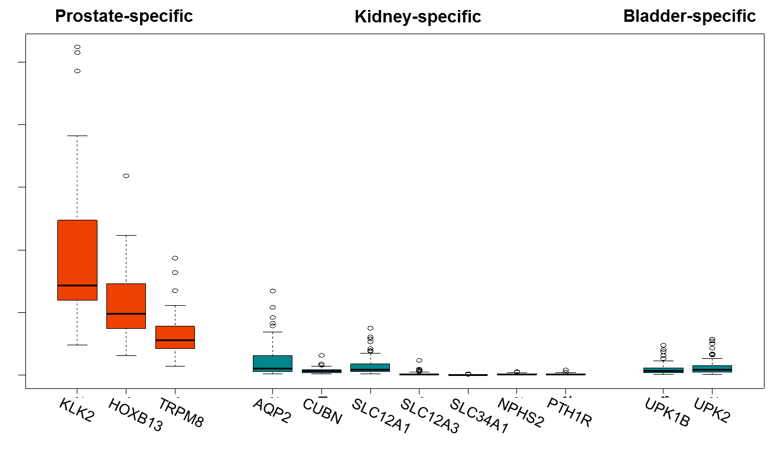
Targeted Sequencing of Prostate Ca-Associated RNAs in Extracellular Vesicles From Post-DRE Urine (K Pellegrini et al, ongoing)
A. Post-DRE Urine Extracellular Vesicles Enriched for Prostate RNA
C. RNAseq of Urine EV’s Clusters GS7+Pca (>2-fold change in 178/340 candidate RNA’s)
B. Targeted RNA Seq Discerns Expected PCa-associated RNA’s
Notes:
PCA3 has limited use as a stand-alone marker
We began our studies by optimizing the conditions required for RNA isolation from urine

Slide 14
Serum Biomarkers, Urinary RNA, Imaging to Better Detect Aggressive Prostate Cancer
Serum
  Prostate Health Index: phi (D Chan, L Sokoll et al)
Urinary RNA
  PCA3 (J Wei et al)
  TMPRSS2:Erg (S Tomlins, A Chinnayian et al)
  Multiplex urinary RNA (K Pellegrini et al)
Combining Urinary RNA and Serum Biomarkers
  Serum phi and urinary PCA3 (E Huang et al)
Imaging
  Mets: Axumin-PET(D Schuster, M Alemozaffar et al)

Slide 15
Combining FDA-Approved Clinical Assays: phi and PCA3 RNA Testing to Refine Prostate Cancer Detection
Biomarkers | Cutpoints | Sensitivity | Specificity
PCA3 | 7.6 | 95 | 17
phi | 23 | 95 | 27
PCA3 or phi | phi > 31 OR PCA3 > 29 | 97 [95] | 35 [35]
First phi then PCA3 | phi>31 OR phi>16 AND PCA3>29 | 97 [95] | 38 [37]

Slide 16
Combining Serum Prostate Health Index with post-DRE Urine PCA3 and T2Erg Clinical Assays to Predict Aggressive Prostate Ca (E Huang et al, ongoing)
Serum Prostate Health Index (y axis), post-DRE Urine PCA3 (x axis), and T2Erg (z axis) clinical assay results stratified by aggressive Gleason 7+ prostate cancer (red) vs benign or indolent (blue)
Biospecimen Substrate | Biomarker Combination | Sensitivity | Specificity
Blood (serum) | Prostate Health Index (phi) | 95 | 27
Urine (post-DRE) | PCA3 + T2Erg | 92 | 36
Blood and Urine | phi + PCA3 + T2erg | 97 | 41
1st Blood, then Urine | phi > PCA3 + T2erg | 97 | 45
1st Urine, then Blood | PCA3 + T2erg > phi | 96 | 46
Notes:
PCA3 has limited use as a stand-alone marker
We began our studies by optimizing the conditions required for RNA isolation from urine

Slide 17
Serum Biomarkers, Urinary RNA, Imaging to Better Detect Aggressive Prostate Cancer
Serum
  Prostate Health Index: phi (D Chan, L Sokoll et al)
Urinary RNA
  PCA3 (J Wei et al)
  TMPRSS2:Erg (S Tomlins, A Chinnayian et al)
  Multiplex urinary RNA (K Pellegrini et al)
Combining Urinary RNA and Serum Biomarkers
  Serum phi and urinary PCA3 (E Huang et al)
Imaging
  Mets: Axumin-PET(D Schuster, M Alemozaffar et al)

Slide 18
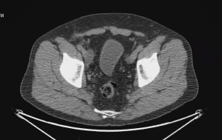
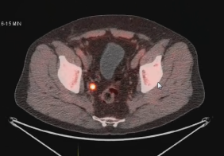
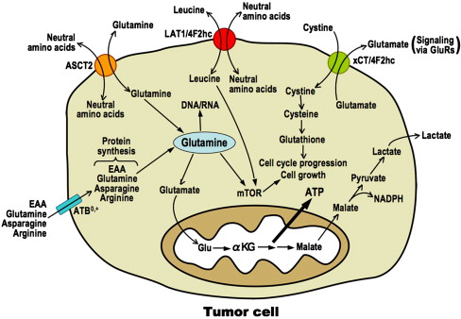
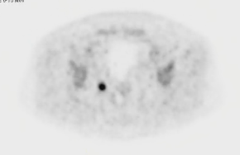
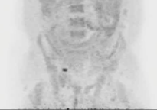
Detection of Prostate Cancer Micrometastatic Disease by FACBC-PET
M Goodman, Dept of Radiology & Chemistry; D Schuster, Dept of Radiology, et al
Detection of sub-centimeter lymph node metastases in patient with rising PSA (0.46) after prostatectomy:
FACBC fluciclovine (Axumin):
Non-natural alicyclic amino acid analogue PET radiotracer
Ganapathy et al. Pharmacology & Therapeutics 2009;121:29
Notes:
PCA3 has limited use as a stand-alone marker
We began our studies by optimizing the conditions required for RNA isolation from urine

Slide 19
Imaging: Axumin PET
Current Status:
FDA-approved, widely available
CMS reimbursement to detect metastases in PSA recurrence following primary treatment
New clinical use: detect metastases at initial diagnosis of high risk disease to guide primary treatment
    Clinical Trial: Axumin-PET prior to superextended lymphadenectomy in high risk, localized prostate cancer
Notes:
-The Prostate Health Index (PHI) is a mathematical formula that was developed by Beckman Coulter
comprising of total PSA, [-2]proPSA and fPSA. And Because of the combination, Phi is more stable against variations in prostate size/benign hyperplasia as compared to total serum PSA.
-Both free PSA which is an unbound form of PSA and [-2]proPSA which is an isoforms of free PSA has been shown to increase specificity in prostate cancer detection.
-Phi is currently FDA approved and commercially available for clinical assay awaiting for reimbursement code/policy.
-In a 2011 landmark study, Phi was not only shown to detect prostate cancer with increased accuracy over PSA and percent free PSA, But also was positively associated with Gleason score on biopsy.
-However, this and most of the other studies were evaluated in mixed setting of initial as well as the repeat prostate biopsies.
-Moreover, the only study that described Phi performance initial biopsy population, did not evaluated Phi's ability to separate aggressive prostate cancer from indolent and results were not independent of total PSA.

Slide 20
Serum Biomarkers, Urinary RNA, Imaging to Better Detect Aggressive Prostate Cancer
Serum
  Prostate Health Index: phi (D Chan, L Sokoll et al)
Urinary RNA
  PCA3 (J Wei et al)
  TMPRSS2:Erg (S Tomlins, A Chinnayian et al)
  Multiplex urinary RNA (K Pellegrini et al)
Combining Urinary RNA and Serum Biomarkers
  Serum phi and urinary PCA3 (E Huang et al)
Imaging
  Mets: Axumin-PET(D Schuster, M Alemozaffar et al)

Slide 21


