Slide 1
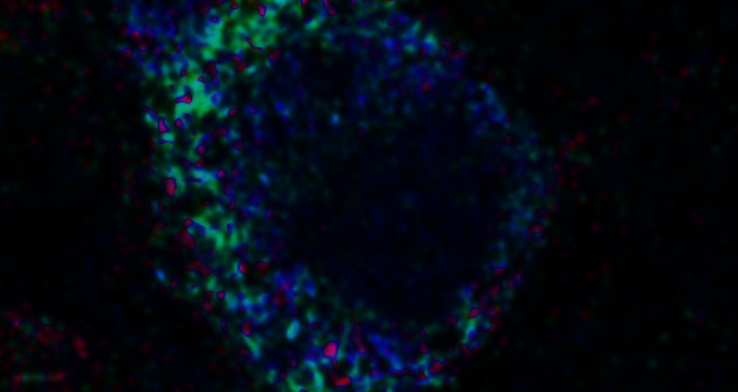
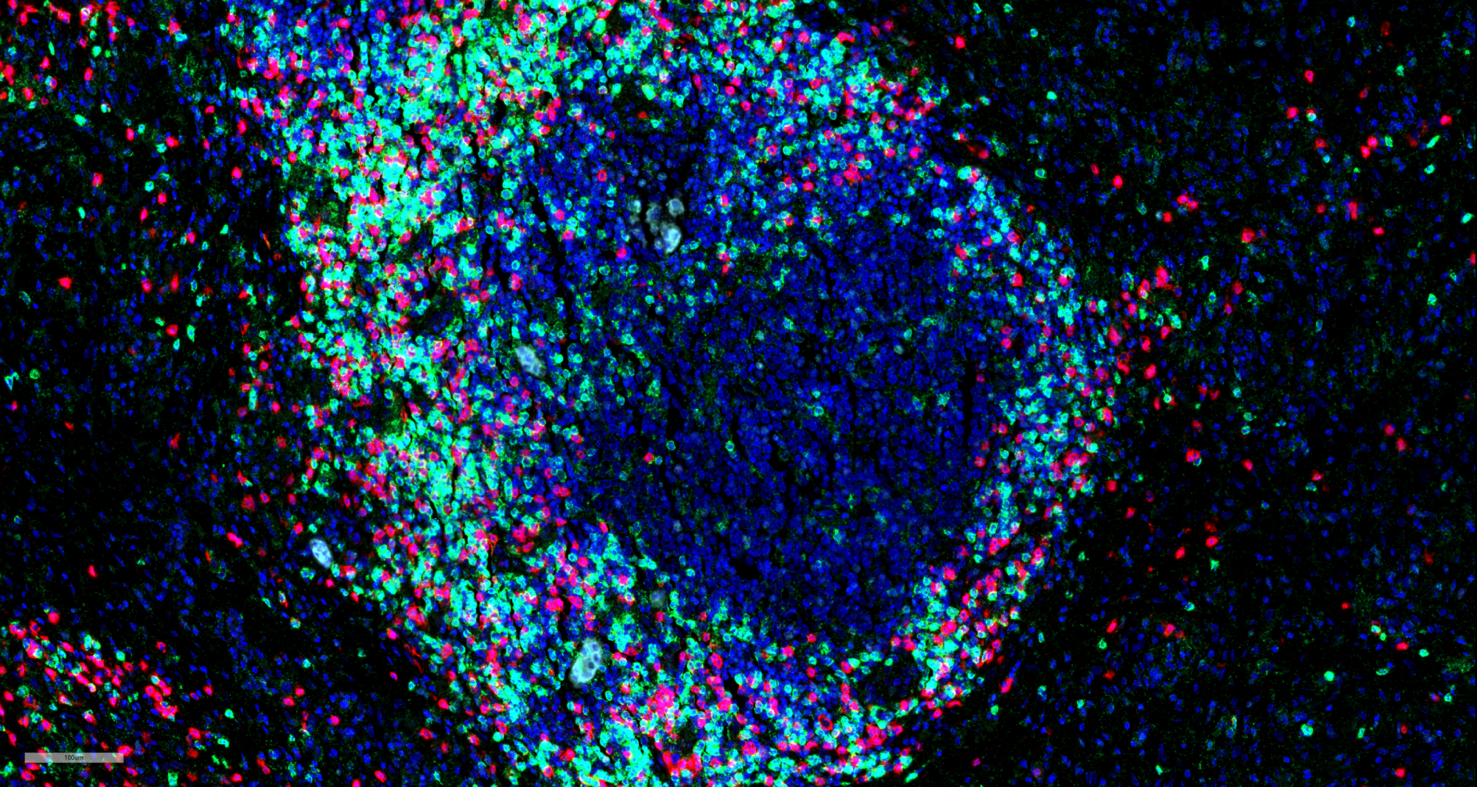
The immunobiology of pulmonary premalignancy
32nd EDRN Steering Committee Meeting
Seattle
September 13, 2017
Steve Dubinett
David Geffen School of Medicine at UCLA
Representing the BU/UCLA BDL
Notes:
1

Slide 2
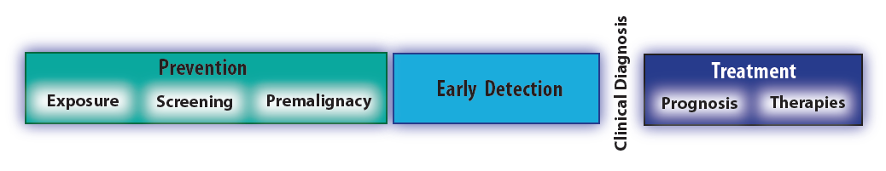
Rate limiting step to develop new interception approaches is lack of understanding of the earliest molecular events associated with disease initiation and progression
JCO 2013

Slide 3
Loss of immunosurveillance with tumor progression
Metastatic
Invasion
In situ lesion
Premalignant lesion
Initiating
event
Developing tumor
developing
tumor mass
Time
Zitvogel et al, Immunity 39: 74-88, 2013

Slide 4
Loss of immunosurveillance with tumor progression
immunosurveillance
Escape
Equlibrium
Elimination
developing
tumor mass
Time
Zitvogel et al, Immunity 39: 74-88, 2013

Slide 5
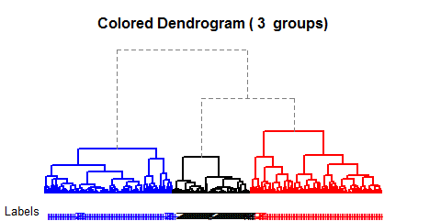
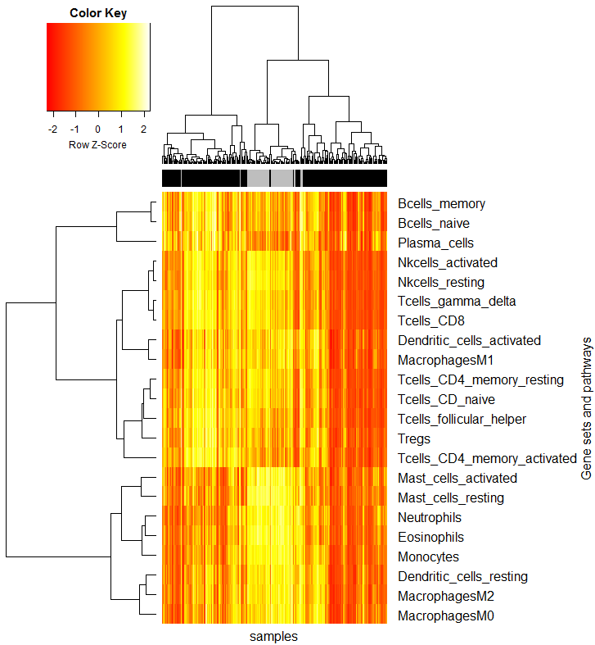
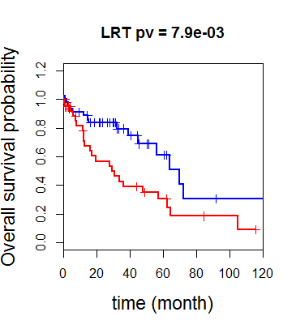
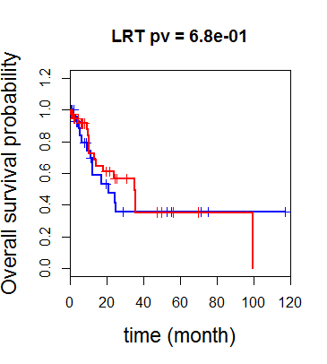
TCGA Lung Squamous Carcinoma – leukocyte signature genes* appear to be important in Stage I
A
score
B
Stage I patients
Heatmap of GSVA-derived scores of 22 immune-related cell profiles in 229 samples. Samples and cellular profiles were ordered based on unsupervised hierarchical clustering.
(B) Survival of Stage I patients in G2 (n = 49) and G3 (n = 37). HR= 2.4 (95% confidence interval 1.2 - 4.7).
(C) Kaplan-Meier curves of Stage II and higher patients in G2 (n = 33) and G3 (n = 39). HR= 0.9 (95% confidence interval 0.4-1.8).
G2
G1
G3
LRT p = 0.0079
TU
G2
NOR
G3
Overall survival prob.
C
Stage II & higher patients
LRT p = 0.68
G2
G3
Overall survival prob.
Samples
Time (month)
(*Gentles AJ, Newman AM et al Nat Med 2015)

Slide 6
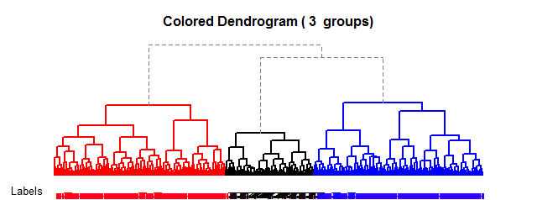
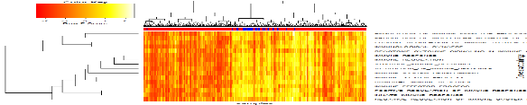
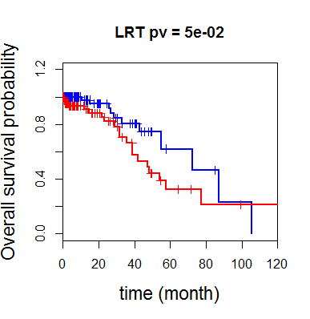
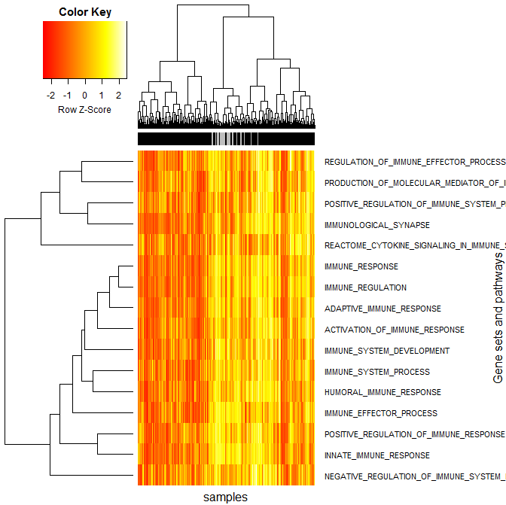
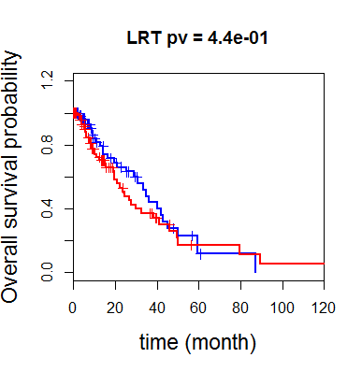
TCGA Lung ADC – Immune-related pathways appear to be important in Stage I
A
TU
B
Stage I patients
Tumor immune profile of TCGA lung ADC
(A) Heatmap of GSVA-derived scores of 16 immune-related pathways in 502 samples. Samples and pathways were ordered based on unsupervised hierarchical clustering.
(B) Kaplan-Meier curves of Stage I patients in G2 (n = 101) and G3 (n = 91). Hazard ratio = 2.0 (95% confidence interval 0.99-4.25). (C) Kaplan-Meier curves of Stage II and higher patients in G2 (n = 77) and G3 (n = 90). Hazard ratio = 1.2 (95% confidence interval 0.74-1.98).
score
NOR
-2 0 2
G3
G1
G2
LRT p = 0.050
G2
G3
Overall survival prob.
C
Stage II and higher patients
Immune related pathways
LRT p = 0.44
G2
Overall survival prob.
G3
Samples
Time (month)
(16 pathways from Molecular Signature Database)
Notes:
Samples clustered based on spearman distance and ward.D2 agglomerate method

Slide 7
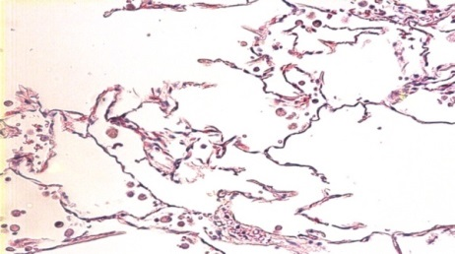
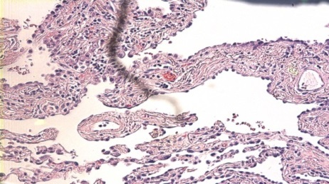
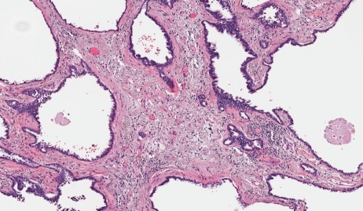
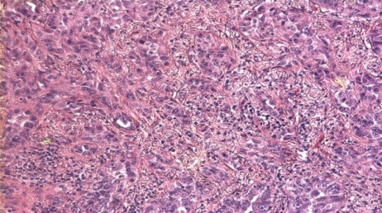
Rationale
The complete mutational profiles of atypical adenomatous hyperplasia (AAH) premalignant lesions and adenocarcinoma in situ (AIS) have not been studied
Molecular mechanisms underlying AAH formation and potential progression are not well understood
The role of the immune system and microenvironment in premalignancy and tumor progression is not fully investigated
?
?
Normal AAH AIS ADC

Slide 8
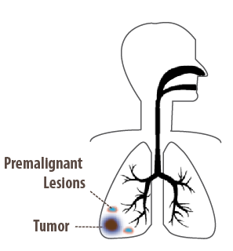
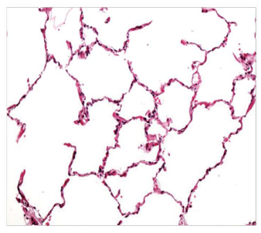
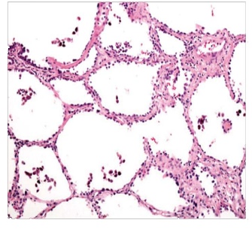

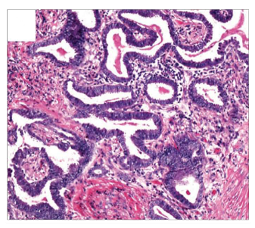
Aim 1B: Study Design
PCA of Premalignant Adenomatous Lesions
Normal
AAH
RNA Seq
LCM Tissue
Whole Exome Seq
AIS
ADC
Multiplex Immunofluorescence
Identify immune contexture in premalignancy and the associated tumor
Identify AD premalignant neoepitopes
3) Derive novel molecular subclasses of AD premalignancy, using genomic and transcriptomic heterogeneity
Notes:
Steve: edit deliverables

Slide 9
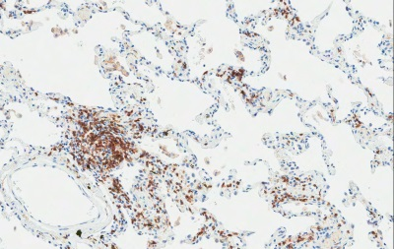
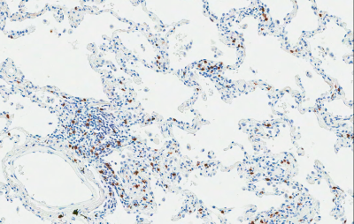
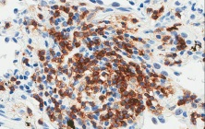
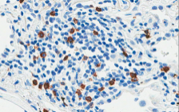
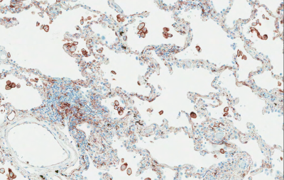
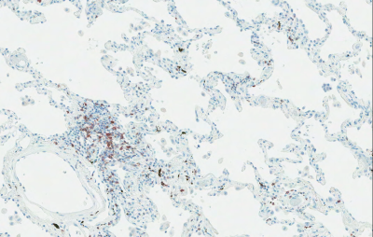
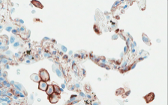
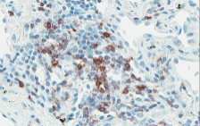
Extending the PCA to premalignant lesions for adenocarcinoma (AAH):
Immune recognition and suppression in lung premalignancy
The battle between host and tumor starts very early
A
B
CD4
CD8
AAH lesion
C
D
PD-1
PD-L1
AAH lesion
Krysan, Tran, Grimes, Walser, Fishbein, Dubinett UCLA

Slide 10
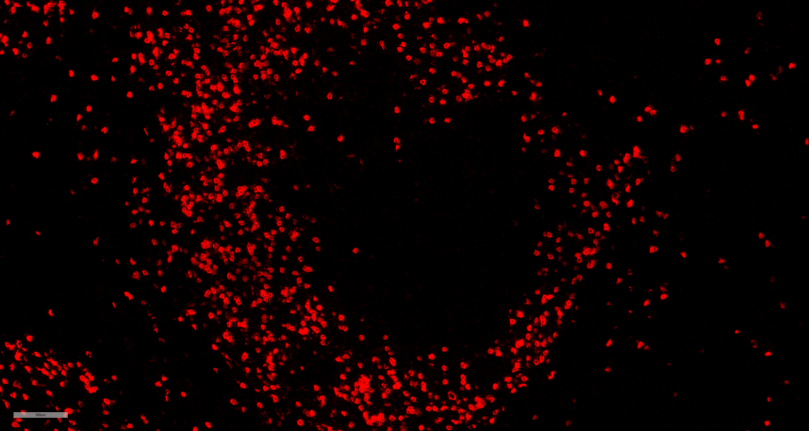
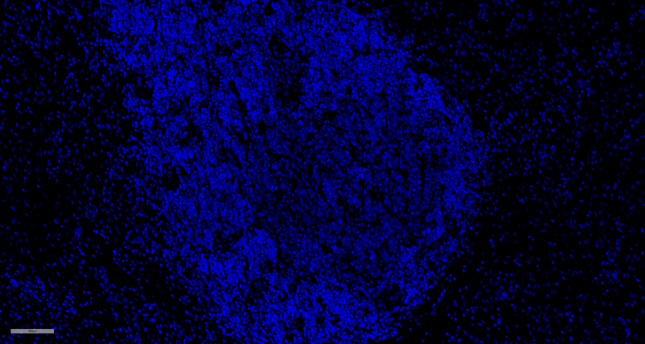
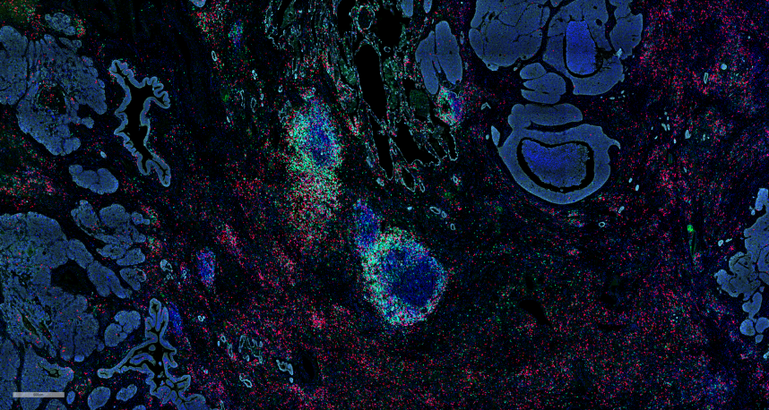
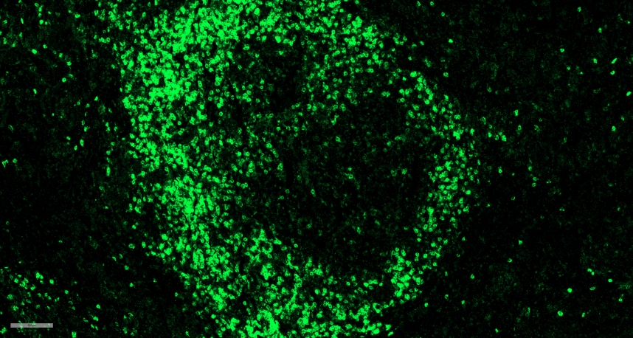
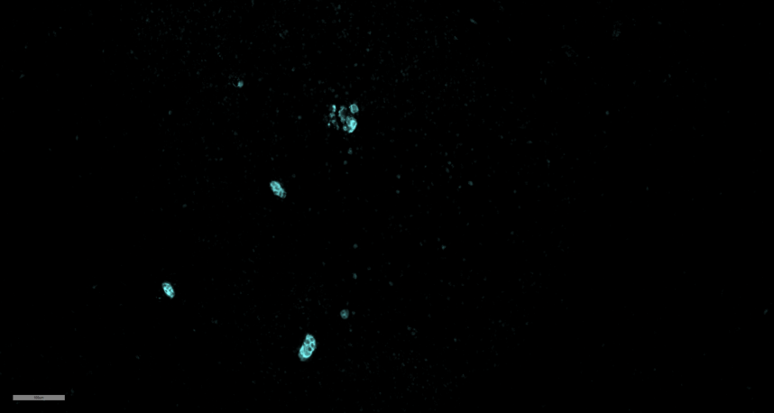

S10-02355-F7
SCC-SM Case
TLN ROI
CD8-Red
DAPI
CD4-Green
PanCK-Cy5

Slide 11
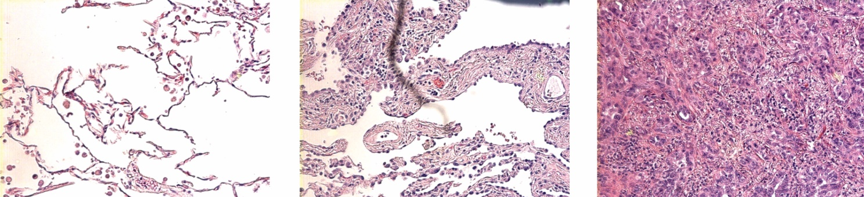
Work flow for neoantigen discovery and validation
Normal
Premalignant
Cancer
WES
Tissue microenvironment
Gene
expression
Putative
neoantigens
identification
Data
integration
Functional analysis of neoantigens
Future vaccines (?)

Slide 12
Experimental design
FFPE tissue blocks from 41 patients with multiple AAH lesions, AIS and ADC obtained from UCLA Lung Cancer Tissue Repository
For each patient, the following regions were isolated by Laser Capture Microdissection (LCM) and sequenced utilizing whole exome sequencing:
1-3 regions of normal lung
2-4 premalignant AAH lesions
1-3 regions of AIS (where present)
1-3 regions of invasive ADC
A total of 50 normal areas, 89 AAH, 15 AIS and 55 ADC were sequenced

Slide 13
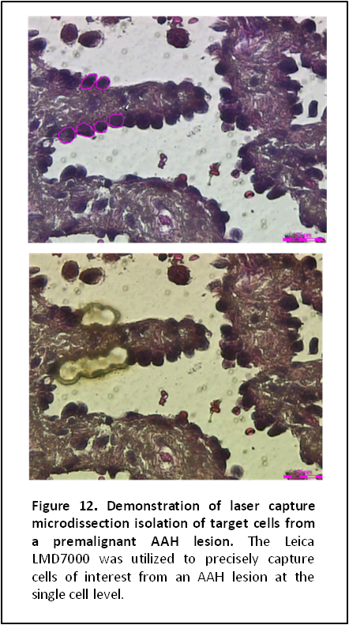
Mutational landscape in pulmonary premalignancy
Whole-exome sequencing of at least three non-overlapping regions of adenocarcinoma,
AAH and normal airway epithelial cells (n=41)
Representation of Mutations
premalignancy
adenocarcinoma
normal
Premalignancy | Cancer | Premalignancy & Cancer
NOTCH2, FOXP1, CASZ1, SPEN, HNRNPR, RCAN3, RUNX3, MAP3K6, RPA2, PHACTR4, RCC1, HDAC1, POU3F1 Next steps: Identify neo-epitopes | BRAF, PIK3CA, NFE2L2, SMARCA4, EGFR, CUL3, STK11, LRP1B, EPHA3, KDR, NTRK3, FGFR4, ZMYND10, TMEM180, EPHA5, TP53TG3, TP53I13, PAX2, FAM178A, NR0B2, FCN3, DNAJC8, TAF12, GJB3, NDUFS5, OXCT2, KRAS Krysan, Tran, Grimes, UCLA; EDRN and MCL | KEAP1, MLL2, HLA-A, NOTCH1, RB1, NF1, APC, ATM, GNAS, SLC38A3, DMBT1, DOCK1, MKI67, CAMKK2, CDK11A, TP73, EXTL1, TP53BP1, TP53BP2, STK11IP, TP53TG5, PDCD11, SORCS1, SORCS3, PPP2R2D, RASSF7, KDM2B, AHDC1, FGR, PTPRU, COL16A1, BAI2, SPOCD1, GRIK3, ZC3H12A

Slide 14
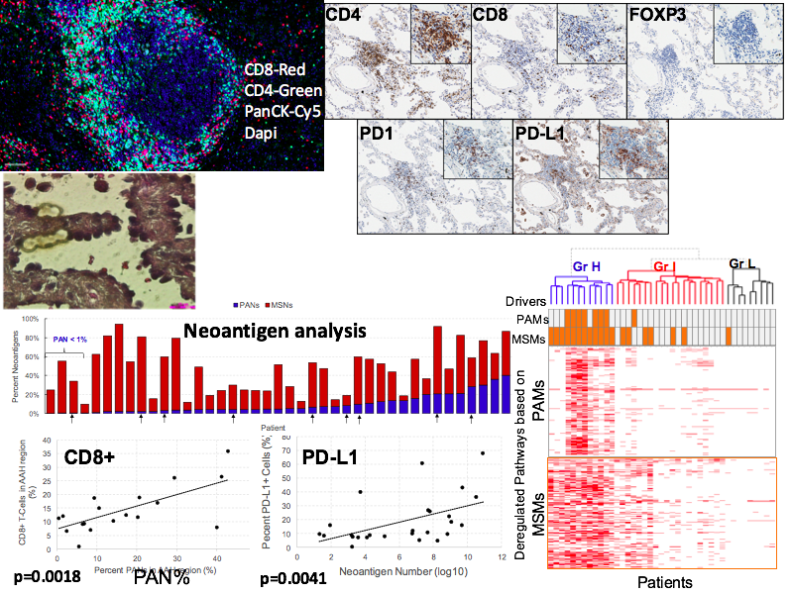
Immune infiltration and neoepitopes in lung adenocarcinoma premalignancy
LCM
PAN%

Slide 15
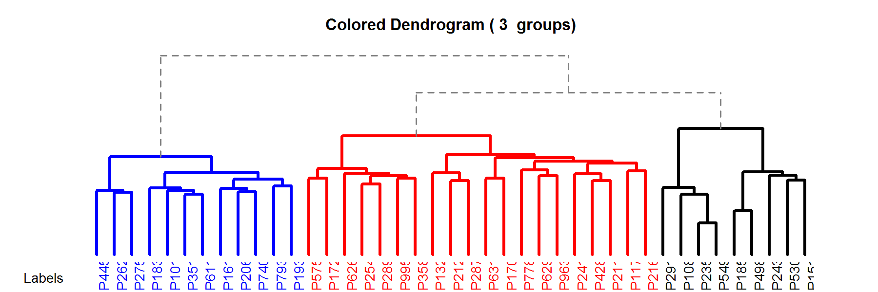
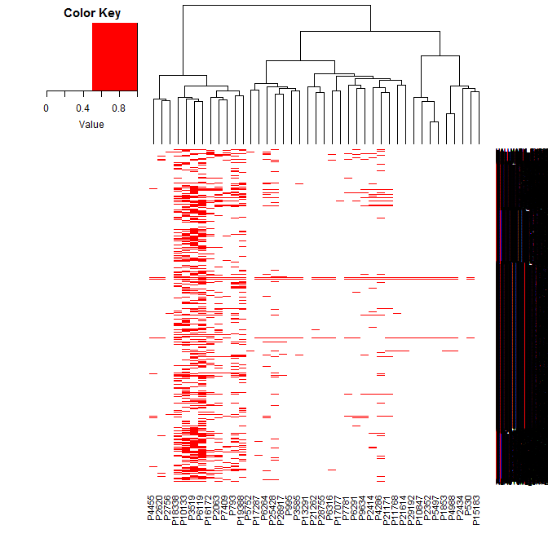
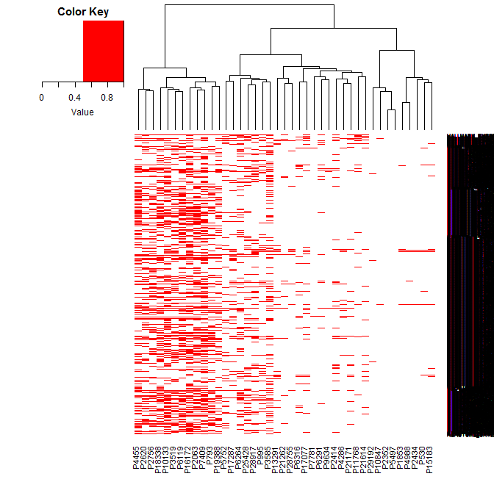
Dysregulated pathways in lung adenocarcinoma premalignancy
Aim 1B: Preliminary Data
High
Intermediate
Low
Drivers
PAMs
MSMs
PAMs
Deregulated Pathways based on
MSMs
Patients

Slide 16
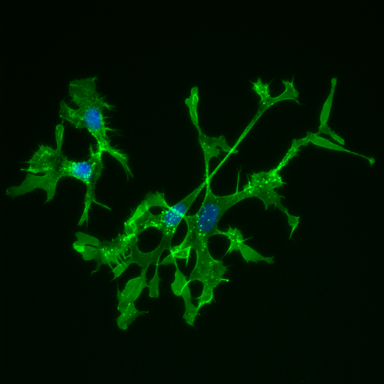
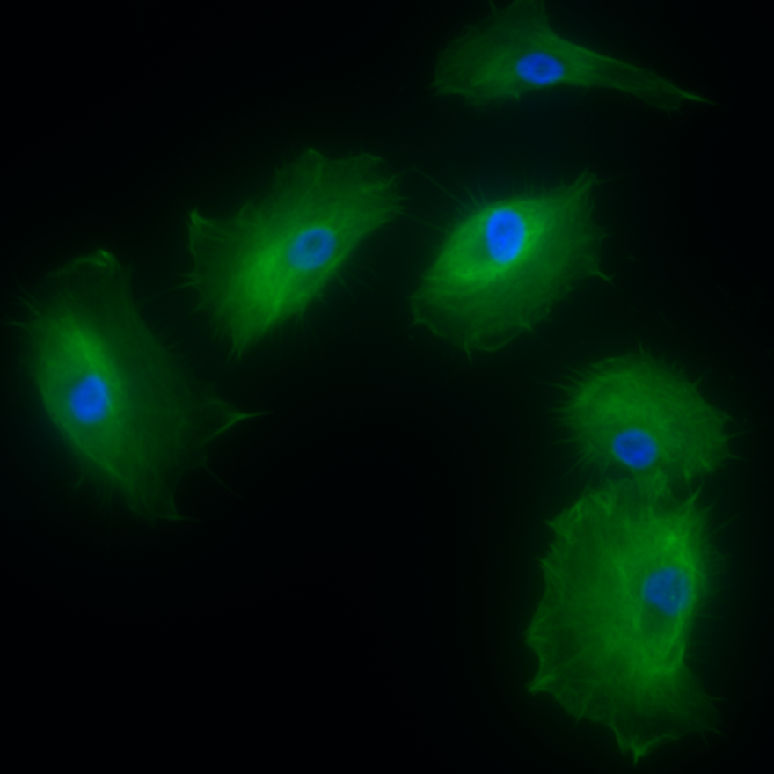
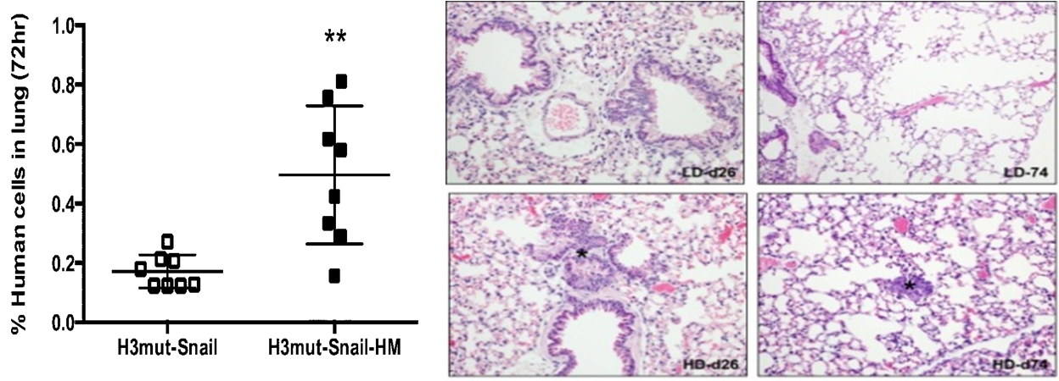
Human bronchial epithelial cells after selection
for migratory capacity
HBEC High Migratory
HBEC
Highly migratory
cells induce
pulmonary metastases

Slide 17
Linh Tran
Kostyantyn Krysan
David Elashoff
Michael Fishbein
Dean Wallace
Jay Lee
Edward Garon
Gina Lee
Brian Gardner
Fran Rosen
Brigitte Gomperts
Sherven Sharma
Wen Mao
Ying Lin
Zhe Jing
Stacy Park
Paul Pagano
Rui Li
Tonya Walser
Dino DiCarlo bioengineering Denise Aberle
Avi Spira (Boston University)
Marc Lenburg (Boston Univ) Ignacio Wistuba (MDA)
Pierre Massion (Vanderbilt)
Harvey Pass NYU
Jerry Shay
John Minna (UT Southwestern)
EDRN
Lynn Sorbarra,
Sudhir Srivastava
Supported by:
NCI EDRN, Lung Cancer SPORE, VA, DOD, LungEVITY, Tobacco Related Disease Res Program, Broad Foundation, UCLA CTSI, LCMC, SU2C

