Slide 1







Integrated Genomic and Proteomic Biomarkers for Non-Invasive Identification of Aggressive Prostate Cancer Dr. Paul C. Boutros

Slide 2
Pathway
Overview of Clinical Space
Genomics
Proteomics
Fluids
Summary

Slide 3
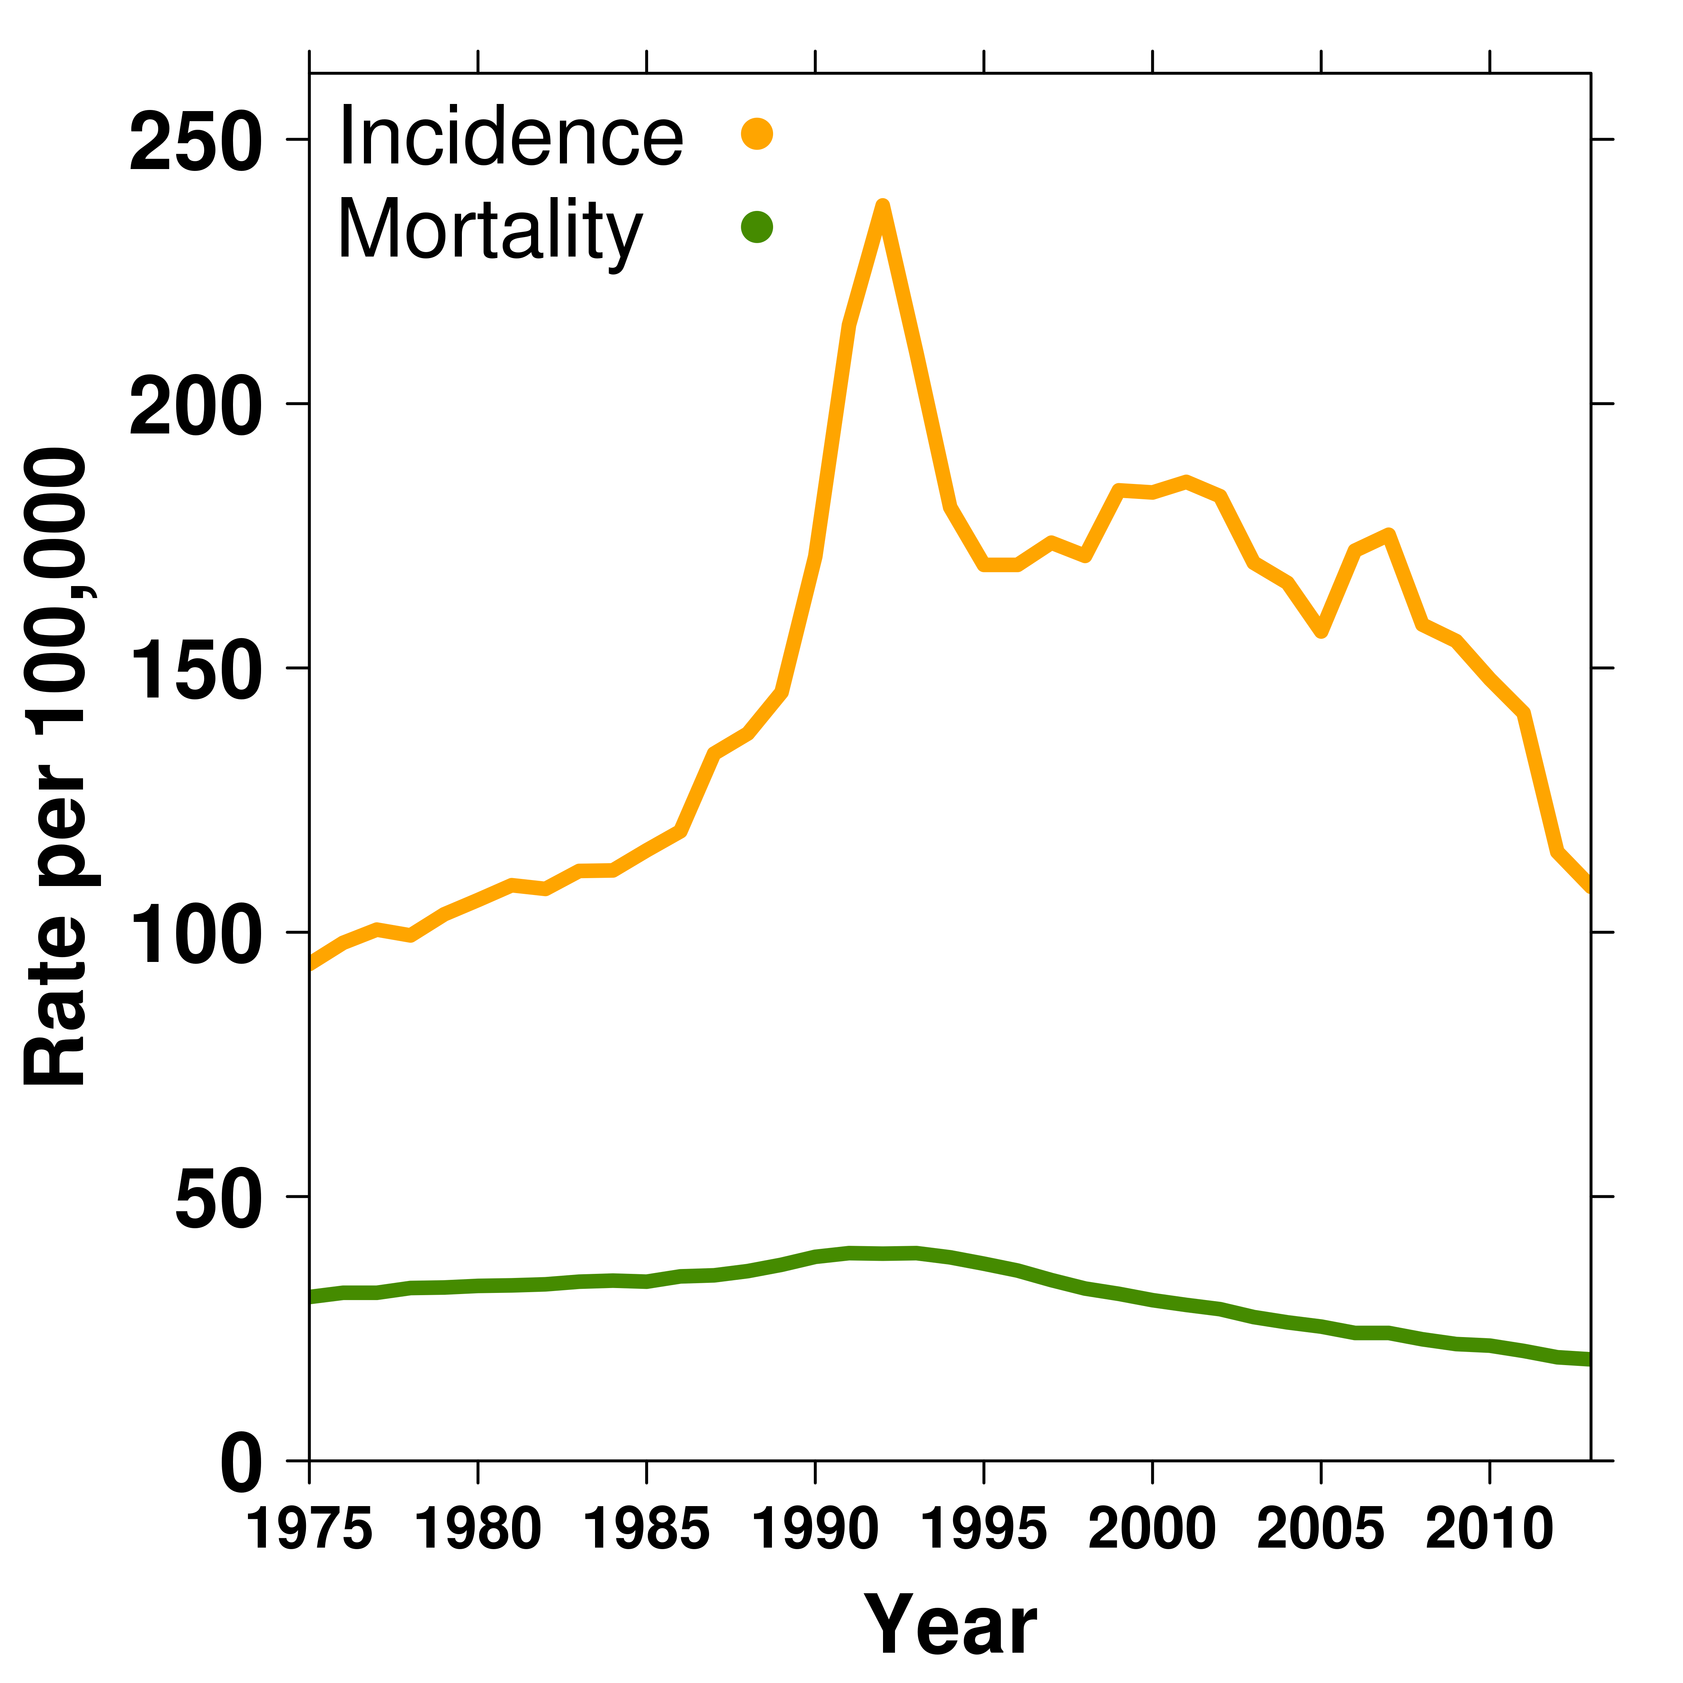
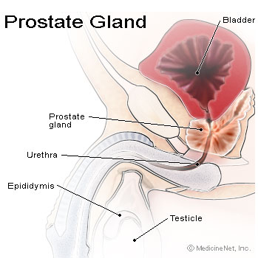
Prostate Cancer Epidemiology
Incidence:
~1 in 7 men
(1,515 per million)
Mortality: ~1 in 29 men
(242 per million)
Risk factors:
Age
Family history
High-fat diet
African ancestry
Notes:
3
Canadian stats
Third most common cancer death in males

Slide 4
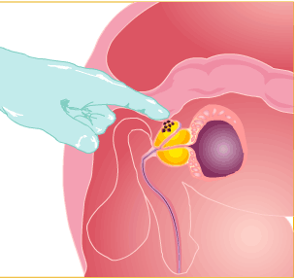
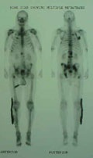
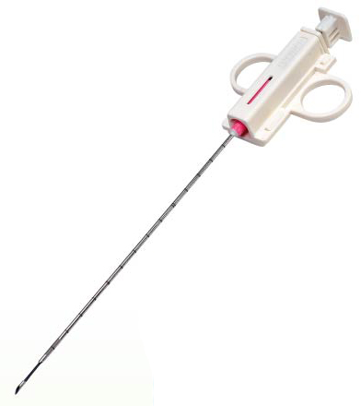
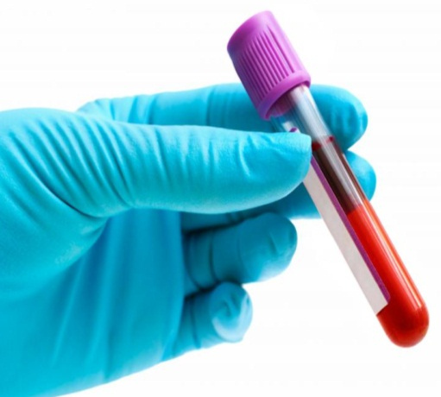
Prostate Cancer Prognosis
Digital Rectal
Exam Imaging Biopsy Blood test
TNM stage Tumour grade PSA
Low
risk
Intermediate
risk
High
risk
Metastatic
Localized cancers

Slide 5
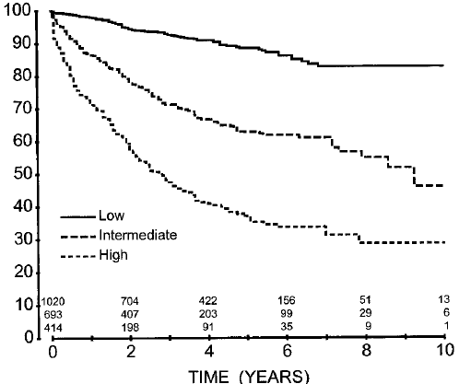
Clinical stratification of localized cancer
% Biochemical RFR
Low
Active Surveillance
Intermediate
Radiotherapy or Radical prostatectomy
High
Radiotherapy or Radical prostatectomy
+ adjuvant treatment
D'Amico, et al. 2001. Urology.

Slide 6
Pathway
Overview of Clinical Space
Genomics
Proteomics
Fluids
Summary

Slide 7
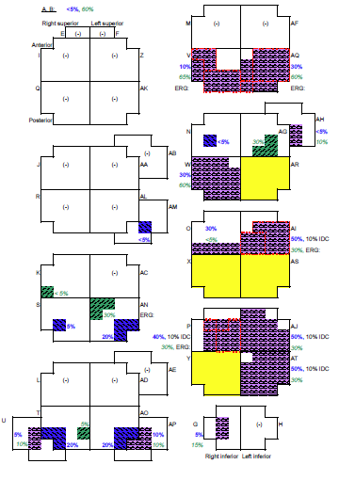
Spatial Sampling of Prostate Cancer
Boutros et al. Nature Genetics 2015

Slide 8
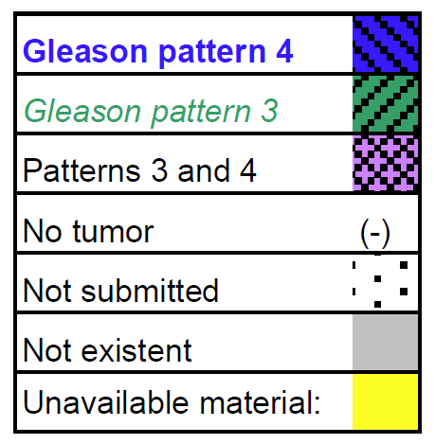
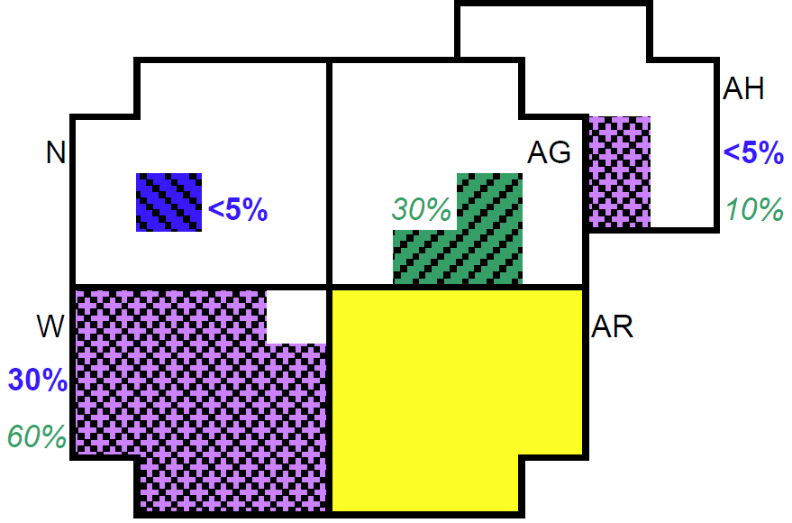

Slide 9
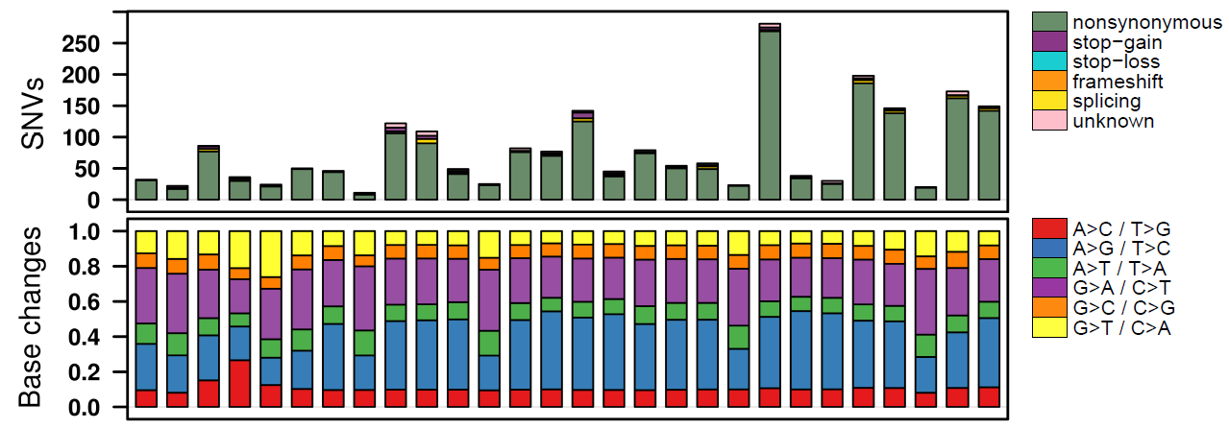
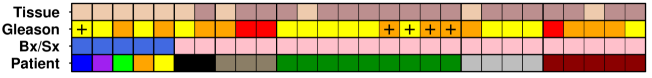
Immense Intra-Prostatic Diversity…

Slide 10
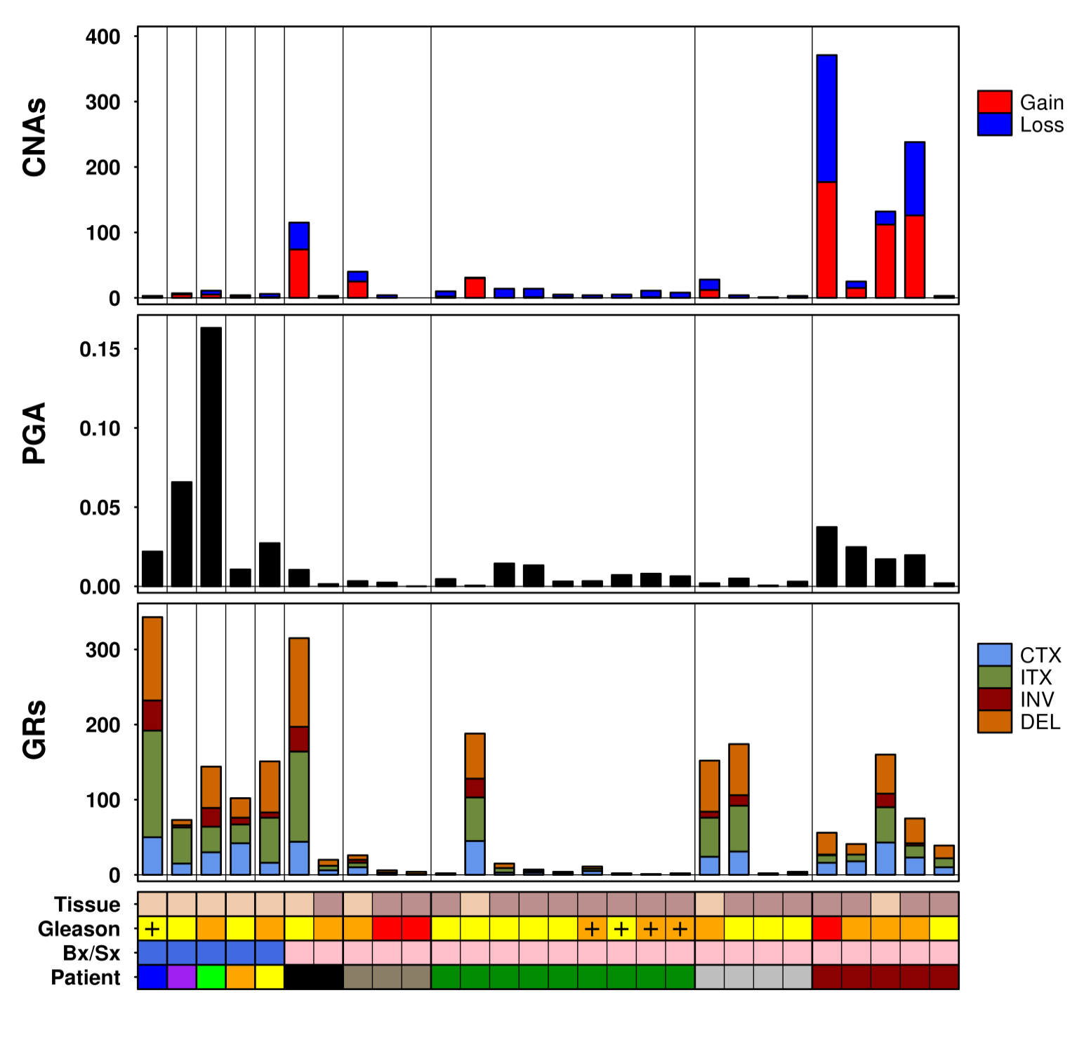
…At All Levels of Investigation

Slide 11
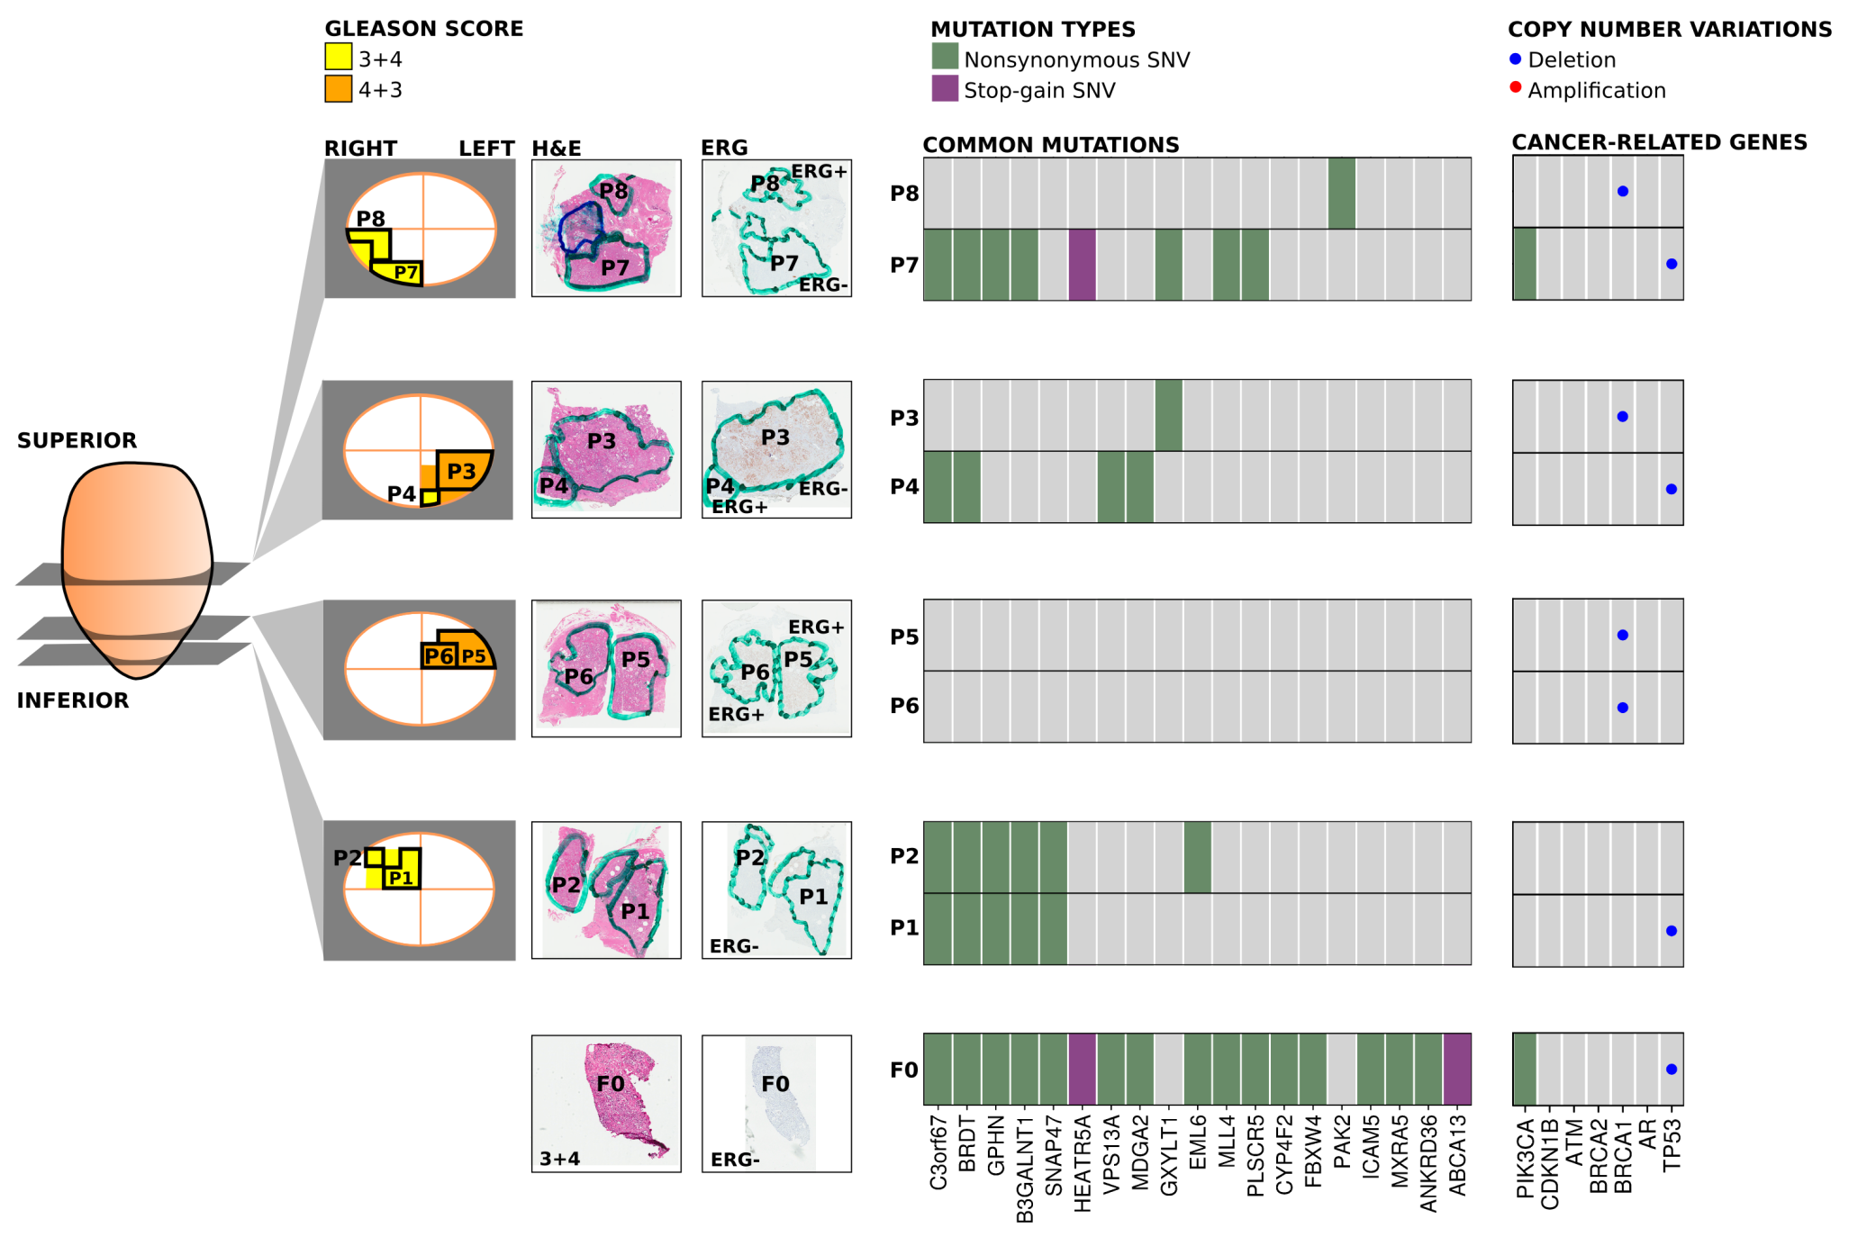
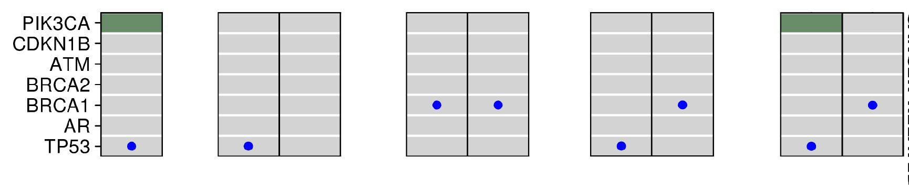
Is This Heterogeneity Clinically Relevant?
3+4
3+4
3+4
4+3
4+3
3+4
4+3
3+4
3+4
Boutros et al. Nature Genetics 2015

Slide 12
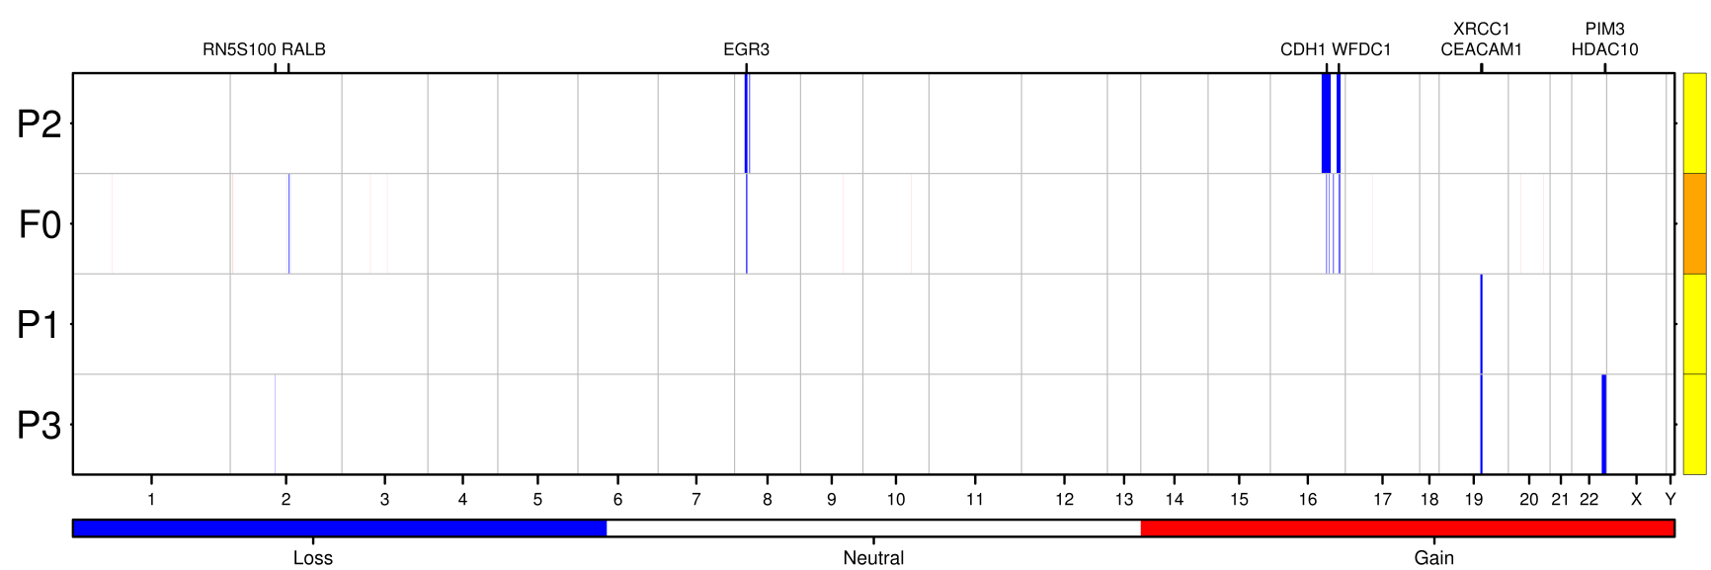
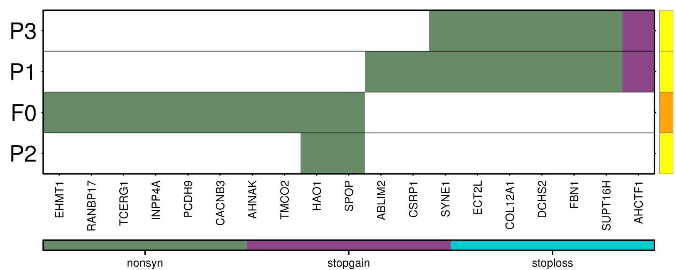
Multiple Primaries

Slide 13
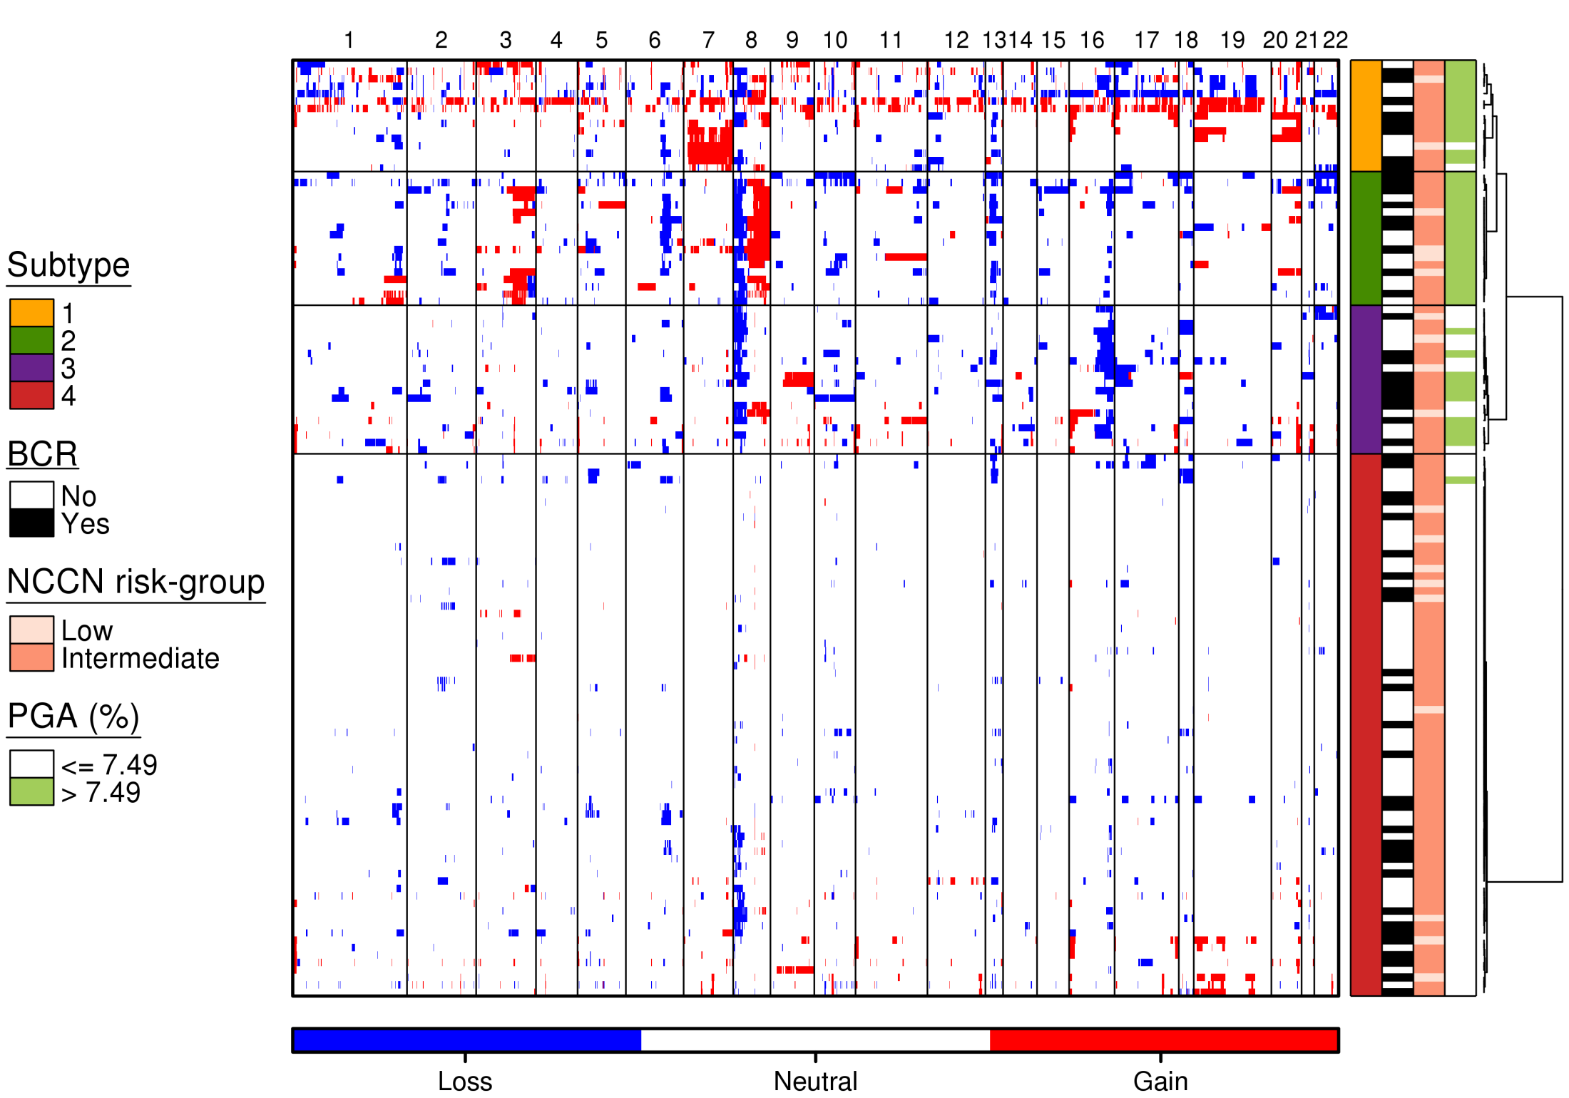
Training Cohort
RB1
MYC
NKX3-1

Slide 14
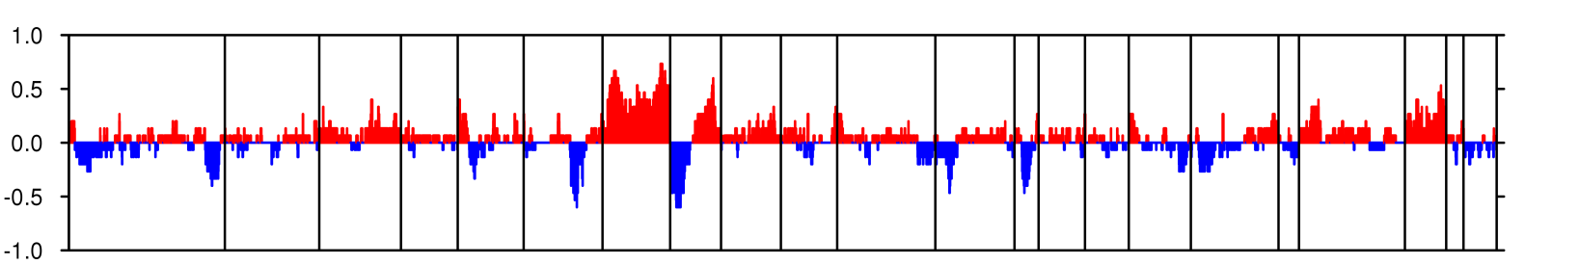
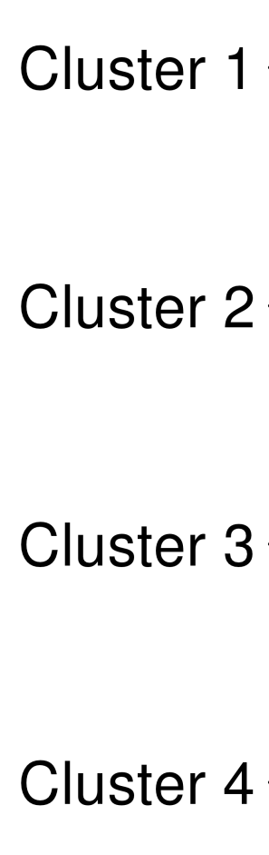
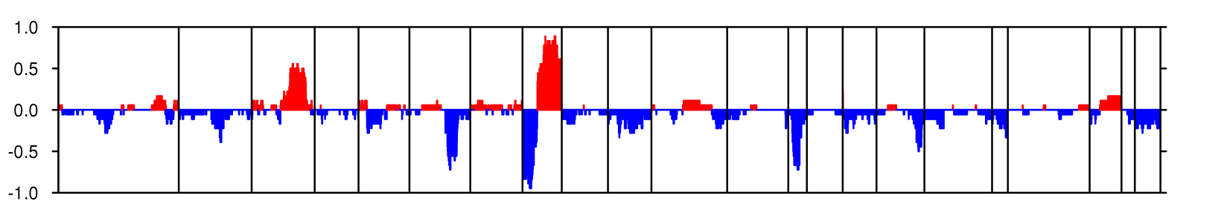
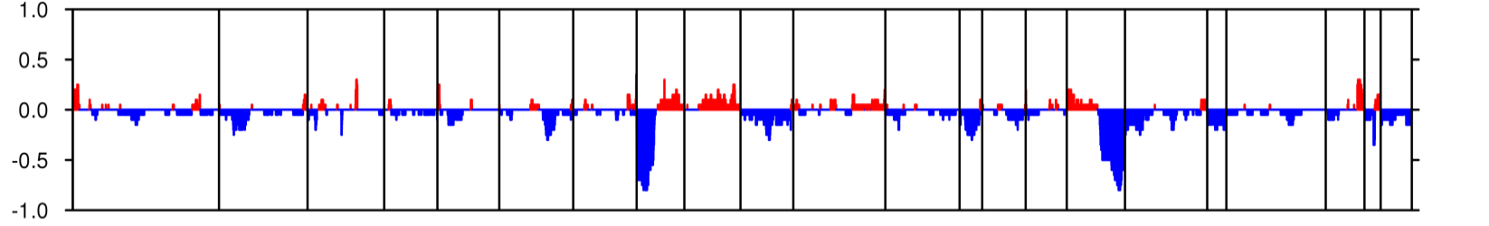
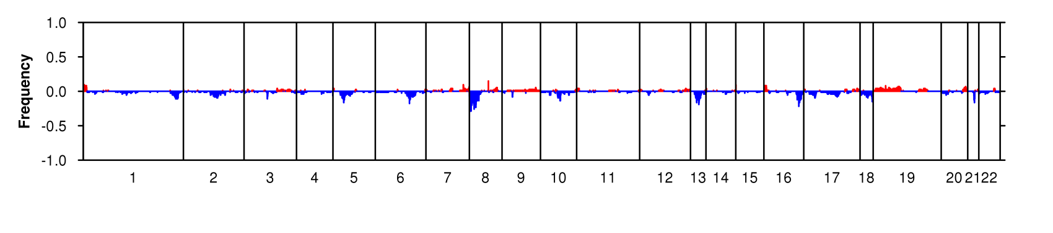
Cluster CNA profiles
Lalonde et al. Lancet Oncology 2014

Slide 15
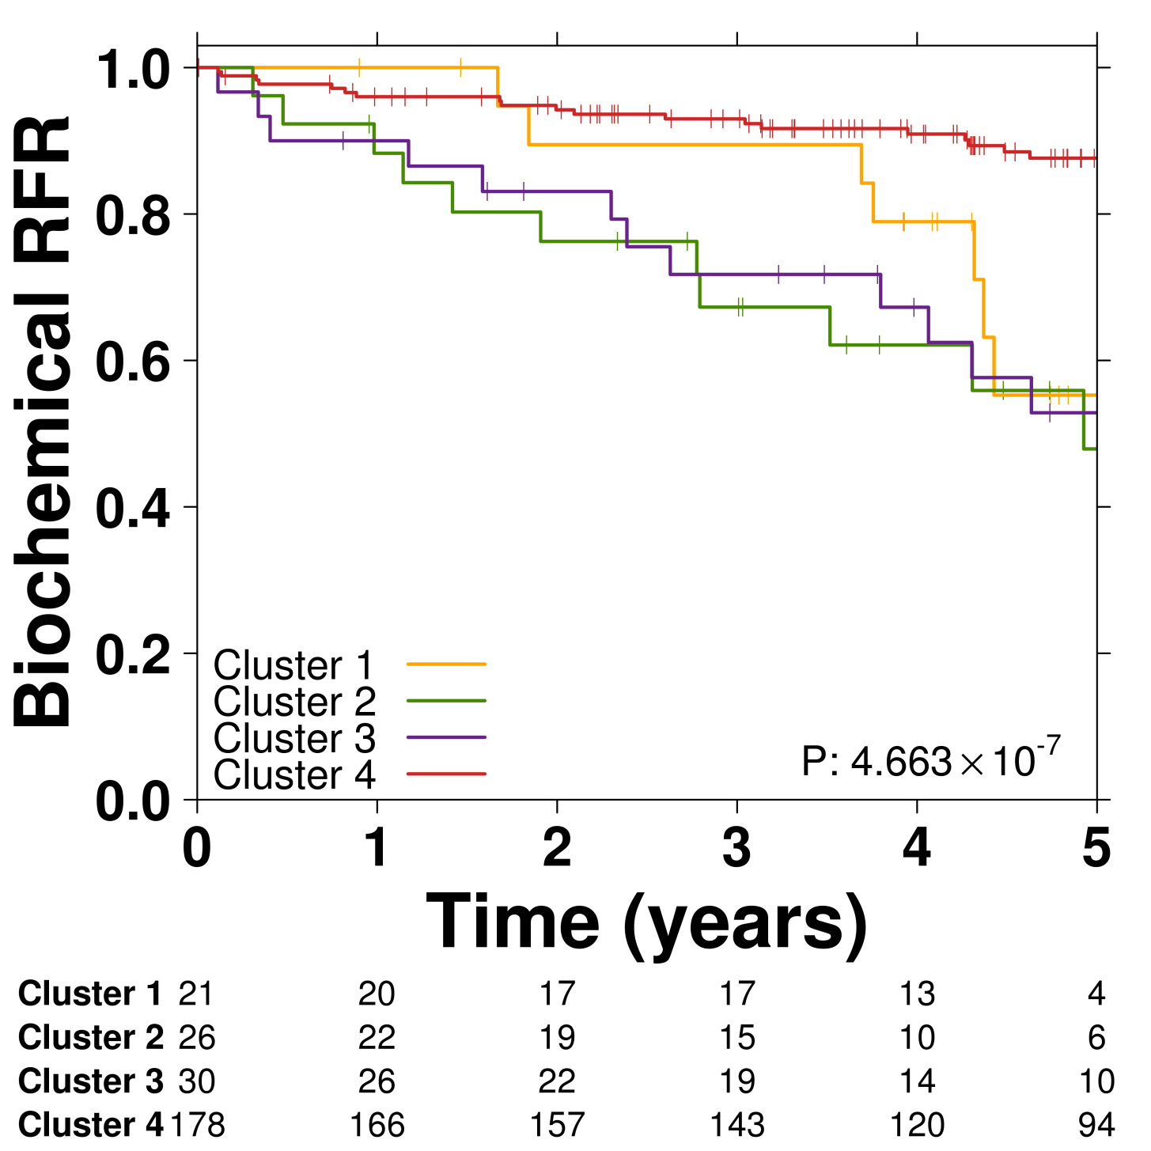
Clusters are associated with outcome

Slide 16
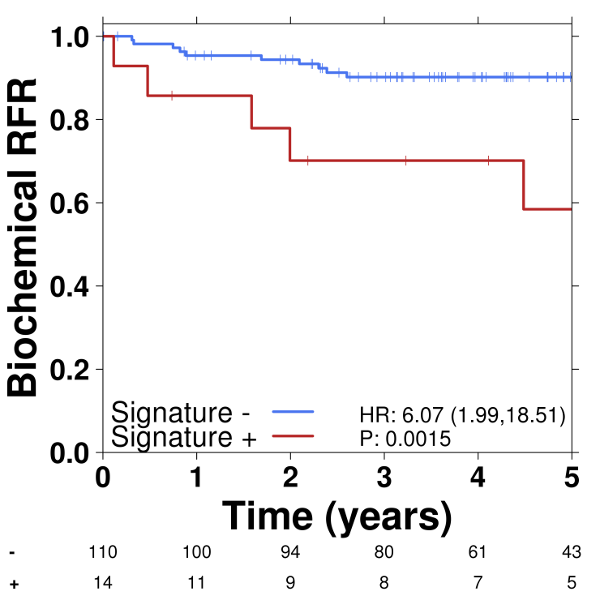
Classifier evaluation
 | Predictions
Accuracy | 77.5%
Sensitivity | 50.0%
Specificity AUC | 83.8% 0.658
100 genomic regions or 245 genes
Lalonde et al. Lancet Oncology 2014

Slide 17
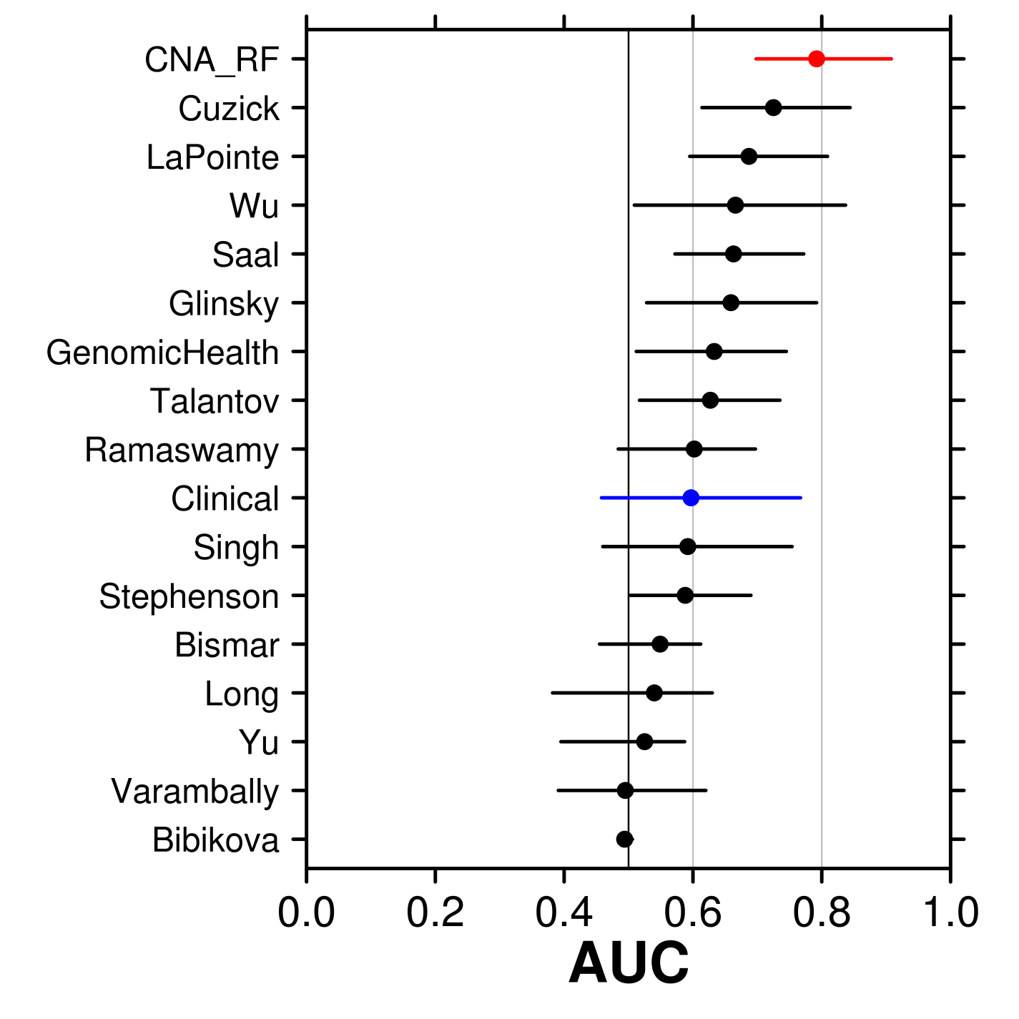
This Is the Best Performing Signature
With GenomeDx

Slide 18
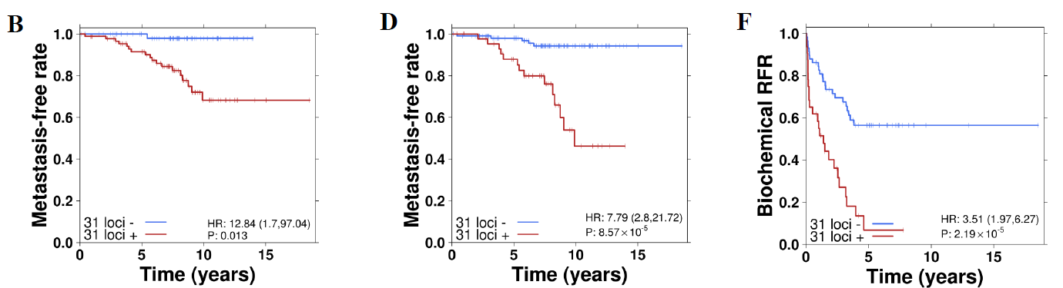
Validation in >500 Patients
Low-Risk
Intermediate-Risk
High-Risk
AUC ~0.8 in tertiary validation cohorts
Lalonde et al. European Urology 2017

Slide 19
What About Other Mutation Types?
WGS of 200 prostate cancer tumour/normal pairs
OncoScans of all 200 patients
Methylomes on 150 patients
Array-based RNA profiling (HTA) on 150 patients
Clinical outcome
Lots of bioinformatics
Fraser et al. Nature 2017

Slide 20
WGS of 200 Prostate Tumours

Slide 21
WGS of 200 Prostate Tumours
Fraser et al. Nature 2017

Slide 22
Pathway
Overview of Clinical Space
Genomics
Proteomics
Fluids
Summary

Slide 23
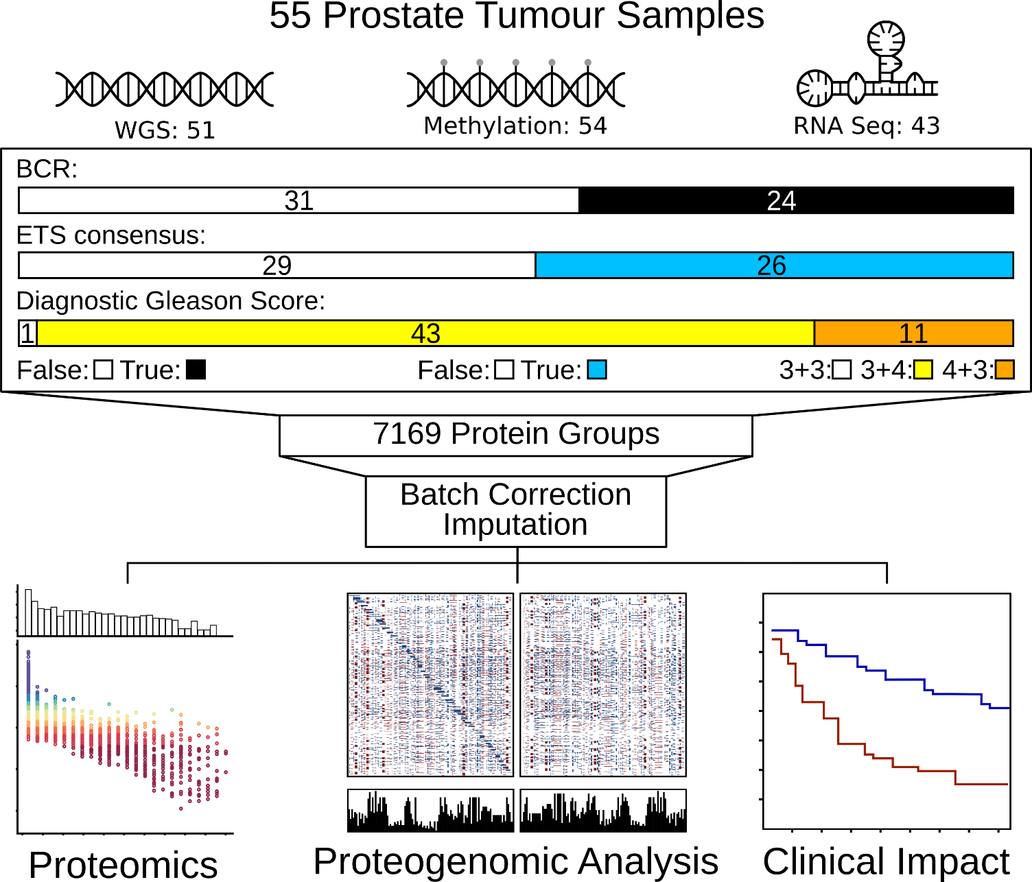
What About the Proteome?

Slide 24
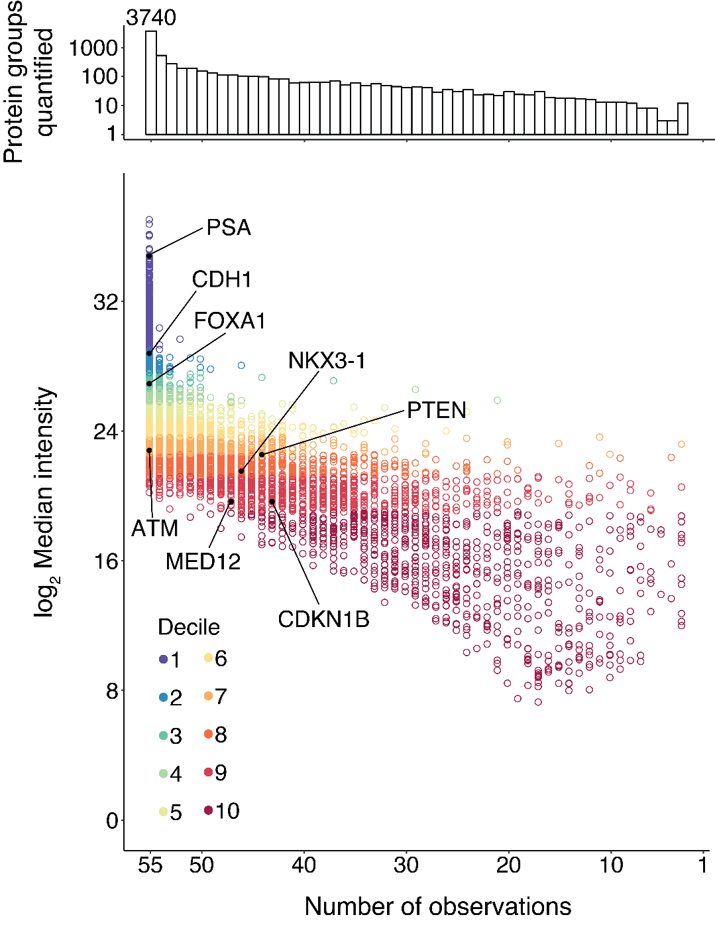
Distribution of Driver Gene Abundance

Slide 25
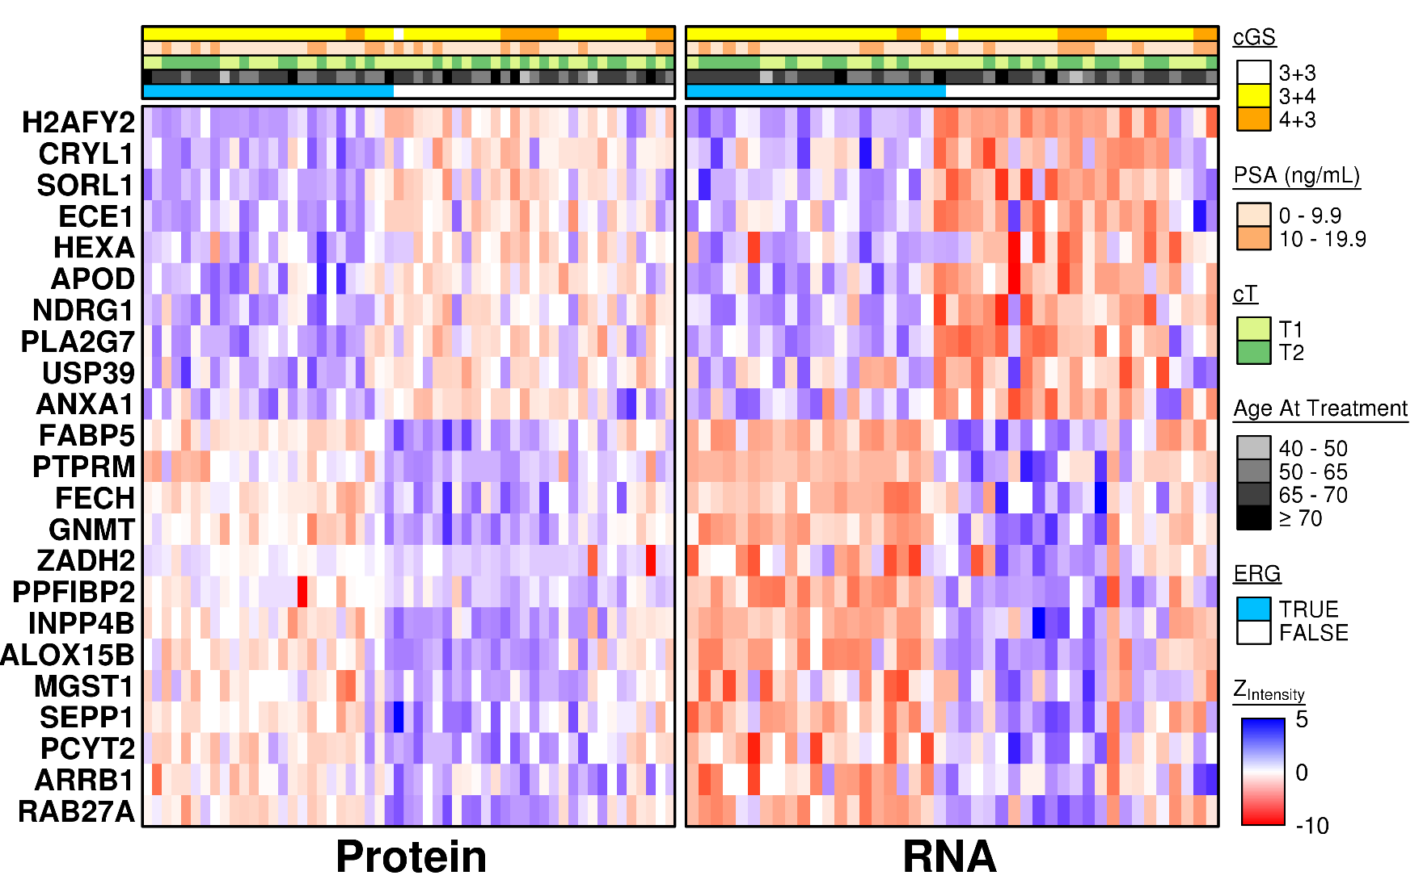
ETS-Fusion Associated Protein vs. RNA

Slide 26
Protein Has Greater Dynamic Range

Slide 27
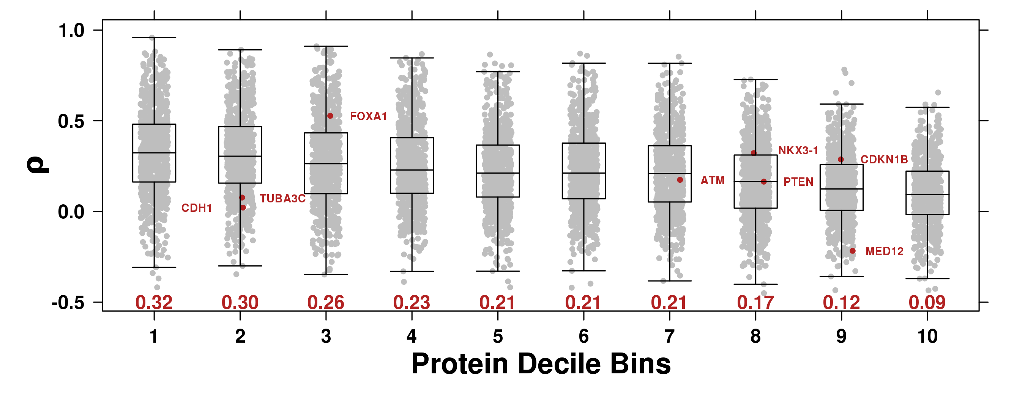
Protein Weakly Associated to RNA

Slide 28
All Multi-Omic Correlations Are Weak
RNA-Methylation
Protein-RNA
Protein-Methylation
RNA-CNA

Slide 29
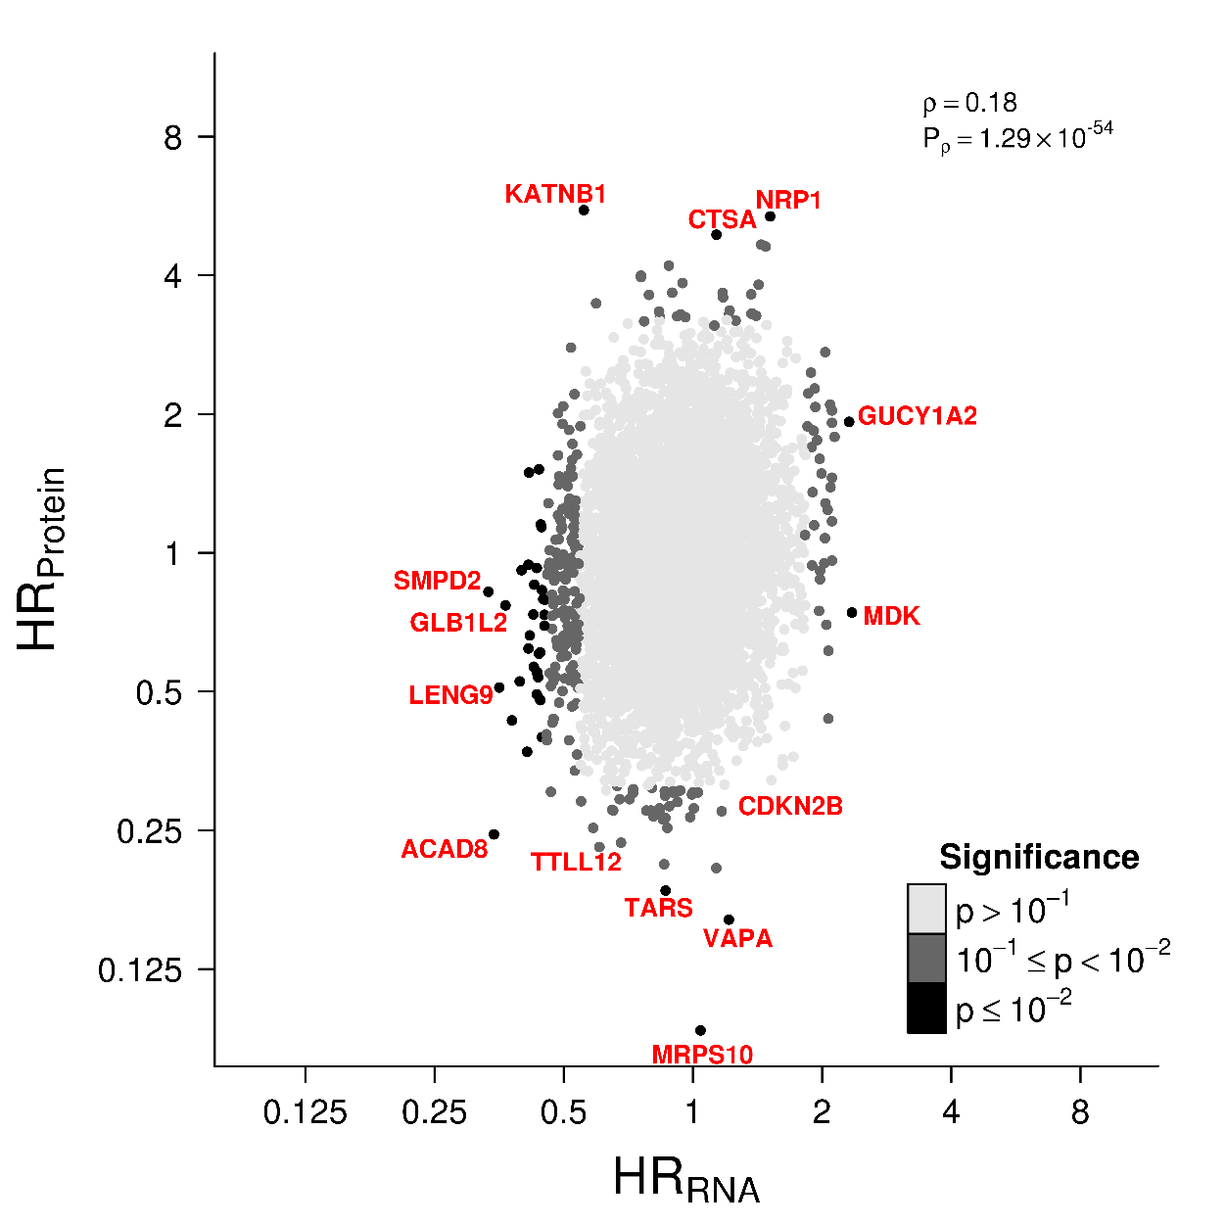
Protein-RNA Survival Associations

Slide 30
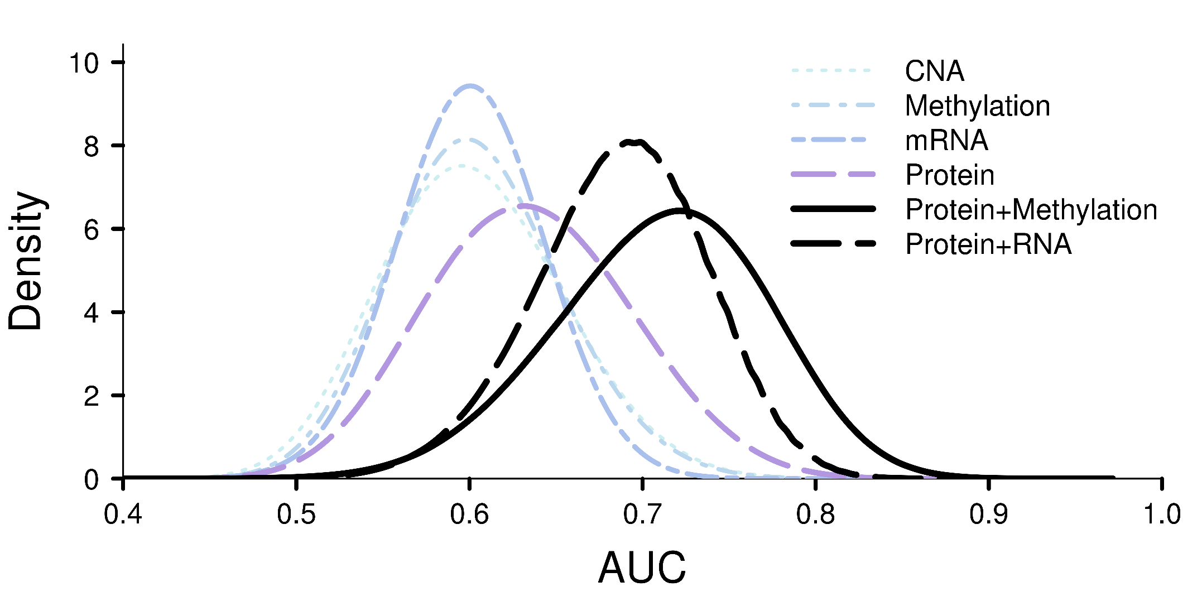
RNA Complements Protein Biomarkers

Slide 31
Pathway
Overview of Clinical Space
Genomics
Proteomics
Fluids
Summary

Slide 32
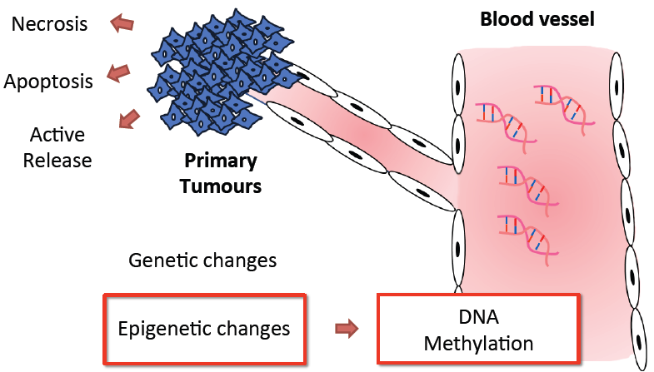

Slide 33
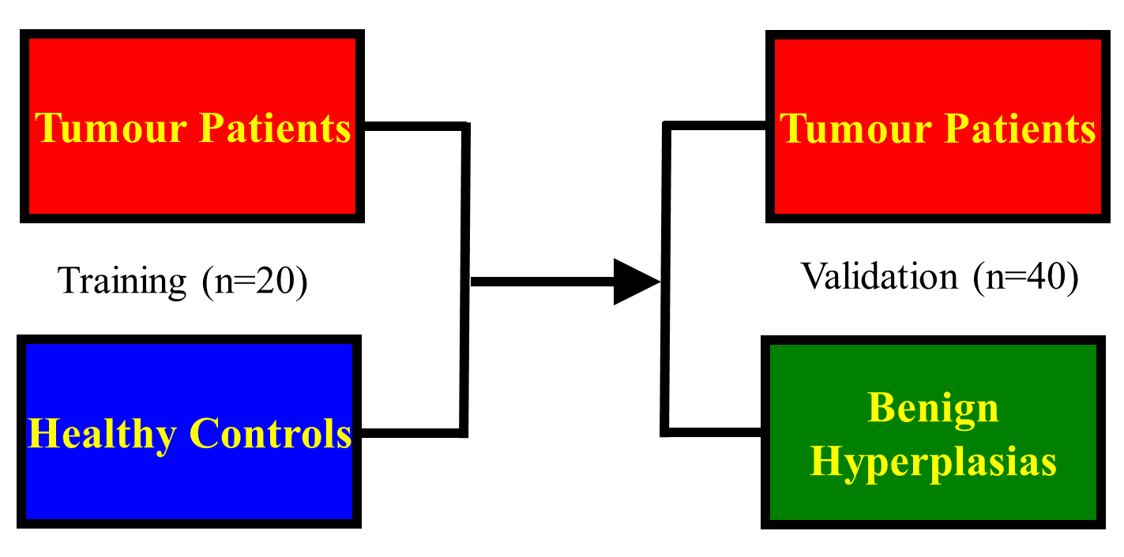
Experimental Design
Cortese et al. Human Mol Genet

Slide 34
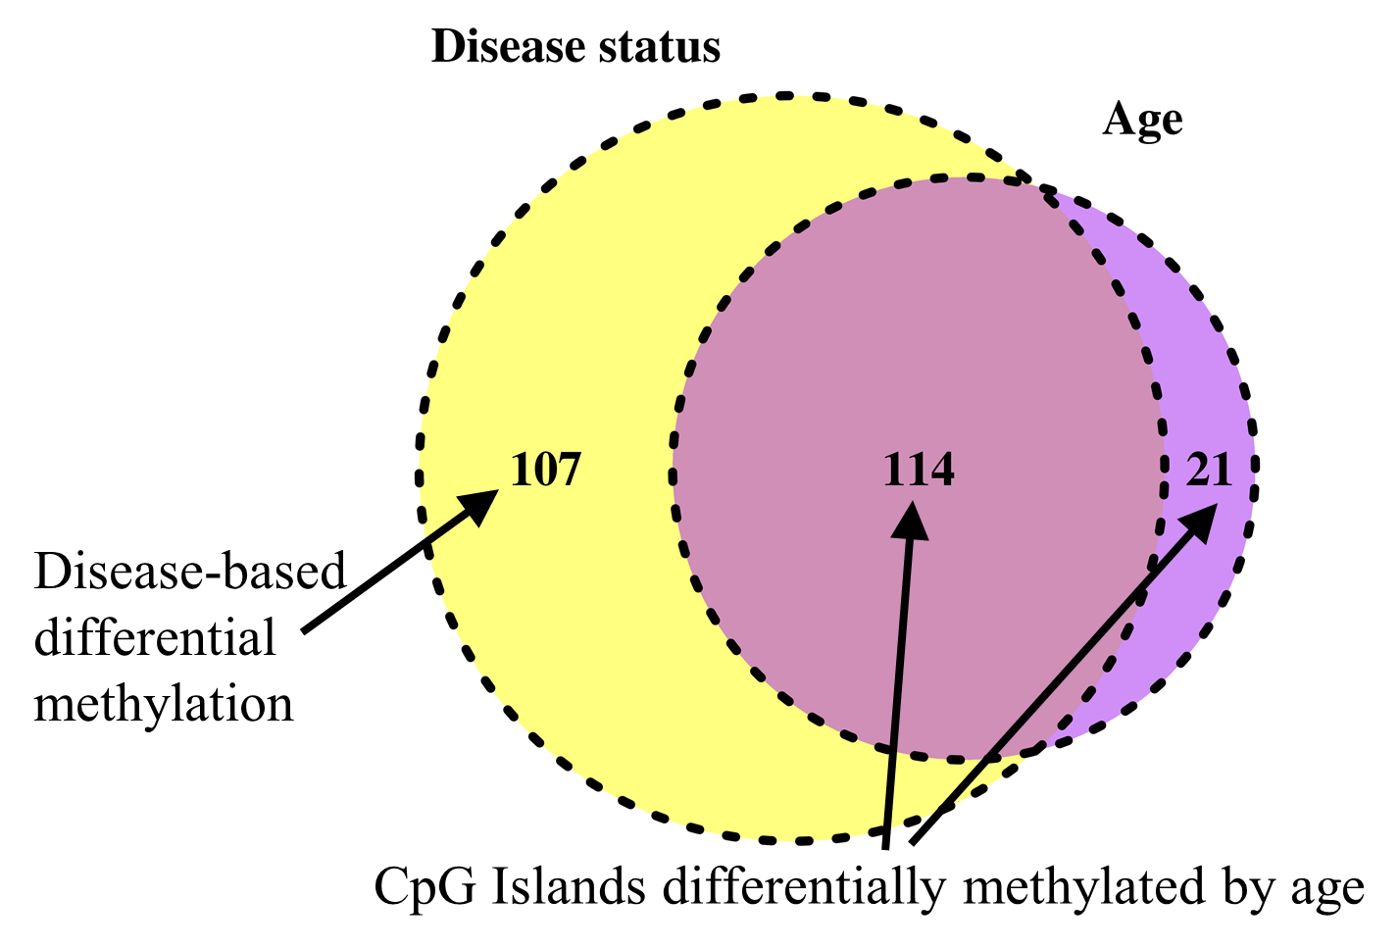
Important Control: Age Effects

Slide 35
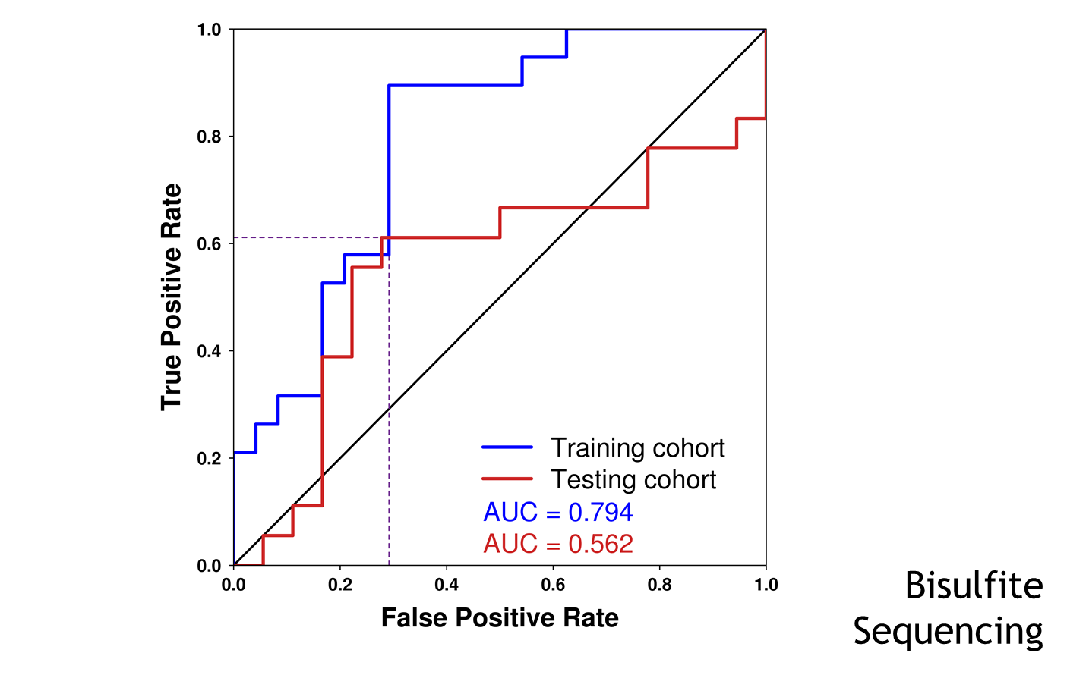
We Independently Validate 13 of These As Weak Biomarkers

Slide 36
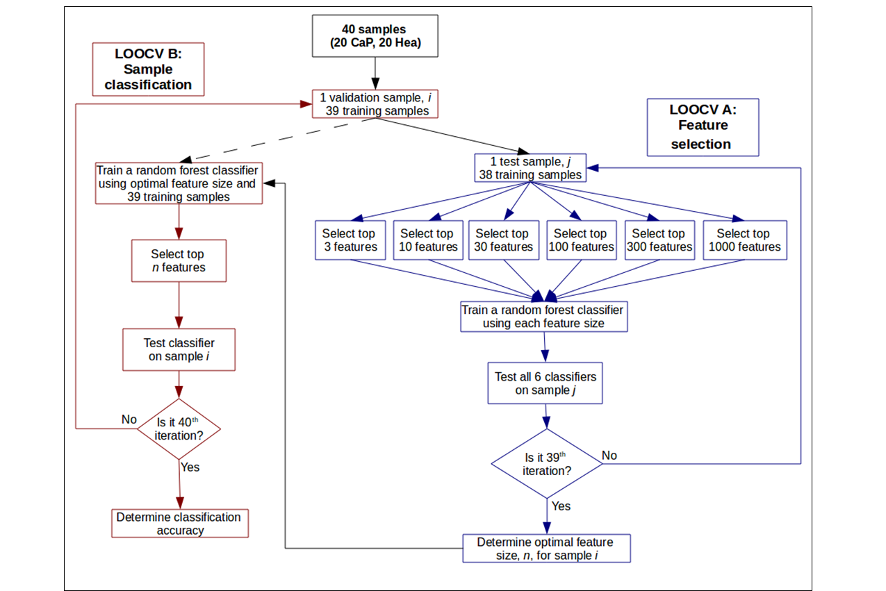
Signature Identification Using a Nested Machine-Learning Model

Slide 37
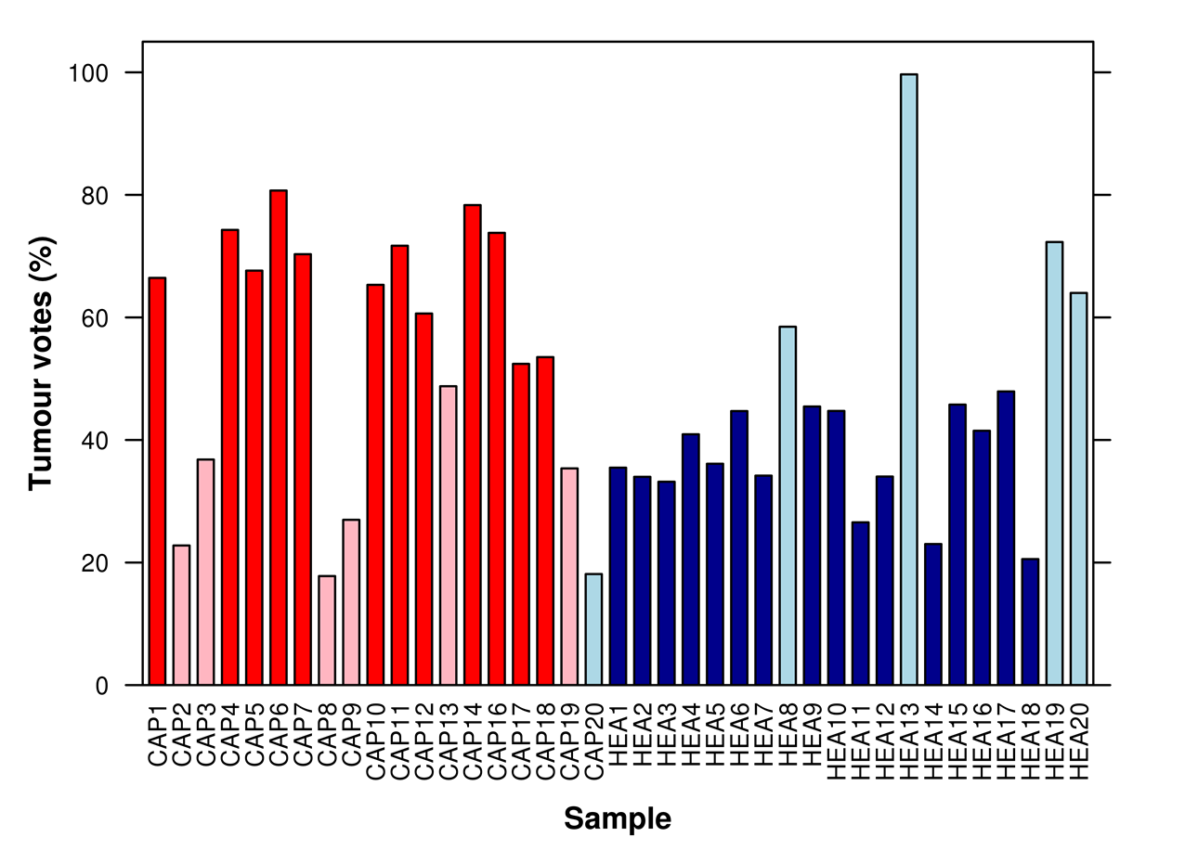
Final Multivariate Biomarker: 71% Accuracy

Slide 38
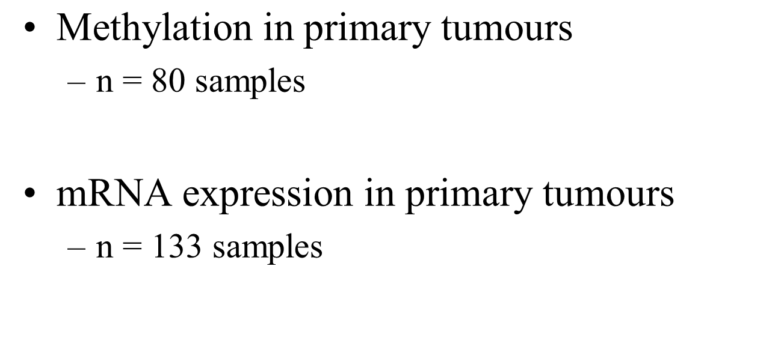
Can We Provide Additional Functional Evidence for These Genes?

Slide 39
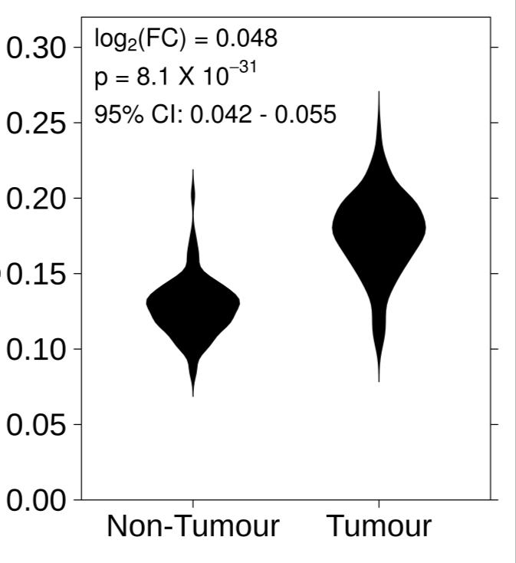
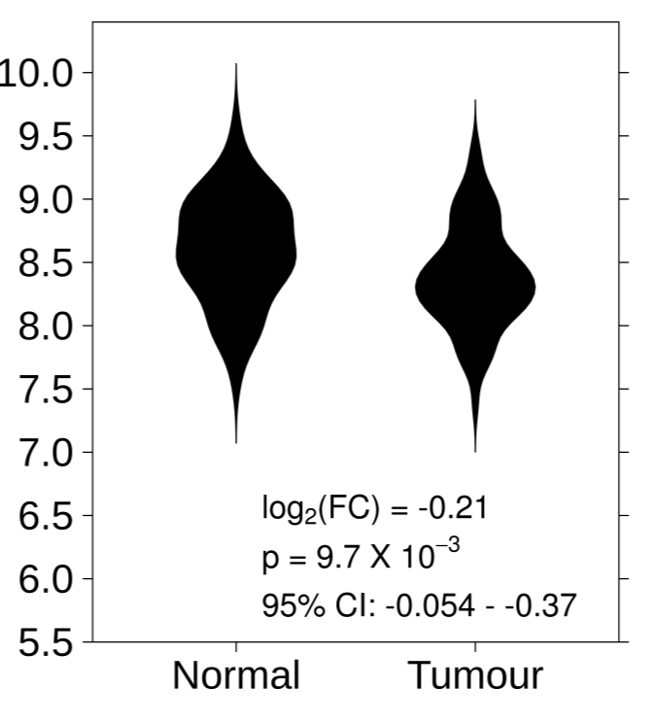
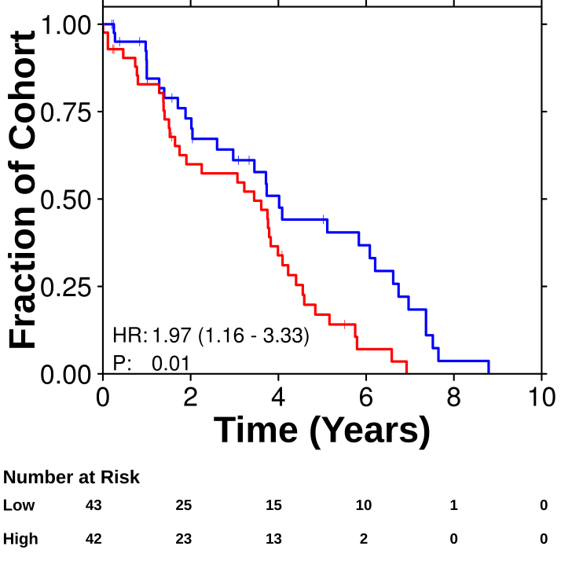
AHRGAP1
Methylation
mRNA
mRNA Survival

Slide 40
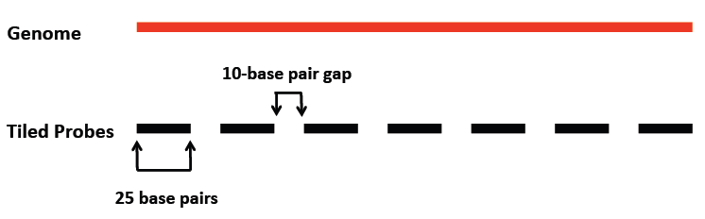
Current Directions: Improved Study Design
Larger patient cohort (n = 200)
Mixed low- and high-risk patients
Better resolution
Tiling arrays

Slide 41
But Is there Another Easily Accessible, Prostate-Proximal Fluid We Can Assess?

Slide 42
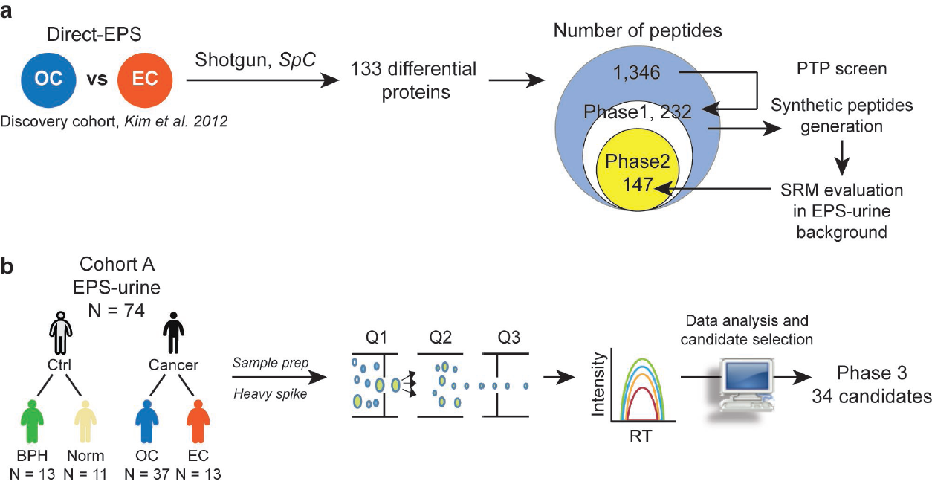
EPS-Urine Proteomics
Kim et al. Nature Communications 2016

Slide 43
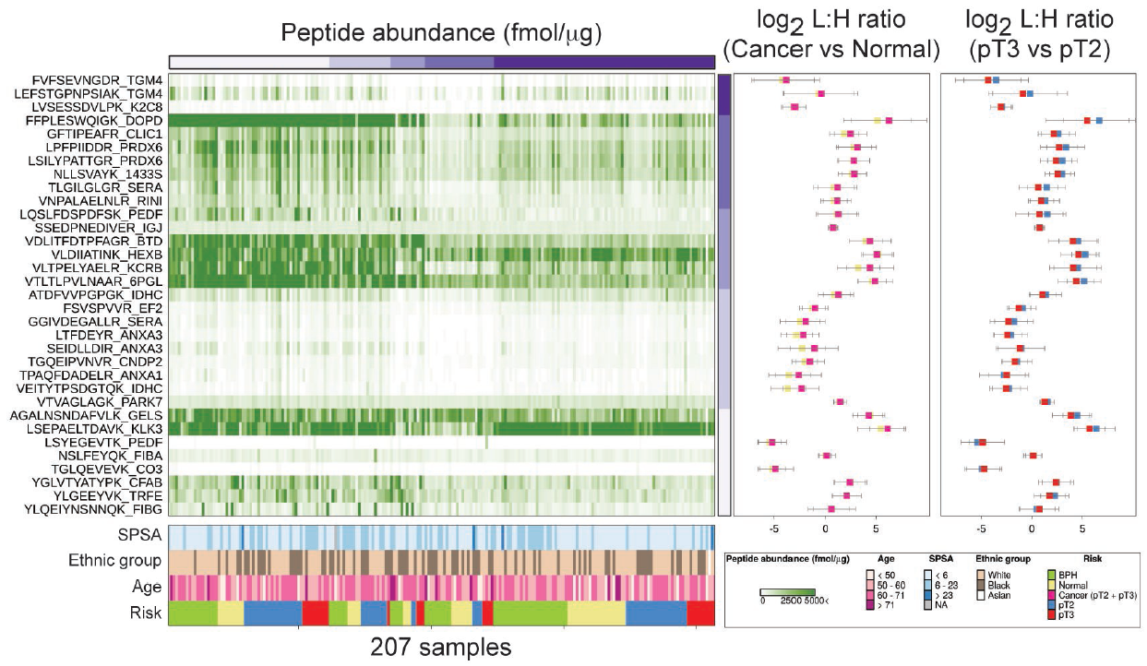
Almost All Proteins Detectable

Slide 44
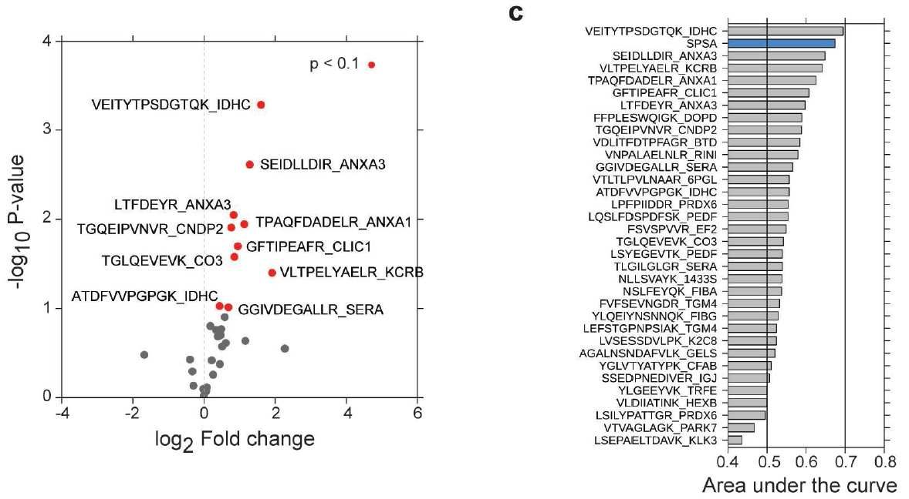
Individual Peptides Are Predictive

Slide 45
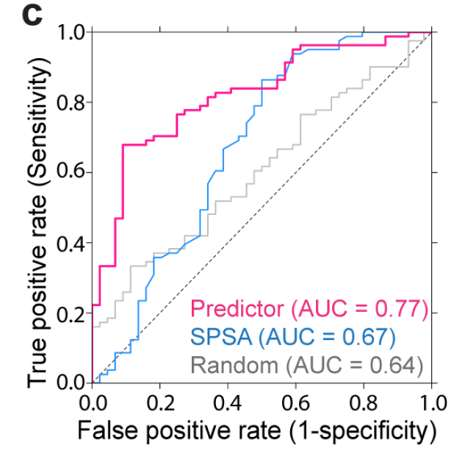
And Together Form A Predictive Model

Slide 46
Pathway
Overview of Clinical Space
Genomics
Proteomics
Fluids
Summary

Slide 47
Summary
Biomarkers can:
Be developed using multiple data-types
Overcome spatial heterogeneity
The germline genome:
Influences tumour progression and mutations
Is under-studied
These data call for composite germline, somatic, imaging and fluid biomarkers to diagnose, prognose and monitor progression.
These studies required extensive inter-disciplinary team-work and collaboration (and funding!).

Slide 48

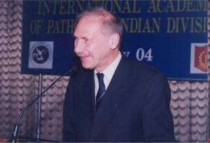
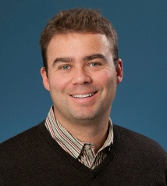
CPC-GENE: The People Involved
Dr. Robert Bristow
Dr. Theodore van der Kwast
Dr. Thomas Kislinger
PIs & PMs
Michael Fraser
Neil Fleshner
Theo van der Kwast
Colin Collins
O. John Semmes
Mathieu Lupien
Stanley Liu
Genomics
Taryne Chong
Andrew Brown
Michelle Sam
Jeremy Johns
Lee Timms
Ken Kron
Ankit Sinha
Boutros Lab
Julia Hopkins
Ankit Sinha
Cindy Yao
Vincent Huang
Emilie Lalonde
Takafumi Yamaguchi
Katie Houlahan
Julie Livingstone
Natalie Fox
Sylvia Shiah
Lawrence Heisler
Shadrielle Espiritu
Veronica Sabelnykova
Informatics
Timothy Beck
Fouad Yousif
Melania Pintilie
Xuemei Luo
Clinico-Molecular
Dominique Trudel
Alice Meng
Gaetano Zafarana
Melvin Chua

Slide 49

Questions?
Positions Available: Paul.Boutros@oicr.on.ca

