Slide 1

Welcome to Seattle

Slide 2

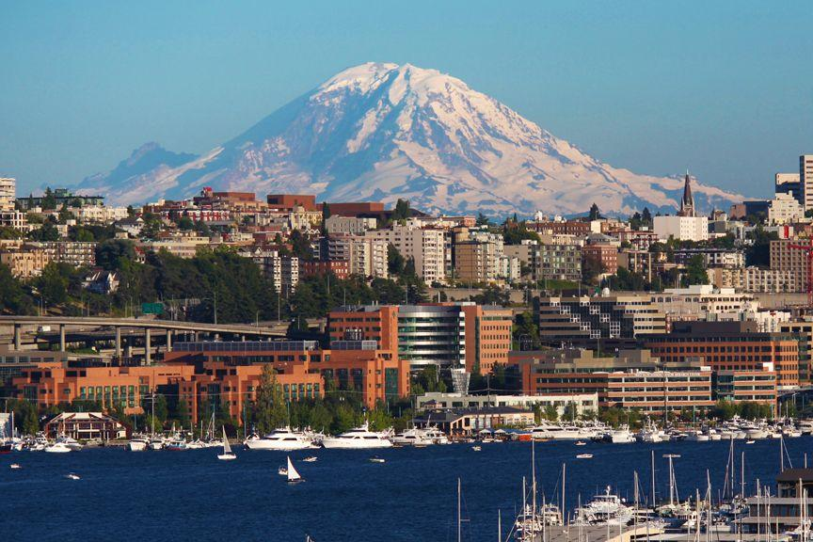
Fred Hutch campus in South Lake Union

Slide 3
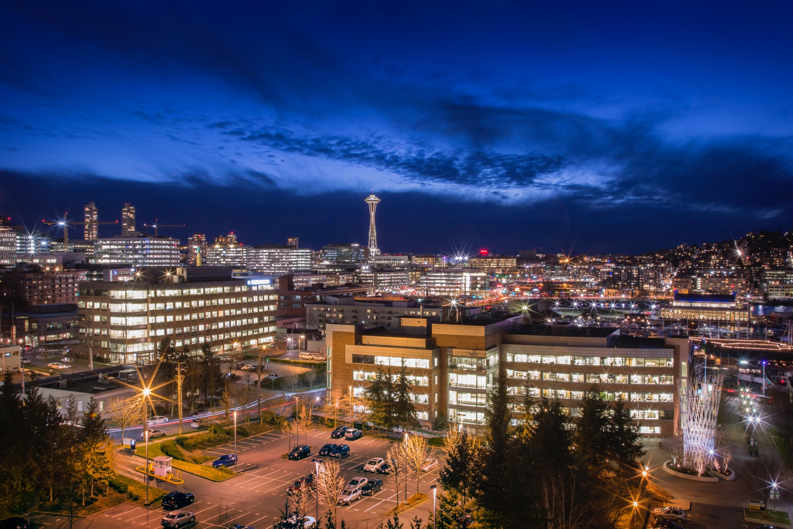
Our campus
Home to 2,700+ staff, including 223 scientific faculty
Located on 15 acres in Seattle’s vibrant South Lake Union neighborhood
Notes:
Home to 2,700+ staff, including nearly 220 scientific faculty
Located on 15 acres in Seattle’s vibrant South Lake Union neighborhood

Slide 4
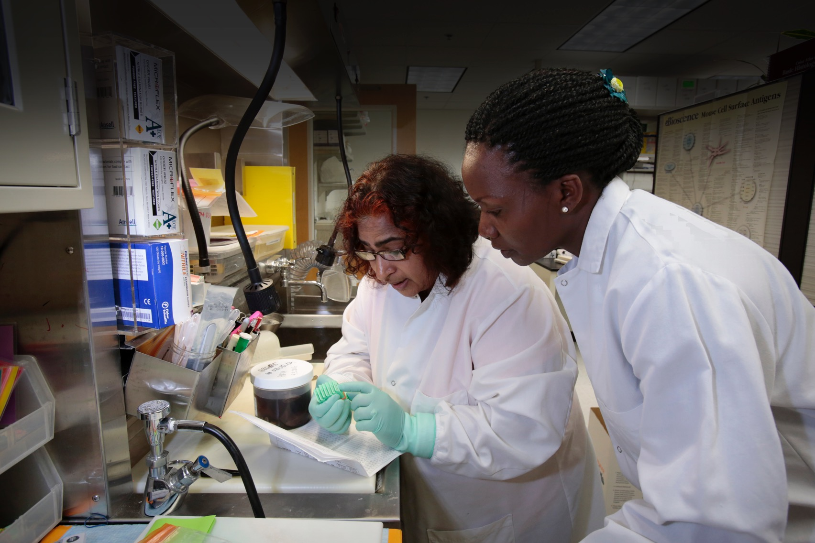
Organization
Five Scientific Divisions:
Clinical Research
Basic Sciences
Public Health Sciences
Human Biology
Vaccine and Infections Diseases
Interdivisional initiatives
Hutchinson Institute for Cancer Outcomes Research (HICOR)
Immunotherapy Integrated Research Center (IRC)
Pathogen-Associated Malignancies IRC

Slide 5
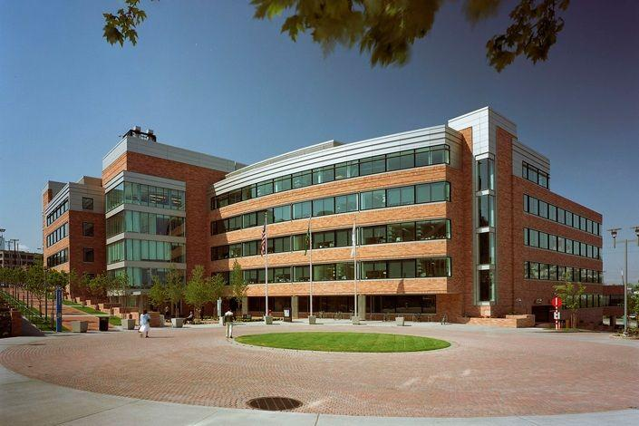
Public Health Sciences
Our objective: To identify strategies that will ultimately reduce the incidence of and mortality from cancer and other diseases.
142 Faculty organized into 5 programs
Translational Research
Epidemiology
Cancer Prevention Research
Biostatistics
Computational Biology

Slide 6

Carotene and Retinol Efficacy Trial
18,000 men and women at high risk for lung cancer
Biospecimens:
Serial pre-diagnosis serum, plasma, whole blood, blood spots
Lung cancer tissues
Information: www.compass.fhcrc.org/caretWeb/
Contacts:
Mark Thornquist (mthornqu@fredhutch.org)
Gary Goodman (gary.goodman@swedish.org)
Cancers | Cases
Lung | 2460
Prostate | 1256
Breast | 606
Bladder | 541
Colorectal | 512
Other sites | 2557

Slide 7


CANCERS |  | SELECT (n=34,887) | PCPT** (n=18,880)
Any Cancer |  | 4,815 | 3,704
 | Prostate | 2,494 | 2,401
 | Bladder | 249 | 146
 | Colorectal | 323 | 210
 | Lung | 381 | 255
 | Melanoma | 333 | 158
 | Pancreatic | 118 | 38
 | Renal | 110 | 56
 | Other primary cancer | 807 | 474
DEATHS |  | 3,761 | 6,043
Median follow-up |  | 9 yrs | 19 yrs
PCPT: 18,880 men; SELECT: 34,887 men
Serial prediagnostic bloods
Prostate biopsy and prostatectomy specimens
Information:
www.swog.org/Visitors/PCPT.asp
www.SWOG/visitors/SELECT
Contacts:
Cathy Tangen (ctangen@fredhutch.org)
Phyllis Goodman (pgoodman@fredhutch.org)

Slide 8


161,000 post-menopausal women
Biospecimens
Serum, plasma, buffy coat collected at 2 timepoints
FFPE tumor specimens for selected solid tumor sites (LILAC)
Information: www.whi.org/researchers
Contacts:
Garnet Anderson (garnet@whi.org)
Charles Kooperberg (CLK@fredhutch.org)
Lisa Johnson (ljohnson@whi.org)
Cancers | Cases | Deaths | Tissues*
Inv. Breast | 10520 | 1488 | 2089
Colorectal | 3099 | 1045 | 644
Lung | 3668 | 2938 | 518
Endometrial | 1735 | 209 | 384
Ovarian | 1185 | 846 | 233
Melanoma | 2278 | 172 | 451
NHL | 1661 | 619 | NA
Leukemia | 998 | 563 | NA
Other | 6691 | 5092 | NA
Total | 31835 | 12972 | 4319
*
Notes:
11

Slide 9
Accessing these cohorts
All are eager to have their repositories support high quality research
All have well-defined mechanisms to evaluate requests for specimens
All require
Written scientific proposal with preliminary data
Collaboration
Funding

Slide 10


Slide 11
