Slide 1
GLNE 010: Aims in 2007
1. Estimate the sensitivity and specificity for
a. colorectal adenocarcinoma
b. screen relevant neoplasms (SRN) (colorectal adenocarcinoma, high grade dysplasia, and adenomas ≥1cm) for stool (vimentin methylation) and circulating (galectin-3 ligand, ctDNA, other future) biomarkers
2. Determine whether stool vimentin methylation sensitivity >FIT same specificity of stool vimentin methylation test.
Notes:
Is the third bullett relevant/important?

Slide 2
GLNE 010: Aims in 2007
3a. Estimate sensitivity and specificity of the above individual binary biomarkers in combination with FI.
3b. Determine if sensitivity of stool vimentin methylation + FIT > FIT
4. Establish an highly quality FDA GCP biosamples for future validation and discovery.
Notes:
Is the third bullett relevant/important?

Slide 3
Study Design “GLNE 010”
Stool Collection
Blood Collection
Urine Collection
Data Elements
FIT
Preparation procedure
Colonoscopy

Slide 4
Registrations, Evaluable,
Case Rates
Registrations: 5,154
Evaluable Completions: 4,669 (88%)
Number of Events to Date: 29
  Cancers: 10 (0.2%)
  High Grade Dysplasia: 19 (0.4%)
Case Proportion: 0.6%
Projected Case Proportion: 1.5%
  Large adenoma case proportion: 14%
This was complete in 2013
We recruited 4,669 eligible in 18 months.

Slide 5
Project Activation Steps 1
1. Finalize protocol
  Required 7 months of internal EDRN review
2. Submit, negotiate Core Funds, Set aside funding
3. IRB Review
  8 EDRN Institutions, 3 new institutions
  Alliance
4. CDAs, MTAs
  Negotiate, execute with three different companies

Slide 6
Project Activation Steps 2
5. Subcontracts
  Execute Subcontracts with Each Institution
  3 Separate Funding pools—Overhead problems
6. Training
  Site Visit
7. Procuring Supplies
  Manufacturing 1000s of kits for shipment

Slide 7
GLNE 010 Current Status

Slide 8
GLNE 010: Aims in 2007
It has been a decade!
Science marches on!
Notes:
Is the third bullett relevant/important?

Slide 9
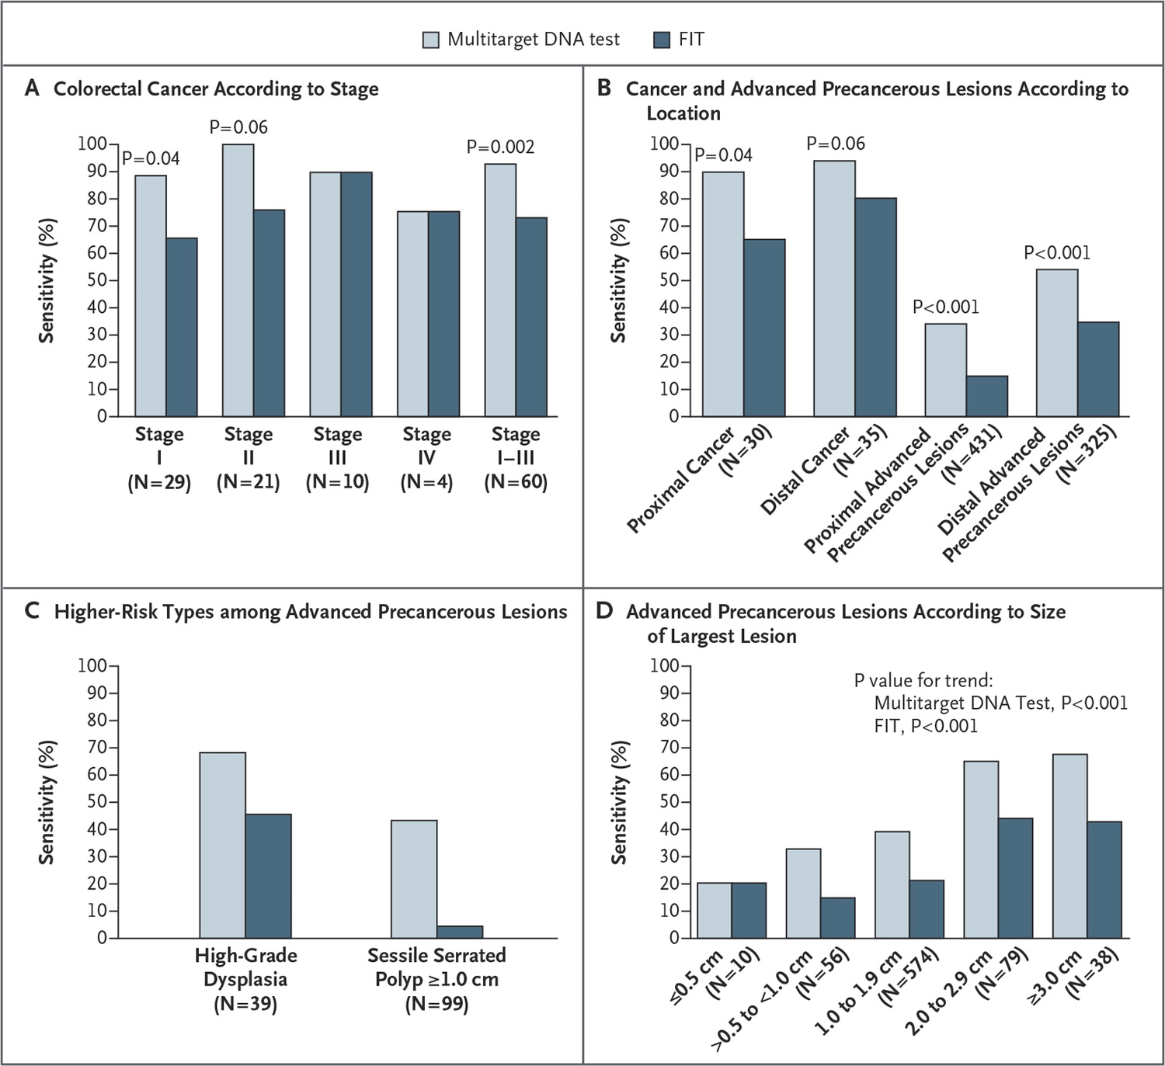
Exact Sciences Panel
Exact Panel
Sensitivity
By
Stage
Histology
Imperiale TF et al. N Engl J Med 2014;370:1287-1297.

Slide 10
Issues with Stool DNA and Fecal Occult Blood Tests
FIT test x 1 only. Serial testing may alter FIT performance.
High cost
Complex collection and shipping procedures
Universal FIT Screening Programs: 40% Refuse the Test
Exact test improved over FIT but insufficient for adenoma (non-invasive neoplasm)
Exact did not collect blood!

Slide 11
Key Challenges in Colon Cancer Early Detection
Enhancing Adherence to Current Screening Guidelines
  40% of USA population non-adherent
  Barriers: Cost, discomfort, cultural taboos
Strategy: Circulating Markers
Tayloring Colonoscopic Screening to Individual Risk
  Select high risk for endoscopic screening. Rest no screening.
  Specific demographic risk groups (genetic groups, African Amer)
Strategy: High sensitivity (99%) biomarker panels

Slide 12
Key Challenges in Colon Cancer Early Detection
Persistently Positive Biomarker Tests, Neg Endoscopy
  Stool methylated DNA panels report 5% “false positives”
  Potential Sources: Upper GI; flat adenomas, serrate lesions
  Non-GI sources
Strategy: Develop longitudinal subsets; specialized endoscopy (molecular probes); upper GI; more extensive screening (pancreas, extra GI source)

Slide 13
Key Challenges We Can Address
Circulating Markers
  Can we identify a panel that can equal FIT stool screening?
  Must a circulating biomarker panel be equal to or beat FIT to be useful?

Slide 14
Sources of Circulating Markers
Glycoproteins
Circulating Genetic Material
  Methylated genes appear to have stronger signals
Carcinogenesis Associated Genes
  Rate limiting control of pivotal inflammation mediators
Antibodies

Slide 15
A Strong Circulating Biomarker
Galectin-3 Ligand--Glycoprotein
Beta-galactoside-binding protein implicated in tumor progression and metastasis.
In colon cancer sera, a 40 kDa band distinct from mucin, CEA.
This band was also detected by Lotus tetragonolobus lectin and Erythrina cristagalli lectin (ECL), indicating that it is a glycoprotein containing fucose and N-acetyllactosamine.
R. Bresalier, MD Anderson/GLNE CVC EDRN
Notes:
Is the third bullett relevant/important?

Slide 16
Modeling: Galectin3 Ligand , CYFRA21, CEA
Using 300 EDRN Samples
Model 1- logistic regression based on forward selection: Galectin3 Ligand , CYFRA21, CEA are selected, their coefficients are determined using logistic regression model.

Slide 17
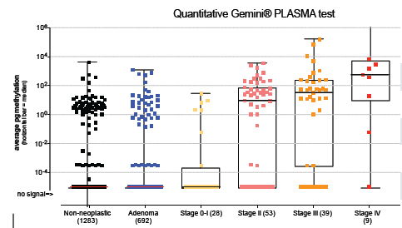
Circulating Methylated Genes from Clinical Genomics
IKZF1, BCAT1

Slide 18
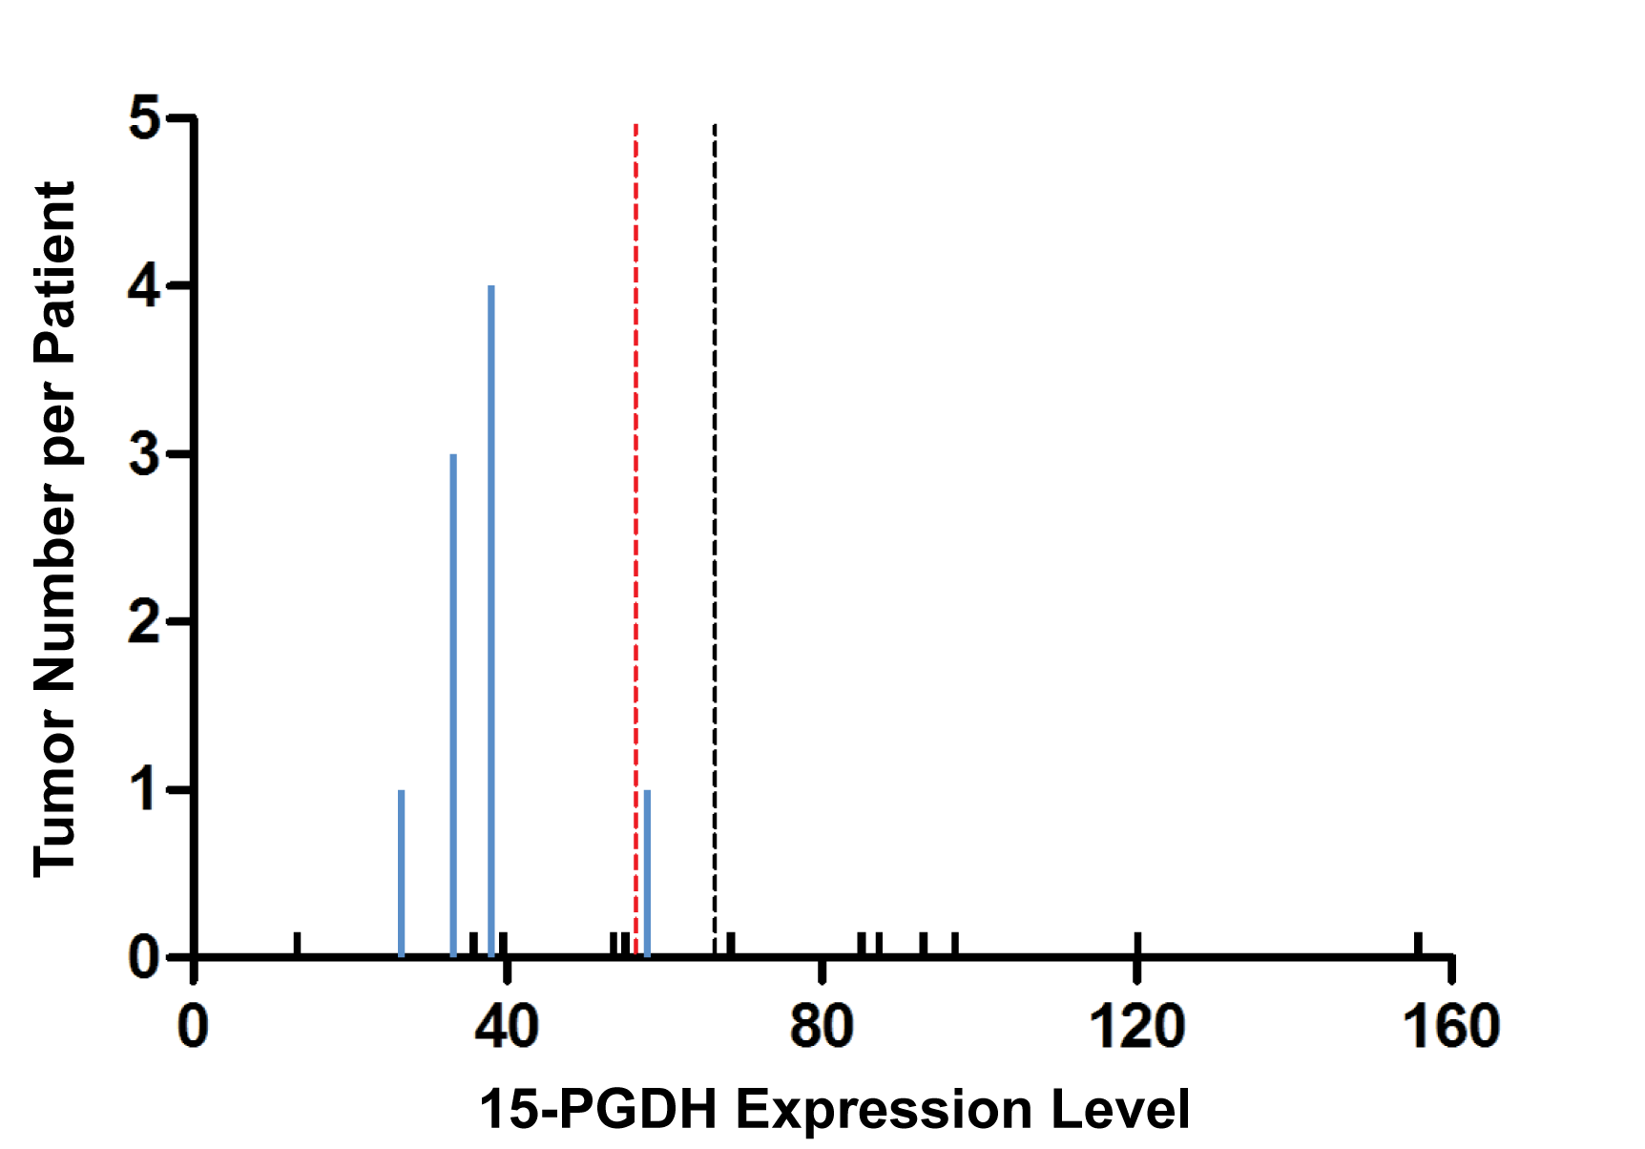
Carcinogenesis Mechanism Based Gene
Markowitz Laboratory
PGDH as Predictor of Adenoma Recurrence

Slide 19
Autoantibodies
Lampe Laboratory EDRN

Slide 20
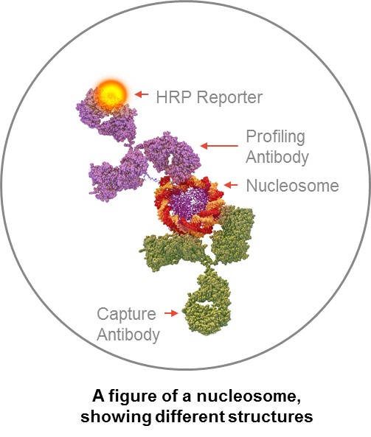
Antibodies to Nucleosomes
Volition, Inc
Family of 39 Different Antibodies, 5 key families
  Specific DNA Modifications
  Histone Variants
  Histone Modifications
  Nucleosome—Protein Adducts
  Total Nucleosomes

Slide 21
Panel of 4 Nucleosome Antibodies, Serum Assay
Preliminary Validation by Volition, Inc
4800 Symptomatic Patients Undergoing Colonoscopy
  Sensitivity 81%, Specificity 78% for invasive Colorectal Neoplasms
Preliminary Screening Detection of Stage I Cancers
  Sensitivity 74% at Specificity of 90%
High Risk Adenoma (≥1 cm, dysplasia)
  Sensitivity 61% @ Specificity of 80%; 530 symptomatic patients

Slide 22
Tayloring Colonoscopic Screening to Individual Risk
  Select high risk for endoscopic screening. Rest no screening.
Strategy: High sensitivity (99%) biomarker panels

Slide 23
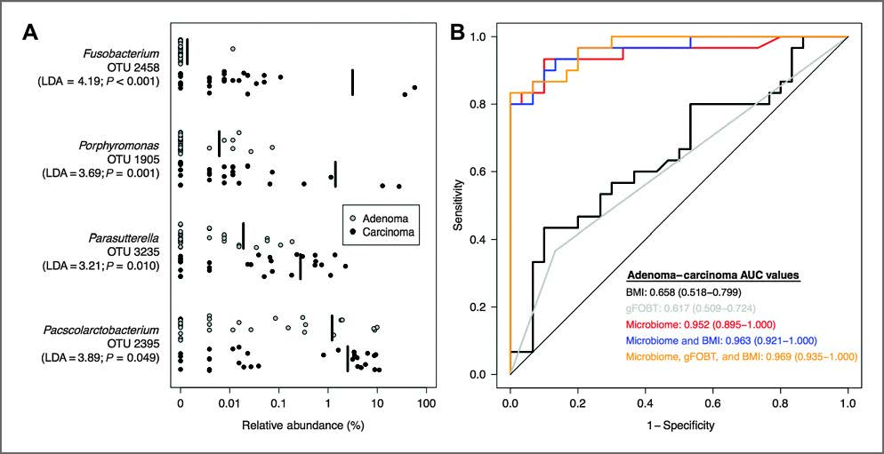
Will Microbiome Add the Necessary 7% Sensitivity?

Slide 24
Key Challenges We Can Address
Tayloring Colonoscopic Screening to Individual Risk (goal of 99% sensitive marker panel at specificity of >70%)
  If we combine circulating markers with FIT will be equal or surpass Exact Sciences panel?
  Will vimentin beat the Exact panel?
  Will digital sequencing analytical technology improve stool DNA sensitivity to get us to the 99% target?
  Will the microbiome be the component that pushes stool panes to the 99% target?

Slide 26
Managing Accrual to Ensure Successful Completion
Group A--Reopened
  50-59 yr
  First colonoscopy
Group B--Reopened
  60-69 yr
  Prior colon exam, none within 108 months
Group C
  ≥60 yr
  No prior colon exam
Group D
  ≥70 yr
  No prior OR prior colon exam within 108 months
Group E
  ≥65 yr
  Prior advanced adenomas (>1 cm, sessile)
  No colon exam within 36 months
Group F
  50-64 yr
  Prior 3-10 tubular adenomas, no colon exam within 60 months OR
  Prior >10 adenomas, no colon exam within 36 months OR
  Prior advanced adenoma, no colon exam within 36 months OR
  Prior adenoma with high grade dysplasia, no colon exam within 36 months OR
  Sessile serrated polyps, no colon exam within 60 or 36 months depending upon size

Slide 27
Comparison to Equivalent Studies

Slide 28
WHAT HAPPENED???

Slide 29
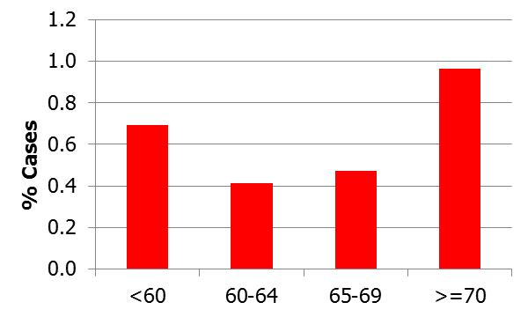
Age

Slide 30
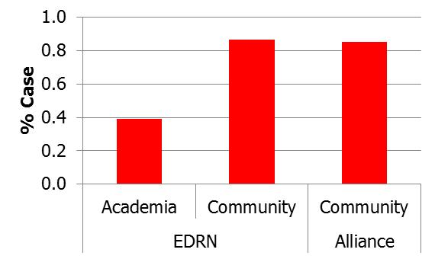
Community Vs Academic

Slide 31
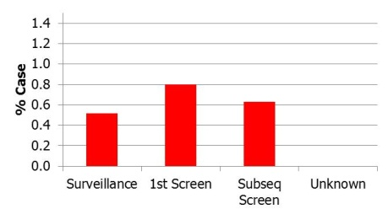
Screen Vs Surveillance

Slide 32
Registrations on Study

Slide 33
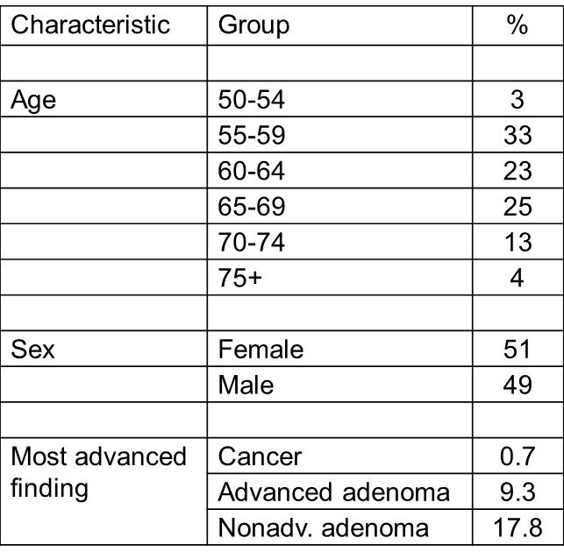
German Screening-Biomarker Trial (BliTz—H Brenner)
N = 7,950
Study Duration:
7 yrs

Slide 34
Colonoscopy Screening Rates
USA: 61%
Germany : 16%

Slide 35
Why Exact, PreSept, BliTz with Higher Event Rates
Exact
  Required 2/3rd enrollments ≥65 yrs.
  More community sites.
PreSept
  Enrolled first colonoscopy screens only.
  Half enrollment in Germany
  65% ≥ 60 yrs
Blitz
  Same enrollment as GLNE 010
  Entirely in Germany (16% colonoscopy screening rate)

Slide 36
Bias
Screening population—have access to care, including minorities on trial. Minority accrual 17%.
Pathologist Bias? Fewer academic pathologist make high grade dysplasia diagnosis

Slide 37
Inferences
Rapid changes in standard of care in USA from 2007 to now.
Low screening adherence in Germany (16%) results in published cancer event rate of 0.7%. Same as in literature.
“Downstaging” from invasive carcinoma to advanced adenomas.

Slide 38
Plan
Cancer Endpoint Only
  Dysplastic adenomas as endpoints degrade biomarker performance.
  Reduces the likelihood of successful identification of early detection biomarkers for colorectal neoplastic disease.
  increases barriers for success to the very biomarkers that the EDRN exists to discover and validate.
  Degrades the usefulness of the repository samples generated by GLNE 010 for future validation trials.

Slide 39
Plan
Substantial enrollment in Germany
USA enrollment restricted to ≥60 yrs, first colonoscopy only
Incremental industrial funding available (meets Executive Committee requirements)

Slide 40
Analytical Validation
Galectin-3 Ligand Assay
  Bresalier Laboratory—Invented Assay
  BRL—UCLA—Converted to Luminex Assay
  Going to run at UCLA
Vimentin Methylation
  Markowitz Laboratory—Invented Assay
  BRL—University of Maryland—Converted to qPCR
    Now extracted from 88 subjects
Notes:
US Postal issues: Slow delivery for postage due. Postage due ranges from 11 cents to $1.11. Some Post offices consider it an envelope and some consider it a package.

Slide 41
Team Projects: Aims
Identify biomarkers that predict the presence of advanced colorectal adenomas
  Discovery in blood, tissue, stool
  Promising markers go to validation in blinded reference sets from previous GLNE CVC samples
  Validated biomarkers to includ in GLNE 010 (cross-sectional colon validation study)

Slide 42
Grady Laboratory
Methylated NTRK3 in Stool DNA-based assay
NTRK3 promoter methylation in stool samples. (MethyLight)
Patients | n | Methylated *
 |  | n | %
Adenocarcinoma | 20 | 11 | 55.0%
Adenoma | 20 | 9 | 45.0%
Normal | 16 | 2 | 12.5%
*Use the same cutoff as the tissue-based MethyLight assays.

Slide 43
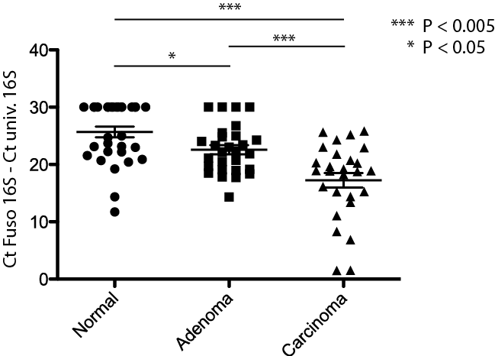
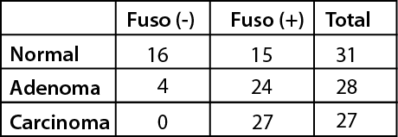
Microbiome
Kostic et al, Cell Host and Microbiome, In press

