Slide 1


Development of Prostate Cancer Early Detection and Prognostic Biomarkers
Scott A. Tomlins M.D., Ph.D.
Arul Chinnaiyan M.D., Ph.D.
Umich BDL
September 13, 2017

Slide 2
Disclosure Information
I have the following financial relationships to disclose:
The University of Michigan has been issued a patent on ETS gene fusions on which I am a co-inventor.
The diagnostic field of use has been licensed to Hologic/Gen-Probe, Inc., which has sublicensed rights to Roche/Ventana Medical Systems
Consultant for and honoraria from Roche/Ventana Medical Systems, Jansenn, AbbVie, Almac Diagnostics and Astellas/Medivation
Sponsored research agreement with and travel support from with Compendia Biosciences/Life Technologies/ThermoFisher Scientific
Sponsored research agreement with Astellas and GenomeDX
Co-founder of, equity holder in and Laboratory Director for Strata Oncology

Slide 3
Assess Science
Established screening biomarker (PSA)
Numerous clinical models and FDA/LDT tests shown to improve upon performance of serum PSA for predicting aggressive cancer on biopsy
Prostate cancer is extremely common and usually multifocal
Multiple LDT tissue tests available to improve prediction of undersampled aggressive cancer on biopsy
Urology is extremely entrepreneural testing specialty

Slide 4
Project Overview
Identify and validate novel prostate cancer and aggressive prostate cancer specific transcriptomic biomarkers
Determine the utility of prognostic transcriptomic tissue based biomarkers
Determine the utility of diagnostic transcriptomic urinary based biomarkers

Slide 5
Project Overview
Identify and validate novel prostate cancer and aggressive prostate cancer specific transcriptomic biomarkers
Determine the utility of prognostic transcriptomic tissue based biomarkers
Determine the utility of diagnostic transcriptomic urinary based biomarkers

Slide 6
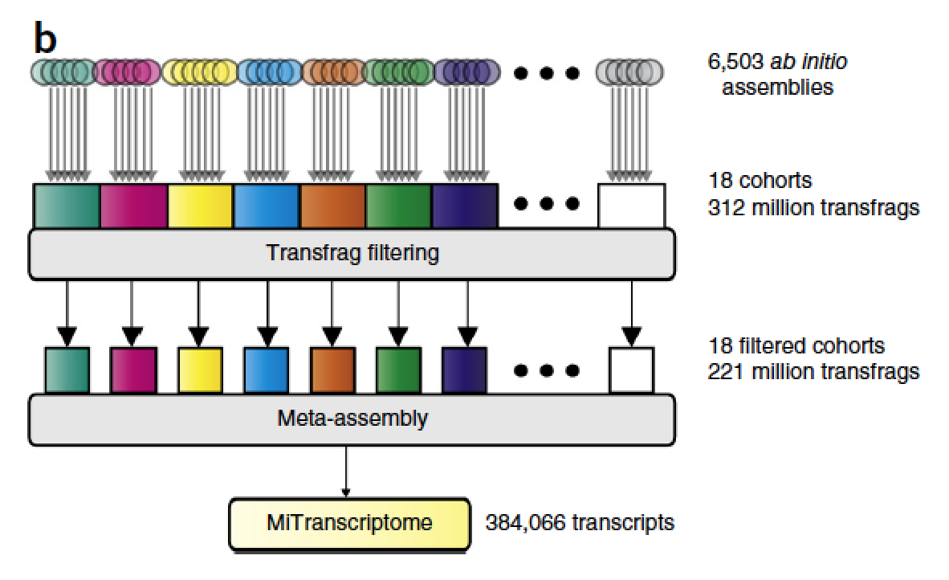
The landscape of lncRNAs in the transcriptome
Iyer, Niknafs et al
Nature Genetics 2015
Notes:
>7000 RNA-seq libraries, >20 studies, 50,000 lncRNAs, 8000 lineage and/or cancer specific

Slide 7
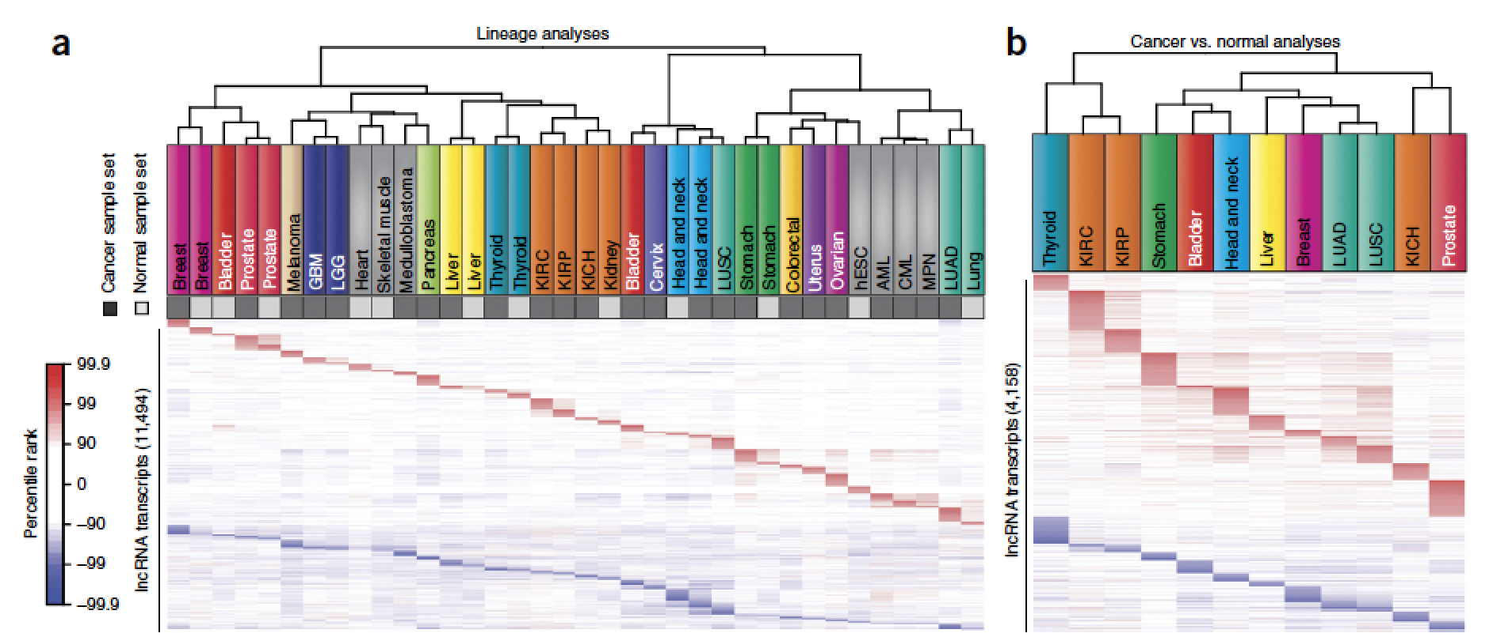
Cancer/Lineage Association of MiTranscriptome lncRNAs
Iyer, Niknafs et al
Nature Genetics 2015

Slide 8
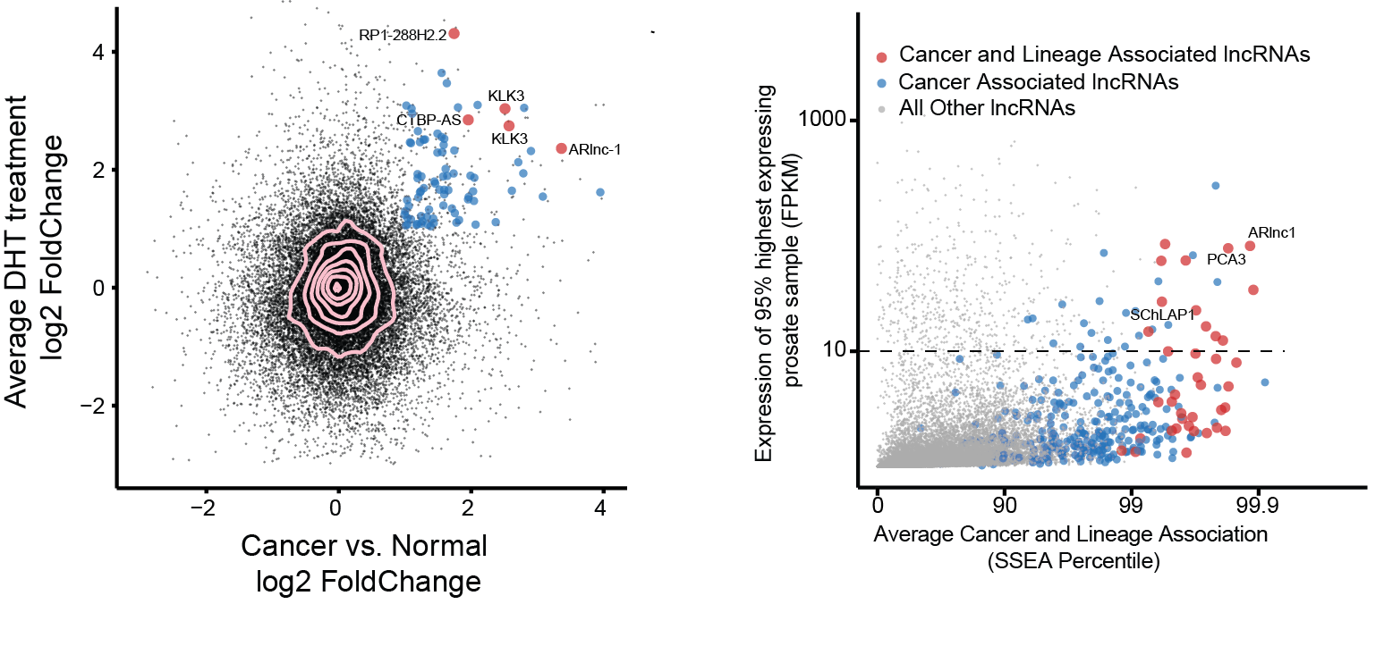
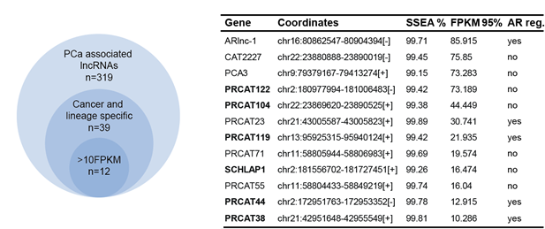
Nomination of ARlnc1 as a prostate lineage and
cancer-specific lncRNA
Zhang et al, unpublished

Slide 9
ARlnc1 (Androgen Receptor lncRNA1) is a prostate lineage and cancer specific lncRNA
Zhang et al unpublished

Slide 10
Project Overview
Identify and validate novel prostate cancer and aggressive prostate cancer specific transcriptomic biomarkers
Determine the utility of prognostic transcriptomic tissue based biomarkers
Determine the utility of diagnostic transcriptomic urinary based biomarkers

Slide 11

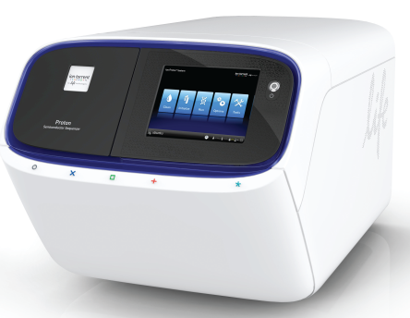
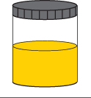
Multiplex RNAseq
Ampliseq RNA
(RT, multiplex PCR,
Ligate adaptors/barcode)
Isolate RNA
(and DNA)
NGS
Potential advantages
<1-10ng FFPE or urine RNA vs. >>10ng qRT-PCR for many targets
Multiplexing is easier by sequencing than most qRT-PCR
Digital data (sequence information)
Combinatorial priming for gene fusions/splice variants

Slide 12
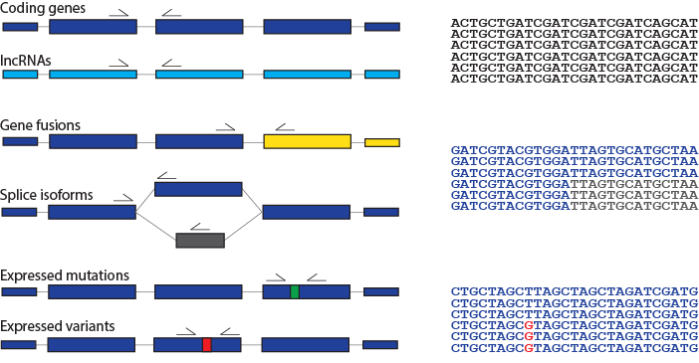
306 transcript targeted RNAseq assay
Decipher
Oncotype DX
Prolaris (CCP)
Diagnostic genes
Subtyping genes (all ETS fusions)
AR splice variants
NePC genes
lncRNAs
Expressed mutations

Slide 13
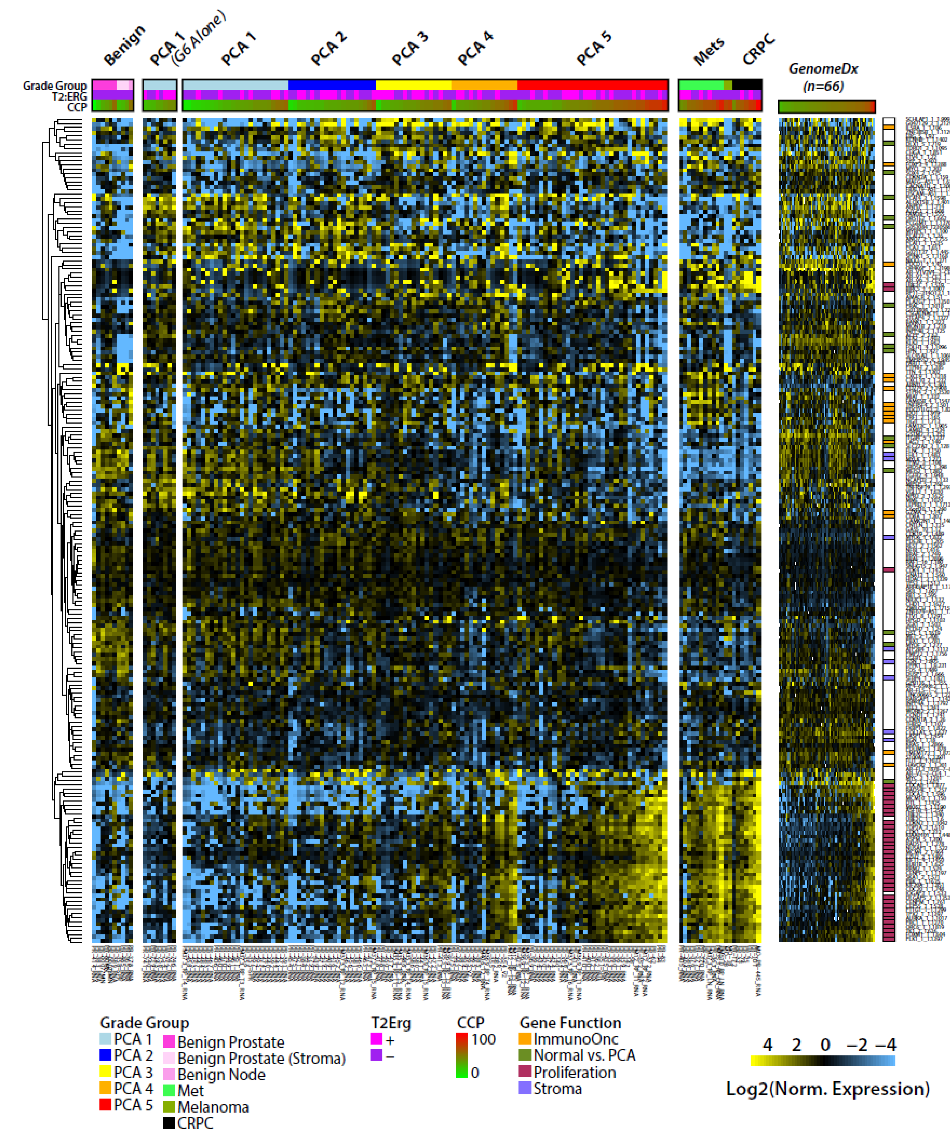




Slide 14
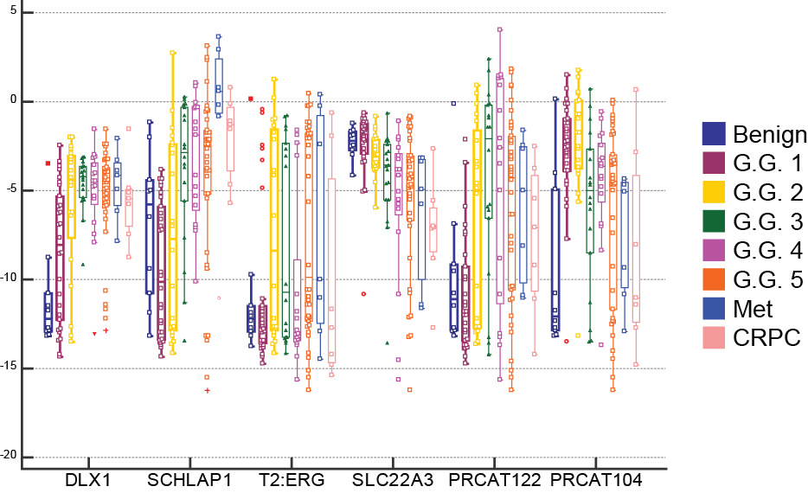
Expected transcript expression

Slide 15
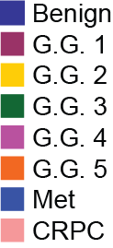
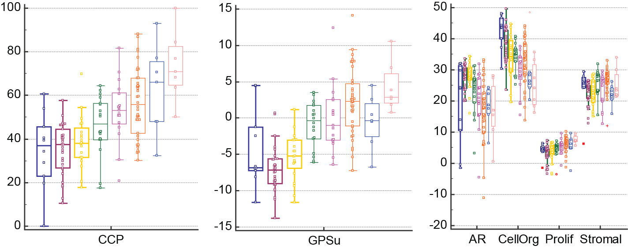
Derived prognostic signatures

Slide 16
Project Overview
Identify and validate novel prostate cancer and aggressive prostate cancer specific transcriptomic biomarkers
Determine the utility of prognostic transcriptomic tissue based biomarkers
Determine the utility of diagnostic transcriptomic urinary based biomarkers

Slide 17
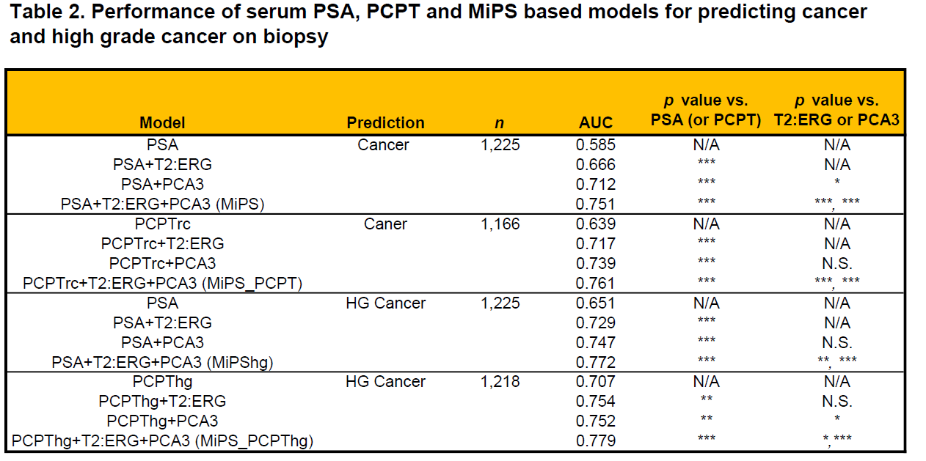
Serum PSA + urine T2:ERG, urine PCA3
Comparison of serum PSA, PCPT and MiPS based models for predicting PCa and
High-Grade PCa
Tomlins et al., European Urology, 2015
Notes:
Among 1225 informative validation cohort patients, AUCs for PSA, PSA plus T2:ERG score, PSA plus PCA3 score, and Mi-Prostate Score (MiPS) were 0.585, 0.693, 0.726, and 0.751, respectively
all MiPS models showed significantly greater AUC than singlebiomarker (PSA or PCPT) or two-biomarker (PSA or PCPT plus T2:ERG or PCA3) models

Slide 18
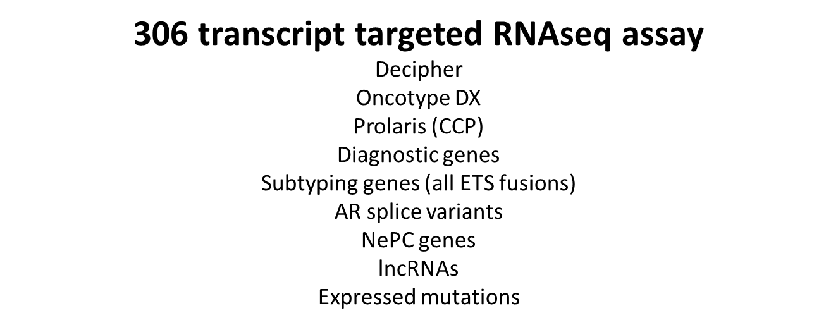
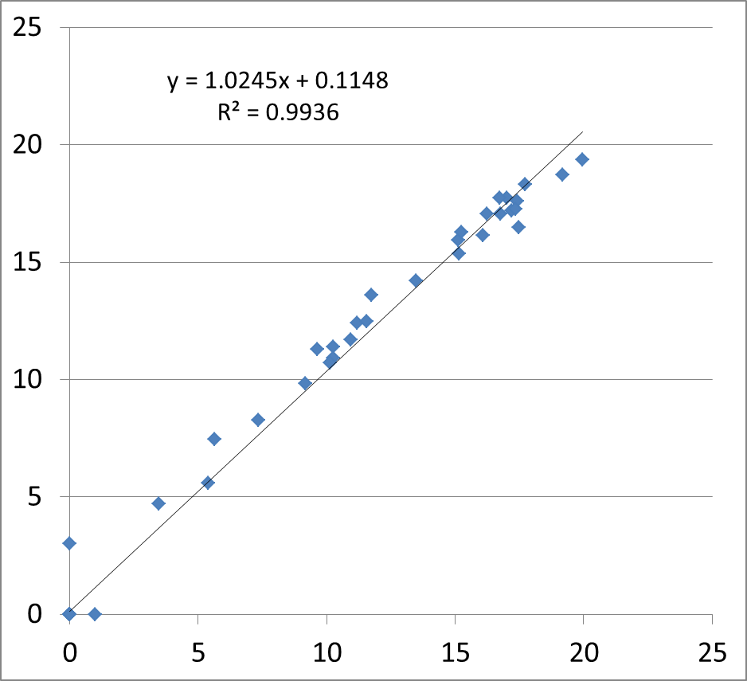
Urine RNAseq panel
60 Pre-specified fusions
29 target genes/lncRNAS

Slide 19
Timeline/Implementation
Identify and validate transcriptomic biomarkers
Determine the prognostic utility of transcriptomic tissue biomarkers
Evaluate added utility of biomarkers in area of clinical use (biopsy tissue)
Determine the diagnostic utility of transcriptomic urinary biomarkers
Evaluate added utility of biomarkers in area of clinical use (post-DRE urine)

Slide 20
Outcome Expected
Identification of the most aggressive prostate cancer specific
biomarkers
Tissue biomarkers will show almost no clinical utility when
applied to optimized clinicopathological models
Urine biomarkers will show incremental addition to optimized
clinicopathological models

Slide 21
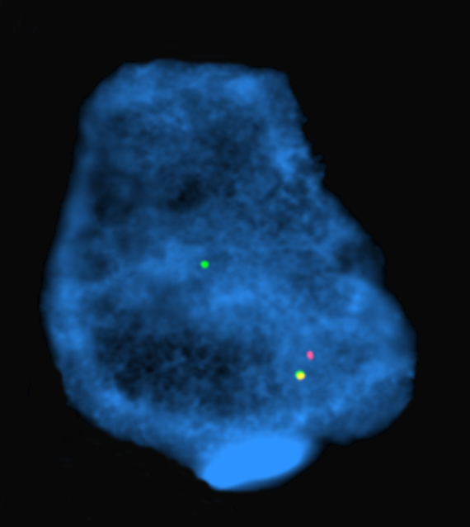









Acknowledgements
Tomlins Lab
Chinnaiyan Lab (MCTP)
Daniel Hovelson
Andi Cani
Andrew McDaniel
Albert Liu
Lorena Lazo de la Vega
Komal Kunder
Sumin Han
Fengyun Su
Rui Wang
Elena Stoffel
Jeffrey Innis
J. Scott Roberts
Moshe Talpaz
Jeff Innis
Javed Siddiqui
Rodney Dunn
Todd Morgan
John Wei
Javed Siddiqui
Muneesh Tewari
Maha Hussain
Arul Chinnaiyan
Rajen Modoy
Dan Robinson
Yi Mi Wu
Robert Lonigro
Xuhong Cao
Sameek Roychowdhury
Pankaj Vats
Kevin Frank
Jonathan Dillman
Raja Rabah
L. Priya Kunju
Jessica Everett
Yu Ning
Collaborators
Pete Nelson (FHCRC)
Jack Groskopf (Hologic) ThermoFisher Ampliseq R&D Team
International SU2C Team

Slide 22
Outline
Identify and validate novel prostate cancer and aggressive prostate cancer specific transcriptomic biomarkers
Determine the utility of prognostic transcriptomic tissue based biomarkers
Determine the utility of diagnostic transcriptomic urinary based biomarkers

Slide 23
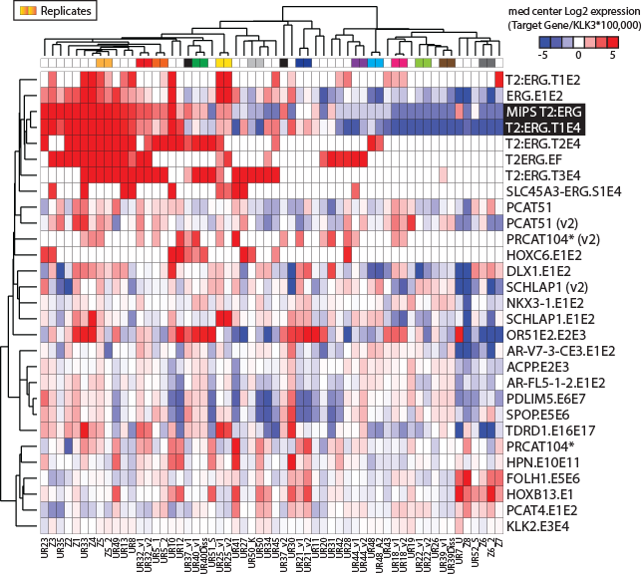

Slide 24
Challenges
Ensuring adequate RNA isolation from post-DRE urine collected in UTM
Enable validation through EDRN and banked UM samples
Updating panel for needed content
Remove amplicons that take up too many reads
Add PCA3
Add additional lncRNAs

Slide 25
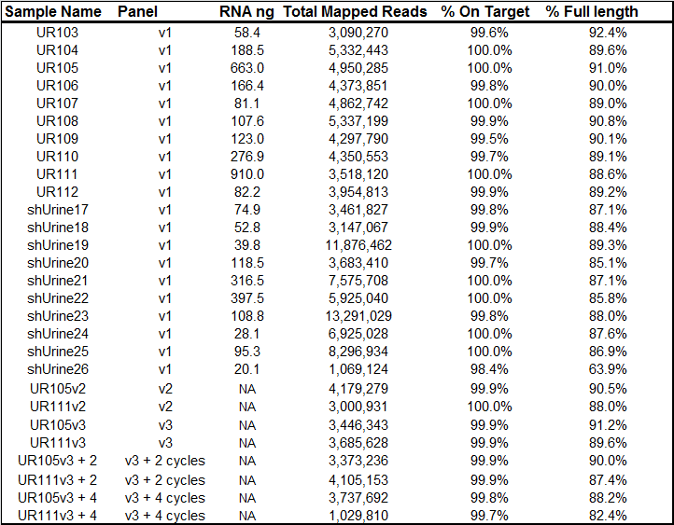
Optimization

Slide 26
