Slide 1




Mucins and their Associated Serological Panel for Diagnosis of Pancreatic Cancer
Randall E. Brand, M.D.
University of Pittsburgh Medical Center
Surinder K. Batra, Ph.D.
University of Nebraska Medical Center

Slide 2
Pancreas CVC (UPMC and UNMC)
The overall theme of the CVC is to validate the utility of selective mucins and their glycoforms as biomarkers for early detection of PC and effectively identify pancreatic cystic neoplasms with higher lethal potential.
Proposed biomarkers arose from previously funded work in BDLs

Slide 3
PRESENTATION OUTLINE
Mucins: Potential diagnostic marker
MUC4 &MUC5AC
Assessment of mucins diagnostic potential (AIM 1)
IHC studies
Training set
Validation set I
Blinded Validation set II
REFERENCE SET from EDRN
Trefoil Factors (TFFS) and MUCs
Differentiating Benign and Malignant Cystic Neoplasms (Aim 2)

Slide 4
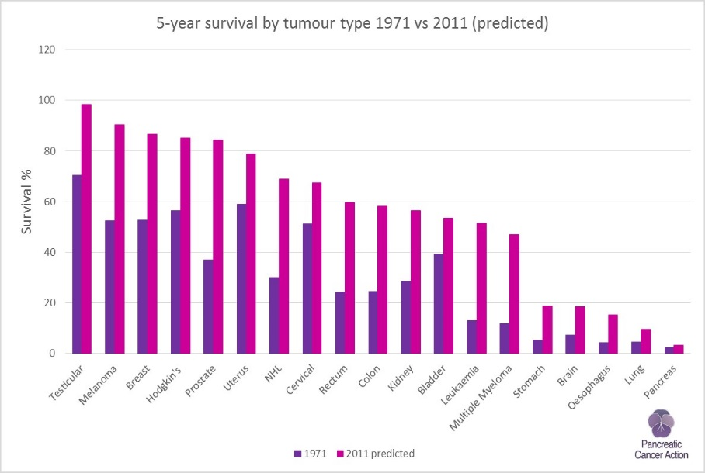
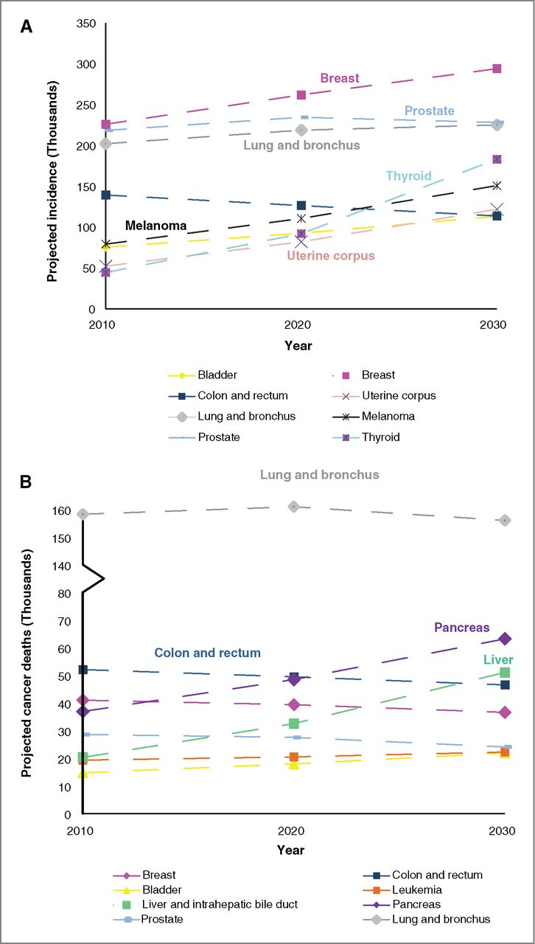


PANCREATIC CANCER (PC)
Estimated new cases and deaths from PC in the United States in 2017: New cases: 53,070 people (27,670 men and 25,400 women) Deaths: 41,780 people (21,450 men and 20,330 women)
Quaresma et al, Lancet Oncology, 2014
Rahib et al, CCR, 2014
PC mortality rates has not changed over the last four decade
BETTER DIAGNOSTICS TOOLS WILL LEAD TO BETTER PC TREATMENT

Slide 5
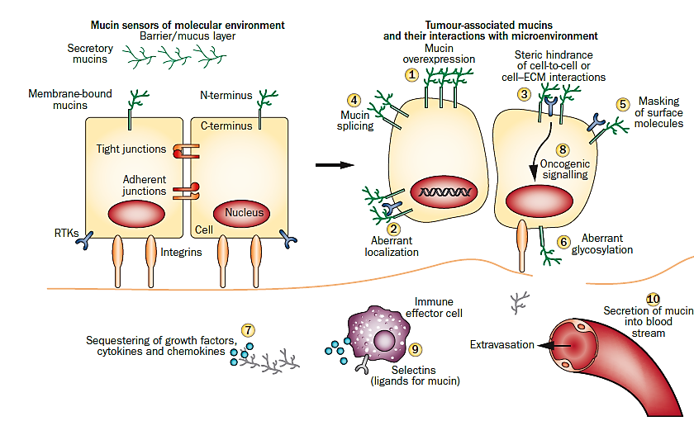
MUCINS AND CANCER
Kaur & Batra. Nat Rev Gastroenterol Hepatol. 2013

Slide 6
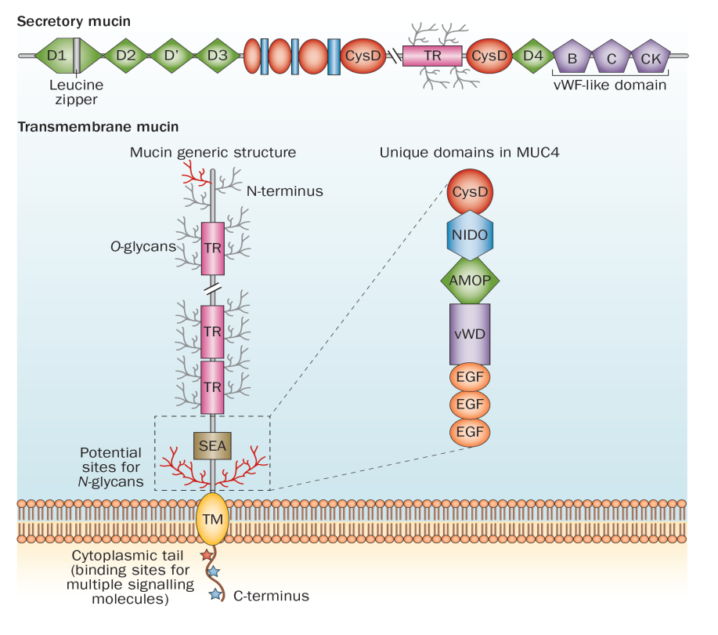
MUCINS AND CANCER
Membranous/ Secreted
Differential Glycosylation
Epitope
Multiplicity
Highly immunogenic
Kaur & Batra. Nat Rev Gastroenterol Hepatol. 2013

Slide 7
EXPRESSION PROFILE OF MUCINS IN PANCREATIC PATHOLOGIES
Kaur & Batra. Nat Rev Gastroenterol Hepatol. 2013

Slide 8
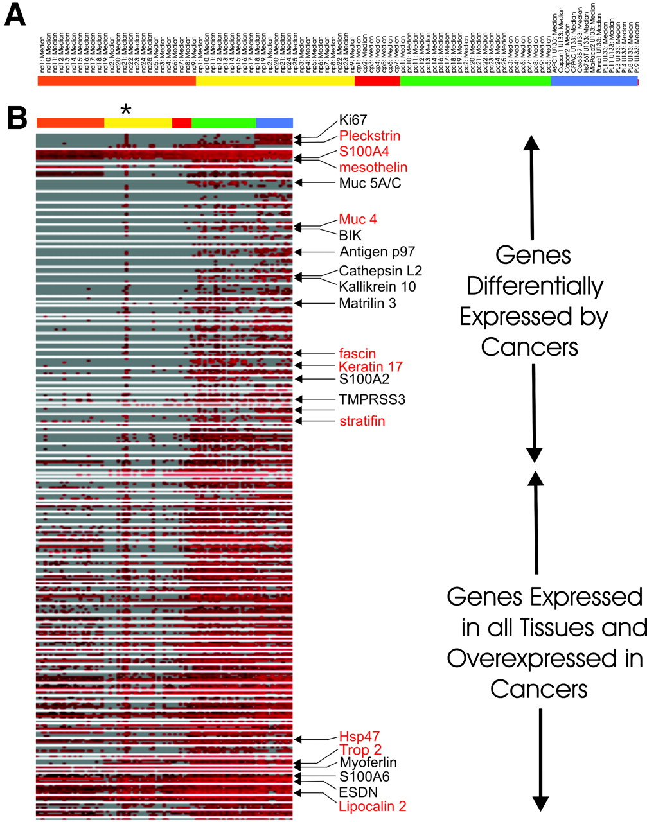
MUC4 AND MUC5AC are Differetially Expressed in PDAC (
cDNA array, oligonucleotide array and SAGE Analysis
Iacobuzio-Donahue, C. A. et al. Cancer Res 2003;63:8614-8622

Slide 9
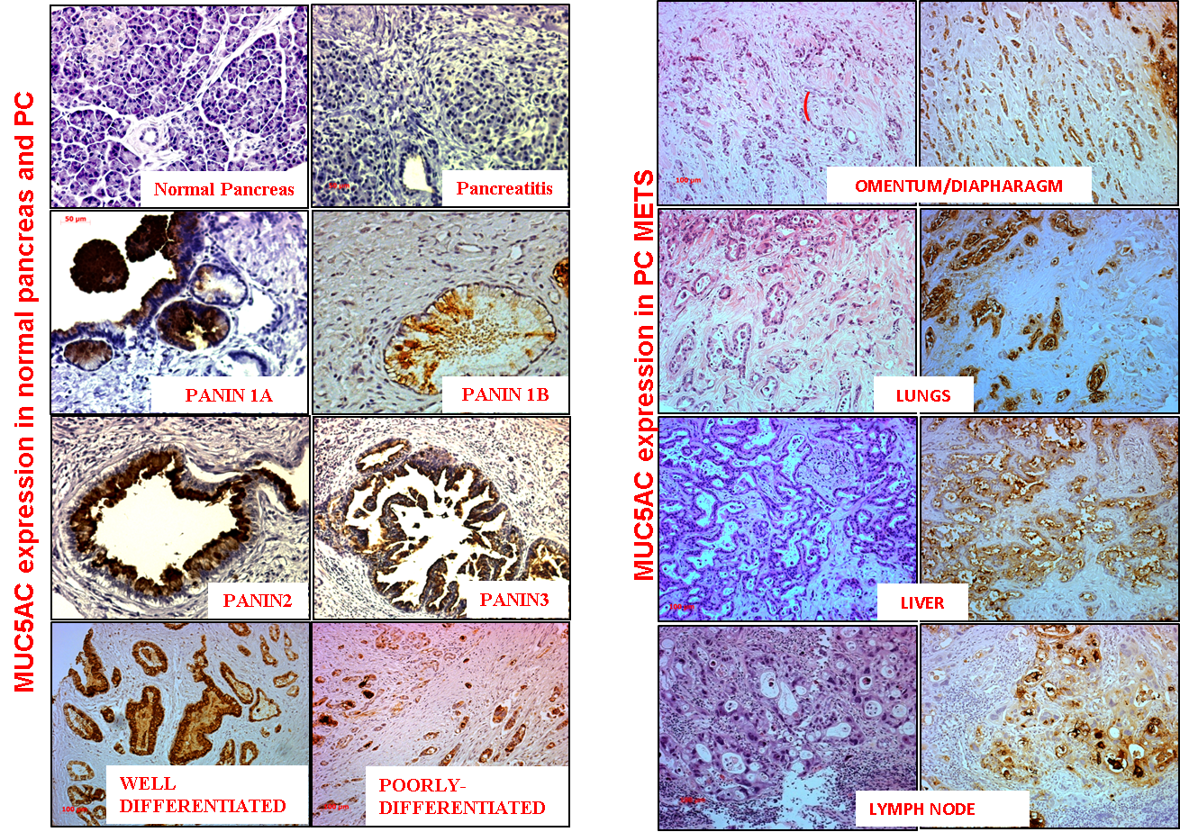
MUC5AC DURING PROGRESSION OF PC
MUC5AC APPEARS EARLY AND EXPRESSION IS MAINTAINED TILL METASTATIC STAGES
Kaur et al., American Journal of Gastroentrology, 2016, (Accepted MS)

Slide 10
MUC5AC EXPRESSION IN DIFFERENT PANCREATIC DISEASES
Commercial TMA : 101 patients (208 cores)
MUC5AC EXPRESSION FOUND TO BE SPECIFICALLY ELEVATED DURING PC

Slide 11
MUC5AC DIAGNOSTIC SIGNIFICANCE ASSESSMENT
MEASUREMENT OF SERUM MUC5AC
TRAINING SET: UPMC DIAGNOSTIC SIGNIFICANCE (N=241)& UNMC PREDICTIVE SIGNIFICANCE (N=201)
VALIDATION SET I: MAYO CLINIC (N=94)
VALIDATION SET II: UPMC BLINDED SET (N=322)
REFERENCE SET: NCI (N=242)

Slide 12
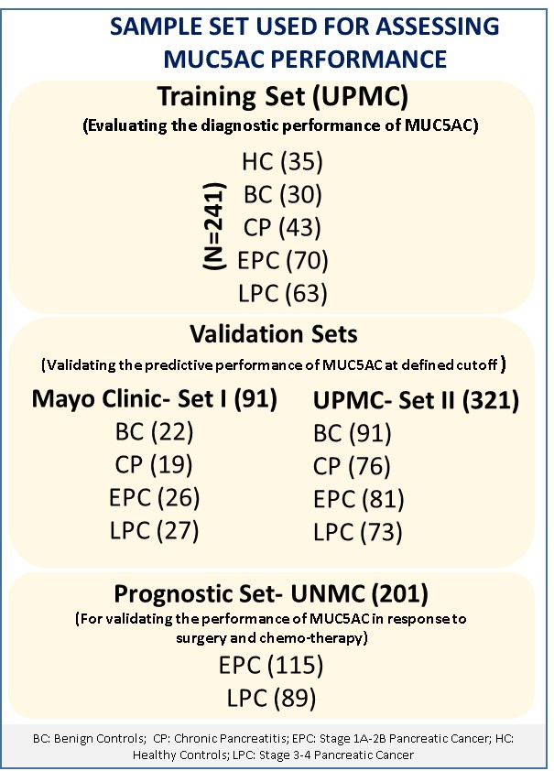
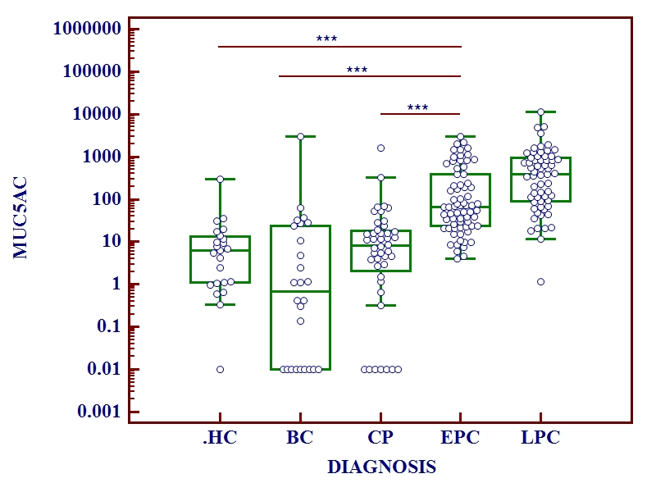
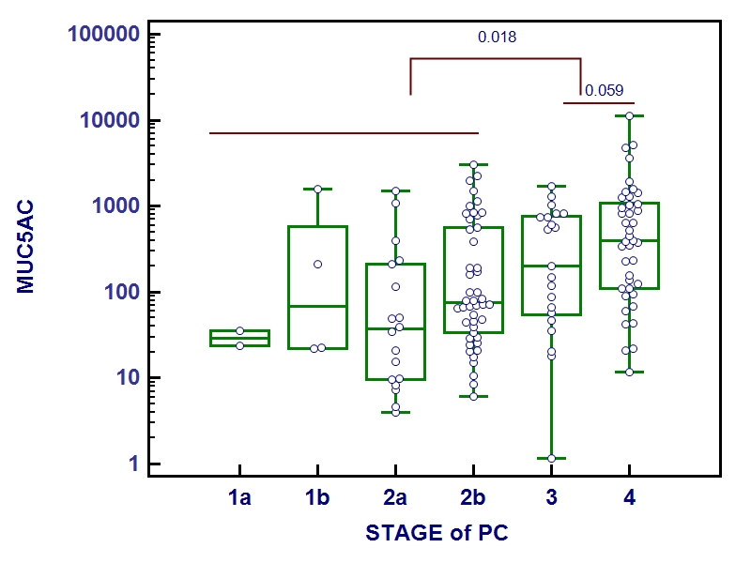
Training Set
A
B
C
Elevated levels of MUC5AC are observed in both early and late stage pancreatic cancer cases.
MUC5AC emerged as highly potential biomarker for differentiating PC
D
E
F
(Sensitivity)
(1-specificity)

Slide 13
MUC5AC IN COMBINATION WITH CA19.9
Sensitivity
CA19.9-37 U/ML
CA19.9-37 U/ML
1-specificity
D
THE COMBO(MUC5AC AND CA19.9) IMPROVES THE SENSITIVITY AND SPECIFICITY FOR DIFFERENTIATING EPC FROM CONTROLS
 | Comparison | AUC | SE | Threshold | SP | SN
EPC vs. BC | MUC5AC | 0.84 | 0.04 | ≥20⋅40 | 0⋅7 | 0⋅83
 | CA19-9 | 0.57 | 0.05 | >=37 | 0⋅48 | 0⋅67
 | Ln(MUC5AC) + CA19-9 | 0.85 | 0.04 | P(EPC) ≥0⋅553 | 0⋅72 | 0⋅85
EPC vs.CP | MUC5AC | 0.82 | 0.05 | >=20.404 | 0.76 | 0.84
 | CA19-9 | 0.50 | 0.05 | >=37 | 0.32 | 0.7
 | Ln(MUC5AC) + CA19-9 | 0.84 | 0.043 | P(EPC)>= 0.472 | 0.78 | 0.86
N=199 where both MUC5AC and CA19.9 values were available; CA19.9 AT 37 U/ML

Slide 14
SUMMARY-MUC5AC+CA19.9
Elevated levels of MUC5AC are present in early stages of pancreatic cancer patients.
MUC5AC at its optimal cut-off (20.4 ng/ml) improves the diagnostic efficacy of CA19.9
The combination of MUC5AC and CA19.9 improve differentiation of
A. EPC cases from benign controls (Sensitivity and Specificity of 85.4% and 71.7%)
B. EPC and chronic pancreatitis cases (Sensitivity and specificity of 86% and 78%) in comparison to CA19.9 alone (66% sensitivity 47.8% specificity for BC; 69.8% sensitivity 31.7 % specificity for CP).

Slide 15
DIAGNOSTIC PERFORMANCE OF MUC5AC IN VALIDATION SETS
Validation Set I- MAYO CLINIC N=94 MUC5AC CUT-OFF ≥20.4NG/ML
 | Estimated Sensitivity | Estimated Specificity | Total cases | AUC | PPV | NPV | AC
PC vs. BC | 75% (39/52) | 73% (16/22) | 74 | 0.74 | 87% | 55% | 74%
PC vs. CP | 75% (39/52) | 79% (15/19) | 71 | 0.77 | 91% | 54% | 76%
EPC vs. BC | 68% (17/25) | 73% (16/22) | 47 | 0.70 | 74% | 67% | 70%
EPC vs. CP | 68% (17/25) | 79% (15/19) | 44 | 0.74 | 81% | 65% | 73%
LPC vs. BC | 81% (22/27) | 73% (16/22) | 49 | 0.77 | 79% | 76% | 78%
LPC vs. CP | 81% (22/27) | 79% (15/19) | 46 | 0.80 | 85% | 75% | 80%
Blinded Validation Set II UPMC-N=341 MUC5AC CUT-OFF ≥20.4NG/ML
PC vs. BC | 68% (107/157) | 83% (94/113) | 270 | 0.76 | 84% | 65% | 74%
PC vs. CP | 68% (107/157) | 72% (36/50) | 207 | 0.70 | 88% | 42% | 69%
EPC vs. BC | 65% (53/82) | 83% (94/113) | 195 | 0.74 | 74% | 76% | 75%
EPC vs. CP | 65% (53/82) | 72% (36/50) | 132 | 0.68 | 79% | 55% | 67%
LPC vs. BC | 73% (53/73) | 83% (94/113) | 186 | 0.78 | 74% | 82% | 79%
LPC vs. CP | 73% (53/73) | 72% (36/50) | 123 | 0.72 | 79% | 64% | 72%
MUC5AC IS POTENTIAL DIAGNOSTIC MARKER FOR IDENTIFYING EARLY STAGE PANCREATIC CANCER (STAGE 2B)

Slide 16
REFERENCE SET
242 blinded samples collected by NCI under EDRN program
DIAGNOSIS | SAMPLES | AGE AND DIABETES ADJUSTED
HEALTHY CONTROLS | 58 | 53
CHRONIC PANCREATITIS | 59 | 57
ACUTE BILIARY OBSTRUCTIONS | 30 | 30
STAGE IA/IB/IIA | 52 | 51
STAGE IIB | 41 | 37
TOTAL CASES | 240 | 228
TOTAL PANCREATIC CANCER | 93 | 88
Patients till stage 2B were present in the reference set

Slide 17
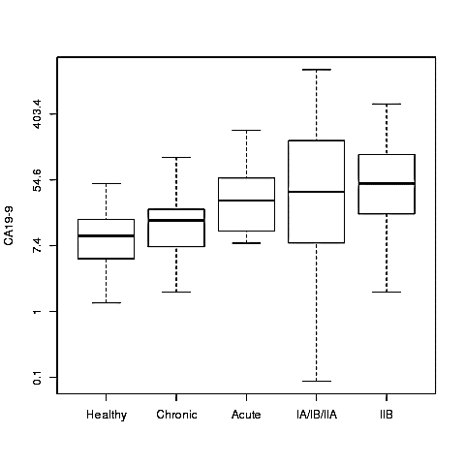
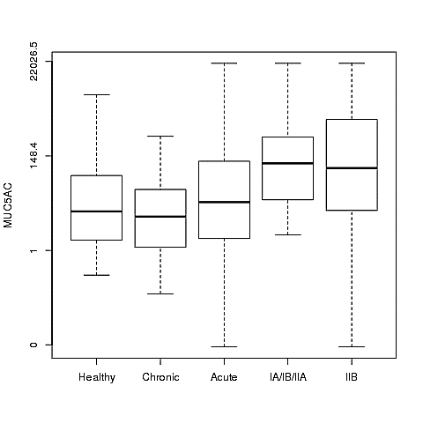
CA19.9 AND MUC5AC LEVELS
Elevated levels of both MUC5AC and CA19.9 were observed in PC early stages in comparison to various control groups
Similar trend was observed after age, diabetes adjustment
Elevated levels of CA19.9 were observed in acute biliary obstruction cases while MUC5AC showed varying trend in this group

Slide 18
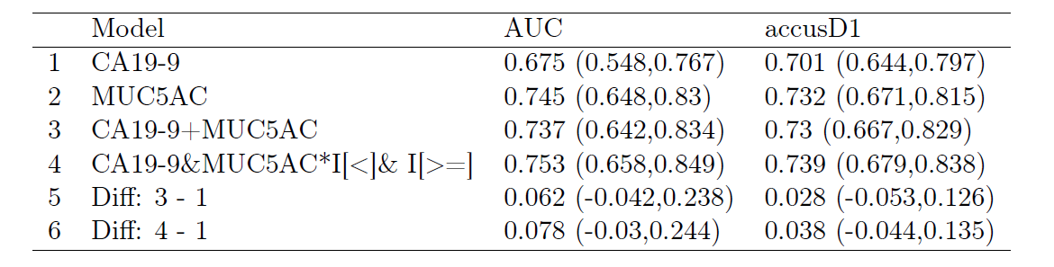
STAGE IA/IB/IIA VS CHRONIC PANCREATITIS
0.67 TO 0.75
MUC5AC PERFORMED BETTER THAN CA19.9 IN DIFFERENTATING CHRONIC PANCREATITIS CASES FROM CA19.9 THAT WAS USED AT ITS OPTIMAL CUT-OFF

Slide 19
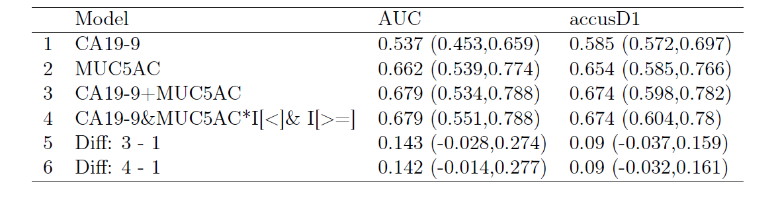
STAGE IA/IB/IIA VS ACUTE BILIARY OBSTRUCTIONS
0.54 TO 0.68
MUC5AC HAS HIGH DIAGNOSTIC POTENTIAL IN ACUTE BILIARY OBSTRUCTION CASES AND COMBINATION PERFORMED MUCH BETTER THAN CA19.9 ALONE
Notes:
DIFFERENCES DID NOT REACH SIGNIFICANCE DUE TOLOW SAMPLE NUMBER

Slide 20
Summary: CA19.9 AND MUC5AC LEVELS
SIGNIFICANTLY ELEVATED LEVELS OF MUC5AC ARE OBSERVED IN EARLY STAGE PC CASES. (training sets, two centers and blinded EDRN reference sets)
MUC5AC ALONE DIFFERENTIATE STAGE 1A/1B/IIA FROM VARIOUS CONTROL GROUP WITH AUC BETTER THAN CA19.9
MUC5AC HAS HIGH DIAGNOSTIC POTENTIAL FOR DIFFERENTIATING CP AND ABO CASES FROM CANCER CASES DURING EARLY STAGES
MUC5AC EMERGED AS PROMISING MARKER IN COMBINATION WITH CA19.9 FOR STAGE IA/IB/IIA PATIENTS

Slide 21
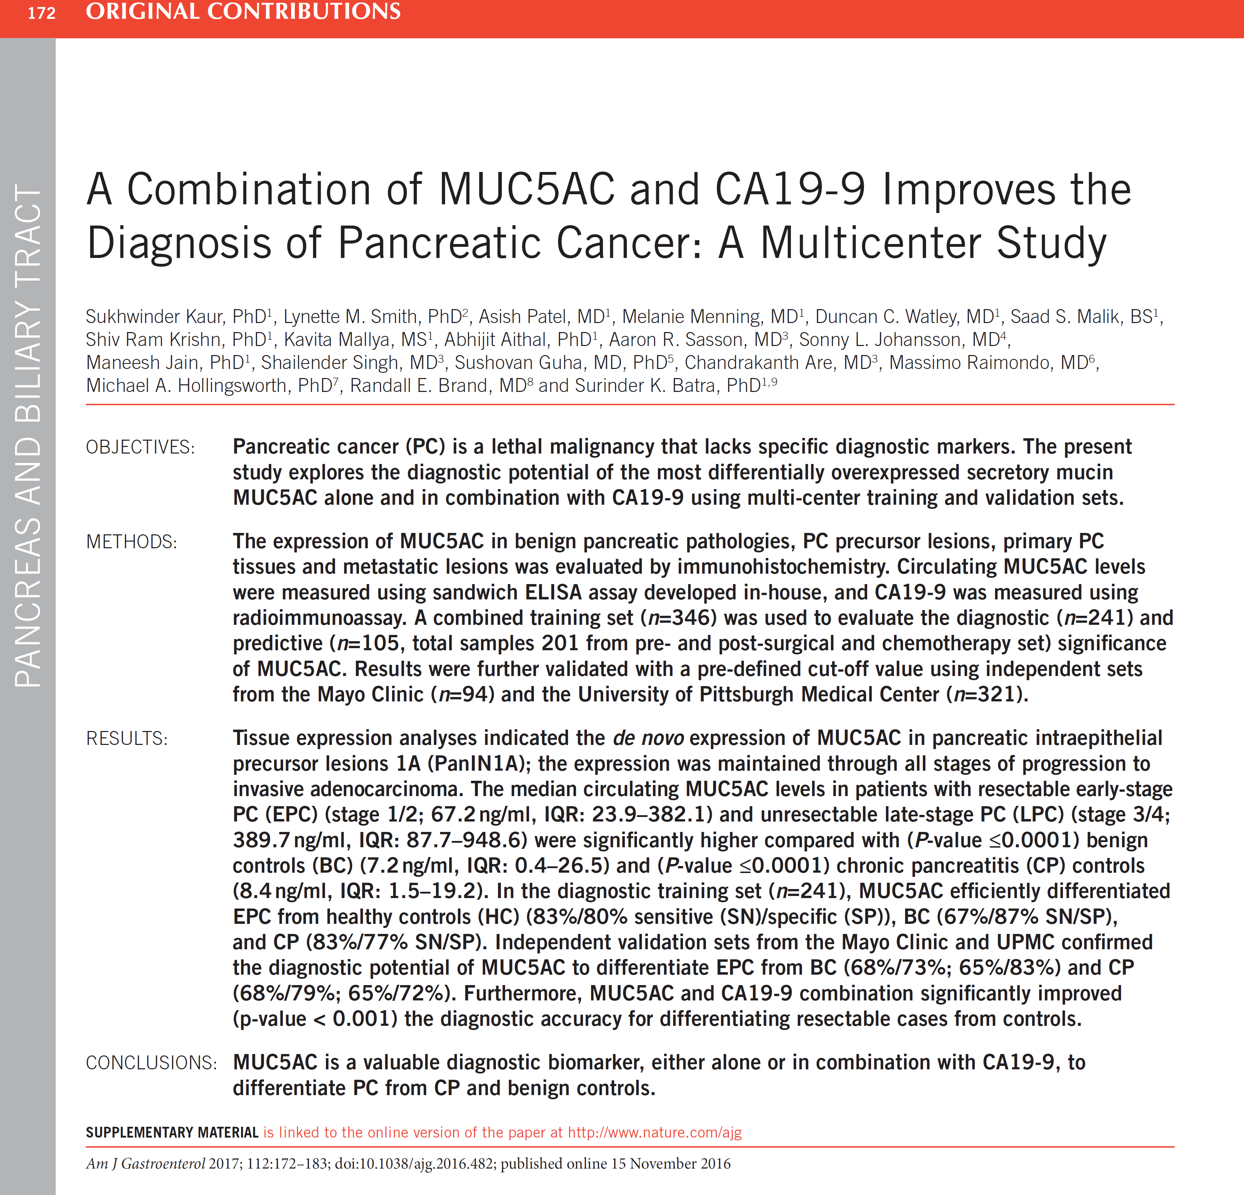

Slide 22
PLANS for Future Analysis
Validate the diagnostic potentials of MUC5AC in another blinded set from UPMC (250 EPC; 250 controls)
PROGNOSTIC EFFICACY OF MUC5AC AND CA19.9 COMBINATION.
DOES EVLUATING MUC5AC IN LONGITUDINALLY COLLECTED PLCO SAMPLE SET HELP IN IDENTIFYING CANCER PATIENTS WITH IMPROVED DISCRIMINATORY POWER?
HOW MUC5AC IMPROVES THE PATIENTS STRATIFICATION IN DELENIATING THE RESPONSE TO CHEMOTHERAPY AND SURGERY?

Slide 23
Diagnostic Significance
of Circulating MUC4 mucin

Slide 24

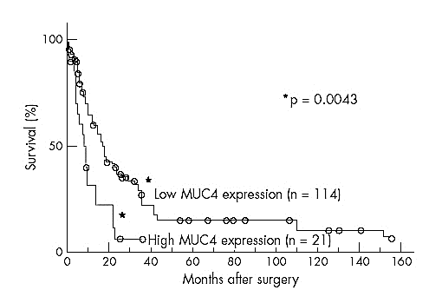
MUC4 Expression in Pancreatic Cancer
Pancreatic Cancer Progression Model
MUC4
Hruban H, et. al. Clin Cancer Res. 2000 (model)
Andrianifahanana et al, 2002, Clin Cancer Res
Swartz M.J. et al., 2002; Amer J Clin Patholog
Park et al., 2003; Pancreas
Jhala et al., 2006. Am J Clin Pathol, 2006
Correlation between MUC4 expression and cumulative survival rate in 135 patients with invasive ductal carcinoma, as determined by the Kaplan–Meier method. The survival of patients with high MUC4 expression was worse than those with low MUC4 expression. (Saitou et al. Batra SK. J. Clin Pathology 58;845-52, 2005)

Slide 25
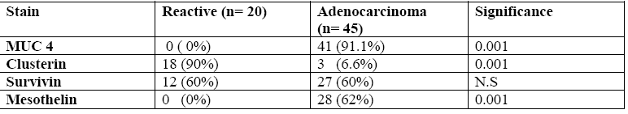
Immunophenotypic expression of various markers in EUS-guided Fine Needle Aspirates (FNAs) in patients with and without adenocarcinomas
(Jhala et al. Am J Clin Pathol, 2006, 126, 572-9)

Slide 26
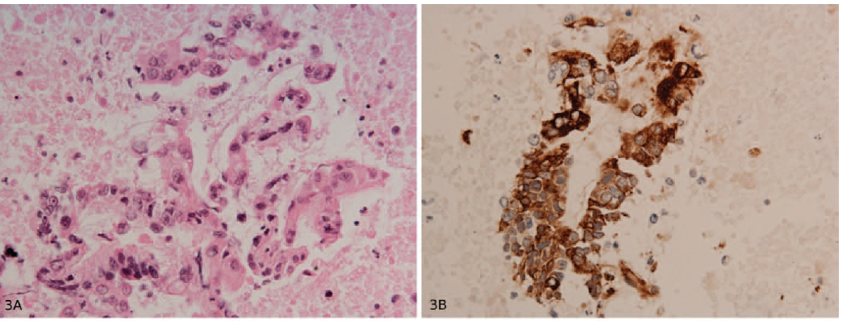
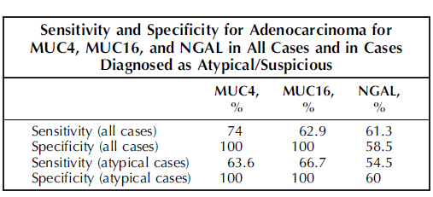
EUS-guided FNA samples in patients with and without adenocarcinomas
Horn et al, Batra, Lele, Archives of Pathology, 137, 546-51, 2013 : Immunocytochemistry for MUC4 and MUC16 is a useful adjunct in the diagnosis of pancreatic adenocarcinoma on fine-needle aspiration cytology
Atypical pancreatic ductal epithelium:
48 atypical/suspicious cases: 31(65%) positive for adenocarcinoma; 17(35%) negative for adenocarcinoma
A, hematoxylin-eosin; B, anti-MUC4
Higashi et al, Batra, Yonezawa. Pancreas 44 (5), 728-734, 2015. Mucin expression in endoscopic ultrasound-guided fine-needle aspiration specimens is a useful prognostic factor in pancreatic ductal adenocarcinoma
Total samples: 114
MUC4 positive, (106/114)
93%
Representative microscopic features in EUS-FNA
(A) Hematoxylin-eosin (D ) MUC4 staining

Slide 27
MUC4-SERS Sandwich Immunoassay Format

Slide 28
Detection of MUC4 in PC Patient Sera
Healthy Controls (HC)
Chronic Pancreatitis (CP)
Early Stage PC (EPC)
Late Stage PC (LPC)
N=19 for each group
Based on the 95% confidence interval Raman Intensity discriminates:
PC vs. HC
EPC vs. HC (p=0.0053)
LPC vs. HC (p=0.0050)
PC vs. CP
EPC vs. CP (p=0.0011)
LPC vs. CP (p=0.0011)
MUC4 is 61% sensitive and 95% specific in differentiating
PC from HC.
MUC4 was 76% sensitive and 95% specific in differentiating PC from CP.

Slide 29
MUC4, MUC5AC and CA19.9 combination
1.0
0.8
The combined utility of MUC4, MUC5AC and A19-9 for differentiating EPC from controls. Differences of biomarkers between PDAC compared to control subjects were assessed using logistic regression and ROC curve analysis. Cutoff points were determined for each marker using optimal SN and SP. MUC4, MUC5AC and CA19-9 added up to differentiate PC cases from benign controls with SN of 95% and SP of 100%
0.6
sensitivity
0.4
MUC5AC+MUC4+CA19-9
0.2
MUC5AC
MUC4
CA19-9
0.0
0.2
0.4
0.6
0.8
1.0
1-specificity

Slide 30
Diagnostic Significance of
Trefoil Factors (TFFs)

Slide 31
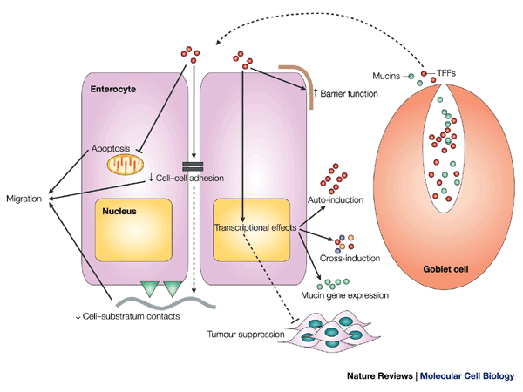
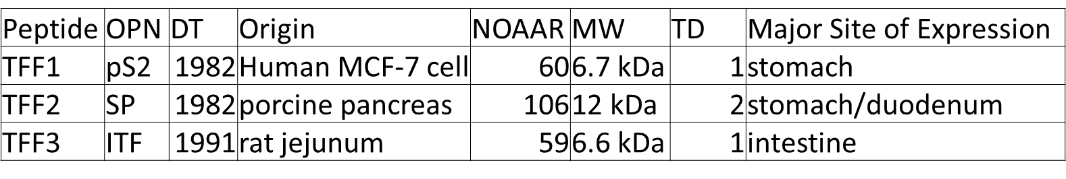
Trefoil Factors
Trefoil factor family (TFF) peptides are mucin-associated molecules co-expressed with MUC mucins and involved in the maintenance of mucosal barrier and the biological behavior of epithelial and carcinoma cells
CELL | TFF Peptide/Mucin
Gastric surface cel | TFF1/MUC5AC
Brunner's glands | TFF1+TFF2/MUC6
Gastric mucous neck cel | TFF2/MUC6
Intestinal goblet cell | TFF3/MUC2
Conjunctival goblet cel | TFF1+TFF3/MUC5AC
Respiratory goblet cell | TFF3/MUC5AC+MUC5B
Respiratory submucosal glands | TFF3/MUC5B
Endocervical epithelial cell | TFF3/MUC5B
Submandibular gland: serous cell | TFF3/MUC7

Slide 32
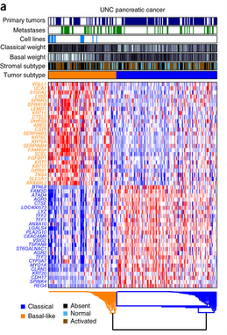
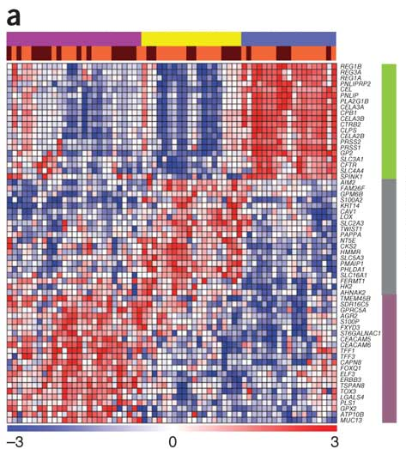
Trefoil Factors: Potential markers for Classical Subtypes in Pancreatic Cancer
Collison group
Moffitt group
Classical
Quasimesenchymal
Exocrine
Basal
Classical
Collison et al. Nature Medicine 2010
Moffitt et al. Nature Genetics 2015

Slide 33
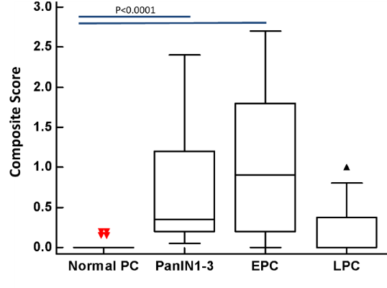
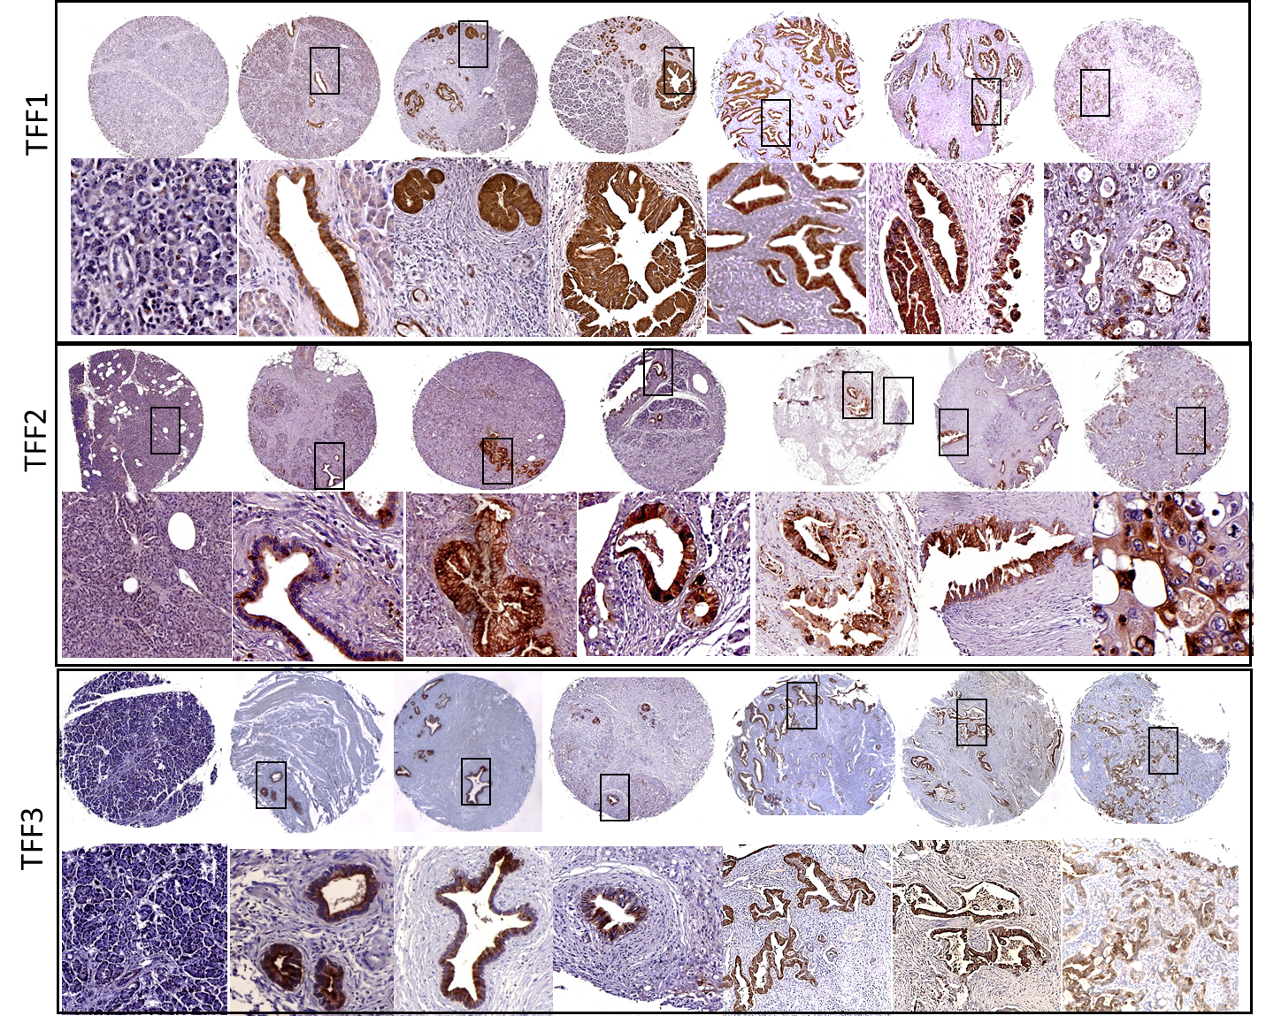
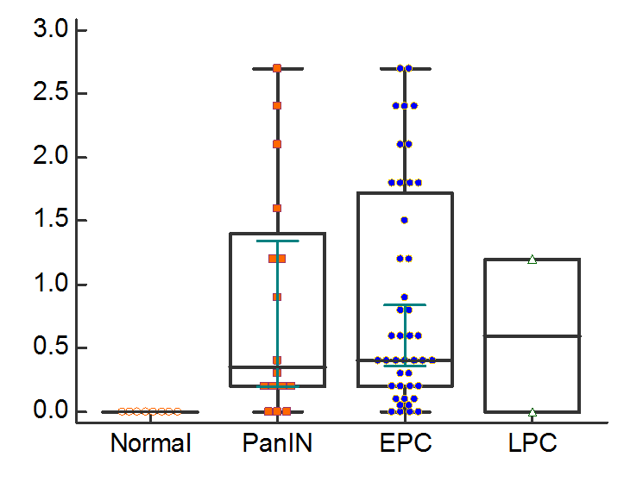
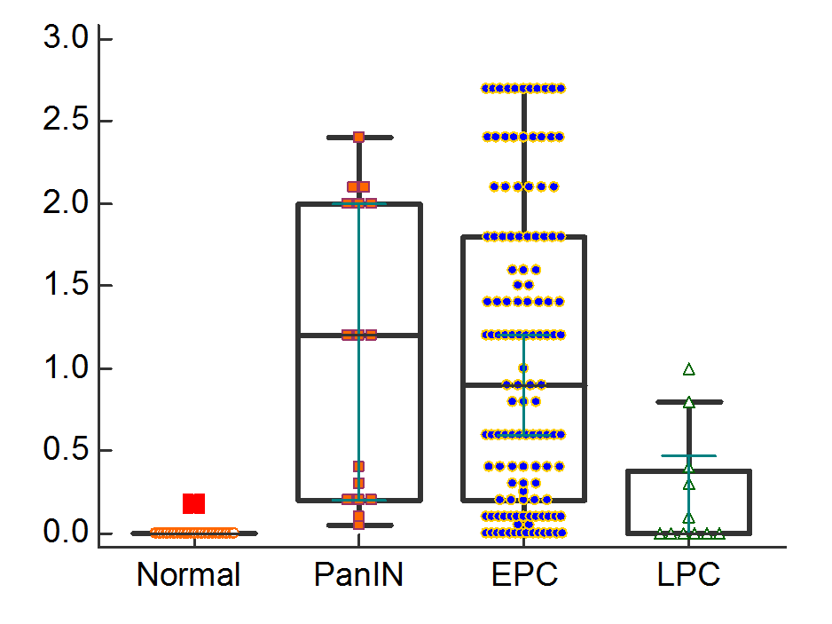
Expression analysis of TFF1-3 in normal, PanIN and PC tissues
PanIN 2
PanIN 3
MD
PD
Normal
PanIN 1
WD
P<0.001
Composite Score
P<0.001
Composite Score
All TFF showed significantly high expression in PanIN and EPC

Slide 34
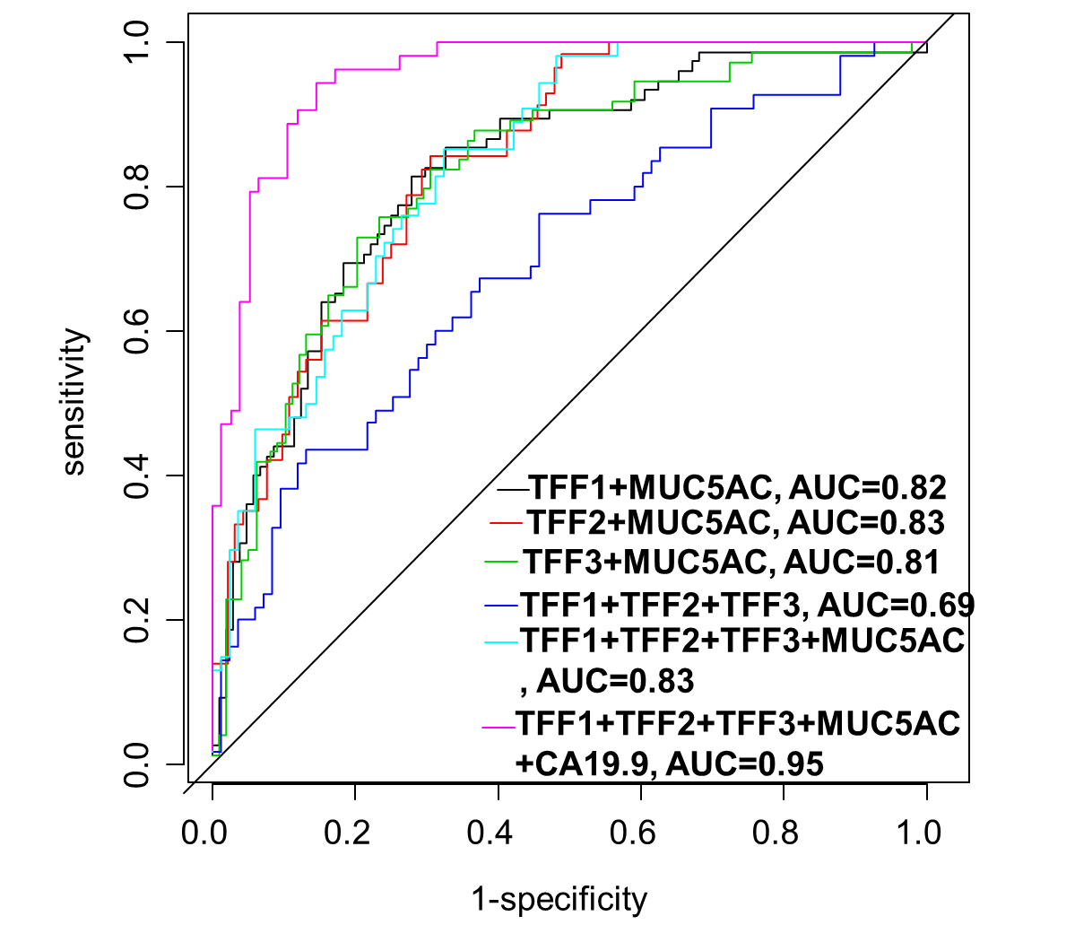
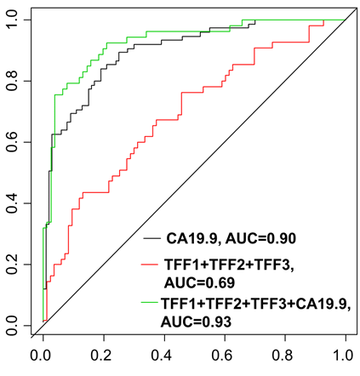
Diagnostic Performance of combination of TFFs, MUC5AC and CA19.9
EPC vs BC
Combination of TFFs, MUC5AC and CA19-9 can better predict EPC compared to other groups

Slide 35
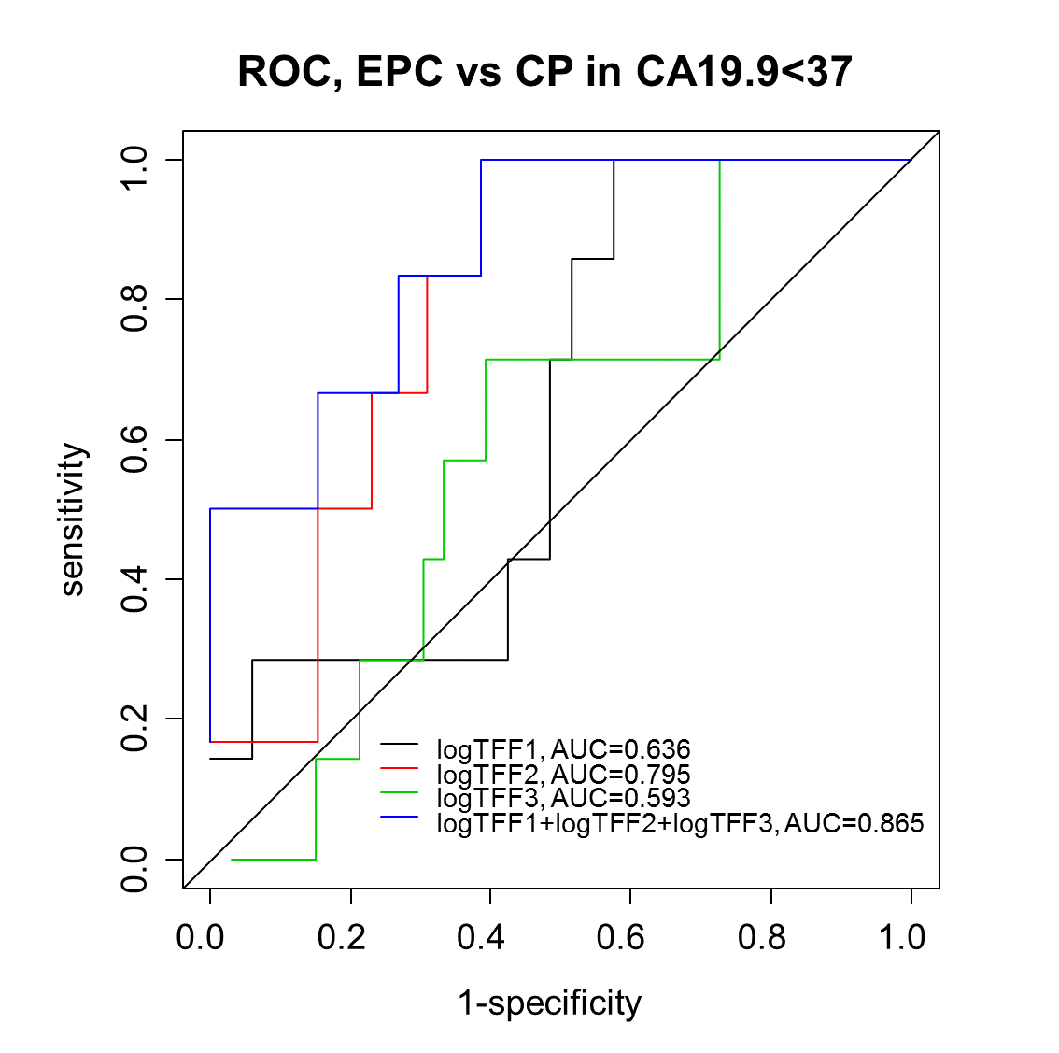
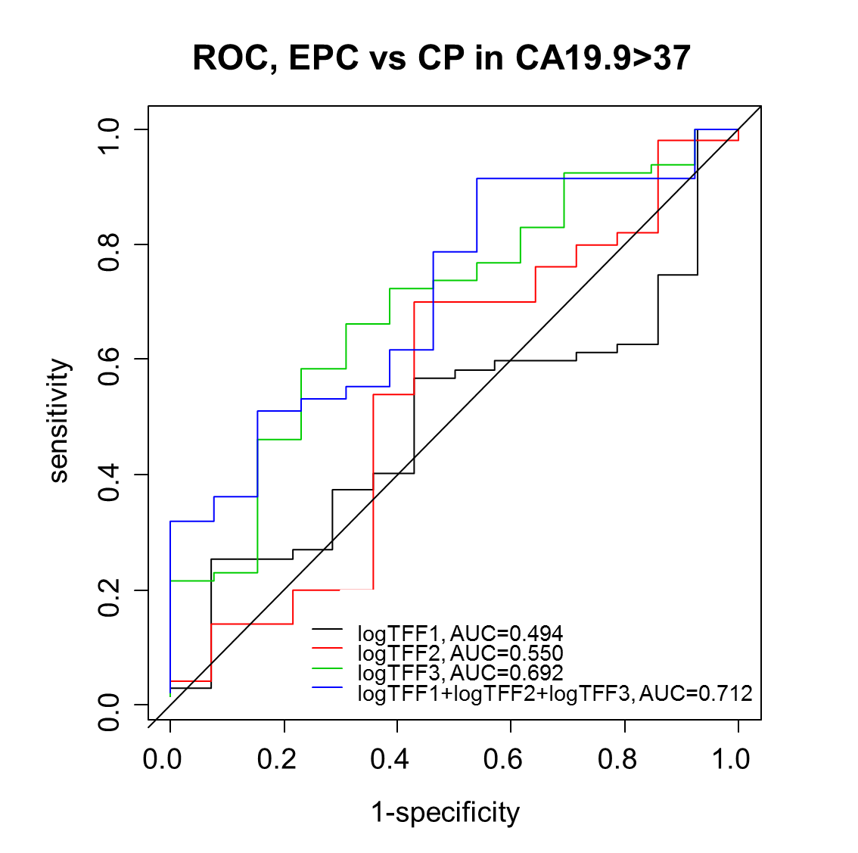
Diagnostic Performance of combination of TFFs in low and high CA19.9
*TFF1-3 can better predict EPC compared to CP in low CA19.9 group

Slide 36
MUC4 EXPRESSION AND IPMN RISK STRATIFICATION

Slide 37
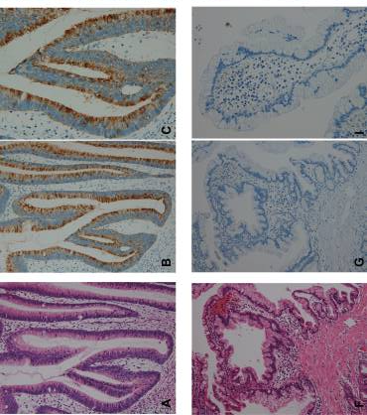
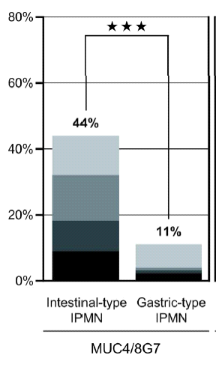
MUC4 EXPRESSION IN IPMNs
Intestinal-type Gastric Type

Slide 38
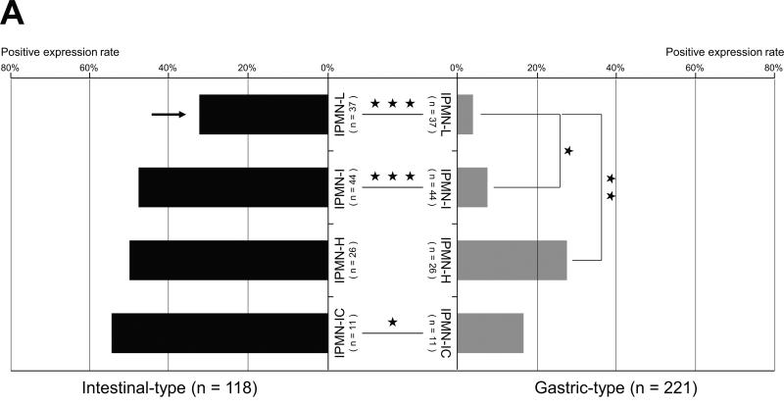
MUC4 EXPRESSION IN IPMNs
IPMN-L indicates low-grade dysplasia; I, intermediate-grade dysplasia; H, high-grade
dysplasia including carcinoma in situ; IC, invasive carcinoma. ***P G 0.001; **P G 0.01; *P G 0.05.
Kitatono…..Batra, Yonezawa et al Pancreas. 2013;42(7):1120-8.

Slide 39
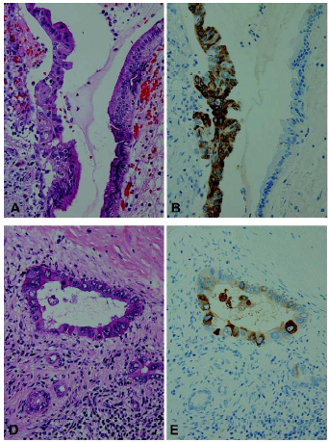
MUC4: A Specific-Marker for Malignancy in Early Lesions
Expression pattern of MUC4/8G7 in gastric-type IPMN-H- ONLY IN NEOPLASTIC CELLS EXHIBITING HIGH GRADE DYSPLASIA

Slide 40
Conclusions
The results presented here validate the potential of MUC4 as a PC biomarker and the capability of the SERS technology for the detection of MUC4 in PC patients.
Overall, the diagnostic performance of MUC4, MUC5AC was superior to CA19-9 in distinguishing PC patients from healthy individuals or patients with chronic pancreatitis.
The combination of markers could provide much needed diagnostic marker set for PC
MUC4 distinguishes high-risk cystic lesions in pre-surgical EUS FNAs

Slide 41
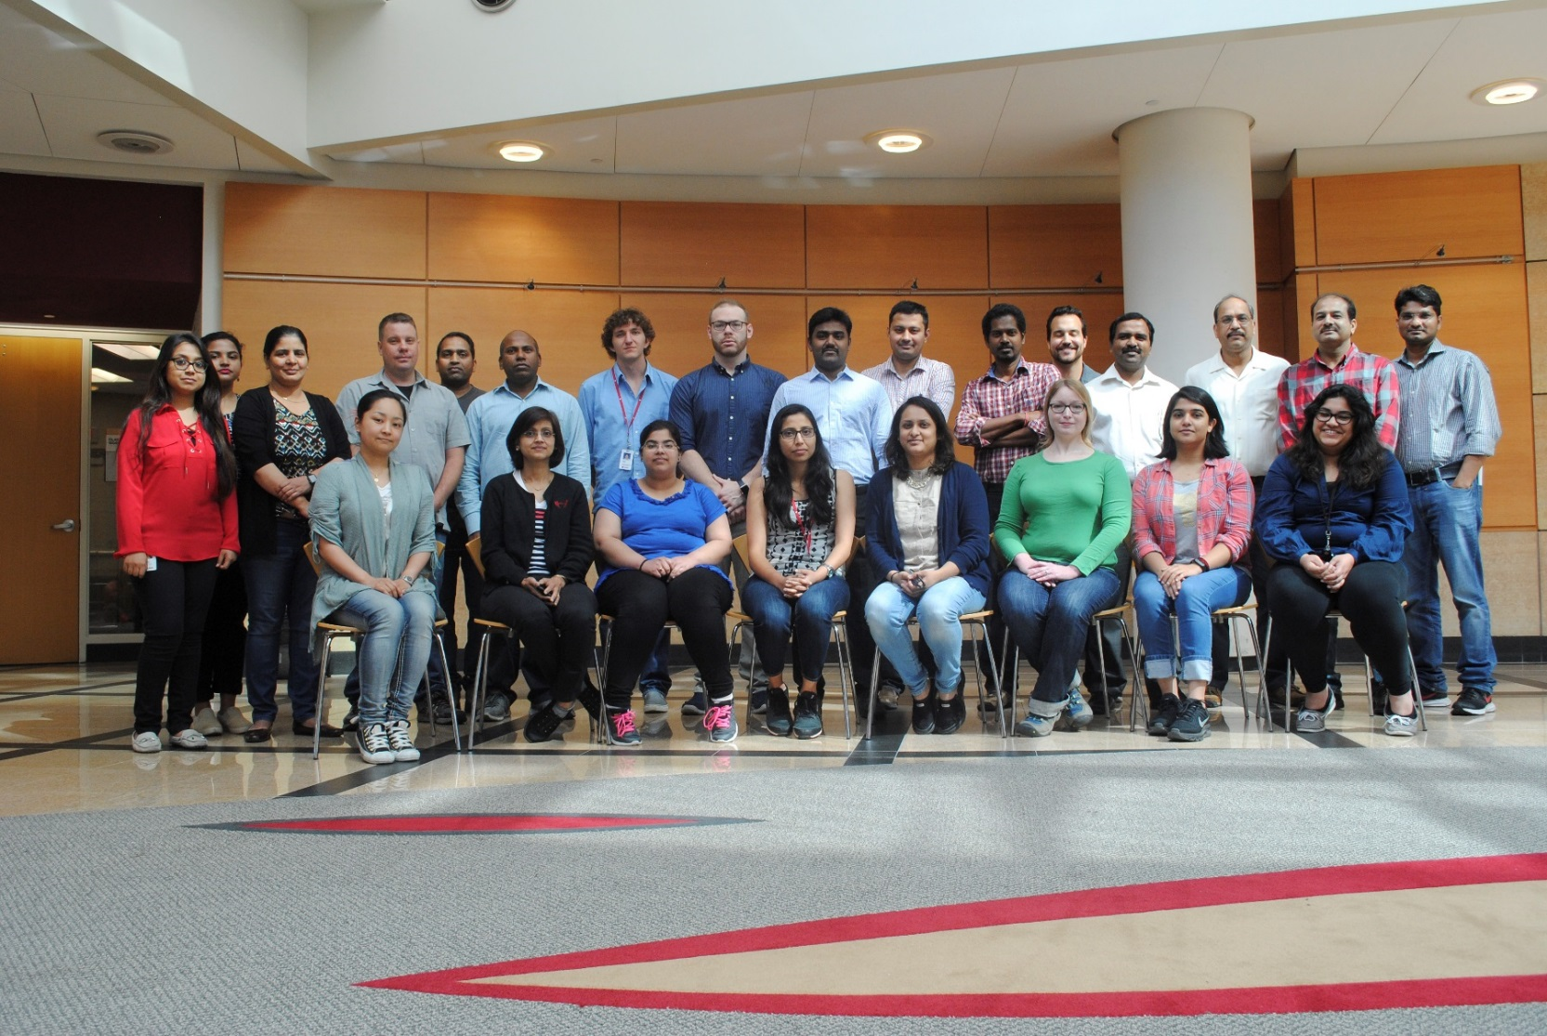
UNMC CVC Program

Slide 42

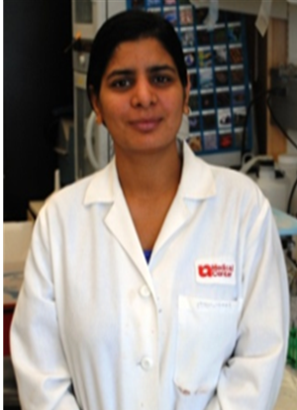

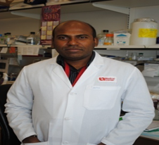










Maneesh Jain, Ph.D.
Sukhwinder Kaur Ph.D.
Tony Hollingsworth, Ph.D.
Satya Rachagani Ph.D.
Sushil Kumar Ph.D.
Shialender Singh, M.D.
Subodh Lele, MD.
Chandra Are, M.D.
Aaron Sasson, M.D.
Alexey Krasnoslobodtsev, Ph.D
Jane Meza, Ph.D.
Lynette Smith, Ph.D.
Simon Sherman, Ph.D.
Yuri Lyubchenko, Ph.D.

Slide 43

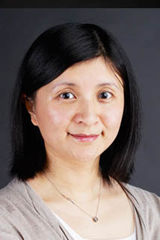


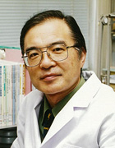
Collaborations outside UNMC
Ying Huang, Ph.D
Fred Hutchinson Cancer Research Center
Randall E. Brand, MD
University of Pittsburg
Uwe Wittel, MD
Germany
Sushovan Guha, MD, PhD
MD Anderson Cancer Center
Suguru Yonezawa, M.D.
Kagoshima University
Japan
Lewis R. Roberts, M.B.B.S
Mayo Clinic

Slide 44

UPMC Pancreas Clinical Program

Slide 45
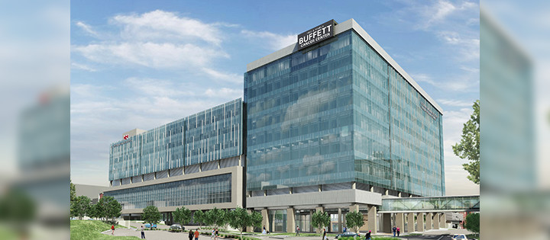

Thanks!

