Slide 1

EDRN Pancreatic Cancer Collaborative Group Update
Seattle WA
09/14/2017
Anirban Maitra
UT MD Anderson Cancer Center

Slide 2

A Assess the science
C Critique progress
T Timeline for project
I Implementation of the project
O Outcome expected
N New or continuing

Slide 3
A = Assess the science
Risk Marker
(Clinical or biochemical)
BIOMARKER
Early Detection Marker
EDRN GOAL
CA19-9 + Most Biomarkers
Risk
Asymptomatic PDAC
Early stage PDAC
(symptomatic)
Late stage PDAC (85%)
High risk families
Cancer syndromes
Pancreatic cysts
“Sporadic” Risk
New onset diabetes

Slide 4

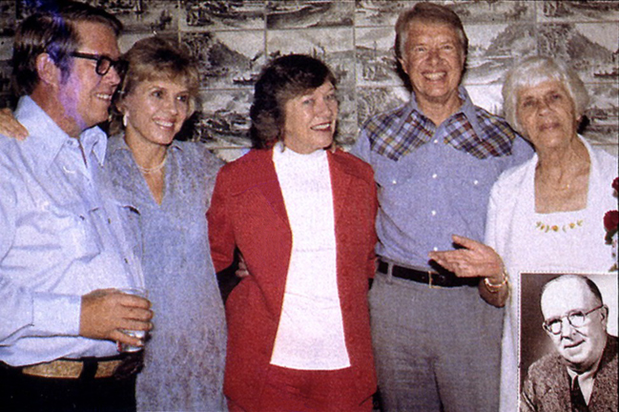
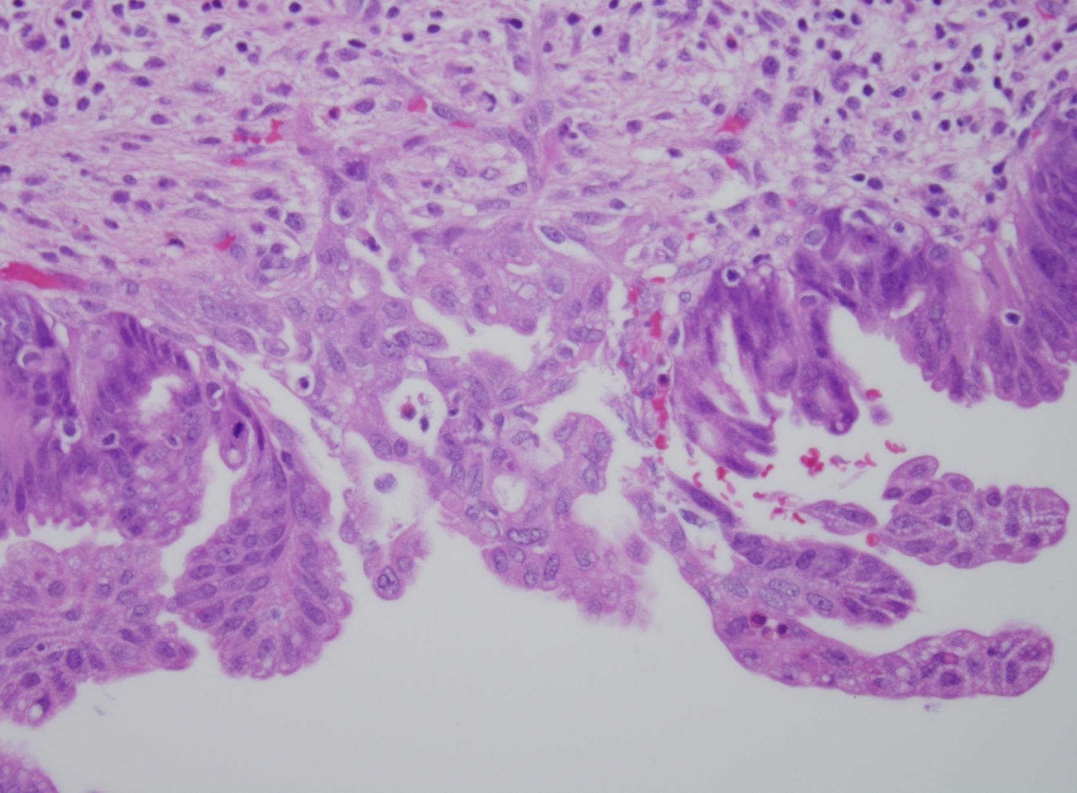
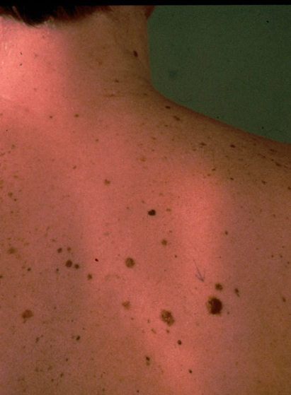
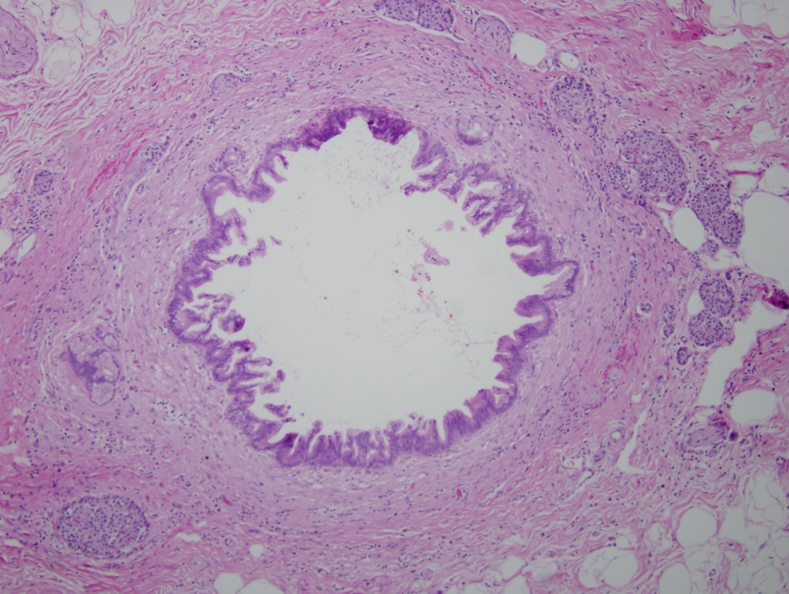
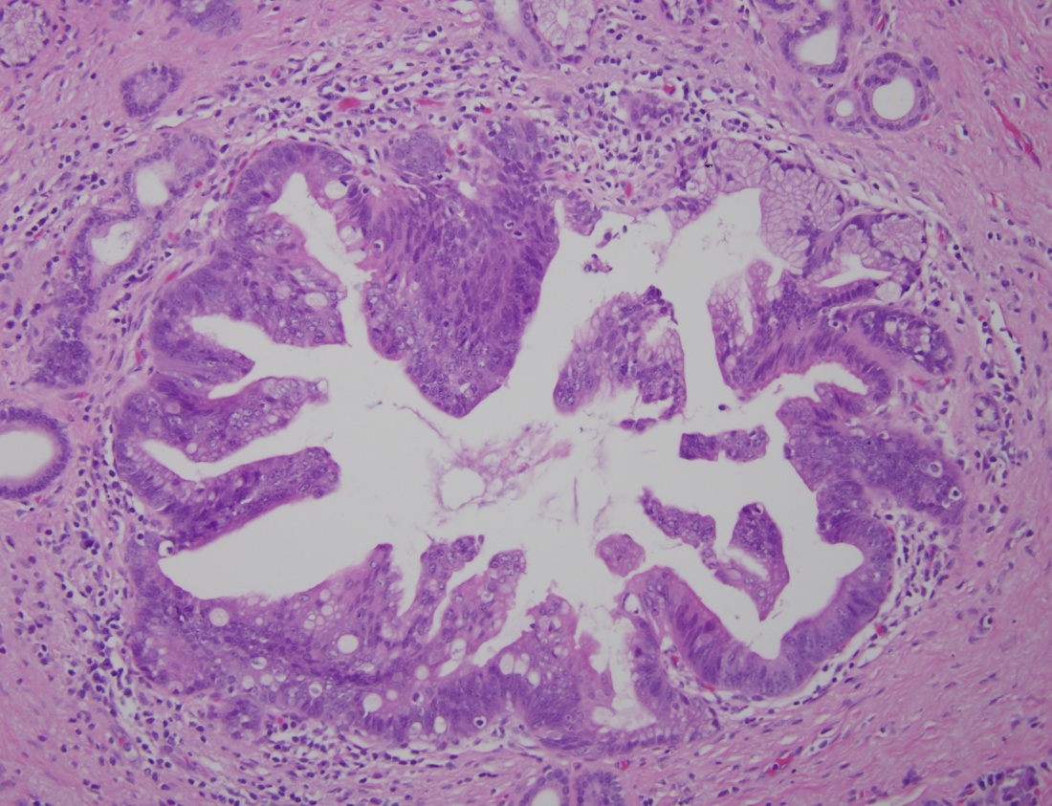
BRCA2 germline mutations
~5% of pancreatic cancers
Most common known familial pancreatic cancer gene
Founder mutation in Ashkenazi Jewish population
“Familial Pancreatic Cancer”
5-10% - Positive
Family History
Familial Melanoma

Slide 5
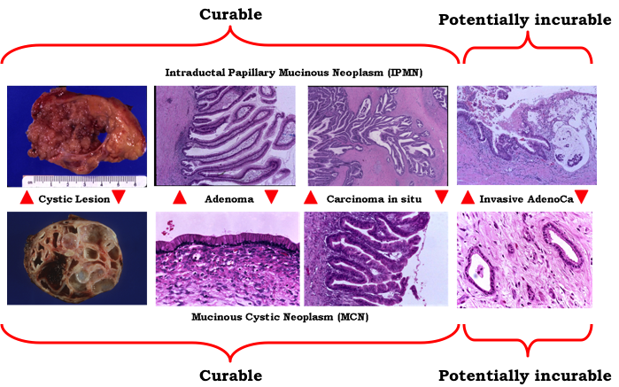
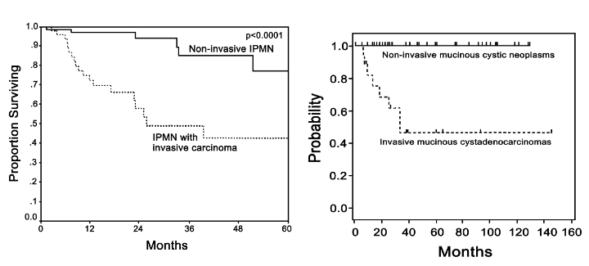
Natural history of cystic neoplasia in the pancreas
Caveat: Vast majority (>90%) of mucinous cysts are not going to progress to pancreatic cancer
Challenge:
Identify the minority with aggressive biology using biomarkers that will predict which patients need surgery

Slide 6
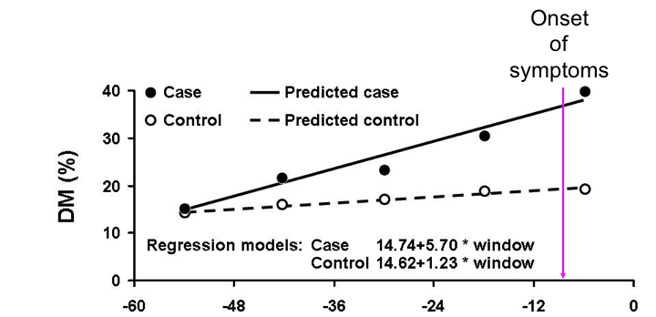
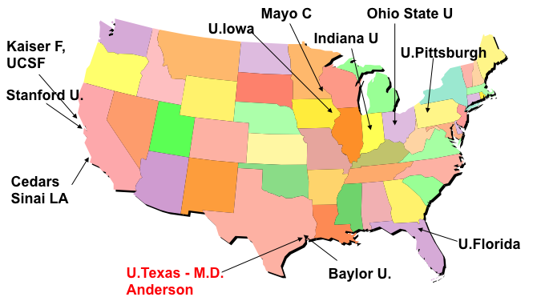
New Onset Diabetes (NOD) as a Biomarker of Asymptoamtic Pancreatic Cancer
Consortium for the Study of Chronic Pancreatitis, Diabetes and Pancreatic Cancer (CPDPC)
NIDDK/NCI Consortium
Up to ~50% of pancreatic cancer patients may have new-onset diabetes (NOD) as their first symptom
Can pre-date cancer diagnosis by 2 years
~1% of NOD have occult PDAC
Chari et al, Mayo
10,000 NOD patients recruited prospectively
~100 will develop PDAC over follow up with pre-diagnostic blood samples

Slide 7
It’s a good time to be a pancreatic cancer researcher!
EDRN
1st time has two Clinical Validation Centers (CVCs) in PDAC
UPMC and MD Anderson Cancer Center
Biomarkers of Preclinical Pancreatic Cancer (BPPC) (“Cyst Bakeoff”)
Molecular Characterization Laboratory (MCL) (“Overdiagnosis consortium”)
Pancreatic cancer MCL (MD Anderson Cancer Center + partners)
Consortium for Chronic Pancreatitis, Diabetes and Pancreatic Cancer (CPDPC)
10 consortium sites, MD Anderson Coordinating Center
“NOD” Cohort (JoAnn Rinaudo)

Slide 8
….but that’s not all
Pancreatic Cancer Detection Consortium (PCDC)
Goel / Von Hoff (Baylor/Translational Genomics Research Institute)
Goggins (Johns Hopkins)
Hollingsworth (U Nebraska Medical Center)
Petersen/Zaret (Mayo Clinic/U Penn)
Sutcliffe (UC Davis)
Willmann/Park (Stanford)
Wolpin (Dana Farber)
RFA is still open!

Slide 9

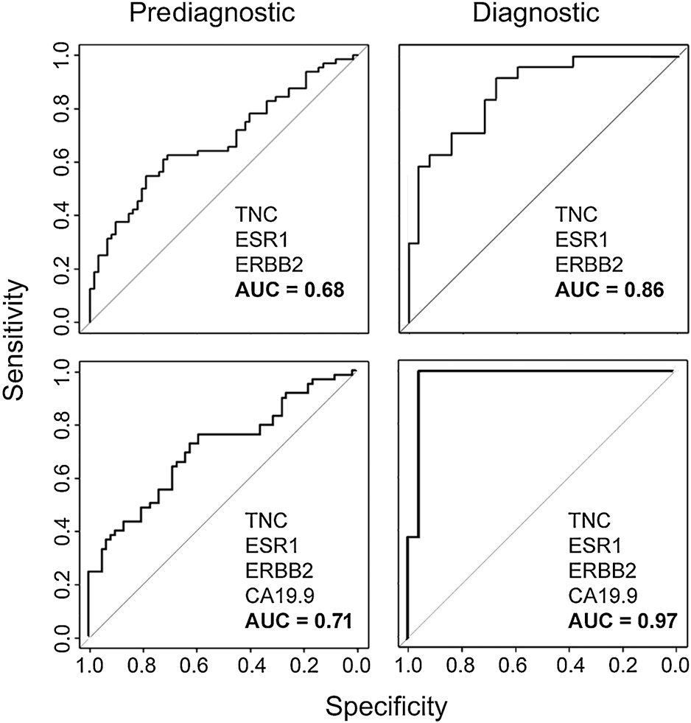
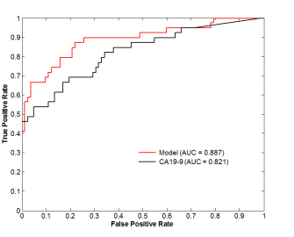
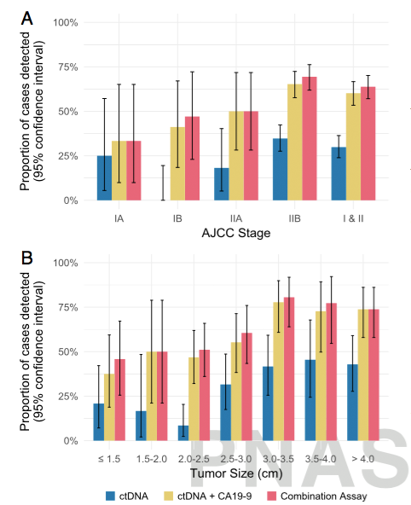
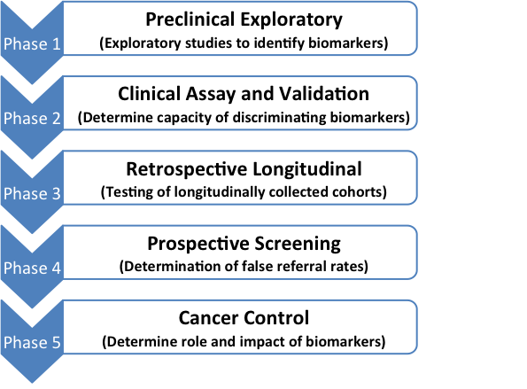
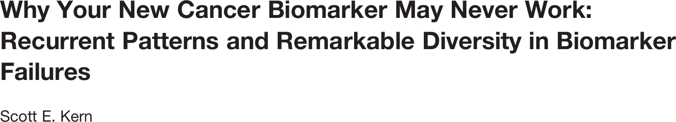
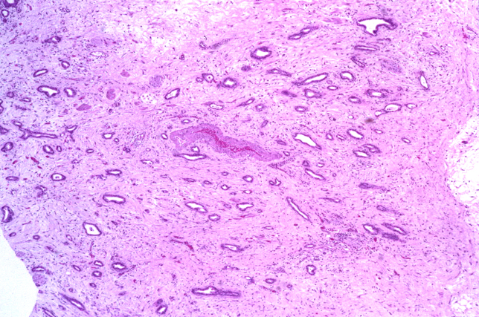
Why Do We Need a Biomarker Bake Off?
Pepe,Feng et al 2001

Slide 10
EDRN Pancreas Collaborative Group Bakeoff
“Biomarkers of Resectable Pancreatic Cancer” (BRPC)
Directed by JoAnn Rinaudo (NCI)
Blinded cases and control samples (N = ~180)
Two CVC sites (UPMC and MDACC, with assist from Mayo Clinic)
Centralized study design and statistical analysis at DMCC (Ying Huang)
Participating laboratories:
Brian Haab VARI
Surinder Batra UNMC
Sam Hanash MDACC
Anna Lokshin UPMC
Goal: A curated biomarker panel that can make the case for access to pre-diagnostic samples such as NOD cohort.

Slide 11
EDRN Pancreatic Cyst Bakeoff
“Biomarkers of Preclinical Pancreatic Cancer” (BPPC)
Led by Aatur Singhi and Randy Brand (UPMC)
Blinded cases and control samples
Intent 1: Distinguish IPMN from other cysts (N= 276)
Intent 2: Distinguish high grade from low grade dysplasia (N = 209)
Centralized study design and statistical analysis at DMCC (Ying Huang)
Participating laboratories:
Aatur Singhi UPMC Genomic markers
Brian Haab VARI Mucins (MUC5AC, endorepellin)
Walter Park Stanford Amphiregulin
Charles Craik UCSF Gastricsin/Cathepsin
Michael Goggins JHU Methylation markers, telomerase
Koushik Das WUSTL Das-1
Goal: A curated biomarker panel that can be tested in prospective cyst cohorts (CVC and MCL)

Slide 12
C = Critique Progress
BRPC
Samples have been distributed to participating sites
Many thanks to DMCC team for blinding!
BPPC
Cyst fluid samples are being sent to UPMC for blinding and distribution

Slide 13
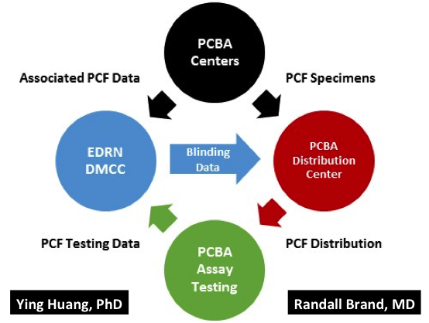
T = Timeline for project
BRPC
Samples will be analyzed by January 31, 2018
Ying to complete statistical analysis in time for March 2018 meeting
Phase 2 will include access to EDRN Reference set (including new prospective samples being collected by CVC and PCDC sites)
BPPC
Two year timeline

Slide 14
I = Implementation of project
DMCC Blinding has been crucial
Implementation being monitored closely by JoAnn Rinaudo (BRPC) and Matt Young (BPPPC)
Currently on course for stated timelines

Slide 15
O = Outcome(s) expected
BRPC = access to new “reference set” samples being collected by CVCs and PCDCs, as well as support for access to pre-diagnostic PLCO, WHI, EPIC samples.
BPPC = access to longitudinal cyst fluid samples collected by CVCs and PCDCs

Slide 16
N = New or continuing
New EDRN reference set being built by the CVC and PCDC sites
Samples will be tied to imaging data (assistance from JPL)
Potentially pathology data as well for resected cases
Eventual goal: Integrate multi-omics tissue based parameters with biomarkers and imaging
Thank You! See you in DC

