Slide 1



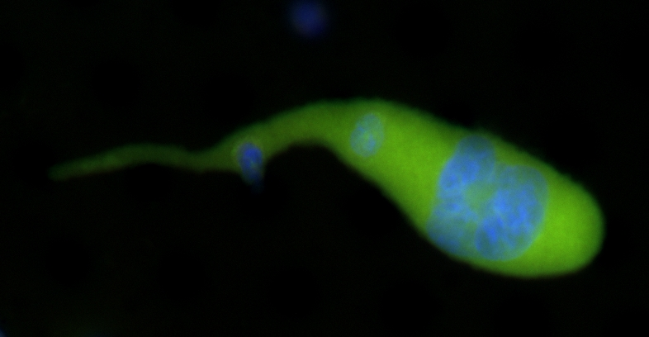
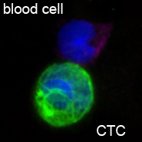
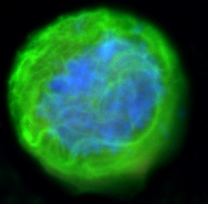
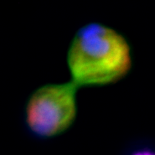
Tumor-Derived Macrophages
A Unique Blood Based Biomarker
for Cancer Screening and Diagnosis
September 13, 2017
Merged
Cancer associated macrophage-like cell
(CAMLs)
CTCs
25 µm

Slide 2
Outline
Biomarker
Biomarker isolation method
Assay techniques
Duke pilot study for breast cancer
EDRN collaborative study
Other cancer screening and diagnostic capabilities
Notes:
We were the first group to commercialize array patterned microfilters
2

Slide 3
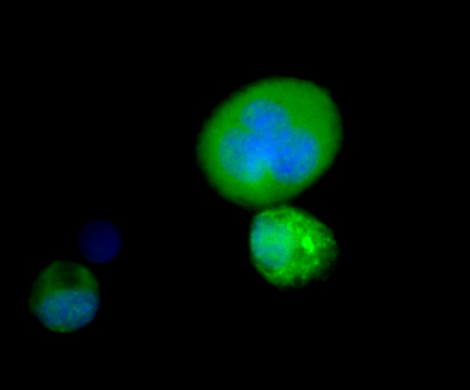
Are these Giant Polyploids CTCs? When we were looking for circulating tumor cells
Cytokeratin – marker for epithelial cells
CD45 – marker for white blood cells
DAPI – Nucleus
30 µm
Notes:
While attempted to better isolate circulating tumor cells we found one subtype had an unusual profile (diffuse cytokeratin and multinucleation)

Slide 4
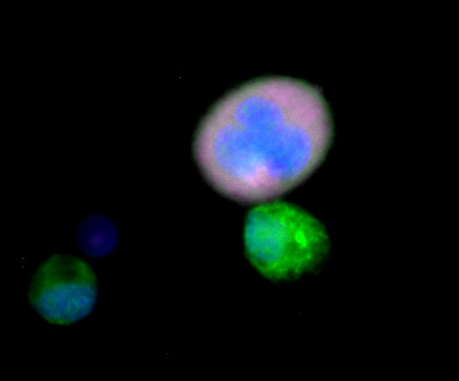
Biomarker Discovery Very large cell in cancer patients’ blood
Cytokeratin – marker for epithelial cells
CD45 – marker for white blood cells
DAPI – Nucleus
CD14 – myloid cell marker
???
WBC
CTC
CTC
30 µm
Notes:
Upon further assessment we found that these cells were multinucleated myeloid/CD45 positive

Slide 5
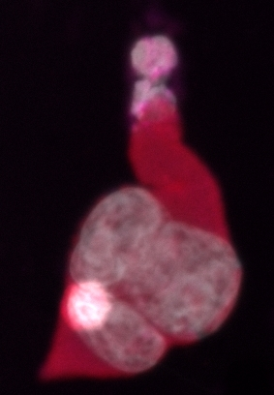
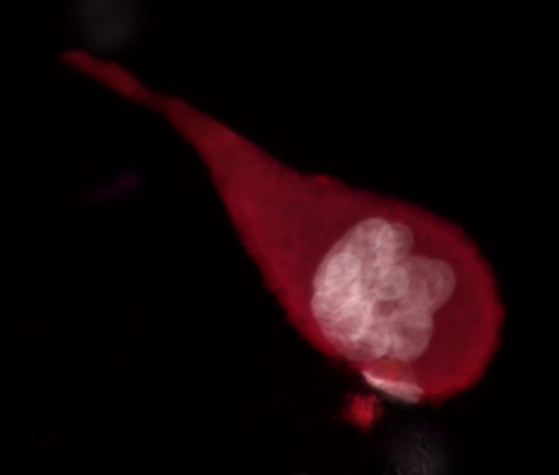
Source of Polyploids
Engulfed tumor cells and maybe other cells and debris
DAPI - white
DAPI - white

Slide 6
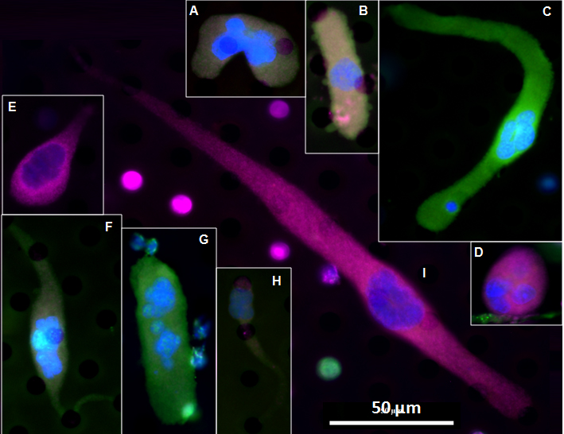
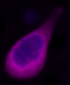
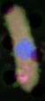
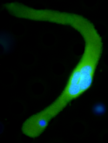
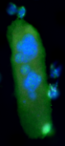
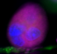
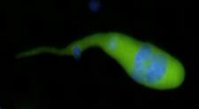
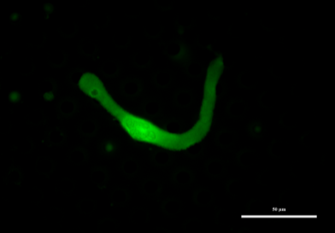
Circulating Cancer Associated Macrophage-like Cells (CAMLs)
Polyploid nucleus
May express CK and EpCAM
Most are CD45 positive
Large: 25 - 300 µm
Macrophage markers (CD11c/CD14)
Not true macrophage - express endothelial markers CD146, TIE-2
Average
diameter
platelet
RBC
WBC
CTC
50 um
Adams, et al. PNAS 2014
Notes:
We were the first group to commercialize array patterned microfilters
6

Slide 7
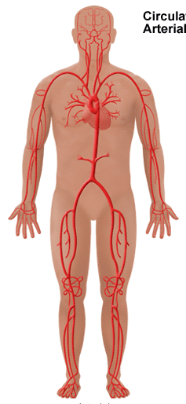
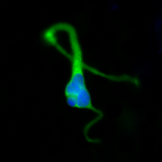
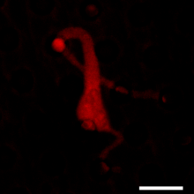
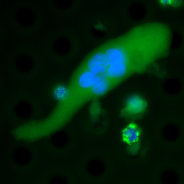
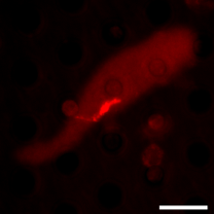
CAMLs Contain Ingested Tumor Markers
DAPI, CK PDX-1
Pancreas
CAML
DAPI, CK PSMA
Prostate
CAML
Adams et al. PNAS 2014
80 µm
7
Notes:
We can determine the protein makeup of the tumor cells they phagocytosed. But by staining for organ specific markers we can also possibly track back to original tumor site. But will stain positive for tumor markers.

Slide 8
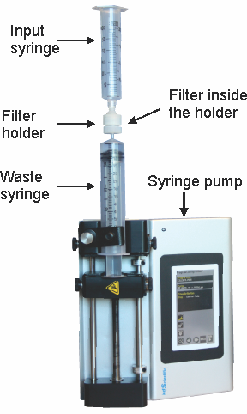
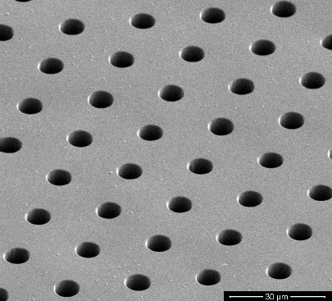
CellSieveTM Microfilters Collect large cells and clusters
Uniform 7 µm pore size and distribution with high porosity
– Rapid, consistent, gentle
– 3 min to filter 7.5 ml of blood
– Eliminates all red blood cells
– Eliminates ~99.99% of white blood cells
Low fluorescence background
Captures both CAMLs and CTCs
CellSave samples good up to 4 days
Notes:
We were the first group to commercialize array patterned microfilters
8

Slide 9
Assay Techniques
Markers + cell morphology → accurate cell identification
Can analyze up to 12 markers on the same cell
Cryo-preservation protocol
Bone marrow analysis protocol
Urine sample preservation reagent and protocol
FISH
PCR
Sequencing
Notes:
We were the first group to commercialize array patterned microfilters
9

Slide 10
Patient Samples
> 50 healthy controls
Zero CTCs, zero CAMLs
Close to 2000 patient samples
14 cancer types (peripheral blood)
Breast, Prostate, Pancreatic, NSCLC, renal cell carcinoma, bladder, sarcoma, colorectal, uterine sarcoma, neuroblastoma, esophageal, ovarian, melanoma, liver
localized, metastatic, remission, recurring
CAMLs have been found in all 14 cancer types
CTC range 0 to >900
CAML range 0 to 105

Slide 11
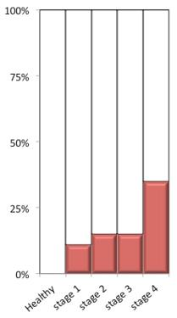
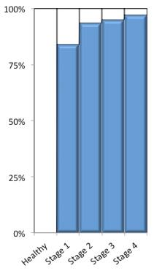
CAMLs and CTCs by Stage
11% 35%
Importance of CAMLs
Independent, affirmative marker for solid tumors at all stages
High percentage even in Stage I
Applicable for early detection of cancer
Suitable and effective for precision monitoring of therapy
Actionable information
84% 97%
Cancers | Total n=293
Breast (n=59) | Prostate (n=52)
Pancreatic (n=52) | NSCLC (n=59)
RCC (n=37) | Esophageal (n=27)
CTCs
CAMLs
Adams, et al., ASCO 2017

Slide 12
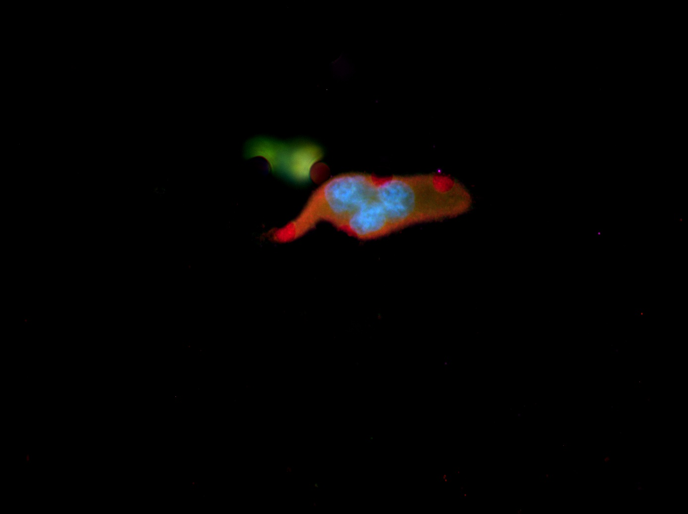
Breast Cancer Screening
Gold Standard Double Blind Study
41 mammography positive patients from Duke University
Median age 52
Double blinded study
CAML blood test versus
Tissue biopsy
Blood test criteria – 1 or more CAML
≥ 30 µm, CD14⁺
CAMLs differentiated benign vs malignant conditions
(Assuming biopsy is accurate)
Sensitivity (cancer) – 88%
Specificity (no cancer ) – 74%
40 um

Slide 13
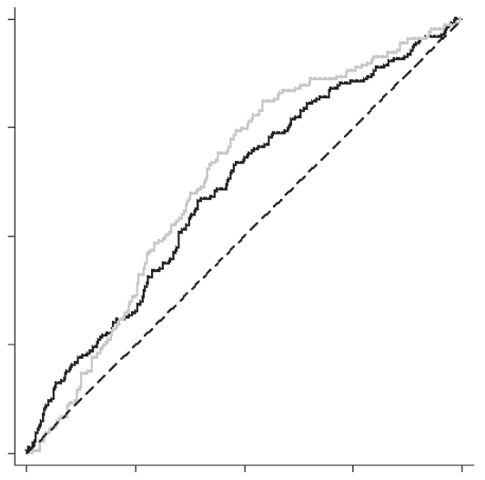
CAMLs for
Breast Cancer Screening
Biopsy Results
100%
AUC=0.96 (Invasive vs normal)*
n=17
n=19
AUC=0.78 Invasive vs benign
n=5
75%
# of CAMLs/sample
50%
True positive rate
Non-Invasive
AUC=0.60-0.63
Standard Mammography
Invasive vs normal
Invasive
Benign
25%
Follow-up
2 developed breast cancer
DCIS - 15 months later
Invasive - 27 months later
*Age matched
0
0
25%
50%
75%
100%
False positive rate
Adams, et al., CEBP 2016
Notes:
41 Mammography positive. Double blind 88%sensitivity and 74% specificity. Assuming biopsy is the gold standard.

Slide 14
EDRN Breast Cancer Collaborative Study
Study goal
1000 mammography BIRAD 4 patients
Predict breast cancer based on presence of CAMLs
Restain to identify CAML is from breast cancer
Study plan
Run 2 tubes of blood per patient separately
Stain for CK 8, 18 & 19, CD31, and CD45
Study Status as of 9/8/2017
Processed 110 patient samples
Developing markers set to identify CAMLs is from breast cancer
Positive markers : mammoglobin, HER2, ER
Negative marker: mamothelin (distinguish from ovarian cancer)
Notes:
We were the first group to commercialize array patterned microfilters
14

Slide 15
Other Cancer Screening Possibilities
Screening for individual cancers
Screening for group of cancers, such as
screen for the top 4 major cancers and identify the cancer of origin
Women: Breast, lung and colorectal cancer
Men: prostate, lung and colorectal cancer
Can determine the cancer of origin by restaining for markers in the cell
Notes:
We were the first group to commercialize array patterned microfilters
15

Slide 16
Other Applications of CAMLs
11% 35%
84% 97%
Companion diagnostics
Monitor treatment response
Monitor recurrence
Prognosis of survival
Cancers | Total n=293
Breast (n=59) | Prostate (n=52)
Pancreatic (n=52) | NSCLC (n=59)
RCC (n=37) | Esophageal (n=27)
CTCs
CAMLs
Adams, et al., ASCO 2017

Slide 17
CAMLs Prognostic of Survival
Multivariate analysis
Variable | OS (p value) | PFS (p value)
Stage | 0.866 | 0.751
# CTCs (<5 vs ≥5) | 0.995 | 0.136
# CAMLs (<6 vs ≥6) | 0.816 | 0.244
CAML Size (<50 µm vs ≥50 µm) | 0.015 | 0.000
Therapy chemo/targeted/none | 0.056 | 0.645
Metastatic pos vs neg | 0.678 | 0.165
Node neg, local, distant | 0.017 | 0.231
Tumor Size (T1, T2, T3 or T4) | 0.012 | 0.485
M/F | 0.036 | 0.796
Age | 0.088 | 0.066
Race (Cau/Bla/Asi/His) | 0.152 | 0.055
Oral Presentation at ASCO 2017

Slide 18
CAMLs Prognostic of Survival
Adams, et al., ASCO 2017

Slide 19
Summary
CAML biomarker
Found in all stages of cancer
In high percentages in Stage I for major cancers
CellSieveTM blood based cell biopsy
Can always isolate CAMLs
EDRN early detection of breast cancer
Collected and processed 110 patient samples for BIRAD 4
Will be combining CAMLs with imaging and immunosignaturing
Many other clinical applications
Possible for screening for other cancers
Prognostic for survival

Slide 20
Daniel Adams
Cha-Mei Tang
Peixuan Zhu
Shuhong Li
Pete Amstutz
Jeffrey Marks
John Heine

Slide 21
Acknowledgements
Thank the volunteers who contributed to these studies
Thank all the collaborators
Maryland TEDCO MTTCF award
The U.S. Army Research Office (ARO) and
the Defense Advanced Research Projects Agency (DARPA)
(W911NF-14-C-0098)
NIH NCI (U01 CA214183)
The content of the information does not necessarily reflect the position or the policy of the US Government.

