Slide 1

Ten Years of Mesothelioma Biomarkers: Controversy and Evolution
EDRN Seattle September 2017

Slide 2
Disclosures
Grants: NCI EDRN,TCGA, DOD, Technion, CDC
Philanthropy: Rosenwald Foundation, Stephen A. Banner Lung Cancer Foundation, Belluck and Fox, Levi, Phillips and Konigsberg, Simmons Foundation, Baron and Budd, multiple patients who shall remain anonymous
Royalties: NCI cell lines
Industry: Fujirebio, 20/20 Gene, MesoScale Diagnostics, Cynvezio, Source MDX, Celera, OPKO, SomaLogic, Genentech, Integrated Diagnostics, Transgenomics, Rosetta Genomics, Calithera, Pinpoint Genomics, Cizzle, emeraldLogic, HTG, Freenome,
Patents (no money): Osteopontin for diagnosis and prognosis of MPM; fibulin 3 for diagnosis and prognosis of MPM; mir-29c* for prognosis of MPM; mir-31 for diagnosis of MPM, HMGB1 for diagnosis of MPM

Slide 3
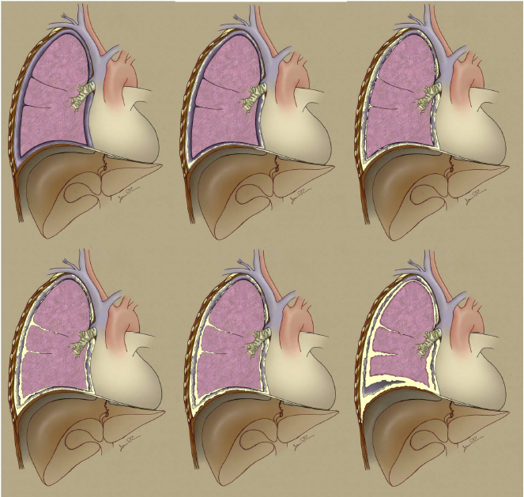
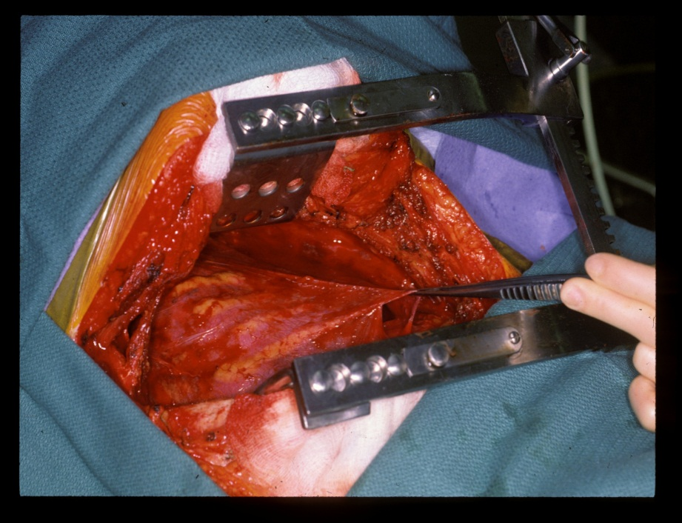
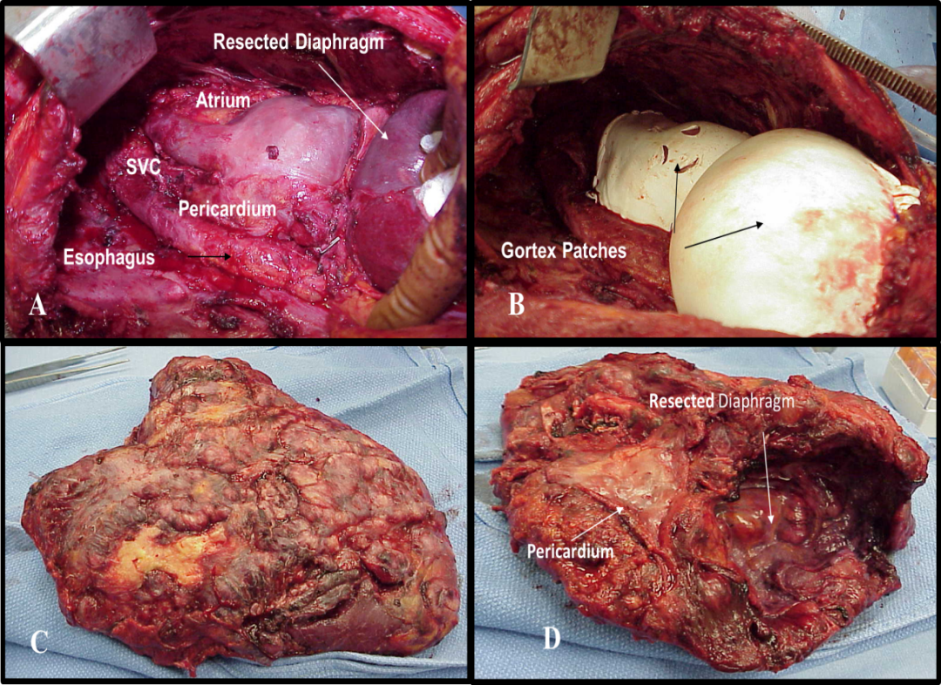
Stage I
T1- T1a
tumor limited to ipsilateral
pleura, no involvement
of visceral pleura
T1b
involvement of visceral pleura
What are the evolving thoughts regarding the approach to the potentially cytoreducible mesothelioma patient?
Stage II
EPP
T3
Locally advanced but
potentially resectable tumor
(i.e. pericardium)
Courtesy David Rice MD

Slide 4
58
18
12
6

Slide 5
“Fluid Based Screening” for Mesothelioma
How do patients present in the US?
91% have an exposure to asbestos
90% of pleural patients present with an effusion
77% of abdominal patients present with ascites
Effusions do NOT OCCUR OVERNIGHT
Screening is done in asymptomatic patients with a history of exposure to asbestos
Therefore, you are attempting to define plasma biomarker changes which could reflect the development of an asymptomatic effusion or some “perturbation of mesothelial physiology” over time.
A change in marker indices could lead to a CT of the chest/abdomen
But the markers must be specific for a given “disease/malignancy”

Slide 6
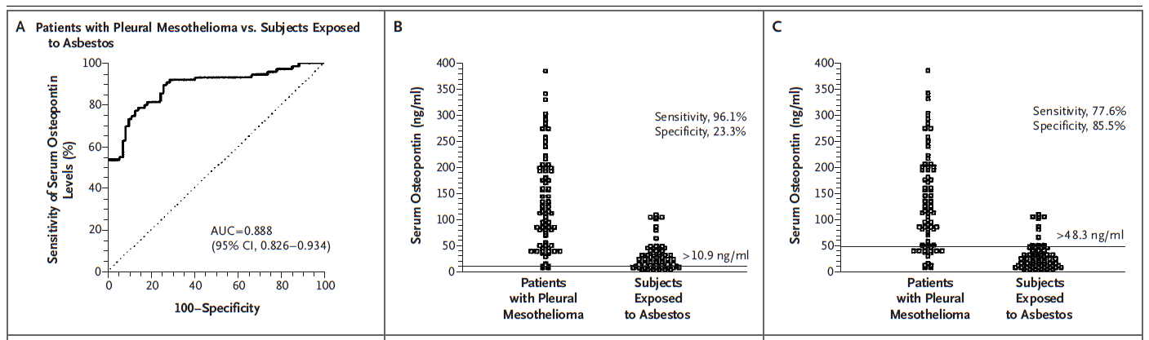
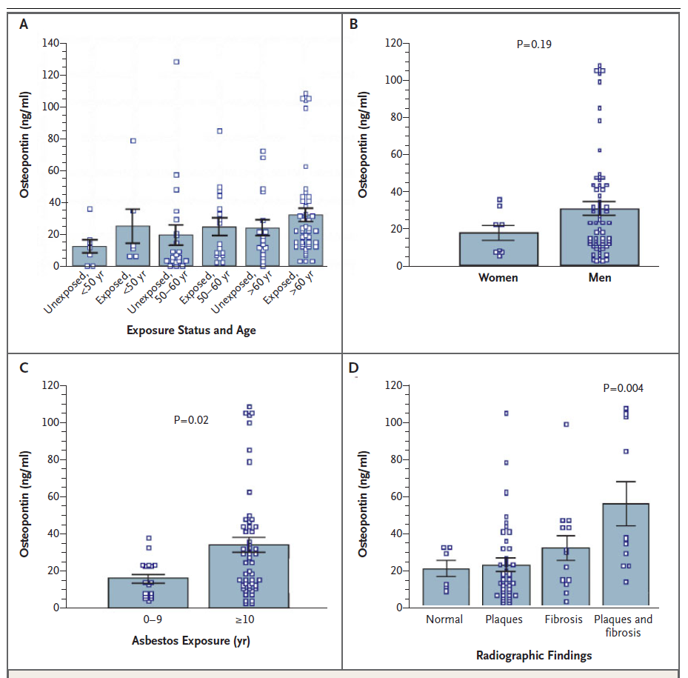
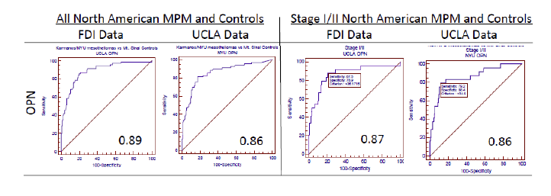
Not a good maker for diagnosis due to lack of specificity
N Engl J Med. 2005 Oct 13;353(15):1564-73.

Slide 7
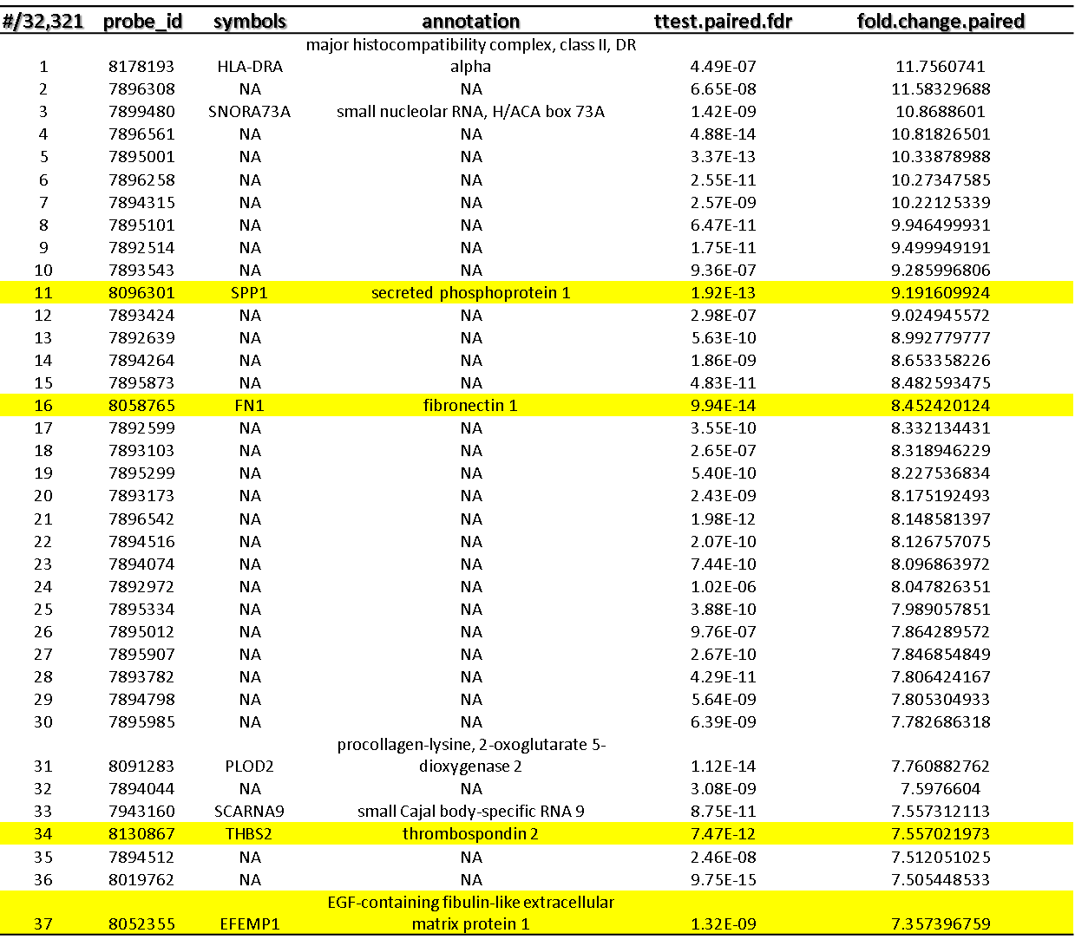
But what about diagnostic specificity???
Notes:
Of 32000 probe IDs, four potentially secreted markers were in the top 37 for fold change

Slide 8
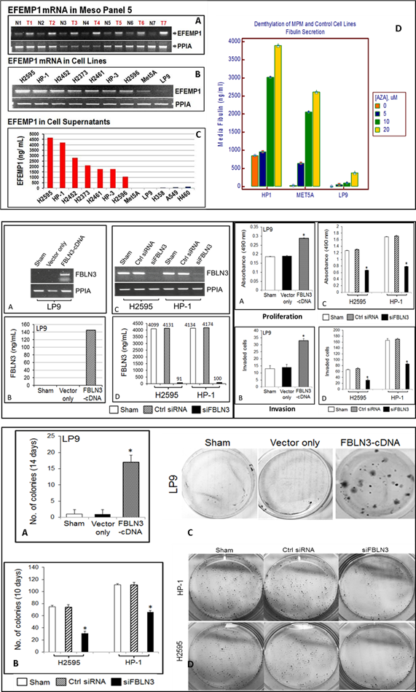
FBLN-3 has function in MPM

Slide 9
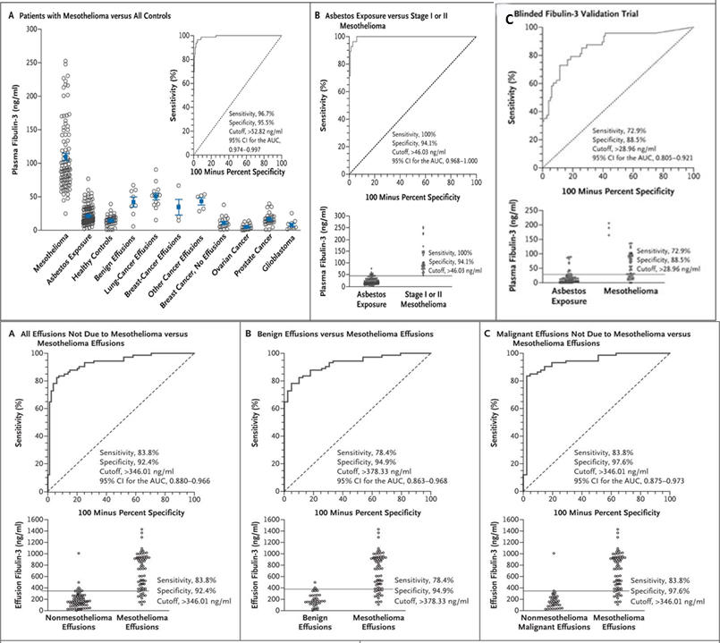
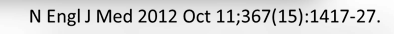
Notes:
The development of our MPM assay is illustrated in Figure 21. (A) SOMAmer with 5’ biotin and a photo-cleavable linker between the SOMAmer and the 5’ biotin are pre-bound to streptavidin coated beads (either magnetic or agarose beads can be used) and beads are added to samples in microwells (B-H) Schematic sequence of assay steps leading to quantitative readout of target proteins. (B) Proteins, shown as different shapes, and beads with SOMAmers are mixed in solution (C) SOMAmers attached to magnetic beads bind to proteins specifically (gold and green) and some non-specifically (blue). Unbound proteins are washed away (Catch 1) (D) Tagging: Proteins bound to SOMAmers are tagged with NHS-biotin. (E) Photocleavage and kinetic challenge: UV light (hy) cleaves the linker (L) between the SOMAmer and the 5’ biotin, releasing SOMAmers into solution. Taking advantage of a SOMAmer’s slow-off rate from its target protein, further specificity of a SOMAmer to its protein target is derived from a kinetic challenge, by adding excess anionic competitor (“random” SOMAmers) to the SOMAmer-protein complex in solution; cognate complexes (gold and green) dissociate slowly, but non-cognate complexes (blue SOMAmer) dissociate rapidly and competitor prevents re-binding. (F) Catch 2: The SOMAmer-protein complexes that remain after the kinetic challenge are captured onto new streptavidin (SA) coated magnetic beads by the biotin tag on the protein from the NHS-biotin labeling of the protein (D) and unbound SOMAmers are washed away. (G) Elution: SOMAmers are eluted into solution by disrupting complexes (e.g. proteins denatured with sodium perchlorate) (H) Readout: Eluted SOMAmers are hybridized to complimentary probe sequences on coded Luminex beads and quantified by flow cytometry on Luminex.

Slide 10
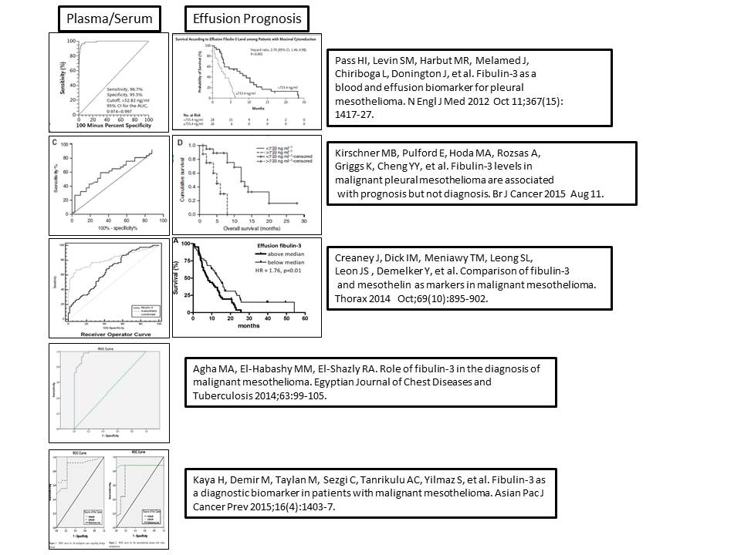

Slide 11
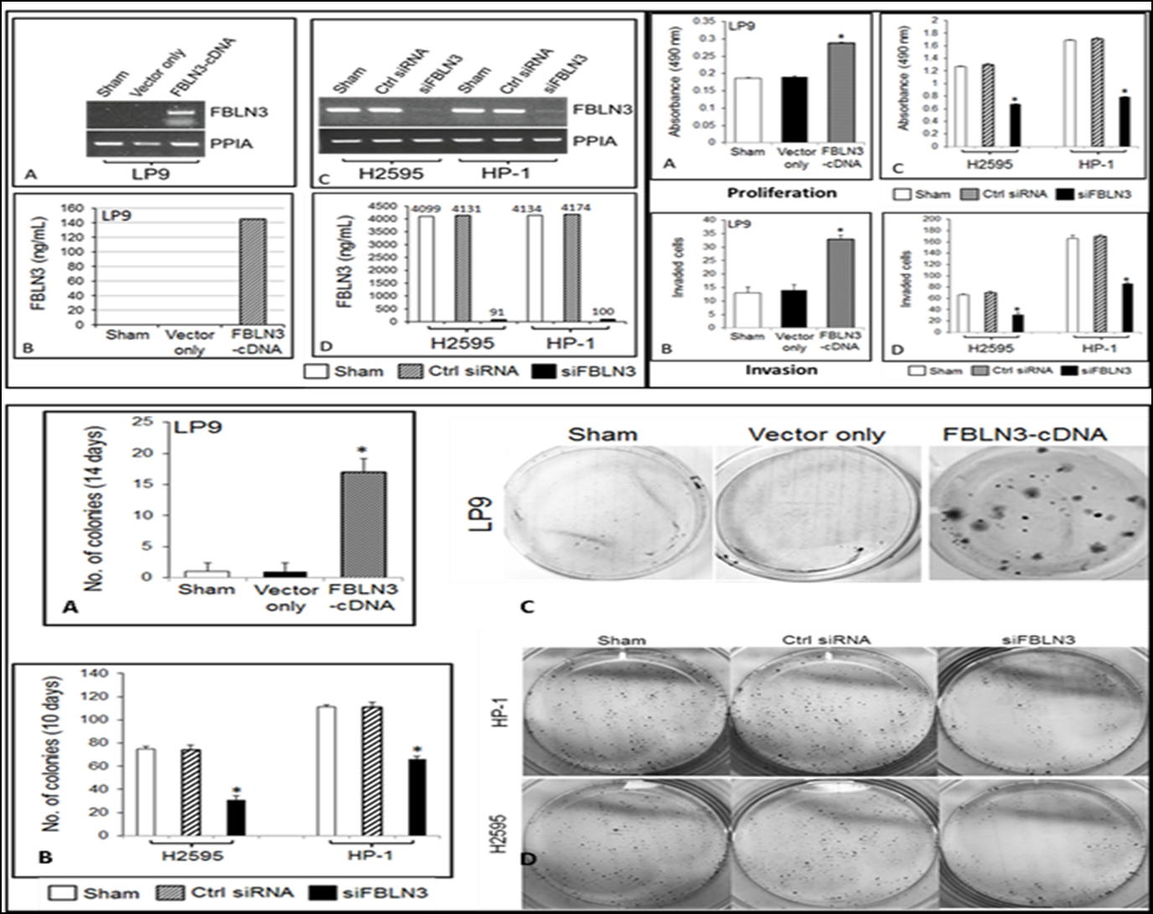
asRNA EFEMP1 HP1 |  |  |  |  |  | asRNA EFEMP1 H2595
p-value | regulation | FCAbsolute | genesymbol | genedescription |  | p-value | regulation | FCAbsolute | genesymbol | genedescription
9.06E-05 | down | 5.1 | POSTN | periostin,osteoblastspecificfactor |  | 5.18E-06 | down | 4.8 | POSTN | periostin,osteoblastspecificfactor
2.20E-05 | down | 4.0 | SYT14 | synaptotagminXIV |  | 2.90E-05 | down | 4.5 | SYT14 | synaptotagminXIV
3.61E-08 | down | 4.0 | EFEMP1 | Fibulin-3 |  | 2.83E-06 | down | 4.0 | EFEMP1 | Fibulin-3
6.80E-05 | down | 3.2 | MUC15 | mucin15,cellsurfaceassociated |  | 1.18E-04 | down | 3.3 | IL33 | interleukin33
3.66E-05 | down | 3.2 | IL33 | interleukin33 |  | 1.14E-04 | down | 3.2 | MMP24 | matrixmetallopeptidase24(membrane-inserted)
2.53E-05 | down | 3.0 | RDH10 | retinoldehydrogenase10(all-trans) |  | 8.51E-05 | down | 3.0 | SULT1E1 | sulfotransferasefamily1E,estrogen-preferring,member1
2.01E-04 | down | 2.9 | DNAJC15 | DnaJ(Hsp40)homolog,subfamilyC,member15 |  | 3.56E-05 | down | 2.9 | RDH10 | retinoldehydrogenase10(all-trans)
5.99E-05 | down | 2.8 | LUM | lumican |  | 3.64E-04 | down | 2.9 | DNAJC15 | DnaJ(Hsp40)homolog,subfamilyC,member15
1.25E-05 | down | 2.8 | TLL1 | tolloid-like1 |  | 4.53E-05 | down | 2.8 | MUC15 | mucin15,cellsurfaceassociated
2.75E-05 | down | 2.8 | ANKRD10|ANKRD10-IT1 | ankyrinrepeatdomain10 |  | 2.91E-05 | down | 2.8 | LUM | lumican
Intriguing…..POSTN seems to be in the same pathway as EFEMP1…is it another biomarker?????
MPM: 37
AE: 19
MPM: 85
Non MPM Effusion: 31
AE: 89
MPM: 47
Non MPM Effusion: 31
AE: 19
MPM: 38
AE: 70

Slide 12
So what else is new????
Hypothesis:
Buffy Coat/PBMC RNA Immune RNA expression profiles
differ between asbestos exposed, unexposed, and
mesothelioma populations

Slide 13
Nanostring Immune-Oncology Panel
770 gene panel
gene expression of human immune response in all cancer types
24 different immune cell types and populations
109 genes to cell surface markers for 24 different immune cell types and populations,
30 common cancer antigens
Genes that represent all categories of immune response including key checkpoint blockade genes.

Slide 14
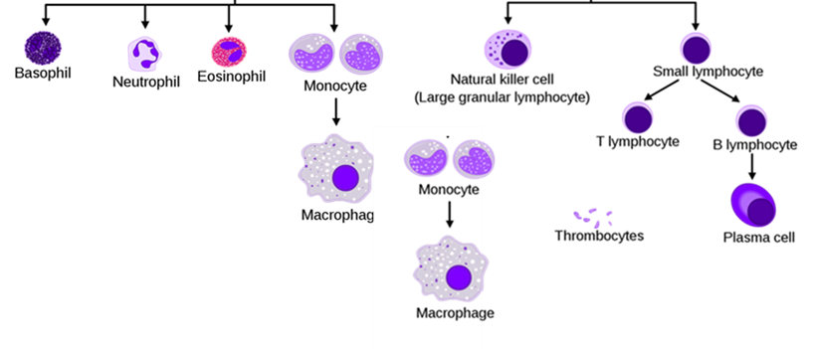
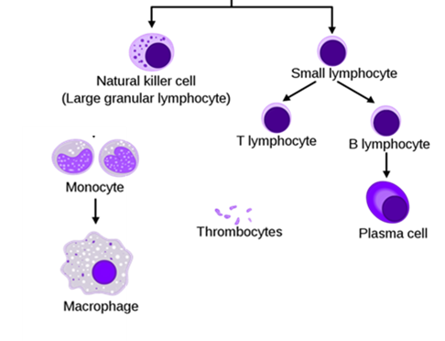
Possibilities and different microenvironments
Plasma
EDTA
Non Cellular
Protein
cfDNA, microRNAs, exosomes and microvescicles
Cellular
Buffy coat
Granulocytes, platelets, granulocytes, monocytes
Citrated
Non Cellular
Protein
cfDNA, microRNAs, exosomes and microvescicles
PBMC
Platelets, monocytes, lymphocytes
Serum
Non Cellular
Protein
cfDNA, microRNAs, exosomes and microvescicles

Slide 15
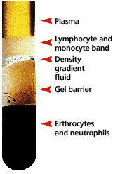
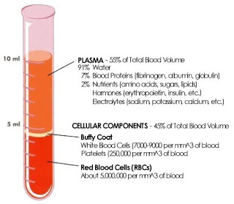
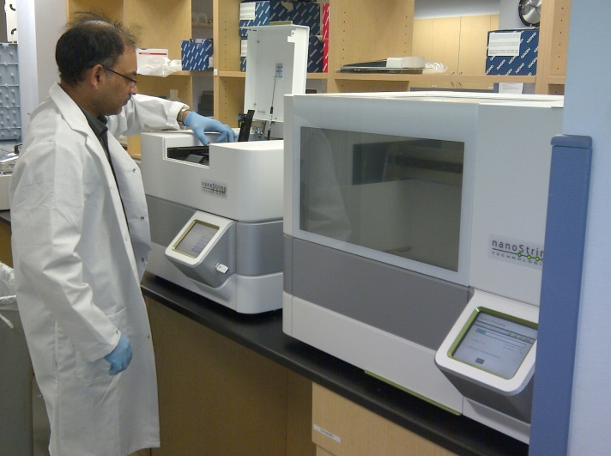
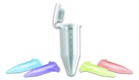
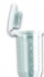

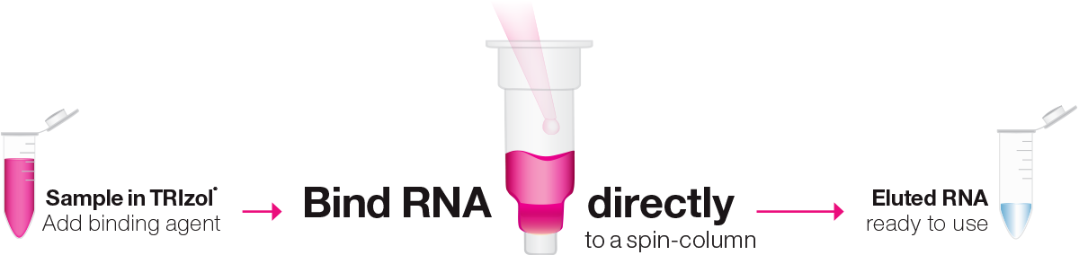


17 High Risk vs 17 AE vs 17 MPMs
CPT
EDTA
Freeze Pellet
Load Fluidics

Slide 16
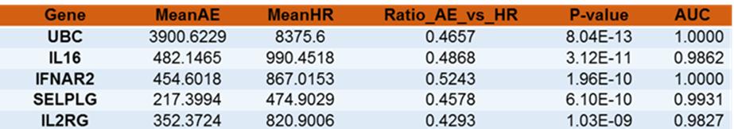
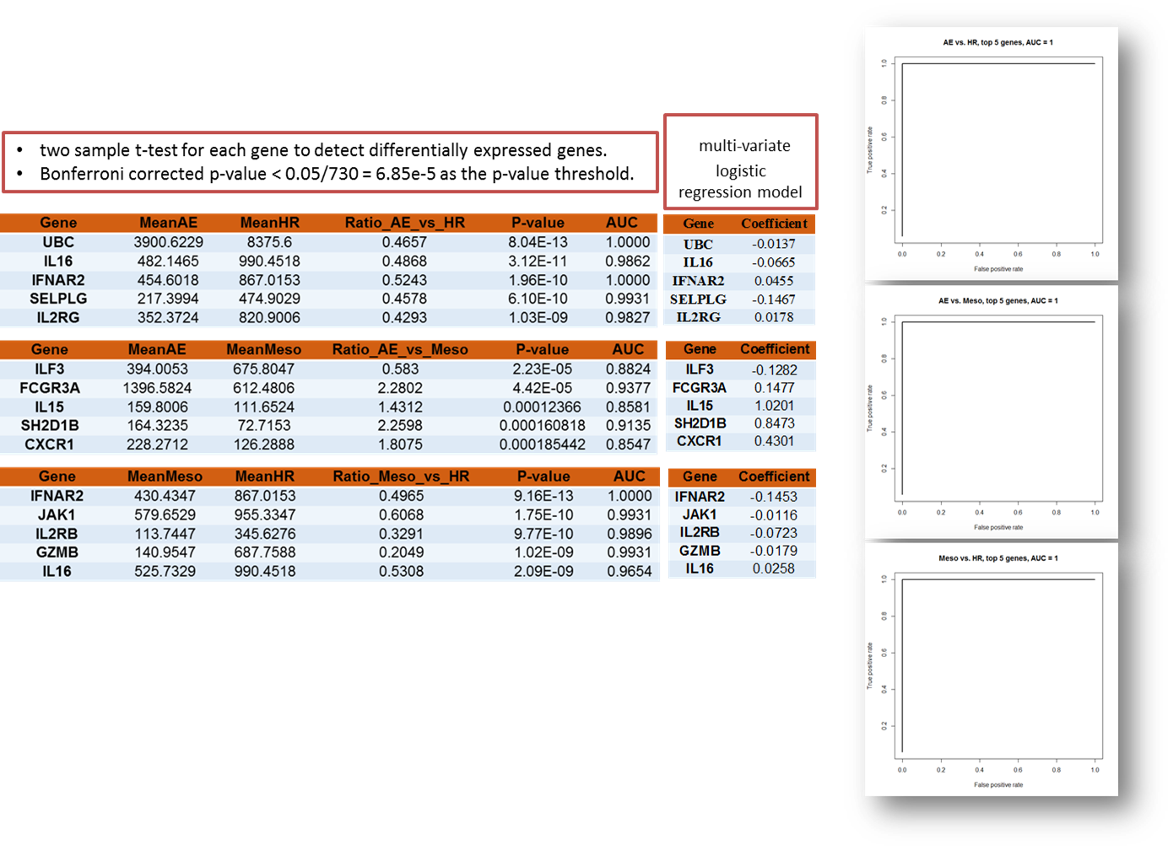
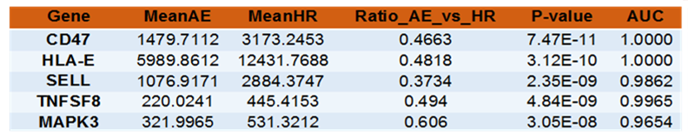
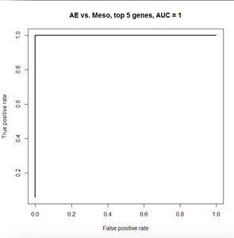
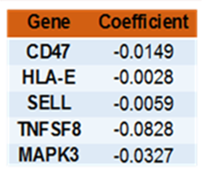
Buffy Coat
HMGB1: 2.16 FC AE/HR, p=2.77E-09
Healthy Age and Tobacco Matched Cohort vs
Asbestos Exposed
PBMC
HMGB1: 1.20 FC AE/HR, p=0.001

Slide 17
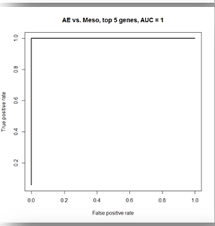
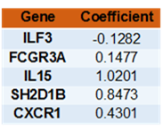
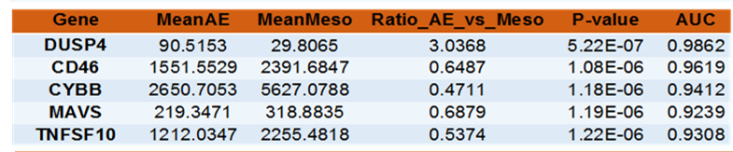


Buffy Coat
Asbestos Exposed
vs
Mesothelioma

Slide 18
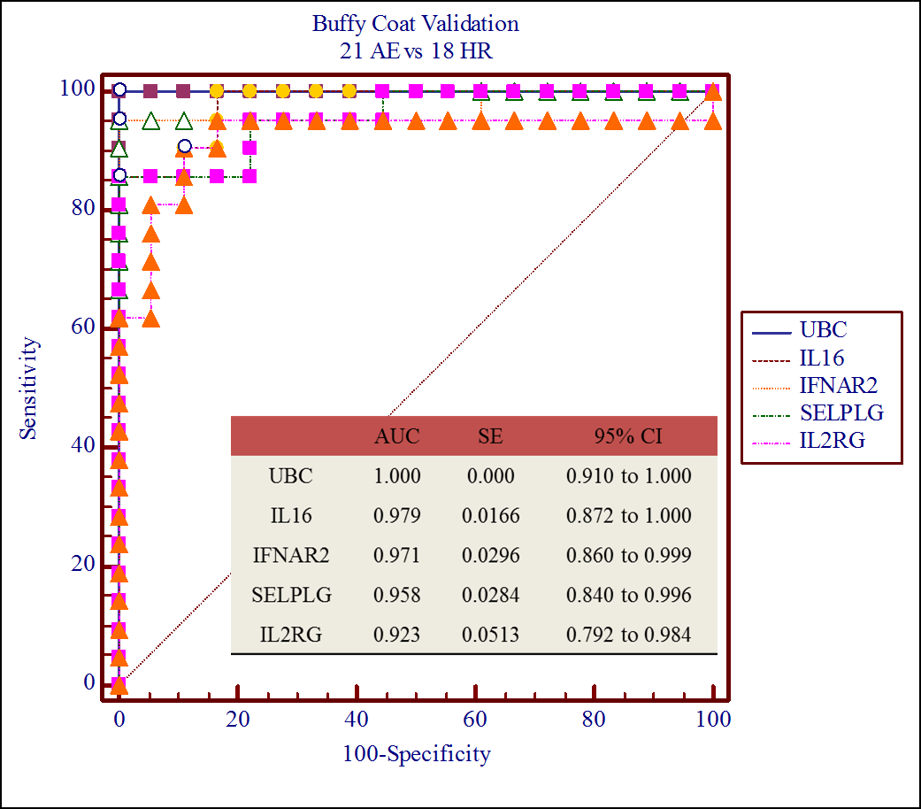
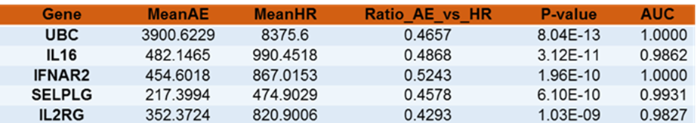
Validation: BC Asbestos Exposed vs Healthy Matched

Slide 19
But who the hell cares about mesothelioma???

Slide 20
What about early stage lung cancer (cStage I?
Can this BC immunooncology method separate patients by
histology
their chances of recurrence/progression within the first 5 years after complete resection?

Slide 21
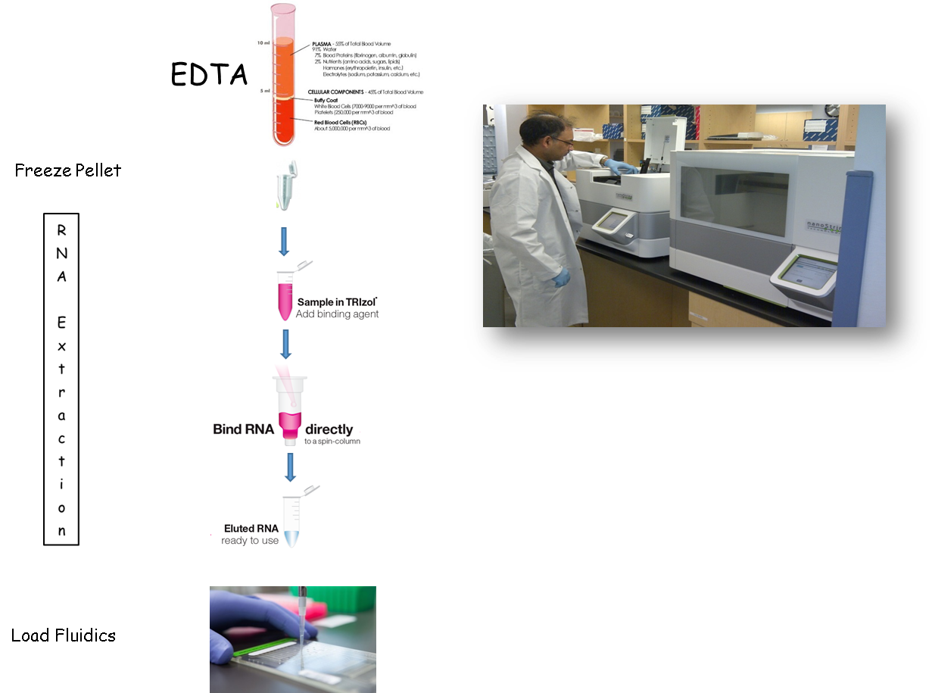

Slide 22
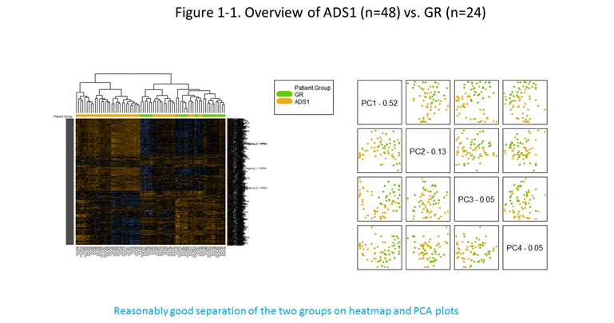

Slide 23
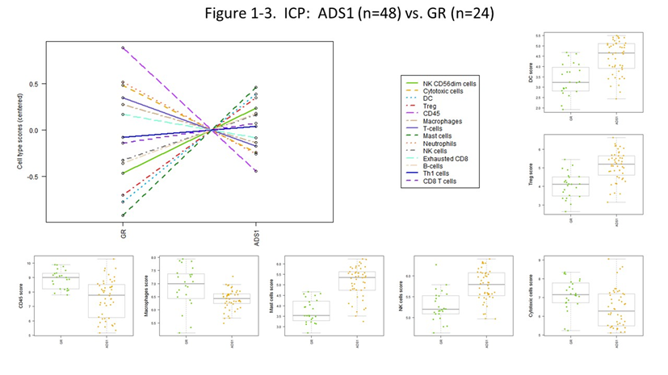

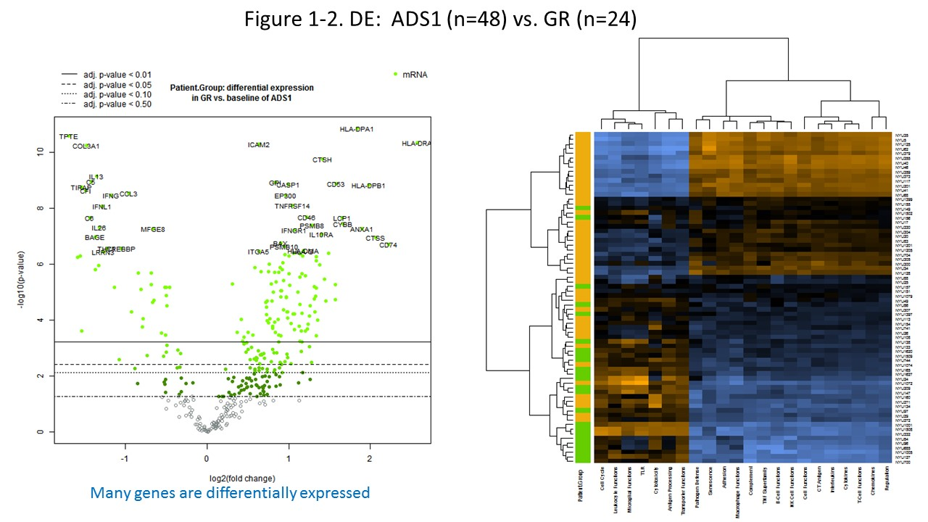

Slide 24
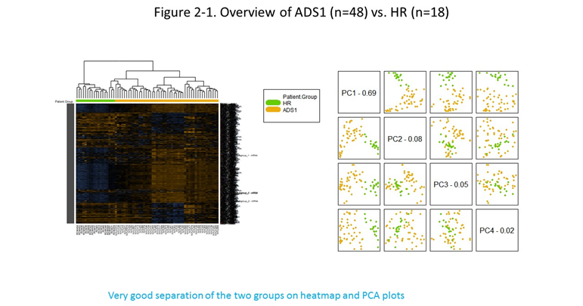

Slide 25
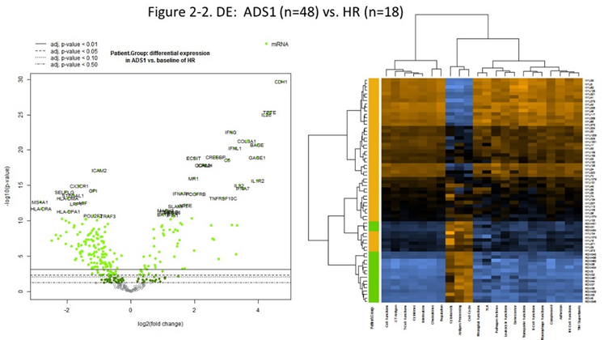

Slide 26
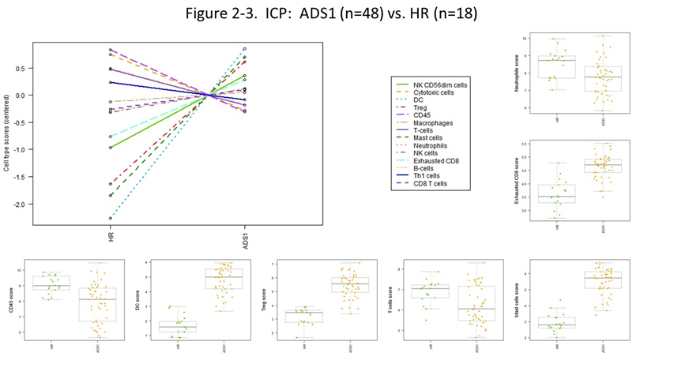

Slide 27
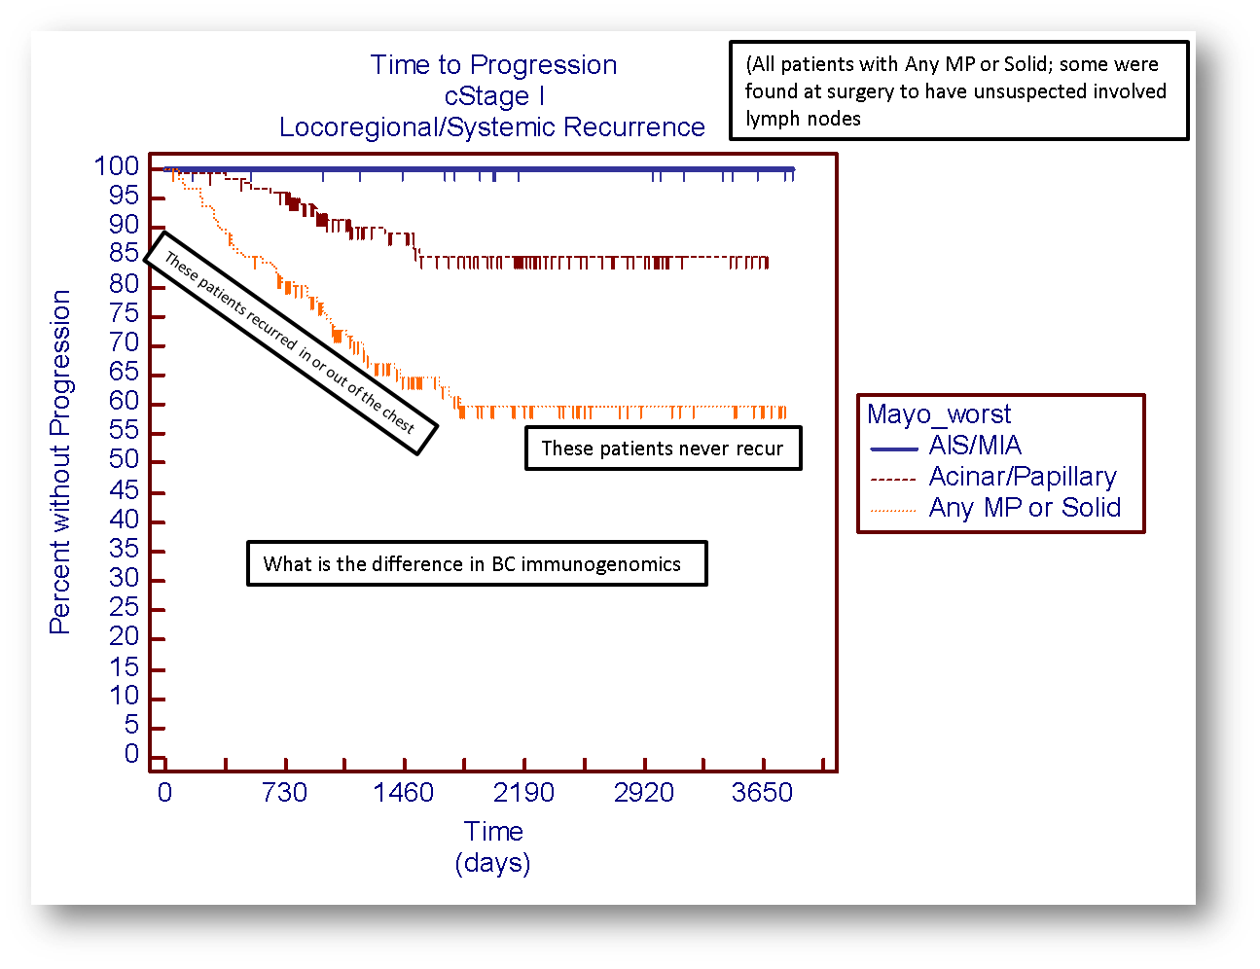

Slide 28
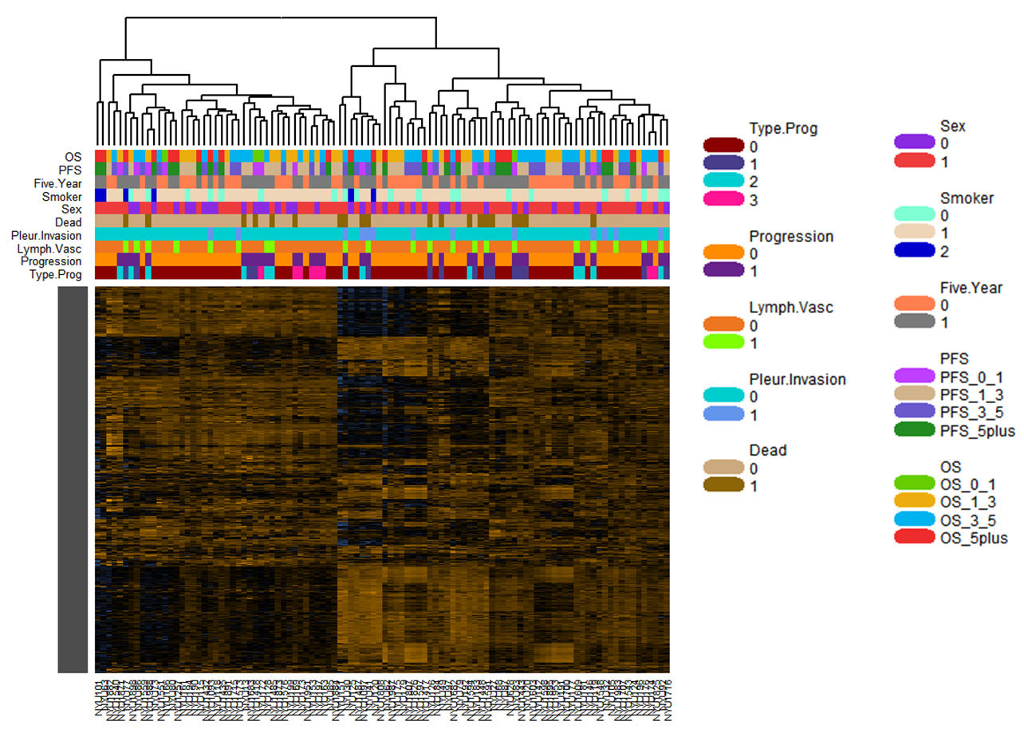
Prognostic Comparisons – Overview (102 patients)

Slide 29
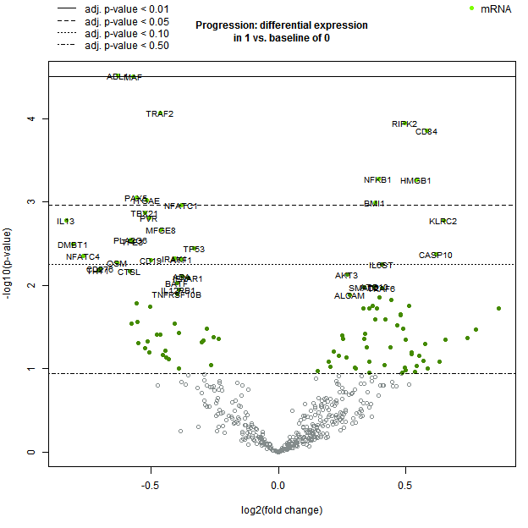
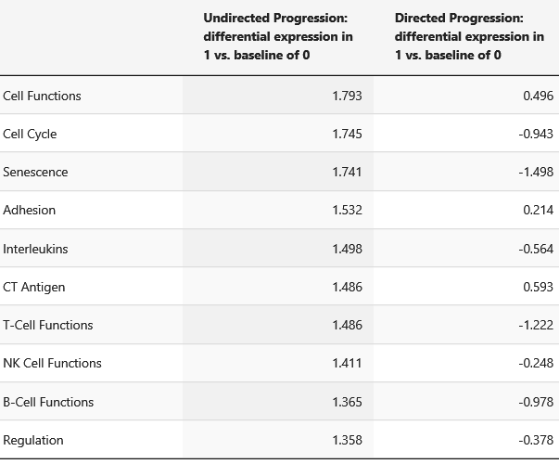
DE – Progressed (28) vs. Not Progressed (66)
Gene Set Analysis

Slide 30
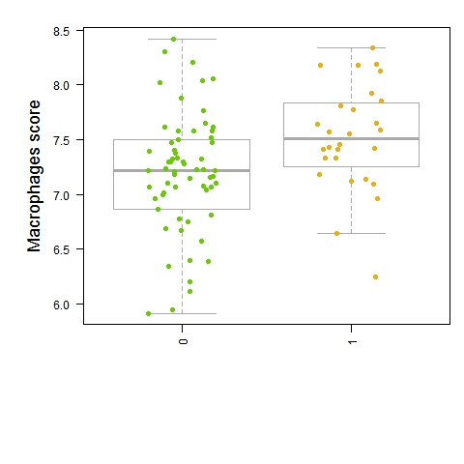
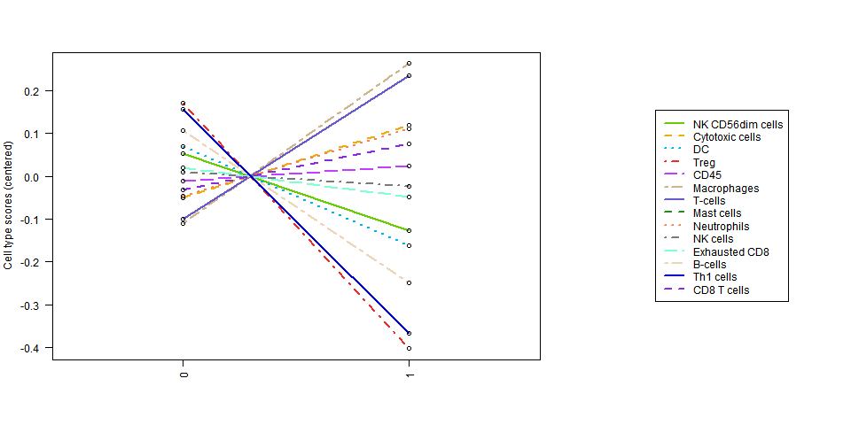
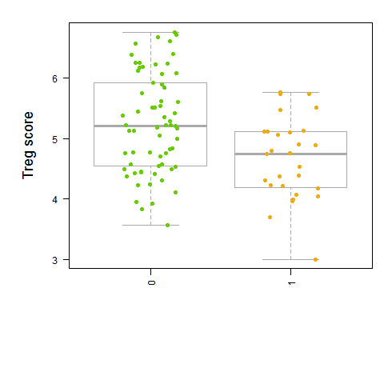
Immune Cell Profiling – Progressed (28) vs. Not Progressed (66)

Slide 31
Thanks to…
NYU Thoracic Lab
Chandra Goparaju PhD
Ryan Harrington BS
Amanda Beck MD
Joe Levin MD
Nathalie Hirsch MD
Mt. Sinai Selikoff Foundation
Stephen Levin MD
Carbone Laboratory, University of Hawaii
Michele Carbone MD, PhD
Haining Yang, PhD
University of Toronto
Ming-Sound Tsao MD
Geoffrey Liu MD
Marc De Perrot MD
Ohio State University
Carlo Croce MD
Stefano Volina PhD
Industrial Partners
Indie Diagnostics
SomaLogic
Fujirebio
Karmanos Cancer Institute
Anil Wali PhD
Early Detection Research Network, NCI, NIH
DMCC
Mark Thornquist PhD
Lung Cancer Foundation of America/IASLC
…..and of course all the patients and volunteers who contributed specimens so this could be done

Slide 32
The Old Standbys……..
 | Year | Author | N | Prognostic/ Diagnostic | Controls | Methods | Results | Conclusions
Osteopontin | 2016 | Bonotti | 56 | Clinical Response | None | Serum; commercial ELISA kit | Osteopontin change varies w/ disease status | Particularly effective for partial response, disease progression
 | 2016 | Pass | 194 | Prognostic | None | Plasma, adjusted for EORTC PI | Higher osteopontin – worse prognosis; w/ EORTC PI improves Harrell’s C Index | Independently significant predictor
 | 2014 | Hu |  | Diagnostic |  | Serum, plasma | Diagnostic sensitivity – 0.65, specificity – 0.81 | Effective for MPM diagnosis
 | 2014 | Felten | 2,262 | Diagnostic | Non-asbestos exposed | Blood; Commercial ELISA | Osteopontin rise assoc w/age
 | 2014 | Bayram | 546 | Diagnostic | Pleural plaques, healthy asbestos exposed, unexposed | Serum; Kruskall – Wallis Test | Osteopontin independently assoc. w/ MPM, age, smoking pack years; sensitivity .75, specificity .86 | Combination w/ mesothelin distinguishes MPM
Mesothelin | 2016 | Bonotti | 56 | Clinical Response | None | Serum; commercial ELISA kit | Mesothelin change varies w/ disease status | Particularly effective for partial response, disease progression
 | 2016 | Pass | 194 | Prognostic | None | Plasma, adjusted for EORTC PI | Higher osteopontin – worse prognosis; w/ EORTC PI improves Harrell’s C Index | Independently significant predictor
 | 2014 | Creaney | 153 | Diagnostic + Prognostic | Non-MM malignant, benign | Plasma, Pleural Fluid; ELISA | Plasma and pleural fluid mesothelin, NLR not independent prognostic for survival | Mesothelin, NLR better as diagnostic markers
 | 2014 | Linch | 53 | Prognostic | None | Serum, Kruskall – Wallis Test | Low/high mesothelin – PFS: 8.0/5.1 months, OS: 17.2/11.3 months | Serum mesothelin provides prognosis, not correlated w/ treatment response
 | 2014 | Felten | 2,262 | Diagnostic | Non-asbestos exposed | Blood; commercial ELISA | Mesothelin rise assoc w/age; steep rise w/ MPM | Consistent w/Mesothelin rise 6-18 months before clinical symptoms
 | 2014 | Bayram | 546 | Diagnostic | Pleural plaques, healthy asbestos exposed, unexposed | Serum; Kruskall – Wallis Test | Mesothelin independently assoc. w/ MPM, age, smoking pack years, BMI; sensitivity .58, specificity .83 | Combination w/ osteopontin distinguishes MPM
 | 2013 | Creaney | 213 | Diagnostic | Other malignant, benign, asbestos exposed healthy, kidney disease | Pleural Fluid, serum | Pleural and serum soluble mesothelin elevated in MM relative to all controls | Mesothelin conveys equivalent diagnostic accuracy in pleural fluid and serum
SMRP | 2016 | Demir | 131 | Diagnostic | Asbestos exposed, healthy | Serum | SMRP graded increase: control-asbestos-MPM; Sensitivity .976, Specificity .689 | SMRP and w/ TRX provide better diagnosis than EGRF, mesothelin, SDC-1, Fibulin-3
 | 2015 | Santarelli | 188 | Diagnostic | Asbestos exposed, healthy | Serum | SMRP w/ miR-126 + Met-TM outperforms SMRP in diagnosis | SMRP w/ two epigenetic factors overcomes sensitivity limits of SMRP alone
 | 2014 | Filiberti | 1,715 | Diagnostic | None | Blood; ELISA | 1 and 2 year samples pre-MPM diagnosis showed no SMPR variation | SMRP is not an early marker for detection at 1 year interval
 | 2013 | Ferro | 102 | Diagnostic | Non-MPM pleural metastasis, benign | Pleural effusion, Serum; MesoMark ELISAs | MPM vs. controls – Pleural SMRP sensitivity .698, specificity .881 Serum SMRP sensitivity .465 specificity .847 | Pleural SMRP has better diagnostic accuracy than serum SMRP
 | 2013 | Filiberti | 1,704 | Diagnostic | Asbestos-related pleural lesions, benign, healthy | Serum; ELISA | Increased SMRP predictors – age >57, current smoking, BMI< 25, positive anamnesis for cancer, pleural lesions | SMRP is a candidate marker predictive of mesothelioma
HMGB1 | 2016 | Napolitano | 100 | Diagnostic | Asbestos exposed, benign effusion, other malignant effusion, Healthy | Serum | At 2.0 ng/mL cutoff value, hyperacetylated HMGB1 specificity, sensitivity both 100%; Total HMGB1 (w/ nonacetylated) higher | Hyperacetylated HMGB1 is effective for differentiating MPM
 | 2013 | Tabata | 58 | Diagnostic | Benign Asbestos Diseases | Serum | DMPM patients displayed significantly higher serum HMGB1 | Serum HMGB1 useful marker for Diffuse Malignant Peritoneal Mesothelioma
 | 2013 | Tabata | 106 | Diagnostic | Benign Asbestos Diseases | Serum, ELISA | Higher serum HMGB1 associated with MPM diagnosis, lower OS
Fibulin-3 | 2016 | Napolitano | 100 | Diagnostic | Asbestos exposed, benign effusion, other malignant effusion, Healthy | Serum | Combined w/ HMGB1, increased sensitivity, specificity for differentiating MPM | With HMGB1, is effective differentiating marker for MPM
 | 2015 | Kirschner |  | Prognostic | Benign mesothelial cell lines, Non-MPM patients | Plasma, Pleural Fluid; ELISA | Plasma higher in MPM, but diagnostic accuracy low Pleural no significant diff. from controls; but prognostic value | Pleural Fibulin-3 independently associated w/ prognosis; plasma, pleural not effective for diagnosis
 | 2015 | Kaya | 83 | Diagnostic + Prognostic | Healthy | Serum | Higher in MPM, cutoff 36.6ng/ml, sensitivity .93 specificity .90; Prognostic factors – advanced stage, high WBC, Platelet, C-Reactive Protein counts | Serum Fibulin-3 more useful for diagnosis than prognosis
 | 2015 | Rapisarda |  | Diagnostic | Non fluoro-edenite exposed | Pleural Plaques, Plasma | Higher plasma fibulin-3 in exposed subjects | Plasma levels show high predictive value for pleural plaques
 | 2014 | Creaney | 153 | Prognostic | Non-MM malignant, benign | Plasma, Pleural Fluid; ELISA | Higher pleural Fibulin-3 associated w/ lower survival | Pleural Fibulin-3 independent prognostic factor for survival; not as effective for diagnosis

Slide 33
Other Players
 | Year | Author | N | Prognostic/ Diagnostic | Controls | Methods | Results | Conclusions
Neutrophil – Lymphocyte Ratio (NLR) | 2014 | Cedres | 52 | Prognostic | None | Immunohistochemistryanalysis staining | NLR <5 associated with significant increase in OS | NLR is significant prognostic factor for MPM survival
 | 2013 | Meniawy | 274 | Prognostic | None |  | Baseline NLR >5 does not predict worse OS Multivariate prognostic – age, histology, performance status, weight loss, chest pain, platelet count | NLR at diagnosis not a significant prognostic factor
Lymphocyte – Monocyte Ratio (LMR) | 2015 | Yamagishi | 150 | Prognostic | None |  | LMR<2.74: OS lower; LMR is independently associated with OS | LMR is independent prognostic marker for MPM OS
Micro RNA | 2016 | Bononi | 30 | Diagnostic | Asbestos Exposed workers; Healthy | Serum; microarray, RT-qPCR | miR-197-3p, miR 1281, miR-32-3p upregulated in MPM | Three mRNAs proposed as potential new biomarkers
 | 2016 | Micolucci |  | Diagnostic | Asbestos Exposed workers; Healthy | serum | miR-126-3p, miR-103a-3p, and miR-625-3p | Review of Literature
 | 2016 | Truini |  | Prognostic |  |  | miR-29c* and miR-31 | Review
 | 2016 | Quinn |  |  |  |  |  | Review
 | 2016 | Santarelli | 188 | Diagnostic | Asbestos Exposed; Healthy | Serum | miR-126 combined with SMRP, Methylated Thrombulin(Met-TM) differentiates MPM | Combination of the 3 markers serves as early diagnostic; overcomes SMRP low sensitivity limit
 | 2015 | Reid | 16 | Prognosis | surgical patients | Tissue | hsa-miR-210-3p, hsa-miR-93-5p, hsa-miR-221-3p, hsa-miR-20a-5p, hsa-miR-92a-3p, hsa-miR-30e-5p, hsa-miR-17-5p, hsa-miR-1469, hsa-miR-662
 | 2014 | Matsumoto |  | Diagnostic + Prognostic | Reactive Mesothelial Proliferations | RT-qPCR, formaldehyde-fixed paraffin embedded samples | miR-31 expression reduced in MPM, inverse relationship with OS, particularly sarcomatoid type | miR-31 level may serve as good diagnostic of histological typing and prognostic
 | 2014 | Gayosso-Gomez | 92 | Diagnostic | Adenocarcinoma; Healthy | Serum; Deep Sequencing | 7 miRNAs upregulated in MPM, 12 upregulated in AD; 3 unique to MPM – associated w/ p38 pathway | Differing upregulation in MPM and AD can be useful for diagnosis; Possible p38 pathway MPM association
 | 2014 | Andersen | 45 | Diagnostic | Reactive Mesothelial Proliferations | RT-qPCR, formaldehyde-fixed paraffin embedded Pre Op biopsy samples | 4 miRNA group – miR-126, miR-143, miR145, miR-652 differentiated MPM, sensitivity .95, specificity .93 | All four miRNA’s may be suitable for differentiating MPM from RMP’s
CTCs | 2015 | Raphael | 27 | Prognostic | none | CellSearch | CTCs detected in 44%. No correlations with prognosis
 | 2014 | Yoneda | 136 | Diagnostic + Prognostic | Non Malignant disease | Cell Search | CTCs detected in 33% MPM and 9% controls. AUC 0.6. CTC count was prognostic for epitheliod | Low prevalence; possible prognosis

Slide 34
Tissue
 | Year | Author | N | Prognostic/ Diagnostic | Controls | Methods | Results | Conclusions
Long ncRNA | 2013 | Wright | 85 | Diagnostic | Benign Pleura | RT-qPCR, microarrays | 2 candidate long ncRNA’s separated benign pleura from MPM; high sensitivity, specificity | LncRNA’s have potential as MPM biomarkers
BAP1 | 2016 | Hwang | 33 | Diagnostic | Sarcomatoid Carcinoma | Tumor Tissue; FISH testing, Immunohistochemistry | BAP1 loss by immunohistochemistry insensitive to sarcomatous, desmoplastic mesotheliomas; loss in 15% of tumors | BAP1 loss insensitive, but favors mesothelioma
 | 2015 | Cigognetti | 266 | Prognostic | Reactive Mesothelial Proliferations, benign tumors | Tissue; Immunohistochemistry, FISH, Cytology | BAP1 loss predictive of mesothelial malignancy and most common in epethelioid/biphasic type MM; Differentiation from benign specificity 1.00 | BAP1 immunostain is an effective marker for benign and malignant differentiation
 | 2015 | Farzin | 229 | Prognostic | None | Tissue Microarray, Immunohistochemistry | BAP1 loss strongly assoc. w/ younger onset age, epithelioid differentiation; BAP1 loss predicted improved median survival by 16.11 mo | BAP1 loss IHC may be predictive of prolonged survival
P16 – CDKN2A | 2016 | Hwang | 33 | Diagnostic | Sarcomatoid Carcinoma | Tumor Tissue; FISH testing | P16 deletion by FISH in 80% of mesothelioma tumors, 15% sarcomatoid carcinoma; good sensitivity | Potential diagnostic w/ BAP1 loss; alone can’t differentiate sarcomatous mesothelioma and sarcomatoid carcinoma
 | 2014 |  | 18 | Diagnostic | None | Pleural, Peritoneal; FISH | Homozygous P16 FISH deletion in mesothelial surface proliferations assoc. w/ deletion in mesotheliomas; absence of p16 deletion did not rule out diagnosis | P16 homozygous FISH deletion could provide a diagnostic marker for mesothelioma
Integrin ITGA7 | 2015 | Laszlo | 200 | Prognostic | Non-malignant mesothelial cells | MPM cell lines; Genome-wide expression array analysis | Deceased ITGA7 expression in MPM cells at transcription and protein levels; high tumor cell ITGA7 expression – higher OS | ITGA7 is independent prognostic factor; no correlation w/ histological type
Calretrin | 2016 | Thapa | 329 | Prognostic | None | Tissue Microarray | Higher expression assoc. with epithelioid histology, better survival | Calretrin expression is an independent predictor of survival; can predict histology
 | 2014 | Cedres | 52 | Prognostic | None | Immunohistochemistryanalysis staining | Higher expression assoc. w/ epithelioid histology No significant increase in OS | Calretrin is not a useful prognostic factor for MPM OS
Caveolin-1 | 2016 | Thapa | 329 | Prognostic | None | Tissue Microarray | Higher expression in mesothelioma; Not assoc. with histology or better survival | Caveolin-1 expression is a sensitive MM biomarker; does not predict histology, survival
 | 2014 | Righi | 131 | Prognostic |  | Immunohistochemistry | CAV1 detected in neoplastic cells of 77% of epithelial, 100% of biphasic, sarcomatoid MPM Stromal cell CAV1 in 67% of epithelial MPM | CAV1 expression differs by low- to high-grade histotypes Stromal CAV1 expression assoc. w/ worse prognosis, particularly MPM epithelial

Slide 35
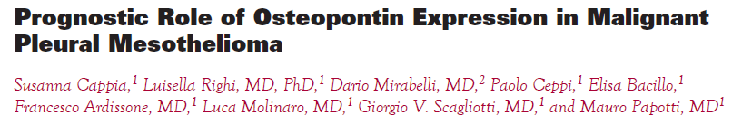
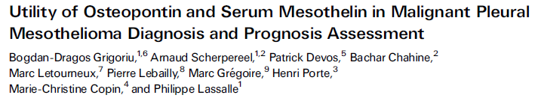
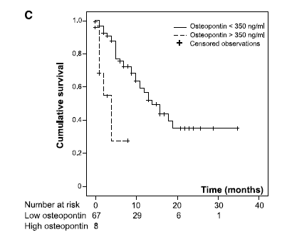

MPM, OPN, and Prognosis
IBL kit

Slide 36
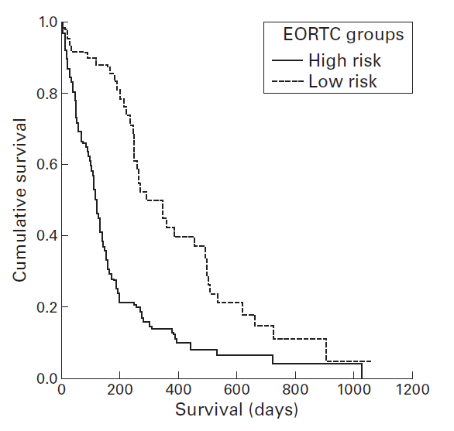
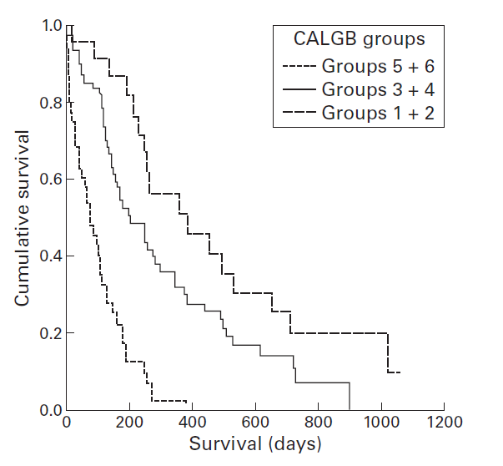

Can Plasma Biomarkers “add value” to already established Clinical Prognostic Indices?
EORTC and CALGB Prognostic Indices are already an established clinical Prognostic Index for MPM
Can any of the Biomarkers we have talked about add value to the EORTC Prognostic Index?
Take the most relevant biomarkers in the literature and investigate that…..
SMRP, Osteopontin
Discovery Set: 83 MPMs from NYU and Wayne State University
Blinded Validation Set: 111 MPMs from Princess Margaret Hospital
Gender, WBC,
PS, Histology

Slide 37
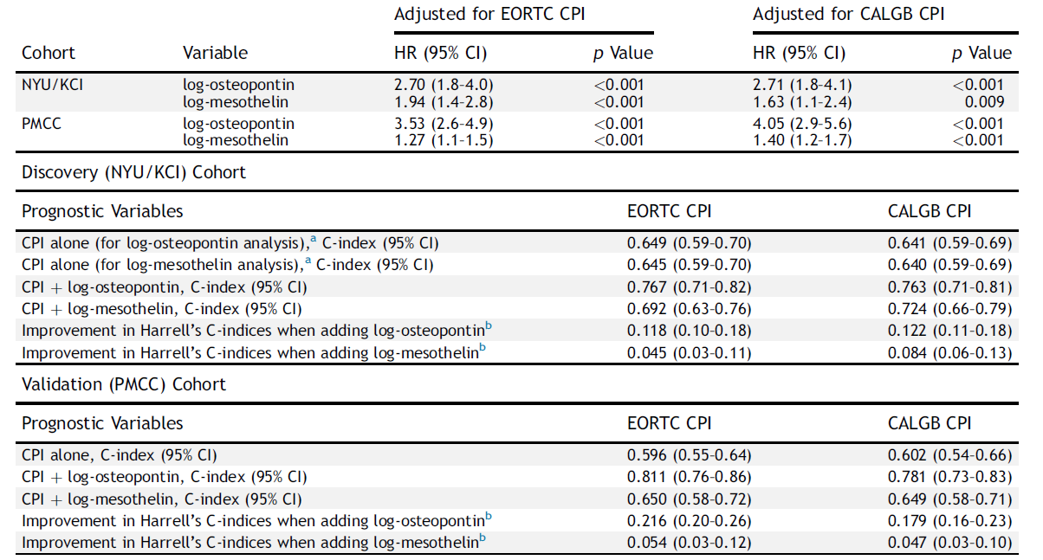
(N=83)
(N=111)
Journal of Thoracic Oncology 2016: 6: 900-909

Slide 38
Present EDRN Renewal, 2016-2021
Aim 1: Develop a novel SOMAmer based proteomic platform in order to validate plasma and pleural effusion diagnostic and prognostic biomarkers
Subaim 1a: Develop and technically validate a 14 SOMAmer, luminex based assay (SOMA14 NYU-MPM) combining Fibulin-3 with the 13 SOMAmer MPM test.
Subaim 1b: Validate the using new cohorts from the NYU Thoracic Surgery Archives
Subaim 1c: Validate the plasma prognostic accuracy of the Soma 14 NYU MPM assay
Subaim 1d: Determine whether the Soma 14 NYU MPM assay can diagnose MPM pleural effusion
Subaim 1e: Blinded validation of the diagnostic and prognostic capabilities of SOMA14 NYU-MPM using plasma cohorts from the Princess Margaret Cancer Center and pleural effusion cohorts from NYU and University of Glasgow
Aim 2: To determine the accuracy of HMGB1 and its Isoforms for the diagnosis of MPM pleural effusions
Subaim 2a: Compare sensitivity and specificity of total ELISA HMGB1 pleural effusion levels to MRP and Fibulin-3 using pleural effusions from the NYU Thoracic Surgery Archives
Subaim 2b: Measure Total, oxidized, and acetylated forms of HMGB1 in pleural effusions using pleural effusions from the NYU Thoracic Surgery Archives using a novel mass spectroscopy platform
Subaim 2c: Blinded diagnostic validation of HMGB1 and Fibulin-3 ELISAs compared to total, oxidized, and acetylated forms of HMGB1 pleural effusion cohorts from NYU and University of South Glasgow.
Aim 3: To determine whether buffy coat/PBMC immuno-oncologic RNA expression can define asbestos exposure and diagnose MPM
Subaim 3a: Further refine and validate Nanostring Immuno-oncology profiles in the diagnosis of asbestos exposure and MPM
Subaim 3b: Blindly validate locked in Nanostring Immuno-oncology profiles for healthy, non-AE vs AE, AE vs MPM, and MPM vs non-MPM using buffy coat/PBMC from the Princess Margaret Cancer Center
Aim 4: Integrate the best analytes from Aims 1-3 into a diagnostic and prognostic profile for separating plasmas from healthy, non-AE vs AE, AE vs MPM, and MPM vs non-MPM and MPM vs non-MPM pleural effusions
The discovery and validation of the proposed plasma and pleural effusion biomarkers from these studies will have the potential to monitor patients for the development of MPM in the future. The profiles that are promising from these studies could then be subjected to for further validation in ongoing longitudinal prospective/retrospective cohorts for the screening of MPM including the EDRN sponsored MPM Screening Trial in Santiago, Chile.

Slide 39










Biomarker Discovery with SomaLogic Slow Off Rate Modified Aptamers Platform
N*
N**
N
P_{iii}
P_{i}
A
PC
P_{ii}
P_{i}
A
PC
A
hv
A
P
P_{i}
A
A
39
Notes:
39
Mix ~1100 different SOMAmers with plasma
Purpose: enable each SOMAmer to bind to its recognized protein
Capture the SOMAmer/protein complex on beads
Purpose: wash away unwanted unbound proteins
Release protein SOMAmer complex back into solution using photo-cleavage
Capture the complex a second time using the tagged protein
Purpose: wash away aptamers with no protein
Release bound SOMAmer and detect using any DNA detection technique and its fluorescent tag

Slide 40
Aim 1: Develop a novel SOMAmer based proteomic platform in order to validate plasma and pleural effusion diagnostic and prognostic biomarkers
Subaim 1a: Develop and technically validate a 14 SOMAmer, luminex based assay (SOMA14 NYU-MPM) combining Fibulin-3 with the 13 SOMAmer MPM test.
Subaim 1b: Validate the using new cohorts from the NYU Thoracic Surgery Archives
Subaim 1c: Validate the plasma prognostic accuracy of the Soma 14 NYU MPM assay
Subaim 1d: Determine whether the Soma 14 NYU MPM assay can diagnose MPM pleural effusion
Subaim 1e: Blinded validation of the diagnostic and prognostic capabilities of SOMA14 NYU-MPM using plasma cohorts from the Princess Margaret Cancer Center and pleural effusion cohorts from NYU and University of Glasgow
Aim 2: To determine the accuracy of HMGB1 and its Isoforms for the diagnosis of MPM pleural effusions
Subaim 2a: Compare sensitivity and specificity of total ELISA HMGB1 pleural effusion levels to MRP and Fibulin-3 using pleural effusions from the NYU Thoracic Surgery Archives
Subaim 2b: Measure Total, oxidized, and acetylated forms of HMGB1 in pleural effusions using pleural effusions from the NYU Thoracic Surgery Archives using a novel mass spectroscopy platform
Subaim 2c: Blinded diagnostic validation of HMGB1 and Fibulin-3 ELISAs compared to total, oxidized, and acetylated forms of HMGB1 pleural effusion cohorts from NYU and University of South Glasgow.
Aim 3: To determine whether buffy coat/PBMC immuno-oncologic RNA expression can define asbestos exposure and diagnose MPM
Subaim 3a: Further refine and validate Nanostring Immuno-oncology profiles in the diagnosis of asbestos exposure and MPM
Subaim 3b: Blindly validate locked in Nanostring Immuno-oncology profiles for healthy, non-AE vs AE, AE vs MPM, and MPM vs non-MPM using buffy coat/PBMC from the Princess Margaret Cancer Center
Aim 4: Integrate the best analytes from Aims 1-3 into a diagnostic and prognostic profile for separating plasmas from healthy, non-AE vs AE, AE vs MPM, and MPM vs non-MPM and MPM vs non-MPM pleural effusions
The discovery and validation of the proposed plasma and pleural effusion biomarkers from these studies will have the potential to monitor patients for the development of MPM in the future. The profiles that are promising from these studies could then be subjected to for further validation in ongoing longitudinal prospective/retrospective cohorts for the screening of MPM including the EDRN sponsored MPM Screening Trial in Santiago, Chile.

Slide 41

37matched Peritonea and MPMs
RNA extraction
HG 1.0 ST Arrays
28,869 genes
Candidate Genes for Secreted Proteins
ELISA determination in Plasma
58 NYU MPM
96 NY Asbestos Exposed
30 “other” NYU Effusions
Inquire GEO profiles
DISCOVERY
IN SILICO VALIDATION
FIRST ORDER VALIDATION
Notes:
Discovery Algorithm

Slide 42

Future Validations and Pre-Diagnostic Opportunities

Slide 43


EDRN Sponsored Validation Trial in Santiago, Chile
Help from NYU and NCI sought from Chilean Clinic in the screening of asbestos exposed workers as mandated by the Government
EDRN approved Trial, December 2013
Chile approved, July 2014
NYU IRB, approved October 2014
Site Visit, May 28, 2015
Funding Approved, October 2016
Start Date August 2017

