Slide 1
Breast Cancer Collaborative Group Update on Team Projects
Identification of biomarkers for ER+ breast cancer (Lead: Christopher Li)
Breast cancer imaging and blood biomarkers (Leads: Jeffrey Marks and John Heine)
Avatar mice-to-human breast cancer biomarkers (Leads: Amanda Paulovich and Karin Rodland)

Slide 2
Breast Cancer Collaborative Group Update on Team Projects
Identification of biomarkers for ER+ breast cancer (Lead: Christopher Li)
Breast cancer imaging and blood biomarkers (Leads: Jeffrey Marks and John Heine)
Avatar mice-to-human breast cancer biomarkers (Leads: Amanda Paulovich and Karin Rodland)

Slide 3
Potential Clinical Applications
Biomarkers to inform timing of subsequent screening in women who have had a negative mammogram:
Goal: Identify markers that inform whether subsequent mammogram should occur in 6 months (early recall), 1 year, or 2 years
Biomarkers to inform continuation of mammographic screening among women 75-79 years of age:
Goal: Identify women who have a 2-fold higher risk of developing breast cancer who may benefit from opting in for screening.
3. Identify high risk women who should be prioritized for screening in areas with limited resources/access to mammography
Goal: Identify a subset of women 50-69 with a 2-fold higher risk of breast cancer who would particularly benefit from screening.

Slide 4
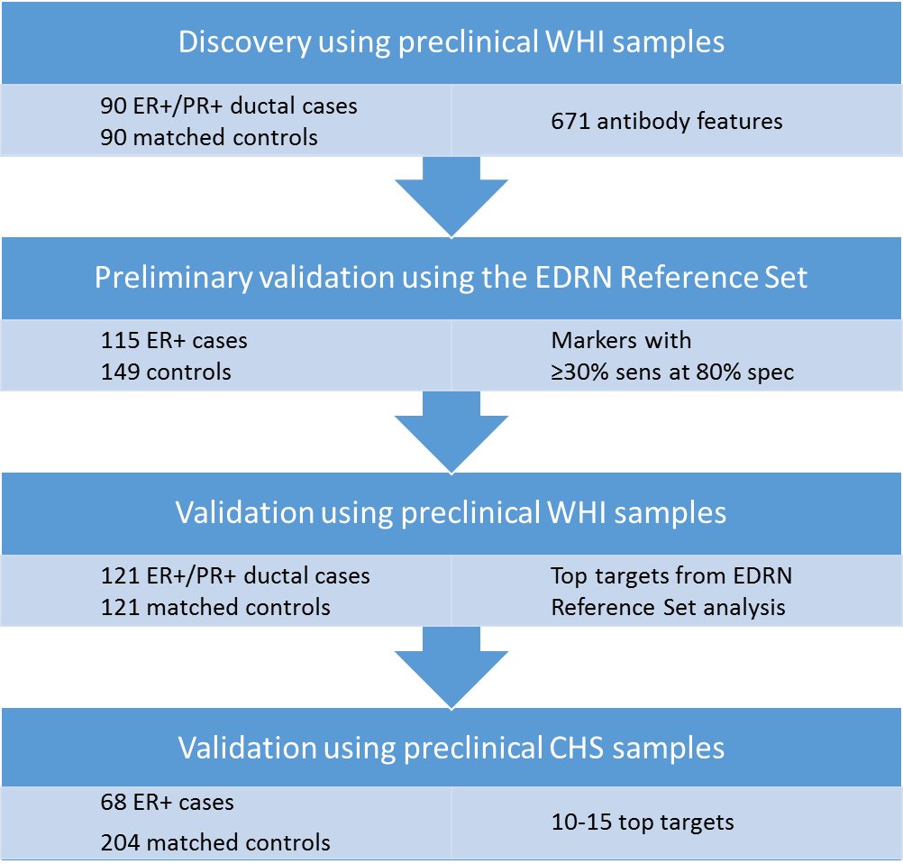
Work Flow
Preclinical samples from postmenopausal women 50-79 recruited nationally
Serial preclinical samples from women >65 recruited from 4 sites (CA, MD, NC, PA)

Slide 5
Timeline and Milestones (approved 3/2017)
Months | Milestone | Status
0-12 | Assessment and analysis of markers using the EDRN Reference Set | Complete for FHCRC and ASU markers
12-24 | Assessment of top markers using WHI samples | Lab work complete for FHCRC markers, analysis pending Plan developing for ASU markers
24-36 | Assay development/testing of top 10-15 markers using CHS samples | Not started

Slide 6
Breast Cancer Collaborative Group Update on Team Projects
Identification of biomarkers for ER+ breast cancer (Lead: Christopher Li)
Breast cancer imaging and blood biomarkers (Leads: Jeffrey Marks and John Heine)
Avatar mice-to-human breast cancer biomarkers (Leads: Amanda Paulovich and Karin Rodland)

Slide 7
Purpose and Goal
Breast cancer biopsy is performed routinely on a large number of women who have a low probability of cancer
Goal is to improve predictive accuracy of mammography towards reducing the rate of biopsy by combining image analysis and blood based biomarkers
Trying to achieve 98% NPV
In conjunction with this project, the intent is to create a repository of images and matched blood for future studies

Slide 8
Cohorts
Retrospective cohort of ~1000 images/blood (partially linked to existing breast cancer reference set at NCI-Frederick)
Mostly Duke subjects given the blood repository
Exclusively full field digital mammography (FFDM)
Among other purposes, training of image analysis
Prospective cohort of ~1000 images/blood
Moffitt and Duke – both FFDM and tomosynthesis
CAML detection (Creatv MicroTech) can only be performed on freshly collected blood

Slide 9
Progress to Date
Began Prospective Accrual at Duke in February
Almost exclusively BI-RADS 4A and 4B
110 enrolled and analyzed for CAMLs
Immunosignaturing performed on Stage I and benign conditions
330K peptide array
Training and validation paradigm
Multi-institutional training cohorts
Independent analysis by ASU and IBM
Blinded validation underway
Moffitt IRB approved and began prospective accrual recently
Four-way discussion for image storage and annotation
Test images will be delivered to JPL this week

Slide 10
Breast Cancer Collaborative Group Update on Team Projects
Identification of biomarkers for ER+ breast cancer (Lead: Christopher Li)
Breast cancer imaging and blood biomarkers (Leads: Jeffrey Marks and John Heine)
Avatar mice-to-human breast cancer biomarkers (Leads: Amanda Paulovich and Karin Rodland)

Slide 11
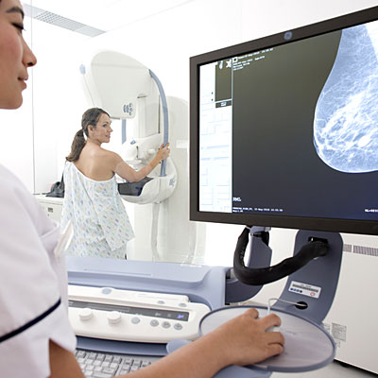
Our clinical goal is to identify a blood-based biomarker that could be used in conjunction with mammography to improve sensitivity and specificity
Limitations of Mammography
Specificity of mammography for distinguishing benign vs. cancerous lesions
Sensitivity of mammography in some patient populations (e.g. dense breasts)
Over-diagnosis (e.g. some DCIS).
This hypothetical biomarker would be impactful by detecting treatable cancers missed by mammography (mortality), and by allowing patients to avoid unnecessary procedures for benign disease (morbidity).

Slide 12
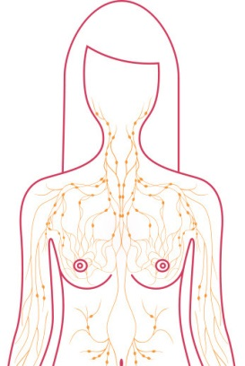

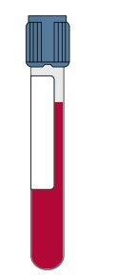
Human proteins are present in the plasma of mice harboring breast cancer xenografts.
Human proteins are detected in the mouse plasma by mass spectrometry.
mouse
human-in-mouse breast cancer xenograft
We hypothesize that a subset of the human tumor-derived proteins in the plasma of xenografted mice will be elevated in the plasma of women with breast cancer, and that a subset of these will be useful for early detection.

Slide 13
We pooled & analyzed the unlabeled, double-depleted plasma samples from 9 PDX mice for LC-MS/MS analysis.
Data were stringently filtered to remove peptides mapping to spectra
that gave IDs in both the mouse and human databases.
PNNL
7,319
FHCRC
4,592
3,323
3,996
596
MS/MS search: MaxQuant
human Uniprot db
mouse Uniprot db
Spectra filter
3,337 human peptides
951 human proteins!!
572 proteins (60%) have ≥ 2 unique peptides.
Notes:
Spectral filter removed 16.5% of peptides ((3996-3337)/3996)
And removed 14.6% of proteins ((1113-951)/1113)
Note: 141 of 3337 peptides contain NXS/T motif (4.2%)

Slide 14
Although candidate proteins were enriched in breast cancer, none was observed exclusively in breast cancer.
74% of circulating proteins were seen in all CPTAC breast tumor samples, while only 25% were seen in all ovarian tumors, and 17% in all colon tumors.
Notes:
While there were very few breast tumor specific proteins, the human proteins circulating in the PDX plasma were most similar to breast tumor samples

Slide 15
Next steps
Perform additional due diligence to ensure these are really human proteins; consider analyzing normal mouse plasma.
Attempt to replicate the results with an independent set of PDX mice.
Consider enriching EVs from PDX and human plasmas for proteomic analyses.
AIMS analyses to check for candidates in the plasma of human breast cancer patients.
Further work on clarifying potential clinical applications and design of subsequent human validation studies.

