Slide 1

Longitudinal Biomarker Interpretation for Early Detection of Ovarian Cancer
EDRN SC Meeting
Seattle 12-14 September 2017
Steven J. Skates PhD
Massachusetts General Hospital and Harvard Medical School

Slide 2
Acknowledgements and Declaration of Interests
Ian Jacobs
Usha Menon
Michael Birrer
Dianne Finkelstein
Robert Bast
Karen Lu
Robert Knapp
Mark Greene
Funding: MRC, CR-UK, Eve Appeal, NCI EDRN
Co-developer of ROC algorithm with Ian Jacobs (1996)
MGH & QMUL (2014) licensed software to Abcodia
Consultant to Abcodia
Notes:
Coals to Newcastle

Slide 3
Outline
CA125
First trials for early detection of ovarian cancer
Risk of Ovarian Cancer given longitudinal CA125
Ovarian Cancer Screening Trials with ROCA
Longitudinal Test Results
Conclusions

Slide 4
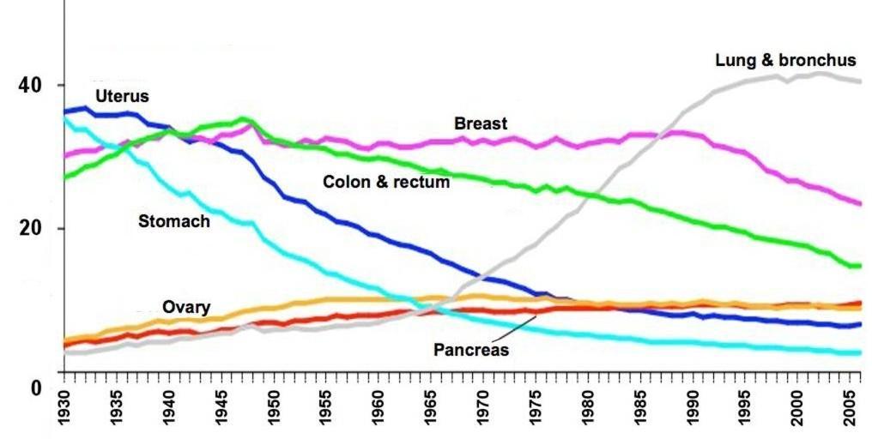
Cancer Death Rates: (US 1930-2006)*
Cisplatin
Cytoreduction
Paclitaxel
Cisplatin
IP
*Age-adjusted to the 2000 US standard population.
Source: US Mortality Data 1960-2006, US Mortality Volumes 1930-1959, National Center for Health Statistics, Centers for Disease Control and Prevention, 2009
(American Cancer Society, Cancer Facts & Figures 2010, Atlanta: American Cancer Society, 2010)
Notes:
4

Slide 5
Ovarian Cancer Death Rates - Yellow
Advances in therapy over 50 years
Increased survival (2 -> 4 years)
Decreased toxicity
Have NOT changed mortality
Can early detection DECREASE mortality?
Cisplatin
Cytoreduction
Paclitaxel
Cisplatin
IP
Notes:
5

Slide 6
Ovarian Cancer – Early Detection Target?
Late stage detection: > 75%
Late stage 5 year survival rate: < 20%
Early stage 5 year survival rate: >85%
Annual Incidence in postmenopausal women: 40-50 per 100,000
        (1 in 2,300)

Slide 7
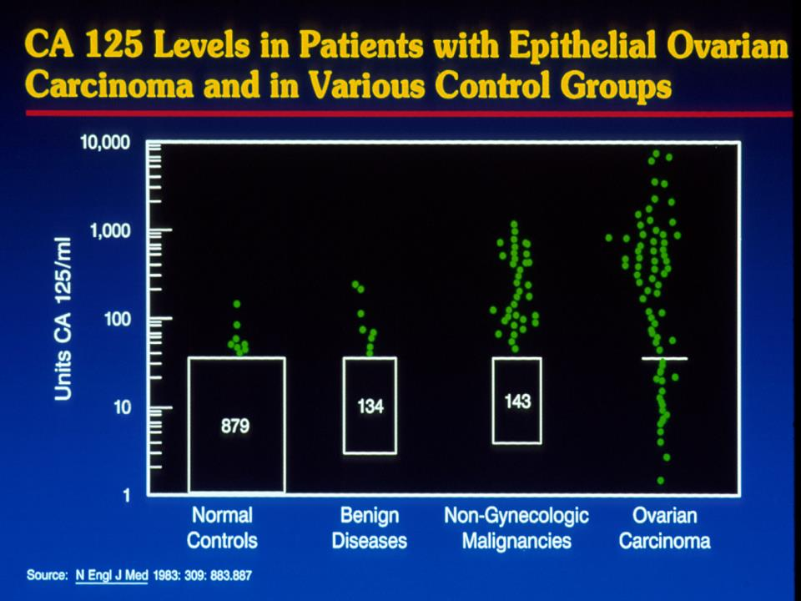

Slide 8
Early Detection with Serum Markers
PPV constraint – 10%
  Low incidence and moderate specificity may result in unacceptably low positive predictive value
  Ovarian Cancer Incidence: 1 in 2,000 women/year
  CA125 Specificity (> 30U/ml) : 98%
  CA125 Sensitivity : 63%
  Positive Predictive Value : 2%

Slide 9
Early Detection with Serum Markers
PPV constraint – 10%
  Low incidence and moderate specificity may result in unacceptably low positive predictive value
  Ovarian Cancer Incidence: 1 in 2,000 women/year
  CA125 Specificity (> 30U/ml) : 98%
  CA125 Sensitivity : 63%
  Positive Predictive Value : 2%
  Follow-up imaging with TVS : 20%

Slide 10
Ovarian Cancer Screening – Previous Studies
Screening for familial ovarian cancer: poor survival of BRCA1/2 related cancers.
J Med Genet. 2009;46:593-7.
Annual surveillance by CA125 and transvaginal ultrasound for ovarian cancer in both high-risk and population risk women is ineffective.
BJOG. 2007;114:1500-9.
Prospectively detected cancer in familial breast/ovarian cancer screening.
Acta Obstet Gynecol Scand. 1999;78:906-11.
CA125 and transvaginal ultrasound monitoring in high-risk women cannot prevent the diagnosis of advanced ovarian cancer.
Gynecol Oncol. 2006;100:20-6.
Biology of epithelial ovarian cancer: implications for screening women at high genetic risk.
J Clin Oncol. 2004;22:1315-27.
[NO ] Effect of Screening on Ovarian Cancer Mortality: The Prostate, Lung, Colorectal and Ovarian (PLCO) Cancer Screening Randomized Controlled Trial
JAMA 2011; 305(22):2295-2303.

Slide 11
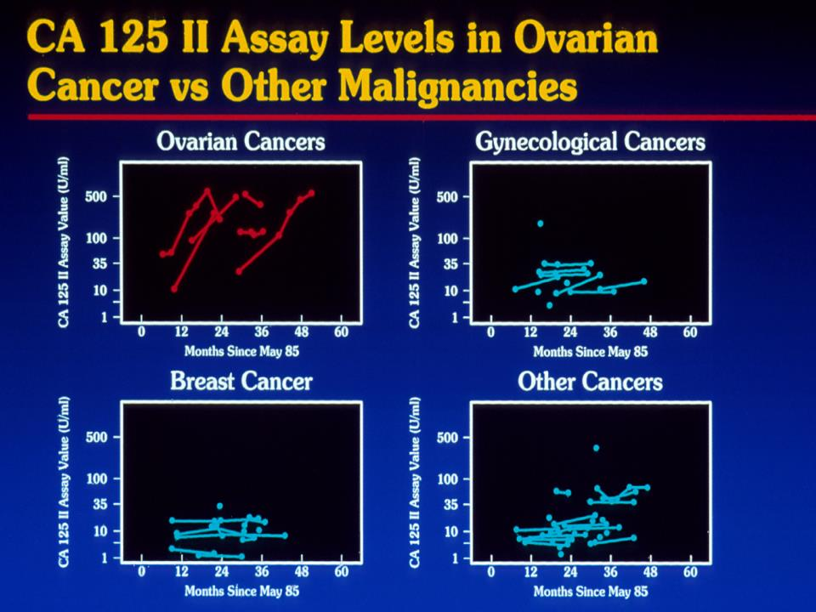

Slide 12
CA125 in 3 women with occult ovarian cancer & 3 women without ovarian cancer
1
3
500
2
CA125-II
50
4
6
5
5
88
89
90
91
92
93
94
Year
Notes:
This figure displays CA125 levels over time prior to detection of any disease from six women in the UK study. Three women in the figure were diagnosed with ovarian cancer and three women did not have ovarian cancer at the end of the study in July 1995. The initial level of CA125 does not distinguish between the women subsequently diagnosed with ovarian cancer and those without ovarian cancer at the end of the study. However the changes in CA125 values over time clearly differentiate between the women with ovarian cancer and the women without ovarian cancer. The Risk of Ovarian Cancer Algorithm will exploit this pattern of CA125 values over time to improve sensitivity while maintaining a very high level of specificity. The pattern of CA125 values over time we expect to see in women with ovarian cancer is best exemplified in subject #5, where we see an initial flat profile, followed by a rise. We refer to this as an “Elbow pattern”. Women #1 and #3 illustrate the latter part of the elbow pattern. The elbow pattern indicates the probable presence of ovarian cancer. In contrast, a flat pattern as illustrated by women #2, #4, and #6, even with a very high level e.g. #2, indicates probable absence of ovarian cancer. For an asymptomatic woman, we determine the relative goodness of fit to her multiple CA125 values between an “elbow pattern” compared with a “flat pattern” to assess her risk of ovarian cancer.

Slide 13
Expected CA125 Levels in Woman with
Logarithmic CA125 Scale
Ovarian Cancer Prior to Clinical Detection
1500
1500
Clinical Detection
Clinical Detection
500
1000
CA125
CA125
100
Linear Rise
Doubling Time
50
500
Flat Profile
10
*
Flat Profile
Tumor Inception
5
Tumor Inception
0
*
0
1
2
3
4
0
1
2
3
4
Time in Years
Time in Years
Rise most readily detected when a baseline has been established

Slide 14
Between Women Sources
Within Woman Sources
of CA125 Variability
of CA125 Variability
50
40
30
Between Woman
Flat Profile Variability
CA125
Linear Rise
CA125
20
Within Woman
Flat Profile
CA125 Variability
15
*
Between Woman
Slope Variability
*
Tumor Present
10
2x
0
1
2
Time in Years
Time in Years
Within Woman Sources
Three Women with Two Serial CA125 Levels
of CA125 Variability
All Women have Same Slope yet have
Decreasing Levels of the Risk of Ovarian Cancer
50
40
1
Tumor Absent
30
CA125
CA125
20
2
*
15
Within Woman
3
CA125 Variability
10
Time in Years
Time in Years

Slide 15
Probability or Risk of having Ovarian Cancer
The probability of having ovarian cancer given a CA125 profile accounts systematically for all sources of “signal” and “noise”
The initial baseline level
The variability of the baseline level between women
The slope over time following the change-point
The variability of the slope between women
The amount of rise above the baseline level
Assay and biological variability over time within a woman
Notes:
The probability of having ovarian cancer is influenced by three sources of “signal” and three sources of “noise”. The three “signal” are the baseline level, the slope over time following the change-point, and the amount of rise above the baseline level. These “signals” are obscured by three sources of “noise”: variability between women in the baseline level, variability between women in the slope, and CA125 variability due to assay and biological variability over time within a woman.
The rule using the slope only accounts for one source of the signal, namely the slope. The rule using a fixed cut-off only uses the last CA125 value. To accurately calculate the risk, one needs to account for all three sources of signal, and all three sources of variability.

Slide 16
Probability or Risk of having Ovarian Cancer
To calculate the probability of having ovarian cancer given a
CA125 profile:
Develop longitudinal CA125 model for non-cases
    Transform CA125 (log)
    Individual constant mean (baseline)
    Individual variation about baseline
    Y_{ij} = log(CA125), i^{th} patient, time t_{j}
    Y_{ij} = μ_{i} + ε_{ij} ε_{ij} ~ N(0, σ_{i}²) μ_{i} ~ N(μ, ω²)
    ω ≈ 2 σ. between woman SD = twice within woman SD
Notes:
The probability of having ovarian cancer is influenced by three sources of “signal” and three sources of “noise”. The three “signal” are the baseline level, the slope over time following the change-point, and the amount of rise above the baseline level. These “signals” are obscured by three sources of “noise”: variability between women in the baseline level, variability between women in the slope, and CA125 variability due to assay and biological variability over time within a woman.
The rule using the slope only accounts for one source of the signal, namely the slope. The rule using a fixed cut-off only uses the last CA125 value. To accurately calculate the risk, one needs to account for all three sources of signal, and all three sources of variability.

Slide 17
Probability or Risk of having Ovarian Cancer
To calculate the probability of having ovarian cancer given a
CA125 profile:
Develop longitudinal CA125 model for cases
    Baseline, change-point, linear increase in CA125 (fraction p)
    Baseline (small proportion not producing CA125: 1-p)
    Y_{ij} = μ_{i} + γ_{i}(t_{ij} – τ_{i})⁺ + ε_{ij} ε_{ij} ~ N(0, σ_{i}²)
    μ_{i} ~ N(μ, ω²); log(γ_{i}) ~ N(γ, ψ²); δ_{i} ~ N(2, 0.75²) T(0,5)
    δ_{i} = d_{i} – τ_{i} preclinical duration
    (μ_{i}, log(γ_{i}), δ_{i}) ~ MVN
Notes:
The probability of having ovarian cancer is influenced by three sources of “signal” and three sources of “noise”. The three “signal” are the baseline level, the slope over time following the change-point, and the amount of rise above the baseline level. These “signals” are obscured by three sources of “noise”: variability between women in the baseline level, variability between women in the slope, and CA125 variability due to assay and biological variability over time within a woman.
The rule using the slope only accounts for one source of the signal, namely the slope. The rule using a fixed cut-off only uses the last CA125 value. To accurately calculate the risk, one needs to account for all three sources of signal, and all three sources of variability.

Slide 18
Probability of Having Ovarian Cancer
25
Red Dots: CA125 Values
Green Line: Flat Pattern
Yellow Line: Elbow Pattern
Initial odds: From woman’s age
Z-values: Distance from Pattern to CA125 values. Smaller distance implies pattern is more likely.
Final Distance:
Sum of squared Z values
Divided by CA125 variability σ*
Odds: Ratio of average “yellow” to average “green” distance
Final odds: (Initial odds) * (odds ratio)
Probability: Odds/(Odds+1)
20
z
*
15
5
CA125
*
μ*
z
*
4
10
z
1
z
*
3
8
*
z
2
5
0
3
6
9
12
Time in Months
25
z
20
z
5
4
15
γ*
CA125
10
z
μ*
z
1
3
8
δ*
z
2
5
0
3
6
9
12
Time in Months
Notes:
Two graphs represent one woman’s CA125 values over time. What is the probability the woman has ovarian cancer? The initial odds are given by the woman’s age. We calculate the “green” distance between the “flat pattern” and the CA125 values represented by red dots. The particular level of the flat pattern is the best possible fit we can find. We calculate the “yellow” distance between the “elbow pattern” and the same red dots. The particular elbow pattern is again the best fit we can find. The distance is the sum of squared differences between the “pattern” and the actual CA125 values represented by the z-values. The sum is then divided by the known variability of CA125. The ratio of the “yellow” distance to the “green” distance gives the relative odds. The product of the initial odds, based on age, times the relative odds, based on CA125 values, gives the final odds. The probability is the odds/(odds+1). Using our computer program we computed that this woman has a risk of 0.07% of having ovarian cancer, which is an intermediate risk. ROCA suggests a CA125 test in 4 months. Under the usual CA125 interpretation, the woman would return in one year for her next CA125 test.

Slide 19
ROCA: Risk of Ovarian Cancer Algorithm
Regular
CA125 Test
Risk of Ovarian Cancer Calculation
based on longitudinal CA125 values (ROCC) & age
Normal
ROCC < low
Intermediate
low < ROCC < high
Elevated
ROCC > high
Repeat CA125
Interval determined by ROCC
TVS
+ CA125

Slide 20
ROCA Screening Trials
UK Pilot Trial (Barts III) 1995 – 2001
    14,000 normal risk women randomized to screen/ no screen
ROCA study 2001 – 2015
    2,400 high risk women, age > 30, CGN/SPORE/EDRN
UKCTOCS 2001 - 2015
    200,000 normal risk, postmenopausal women randomized to screen/ no screen
MDACC study in normal 2001-2011
    4,000 normal risk postmenopausal women
GOG0199 - screening arm 2003-2011
    1,600 high risk women, age > 30
UKFOCSS 2003 – 2013
    4,000 high risk women, age > 35
Jacobs, The Lancet 1988
Skates, JASA 2001
Menon, JCO 2005
Lu, Cancer 2011
Jacobs Menon, The Lancet 2015
Skates, Clinical Cancer Research 2017
Rosenthal, JCO 2017

Slide 21
ROCA Screening Trials Results
All 6 trials significantly increased early stage cancer
No other ovarian cancer screening trials had an increase
All other ovarian cancer screening trials: single CA125 cutoff
Individualizing test with ROCA contributed to early stage increase
UKCTOCS had a non-significant Cox regression result for mortality for all cases
UKCTOCS had a pre-specified subgroup analysis for incident cases (80% of cases): a significant mortality reduction

Slide 22
Conclusions
Longitudinal test relies on each patient having their own baseline levels of a test (sigma-within << sigma-between)
Longitudinal interpretation of test for each patient led to significant increase in detection of early stage disease
Longitudinal test most effective when baseline has been measured (incident cases)
Longitudinal test reduced mortality for incident cases
Longitudinal method applied to existing or novel biomarkers may substantially increase impact

