Slide 1

Early Detection of Pancreatic Cancer
Anirban Maitra, M.B.B.S.
Professor of Pathology and Translational Molecular Pathology
University of Texas MD Anderson Cancer Center

Slide 2

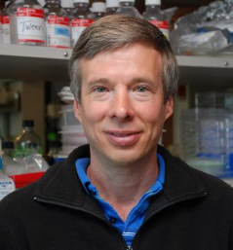
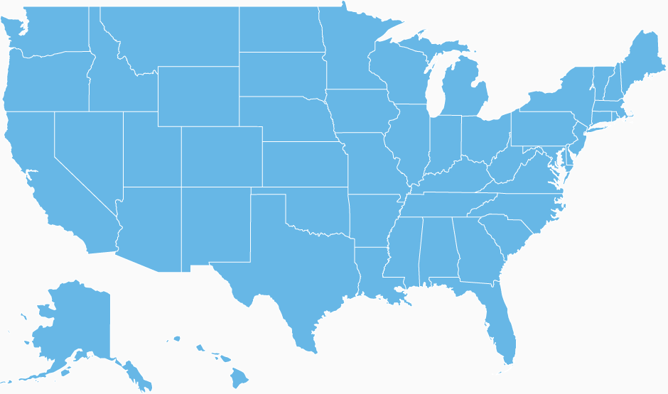




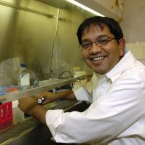





MDACC EDRN CVC Team
FHCRC
Paul Lampe
Sunil Hingorani
Indiana U
C. Max Schmidt
Michele Yip-Schneider
Utah
Sean Mulvihill
Matt Firpo
MDACC
Anirban Maitra
Sam Hanash,
Ziding Feng
Michela Capello
Eugene Koay
Nabihah Tayob

Slide 3
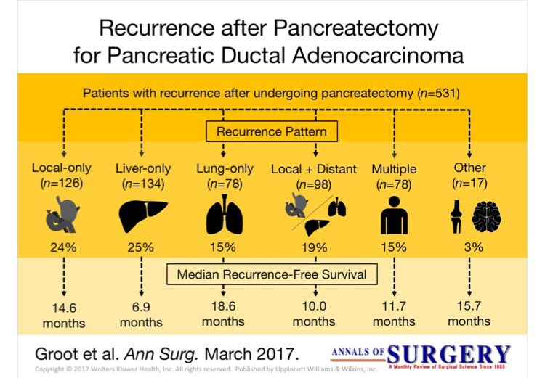
Resectable Pancreatic Cancer Resectable Breast, Prostate or Colon Cancer

Slide 4
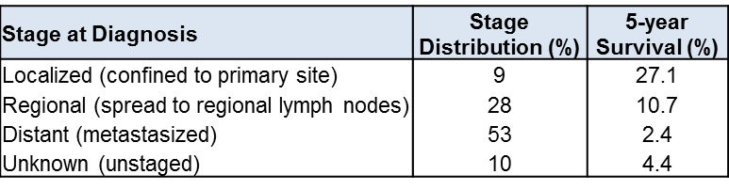
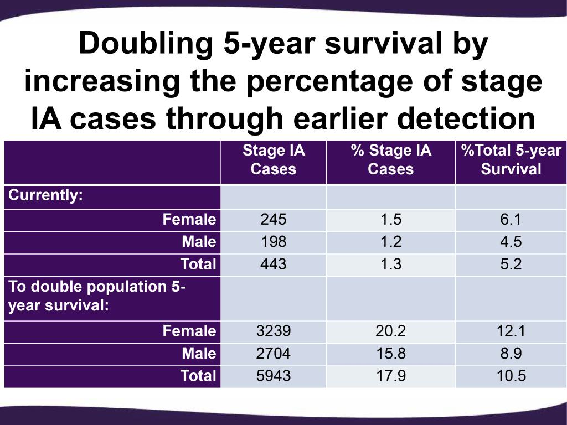
Early Detection of Pancreatic Cancer & Survival
SEER 18 2005-2011
<1 cm tumors: 5-year survival rate of >60%
What would it take to “double” pancreatic cancer survival?
Sean Mulvihil, Utah

Slide 5
Biomarker Goals for Early Detection of Pancreatic Cancer – Asymptomatic Disease is the Target
Risk Marker
(Clinical or biochemical)
BIOMARKER
Early Detection Marker
EDRN GOAL
CA19-9 + Most Biomarkers
Risk
Asymptomatic PDAC
Early stage PDAC
(symptomatic)
Late stage PDAC (85%)
High risk families
Cancer syndromes
Pancreatic cysts
“Sporadic” Risk
New onset diabetes

Slide 6
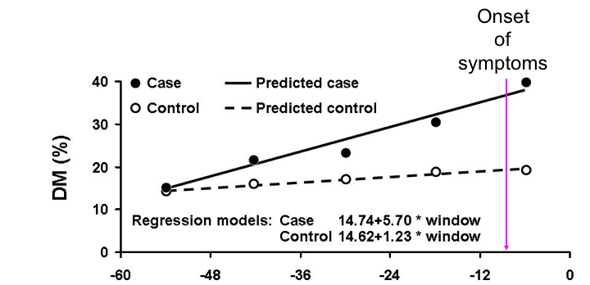
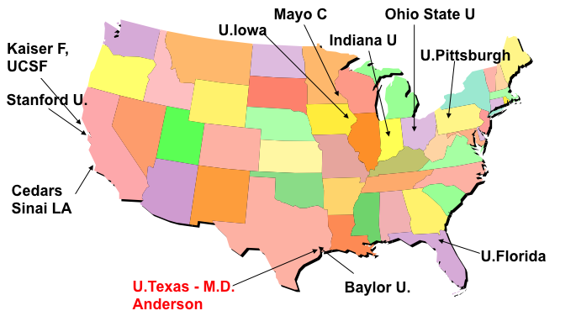
New Onset Diabetes (NOD) as a Biomarker of Asymptoamtic Pancreatic Cancer
Consortium for the Study of Chronic Pancreatitis, Diabetes and Pancreatic Cancer (CPDPC)
NIDDK/NCI Consortium
Up to ~50% of pancreatic cancer patients may have new-onset diabetes (NOD) as their first symptom
Can pre-date cancer diagnosis by 2 years
~1% of NOD have occult PDAC
Chari et al, Mayo
10,000 NOD patients recruited prospectively
~100 will develop PDAC over follow up with pre-diagnostic blood samples

Slide 7
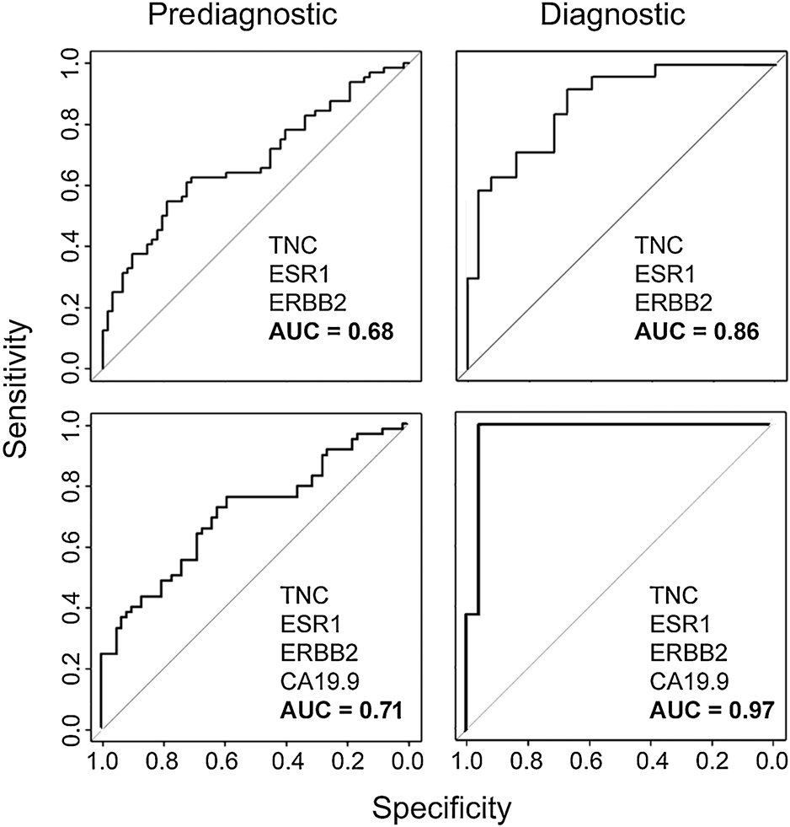
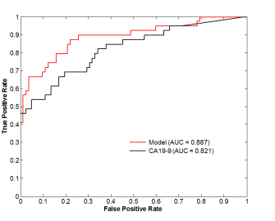
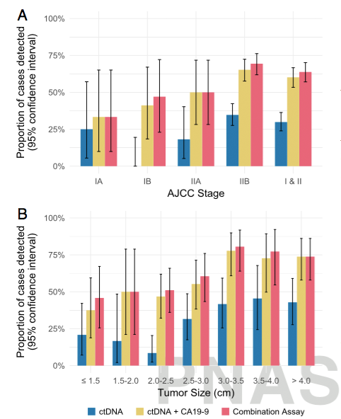
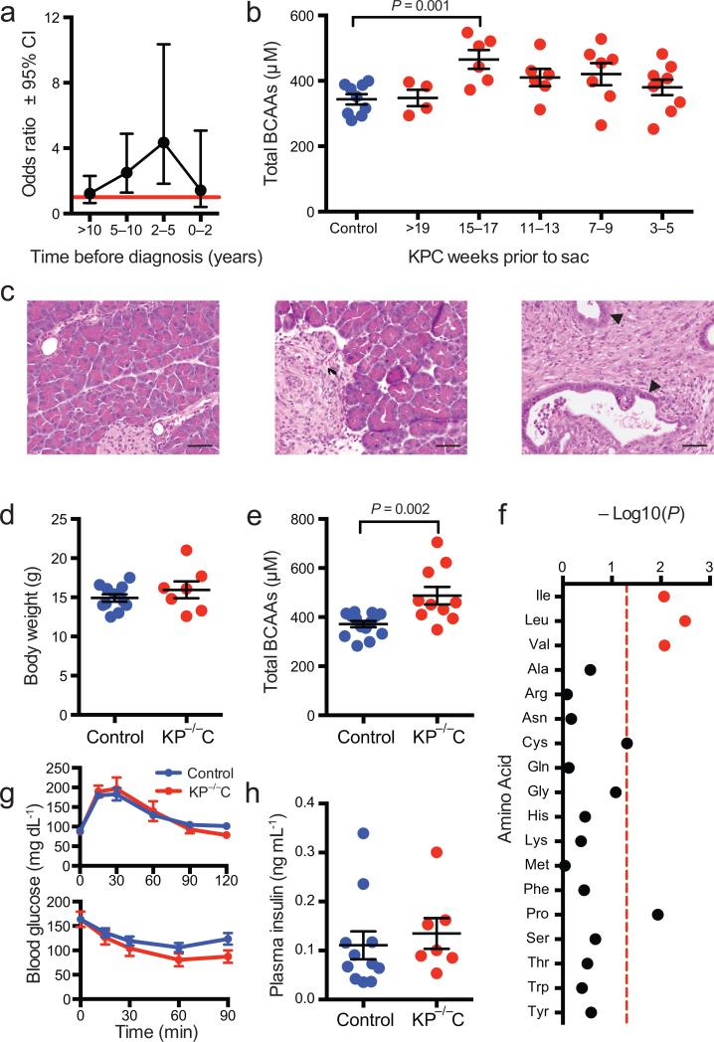
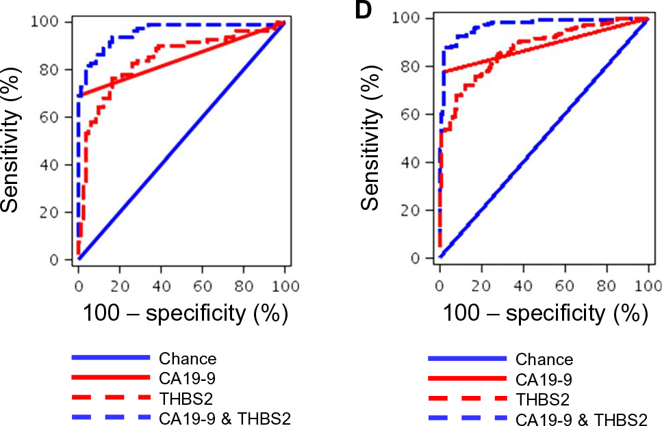
A Biomarker Continuum That Spans Risk and Early Detection of Asymptomatic Disease
SENSITIVE
SPECIFIC
Metabolites
Proteins/autoantibodies
ctDNA
BIOMARKER
Lampe CCR 2015
Capello, JNCI 2017
Plasma BCAAs are elevated years before PDAC diagnosis
Wolpin Nat Med 2014
SafeSeqs ctDNA Assay
Vogelstein, Kinzler, PNAS 2017
Zaret, Petersen, STM, 2017
Risk
Asymptomatic PDAC
“Sporadic” Risk
New onset diabetes

Slide 8

Pancreatic Cancer Early Detection Initiatives at MD Anderson
Extramural
JHU
IARC
PanCAN Early Detection Initiative
Maitra
Hanash
NCI/NIDDK
CPDPC
NOD cohort
Feng
Maitra
Pancreatic Cancer Research Center
NCI BRPC
& BPPC Alliance
Sen
Maitra
NCI MCL Consortium
Maitra
Hanash
Sen
Koay
NCI EDRN CVC
Maitra
Hanash
Feng
Koay

Slide 9
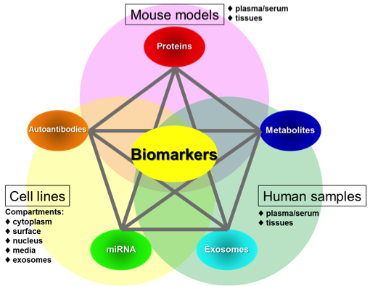
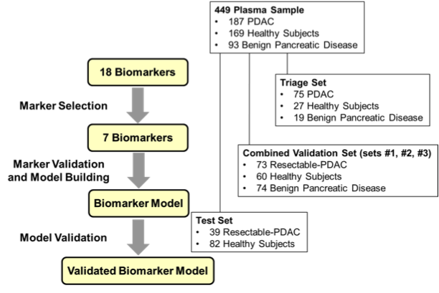
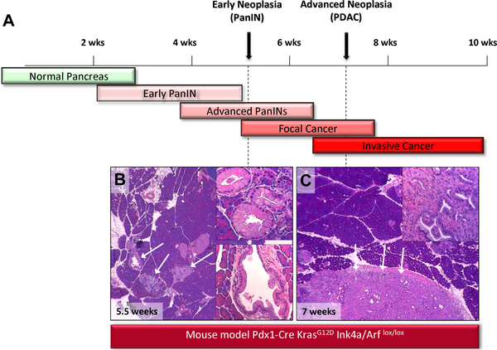
Integrated Sequential Biomarker Discovery and Validation Strategy
MD Anderson EDRN CVC
“Anchor Panel”
PDAC Mouse Model
Faca VM et al, Plos Med 2008
Capello M et al, JNCI 2017

Slide 10
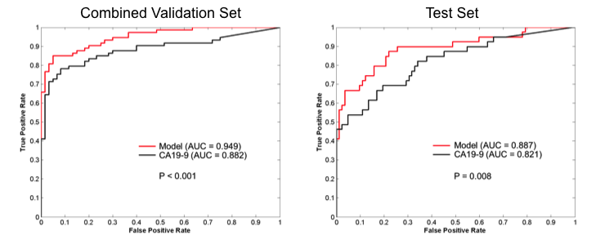
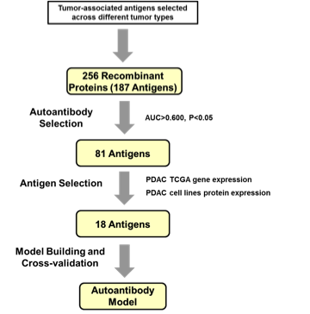
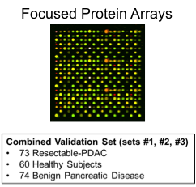
Enhancing the Anchor Panel with Sequential Autoantibody Discovery
TIMP1 + LRG1 + CA19-9
Capello M et al, JNCI 2017

Slide 11
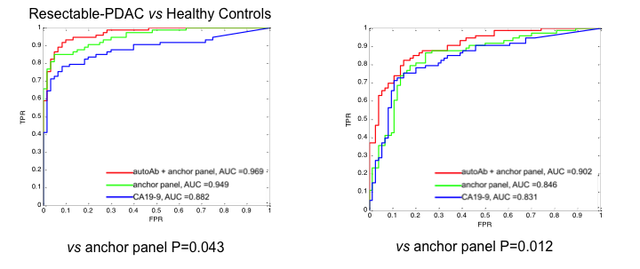
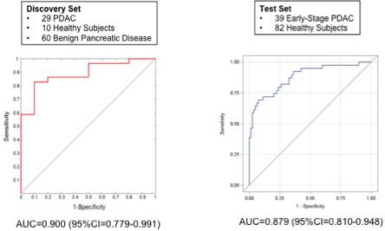
A Multi-Analyte Biomarker Panel [Hanash & Lampe]
Goal: Pre-Diagnostic Cohorts
WHI (Lampe Lab):
47 PDAC (0 to 24 mo. from dx)
35 PDAC (24 to 49 mo. from dx)
87 matched healthy controls
IARC/EPIC (Hanash Lab):
39 early-stage PDAC
82 matched healthy controls
~200 pre-diagnostic PDAC (pending)
PLCO (Hanash Lab)
~175 pre-diagnostic PDAC
~550 matched controls
3 proteins
4 Autoantibodies
3 Metabolites
(Hanash Lab)
NOD Cohort
~100 cases
>9,000 controls
Ancillary Committee approval
3 Proteins
14 autoantibodies
(Lampe Lab)

Slide 12
EDRN Pancreatic Cancer Bakeoff Collaborative
Directed by JoAnn Rinaudo (NCI)
Blinded cases and control samples (N = ~180)
Two CVC sites (UPMC and MDACC, with assist from Mayo Clinic)
Centralized study design and statistical analysis at DMCC (Ying Huang)
Participating laboratories:
Brian Haab VARI
Surinder Batra UNMC
Sam Hanash MDACC
Anna Lokshin UPMC
Goal: A curated biomarker panel that can make the case for access to pre-diagnostic samples such as NOD cohort.

Slide 13
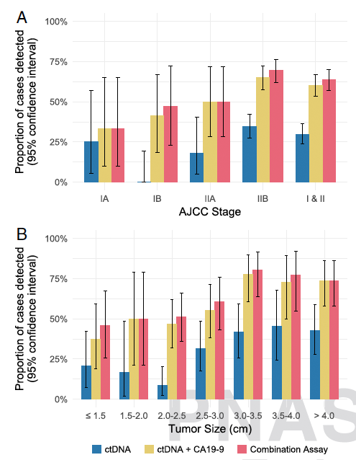
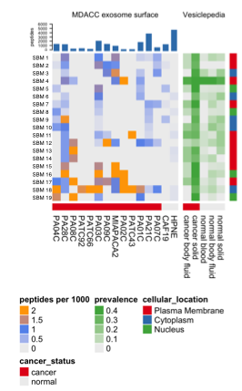
Genomic Assays for Early Detection of Pancreatic Cancer
“Level 2” blood based biomarker assay
Cost limitation - $1,000 range
Volume limitation – 8mL plasma (ctDNA or exoDNA)
Highly specific especially with multi-gene NGS panels, BUT
Sensitivity remains an issue
Isolating Cancer Specific Exosomes
Resectable
33% 71%
LAPC
50% 72%
Metastatic
52% 77%
6 antibody CSE capture cocktail
25-30% sensitivity
>99% specific
Alvarez et al Ann Oncol 2017 (AWR)
Cohen, PNAS 2017

Slide 14
Conclusions: EDRN Pancreatic Cancer Task List
Cohorts at higher risk for pancreatic cancer have been defined (families, cysts), but “sporadic” risk remains largest subset of patients
Need for biochemical risk markers in “sporadic” risk
New onset diabetes is an easily ascertainable clinical sign for an occult pancreatic cancer but only 1% of NOD have cancer
Need for biomarkers that will distinguish T2DM from T3cDM
Meaningful early detection of pancreatic cancer means diagnosis at asymptomatic stage of the disease, or advanced precursor lesion (PanIN-3)
Likely biomarker strategy will be a three (four) step strategy:
Step 1: Biochemical or clinical risk marker
Step 2: Level 1 ED biomarker (proteins/autoantibodies)
Step 3: Level 2 ED biomarker (expensive but specific genetic assays)
Step 4: IMAGING (did not speak about this but big unmet need)

Slide 15




ACKNOWLEDGEMENTS
NCI DCP
Sudhir Srivastava
JoAnn Rinaudo
Lynn Sorbara
Christos Patriotis
Jacob Kagan
Sharmistha Ghosh
Matthew Young
Paul Lampe
Edward Lo
Max C. Schmidt
Michele T. Yip-Schneider
Margaret A Tempero
MDACC
Sam Hanash
Michela Capello
Ziding Feng
Nabihah Tayob
Mark Hurd
Sean J Mulvihill
Matthew A Firpo
Randall Brand
NCI U01CA200468 (EDRN CVC)
NCI U01CA196403 (MCL Consortium)
NCI/NIDDK U01DK108328 (CPDPC)
PanCAN EDI
Paul Brennan Ghislaine Scelo
Peng Li

