Slide 1



Unique approach combining avatar mice and targeted mass spectrometry to identify blood biomarkers for early detection of breast cancer
Amanda Paulovich, M.D., Ph.D.
Member, Clinical Research Division
Fred Hutchinson Cancer Research Center
Mike Lewis, Ph.D.
Associate Professor
Baylor College of Medicine
Steve Skates, Ph.D.
Massachusetts General Hospital

Slide 2
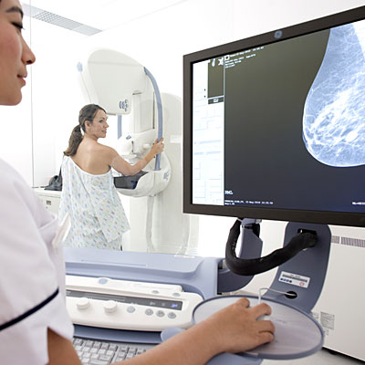
Our clinical goal is to identify a blood-based biomarker that could be used in conjunction with mammography to improve sensitivity and specificity.
Limitations of Mammography
Specificity of mammography for distinguishing benign vs. cancerous lesions
Sensitivity of mammography in some patient populations (e.g. dense breasts)
Over-diagnosis (e.g. some DCIS).
This hypothetical biomarker would be impactful by detecting treatable cancers missed by mammography (mortality), and by allowing patients to avoid unnecessary procedures for benign disease (morbidity).

Slide 3
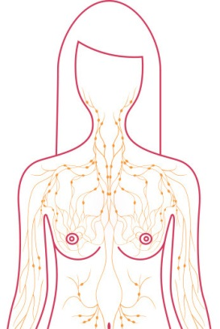

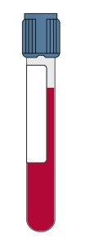
Human proteins are present in the plasma of mice harboring breast cancer xenografts.
Human proteins are detected in the mouse plasma by mass spectrometry.
mouse
human-in-mouse breast cancer xenograft
We hypothesize that a subset of the human tumor-derived proteins in the plasma of xenografted mice will be elevated in the plasma of women with breast cancer, and that a subset of these will be useful for early detection.

Slide 4

Using the mouse PDX model as a conduit for discovering candidate breast cancer biomarkers offers advantages.
All human proteins in the plasma are, by definition, tumor-derived. This should bias the biomarker candidate pool towards tumor-specific proteins.
The mass spectrometry approach to discovering candidate biomarkers from plasma is greatly simplified, because quantification is not necessary in the discovery phase (i.e. results are binary).
If successful, this approach provides a road map that can be applied to additional solid tumors.

Slide 5
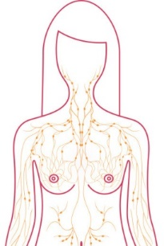


Identify human-specific peptides
(derived from the human tumor xenograft)
LC-MS/MS
PDX
mouse
targeted LC-MS with isotopic standard peptides spiked-in
candidate circulating tumor markers
human
breast
cancer
candidate detected
candidate not detected
check for detection/elevation in plasma pools from cases & controls
detected/elevated in cases
not detected/not elevated in cases
build, validate assays
biomarker validation studies
no further studies
highest priority
candidates
Notes:
Figure 8. Overview of Research Plan and decision tree. Despite considerable effort, attempts to identify blood-based screening biomarkers for early detection of breast cancer have failed, due to technological and methodological limitations. Clearly new approaches are warranted. We are proposing a completely novel strategy, based on the initial discovery of candidate biomarkers in the plasma of “avatar mice” (harboring early passage human breast cancer xenografts), and followed by biomarker triage and validation using our novel biomarker pipeline based on targeted forms of mass spectrometry (MS): Accurate inclusion Mass Screening (AIMS) and multiple reaction monitoring (MRM). If successful, this study could provide a road map for applying this general approach to other cancer sites, beyond breast cancer.
Briefly, candidate circulating biomarkers identified in the avatar mouse plasma will be verified in the plasma from the human patients and prioritized for further testing based on integrative proteo-genomic analyses using large breast cancer datasets generated by NCI consortia (TCGA and CPTAC). A novel, multiplex MRM-based assay will be developed and analytically validated (according to established fit-for-purpose guidelines) to quantify up to 50-100 prioritized biomarker candidates. Candidate biomarkers will be evaluated in an existing, strongly unbiased collection of plasma samples in which plasmas were collected prior to biopsy, compliant with PRoBE study design criteria, under an SOP from women with undiagnosed mammographic lesions. Performance of the candidate biomarkers will initially be assessed in a training set (100 cases, 100 controls) to verify which candidates show a mean difference in plasma levels between cases vs controls, and to test the possibility of building a multiple marker prediction model. Subsequently, individual candidate biomarkers (as well as a potential multiple marker prediction model) will be assessed in an independent testing set (150 cases, 150 controls) to estimate the sensitivity and specificity of the markers/panel.

Slide 6

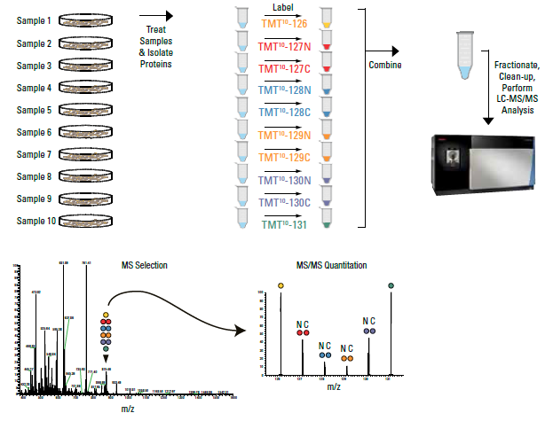
TMT allows relative quantitation of 10 samples at a time.
Deplete plasmas
Trypsin
digestion
Isobaric
labeling
Pool samples
Chromatographic
fractionation
LC-MS
Notes:
https://www.thermofisher.com/us/en/home/life-science/protein-biology/protein-mass-spectrometry-analysis/protein-quantitation-mass-spectrometry/tandem-mass-tag-systems.html

Slide 7
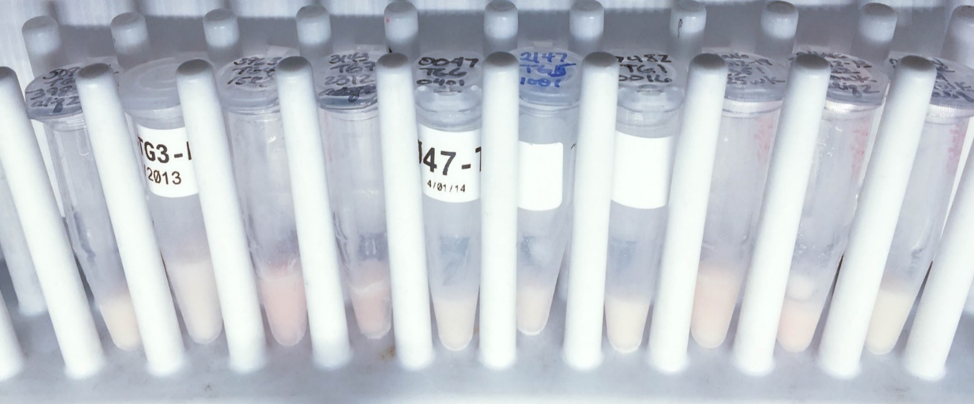
The initial step of sample
PDX plasma samples with evidence of hemolysis are contaminated with erythrocyte proteins and were not used for proteomic analysis.
Biomarker | ER | ER | HER2 | HER2 | TN | TN | TN | Hs MG | Hs MG | Mm
Sample ID | 3989 | 1575 | 1583 | 2312 | 401 | 1001 | 16 | 2351 | 2322 | 49
To date, 28 out of 41 samples have passed this initial QC step.

Slide 8
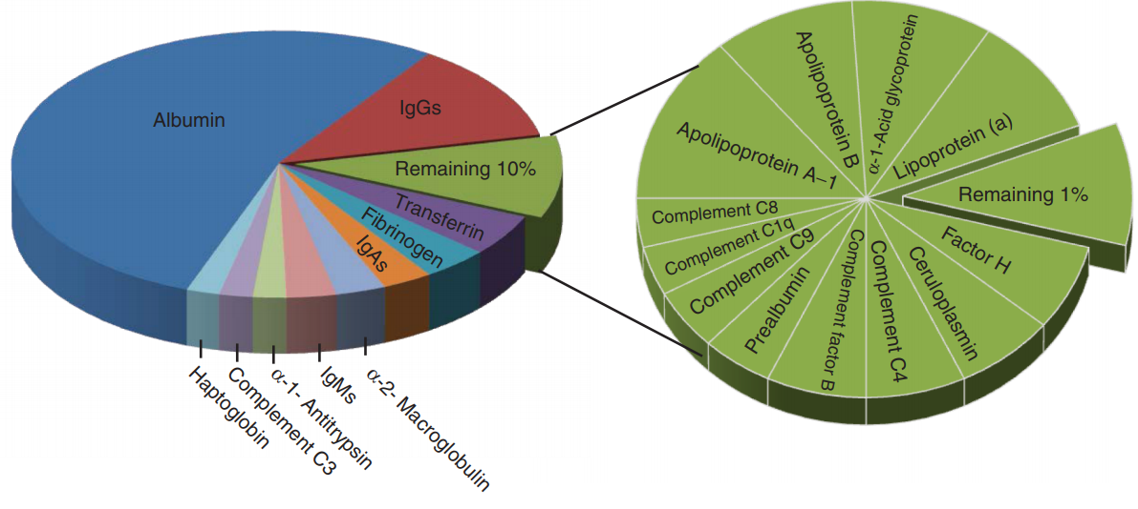
The top ~22 plasma proteins account for >99% of plasma protein mass.
Biomarkers will be low abundant proteins found in this 1% of the plasma proteome.
In order to detect low abundance protein biomarkers, we need to deplete the plasma samples of high and medium abundance proteins.
Notes:
Baker et al. Genome Medicine 2012, 4:63 http://genomemedicine.com/content/4/8/63

Slide 9
The original plan was to deplete mouse plasma of high and medium abundance proteins with a pair of affinity columns run in series.
Input
Plasma
IgY-7
Column
IgY SuperMix column
Flow through
Proteins depleted*
Albumin
Transferrin
Fibrinogen
Haptoglobin
alpha1-Antitrypsin
Depletes medium
abundance proteins
*No IgG or IgM in PDX mice.

Slide 10
However, the IgY-7 column was not available until August 2017, so we used the MARS-3 column, run sequentially.
Input
Plasma
MARS-3
Column
Flow
through
IgY SuperMix column
Flow
through
Proteins depleted:
Albumin
Transferrin
Depletes medium
abundance proteins
Each plasma sample was depleted three times with the MARS3 column, and runs were combined and concentrated.

Slide 11
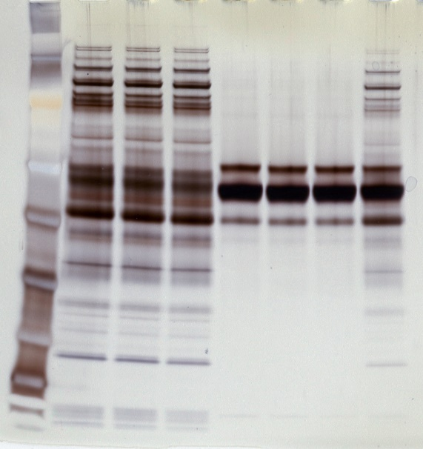
Replicate MARS depletions were highly reproducible in terms of chromatography, protein yield, and protein content.
Flow
through
Sample:
Run:
Eluate
Plasma
Run 1
1 2 3 1 2 3
191 -
A280 (mAU)
97 -
Run 2
64 -
51 -
39 -
Run 3
28 -
Flow
through
Eluate
19 -
14 kDa -
Notes:
Replicate MARS depletions for a single sample:
UV trace to the left
SDS PAGE of samples to the right
Sample = 1575 (ER)

Slide 12
A portion of the MARS3-depleted plasma was trypsin-digested, TMT-labeled, and pooled for analysis by glyco-proteomics at PNNL (enrich secreted proteins).
Glyco-capture
(PNNL)
Plasma sample
MARS-3
Column
MARS dPL plasma
IgY SuperMix column
The remainder of the MARS3-depleted sample was further depleted with the IgY SuperMix column in two successive runs.
double depleted
plasma (ddPL)

Slide 13
While the SuperMix depletion runs were highly reproducible, protein yield from sample to sample was highly variable.
Depletion 1
Y-axis = A280 nm (mAu)
Depletion 2
FT
E
X-axis: volume (mL)
Due to low protein yields of the doubly-depleted plasma, TMT labeling of the individual samples was not possible.

Slide 14
While there was not sufficient protein mass for TMT labeling, these samples should be enriched for human proteins.
Pool of 9
ddPL samples
Trypsin
digestion
Basic reverse
phase fractionation
24 fractions
LC-MS/MS
2 ER+
2 Her2+
4 TNBC
1 Reduction mammoplasty
We pooled & analyzed the unlabeled, double-depleted plasma samples from 9 PDX mice for LC-MS/MS analysis.

Slide 15
Data were searched at PNNL and FHCRC using complementary software packages and strategies.
PNNL
FHCRC
MS/MS search: MS-GF+ tool
Human and mouse RefSeq db
MS/MS search: MaxQuant
Human + mouse Uniprot db
Human
Mouse
Human
Mouse
7,319
20%
13,187
37%
15,597
43%
4,592
21%
8,171
37%
9,109
42%
While the peptide numbers varied with the two search engines, the proportion of mouse and human IDs were very similar.

Slide 16
Data were stringently filtered to remove peptides mapping to spectra that gave IDs in both the mouse and human databases.
PNNL
7,319
FHCRC
4,592
3,323
3,996
596
MS/MS search: MaxQuant
human Uniprot db
mouse Uniprot db
Spectra filter
3,337 human peptides
951 human proteins!!
572 proteins (60%) have ≥ 2 unique peptides.
Notes:
Spectral filter removed 16.5% of peptides ((3996-3337)/3996)
And removed 14.6% of proteins ((1113-951)/1113)
Note: 141 of 3337 peptides contain NXS/T motif (4.2%)

Slide 17
The human proteins in PDX plasma are enriched for extracellular vesicles and RNA binding proteins.
GO Cellular Component | gene count | FDR
extracellular exosome | 533 | 7.64E-234
extracellular vesicle | 534 | 7.64E-234
membrane-bounded vesicle | 547 | 9.14E-200
vesicle | 548 | 5.77E-194
extracellular region part | 555 | 2.46E-192
more…
GO Molecular Function | gene count | FDR
RNA binding | 216 | 7.69E-52
poly(A) RNA binding | 185 | 1.52E-51
protein binding | 383 | 3.92E-41
binding | 612 | 3.52E-27
peptidase regulator activity | 55 | 2.69E-25
more…
We hypothesize that extracellular vesicles are the primary origin of human proteins observed in the mouse plasma.

Slide 18
Consistent with this hypothesis, we compared our data with an extracellular vesicle (EV) data set generated from the NCI-60 cell line collection.
EDRN PDX proteins
(951)
NCI-60 EV proteins
(6,014)
164
787
5,227
Oncotarget. 2016 Dec 27; 7(52): 86999–87015, PMCID: PMC5341331
83% of the human proteins identified the PDX plasma have also been identified in purified EVs from the NCI-60 cell lines.
Notes:
Proteomic profiling of NCI-60 extracellular vesicles uncovers common protein cargo and cancer type-specific biomarkers.
Stephanie N. Hurwitz, Mark A. Rider, Joseph L. Bundy, Xia Liu, Rakesh K. Singh, and David G. Meckes, Jr.
Oncotarget. 2016 Dec 27; 7(52): 86999–87015, PMCID: PMC5341331

Slide 19
The 164 proteins not previously identified in EVs may also be EV proteins.
EDRN proteins
(951)
NCI-60 EV proteins
(6,014)
164
787
5,227
GO Cellular Component | gene count | FDR
extracellular space | 55 | 6.41E-25
extracellular region part | 89 | 6.41E-25
extracellular exosome | 78 | 6.41E-25
membrane-bounded vesicle | 81 | 2.35E-21
blood microparticle | 21 | 2.35E-21
more…

Slide 20
EDRN Pilot Project: Collaboration with PNNL
Karin Rodland and Tao Liu
Glyco-capture
(PNNL)
Plasma sample
MARS-3
Column
MARS dPL plasma
IgY SuperMix column
double depleted
plasma (ddPL)
Results support the exosome hypothesis.

Slide 21
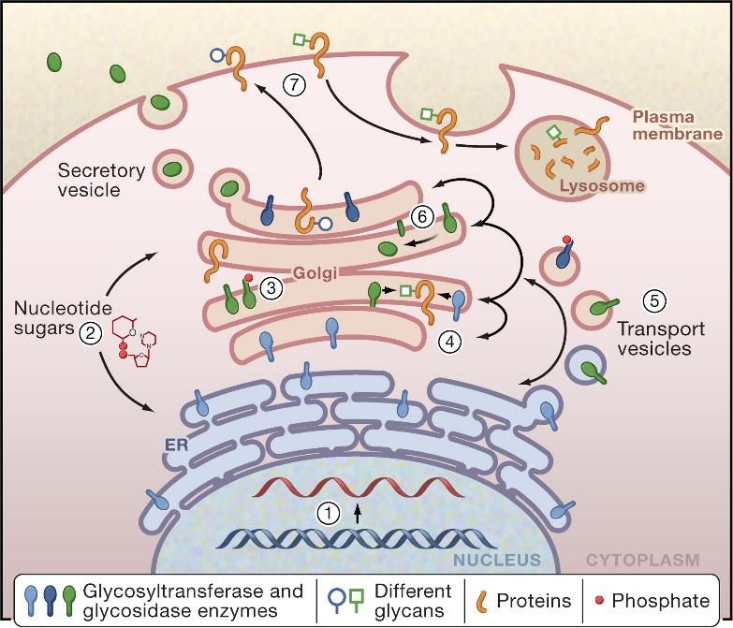
Glycocapture enriches for proteins shed or secreted into plasma.
Glycosylation is added as proteins pass though the ER/Golgi
N-glycopeptides can be captured via hydrazide chemistry
The glyco capture approach is complementary to the bRP fractionation of the doubly depleted plasma.

Slide 22
Only 17 glyco-capture candidates were identified from two independent searches of the data.
FHCRC search
10 human glycopeptides
(10 genes)
PNNL search
11 human glycopeptides
(10 genes)
6
4
7
Peptide sequence | Search | Gene symbol | UniProtID | Protein name [function]
VSNQTLSLFFTVLQDVPVR | FHCRC + PNNL | A2M | P01023 | Alpha-2-macroglobulin [protease inhibitor]
ADGTVNQIEGEATPVNLTEPAK | FHCRC + PNNL | APOD | P05090 | Apolipoprotein D [complex with lecithin-cholesterol acyltransferase]
YQFNTNVVFSNNGTLVDR | FHCRC + PNNL | BTD | P43251 | Biotinidase [Catalytic release of biotin]
VILILDPAISGNETQPYPAFTR | FHCRC + PNNL | MGAM | O43451 | Maltase-glucoamylase, intestinal [starch digestion]
DNNSIITR | FHCRC | BCHE | P06276 | Cholinesterase [Esterase ]
NLSINNDLNLR | FHCRC | EFCAB6 | Q5THR3 | EF-hand Ca-binding domain-containing protein 6 [Negatively regulates the AR]
EMLPFWMNSTGRR | FHCRC | ENPP6 | Q6UWR7 | Ectonucleotide pyrophosphatase/phosphodiesterase family member 6 [Choline-specific glycerophosphodiester phosphodiesterase]
SATVNLTVIR | FHCRC | IGSF5 | Q9NSI5 | Immunoglobulin superfamily member 5 [cell adhesion]
NATYFSMADK | FHCRC | ZBED9 | Q6R2W3 | SCAN domain-containing protein 3 [RNA pol II transcription factor activity]
CNLVDIGQATNNR | FHCRC | ZDBF2 | Q9HCK1 | DBF4-type zinc finger-containing protein 2 [nucleic acid binding]
TVLTPATNHMGNVTFTIPANR | PNNL | C3 | P01024 | Complement C3 [activation of the complement system]
NLFLNHSENATAK | PNNL | HP | P00738 | Haptoglobin [recycling of heme iron]
VVLHPNYSQVDIGLIK | PNNL | HP | P00738 | Haptoglobin [recycling of heme iron]
AFITNFSMIIDGMTYPGIIK | PNNL | ITIH4 | Q14624 | Inter-alpha-trypsin inhibitor heavy chain H4 [inflammatory response]
SGAVNSSAAR | PNNL | MASP1 | P48740 | Mannan-binding lectin serine protease 1 [endopeptidase ]
LVPVPITNATLDR | PNNL | ORM2 | P19652 | Alpha-1-acid glycoprotein 2 [blood transport protein]
PLDEENLTQENQDRGTHVDLGLASANVDFAFSLYK | PNNL | SERPINA3 | P01011 | Alpha-1-antichymotrypsin [endopeptidase inhibitor]
These findings are consistent with the EV/exosome hypothesis.

Slide 23
Next step: narrowing down the candidate list.
CPTAC breast cancer
proteomic dataset
(11,463 proteins)
EDRN PDX proteins
(951 proteins)
21
930
10,533
96% of the human proteins identified in the PDX plasma are expressed in human breast cancers.
Notes:
We compared our list of proteins to the CPTAC breast tumor proteomic data set.

Slide 24
Although candidate proteins were enriched in breast cancer, none was observed exclusively in breast cancer.
74% of circulating proteins were seen in all CPTAC breast tumor samples, while only 25% were seen in all ovarian tumors, and 17% in all colon tumors.
Notes:
While there were very few breast tumor specific proteins, the human proteins circulating in the PDX plasma were most similar to breast tumor samples

Slide 25
Using a data set of cultured human mammary epithelial cells (HMECs), we can subtract out proteins seen in normal breast epithelial cells.
170
EDRN PDX proteins
(951)
20
4,511
CPTAC breast tumors
(11,463)
1
760
6,022
798
HMEC proteins (7,581)
170 breast cancer-associated proteins were observed in the plasma of the PDX mice.

Slide 26
Top 5 enrichment classes for the 170 candidates
GO Cellular Compartment | gene count | FDR
extracellular space | 94 | 1.26E-67
extracellular vesicle | 119 | 3.31E-64
extracellular region part | 130 | 9.12E-64
extracellular exosome | 118 | 1.69E-63
membrane-bounded vesicle | 122 | 6.34E-58
GO Biological Process | gene count | FDR
protein activation cascade | 20 | 1.96E-22
negative regulation of peptidase activity | 26 | 2.43E-18
negative regulation of hydrolase activity | 31 | 2.43E-18
negative regulation of endopeptidase activity | 25 | 1.67E-17
negative regulation of proteolysis | 27 | 7.13E-16

Slide 27
24 of the 170 breast cancer-associated proteins observed in the mouse plasma have not been observed in human plasma from healthy donors.
EDRN PDX proteins
(170)
Plasma proteins, healthy donors
(4,946)
24
146
4,804
The 146 proteins previously observed in plasma could be present at elevated levels in cancer, so remain candidates.

Slide 28
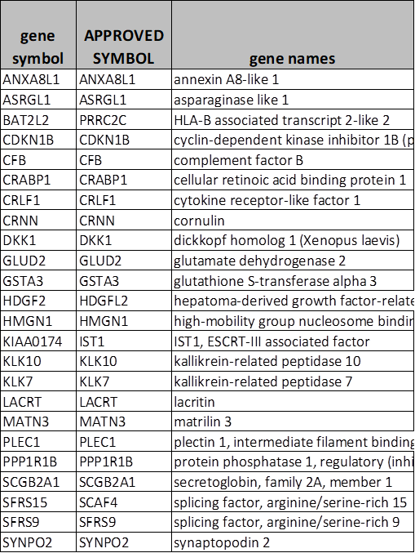
The 24 breast cancer-associated proteins that have not been observed in human plasma from healthy donors.

Slide 29
Summary
The project was delayed due to: delays in obtaining PDX plasmas that were not hemolyzed, delays in obtaining mouse plasma depletion columns.
The need to use an alternative depletion strategy led to technical challenges that reduced protein yield, requiring us to eliminate the TMT label in the first dataset.
Nonetheless, a surprisingly large number of human proteins (951) were detected in the PDX plasma, and these are highly enriched for exosome/EV proteins, suggesting that these candidates may not be generated via shedding, leakage, or secretion.
A high interest set of 170 breast cancer-associated proteins has been identified, including a subset of 24 proteins that have not been observed in healthy donor plasma.

Slide 30
Next steps
Perform additional due diligence to ensure these are really human proteins; consider analyzing normal mouse plasma.
Attempt to replicate the results with an independent set of PDX mice.
Consider enriching EVs from PDX and human plasmas for proteomic analyses.
AIMS analyses to check for candidates in the plasma of human breast cancer patients.

Slide 31

Thank you
FHCRC
Jake Kennedy
ChenWei Lin
Jeff Whiteaker
Regine Schoenherr
Travis Lorentzen
Mandy Paulovich
PNNL
Tao Liu
Karin Rodland
Vladislav Petyuk
Samuel Payne
BCM
Michael Lewis
John Landua

Slide 32
Extra Slides

Slide 33
EDRN Paulovich-Lewis Biomarker Developmental Laboratory
Criteria for advancing candidate biomarkers for additional clinical validation
Goal: Identify blood biomarker panel and classifier with high sensitivity and high specificity as aid in the early detection of breast cancer (BC)
Clinical applications:
blood test in parallel with annual mammography to detect cancers missed by mammography
  38% of breast cancers missed in women with dense breasts
  Aim: increase sensitivity for BC while maintaining same specificity as mammography
Alternative: blood test rules out breast biopsy on detection of breast lesion (by mammography, clinical exam, or self-exam)
  Aim: identify panel with (close to) 100% sensitivity, rule out biopsy for lesions with negative test

Slide 34
The NCI-CPTAC Breast Lesion Plasma Biorepository
Collection Site | Benign | Invasive | DCIS | Without diagnosis | Total
MSKCC | 300 | 62 | 41 | 4 | 407
UCSF | 217 | 49 | 15 | 1 | 282
Vanderbilt | 330 | 89 | 27 | 0 | 446
FHCRC | 398 | 62 | 27 | 0 | 487
Total | 1245 | 262 | 110 | 5 | 1622
Training sample set and Validation sample set from CPTAC Breast Lesion Plasma Biorepository
Validation sample set from Baylor mammography screening of high risk women

Slide 35
The NCI-CPTAC Breast Lesion Plasma Biorepository
Blood samples drawn prior to biopsy for women with breast lesion
Diagnosis assigned after blood draw - at pathology review of biopsy
Avoids bias
same clinic for cases and controls
stress levels same prior to diagnosis
no effect of biopsy on release of proteins from lesion
Differences due to all potential sources of bias balanced between cases and controls
patient selection
lab environment
sample handling and processing
Strongly unbiased
– PRoBE compliant

Slide 36
Training and Validation Sample Sets selected from NCI-CPTAC Biorepository
Training:
100 cases
100 controls
Validation
150 cases
150 controls
Matched by:
menopausal status
age
race
All molecular subtypes represented:
ER, PR, Her2

Slide 37
EDRN Paulovich-Lewis Biomarker Developmental Laboratory
Criteria for advancing candidate biomarkers for additional clinical validation
Clinical application:
blood test in parallel with annual mammography to detect cancers missed by mammography
  e.g. 38% of breast cancers missed in women with dense breasts
  Aim: increase sensitivity for BC while maintaining same specificity as mammography
Alternative: blood test rules out breast biopsy on detection of breast lesion (by mammography, clinical exam, or self-exam)
  Aim: identify panel with (close to) 100% sensitivity, rule out biopsy for lesions with negative test

Slide 38
EDRN Paulovich-Lewis Biomarker Developmental Laboratory
Criteria for advancing candidate biomarkers for additional clinical validation
Minimum Sensitivity/Specificity Criteria for Clinical application #1 – increase sensitivity to detect BC missed by mammography
blood test clinically useful if it:
  detected at least 10% of all breast cancers, and
  complemented mammography
  (best case: would detect over a quarter of cases missed by mammography)
  Set minimum sensitivity = 10% - less than 10% not clinically useful
Need to maintain same specificity as mammography
Specificity criteria for mammography best described by PPV
  Annual Medical Audit Data for Breast Cancer Surveillance Consortium Screening Benchmarks
  acceptable range for the positive predictive value (PPV) of an abnormal screening interpretation that results in tissue diagnosis of cancer as 3 – 8%
  minimum PPV 3%: at most 32 false positive tests resulting in a biopsy of benign breast lesions. for one true positive test resulting in a biopsy which identifies breast cancer

Slide 39
EDRN Paulovich-Lewis Biomarker Developmental Laboratory
Criteria for advancing candidate biomarkers for additional clinical validation
Sensitivity/Specificity Criteria for Clinical application #1 – increase sensitivity to detect BC missed by mammography
derive minimum specificity to achieve a PPV of 3% with a sensitivity of 10%
J = annual incidence of BC in US postmenopausal women = 350 per 100,000, i.e. J = 350/100,000 = 0.35%.
FPR (false positive rate) = 1 – specificity
true positives = J*sens
false positives = (1-J)*FPR
PPV = true positives/(true positives + false positives) = J*sens/((J*sens) + (1-J)*FPR) = 3% = 0.03
Solve: FPR = sens*J*(1-PPV)/((1-J)*PPV) = sens*0.11.
Sensitivity = 10%, require FPR = 1.1% to achieve a PPV of 3%.
1.1% FPR = 98.9% specificity - achieves minimum PPV of 3% at 10% sensitivity
At most 32 biopsies will be performed due to false positive blood tests for each breast cancer detected by the blood test.
Check: 1% of 100,000 – 350 = 1,000 – 3.5 = 996. 10% of 350 = 35 PPV = 35 / (35 + 996) = 3.4%

Slide 40
EDRN Paulovich-Lewis Biomarker Developmental Laboratory
Criteria for advancing candidate biomarkers for additional clinical validation
Benchmark for going forward with further studies with a panel of blood markers
Panel/classifier has at least 10% sensitivity at a specificity of 99%
  Determine classifier cut-off for 99% specificity in controls
  Estimate fraction of cases above this classifier cut-off – green light if > 10%
If the panel meets benchmark in CPTAC samples, likely to reach same benchmark in a screening population of US postmenopausal women.
Then blood panel/classifier warrants further clinical validation in parallel with mammography to determine whether the panel detects cancers missed by mammography – our final clinical goal.

