Slide 1
Experiences & insights on partnering in biomarker discovery towards clinical translation
32nd EDRN Steering Committee Meeting, September 12-14, 2017, Seattle, Washington
“Public Private Partnerships” session with Lynn Sorbara
Invited presenter: Gerard Davis, Ph.D.; Abbott Laboratories; Core Lab R&D; Oncology & CDx
Notes:
Thank you Lynn Sorbara, Dan Chan, and EDRN for invitation to present today

Slide 2
Opening comments

Slide 3
Public private partnership perspective
Stakeholders in developing effective tests
Patient &
advocates
Discovery
(Academia)
Clinician
Today’s Objective:
Share IVD Co background, and perspectives & experiences in collaboration/partnership
In vitro Dx
(IVD) test Getting to the best solution?
Regulators
Laboratory
& others
IVD Co
Development,
Translation & Mfg
Notes:
- Importance of broad stakeholder participation towards successful development of next test
- Team trivia analogy

Slide 4
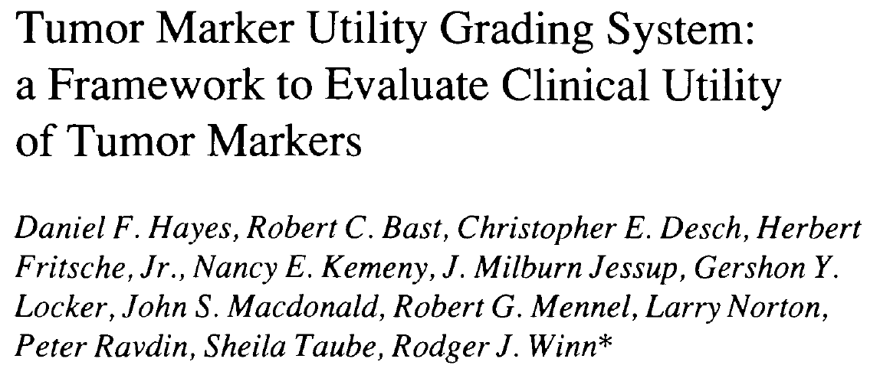
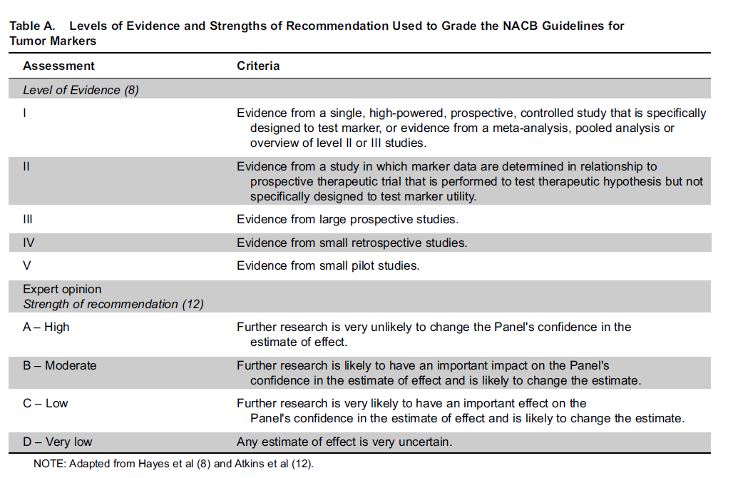
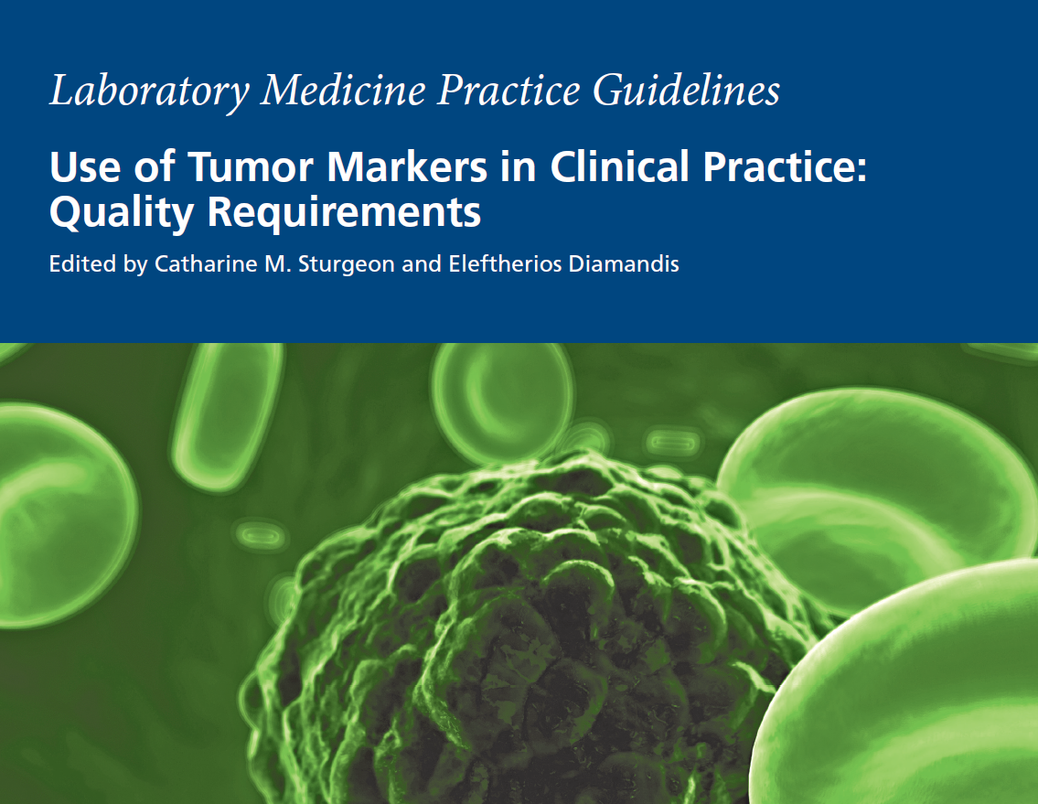
collaboration in “TMUGs” process
Tumor Marker Utility grading system
Notes:
- Great value in TMUGS guidelines – Structured validation path Initial from Dan Hayes et al., later updates from NACB
- Stakeholders share in-process to advance tests to clinics and develop adoption

Slide 5
CRC Collaborations

Slide 6
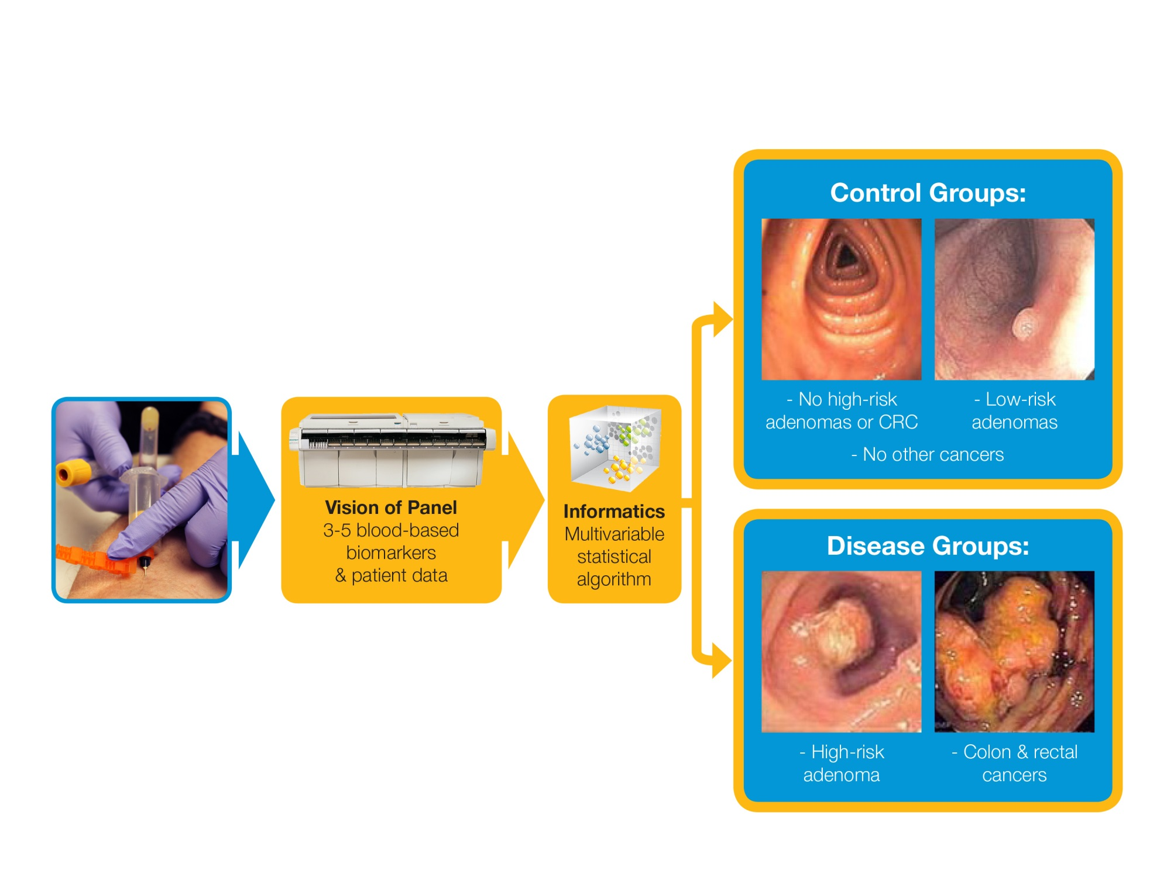
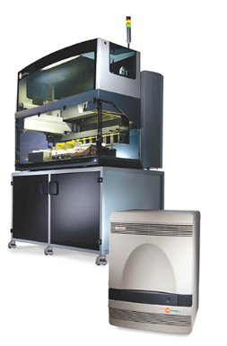
Pilot panel/algorithm area:
Biomarker panel & algorithm approach
Blood based
Panel
Informatics / algorithm
Integrated result to clinician
Notes:
- Objective: Discriminate high risk adenomas & CRC from all others

Slide 7
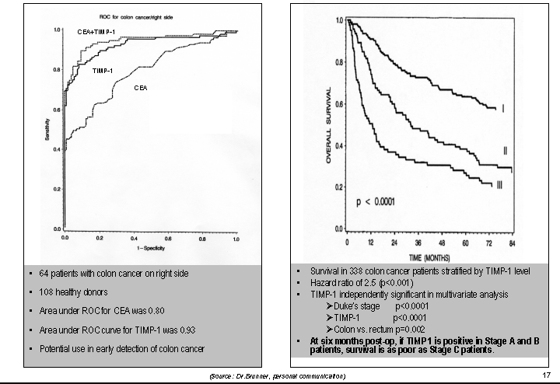
Initial report:
pilot data for a new marker
M.N. Holton-Anderson et al., Clin. Canc. Res. 8:156-164 (2002).
Notes:
Early evaluation/report suggested potential utility of TIMP-1 in CRC early detection
Note situation of “healthy donors” control set.

Slide 8
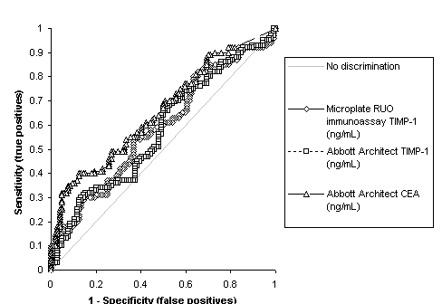
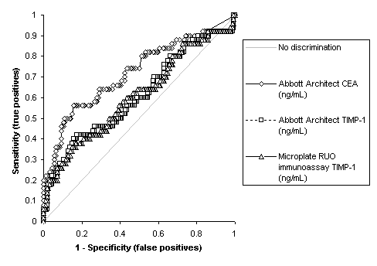
EDRN collaborative Study
Individual marker assessments: TIMP-1 & CEA
Normals & Adenomas vs. CRC
Normals vs. Adenomas & CRC
EDRN reference set (GLNE): 104 normals, 50 adenomas, 50 cancers
Research validations for TIMP-1/CEA yielded much weaker discrimination (including EDRN reference set)
Control set challenge (reflecting test “audience”)
Notes:
- EDRN & other collaboration sets to assess TIMP-1.
- Research validations yielded much weaker discriminations
- Importance of controls

Slide 9
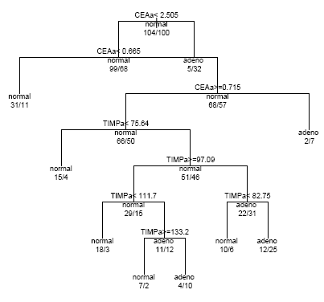
EDRN collaborative Study: Classification Trees
Sensitivity Estimates for TIMP-1 + CEA
Normals vs. Adenomas/CRCs
Early efforts included panel/algorithm approach
  Pilot classification tree to strengthen performance
9
Notes:
- Early efforts focused towards piloting panels too

Slide 10
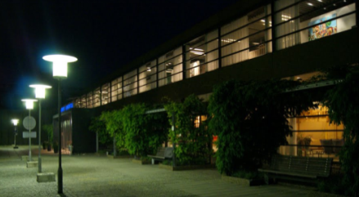
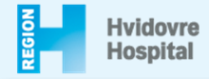
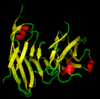
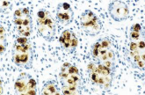
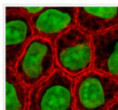
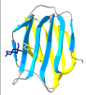
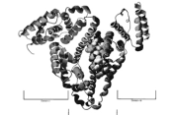
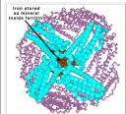
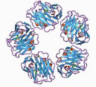
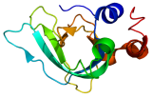

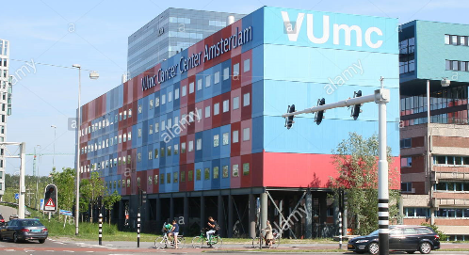
Danish endoscopy II trial
Further panel development efforts
Endoscopy II Clinical Trial (n=4698)
- Symptomatic population with no prior colorectal screening
- PI: Prof. Hans J. Nielsen at Hvidovre Hospital (Denmark)
Non-Disease Group (control):
  3320 with no high risk adenomas or CRC
  290 low risk adenomas
Disease Group:
  399 high risk adenomas*
  * >1 cm, >3 adenomas, villous elements, or high grade neoplasia
  512 CRC with >50% early stages’
  177 “Other cancers (separate)
  Markers selected for initial assessment:
    CEA, CA19-9, Cyfra 21-1, AFP
    Galectin-3, Ferritin, CRP, TIMP-1
    Platform: Abbott ARCHITECT
Notes:
-Study utilized a Danish colonoscopy trial that has blood based specimens and definitive colonoscopic information for each patient.
Objective was to develop a panel to optimally separate HRAs & CRCs from all others.
The trial included about 4700 patients.
Non-disease group patients had no colonic or rectal findings, or low risk adenomas.
Disease group patients had high risk adenomas or colorectal cancers. Cancers included about half that were localized disease.

Slide 11
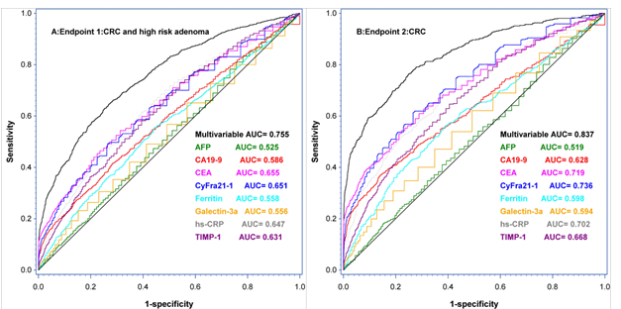
Pilot CRC panel: clinical performance
Discrimination of Non-disease/Control vs. Cancer:
CRC +/- High Risk Adenomas vs. All others
4 marker panel/algorithm similar performance as 8 markers (not shown)
Top markers/features: age, gender, CEA, Cyfra 21-1, hs-CRP, ferritin
Notes:
Panel developed/assessed in population based trial
Pilot panel/algorithm yielded respectable “proof of concept” for panel of age/gender/4 mkrs
Efforts to strengthen panel continue
An included candidate marker includes Galectin-3 ligand (Bob Bresalier); & others

Slide 12
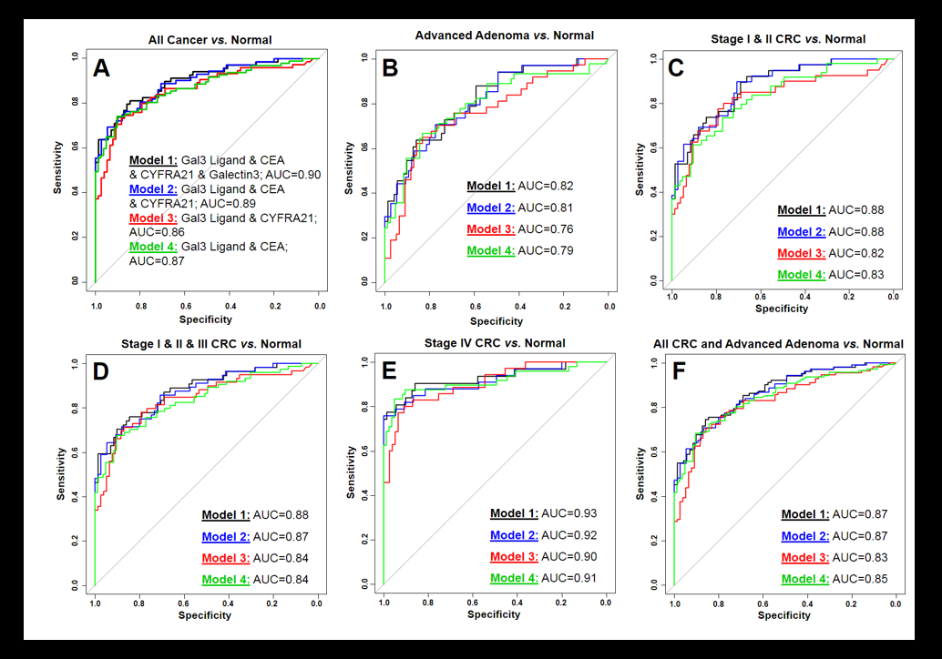
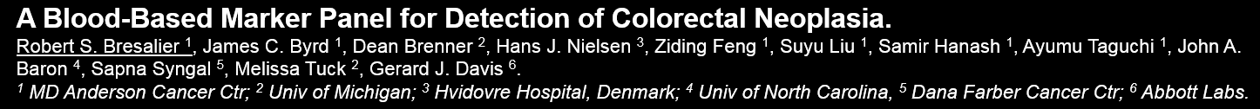
Pilot Biomarker Panels including Gal3-Ligand
Notes:
Pilot panels consisting of lead markers from prior Endoscopy II trial, Gal3-L, and several other markers
Lead pilot panels ROCs shown
Bob Bresalier presented findings at DDW & EDRN meetings in spring this year

Slide 13
HCC Collaborations

Slide 14
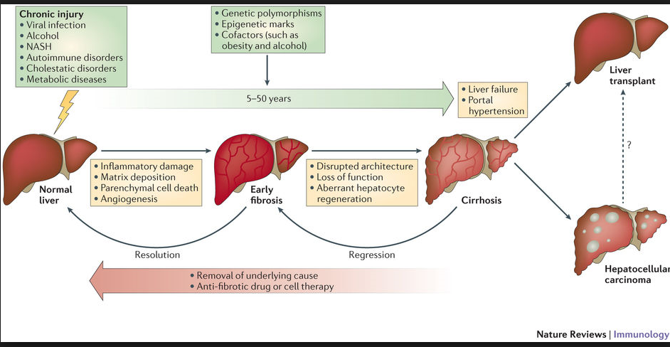
Clinical Discrimination: advanced liver disease & liver cancer (HCC)
Objective: Detection of HCC in patients with advanced liver diseases.
Reference: https://www.google.com/search?q=picture+of+liver+disease+progression+to+cancer&safe=active&tbm=isch&tbo=u&source=univ&sa=X&ved=0ahUKEwjii5TqmY7WAhXnNJoKHeZRARsQsAQIQQ&biw=1920&bih=912#imgrc=tOppqp8-v-78kM:&spf=1504805895386
Notes:
Shared effort in HCC
Series of markers assessed in pilot studies with JHMI and EDRN

Slide 15
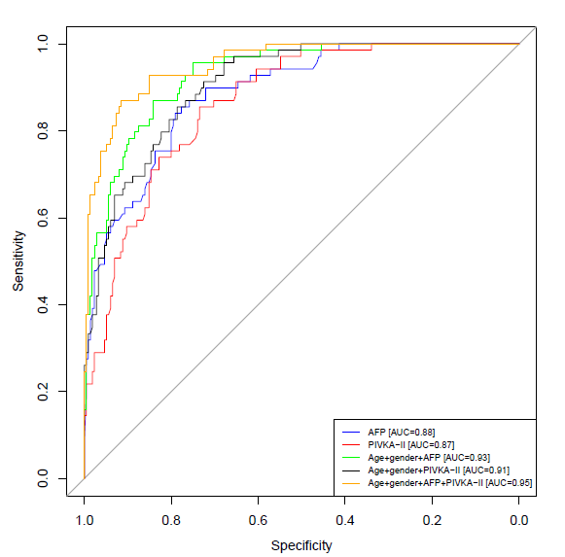
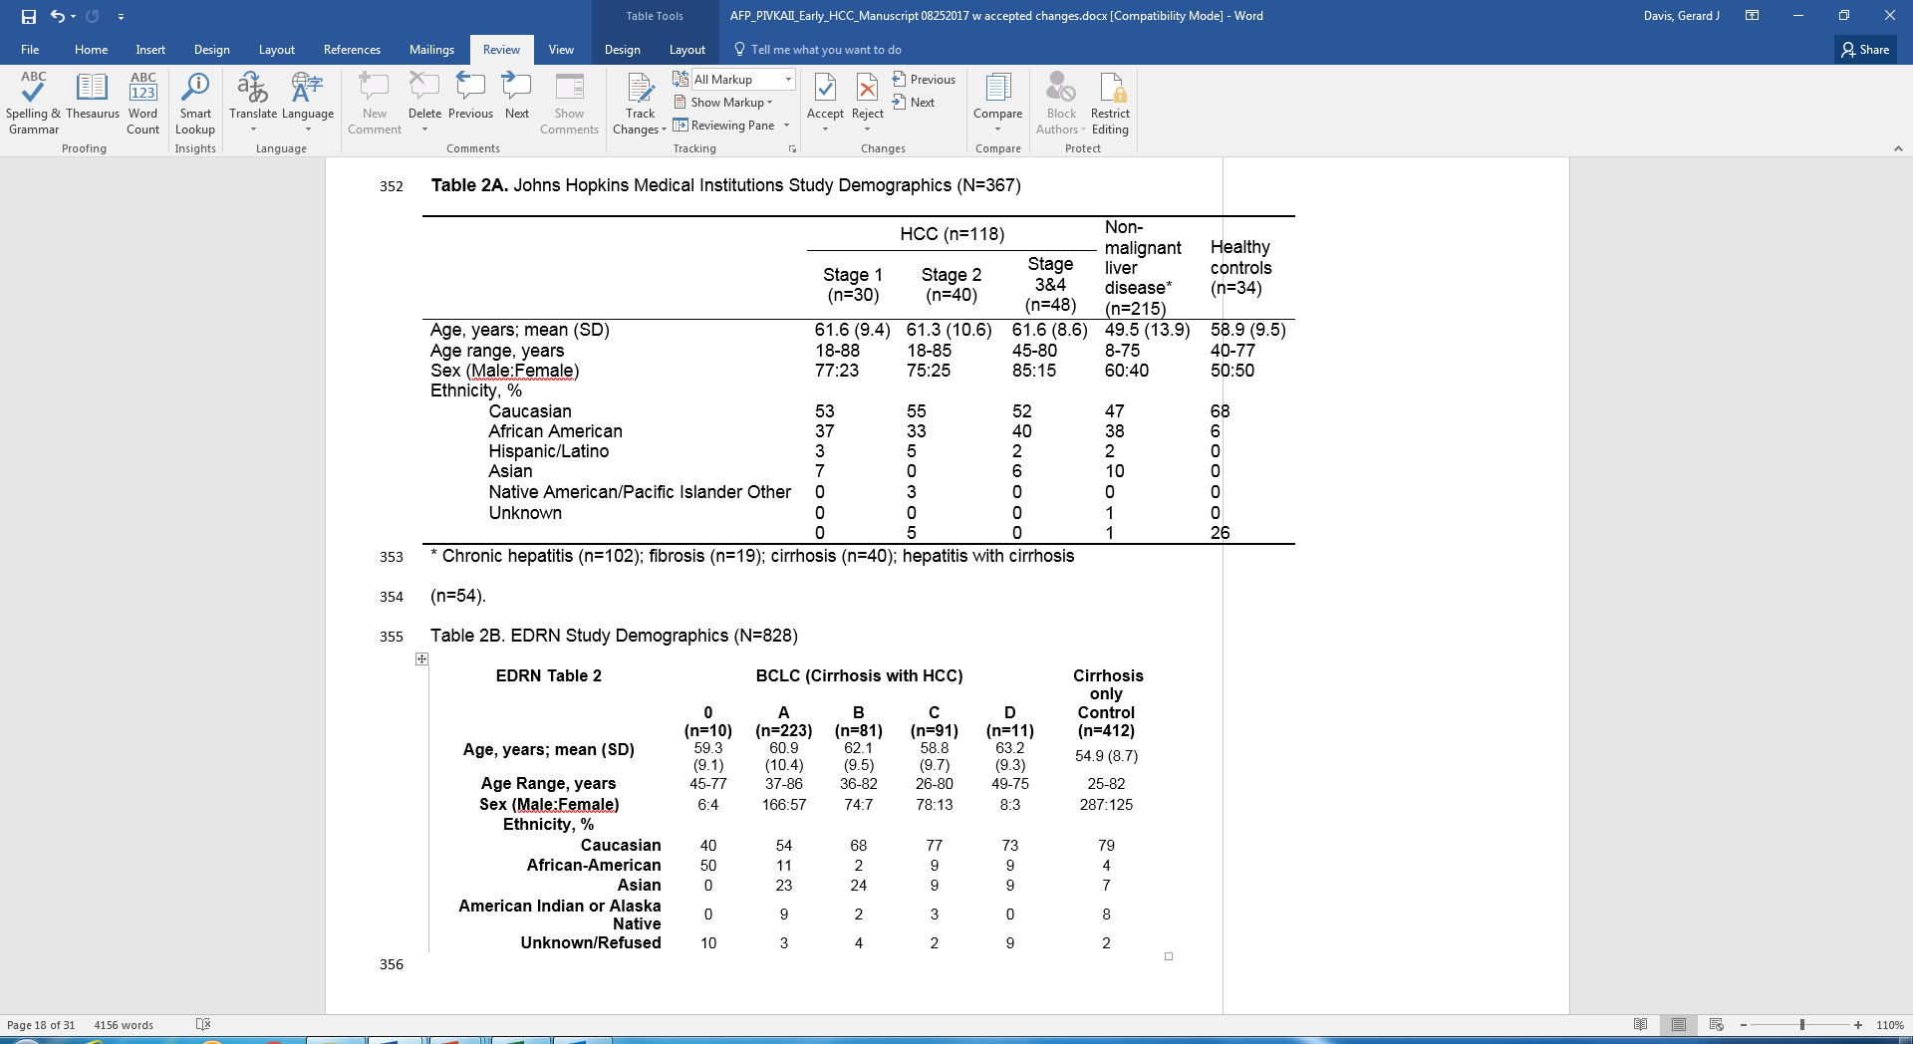
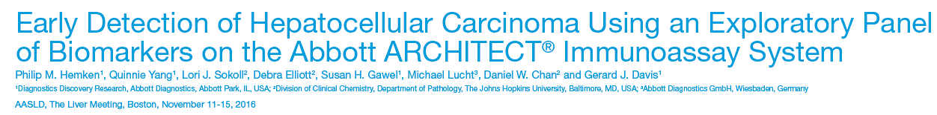
JHMI cohort: Developing a pilot panel
Notes:
Efforts to develop a pilot panel
JHMI case/control specimen set utilized
Series of markers assessed for developing a panel.
Top markers: AFP, PIVKA
Algorithm included age, gender, AFP, PIVKA
Pilot data presented at AASLD (Phil Hemken)

Slide 16
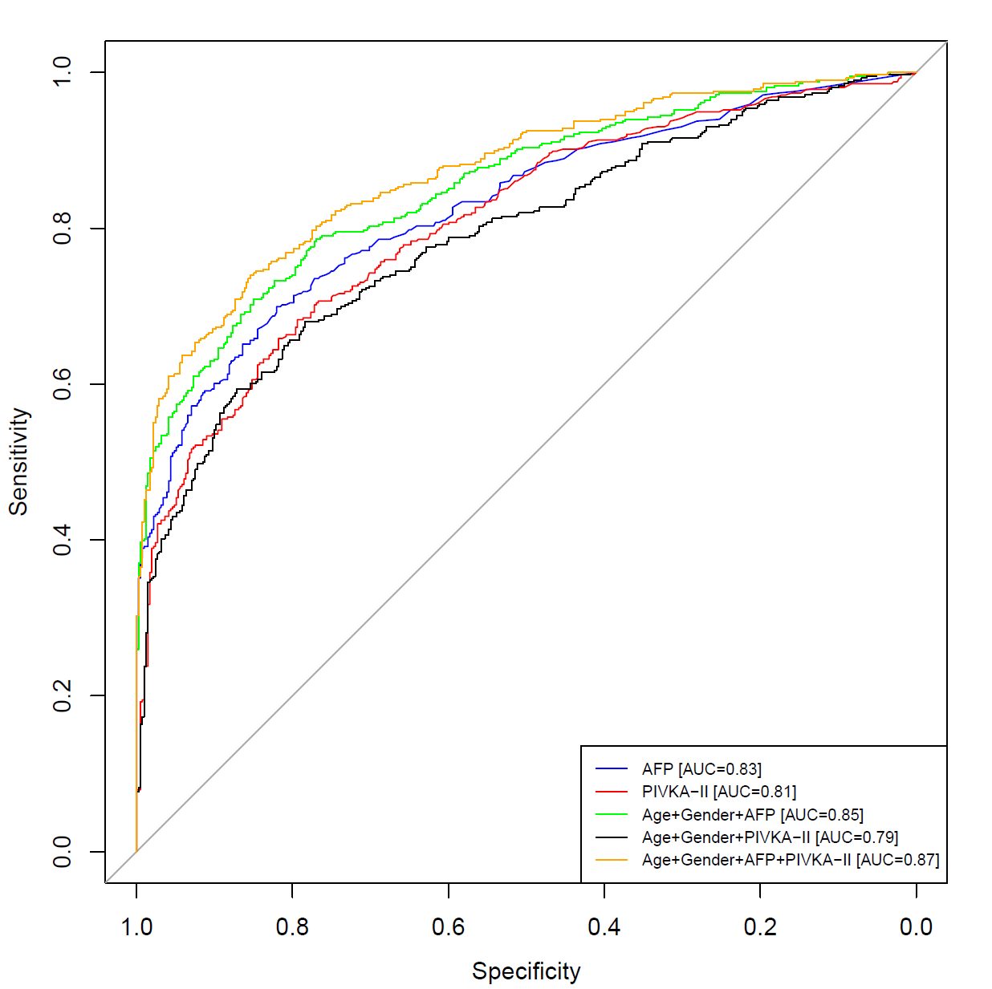
EDRN cohort: assessing the pilot panel
AFP and PIVKA-II for Early Detection of Hepatocellular Carcinoma: A Retrospective Case-Control Study. Lori J. Sokoll¹, Philip M. Hemken², Xiaoqing Yang², Jianliang Dai³, Debra Elliott¹, Susan H. Gawel², Michael Lucht², Ziding Feng³, Jorge A. Marrero⁴, Sudhir Srivastava⁵,Daniel W. Chan¹, Gerard J. Davis²
Notes:
Research validation with EDRN data yielded reasonable performance.
Path to finalizing a panel/format, and validation being considered
Efforts on-going to publish

Slide 17
Biologics & assay considerations

Slide 18
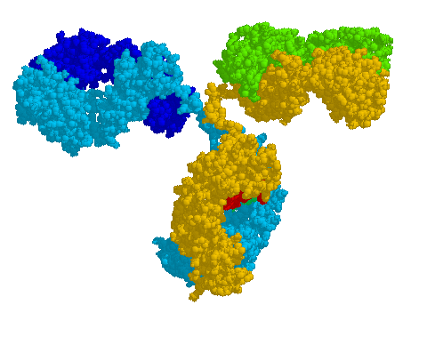
Biologics Discovery
Strong capabilities for developing targeted and novel biologic reagents (monoclonal antibodies, recombinant antigens, recombinant Fabs, etc.)
Broad competencies for hybridoma development, cell culture, antibody purification and fragmentation, animal immunization, and analytical characterization
Capitalizes on 30+ years of internal development experience including a vast bank of catalogued hybridoma cell lines
Track record of designing reagents capable of driving best-in-class immunoassay performance (e.g. HIV Ag/Ab 4th Gen, hsTnI)
Advanced methods and expertise, assuring high performance, efficient/stable cell lines, and scalable/manufacturable processes
Multiple PMA and BLA approved biologics demonstrating firm compliance with FDA regulations
September 11, 2017
18
Notes:
IVD companies has strengths in assay component & robust prototype assay building

Slide 19
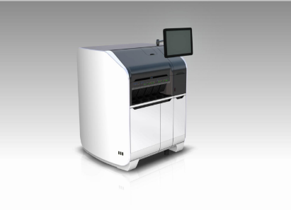

In vitro diagnostics Systems
IVD analyzers are automated high throughput, random access instruments for the clinical laboratory (e.g. ARCHITECT, Alinity)
The immunoassay format utilizes chemiluminescent microparticle immunoassay (CMIA) technology
Biomarker
Acridinium
Paramagnetic microparticle
Monoclonal Antibody
Monoclonal Antibody
September 11, 2017
19
Notes:
IVD systems can be utilized in appropriate research settings
Benefits include:
Assay with level of analytical development
Automated nature of data generation

Slide 20
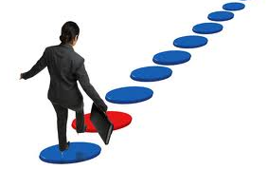
Closing comments
Strengths of EDRN:
Common objective/charter
  Focus on aiding in early detection of cancer
  Help address this clinical need
Open, with inclusion of participants with diverse backgrounds
Reference specimen sets to assess markers
Future considerations:
Continue efforts to engage diverse stakeholders
Explore potential rapid prototyping on IVD platforms earlier
Explore mechanisms for greater openness in analyses of collaboration study data

Slide 21
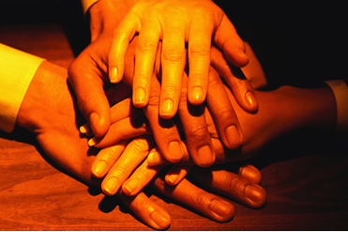
Closing Comments
&
Questions

