Slide 1
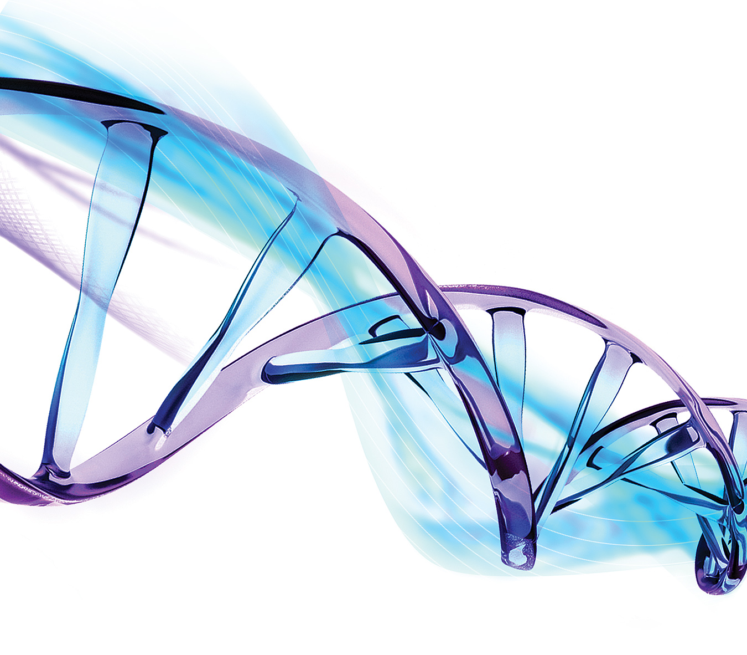
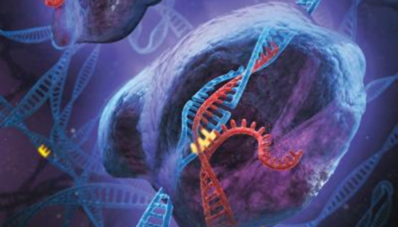

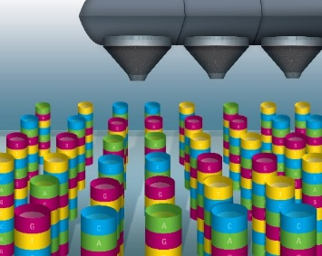


Elucidating Cancer Mechanisms Through Integrated Biology
Carolina Livi
Academic Segment Manager, Disease Research and Toxicology
Sept 2017

Slide 2
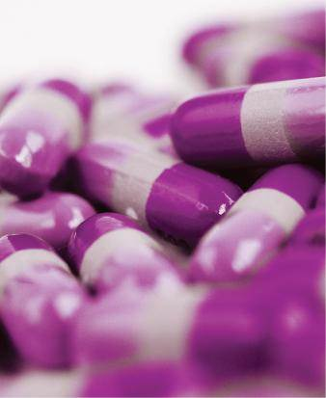
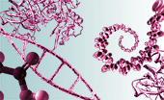
Highlights of Agilent Research Biomedical Solutions in Action
DIAGNOSTICS
Agilent’s GC/MS and LC/MS help find new metabolic markers that may change how we treat heart disease.
PHARMA
Our analytic products support every step of multi-omics integrated biology research.
ACADEMIA
ACADEMIA
For Research Use Only. Not for use in diagnostic procedures.
Notes:
Antibodies
Dako’s Anti-TdT is used to help classify lymphoma and leukemia. Anti-CK 8/18 is used to help classify tumors of unknown origin. Both products provide excellent specificity and sensitivity, and have been reviewed and accepted by key pathology experts.
Heart disease
Heart disease is the leading cause of death in many parts of the world. A major contributing factor is atherosclerosis (hardening of the arteries). The Center for Metabolomics and Bioanalysis in Madrid, Spain recently discovered metabolic markers that may change the way we treat atherosclerosis. The discovery indicates that atherosclerosis patients who are additionally treated for insulin resistance may achieve better results.
World Cup
The Brazilian Army’s Mobile Testing Laboratory includes Agilent solutions to keep spectators safe during the 2014 FIFA World Cup. The mobile labs are at-the-ready to test any suspicious chemical or biological material. Threats might include anthrax or plague. The mobile lab can provide an answer within 30 minutes. [Agilent’s GCMS system and Agilent consumables are in the mobile lab.]
Pesticides
Agilent worked closely with international food-safety experts to create a library and database that enables clear and decisive identification of even the most challenging pesticides and unknown contaminants. This is the first-ever pesticide database that allows scientists to test for 700+ known and unknown pesticides.

Slide 3
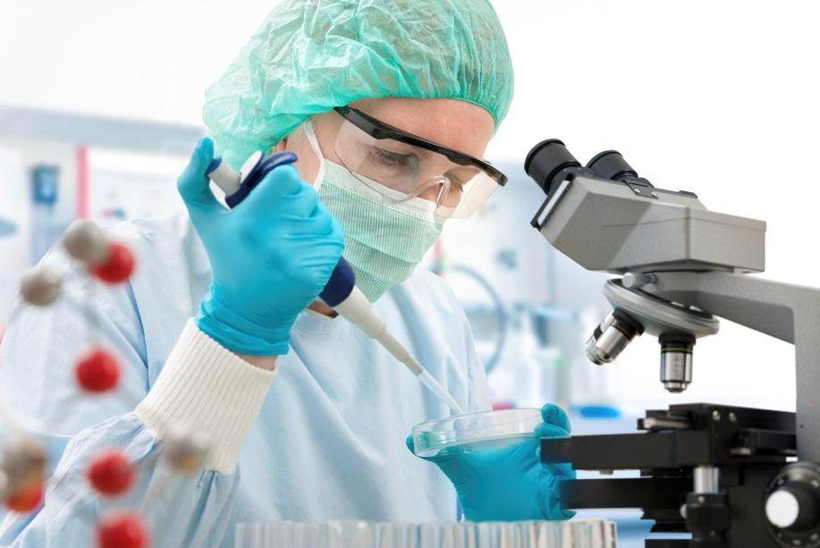

Our Support of Universities and Thought Leaders
UNIVERSITY RESEARCH
THOUGHT LEADER PROGRAM
Agilent’s scientists and technical staff collaborate on academic research. Our products are found in leading research and teaching laboratories.
Through its Thought Leader Program, Agilent supports scientific advancements by leading researchers around the world.
Our global connection to academia also includes educational support, recruitment of top university talent and philanthropy.
We contribute financial support, products and expertise to research in the life sciences, diagnostics and applied chemical markets.
For Research Use Only. Not for use in diagnostic procedures.
Notes:
Agilent takes an active role in supporting higher education and research around the world. This commitment to universities takes the form of research collaborations, research tools, education support, recruiting of top university talent, and philanthropy. Programs include:
The Agilent Thought Leader Award: Agilent promotes fundamental scientific advancements by contributing financial support, products and expertise to the research of influential thought leaders in life sciences, diagnostics and chemical analysis.
Contributions of expertise, products and financial support to academic research: Our connections with the academic research community in our fields of endeavor build enduring partnerships with thought leaders, educate the next generation of employees and customers, inform our development efforts, and result in publications that define important applications of life sciences, diagnostics and applied chemical technologies.

Slide 4
Biology Is Integrated Multi-omics Increases Biological Understanding
DNA
Master program
RNA
Sub-routine
Protein
Execution of sub-routine
Metabolite
Product of sub-routine
Closest to phenotype
Complex regulatory processes
For Research Use Only. Not for use in diagnostic procedures.
Notes:
We are all aware that what defines biological processes are first and foremost integrated. And that the processes constitute a complex series of circuits and feedback loops that are required for maintaining homeostasis—or the healthy state.
Over the years we have developed and produced sophisticated measurement technologies that enable the user to evaluate the state of an organism at a certain level such as at the genomic, proteomic or metabolomics level. Lately, several technological advances have converged to enable omics type analyses at multiple levels. The degree with which we are now able to draw hypotheses and make conclusions, depends in part on what level of the biochemical cascade of information we choose to measure, the degree of robustness of the platform and its associated level of sensitivity. Any one type of biological measurement is important. But gaining a holistic view requires the appropriate software tools for integrating all this information, and that has proven to be very challenging.
Genomics, transcriptomics, proteomics, metabolomics - these experiments when performed alone-often lack the power to uncover meaningful correlations. We all know that DNA is transcribed into RNA that is translated into protein that produces a metabolite product. If we collect and analyze each of the omics results individually, such as transcriptomics, we do not capture the information flowing in/out of this level.
Biology is not simply the sum of it parts. We know that it is the complex regulatory steps that determine the ultimate phenotype.
Only by studying the entire system can emergent properties of interconnected levels be revealed

Slide 5
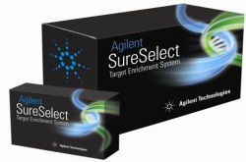
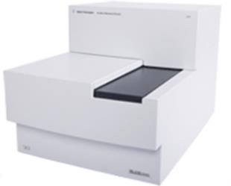
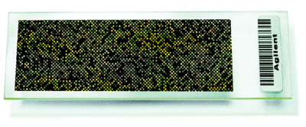
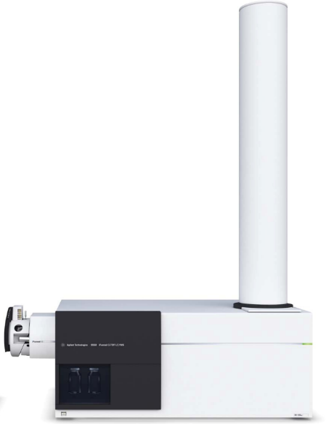
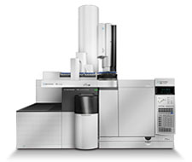
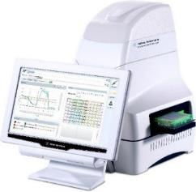
Omics Measurements
Genomics and Transcriptomics
Agilent SureSelect capture NGS
Agilent Microarrays
Agilent qPCR
Agilent Microfluidics
Proteomics
LC/MS
Metabolomics
LC/MS
GC/MS
Seahorse (functional metabolism)
For Research Use Only. Not for use in diagnostic procedures.
Notes:
Genomics measurements are very familiar to this audience so I will not go into detail on this.
Proteomics is the study of gene products aka endogenous proteins, called the proteome. While proteins have similar characteristics, the sheer complexity of the proteome presents a large analytical challenge!
The human proteome is estimated to be about 20,000 proteins. For analytical reasons, proteins are enzymatically digested so we are typically analyzing peptides from of the proteins. The most commonly used enzyme is trypsin which yields about 50 peptides per mammalian protein. So now we are looking at 1 million peptides!!!
Another challenge is dynamic range. Plasma is generally regarded as the biggest challenge as the proteins present have “leaked” from the tissue and the dynamic range is about 10¹¹!
Metabolomics is the study of endogenous metabolites, called the metabolome, which is a collection of low molecular weight (50-1,500 Da) compounds with a wide range of physiochemical properties.
Measuring the metabolome provides important information about the functional status of a biological system.
Its close proximity to the phenotype of an organism provides complementary information to genomics and proteomics.

Slide 6

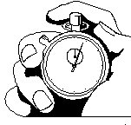


Mass Spectrometry Overview
“A mass spectrometer is an instrument that measures the masses of individual molecules that have been converted to ions...” from “What is Mass Spectrometry” by ASMS
Separate
Liquid phase (LC, SFC, CE)
Make Ions
EI or CI (GC/MS)
MS Analysis
Determine mass
ESI, APCI, etc. (LC/MS)
Gas phase (GC)
+ or -
or
130.0
130.1234
For Research Use Only. Not for use in diagnostic procedures.
Notes:
Since mass spectrometry is commonly used for proteomics and metabolomics measurements, let’s first look at mass spectrometry from a very basic level. Apologies for any MS experts in the audience for this simple analogy.
MS analysis is can be broken into 3 general steps – separate the compounds in a samples, make those compounds into ions (because MS measures ions!), then “weigh” the compounds to determine the mass. We won’t talk in detail about how ions are made today, but in all ions will typically carry either a positive charge or a negative charge. We can guide those ions into the mass spectrometry using voltage differences – much like a beam of light can be focused and re-directed.
On the mass spec side, we can either use a kitchen scale to get the mass to 1 significant digit (unit mass) or we can use a really good lab scale to get a more precise measurement. We will discuss this in more detail in the following slides.

Slide 7
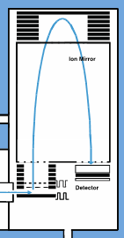
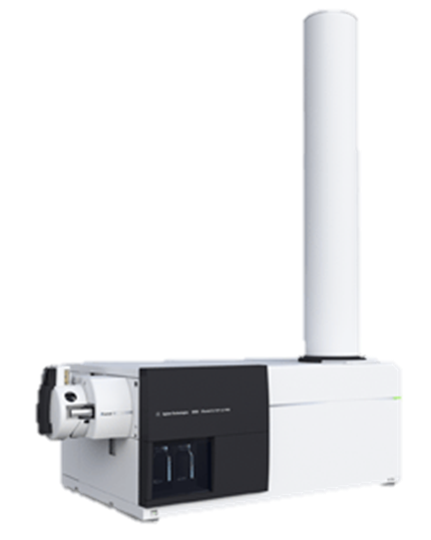
Time-of-Flight (TOF) MS Overview
130.1234
For Research Use Only. Not for use in diagnostic procedures.
Notes:
So let’s take a very brief look at those two types of scales. A time-of-flight instrument takes the ions as packet and throws those ions into a tube under vacuum. The large ions (higher mass) will move more slowly than the smaller ions and hence the ions will be separated and will be detected and accurately weight.
A TOF instrument will typically have a large tube the is the flight tube. In Agilent instruments this is the “chimney” you see on the right. For tandem MS, the time of flight will have a “cage” for trapping the ions before the TOF. This “cage” is a quadrupole mass filter. Let’s discuss quadrupole filters next.

Slide 8
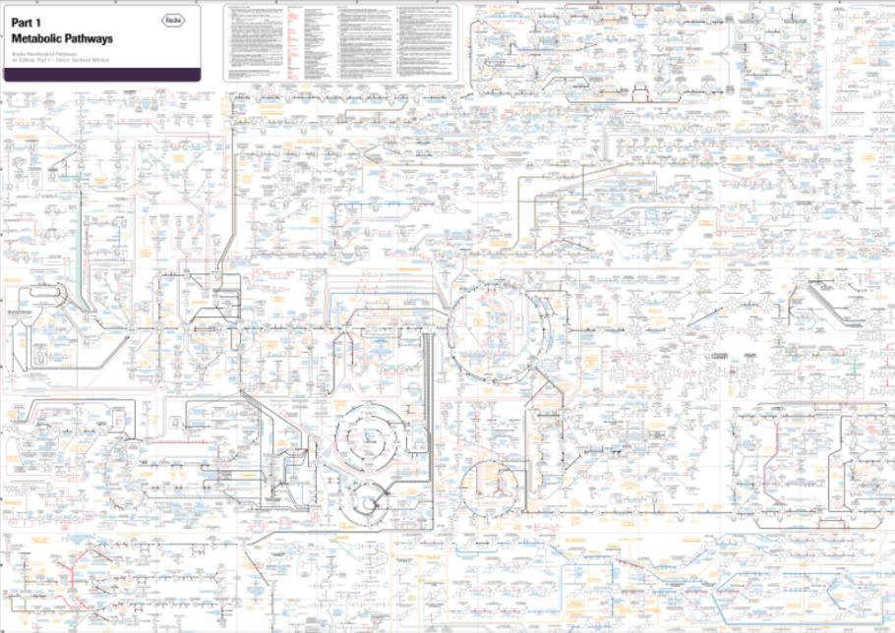
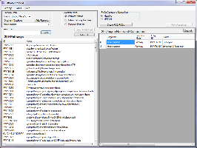

Metabolomics Overview: Discovery, Hypothesis-driven and Targeted Approaches
Targeted:
Collect data on only target proteins or metabolites
Use relative or absolute quantitation
Discovery:
Collect data for all metabolites
Use relative quantitation
130.1234
Hypothesis-driven
Collect data for all metabolites
Mine data for selected pathways
Use relative quantitation
http://biochemical-pathways.com/#/map/1
130.0
For Research Use Only. Not for use in diagnostic procedures.
Notes:
So now that you have the basics of mass spectrometry, let’s talk about what kind of data we might want to collect for a proteomics or metabolomics experiment.
If you want to measure everything in your sample that you possibly can, this is called discovery or untargeted data acquisition. You collect everything – which is easy – but then you need more time on data analysis to extract the information. From all the data. This type of metabolomics data analysis relies on extracting molecular features from the data, then doing statistical analysis to find the differential features. Those features then must be identified – typically through database search – prior to pathway analysis.
For proteomics, the MS/MS spectra are extracted from the data and those MS/MS spectra (all the fragment ions for a given mass at a given time) are then searched against a protein database. Protein databases are typically created from genomics information. After identifying the peptides present, which are then associated with the protein as part of the search, the results can be submitted to statistical analysis to determine differential proteins.
For both metabolomics and proteomics, a pathway targeted (hypothesis –driven) approach can be used to simplify the data analysis. In that case, only a known list of metabolites would be extracted or only MS/MS spectra for predicted peptides from a selected list of proteins would be collected.
A QQQ targeted approach is most commonly used for routine quantitation of known metabolites or proteins (using peptides specific to those proteins). This targeted data acquisition collects data only on those known metabolites or peptides.
While this is a limitation of QQQ methods, this approach provides higher analytical sensitivity than the discovery approach, allows absolute quantitation, and can be used for tens/hundreds of metabolites or peptides! The data can also be statistically evaluated for differential regulation.
Regardless of the approach, MS results can be mapped onto biological pathways for interpretation. We will discuss the software for this in a few minutes.

Slide 9
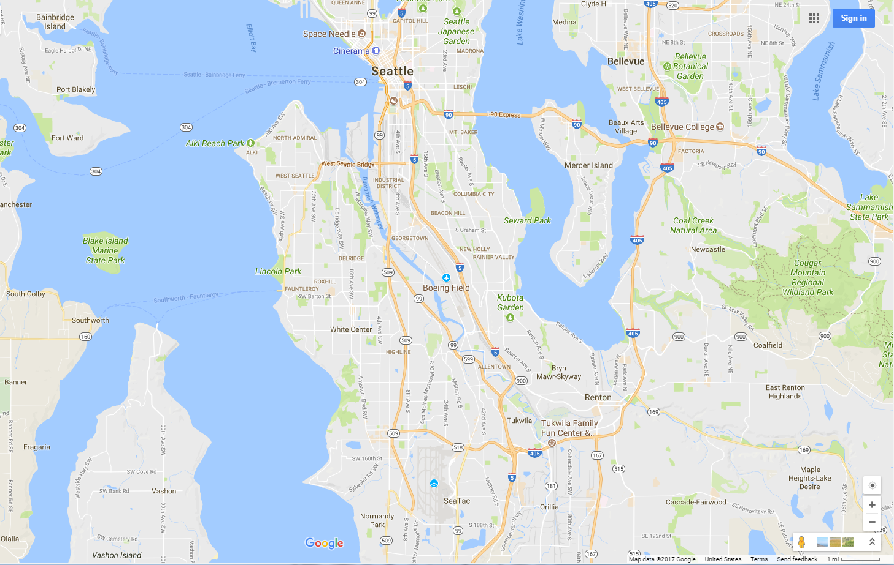
1. Route
For Research Use Only. Not for use in diagnostic procedures.

Slide 10
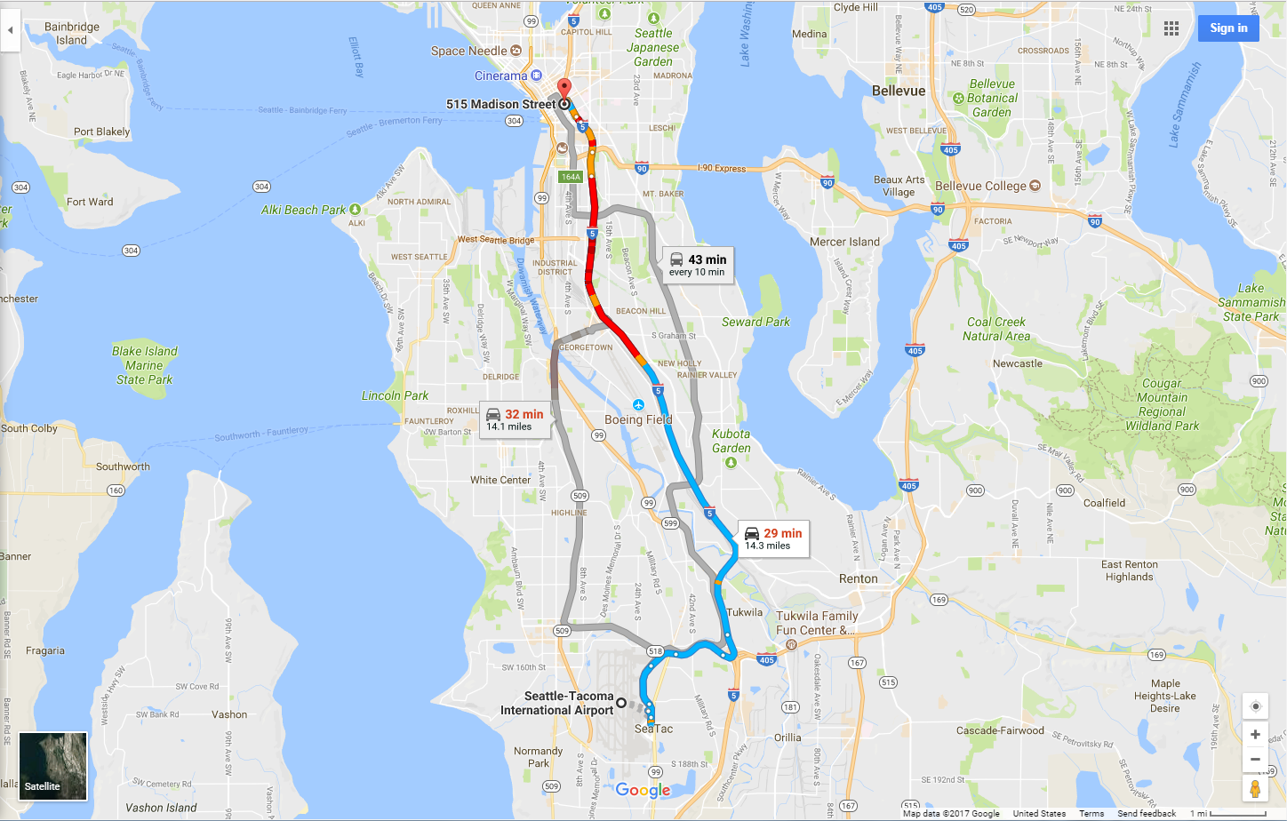
Route #1
1. Route
For Research Use Only. Not for use in diagnostic procedures.

Slide 11
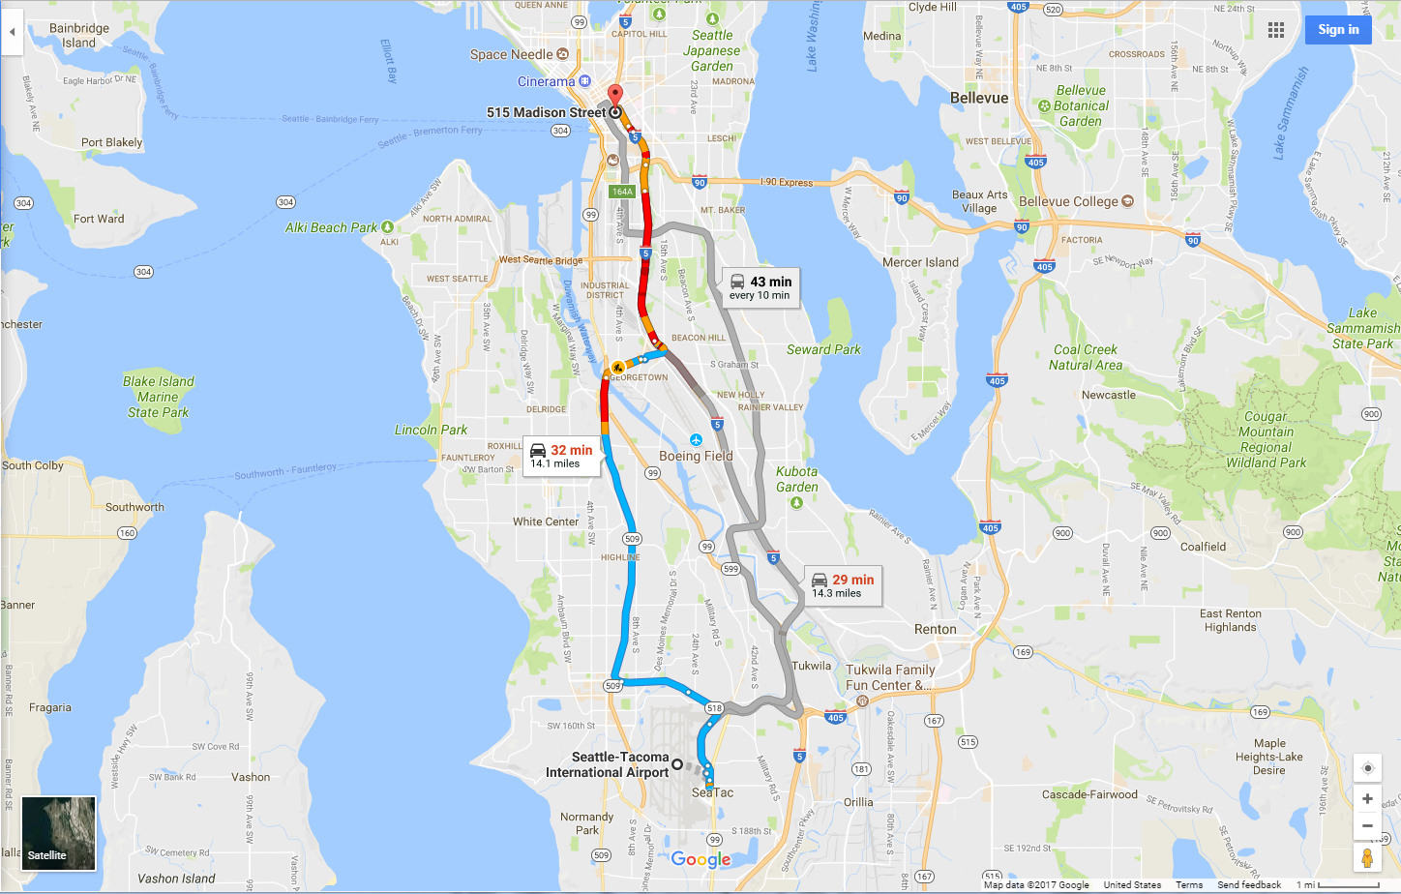
Route #1
1. Route
Route #2
For Research Use Only. Not for use in diagnostic procedures.

Slide 12

Route #1
1. Route
Route #2
Route #3
For Research Use Only. Not for use in diagnostic procedures.

Slide 13
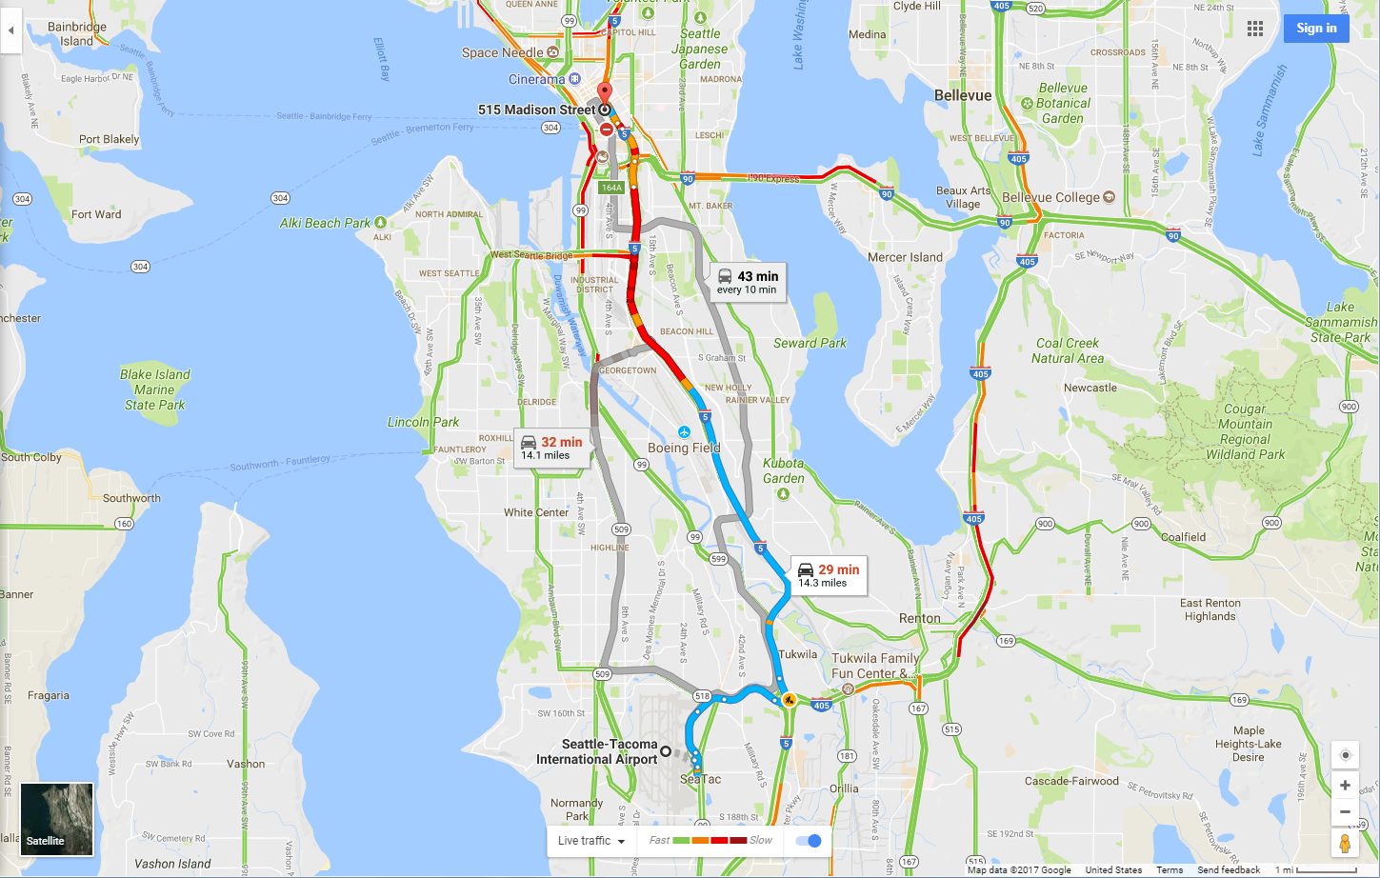
Traffic patterns
1. Route
2. Road choice
For Research Use Only. Not for use in diagnostic procedures.

Slide 14
Route #1
1. Route
2. Road choice
Route #2
Route #3
3. Total travel time
For Research Use Only. Not for use in diagnostic procedures.

Slide 15
1. Route – enzyme reaction
2. Road choice - pathway
3. Total travel time – metabolic flux
For Research Use Only. Not for use in diagnostic procedures.

Slide 16
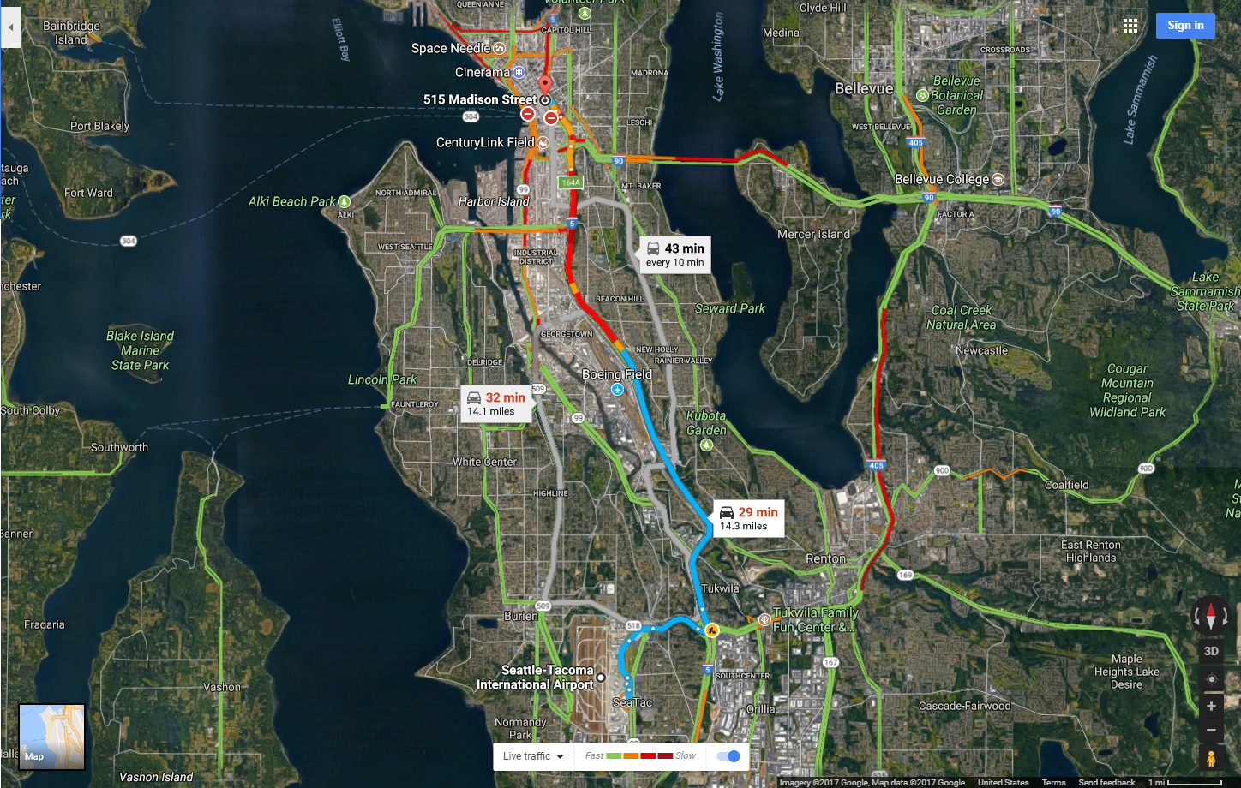
For Research Use Only. Not for use in diagnostic procedures.

Slide 17
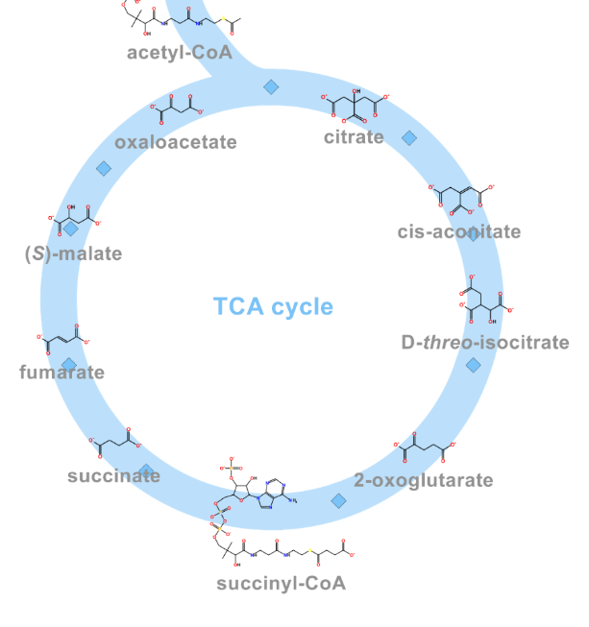
Batch Qualitative Flux Analysis Workflow Agilent VistaFlux Workflow
Metabolomics provides static information on cellular molecular composition
Qualitative flux analysis reveals in vivo pathway activity
Qualitative flux analysis tracks the flow of metabolites through a pathway
Create Target Metabolite List
Acquire TOF Data
Extract Isotopologue Features
Visualize flux on Pathways
For Research Use Only. Not for use in diagnostic procedures.
Notes:
Most metabolomics experiments currently are discovery driven where the statistical significant changes in metabolites are measured between control vs. treated for example. While discovery metabolomics provides an unbiased approach, it also gives only a static view of metabolism. You can measure the amount of a given metabolite but you do not know how fast the metabolite is being converted. The knowledge gained from such an unbiased approach can be used to inform a targeted qualitative flux experiment using stable label isotope tracing.
In stable label isotope tracing experiments, a labeled metabolite is used to “feed” a pathway in order to determine the incorporation of the stable label into the targeted metabolites.
These experiments are performed on a TOF-based MS and special software modes are used to do the isotopologue feature extraction and data analysis. Last year, Agilent introduced the first commercial software workflow for qualitative flux analysis called VistaFlux.
As you can imagine, this type of experiment is the “color movie” to the black and white movie from Seahorse. Seahorse XF gives us the metabolic flux on live cells by measuring the overall products of metabolism (protons and oxygen) while qualitative flux analysis by LC/MS measures individual metabolites.

Slide 18
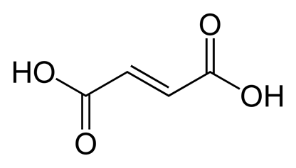
VistaFlux Stable Isotope Tracing Isotopologue Tracking
Use of stable isotope labels (¹³C, ¹⁵N, and ²H)
Monitor stable isotope incorporation
O
HO
C
C
C
C
OH
Isotopologues
M+0: ¹³C₀C₄H₄O₄
M+1: ¹³C₁C₃H₄O₄
M+2: ¹³C₂C₂H₄O₄
M+3: ¹³C₃C₁H₄O₄
M+4: ¹³C₄C₀H₄O₄
O
O
HO
C
C
0 hr
C
C
OH
O
O
8 hr
HO
C
C
C
C
OH
O
O
HO
C
C
C
C
OH
Fumarate C₄H₄O₄
O
4 M+1 Isotopomers
For Research Use Only. Not for use in diagnostic procedures.
Notes:
MassHunter VistaFlux tracks isotopologue using MS data. As shown in the mass spectra on the left, the isotopologues for fumarate clearly show incorporation of ¹³C over the incubation time used in this experiment. Isotopologues tell you only how many stable labeled atoms have been incorporated into the metabolites. Fragmentation data would be required to determine the isotopomers, which are the absolute position of the stable label in the metabolite. The difference between isotopologue and isotopomer are illustrated here for fumarate.

Slide 19
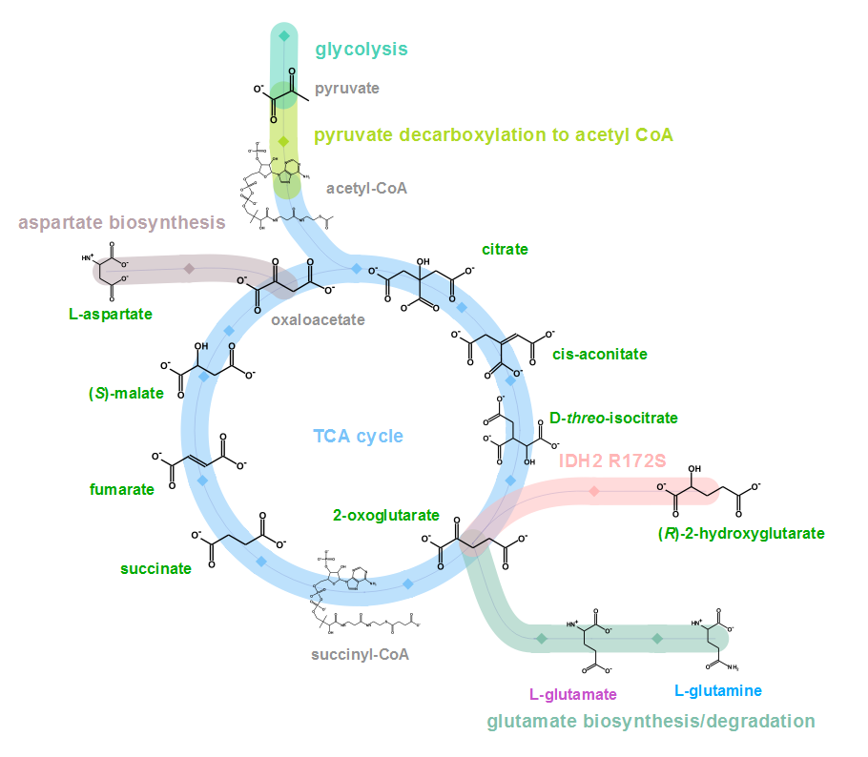
Qualitative Flux Analysis of a Cancer Cell Line with Enzyme Mutation (IDH2)
Goal: Understand impact of IDH2 mutation on glutamate metabolism in chondrosarcoma cell line
Tracer experiment with U-13C-Glutamine (Gln)
Monitoring metabolites labeled in green
Triplicate analysis for each time point (0, 0.5, 1, 3 and 8 hr)
Courtesy of Justin Cross, PhD., Donald B. and Catherine C. Marron Cancer Metabolism Center, Memorial Sloan Kettering Cancer Center
For Research Use Only. Not for use in diagnostic procedures.
Notes:
Data for this example was provide by Dr. Justin Cross of Memorial Sloan Kettering Cancer Center. Using a chondrosarcoma cell line with an IDH2 mutation, uniformly-labeled ¹³C glutamine was used as the tracer for the cells and the source of 13C stable label. In normal cells, glutamine would be converted to glutamate, then would enter the TCA cycle at oxoglutarte and be converted to succinate. However, with the IDH2 mutation, a new oncometabolite (2-hydroxyglutarate) is formed. Because of the enhanced feature extraction of Profinder, we were able to monitor 17 metabolites, shown in green) over the 5 points with 3 replicates per time point.

Slide 20
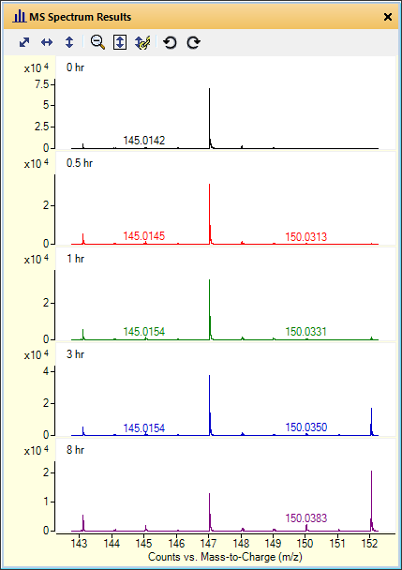
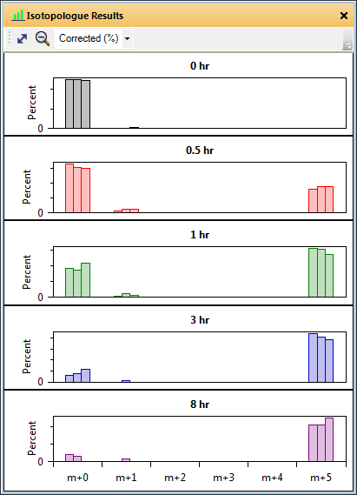
Qualitative Flux Results: Isotopologue Extraction Oxoglutarate
MS Spectra
Isotopologue Results
2-hydroxyglutarate
oxoglutarate
succinate
M+0
M+5
Courtesy of Justin Cross, PhD., Donald B. and Catherine C. Marron Cancer Metabolism Center, Memorial Sloan Kettering Cancer Center
For Research Use Only. Not for use in diagnostic procedures.
Notes:
The graphic on the left is a reminder that glutamate enters the TCA cycle as oxoglutarate and then can go convert to succinate (normal cells) or 2-hydroxyglutarate (IDH2-mutant cells). Let’s look first at the extraction results for oxoglutarate, which as the TCA entry point would be expected to show the first incorporation of tracer.
On the left is the raw MS spectra for each sample group (i.e. time-point). Note that oxoglutarate isotopologues overlap with another metabolite with a stronger signal so the M+0 and M+5 for oxoglutarate are relatively small. The algorithm however has no problem finding and extracting the correct isotopologues for oxoglutarate.
On the right, we see the sample group isotopologue results. Each possible isotopologue shows 3 bars indicating the natural isotope corrected abundance for each of the 3 replicates. Here we can see incorporation into the M+5 isotopologue as quickly as 30 minutes into the time-course. The M+5 level increases until by 8-hour the majority of the oxoglutarate is M+5.

Slide 21
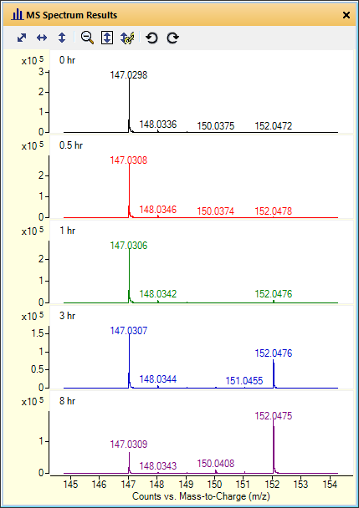
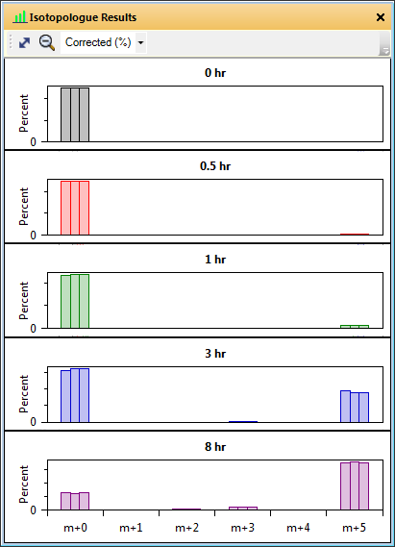
Qualitative Flux Results: Isotopologue Extraction 2-Hydroxyglutarate
MS Spectra
Isotopologue Results
M+0
2-hydroxyglutarate
oxoglutarate
succinate
M+5
Courtesy of Justin Cross, PhD., Donald B. and Catherine C. Marron Cancer Metabolism Center, Memorial Sloan Kettering Cancer Center
For Research Use Only. Not for use in diagnostic procedures.
Notes:
As expected with the IDH2 mutant, significant label-incorporation is seen in 2-HG by 3 hours. Note also that there is excellent agreement between replicates for this metabolite.

Slide 22
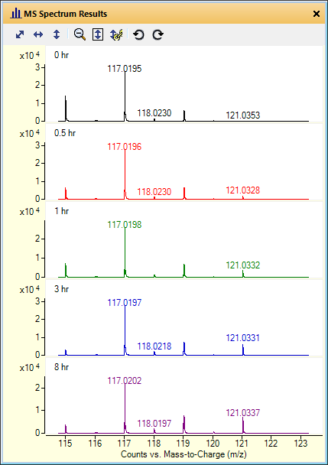
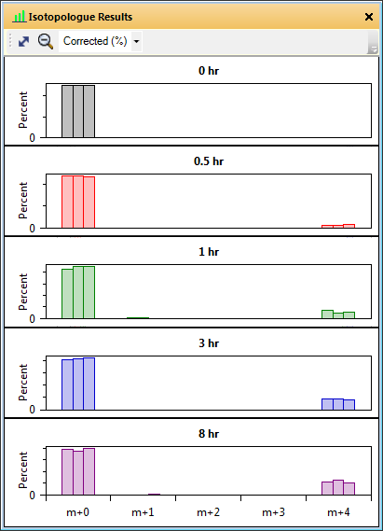
Qualitative Flux Results: Isotopologue Extraction Succinate
MS Spectra
Isotopologue Results
M+0
2-hydroxyglutarate
oxoglutarate
succinate
M+4
Courtesy of Justin Cross, PhD., Donald B. and Catherine C. Marron Cancer Metabolism Center, Memorial Sloan Kettering Cancer Center
For Research Use Only. Not for use in diagnostic procedures.
Notes:
Finally, succinate shows only limited incorporation of stable label even after 8 hours. Again, this is the expected results for the IDH2 mutant cell line.

Slide 23
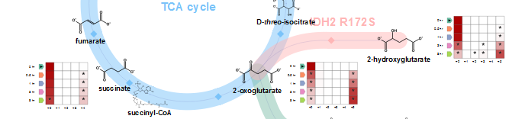
Visualizing Qualitative Flux Results Quilt Plot Display of Isotopologue Results
Quilt plot displays all time points and isotopologue results
Statistically significant (*) label incorporation in M+5 isotopologue of 2-HG at 3 and 8 hours
Courtesy of Justin Cross, PhD., Donald B. and Catherine C. Marron Cancer Metabolism Center, Memorial Sloan Kettering Cancer Center
For Research Use Only. Not for use in diagnostic procedures.
Notes:
The quilt plot provides a more detailed view of the results. As shown in this slide, the quilt plot for each metabolite shows the results for each isotopologue on the x-axis and the time points on the y-axis. In this example, the y-axis is configured to show the 0 point at the top of the y-axis and the 8 hour time point closest to the x-axis. In addition to displaying isotopologue abundance, statistical significance is shown with an asterisk. The statistical significance can be either a Pairwise Welch’s t-test vs. control or ANOVA. In this slide, the asterisk (*) indicates significance based on the t-test with p≤ 0.05 . For the shading, the darker the color the more abundant the isotopologue. So again oxoglutarate shows significant incorporation from 30 minutes increasing with time while succinate shows little incorporation.

Slide 24
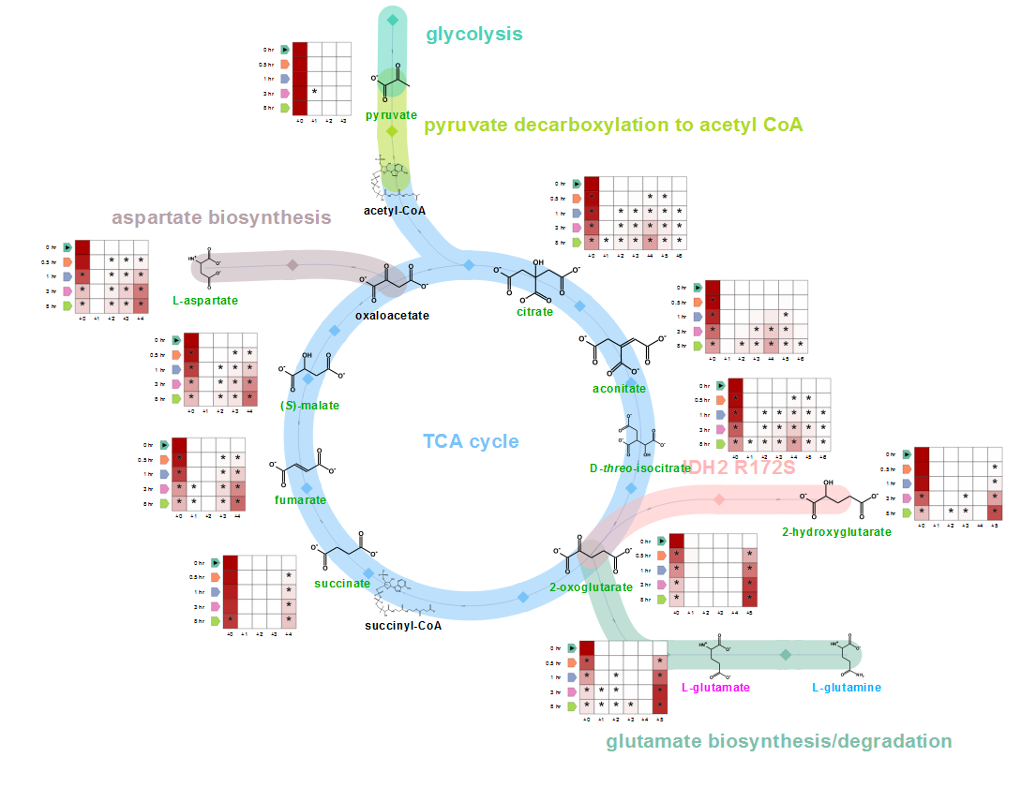
Qualitative Flux Analysis Experiment Comprehensive View of Isotopologue Results on Network
Courtesy of Justin Cross, PhD., Donald B. and Catherine C. Marron Cancer Metabolism Center, Memorial Sloan Kettering Cancer Center
For Research Use Only. Not for use in diagnostic procedures.
Notes:
So for this particular experiment, the results for the TCA cycle show the expected accumulation of stable label in 2-HG and reduced incorporation into succinate. As shown here, it is easy to visualize complex results directly on the network to facilitate interpretation and biological understanding. While stable label isotope incorporation experiments are inherently more complex and expensive than typical discovery metabolomics, targeted qualitative flux analysis enhances understanding of metabolic changes.

Slide 25
Summary
This experiment confirms glutamine is the major substrate used to produce 2-HG in IDH2-mutant CS-1 cells
For 2-HG, the presence of the M+5 isotopologue instead of the M+2 or M+4 isotopologue demonstrates the direction of the reaction
We thank Justin Cross and the many VistaFlux customer collaborator for access to datasets and valuable feedback
For Research Use Only. Not for use in diagnostic procedures.
Notes:
The biological conclusions confirm the known metabolic change associated with IDH2 mutations in cancer cell lines. Using qualitative flux analysis, the presence of the M+5 for 2-hydroxygutarate confirms the direction of the metabolic pathway. With the VistaFlux workflow, we have not only increased the number of metabolites targeted but have greatly reduced the time – from 2 weeks to 2 minute – for isotopologue feature extraction!

Slide 26
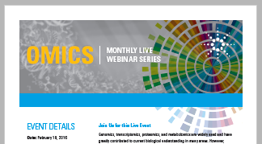
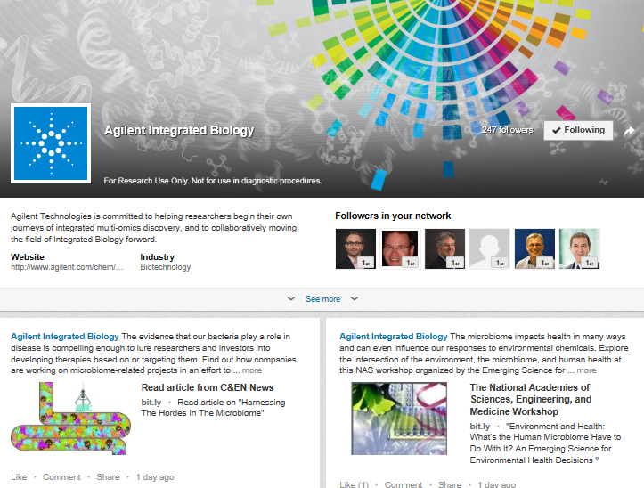
Latest Information From Agilent
Omics eSeminar Series
http://www.agilent.com/en-us/training-events/eseminars/emerging-omics
LinkedIn
Agilent Integrated Biology page
https://www.linkedin.com/company/agilent-integrated-biology?trk=rr_brands_carousel_logo
For Research Use Only. Not for use in diagnostic procedures.

Slide 27

Notes:
27
Are there any questions?

Slide 28
Thank you!
http://www.agilent.com

Slide 29
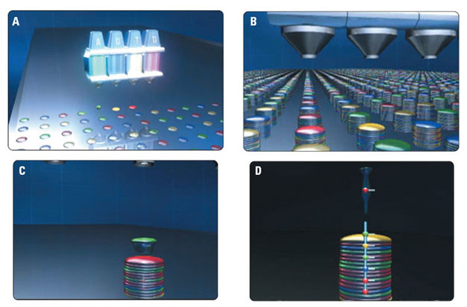
SurePrint Technology Foundation of Agilent’s Genomics Products
Chemical printing oligonucleotides using high speed ink jet technology
For Research Use Only. Not for use in diagnostic procedures.

Slide 30
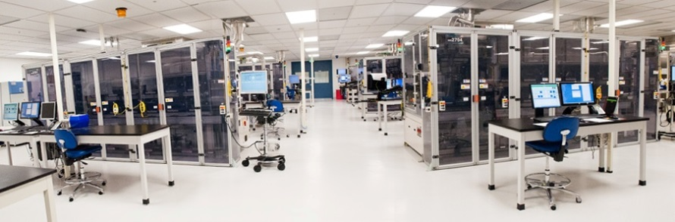

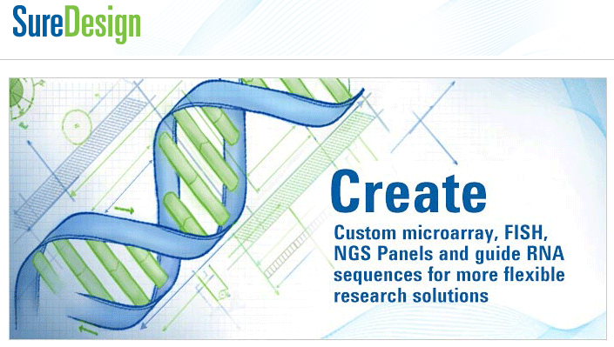
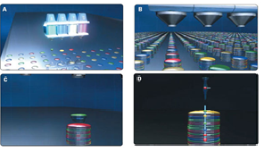
Building on Agilent’s Leadership in Oligonucleotide Synthesis
DNA Oligo Synthesis
RNA Oligo Synthesis
Agilent’s DNA Oligo Library Synthesis (OLS) Manufacturing: SurePrint Technology
Longest and highest fidelity pooled oligos
Up to 230mer, up to 244K complexity pooled oligos
Release oligos from surface
Mixture of pooled oligos
Create custom user-defined oligo library design
SurePrint oligo printing:
Chemically synthesize olgios on array
For Research Use Only. Not for use in diagnostic procedures.
Agilent Confidential
For Research Use Only. Not for use in diagnostic procedures.

Slide 31
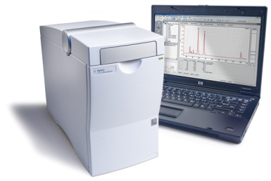
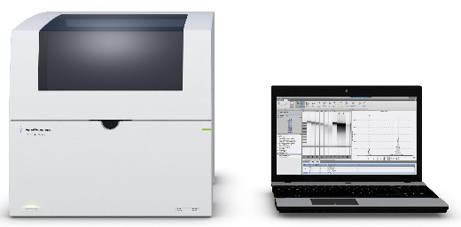
Quality Control Solutions Microfluidics Portfolio
2100 Bioanalyzer System – Electrophoresis in microchannels
Analysis of biomolecules: DNA, RNA, Proteins RIN for user-independent RNA QC
4200 TapeStation System - ScreenTape Technology
Fully scalable from 1-96 samples
96-well plate walkaway
RIN^{e} for user-independent RNA QC
DIN for user-independednt gDNA QC
For Research Use Only. Not for use in diagnostic procedures.

Slide 32
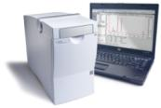

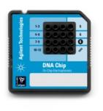
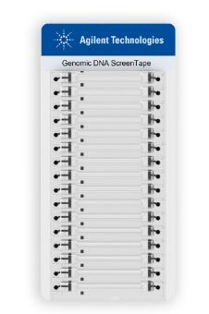
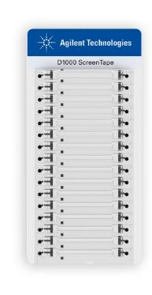
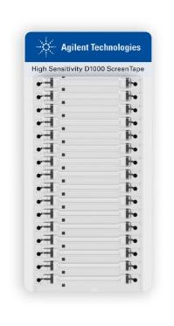
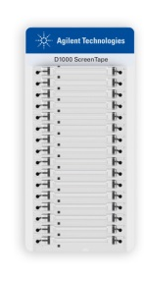
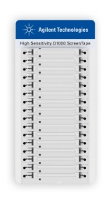




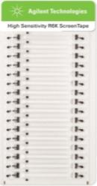
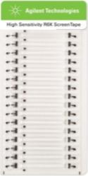



Bioanalyzer and TapeStation Kits DNA, RNA and Protein Assays
Sizing, Quantitation
gDNA integrity (DIN)
PCR products, digests, larger DNA fragments
D5000
HS D5000
Genomic DNA
D1000
HS D1000
DNA assays
DNA1000
DNA7500
DNA12000
High Sensitivity DNA
Sizing, Quantitation
total RNA, mRNA
Purity & integrity determination (RIN; RIN^{e})
RNA
HS RNA
RNA assays
6000 Nano
6000 Pico
Small RNA
Sizing, Quantitation
cell lysates, column fractions, purified proteins, antibodies etc
P200
Protein assays
P230
P80
HSP 250
For Research Use Only. Not for use in diagnostic procedures.

Slide 33




Custom Design Arrays to Your Experimental Needs
Multiple Microarray Formats:
30 µm features
70 µm features
For Research Use Only. Not for use in diagnostic procedures.
Notes:
Switch sides.

Slide 34

Wider Dynamic Range for Analytical Sensitivity to Low Expressors
Agilent
Competitor A
Agilent gene expression microarray data provides the expected normal distribution of signals, with few probes in the noise
Competing platforms suffer from compressed signals without a normal distribution
For Research Use Only. Not for use in diagnostic procedures.
Notes:
Agilent arrays have wide dynamic range of 5 orders of magnitude represented by the signals from Agilent arrays on the left. On the right, from a competitor’s array, the signals span about 2.5 logs. You would expect a normal distribution of signals, with most in the medium range, and fewer genes with high or low expression, and this is seen for Agilent data. For competitor data, not only is the range compressed, but the distribution has an over-emphasis of low expressors, suggesting noise in that area. Agilent arrays have a good distinction between low expressers and no expressors, no distinction is seen in competitor’s lower signals.

Slide 35

Multiple Techniques for Gene Expression Studies
MICROARRAYS WINS | RNASeq WINS
Genome wide analysis | Exome, Targeted or tissue specific expression
Greater sensitivity | Greater specificity
Confirms RNASeq | Discovery & Confirms arrays
For Research Use Only. Not for use in diagnostic procedures.

