Slide 1
Dr Thomas Li, CTO Thomas_li@etpl.sg
EDRN and A*STAR
DxD Hub Partnership
12 SEPT 2017

Slide 2
A*STAR
Mission: We advance science and develop innovative technology to further economic growth and improve lives
Biomedical Research Council
(BMRC)
Joint Council Office
(JCO)
Science & Engineering Research Council
(SERC)
A*STAR Graduate Academy
ETPL
10 Research Units
8 Research Units
Commercialisation
Scholarships
>5,400 Staff
>4,500 Researchers, Engineers and Technical Support Staff
>40% of whom come from 60 countries

Slide 3



Diagnostics Innovations ….
Partnerships through
global – local
private – public
academia – industry

Slide 4
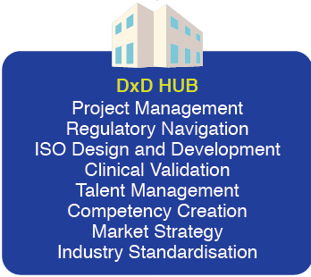

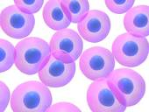
Helping our partners create value
Filling the gap in diagnostics value chain
Biomarker
Discovery
Does the biomarker have a sound scientific basis?
Biomarker
Validation
Does the biomarker show preliminary clinical value?
Assay Development
Can the biomarker
be made into a product?
Analytical & Clinical Validation
Can the product pass technical and clinical requirements?
Regulatory
Approval
Does the regulators approve?
Clinical Utility
Does the product alter clinical practice and improve outcomes?
Open Sourcing
Source for the best diagnostics innovations globally to address the clinical problem statement
Clinicians
Access to Key Opinion Leaders to validate and refine clinical utility
Biobank Access
Access to high quality and well curated Asian samples (retrospective and prospective)
Regulatory
Established communication with Health Sciences Authority

Slide 5
Existing projects within DxD Hub
FY 2017
FY 2018
FY 2019
FY 2020
DxD Hub miRNA Program
Oncology
GC
RUO
IVD
Oncology
BC
RUO
IVD
Optimization project
Oncology
RUO
IVD
GAP Project
Oncology
RUO
IVD
GAP Project
Cardiology
RUO
IVD
GAP Project
Oncology
RUO
IVD
GAP Project
Reproduction medicine
Oncology
Cardiology
Infectious Disease
FY 2017
FY 2018
FY 2019
FY 2020
DxD Hub Immunoassay Program
GAP Project: Recombinant protein and secreted protein rabbit monoclonal Ab Project (Total of 60 ELISA assay development in progress since FY 2013).
Optimization project
Oncology
RUO
IVD
GAP Project
Oncology
RUO
IVD
Optimization project
Oncology
RUO
Legend:
ETPL GAP Project
DxD Hub Optimization project
DxD Hub Project

Slide 6
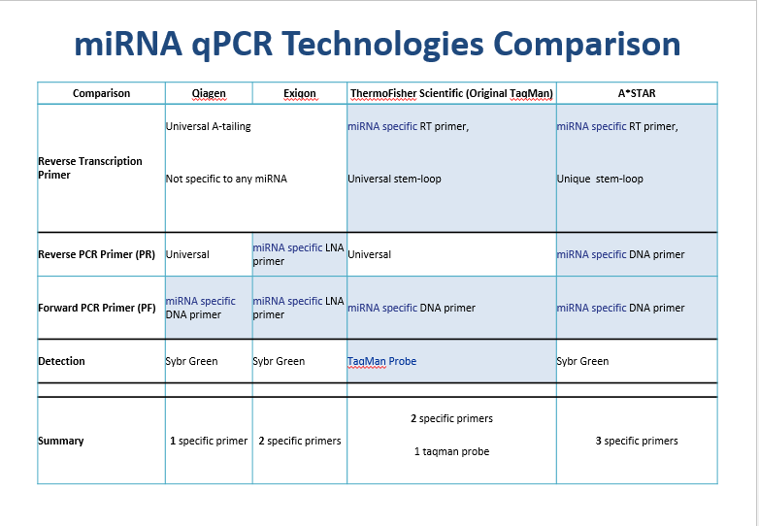

Slide 7
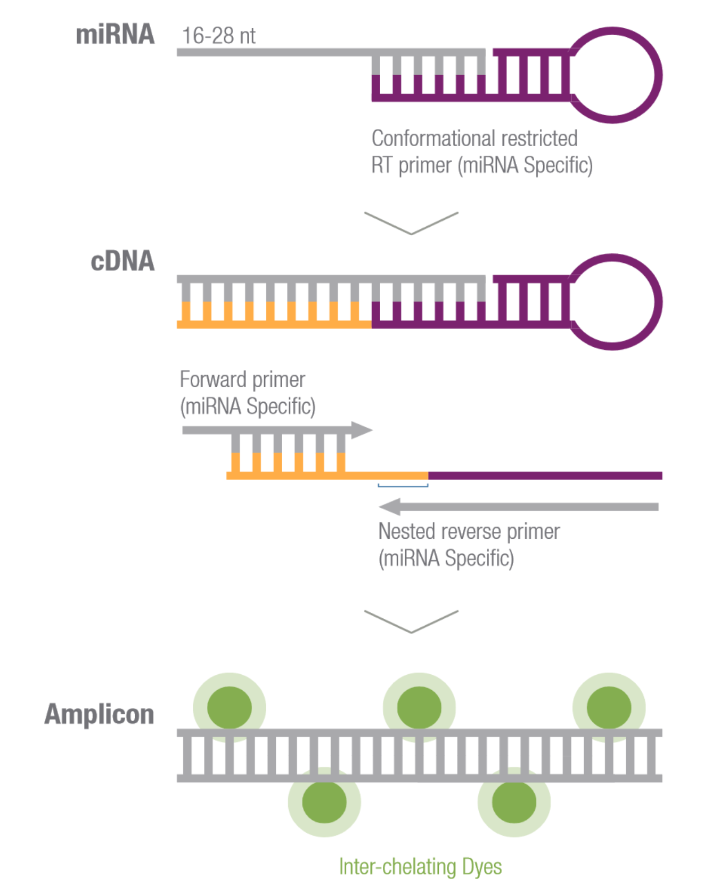
A*STAR
mSMRT-qPCR miRNA method
(modified stem-loop mediated RT-qPCR)
miRNA Specific RT primer (100-plex RT feasible)
miRNA Specific Forward and Reverse Primers
Sybr Green based detection
Notes:
MiRXES is able to achieve both sensitive and specific detection base on 3 specific primers for amplification

Slide 8
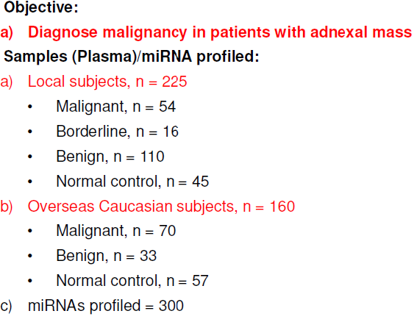
OVARIAN CANCER

Slide 9
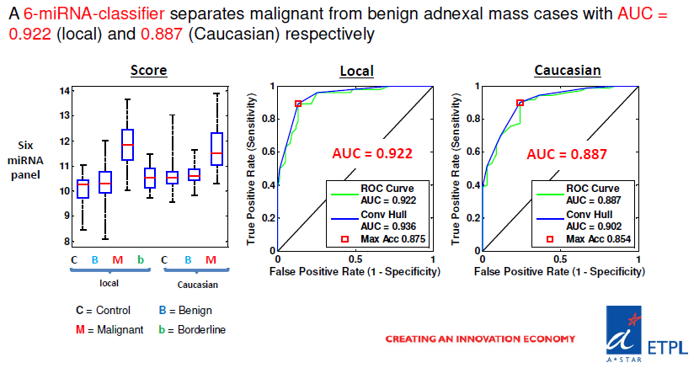
OVARIAN CANCER

Slide 10
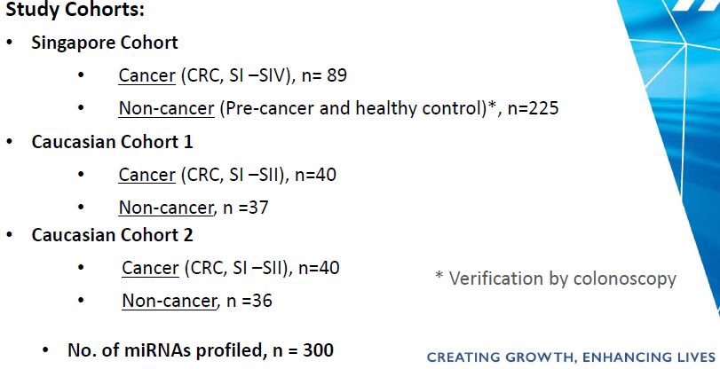
CRC

Slide 11
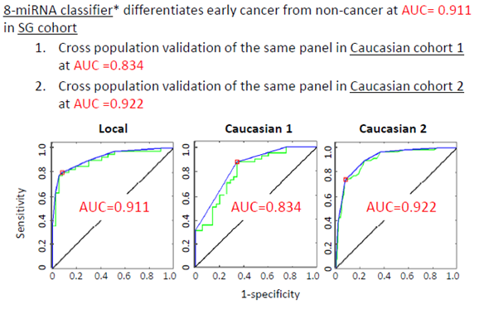
CRC

Slide 12
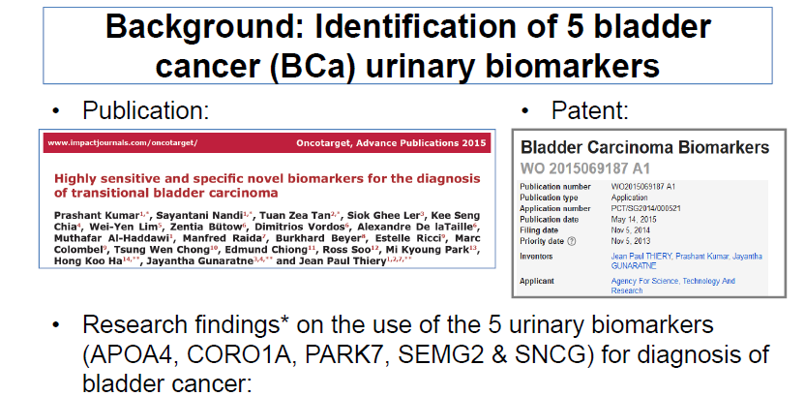

Slide 13
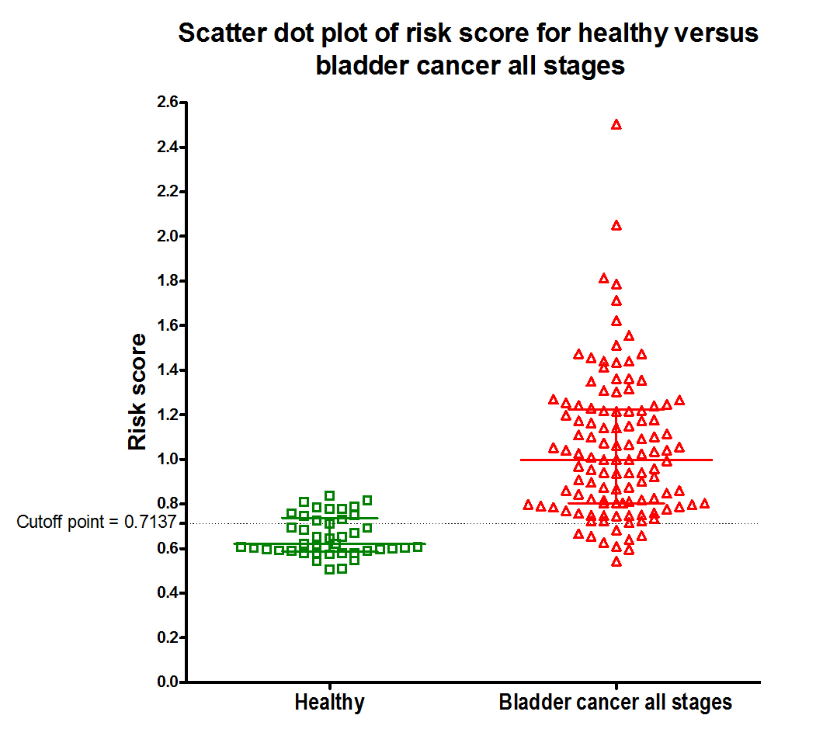
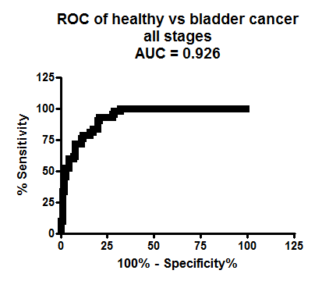
Bladder cancer all stages versus healthy
Diagnostic performance of 5-urinary biomarkers in discriminating bladder cancer (BCa) all stages patients from healthy subjects:
Bladder cancer 5 biomarker panel
Test Outcome | Healthy (n) | BCa all stages (n)
Test Outcome Positive | False Positive = 12 | True Positive = 107
Test Outcome Negative | True Negative = 30 | False Negative = 9
Accuracy = 86.7% | Specificity = 71.4% | Sensitivity = 92.2%
 | NPV = 76.9% | PPV = 89.9%
Scatter dot plot of risk score obtained from old linear regression model comparing healthy (n = 42) and bladder cancer all stages patients (n = 116). Colored bars indicate median and interquartile range.
Disclaimer: AUC generated using old linear regression model

Slide 14

Three-Biomarker Panel (REG1, TFF1, LYVE1) in Urine for Early Detection of Pancreatic Ductal Adenocarcinoma (PDAC)
Intended Use: The PDAC test is a qualitative urine test that combines the results of three biomarkers (REG1, TFF1, LYVE1) measured individually as three immunoassays into a single numerical score. Using an algorithm and the values of these protein biomarkers, the PDAC software generates a single unit-less numerical score from 0.0 to 10.0. This PDAC test is an aid to assess the likelihood that malignancy is present.
Notes:
TBC by Biocartis: semi-quantitative, quantitative, or qualitative (Charter says qualitative for now)

Slide 15
Pancreatic Cancer Protein Biomarkers
Performance To-date
Against chronic pancreatitis (CP):
The 3 biomarker panel gave a higher AUC compared to CA19.9 against both healthy controls as well as individuals with chronic pancreatitis.
Notes:
Accuracy under curve (AUC) for staging liver fibrosis due to NASH, using reference method? is between x?; independent validation dataset of X biopsy samples from confirmed NASH patients was used
Algorithm for staging NASH induced liver fibrosis to be optimized during development with the DxD Hub

Slide 16
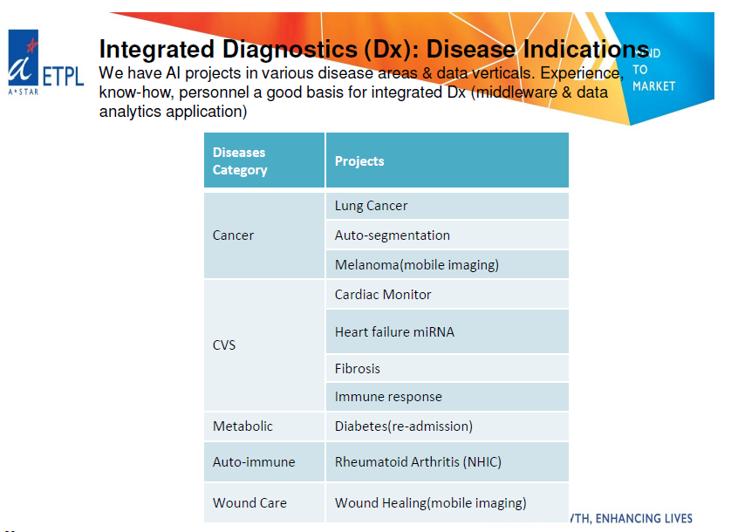



A*STAR AI resources e.g. SERC, BMRC, IHPC, I2R, BII and GIS

Slide 17
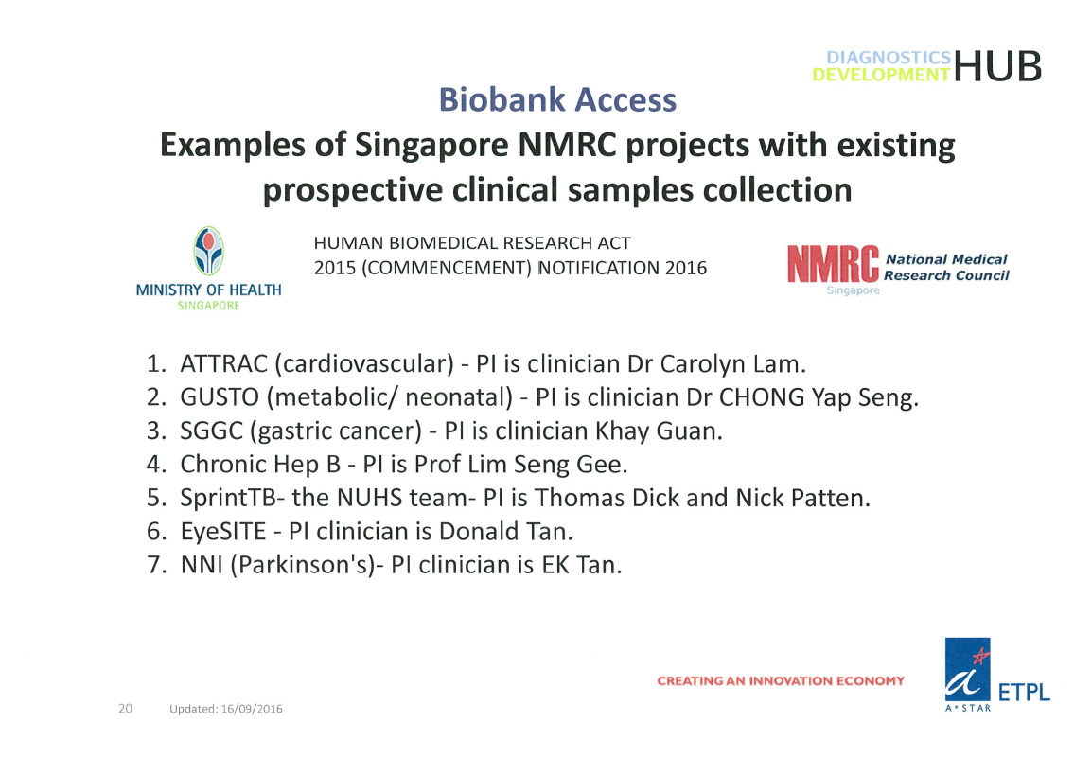
DxD HUB

Slide 18
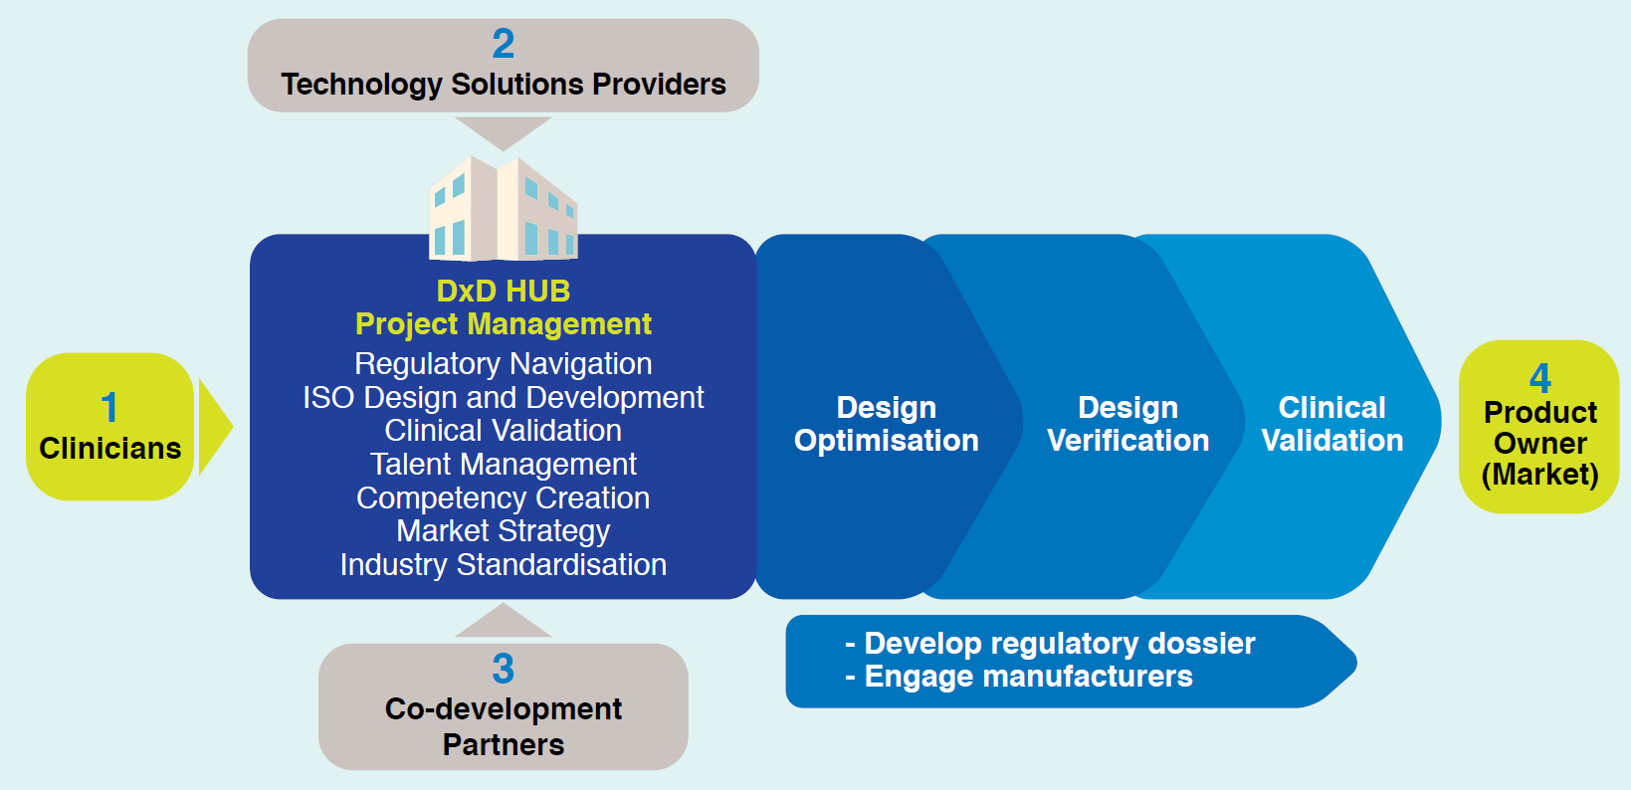
EDRN Partnership with DxD Hub
Accelerating transformation of diagnostics innovations via collaborations
EDRN
DxD Hub
Dr Thomas Li, CTO
Thomas_li@etpl.sg
18

