Slide 1

Fred Hutchinson
Breast, Colorectal, and
Ovary Cancer CVC
Breast: Christopher Li, MD, PhD
Colorectal: Paul Lampe, PhD
Ovary: Charles Drescher, MD

Slide 2
Breast CVC Project:
Phase 3 validation of early detection biomarkers for ER+ breast cancer
Background:
Mammography reduces mortality by 30% among women 50-69 years of age
PPV is 60-80% among women 50-69, but only 20% among women <50
Breast cancer remains the leading cause of cancer mortality in women worldwide

Slide 3
Breast CVC Project:
Phase 3 validation of early detection biomarkers for ER+ breast cancer
Intended clinical applications:
Inform timing of a subsequent mammogram in women with a negative screening mammogram
Inform continuation of mammographic screening among older women (beyond recommended age of screening)
Prioritize women who should be screened with mammography in areas with limited resources

Slide 4
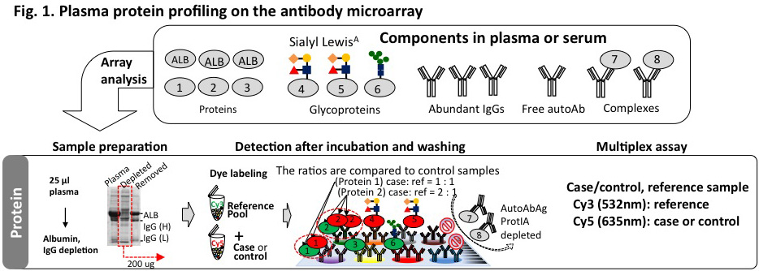
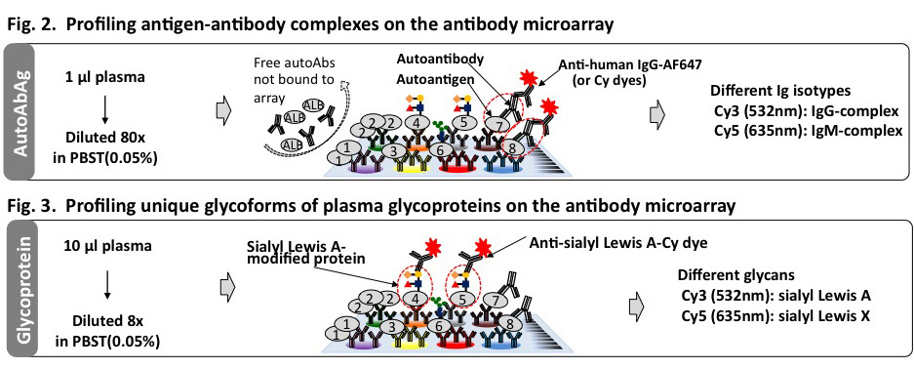
Biomarker discovery

Slide 5
Sample sets evaluated
Proteomics Autoantibody/Glycomics
WHI1
Completed
WHI2
Completed
EDRN Ref Set
Completed
WHI2
Completed
EDRN Ref Set
Completed
WHI1
In progress
 | # of markers
List | Aab IgG | Aab IgM | Glyc SleX | Glyc SleA | Criteria
A | 9 | 13 | 11 | 5 | ↑cases/sens ≥30%
B | 17 | 7 | 7 | 9 | ↓cases/sens ≥30%, ↑cases/sens <30%/p≤0.2
C | 39 | 27 | 19 | 18 | ↓cases/sens <30%/p≤0.2 On proteomics list
List | # of markers | Criteria
A | 9 | Sens ≥30%/p≤0.2
B | 6 | Sens <30%/p≤0.2
C | 17 | A-list markers from WHI2 not validated in the EDRN Ref Set

Slide 6
9 A-list Proteomics Candidates
CUX1: Tumor suppressor, lower expression associated with tumor initiation
NELL2: Overexpressed in ER+ cells
ITGA3: Part of the integrin α3β1 duplex which is a breast tumor promoter
BAD: Contributes to Myc-induced apoptosis
A2M: Previously shown to be elevated in the serum of ER+ and PR+ breast cancer patients

Slide 7
Next Steps
Proteomics Autoantibody/Glycomics
WHI1
Complete
WHI2
Complete
EDRN Ref Set
Complete
CHS
WHI2
Complete
EDRN Ref Set
Complete
WHI1
In progress
CHS
CHS = The Cardiovascular Health Study:
A prospective cohort of people 65+ years of age with serial preclinical blood samples.
Sample size: 68 cases / 204 controls
Power: 80% power to detect markers with at least 30% sensitivity at 95% specificity

Slide 8
Colon CVC Project:
Phase 3 validation of early detection biomarkers for advanced adenoma and colon cancer
Background:
Colonoscopy and FIT reduce mortality.
Low acceptance rate (65% at best).
inconvenience
cost
insurance
3. Proteins in blood might be an alternative

Slide 9
Colon CVC Project:
Phase 3 validation of early detection biomarkers for advanced adenoma and colon cancer
Intended clinical applications:
Identify people unwilling to undergo or with no access to colonoscopy who should be prioritized for colonoscopy (improve/replace stool tests).
Among symptomatic patients identify those who have a very low risk of cancer and can avoid colonoscopy.

Slide 10
Discovery - CHS Prediagnostic
(79 cases vs 79 controls)
Confirmation - EDRN Diagnostic
(120 cases vs 60 controls)
(61)
(●: 78)
(1)
(○: 4)
-Log₁₀(p)
p≤0.015
-Log₁₀(p)
(1294)
(1535)
(6)
(23)
Coef
Coef
Expression in cases:
● Increased (p≤0.015, AUC>0.60)
- Decreased (p≤ 0.015, AUC>0.60)
x Insignificant (p ≤ 0.015)
Expression in cases:
● Increased (p<0.05, AUC≥0.60)
○ Increased (p<0.05, AUC<0.60)
- Decreased (p<0.05)
x Insignificant (p>0.05)

Slide 12

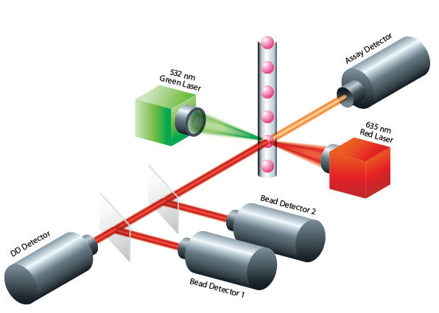
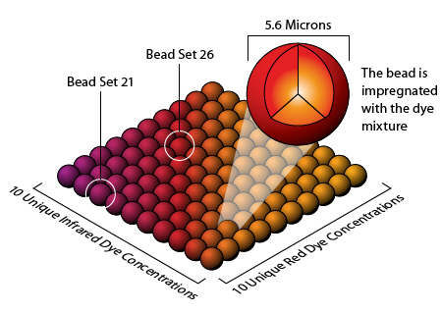
Transfer to quantitative, high-throughput multiplex technique: modified Luminex
Bead-based technology
Suitable for multiplexing
Antibody-based assay
  Directly translate from microarray platform

Slide 13
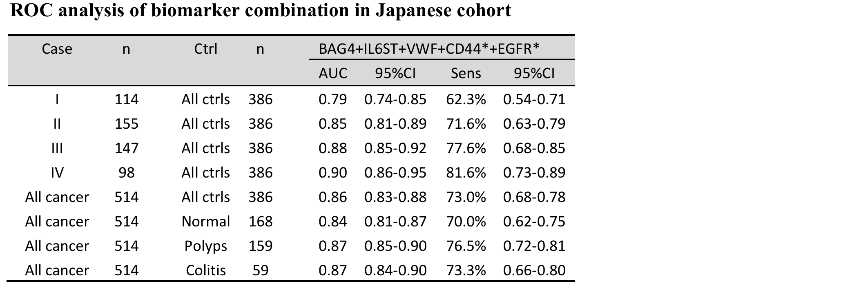
Sera: 514 cases, 386 controls (168 normal, 159 low risk polyps, 59 UC)

Slide 14
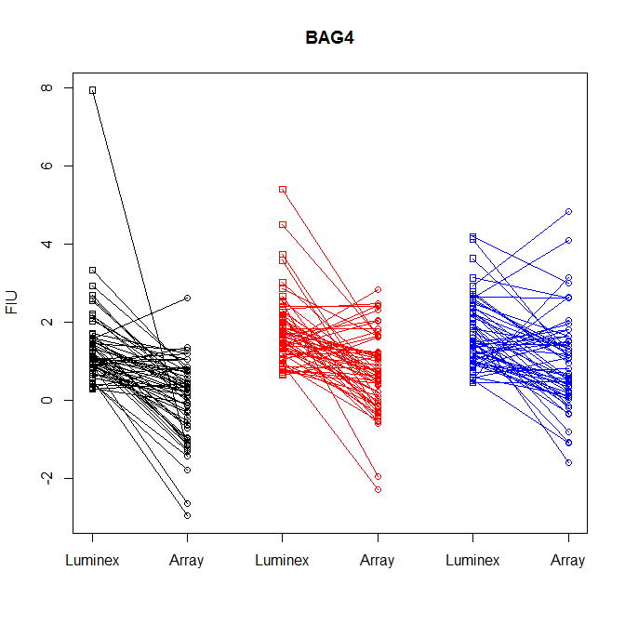
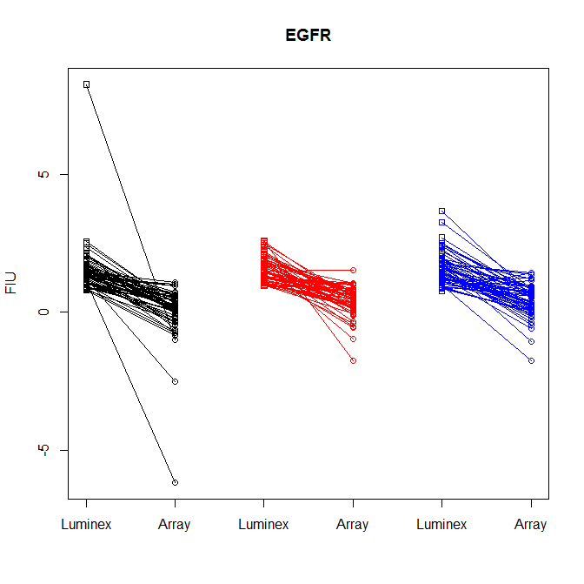
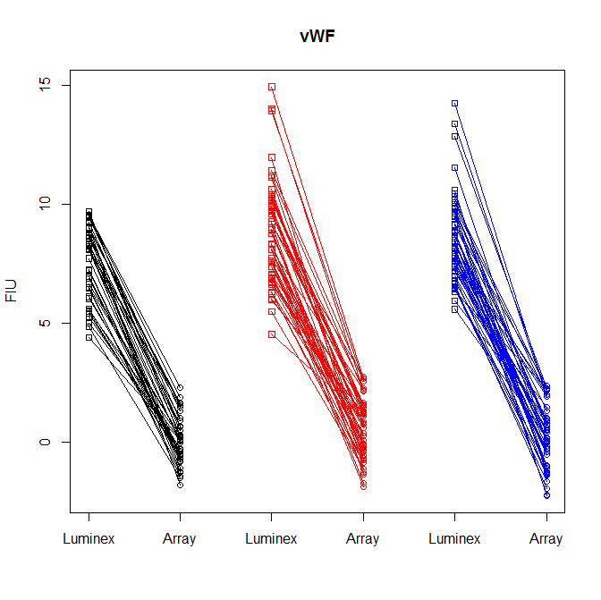
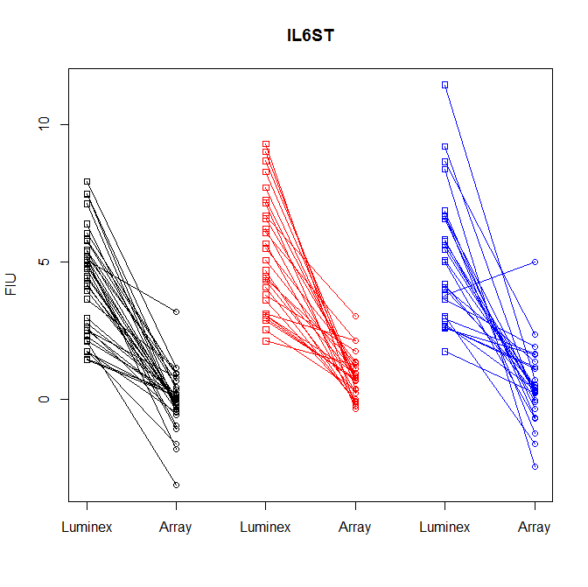
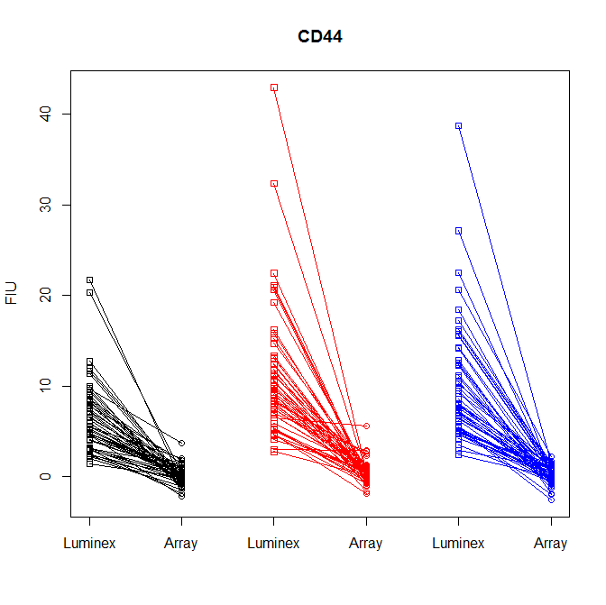
Array vs Modified Luminex – EDRN Samples

Slide 15
Assay Refinement
Many arrayed antibodies are polyclonal
Finite resource
Epitope not defined
Need to develop pairs for ELISA
Notes:
Needed for higher throughput assays

Slide 16
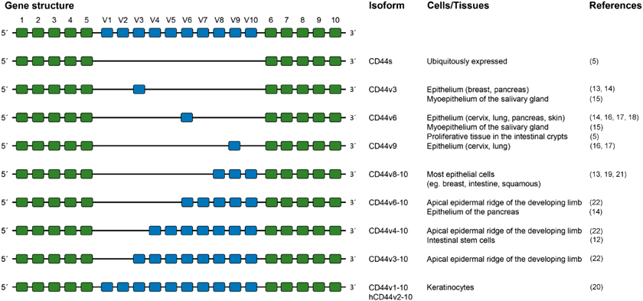
CD44
Notes:
Had 12 antibodies to different regions of CD44

Slide 17
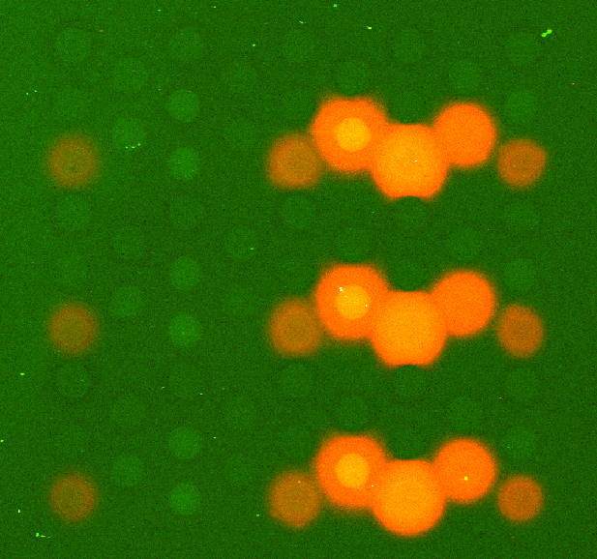
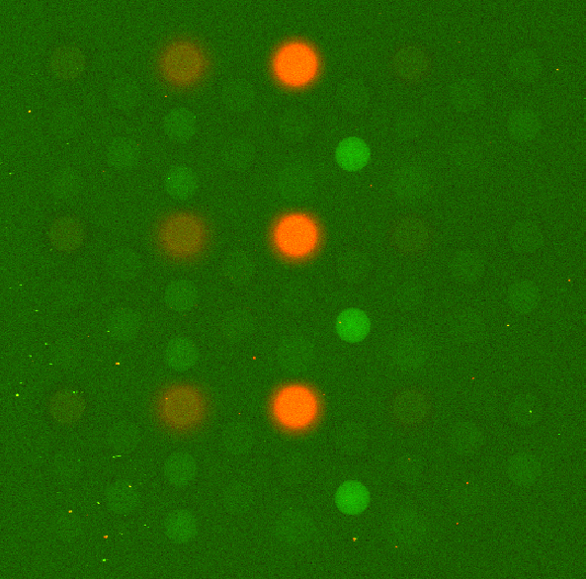
CD44 – defining epitopes
v3 & v4 Binding
v7 Binding
Notes:
20-mers 7 overlapping

Slide 18
CD44 antibody testing
Strong binding
Moderate binding
Weak binding

Slide 19
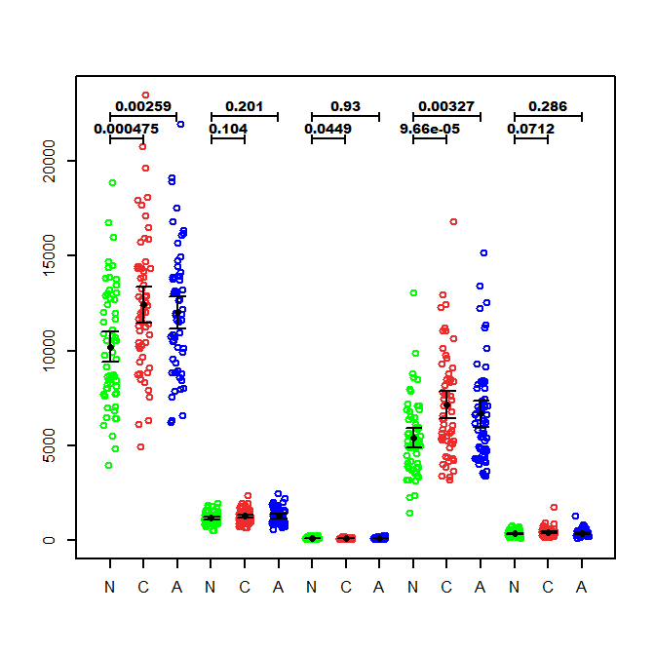
Luminex Comparison – EDRN Samples
Ab#1 Ab#2 Ab#3 Ab#6 Ab#7

Slide 20
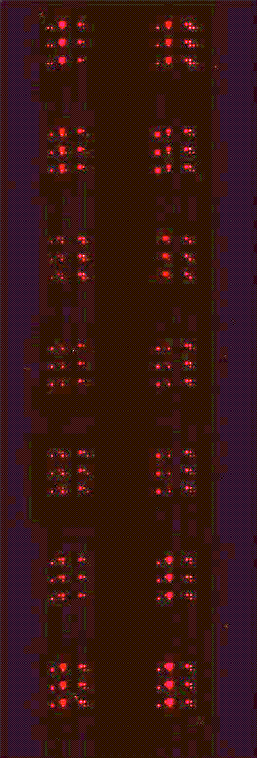
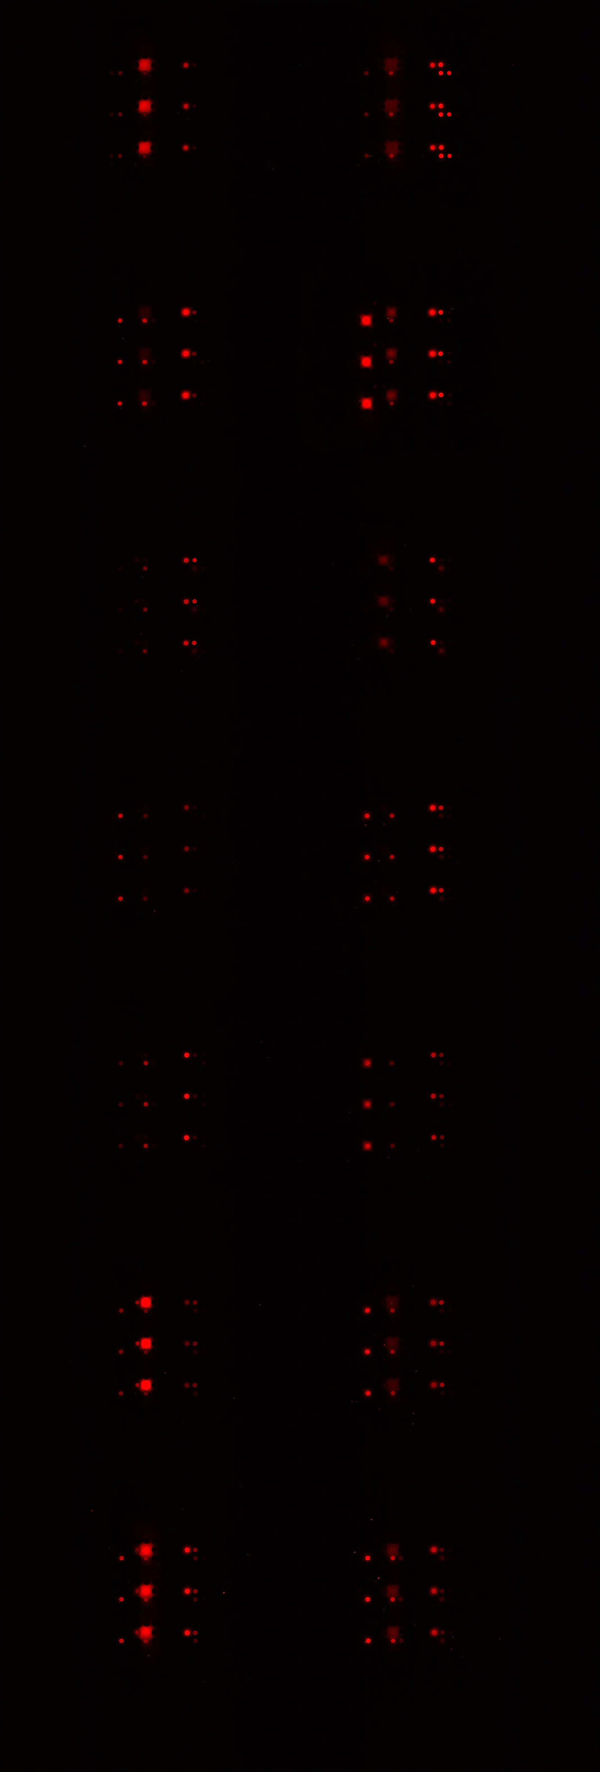
Monoclonal Antibody Development
81c
82c
BAG4
BAG4
54c
55c
IL6ST
83b
84b
63b
64b
80r
57r
EGFR
77f
79f
60f
78f
1:100 Dilution

Slide 21
Colon Cancer Sample Sets
✔
Early discovery in pre-Dx samples – populate array
Cardiovascular Health Study (CHS) pre-diagnostic samples (<3 years from Dx)
EDRN collaborative group project (GLNE7)
UMN colonoscopy study
Japanese sera samples
EDRN sample set 2 from Dean
Danish plasma samples (Hans J. Nielsen)
WHI plasma samples
New collaborative group project (FIT+/-)
✔
✔
✔
✔
First pass
~30% done
Samples received

Slide 22
Lab Crew:
Jon Ladd
Dave Shelley
Jung-Hyun Rho*
Carly Garrison
Joell Solan
Edward Lo
Kristy Lastwica
Stats Crew:
Margaret Pepe
Tracey Marsh
Gary Longton
Mark Thornquist
Collaborators:
Hans Jørgen Nielsen/Ib
Sam Hanash
Dean Brenner
WHI
Breast/Gyn & GI EDRN Groups
Funding: EDRN, CVC: CA152637, BDL CA152746

