Slide 1
Illumina’s Cancer Research Portfolio and Dedicated Workflows
Jonathan Bibliowicz, Phd
Sr. Sequencing Specialist
For Research Use Only. Not for use in diagnostic procedures.

Slide 2
Global Cancer
1 in 3
1 in 2
New cases
Deaths
Living with
14M
8M
32M
Globocan 2012: http://globocan.iarc.fr/Pages/fact_sheets_cancer.aspx
Notes:
Cancer is a disease that affects us all.
1 and 3 women and 1 in 2 men will be diagnosed with cancer accumulating in 14M new cases each year.
8M lives are taken as a result from cancer and 32M people are living with the disease.
Here are Illumina, we believe genetics will significantly reduce these statistics.

Slide 3
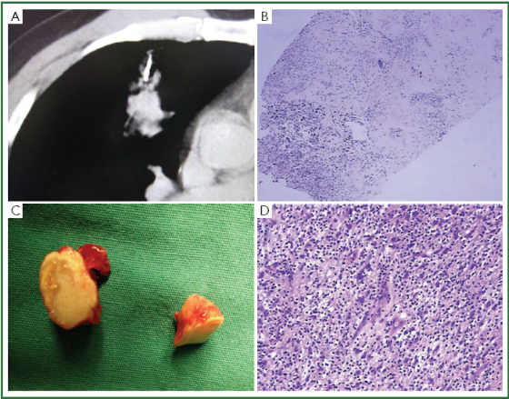
Moving From Single Gene to Multi-Gene
Small tissue samples:
Lung biopsies
Fine Needle Aspirates
An increasing number of variants of known significance
More variants to query
More tests to be performed
The Challenge
How to find more with less?
Image from Chen et al., J Thorac Dis. 2013 Jun;5(3):E93-7. doi: 10.3978/j.issn.2072-1439.2013.04.17. Figure 2

Slide 4

Challenge Iterative testing
Today: Iterative testing increases demands for tissue, time, and costs
KRAS test
BRAF test
NRAS test
…
Negative
Negative
Negative
Colon sample
Positive
30%-50% of results§
Positive
5%-10% of results§
Positive
1%-3% of results*
Colon Cancer investigation
Cumulative testing time** | 7 days | 14 days | 21 days…
Cumulative cost** | $400 | $800 | $1200
Cumulative sample needed | 10 ng | 135 ng | 145 ng
§Roth AD1, Tejpar S, Delorenzi M, et al. Prognostic role of KRAS and BRAF in stage II and III resected colon cancer: results of the translational study on the PETACC-3, EORTC 40993, SAKK 60-00 trial. J Clin Oncol. 2010 Jan;28(3): 466-474.
*Irahara N, Baba Y, Nosho K, et al. NRAS mutations are rare in colorectal cancer. Diagn Mol Pathol. 2010 Sep;19(3): 157-163.
**Duration of testing time begins after the sample material becomes available. Turn-around time & cost will vary from lab to lab.
Notes:
Iterative testing:
increases demands for tissue
time to action
increases costs
Not scalable for additional variants

Slide 5
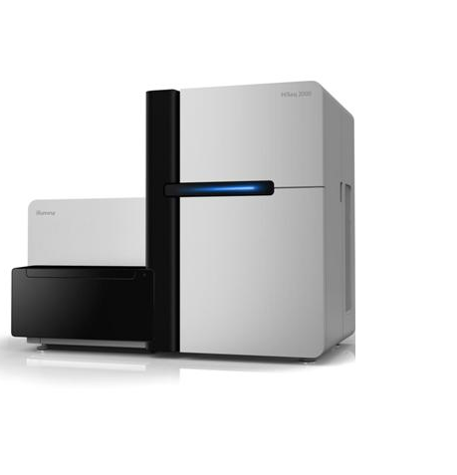
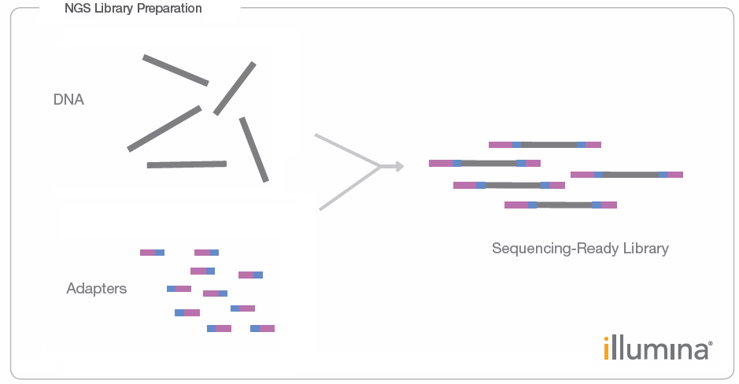
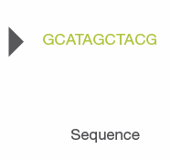
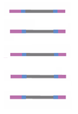
Next-Generation Sequencing using Illumina technology
ATGGCTAGGGCTTATCGGAGGGCTTAGCG
CCGTAGGCTAGCTTTAGAGCTTAGGATCGA
CCCTCTTATTTTATCTTCTTATCGCTAGCTCC
CGGCTTCGATTATTTCGGGCTATCGATCGA
TTATTCGGATTCGGATTTTCGGATTCGGATG
RESULT
For Research Use Only. Not for use in diagnostic procedures.

Slide 6
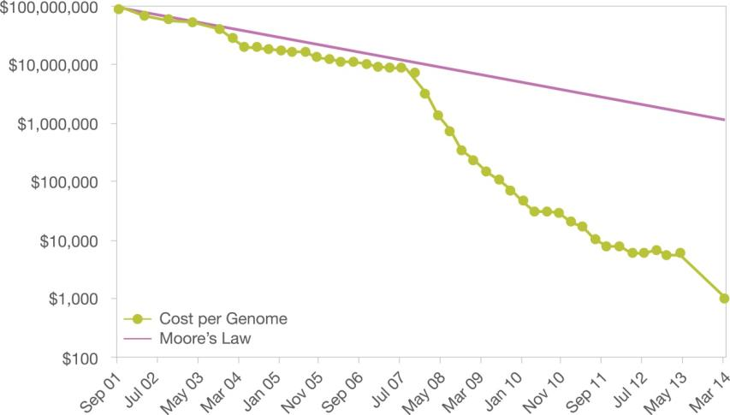
Sequencing Costs Declining
WGS 30x
WES 50x
For Research Use Only. Not for use in diagnostic procedures.
Notes:
While arrays are still the most cost effective option for methylation, sequencing may one day catch up. If we map out the cost per genome (not bisulfite) over time, the drop in seq prices has far outpaced moore’s law. With the help of researchers like you and the community as a whole, we are committed to growing our portfolio to meet projects across the spectrum of technologies.

Slide 7

Multi-Gene Cancer Panel TruSight® Tumor 15
Single assay: Detect pathogenic variants for 7 types of cancer
Lung
Melanoma
Ovary
BRAF
EGFR
ERBB2
KRAS
MET
PIK3CA
RET
TP53
BRAF
GNA11
GNAQ
KIT
PDGFRA
TP53
FOXL2
TP53
Gastric
KIT
KRAS
MET
PDGFRA
Colon
Breast
BRAF
KRAS
NRAS
MET
TP53
AKT1
ERBB2
PIK3CA
Prostate
PIK3CA
For Research Use Only. Not for use in diagnostic procedures.
Notes:
Illumina provides a Library preparation kit that targets 15 relevant genes in solid tumor analyses. The TruSight Tumor 15 provides relevant information not only for CRC, but also for Lung, Breast, melanoma, ovarian, gastric and prostate cancer samples. For your lab, this means being able to use the same trusted method across tumor types, therefore increasing further the lab’s efficiency.
Highlight BRAF being important across different cancer types

Slide 8
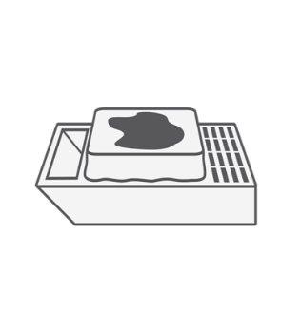

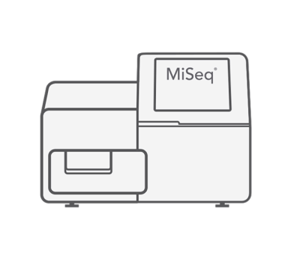
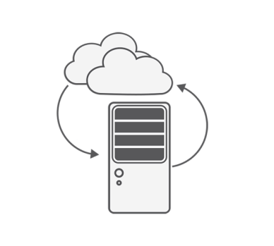
TruSight® Tumor 15 Comprehensive process from prepared sample to report
FFPE Specimens
Library Prep
Illumina Sequencing
Analysis
Tissue requirements ensure optimal results
Extraction & DNA Quant Recommendations
One prep examines 15 genes
Small amount of sample required: 20 ng
FFPE Optimized
MiSeq ® v3 chemistry
2x150 reads
Pre-defined report of filtered variants from 15 genes with most analytical relevance
Local: Local Run Manager Cloud: BaseSpace® App
Time to result -- 2.5 days
For Research Use Only. Not for use in diagnostic procedures.
Notes:
TruSight tumor 15 has a simple, comprehensive workflow, from preparing the FFPE specimen to all the way through analysis and pre-defined report. It is easy and optimized for solid tumor analyses needs with a time to result of 2.5 days

Slide 9
Pre-Defined Report Automates variant detection
Identifies somatic mutations as low as 5% variant allele frequency with >500x coverage
For Research Use Only. Not for use in diagnostic procedures.
Notes:
TST15 analysis automatically greats a pre-defined variant report
Reports on 800 analytically relevant variants (list of variants found in the Report Definitions file)
Variants are annotated by amino acid change and nucleotide change. Variant frequency and transcript ID are also included
Variants must pass a list of quality thresholds. If a variant falls below a threshold, it will appear in the No Calls section

Slide 10
The Value of RNA in Cancer Research
 | Detects | Misses | Why important? | Challenges
WGS DNA | SNVs, indels, CNVs and Structural Variants | Low frequency variants? | Most complete picture of DNA changes | Complex dataset – which variants are significant?
Targeted DNA Seq | SNVs, small indels | CNVs and Structural Variants | Enables higher coverage | Misses some variant classes
RNA Seq | Expressed variants, fusion genes, non-coding RNAs, gene expression profiles | CNVs but can correlate with expression | Which are the key mutations? | Still need to correlate with DNA?
Not all DNA variants are expressed
RNA Seq can be used to understand
Biology of disease
(functional consequences)
Biomarker Discovery

Slide 11
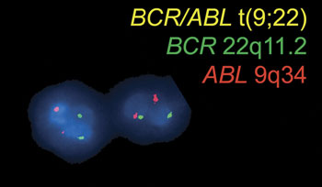
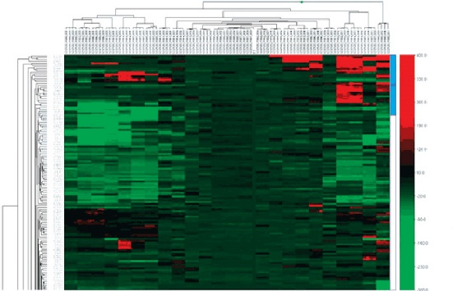
TruSight ® RNA Pan-Cancer
Comprehensive coverage of key cancer pathways and fusion genes
RNA enrichment panel targeting 1,385 oncology genes
Low input, optimized for all sample types (including FFPE)
Fusion discovery - detects both known and novel fusion gene partners
Enables RNA-Seq on a desktop sequencer (~3M reads per sample)
Intuitive BaseSpace App
Dual Color FISH
Microarray Gene
Expression Heatmap
Images from: Oliveira et al., Acta Cytol 2005; 49: 587–594, Applications of Fluorescence in Situ Hybridization in Cytopathology, A Review. Figure 2.
http://www.illumina.com/techniques/microarrays/array-data-analysis-experimental-design/genomestudio.html
For Research Use Only. Not for use in diagnostic procedures.

Slide 12
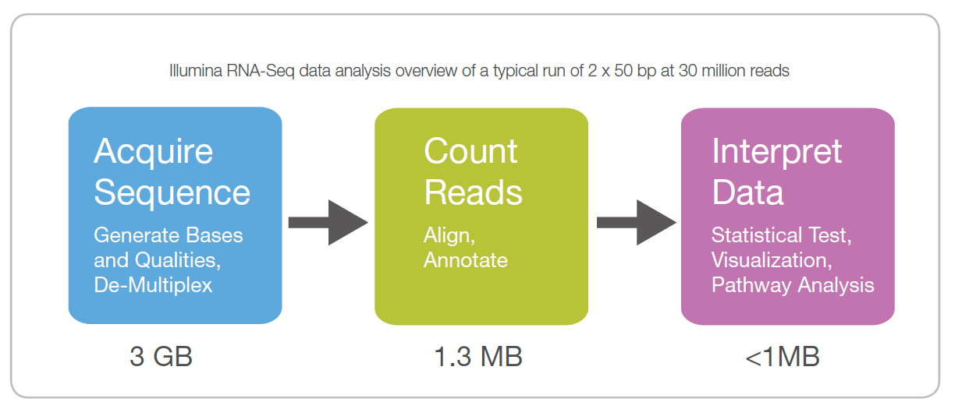
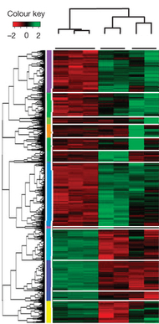
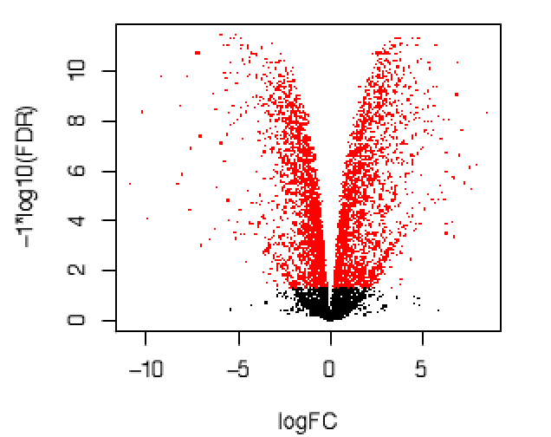
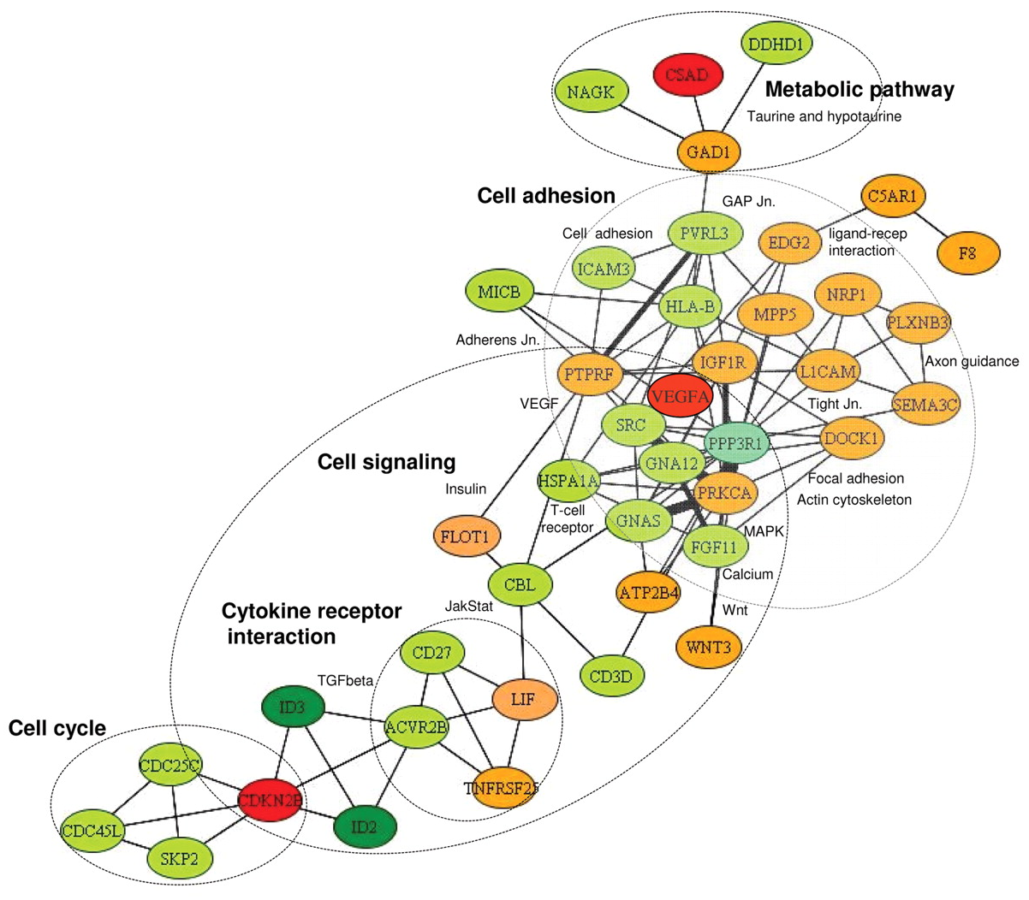
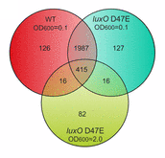
RNA-seq analysis – FPKM, DE, SNPs, Fusions
For Research Use Only. Not for use in diagnostic procedures.
For Research Use Only. Not for use in diagnostic procedures.

Slide 13
TruSight Tumor 170 Multi-Biomarker Cancer Panel
Single assay: Detection of currently relevant DNA & RNA variants for multiple types of cancer
Lung *
Melanoma
Colon
Ovary
Breast
AKT1
ALK
BRAF
DDR2
EGFR
ERBB2
FGFR1
FGFR3
KRAS
MAP2K1
MET
NRAS
PIK3CA
PTEN
RET
TP53
BRAF
CTNNB1
GNA11
GNAQ
KIT
MAP2K1
NF1
NRAS
PDGFRA
PI3KCA
PTEN
TP53
AKT1
BRAF
HRAS
KRAS
MET
MLH1
MSH2
MSH6
NRAS
PIK3CA
PMS2
PTEN
SMAD4
TP53
BRAF
BRCA1
BRCA2
KRAS
PDGFRA
FOXL2
TP53
AKT1
AR
BRCA1
BRCA2
ERBB2
FGFR1
FGFR2
PIK3CA
PTEN
Gastric
BRAF
KIT
KRAS
MET
MLH1
PDGFRA
TP53
Bladder
MSH6
PMS2
TSC1
Prostate
AR
ERG
TMPRSS2
Variant detection from both DNA and RNA targets
For Research Use Only. Not for use in diagnostic procedures.
Notes:
TruSight Tumor 170 targets the key genes associated with multiple solid tumor cancer types
Targets genes that are significant across several different cancers (eg. BRAF, KRAS, TP53 etc)
CAP approved on May 4, 2017 with QuickBase #4333.

Slide 14
TruSight Tumor 170 Content Gene List and Variant Classification
ERBB4
EZH2
FAM175A
FANCI
FANCL
FBXW7
FOXL2
GEN1
GNA11
GNAQ
GNAS
HNF1A
HRAS
IDH1
IDH2
INPP4B
JAK3
MAP2K1
MAP2K2
MCL1
MLH1
CEBPA
CREBBP
CTNNB1
DDR2
DNMT3A
EP300
MPL
MRE11A
MSH3
MSH6
MTOR
MUTYH
MYD88
NBN
CD79A
CD79B
CDH1
CDK12
CDKN2A
NF1
NPM1
PALB2
PIK3CD
PIK3CG
PIK3R1
PMS2
PPP2R2A
PTCH1
PTPN11
RAD51
RAD51B
RAD51C
RAD51D
RAD54L
RB1
SLX4
BARD1
BCL6
BRIP1
BTK
CARD11
CCND2
SMAD4
SMARCB1
SMO
SRC
STK11
TERT
TET2
TP53
TSC1
TSC2
VHL
XRCC2
AKT2
ATM
CCND1
CDK6
CHEK1
CHEK2
ERBB3
ERCC1
ERCC2
FGF1
FGF2
FGF3
FGF4
FGF5
FGF6
AKT1
APC
ARID1A
ATR
BAP1
NRG1
ROS1
FLT3
KDR
KMT2A (MLL)
MDM2
MYCL1
MYCN
MLLT3
MSH2
NOTCH1
NOTCH2
NOTCH3
FGFR1
FGFR2
FGFR3
FGFR4
JAK2
KIT
MET
MYC
PDGFRA
PDGFRB
PIK3CA
RET
RPS6KB1
FGF7
FGF8
FGF9
FGF10
FGF14
FGF23
KRAS
MDM4
NRAS
PIK3CB
PTEN
RICTOR
AKT3
BCL2
CCNE1
CSF1R
ERG
FLT1
ALK
AR
BRAF
BRCA1
BRCA2
CDK4
EGFR
ERBB2
ESR1
ABL1
AXL
EML4
ETS1
ETV1
ETV4
ETV5
EWSR1
FLI1
KIF5B
NTRK1
Amplifications
NTRK2
NTRK3
PAX3
PAX7
PPARG
TMPRSS2
Small Variants
RAF1
CCDN3
FGF19
LAMP1
TFRC
Fusions & Splice Variants
Notes:
CAP approved on May 4, 2017 with QuickBase #4333.

Slide 15
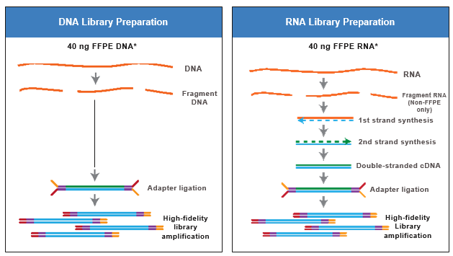
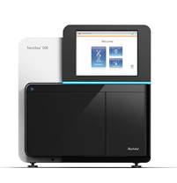
TruSight Tumor 170 Library Preparation Method Overview DNA and RNA workflows processed in parallel and sequenced together
Enrichment
Streamlined workflow:
Post-cDNA synthesis, DNA and RNA workflows are combined into a single plate, enabling automation
Modular Design:
DNA and RNA pools can be purchased separately
Pool DNA and RNA libraries and sequence
Notes:
CAP approved on May 4, 2017 with QuickBase #4333.

Slide 16
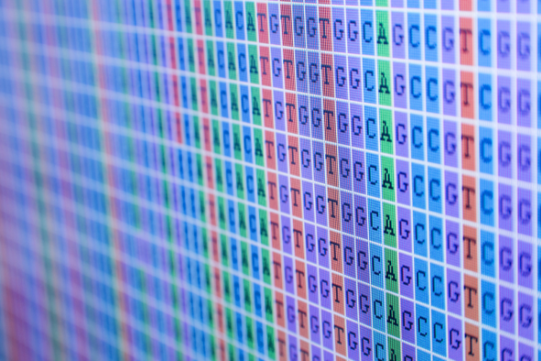
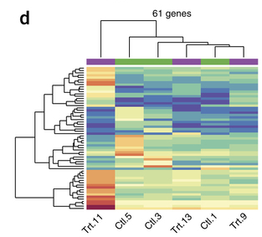
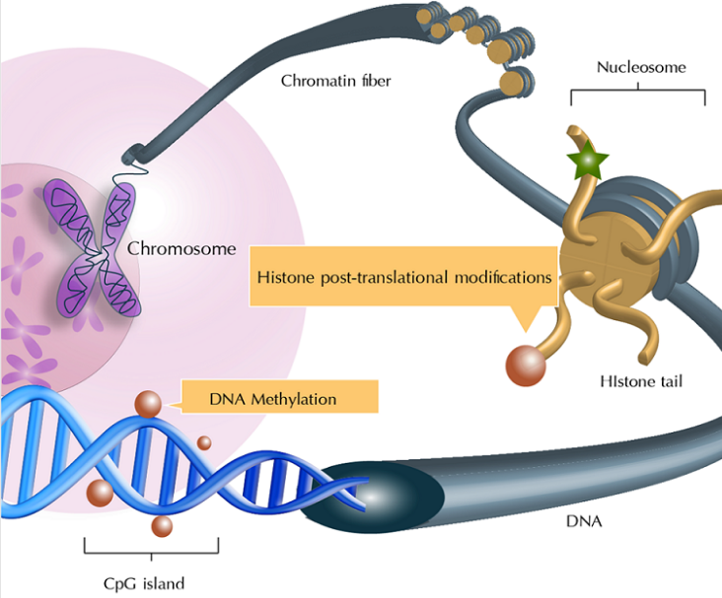
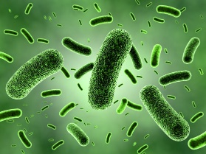
Multi-Omics Approaches Answering more complex questions
How DNA variants correlate with quantitative expression
How methylation
up or down regulates
gene expression
Mutation Detection
RNA-Seq
Epigenetics
Genome
Exome
Panels
Total RNA
mRNA
Small RNA
Methyl-seq
ChIP-seq
ATAC-seq
Metagenomics
From CORRELATIVE towards CAUSATIVE publications
Multiple methods builds confidence in results
For Research Use Only. Not for use in diagnostic procedures.
Notes:
Transcription factors and distal enhancers

Slide 17
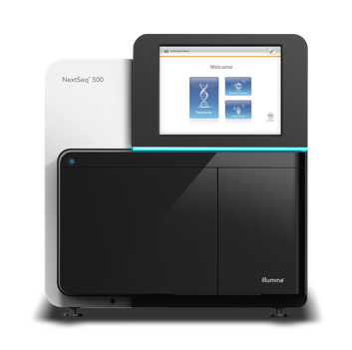
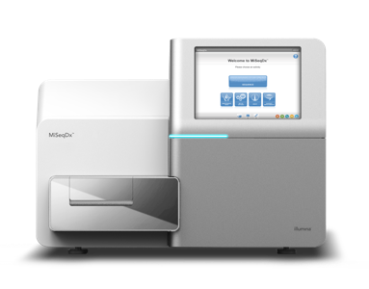
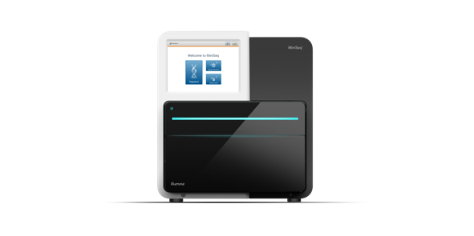
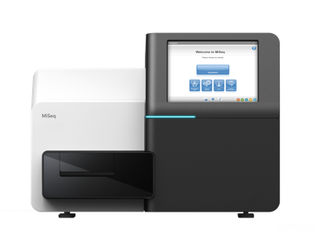
Illumina Benchtop Portfolio Overview
™
MiniSeq
MiSeq®
MiSeqDx®*
NextSeq® 500 / 550
Targeted DNA & RNA
Entry Level
1.9-7.5Gb
PE 2x 150
8 – 25M Clusters
HLA & Immunology
Long read applications
Up to 15Gb
PE 2 x 300
25M Clusters
Clinical utility
Transcriptomes
Exomes
Cytogenetics & Microarrays
16-120Gb
* For In Vitro Diagnostic Use
For Research Use Only. Not for use in diagnostic procedures.

