Slide 1
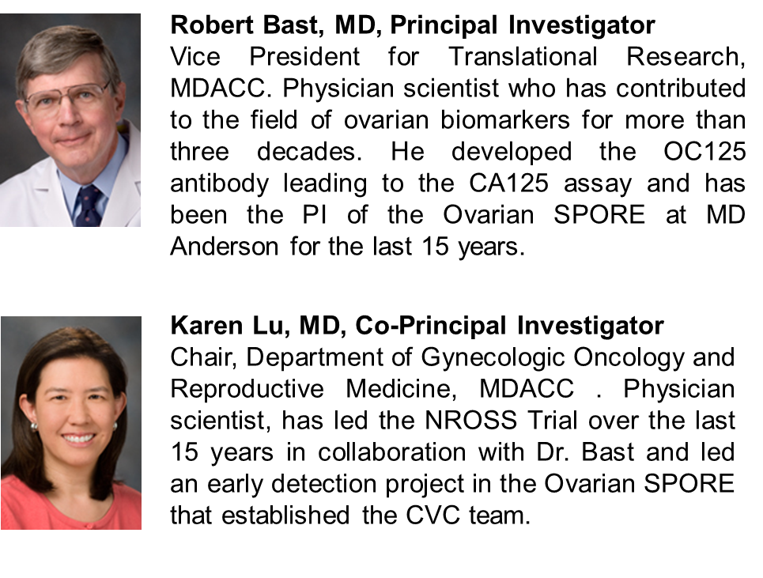
MD Anderson Cancer Center
MDACC Clinical Validation Center for
Early Detection of Ovarian Cancer
September 12, 2017 ion Center for
Early Detection of Ovarian Cancer

Slide 2




MDACC EDRN Co-Investigators
Beverly Handy, MD
Associate Professor of Pathology at MDACC and a board-certified clinical pathologist with 16 years of experience in developing and using biomarker assays. Will supervise the analysis of serum samples provided to the MDACC Clinical Pathology Laboratory where biomarkers for the entire NROSS study are analyzed at a single site.
Deepak Bedi, MD
Professor of Radiology and Director of Ultrasound at MDACC, will review all transvaginal sonograms from patients on the CVC trial at MDACC Women’s Hospital in Houston and will work with imagers at all of the NROSS sites to assure uniform quality and standards.
Jinsong Liu, MD, PhD
Professor of Pathology at MDACC, and a gynecologic pathologist, will review slides from all surgical cases prompted by the ROCA2 and ROCA3 algorithms in the NROSS2 and NROSS3 trials. Dr. Liu will work with Mr. Celestino to maintain the tumor bank and provide quality assurance for diagnosis of stored samples.
Steven Skates, PhD
Associate Professor of Biostatistics at Massachusetts General Hospital and Harvard Medical School, with more than 25 years of experience in biostatistics, will develop the ROCA2 and ROCA3 algorithms that will be required for the NROSS2 and NROSS3 EDRN-CVC trials.
The screening sites include:
1) MDACC, Houston, TX – Therese Bevers, MD, PI
2) Women’s Hospital, Houston, TX – Leroy Leeds, MD PI
3) UT Southwestern, Dallas TX – Matthew Carlson, MD, PI
4) Women’s and Infants Hospital, Providence, RI – Cara Mathews, MD, PI
5) John Stoddard Hospital, Des Moines, IW – Stephen Elg, M.D., PI
6) Carol G. Simon Cancer Center, Morristown, NJ – Daniel Tobias, MD, PI
7) University of Miami, Miami, FL - Michael Slomowitz, MD, PI
8) University of Oklahoma, Oklahoma City, OK – Laura Holman, MD, PI
9) University of Rochester, Rochester, NY- Richard Moore, MD, PI
10) University of Texas Austin, Austin, TX – Yvette Brown, MD, PI
11) University of Texas San Antonio, San Antonio, TX – Georgia McCann, MD, PI

Slide 3
Introduction/Background
Ovarian Cancer Limited to the Ovaries (Stage I) can be Cured in up to 90% of Patients with Currently Available Therapy
Disease that has Spread from the Pelvis (Stage III-IV) can be Cured in only 20% or Less
Only 20% of Ovarian Cancers are Currently Diagnosed in Stage I
Detection of Preclinical Disease at an Earlier Stage Could Improve Survival by 10-30%

Slide 4
Requirements For Screening
Postmenopausal Prevalence: 1:2,500
High Sensitivity: ≥ 75%
Very High Specificity: 99.6%
Positive Predictive Value: 10%

Slide 5
Two Stage Screening Strategies
Used alone, Neither CA125 nor Transvaginal Sonography (TVS) has Adequate Specificity
Ovarian Cancer is Associated with rising CA125 and Benign Disease is not
Very High Specificity and Sensitivity can be attained when rising CA125 is used to trigger TVS in a Two Stage Strategy
The Risk of Ovarian Cancer (ROC) Algorithm relies on each Woman’s own Baseline to determine whether there has been a significant increase

Slide 6
NROSS Screening Protocol
ROC
Algorithm
Annual
CA 125

Slide 7
NROSS Screening Protocol
NORMAL
ROC
Algorithm
Annual
CA 125

Slide 8
NROSS Screening Protocol
NORMAL
ROC
Algorithm
Annual
CA 125
ABNORMAL
USS
SURGERY

Slide 9
NROSS Screening Protocol
NORMAL
ROC
Algorithm
Annual
CA 125
Repeat
CA 125
INTERMED
ABNORMAL
USS
SURGERY

Slide 10
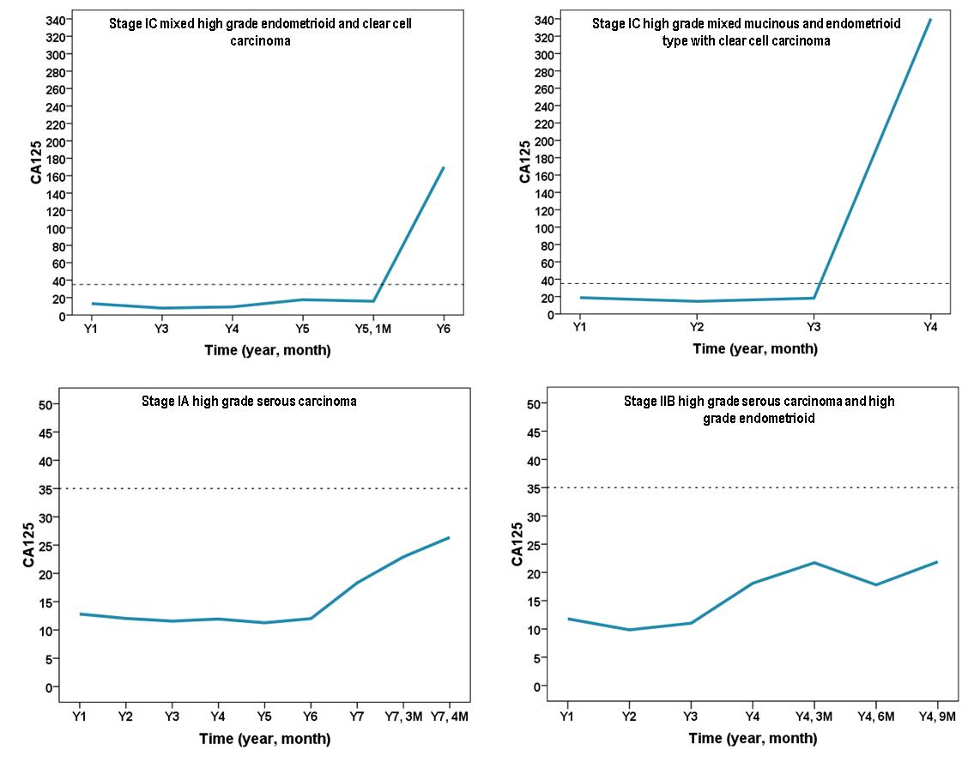
Stage IC high grade invasive cancer
Stage IC high grade invasive cancer
Stage IIB high grade invasive cancer

Slide 11
Early Detection of Ovarian Cancer: Background
of with Other Members of the EDRN
Two Stage Screening Strategies based on the Risk of Ovarian Cancer Algorithm (ROCA)
  The Normal Risk Ovarian Cancer Screening Study (NROSS) conducted by the MD
  Anderson SPORE in Ovarian Cancer screened 5,729 women over 17 years performing
  19 operations to detect 12 ovarian cancers with 9 in stage I or II
  The United Kingdom Clinical Trial of Ovarian Cancer Screening (UKCTOCS) enrolled
  >200,000 women and showed a decrease in mortality of 20% (P<0.021) in non-prevalent
  cases of ovarian cancer, albeit with wide confidence limits
  Both trials required no more than 3-4 operations for each case of ovarian cancer
  detected
CA125 is not optimal for an initial stage in that 20% of ovarian cancers do not express the biomarker.
  From 110 candidates, HE4 and CA72.4 detected 16% of cases missed by CA125, but did not improve lead time.
  Anti-TP53 auto-antibodies detected 16% of cases missed by CA125 and titers were elevated 27 months before clinical detection of disease in CA125 negative cases and 7 months before CA125 in cases detected by the ROCA.
A Multi-Marker ROCA is being developed to achieve greater sensitivity than CA125 alone.

Slide 12

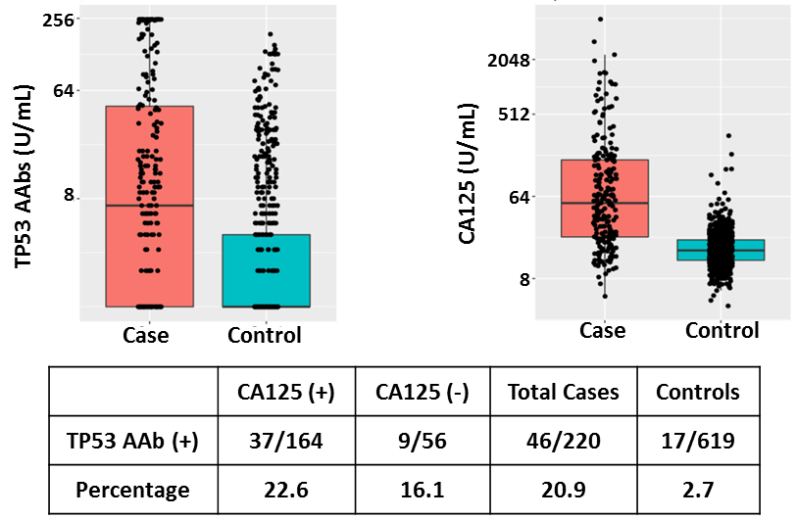
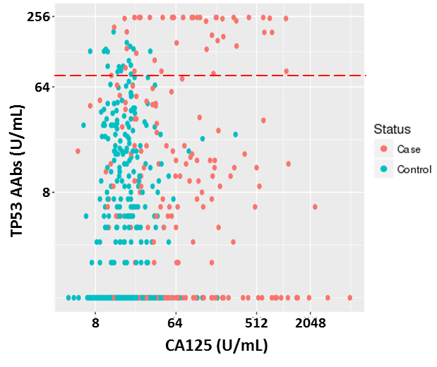
TP53 autoantibodies levels and CA125 values in serum samples from the UKCTOCS screening trial
Yang et. al., Clinical Cancer Research (June 2017)

Slide 13
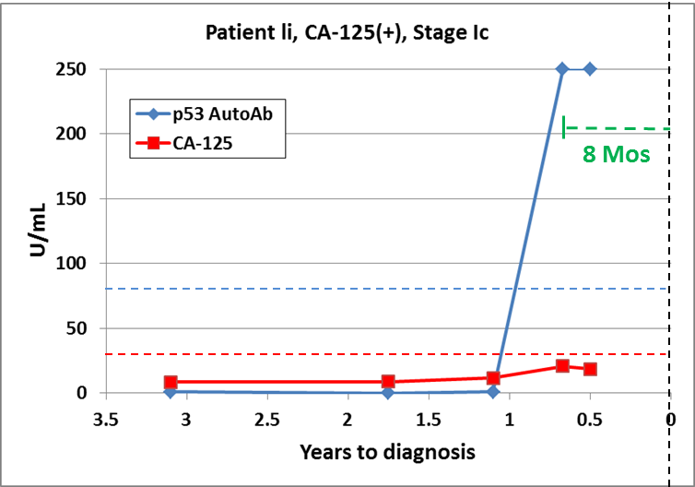
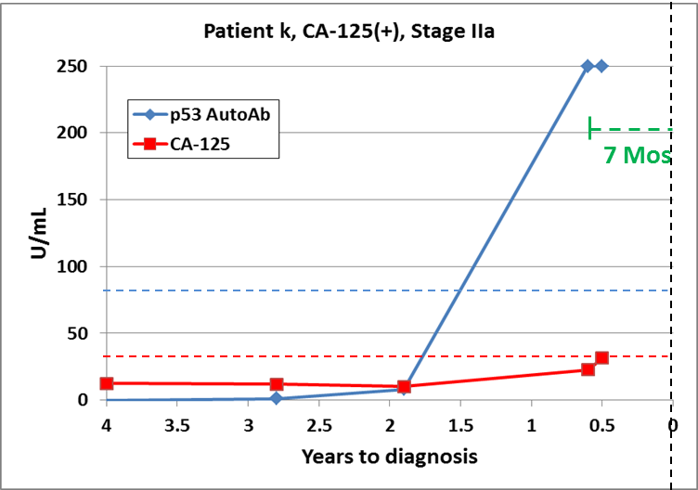
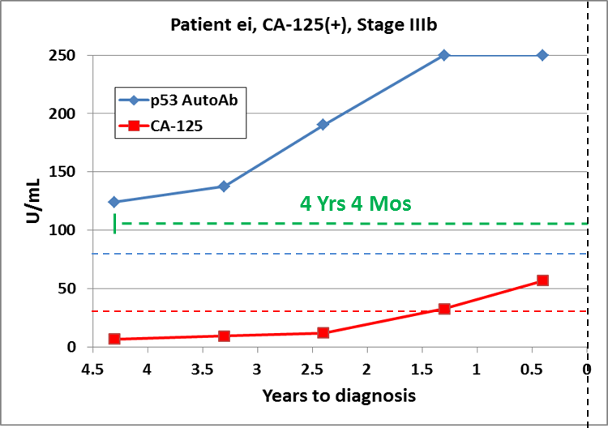
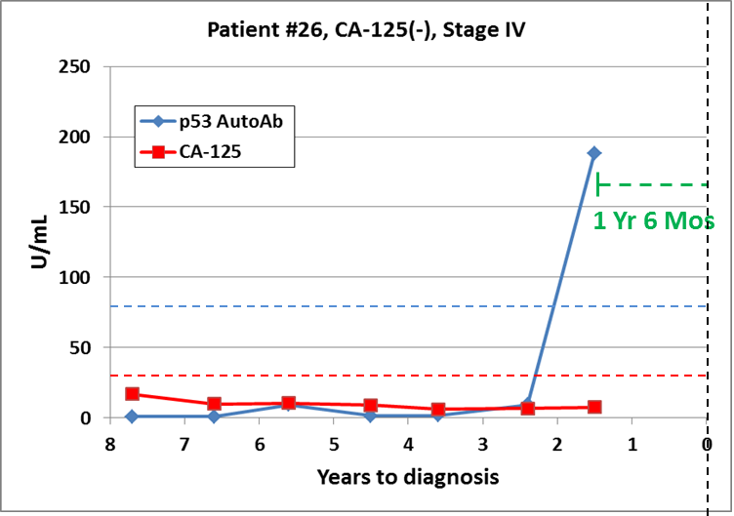
TP53 autoantibody has lead time over CA125 (longitudinal analysis)
Early stage cases
Late stage cases
Yang et. al., Clinical Cancer Research (June 2017)

Slide 14
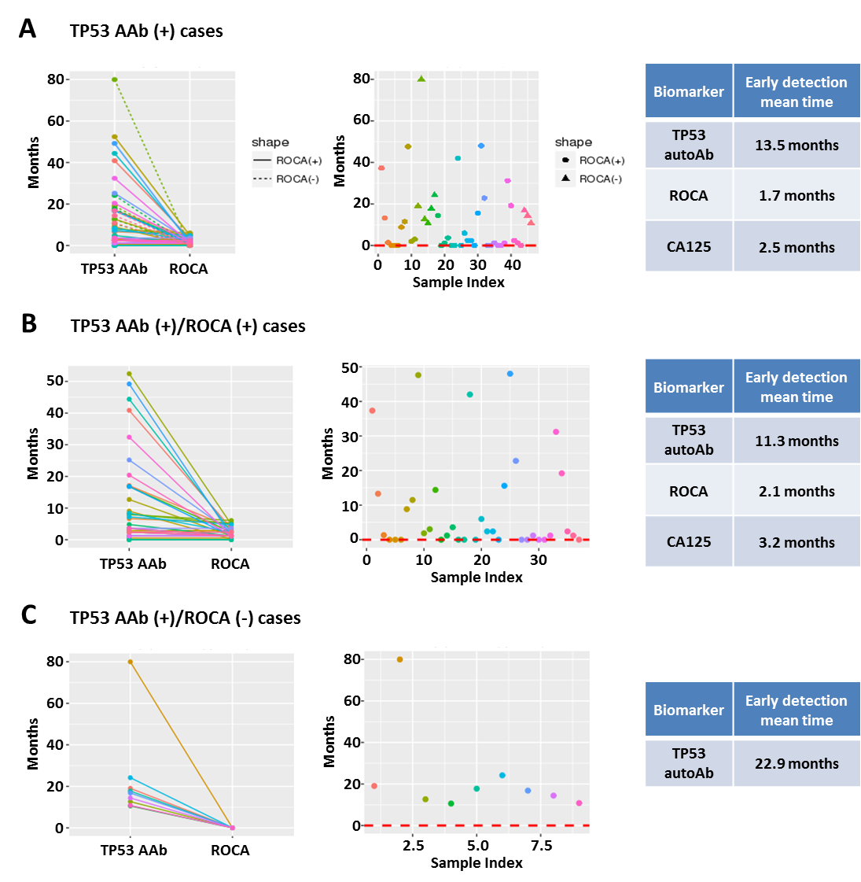
Longitudinal analysis of CA125 and TP53 autoantibodies titers in the UKCTOCS study
Yang et. al., Clinical Cancer Research (June 2017)

Slide 15
MDACC EDRN Specific Aims
Aim 1: To conduct an NROSS2 screening trial to determine the specificity and positive predictive value for a multi-biomarker ROCA potentially including CA125, HE4, CA72.4 and anti-TP53 autoantibodies in a two stage strategy for early detection of ovarian cancer in postmenopausal women at average risk for the disease. We will test the hypothesis that rising values of multiple biomarkers will prompt the referral of no more than 2% of women for TVS and that the overall strategy will achieve a positive predictive value >10%.
Aim 2: To maintain and share a serum and plasma bank to facilitate evaluation of novel biomarkers for early detection. Our goal will be to provide serum, plasma and tissue to multiple sites in the EDRN to identify biomarkers that complement CA125 and provide lead time over CA125.
Aim 3: To collaborate with other Centers in the EDRN Biomarker Development Laboratories to develop a next generation ROCA3 algorithm and an NROSS3 clinical trial for early detection. Our goal will be to develop the ROCA 3 algorithm and initiate an NROSS3 trial before completion of the project period.

Slide 18
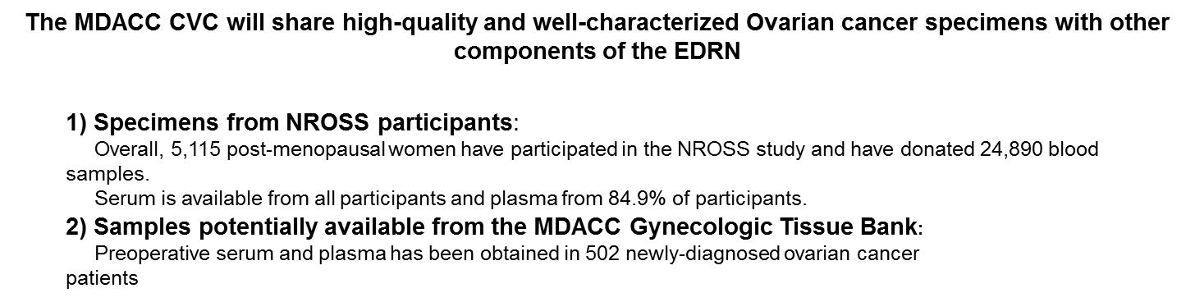
Potential Area(s) Of Collaboration With Other Members Of The EDRN
OVARIAN CANCER |  | Blood only | Blood/ Frozen tissue | Frozen tissue only | Median Age | Serous Carcinoma | Clear Cell Carcinoma | Endometrioid Adenocarcinoma | Mixed | Other
STAGE 1 |  | 31 | 61 | 31 | 54 | 26 | 25 | 23 | 10 | 33
STAGE 2 |  | 20 | 29 | 10 | 64 | 28 | 9 | 9 | 13 | 3
STAGE 3 |  | 116 | 167 | 120 | 61 | 293 | 10 | 14 | 52 | 32
STAGE 4 |  | 35 | 43 | 27 | 59 | 85 | 5 | 2 | 8 | 10
 |  | 202 | 300 | 188
Race and Ethnicity Overall for Ovarian Cancer Patients
 | Asian |  | Black | Hispanic | White | Unk/Other | Total Cases
 | 39 |  | 41 | 91 | 514 | 5 | 690
BENIGN DISEASE |  |  | Specimen |  |  | Age | Race
 | TOTAL |  | Blood only | Blood/ Frozen tissue | Frozen tissue only | Median Age | Asian | Black | Hispanic | White | Unk
TOTAL | 980 |  | 312 | 425 | 243 | 56 | 43 | 100 | 125 | 708 | 4

Slide 19
MDACC EDRN Specific Aim 2
UNTREATED OVARIAN CANCER |  |  |  |  | TREATED OVARIAN CANCER
Stage 1 | Stage 2 | Stage 3 | Stage 4 |  | Stage 1 | Stage 2 | Stage 3 | Stage 4
24 | 6 | 29 | 12 |  | 4 | 5 | 51 | 12
Early Stage = 30 |  | Late Stage = 41 |  |  | Early Stage = 9 |  | Late Stage = 63
Tumor tissue | Serum/Plasma | Tumor tissue | Serum/Plasma |  | Tumor tissue | Serum/Plasma | Tumor tissue | Serum/Plasma
18 | 25 | 34 | 28 |  | 5 | 9 | 42 | 60
Benign Cases
Total = 77
Tumor tissue | Serum/Plasma
40 | 49

Slide 20
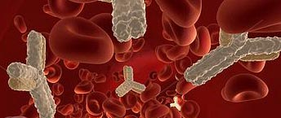
Circulating Autoantibody Biomarkers for Early Detection of Ovarian Cancer
This TEAM project proposes a validation study from existing candidate biomarkers by EDRN investigators
Robert Bast, Karen Lu (MDACC)
Karen Anderson (ASU)
Charles Drescher (FHCRC)
Steven Skates (MGH)
Zhen Zhang (JHMI)
Notes:
Default title slide layout for Basic presentations
Enter copy in the content placeholders (default formatting shown on example slide above)
Another image may be substituted
To change image:
Delete existing image
Drag a new image into the picture placeholder or select the image placeholder and under the Insert tab, select Pictures and upload your photo

Slide 21
Biospecimen Sources:
Samples obtained at diagnosis and matched controls (Bast, Drescher)
Longitudinal preclinical samples from local ovarian cancer screening trials (NROSS, Ovarian Cancer Early Detection Program (OCEDP)
Preclinical samples from large cohort studies (WHI, PLCO, UKCTOCS)
Biomarker Candidates:
Anderson (ASU) – 16 candidates
Drescher (FHCRC) – 5 candidates currently with 25 total expected by year 2
Bast (MDACC) – 4 candidates currently with 10 total expected by years 2-3.
Notes:
Title and Content layout
Always enter text or content in the programmed placeholders
Main content placeholder programmed for up to four levels of text
Each text level has preset font size, line spacing, bullets and indent
To get to next level, hit Increase List Level button in Paragraph section of Home tab and enter copy
To go back to previous level, hit Decrease List Level button in Paragraph section of Home Tab and enter copy
Don’t manually apply bullets or use the tab button

Slide 22
Approach:
Develop MagPlex Luminex assays for promising autoantibodies
Evaluate specificity of candidate biomarkers in the EDRN reference set; Evaluate candidates in the combined MDACC/FHCRC sample set
Rank candidates based on their sensitivity at 95% and 98% specificity in the combined MDACC/FHCRC sample set at the time of conventional diagnosis
Develop a biomarker panel based on the statistical analysis of the MDACC/FHCRC sample sets
    Perform subgroup analysis on high- and low-grade serous, clear cell, mucinous and endometrioid cancers and borderline ovarian tumors

Slide 23
Approach Continued…
Evaluate performance of top markers and biomarker panel in pre-clinical samples from participants in local ovarian cancer screening trials as prelude to requesting samples for large population-based cohort studies or ovarian cancer screening trials
Develop a standard multi-plex platform assay with Zhen Zhang at JHMI
Rank candidates based on assay performance in 100 serum biospecimens from ovarian cancer cases in the WHI observational study diagnosed within one year of second sample and in samples from controls, or samples obtained at diagnosis from EDRN groups
Validate candidates based on assay performance with 1500 serial preclinical samples and 5-fold controls from the UKCTOCS

Slide 24
Candidates for Early Detection of Ovarian Cancer
Will be Considered Validated If:
Clinical sensitivity is achieved (5% or greater) at 98% specificity at least 1 year prior to clinical detection
OR
There is improved performance of a combined biomarker panel
Algorithm
Steve Skates will develop a ROCA-like algorithm with the validated antibodies and CA125 and other EDRN biomarkers to be validated

