Slide 1

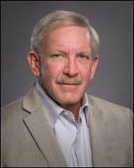
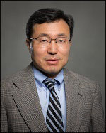

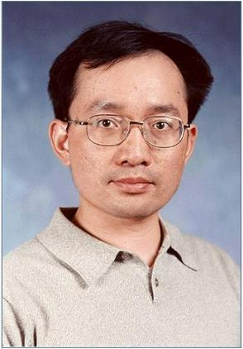
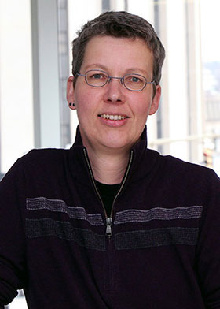
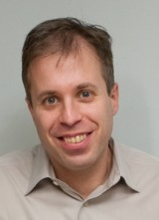
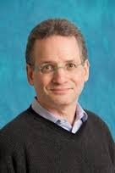


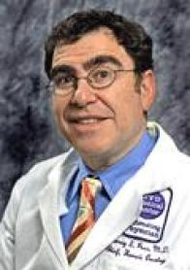

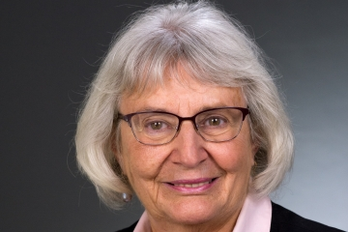
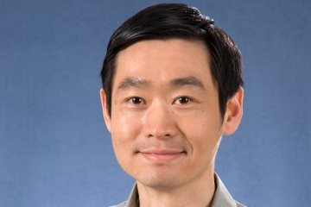

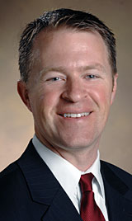


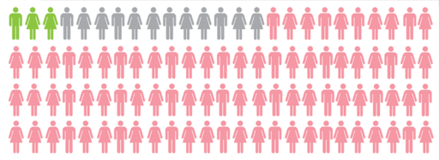

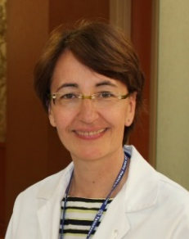


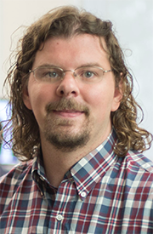

Matt Schabath, PhD
Bob Gillies, PhD
Jae Lee, PhD
Jim Herman,
MD
Jeff Wang, PhD
Brenda Diergaarde,
PhD
Avi Spira MD
Steve Dubinett, MD
Marc Lenburg, PhD
Deni Aberle, MD
Harvey Pass, MD
Haining Yang, MD, PhD
Louise Showe, PhD
Qihong Huang, MD, PhD
Pierre Massion
Eric Grogan
Chirayu Shah
Gary Smith
Funding support
EDRN
CIB
Margaret Pepe, PhD
Sanja Antic
Rosana Eisenberg
Heidi Chen
Bennett Landman

Slide 2
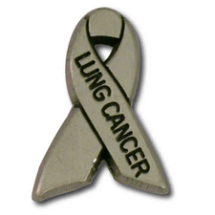
Lung Collaborative Group
Biomarker Development Laboratories
Avi Spira, Steve Dubinett, Marc Lenburg, Deni Aberle | BU, UCLA and Lahey Clinic
Jim Herman, Jeff Wang, David Wilson, Brenda Hoegaarde | U of Pittsburgh
Harvey Pass, Haining Yang, James Tsay | NYU- Hawaii
Louise Showe, Qihong Huang | Wistar Institute
Biomarker Reference Laboratory
Sanford Stass, Feng Jiang | University of Maryland
Clinical Validation Centers
Pierre Massion, Chirayu Shah | Vanderbilt
Bob Gillies, Matt Schabath | Moffitt CC
DMCC
Margaret Pepe, Jackie Dahlgren, Tracey Marsh | Fred Hutchinson CC
Program Officers
Lynn Sorbara | NCI DCP
Karl Krueger | NCI DCP
Notes:
8 institutions, 6 BDLs, 2 CVCs, 2 BRLs.

Slide 3
EDRN Lung collaborative group
1. Biomarker of risk
high risk individuals
BDLs
CVCs
LTP4
3. Molecular & Imaging biomarker for IPNs
LTP2
Risk
Early
Diagnosis
Diagnosis
Progression
2. Biomarker of risk for
never smokers, early onset
disease and strong family history
4. Biomarker of Risk of
post-surgical progression
LTP3
5. Biomarker-based clinical trial
CVC

Slide 4
Collaborative group project LTP2
Assess the science
Critique the progress
Timeline for progress
Implementation for the project
Outcome expected
New or continuing

Slide 5
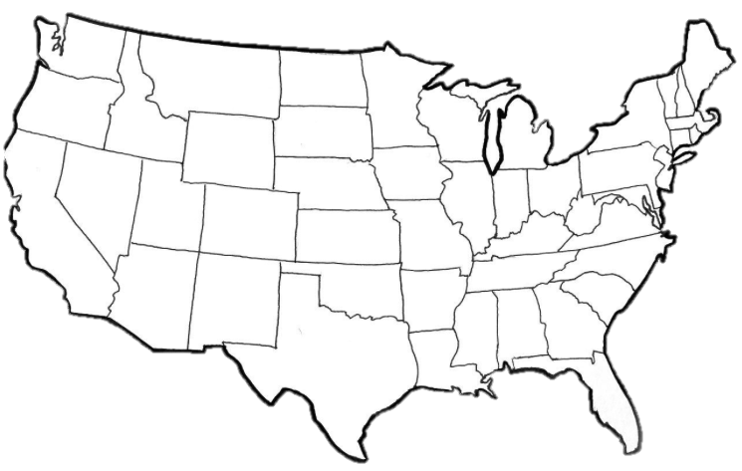
LTP2: Molecular Biomarkers for the Early Detection of Lung Cancer in the setting of Indeterminate Pulmonary Nodules
GOAL: Collaboration among 7 EDRN funded sites across country to improve the diagnostic evaluation of patients with indeterminate pulmonary nodules by determining whether molecular biomarkers for lung cancer diagnosis that are measured in minimally invasive and non-invasive biospecimens are able to distinguish between patients with malignant or benign indeterminate pulmonary nodules that are incidentally detected on CT scan in high risk smokers.
LTP2 Consortium
University of Pittsburg, PA
(PI: Herman)
Fred Hutchison Cancer Research Center, WA
(DMCC)
Boston University & Lahey Clinic, MA
(PI: Spira/Lenburg & Lamb)
New York University, NY
(PI: Pass/Tsay)
Wistar Institute, PA
(PI: Showe)
University of California,
Los Angeles, CA
(PI: Dubinett)
Vanderbilt University, TN
(PI: Massion)
Moffitt Cancer Center, FL
(PI: Schabath)

Slide 6
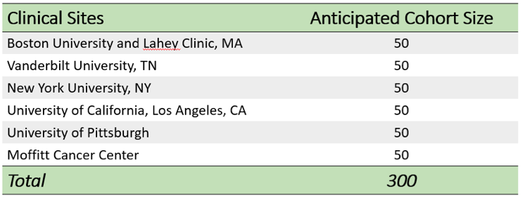
AIM 1: Establish Cohort (n=300)
Establish a cohort of current and former smokers with indeterminate pulmonary nodules (6-25mm) on whom clinical, radiographic and biospecimen repositories are developed and who are followed prospectively (up to 2 yrs) until final diagnosis.
Inclusion Criteria:
Age: >45 yrs
Current/Former Smokers: > 20 PKY
Indeterminate Pulmonary Nodules: 6-25mm
Exclusion Criteria:
Pure ground glass opacities on CT
Established lung cancer diagnosis
We anticipate ~100 patients will have a final diagnosis of lung cancer after 2 yr follow up. Current enrollment totals ~140 patients.

Slide 7
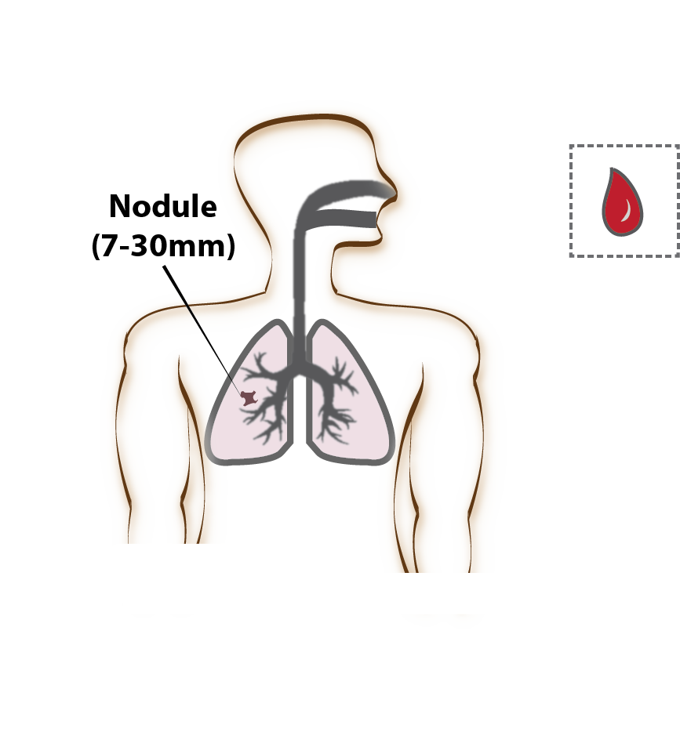
Clinical, Imaging and Biospecimen Collections
Detailed health questionnaire (demographic data, smoking/exposure history)
Bronchial (optional)
& Nasal Epithelial Brushings
(RNA, DNA & Protein)
Nodule
(6-25mm)
Imaging
(LDCT)
Blood
(30 mls for serum, plasma, and paxgene)

Slide 8
AIM 2: Validate Molecular Biomarkers
Validate the diagnostic accuracy of existing lung cancer biomarkers in this indeterminate pulmonary nodule cohort (100 cancer vs. 100 no cancer).
Site | Biosample | Analyte | Assay | Biomarker
Genomics (BU) | Bronchial Epithelium | RNA | RNA-Seq | 23 genes
 | Nasal Epithelium | RNA | RNA-Seq | 30 genes
Proteomics (VU) | Bronchial Epithelium | Protein | LC-MRM-MS | 50 proteins
 | Serum | Protein | CBSI | 3 proteins
Genomics (UCLA) | Plasma | miRNA | RNA-Seq | 5 miRNAs
Epigenomics (PITT) | Plasma | ctDNA | qMSP & HRM | 4 methylation sites
Genomics (Wistar) | Blood (Paxgene) | RNA | Nanostring | 100 genes
Imaging (Moffitt) | CT Images | Semantic & Agnostic Features | N/A | N/A
LC-MRM-MS: liquid chromatography-multiple reaction monitoring mass spectrometry
qMSP: real-time methylation-specific PCR | HRM: semi-digital high-resolution-melt for methylation
Non-invasive biomarkers that discriminate between patients with and without lung cancer could facilitate early treatment and thereby improve lung cancer outcomes, while minimizing complications from diagnostic procedures in patients without lung cancer.

Slide 9
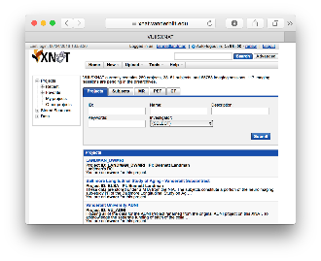
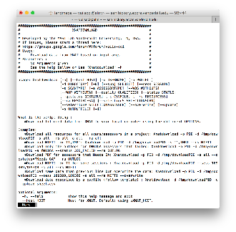
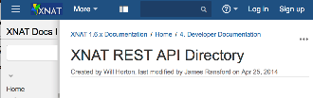

Vanderbilt Lung Imaging Repository
Medical image Analysis and Statistical Interpretation lab
Bennett Landman, PhD
Contributing Sites
Repository Users
External Programs
External Web Browser / Computer
External File System
External PACS
External XNAT
Web portal
Vanderbilt Lung Repository
Q/A and
De-identification
DAX/XNAT
Command line tools
DAX: Neuroimage. 2016 Jan 1;124(Pt B):1097-101. doi: 10.1016/j.neuroimage.2015.05.021.
XNAT: Neuroimage. 2016 Jan 1;124(Pt B):1093-6. doi: 10.1016/j.neuroimage.2015.06.076.
Software API
Image Processing
PACS or XNAT
Notes:
Vandy, Moffitt, Stanford, U Pen,

