Slide 1

Validation of a New Blood-based Biomarker Strategy for the Early Detection of Lung Cancer Michael Kammer, Amanda Kussrow, Heidi Chen, Darryl Bornhop, Pierre Massion
“where the rubber meets the road”

Slide 2
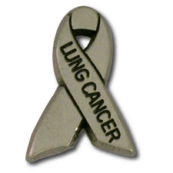
Lung Collaborative Group
Biomarker Development Laboratories
Avi Spira, Steve Dubinett, Marc Lenburg, Deni Aberle | BU, UCLA and Lahey Clinic
Louise Showe | Wistar Institute
Jim Herman | U of Pittsburgh
Harvey Pass, James Tsay | NYU
Biomarker Reference Laboratory
Sanford Stass, Feng Jiang | University of Maryland
Clinical Validation Centers
Pierre Massion, Chirayu Shah | Vanderbilt
Bob Gillies, Matt Schabath | Moffitt CC
DMCC
Margaret Pepe, Jackie Dahlgren, Tracey Marsh | Fred Hutchinson CC
Program Officers
Lynn Sorbara | NCI DCP
Karl Krueger | NCI DCP
Notes:
8 institutions, 6 BDLs, 2 CVCs, 2 BRLs.

Slide 3
EDRN Lung collaborative group
1. Biomarker of risk
high risk individuals
BDLs
CVCs
LTP4
3. Molecular & Imaging biomarker for IPNs
LTP2
Risk
Early
Diagnosis
Diagnosis
Progression
2. Biomarker of risk for
never smokers, early onset
disease and strong family history
4. Biomarker of Risk of
post-surgical progression
LTP3
5. Biomarker-based clinical trial
CVC

Slide 4
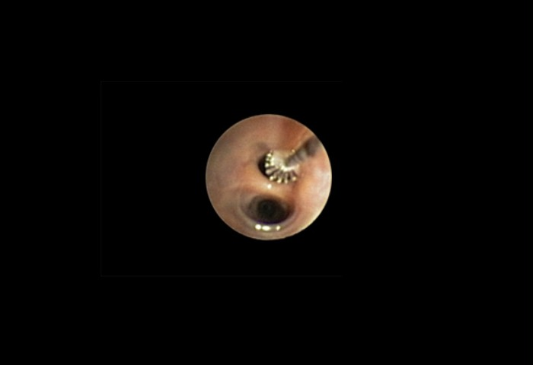
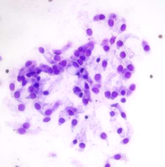
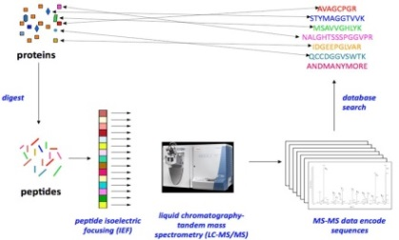
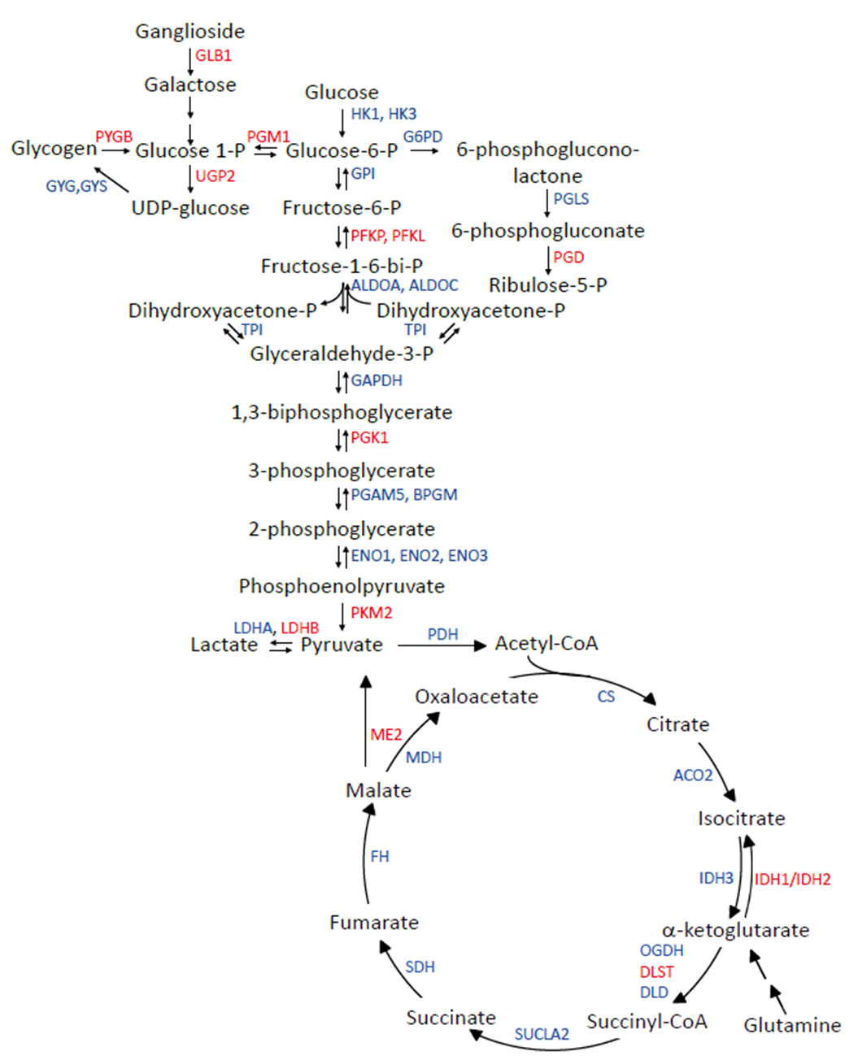
Proteomic analysis of bronchial epithelium in high risk individuals
In the high risk epithelium:
Carbohydrate metabolism reprogramming
Lipid metabolism reprogramming
Looking to test a Link between reprogramming and cancer dvpt
Rahman et al. JCI-I. 2016
Shotgun proteomics

Slide 5
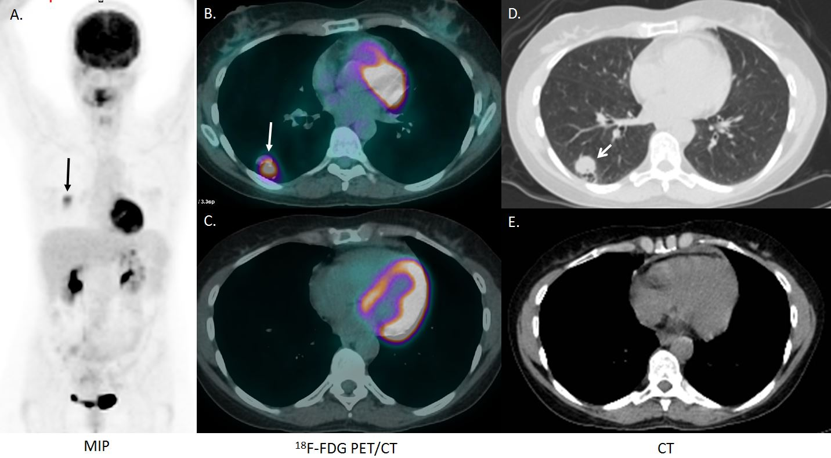
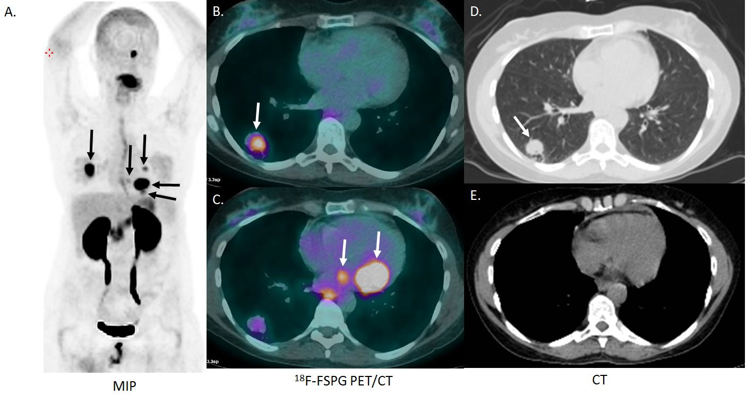
FSPG PET imaging for IPNs.

Slide 6
EDRN Lung collaborative group
1. Biomarker of risk
high risk individuals
3. Molecular & Imaging biomarker for IPNs
CVC
LTP2
Risk
Early
Diagnosis
Diagnosis
Progression
2. Biomarker of risk for
never smokers, early onset
disease and strong family history
4. Biomarker of Risk of
post-surgical progression
LTP3
5. Biomarker-based clinical trial
CVC

Slide 7
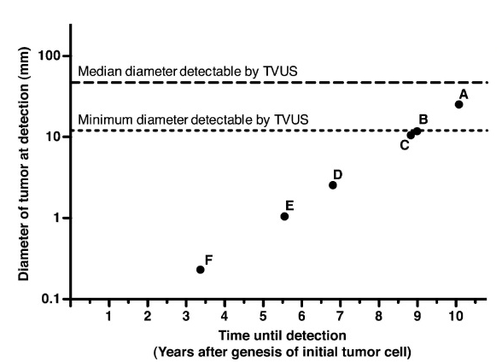
Mathematical Model Identifies Blood Biomarker–based detectability
A: ELISA
B: 100% vasc permeability
C: not shed by healthy cells
D: shedding is 1000x nl
E: not shed in nl and improved 1,000 x assay sensitivity from baseline
F: not shed in nl and improved 100,000 assay sensitivity from baseline
Specific marker, sensitive test
Hori Gambhir STM 2011
Notes:
Fig. 2. Model-predicted detection capability of current and potential strategies
for earlier cancer detection using blood biomarker assays. See Table 2 for
baseline parameter values. Dashed horizontal lines indicate the median
(47 mm) and minimum (12 mm) tumor diameters detected by transvaginal
ultrasound (TVUS) in a study of 725 asymptomatic women with adnexal
mass (29). Detection capability using (A) current clinical ELISA assays (assuming
baseline parameter values); (B) a biomarker that has 100% vascular
permeability (fPL,T = 1); (C) a biomarker not shed by healthy cells; (D) a
biomarker shed by tumor cells at a rate 103-fold higher than baseline; (E)
a biomarker not shed by healthy cells, and decreasing assay detection
limit 103-fold relative to baseline; and (F) a biomarker not shed by healthy
cells, and decreasing assay detection limit 105-fold relative to baseline

Slide 8
CRP and hsCRP
hsCRP revolutionized the value of the biomarker.
This happened based on a 30-fold increased sensitivity of the assay.
CRP is not just a marker of inflammation
CRP is a marker of Cardiovascular risk
Can we reconsider existing cancer biomarkers and improve our risk assessment?
Rifai, Clin Chem 2001
Ridker NEJM 2001

Slide 9
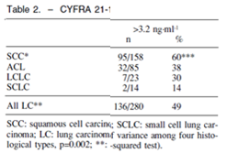
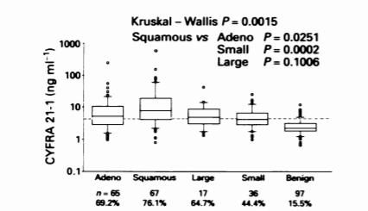
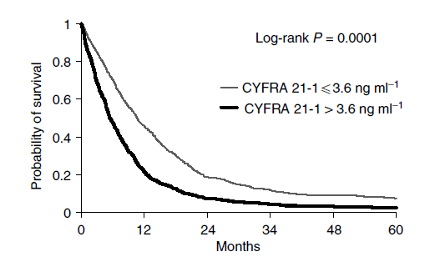
CYFRA 21.1
3.2 ng/mL
3.5 ng/mL
3.6 ng/mL
Rapellino ERJ 1995
Takada, BJC 1995
Pujol, BJC 2004

Slide 10
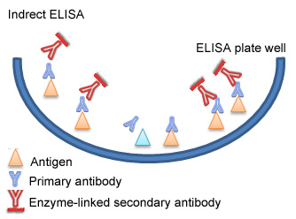
ELISA - enzyme-linked immunosorbent assay
Measures change in absorbance using capture
Direct vs Sandwiched
Pros: Cost, Throughput, Accessibility
Cons: Mileage may vary, probes must be developed

Slide 11
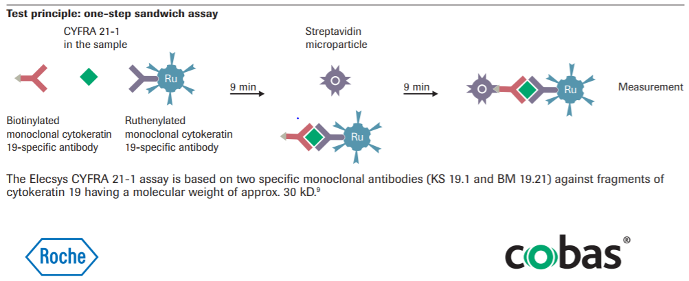
electrochemiluminescence immunoassay (ECLIA)

Slide 12
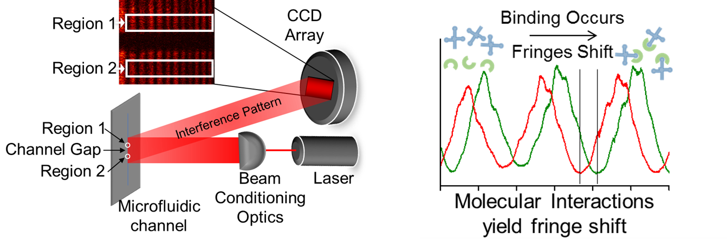
Compensated Backscatter Light Interferometry (CBSI)
Olmsted et al. Anal Chem 2014

Slide 13
Aim & Significance of the Study
Aim:
Apply CBSI technology to validate an existing biomarker CYFRA 21.1 to improve the diagnostic accuracy of the test in three clinical contexts: a. in distinction of cancer among indeterminate pulmonary nodules, b. in monitoring of cancer recurrence and c. in preclinical diagnosis.
Significance: The “so what”
Based on our preliminary data, such biomarker should provide a diagnostic and preclinical tool for early detection of lung cancer, may improve surveillance strategies and save lives.

Slide 14
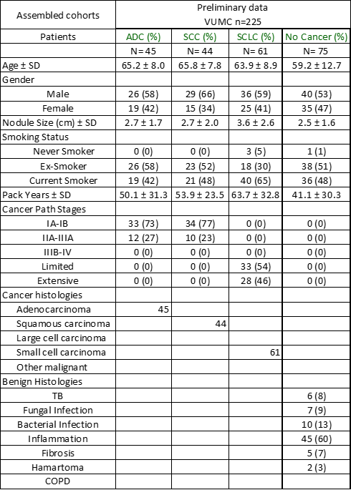
Patients characteristics

Slide 15
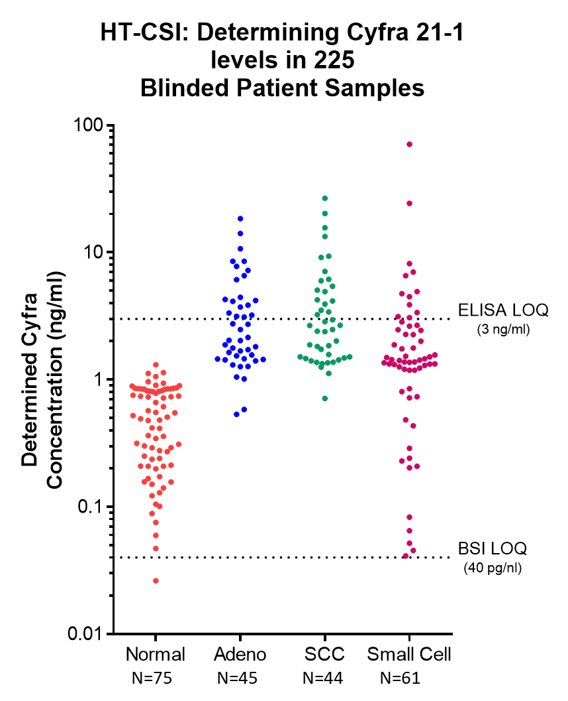
Preliminary Data/Outcomes CBSI for CYFRA 21.1 in 225 blinded serum samples , patients with IPNs

Slide 16
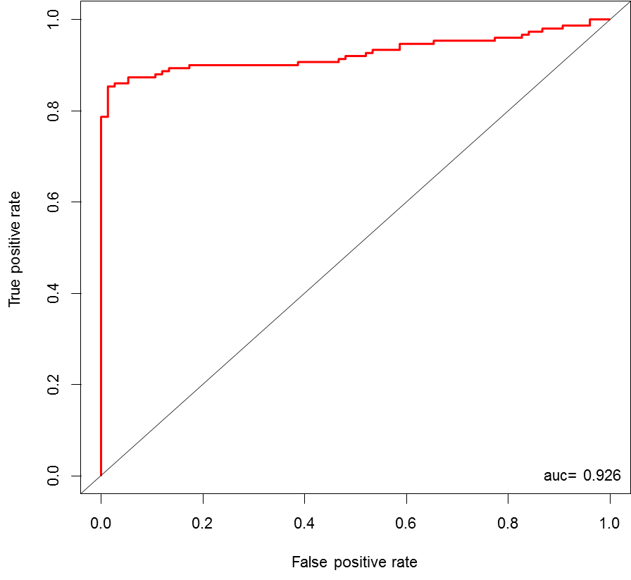
Preliminary cohort: 225 IPNs.

Slide 17
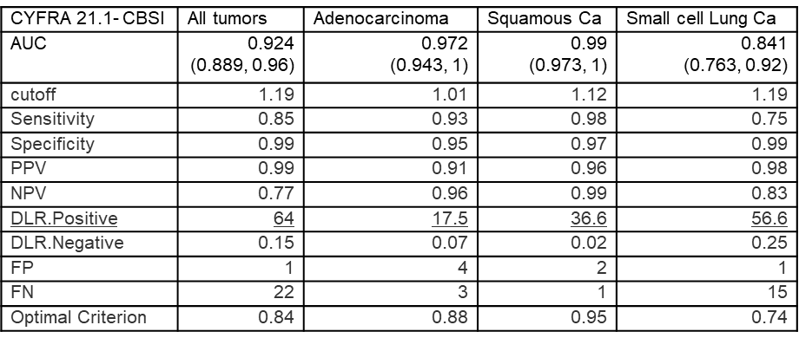
Preliminary Data/Outcomes

Slide 18
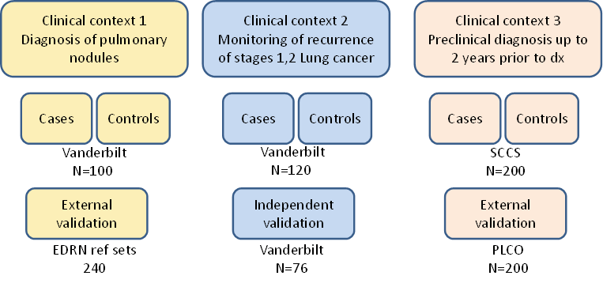
Validation plan
Test the value of Repeated measures over time to increase the diagnostic accuracy
Test other known candidate biomarkers alone and in combination
Test other tumor types

Slide 19




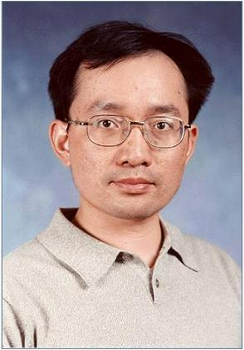













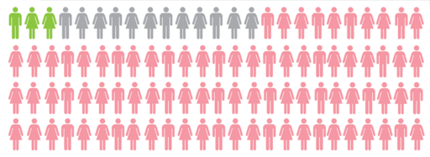

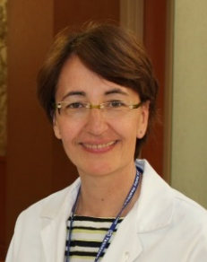



Matt Schabath, PhD
Bob Gillies, PhD
Jae Lee, PhD
Jim Herman,
MD
Jeff Wang, PhD
Brenda Diergaarde,
PhD
Avi Spira MD
Steve Dubinett, MD
Marc Lenburg, PhD
Deni Aberle, MD
Harvey Pass, MD
Haining Yang, MD, PhD
Louise Showe, PhD
Qihong Huang, MD, PhD
Pierre Massion
Eric Grogan
Chirayu Shah
Gary Smith
Funding support
EDRN
CIB
Margaret Pepe, PhD
Sanja Antic
Rosana Eisenberg
Heidi Chen
Bennett Landman

Slide 21
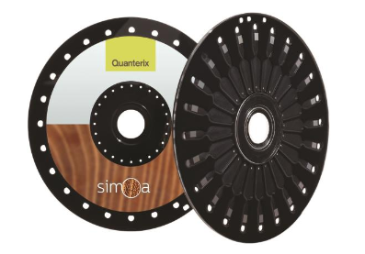
HT-CSI vs. Single Molecule Array (SIMOA)
 | HT-CSI | SIMOA
Probe Volume | 50 nL | 40 fL x 200,000
Throughput | 30 samples in quintuplicate / hour | 68 tests / hour
Sample volume Required (neat) | 2 µL | 5 µL
Precision | <15% CV (Serum) <10% CV (Buffer) | <10% CV
Dynamic Range | 4 decade | 4 decade [1]
Requires immobilization of probe | No | Yes
Allows Mix-and-Read analyte characterization | Yes | No
Allows characterization of binding affinities | Yes | No
Free Solution | Yes | No
Label Free | Yes | No
Sample Type | All Fluids | All Biological Fluids
Instrument Cost | <$40,000 | $150,000
Format | Differential Refractive Index Detector | Single Molecule Fluorescence Array
Demonstrated Sensitivities
Proteins | 0.01 pg/mL (Cyfra 21-1) [10] | 0.005 pg/mL (0.15 fM) PSA [11]
 | 47 fM (Biotin) [12] | 90aM-6fM (Cytokines) [13]
 | 40 pM (IL-2) [2] | 0.1 ng/ml GDF11 [14]
Small Molecules | <500 pM (OPNA Metabolites) DRUGS>>>
SIMOA is a commercially available biomarker detection method highly sensitive for established biomarkers, but does not allow for rapid assay development using a mix-and-read approach

Slide 23
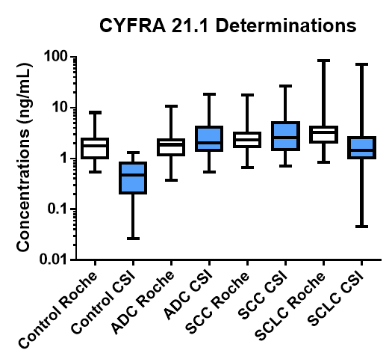

Slide 24
Preliminary Data/Outcomes

Slide 25
Validation in the Southern Community Cohort Study
Cases of lung cancer all stages
N=120
up to 24 months preceding the diagnosis
Compare CYFRA 21.1
OR lung cancer
Added value to PLCO 2012
Cohort high risk individuals
N=240
Controls, matched on age, gender and PKY
N=120

Slide 26
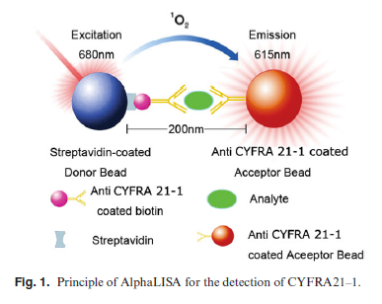
AlphaLISA for CYFRA 21.1
He, Journal of Clinical Laboratory Analysis, 2013

Slide 27
Pre Cancer Atlas.
Histological features of premalignant lesions not adequate for precision risk stratification
Lack of knowledge of ME and genomic and peigene that dreive cancer
Longitudinal collect perform molecular profiling.

