Slide 1
The sTRA Antigen: A New Blood and Tissue Biomarker for Pancreatic Cancer
Daniel Barnett
Van Andel Institute
September 13, 2017

Slide 2
Pancreatic Cancer – Poor Survival, Late Diagnosis
Pancreatic cancer is the 9th most common cancer in the US and the 4th deadliest (number of deaths annually) in males and females. ¹
Overall survival is 7%, 15-25% in resected cancers
Difficult and Late Diagnosis
Resistant to treatments

Slide 3
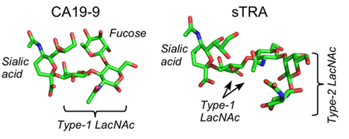
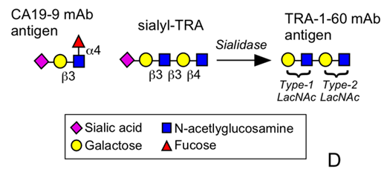
Novel glycan antigen sialyl-TRA (sTRA) is related to current best test antigen (CA19-9)

Slide 4
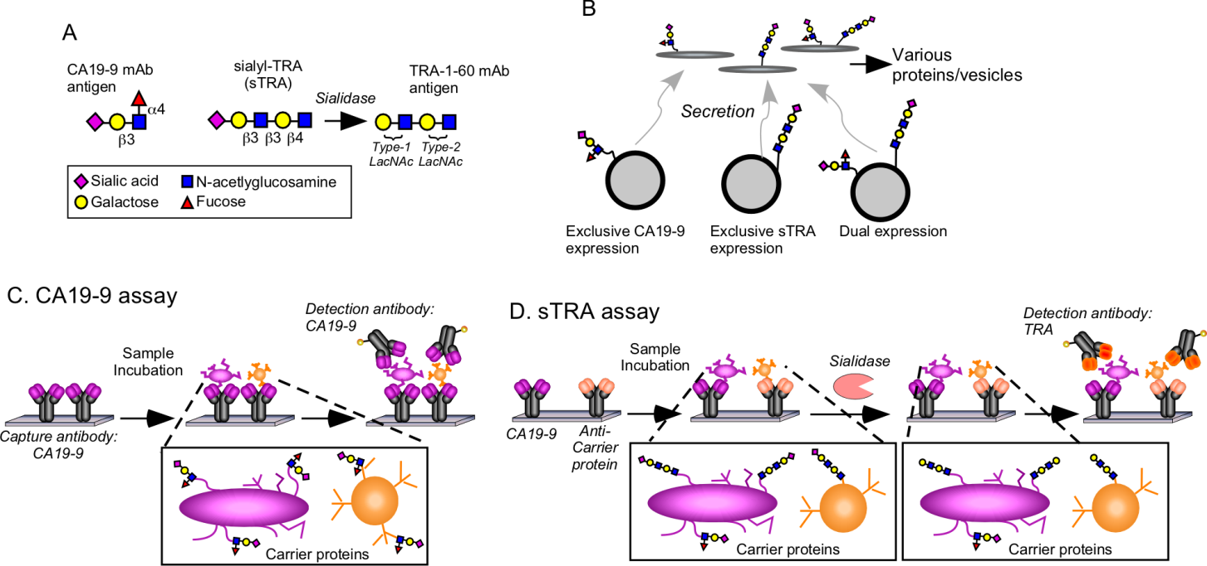
Pancreatic Cancer Heterogeneity and Glycans

Slide 5
Glycans detected on captured proteins and glycans by microarray

Slide 6
Patient Sample Sets
Site - Set | UPitt - Discovery | UPitt - Validation | Upitt - Test | MUSC - Drake | UPitt - Neoadjuvant | UPitt – Discovery Subset
Cases | 109 | 48 | 50 | 52 | 54 | 23
Controls | 91 | 69 | 50 | 8 |  | 26
Total | 200 | 117 | 100 | 60 | 54 | 49

Slide 7
sTRA performs as well or better than CA19-9, but strongest together
Discovery
Validation
Test
Notes:
All combined MUC16: 75.2, 96.7; 72.9, 94.2; 50, 92
MUC16: 50.5, 98.9; 37.5, 98.6; 26..0, 98.0

Slide 8
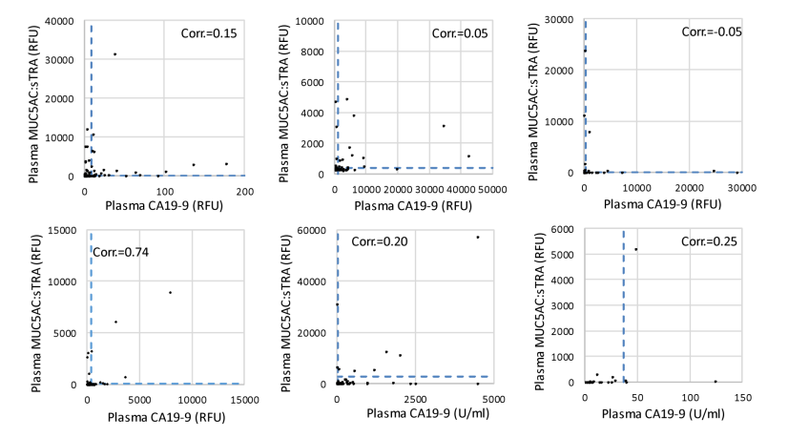
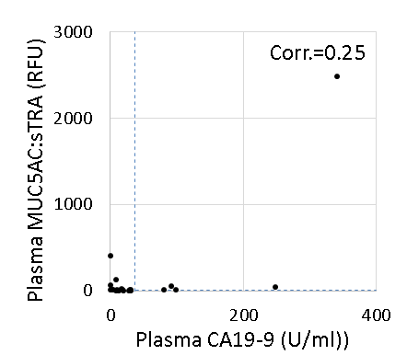
Low correlation between CA19-9 and sTRA expression
UPitt -Discovery
UPitt - Validation
Upitt - Test
MUSC - Drake
Upitt - Neoadjuvant
Discovery Subset

Slide 9
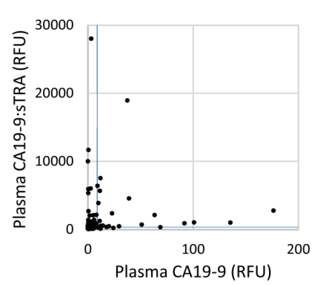
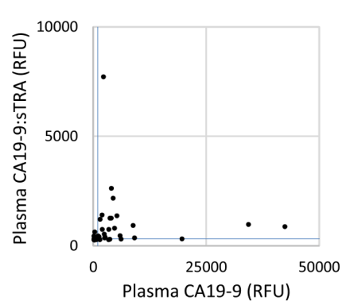
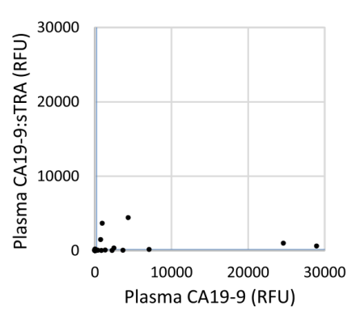
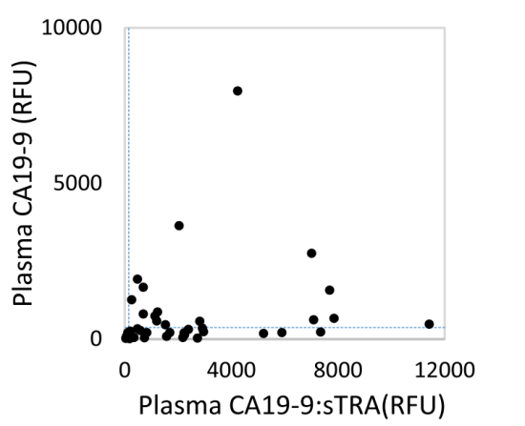
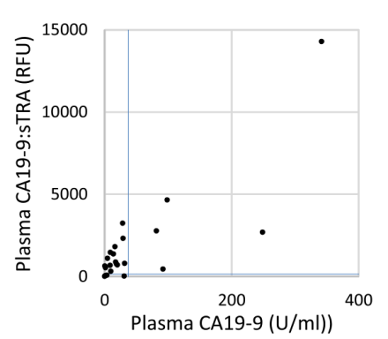
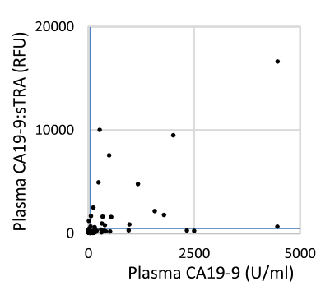
Low correlation between CA19-9 and sTRA expression
UPitt -Discovery
UPitt - Validation
Upitt - Test
Corr. = 0.07
Corr. = 0.06
Corr. = 0.22
Corr. = 0.19
Corr. = 0.69
MUSC - Drake
Upitt - Neoadjuvant
Discovery Subset

Slide 10
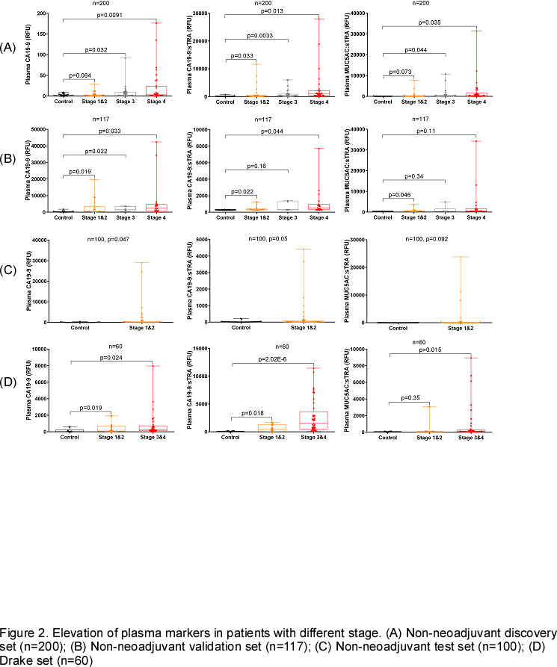
sTRA consistently performs as well or better than CA19-9
Discovery

Slide 11
sTRA consistently performs as well or better than CA19-9
Discovery
Validation

Slide 12
sTRA consistently performs as well or better than CA19-9
Discovery
Validation
Test

Slide 13
sTRA consistently performs as well or better than CA19-9
Discovery
Validation
Test
Drake

Slide 14
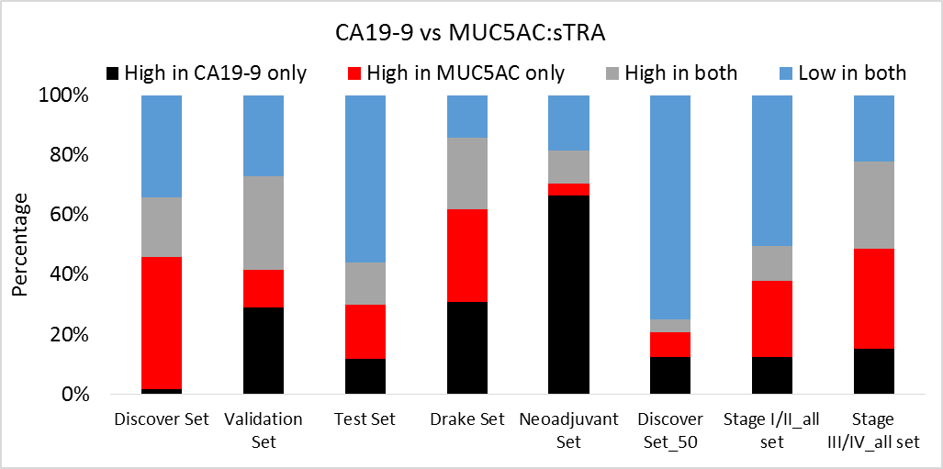
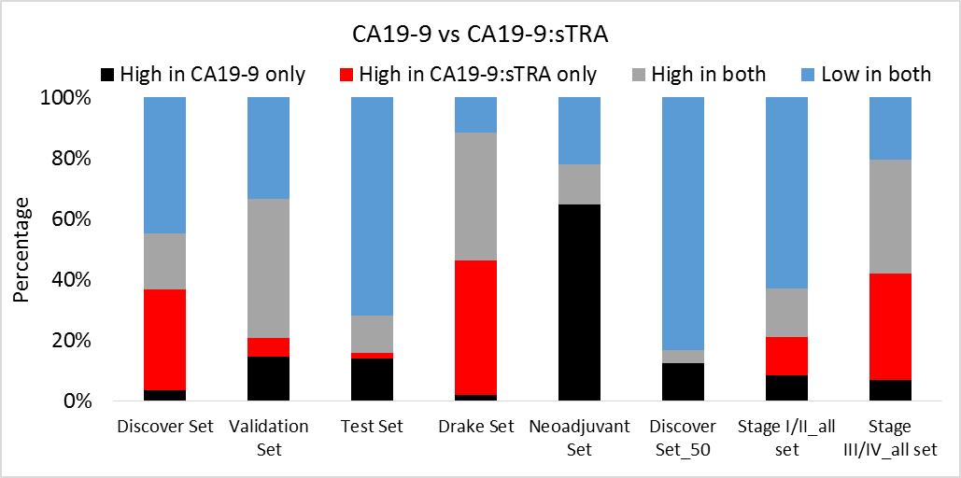
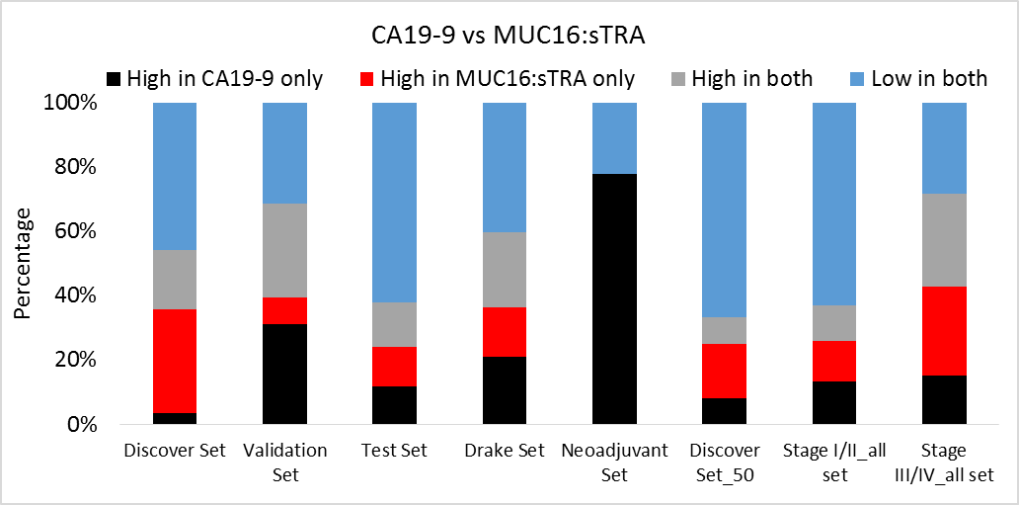
sTRA is complementary to CA19-9

Slide 15
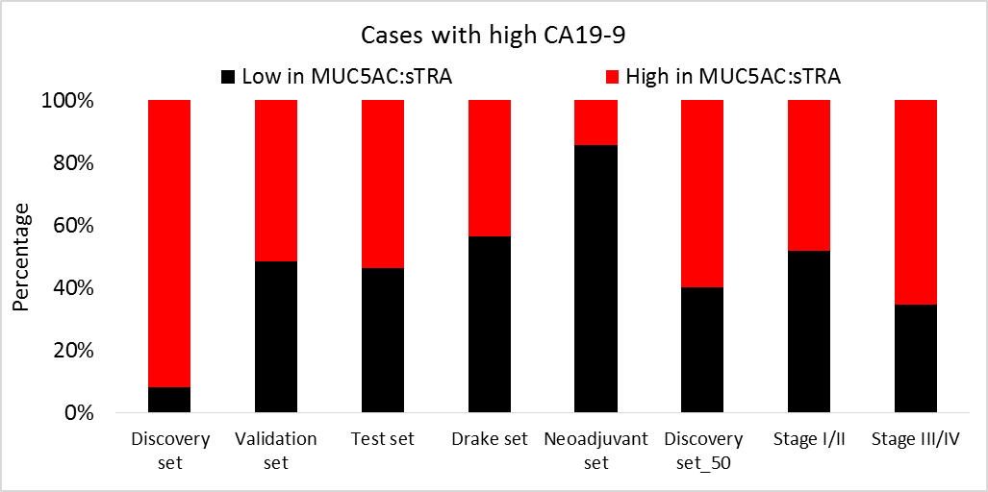
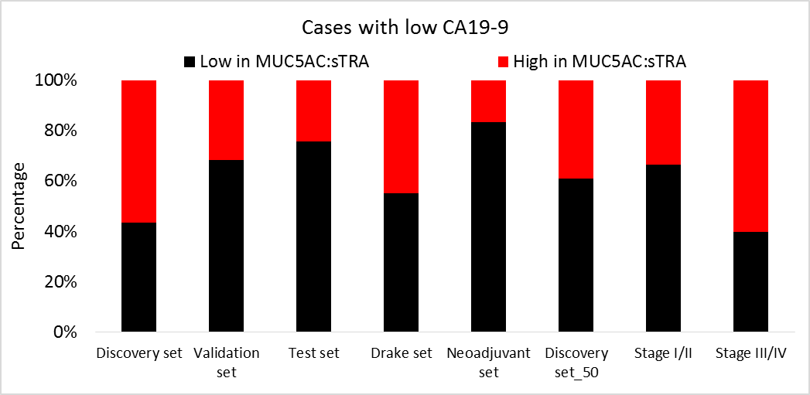
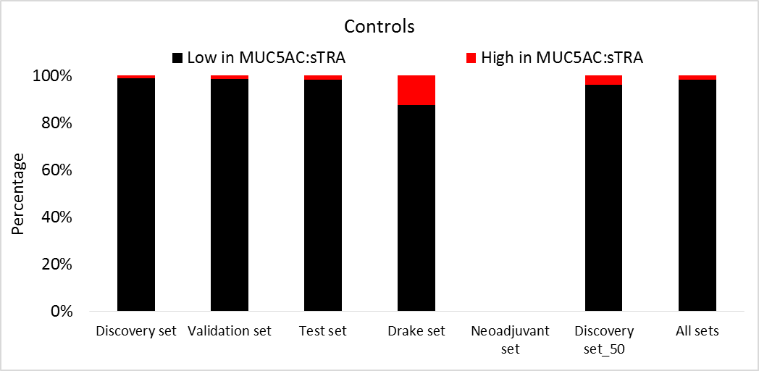
sTRA detects PDAC not detected with CA19-9

Slide 16
MUSC – Drake Set
52 cases, 8 controls
Matched blood and tissue samples (cases)
All patients had resectable cancer
Tumor samples analyzed as a Tissue Microarray

Slide 17
Plasma sTRA and CA19-9
Corr. = 0.19
Plasma sTRA
Plasma CA19-9

Slide 18
Plasma sTRA and CA19-9
Corr. = 0.19
Plasma sTRA
3
4
1
2
Plasma CA19-9

Slide 19
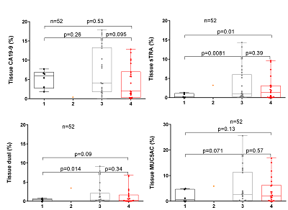
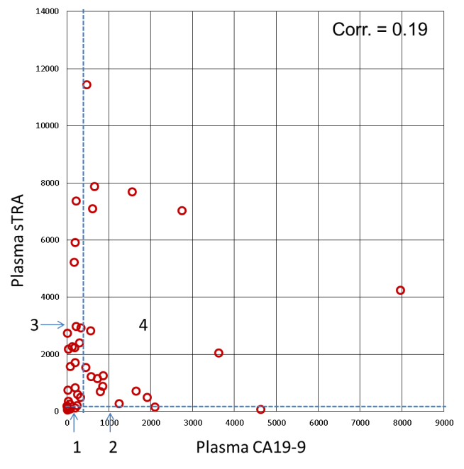
Low serum marker levels show expression in tissues

Slide 20
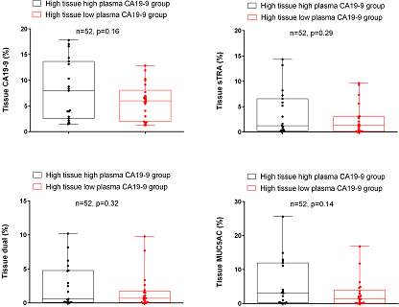
No significant tissue expression difference between high and low serum CA19-9 expression

Slide 21
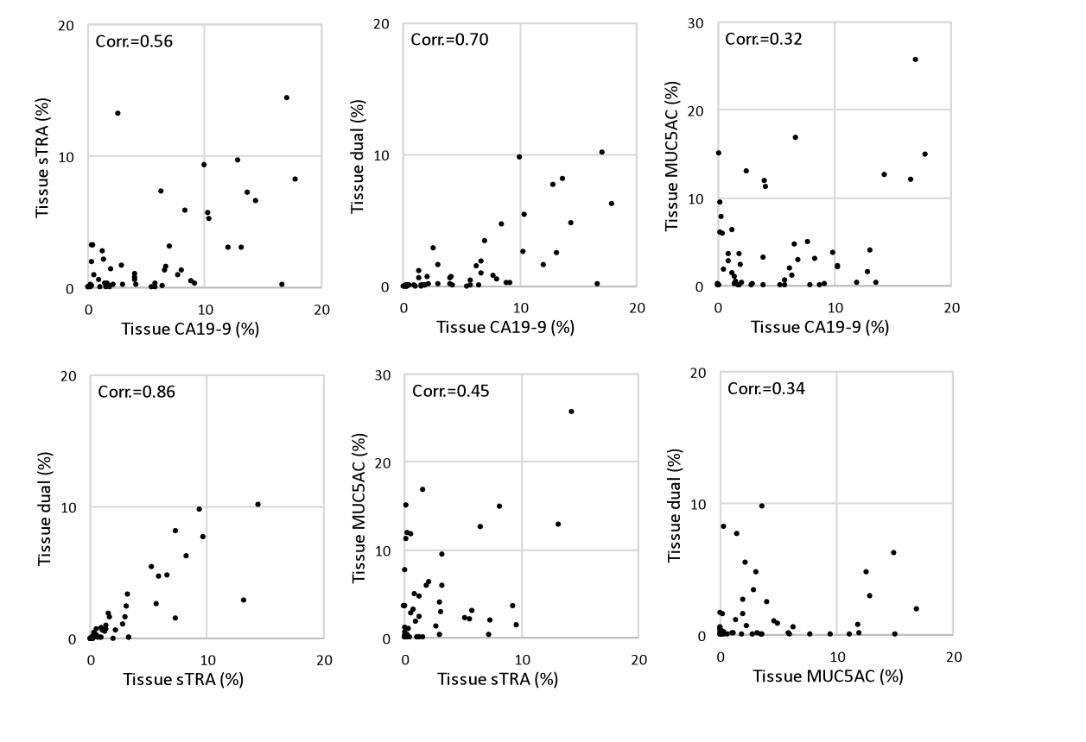
CA19-9 and sTRA expressions are correlated, but complementary

Slide 22
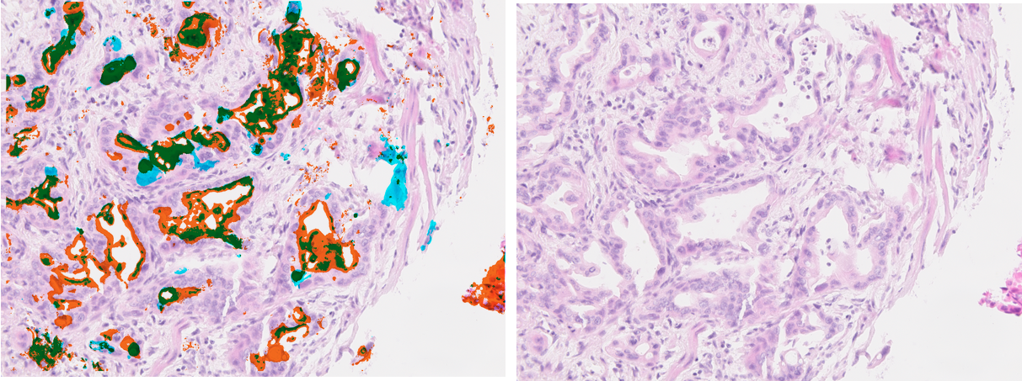
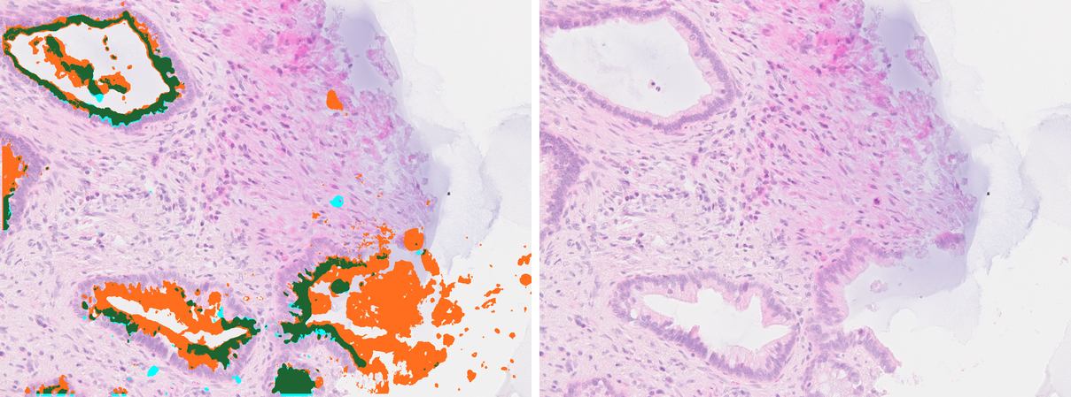
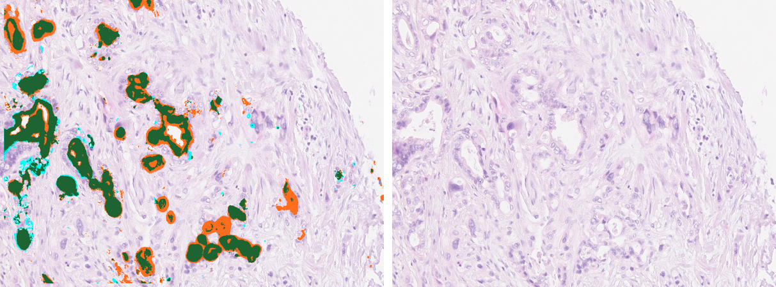
2
1
3
Patients with high plasma in both

Slide 23
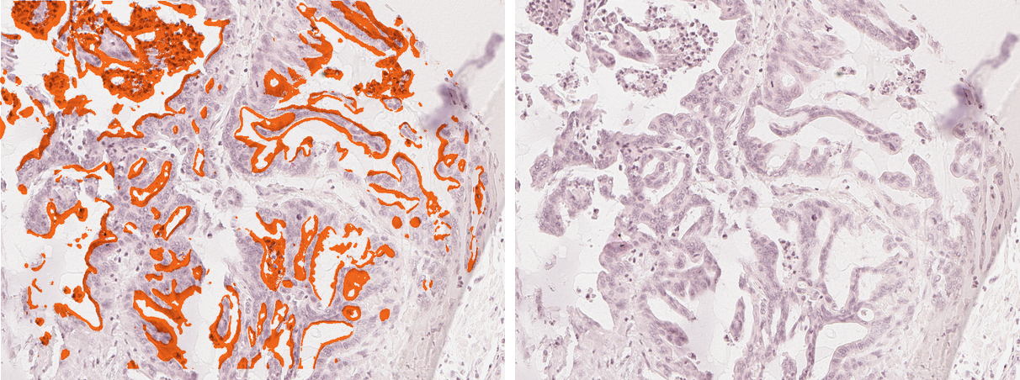
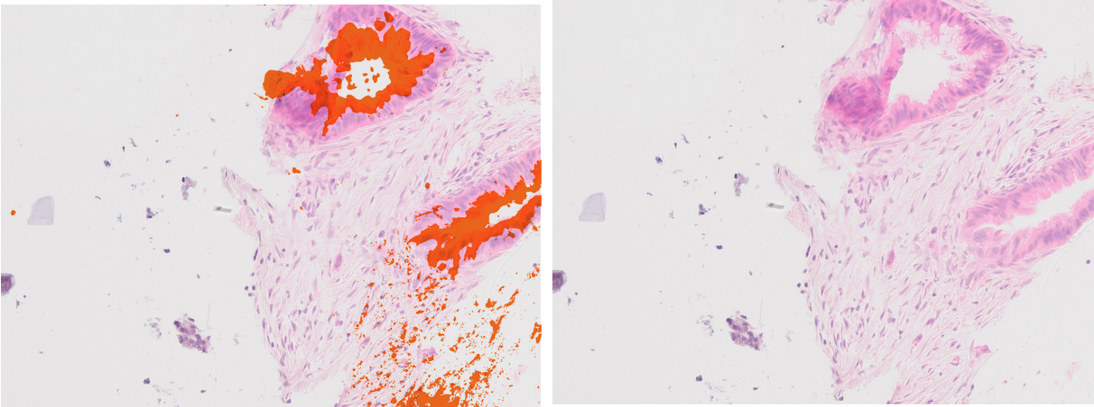
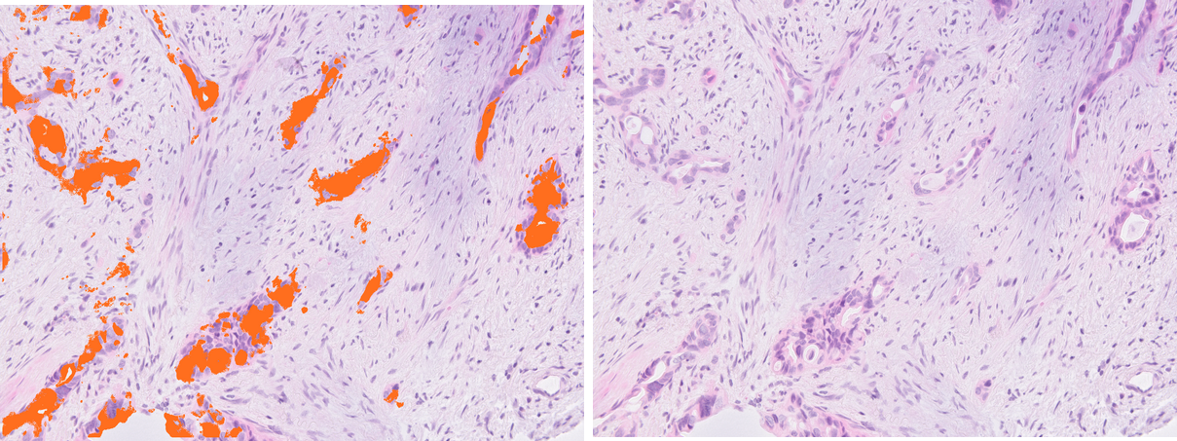
1&2
3
Patients low in both or high in CA19-9 only

Slide 24
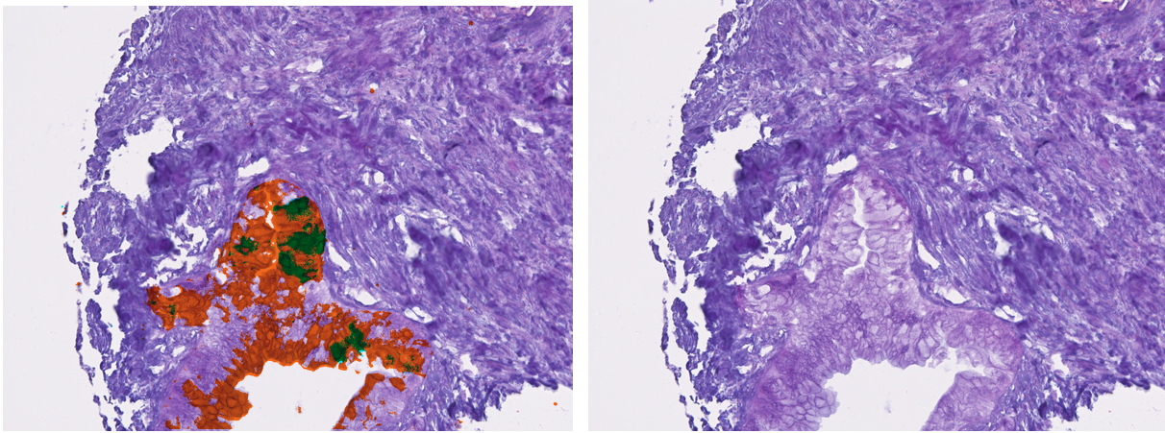
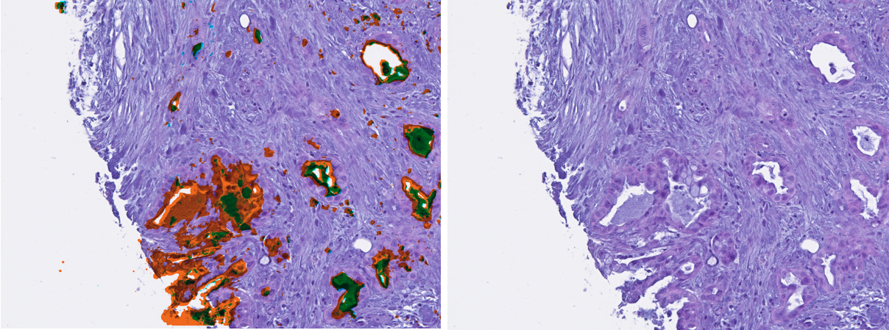
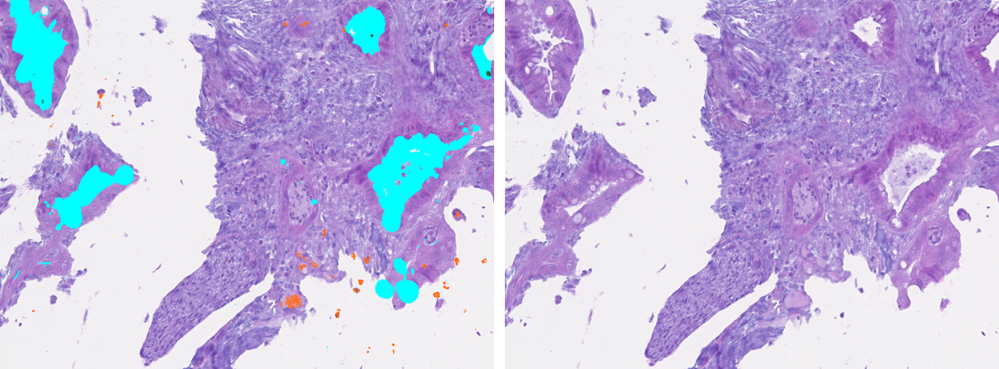
2
3
1
Patients with high plasma sTRA only

Slide 25


Acknowledgements
Haab Lab
Brian Haab, PhD
Ying Liu, PhD
Katie Partyka
Luke Wisniewski
Ben Staal
Peter Hsueh
Chongfeng Gao, PhD
Zach Klamer
Johnathon Hall
David Ayala-Talavarez
Elliot Ensink (former intern)
Huiyuan Tang, PhD (former postdoc)
VAI Confocal Microscopy and Quantitative Imaging Core
Kristin Feenstra
VAI Pathology and Biorepository Core
Galen Hostetter, MD
Carrie Joynt
Lisa Turner
University of Pittsburgh
Randall Brand, MD
Herbert Zeh, MD
Medical University of South Carolina
Richard Drake, PhD
Memorial Sloan Kettering Cancer Center
Peter Allen, MD
Fred Hutchinson Cancer Research Center
Ying Huang, PhD
NIH - NCI
EDRN
Alliance of Glycobiologists

