Slide 1

Plans For The EDRN Lung Team Project 3 (LTP3)….and something new
Harvey I. Pass MD
EDRN Meeting, Seattle, September 2017

Slide 2
Disclosure
All of these specimens were collected at NYU with funding solely from the EDRN

Slide 3
Plans for the LTP3
The specimens for the LTP3 project have been collected and archived under an IRB approved protocol (8896) from September 2006 to June 2015.
The specimens represent 361 patients suspected of having Clinical Stage I-IB lung cancer by the Stage Grouping for the 8th Edition of the TNM classification for Lung Cancer. Essentially, preoperative workup in all patients included CT scanning and integrated PETCT.
Any patient having endobronchial ultrasound or mediastinoscopy prior to resection was confirmed to have non-involved lymph nodes that were sampled.
Of the 361 patients, 27 were found to have N1 disease. No patient in this series had N2 (mediastinal) nodal involvement.

Slide 4
Available Specimens
All of the patients in the series have matching EDTA plasma and Serum.
24 lack CPT plasma, 10 lack buffy coat, and 21 lack PBMC.
Of the 244 with at least one vial of snap frozen tumor, 238 have matching snap frozen lung tissue.
Total RNA from the above 238 matching specimens will be extracted in the NYU Biomarker Discovery Laboratory
As part of the materials which will be available to the investigators, a TMA of all 361 patients, both tumor and normal, will be available (Spring 2018).
150 of the 361 patients apparently have matching high resolution CT scans performed at NYU Radiology Department.

Slide 5
Available Demographics
Record_ID
Extent_of_Resection
IASLC Adenocarcinoma Classification
Mayo_classification
Smoking_Status
Pack years
Date of Surgery
Gender
Ethnicity
Age
Number of Tumors resected
Histology
VATS vs Open
Pleural Invasion
LVI
Size
Number of Lymph nodes resected
Number of lymph nodes positive
TNM stage
Stage Grouping
Adjuvant therapy
Date Follow-up
Date of Recurrence
Type of Recurrence
Date Death
Intervals
Time to progression, Time to Death, Time to Followup

Slide 6
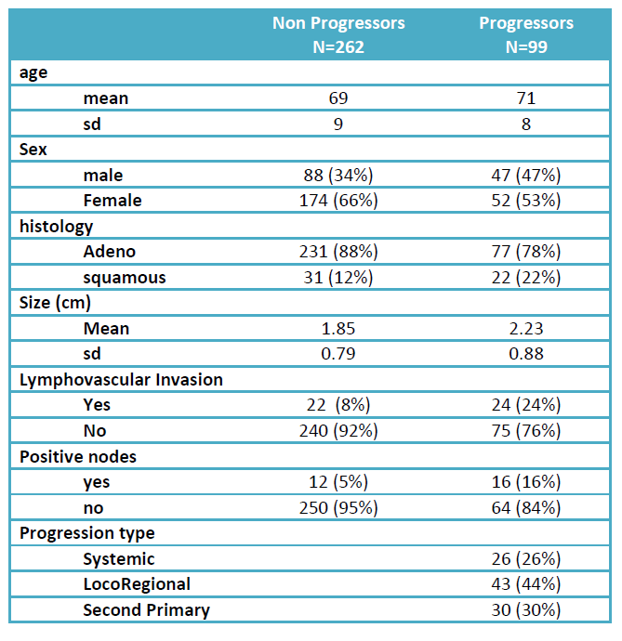
Demographics of Non Progessors and Progressors

Slide 7
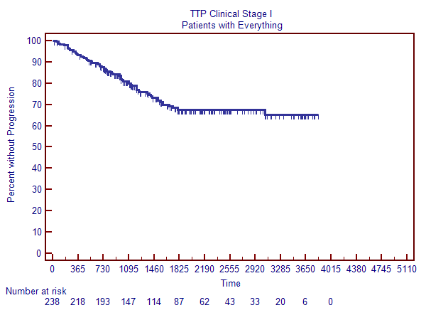
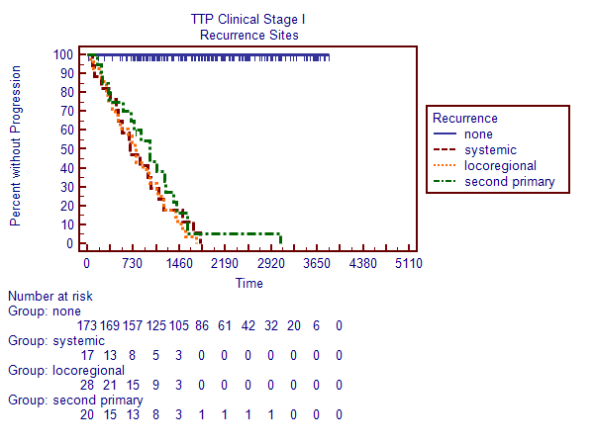
Time to Progression: Clinical Stage I

Slide 8
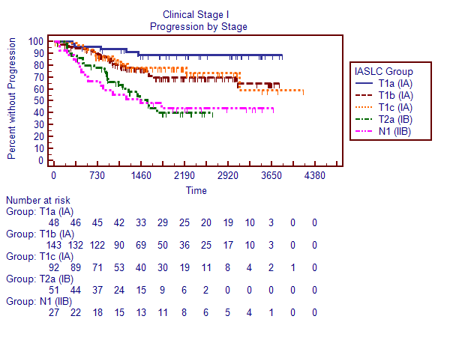
Progression: Clinical Stage I by pStage IASLC 8
1
T1a
T1b
2
1
3
2
T1c
4
3
T2a

Slide 9
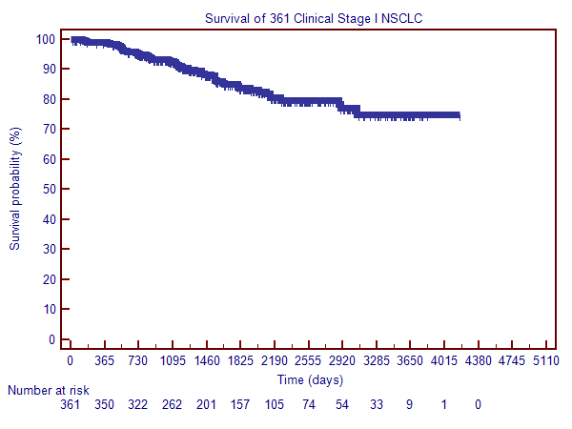
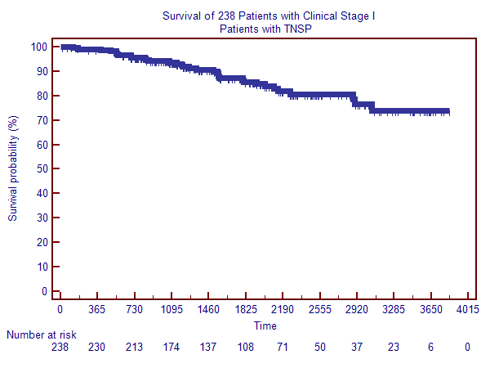
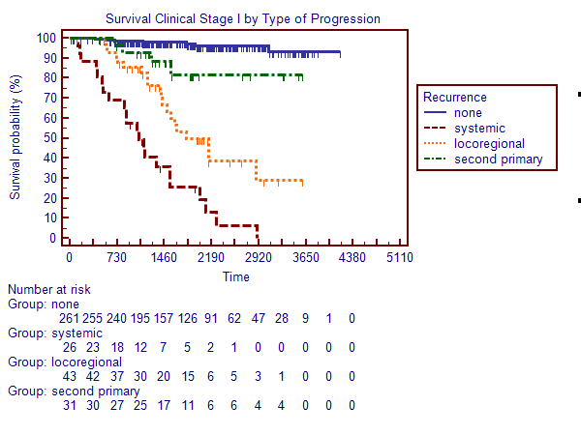
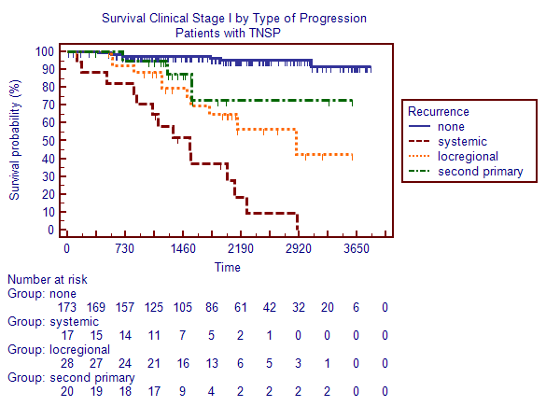
Survival : Clinical Stage I

Slide 10
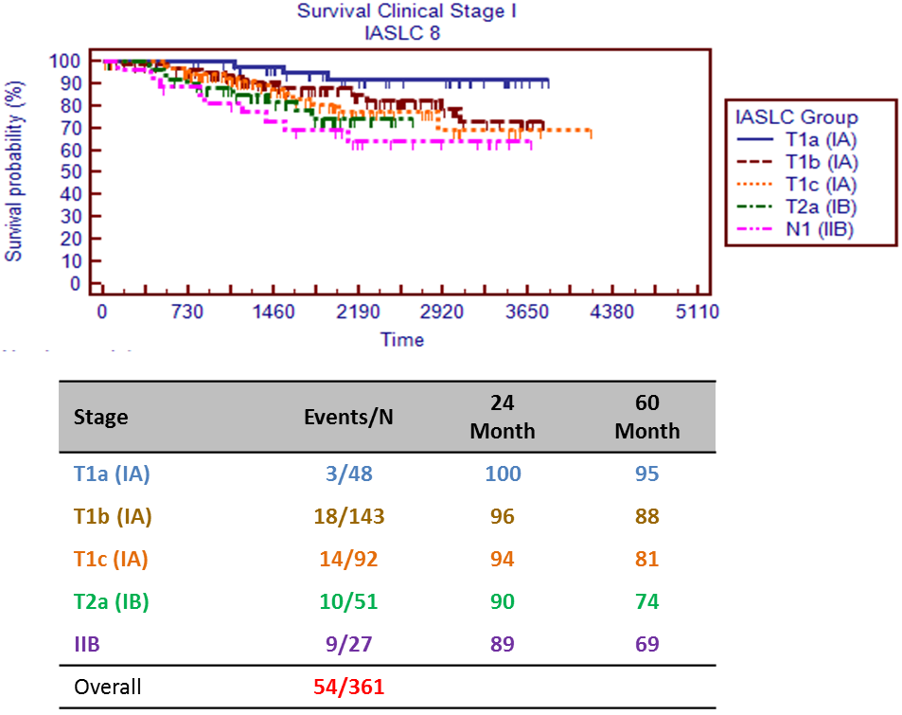
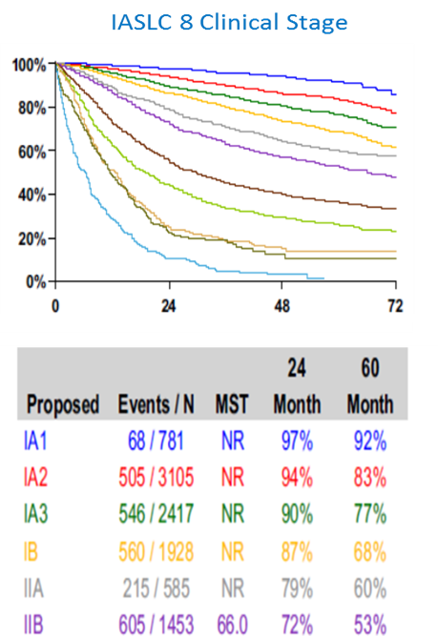
Survival: Clinical Stage I by pStage IASLC 8
Journal of Thoracic Oncology Vol. 11 No. 1: 39-51, 2015

Slide 11
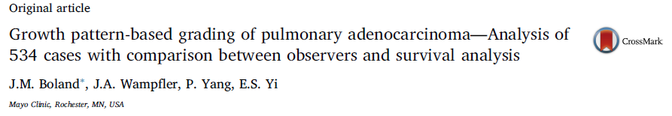
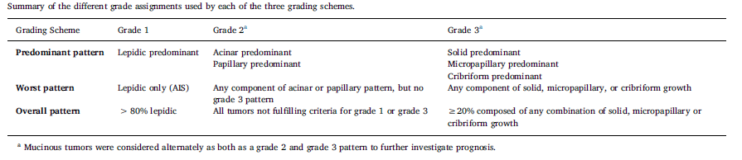
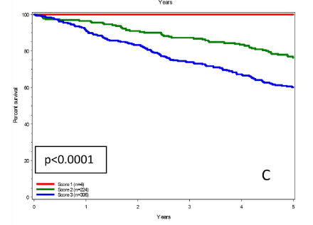
Lung Cancer 109 (2017) 14–20

Slide 12
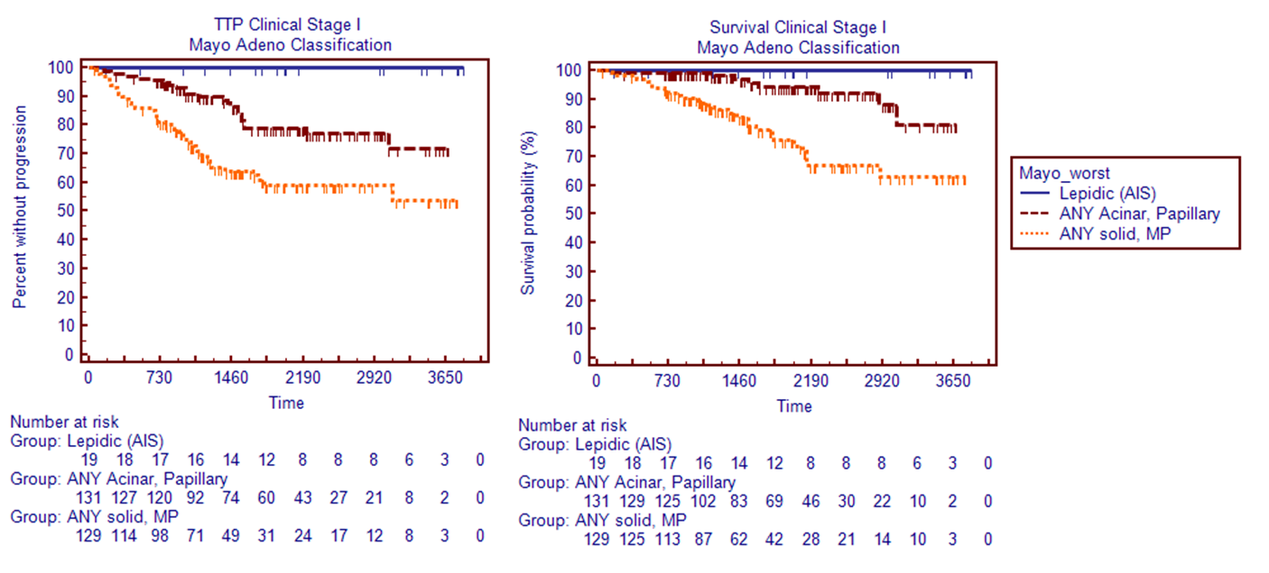
Adenocarcinoma Mayo Classification: Clinical Stage I Can it be beat????

Slide 13
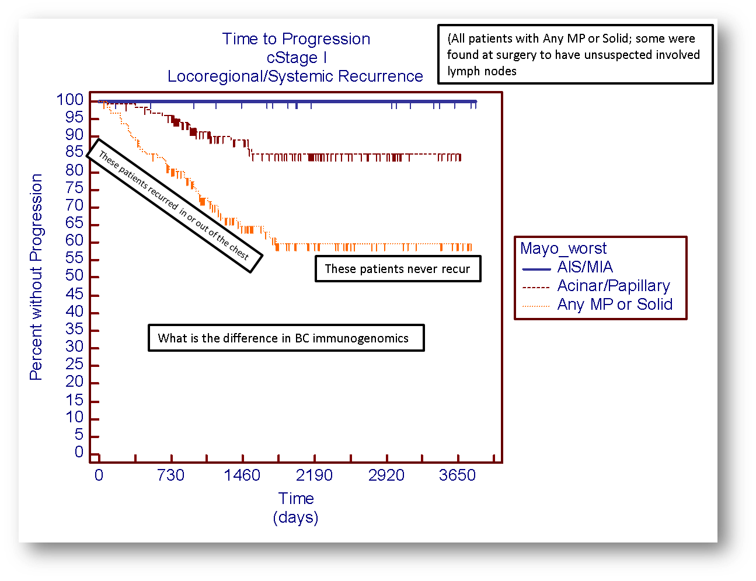

Slide 14
Nanostring Immune-Oncology Panel
770 gene panel which measures gene expression of human immune response in
all cancer types
Combines markers for 24 different immune cell types and populations including 109 genes to cell surface markers for 24 different immune cell types and populations, 30 common cancer antigens and genes that represent all categories of immune response including key checkpoint blockade genes.

Slide 15
Nanostring ImmunoOncology Panel

Slide 16
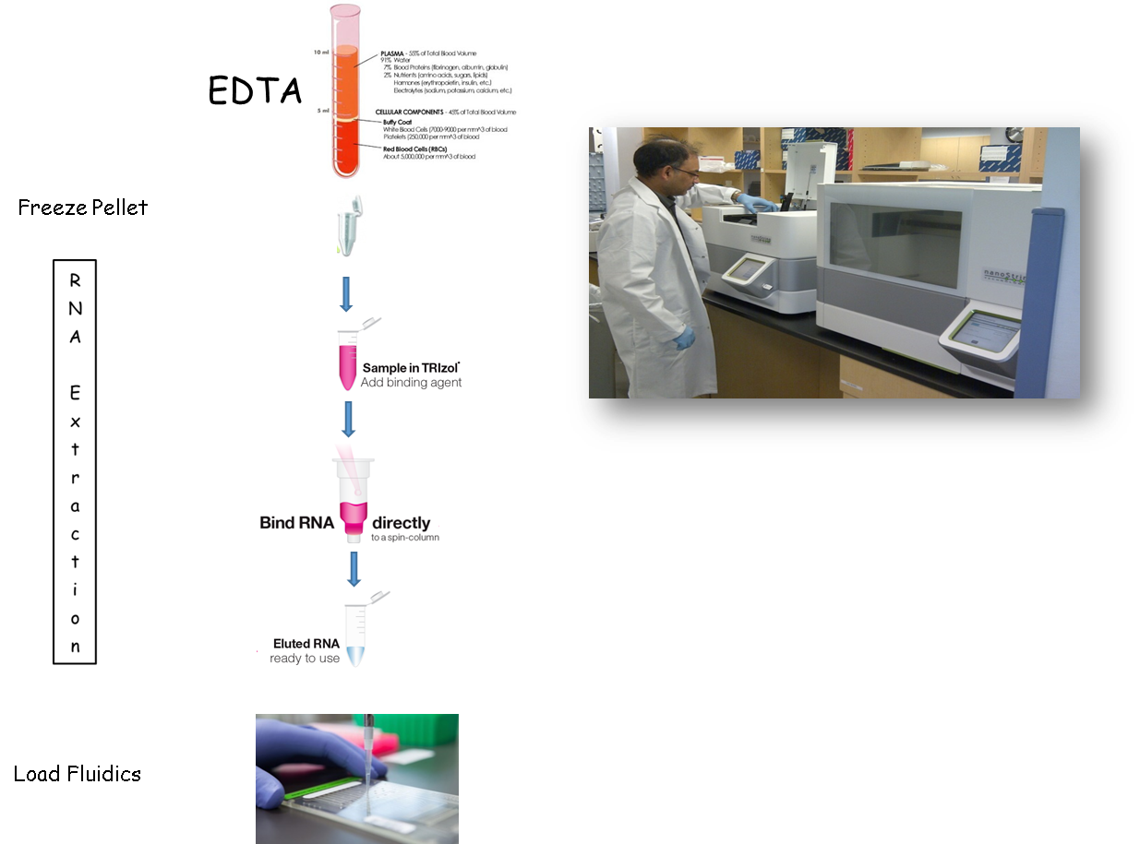

Slide 17
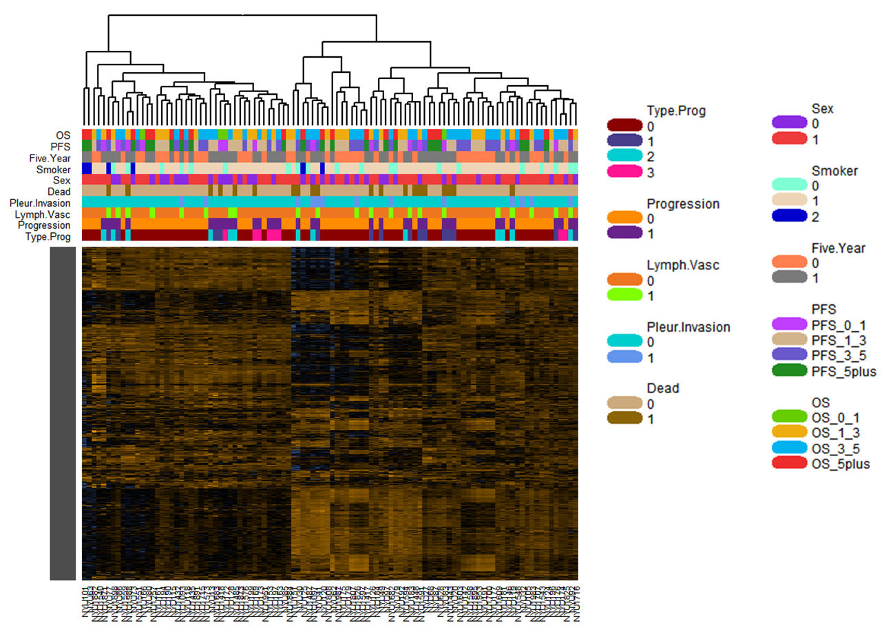
Prognostic Comparisons – Overview (102 patients)

Slide 18
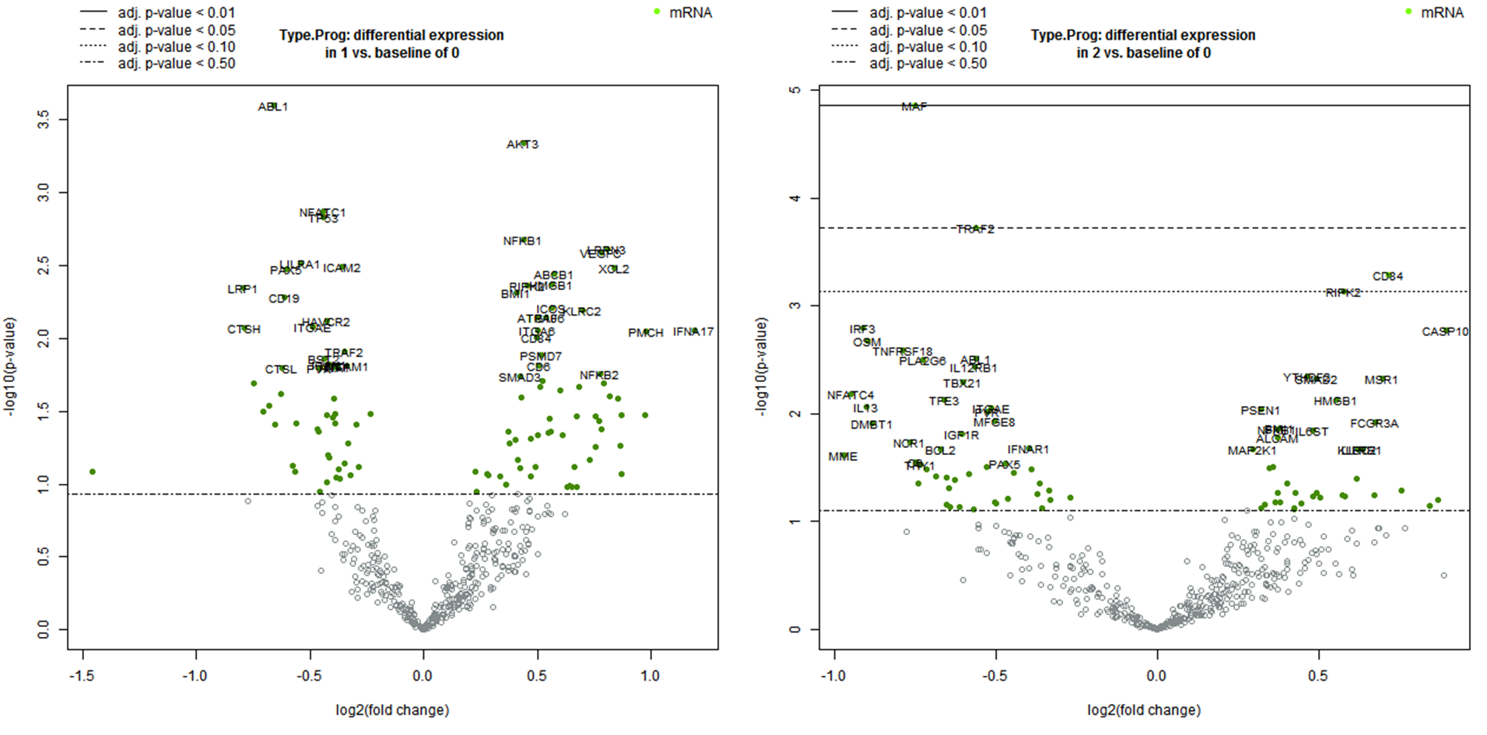
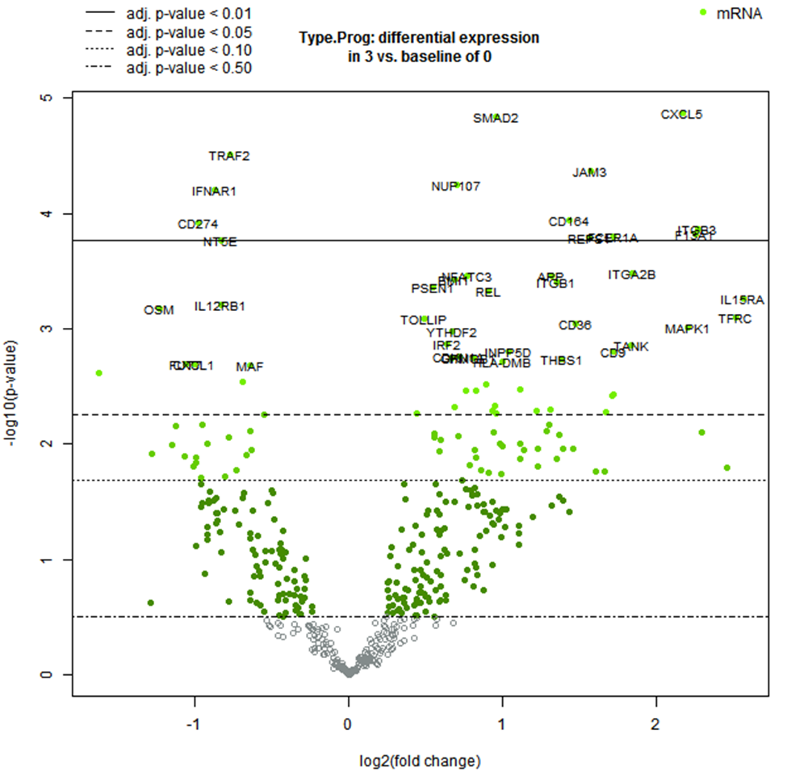
Differential Expression – Type of Progression

Slide 19
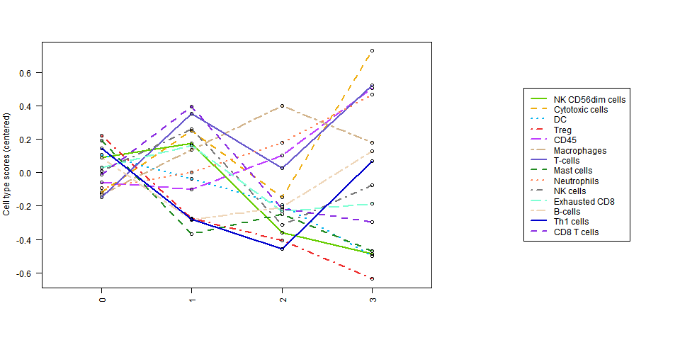
Immune Cell Profiling – Type of Progression

Slide 20
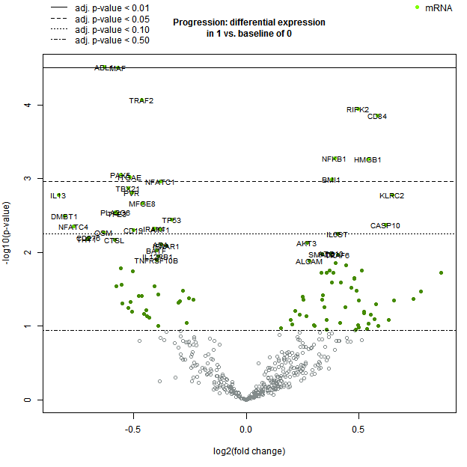
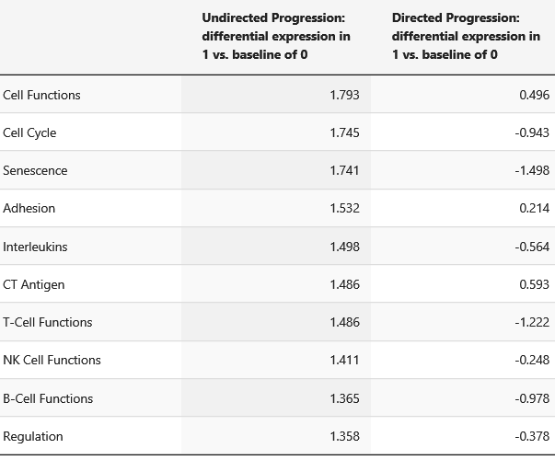
DE – Progressed (28) vs. Not Progressed (66)
Gene Set Analysis

Slide 21
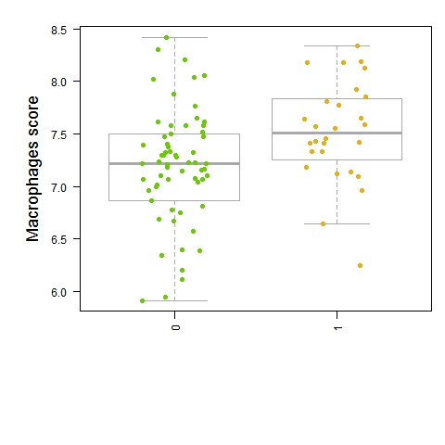
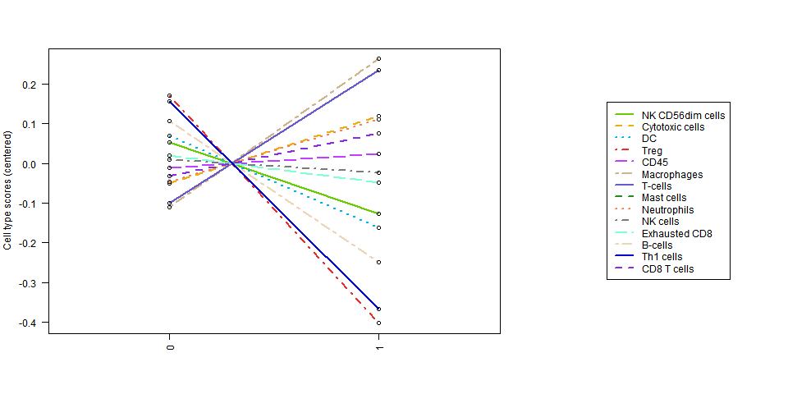
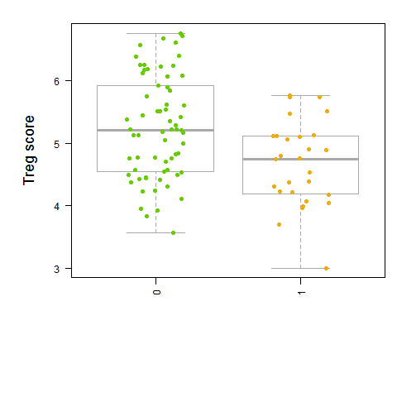
Immune Cell Profiling – Progressed (28) vs. Not Progressed (66)

Slide 22
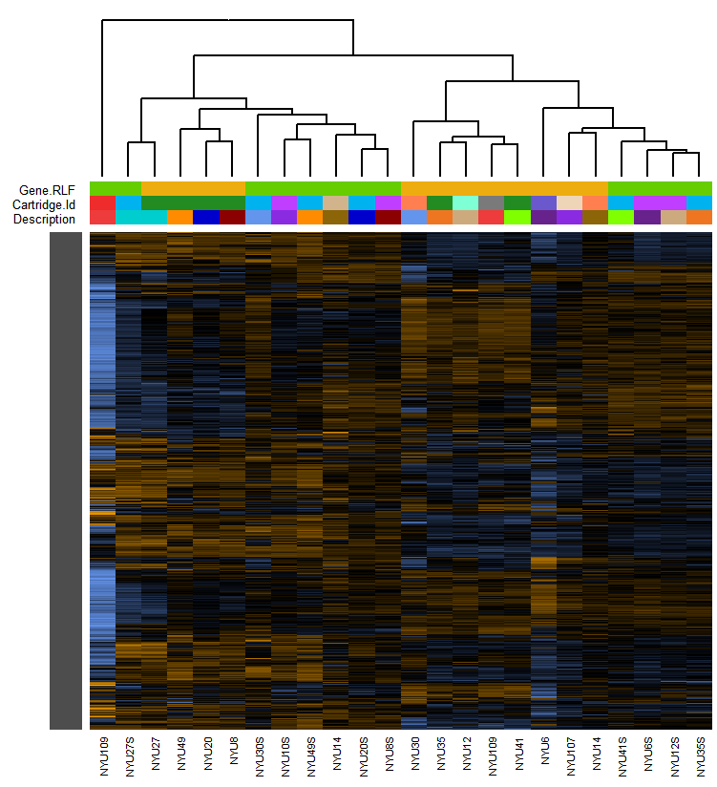
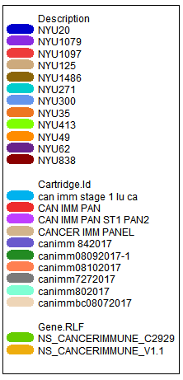
Batch Effect -- Unsupervised Clustering of Normalized Data (12 replicates)
Samples cluster by RLF (i.e. CodeSet lot) rather than by patient ID (i.e same RNA), suggesting a lot-to-lot batch effect
CodeSet lot-to-lot variation (i.e. probe specific efficiency difference) is expected due to the manufacturing process
A calibration process can mitigate the lot-to-lot variation if data from different CodeSet lots need to be combined
Technical replicates run on both lots of CodeSet can be used for calibration

Slide 23
Thanks
Alan Vaynblatt
Ki Prokrym
Nathalie Hirsch
Ryan Harrington
Brady Kwong
Weiming Pai MD
Chandra Goparaju PhD

Slide 24
Questions?

