Slide 1
Deep Learning for Precision Medicine
Hoifung Poon
Notes:
Organizers; background; feedback

Slide 2
Overview
Precision medicine
Deep learning
Project Hanover
EDRN opportunities
Notes:
I’ll start w/ challenges and opportunities in precision medicine, which motivate our work.
I’ll then briefly review DL and present representative examples from our work in Hanover.
Our past work tends to focus on diagnosis/treatment, but many methods and results are potentially applicable to early detection.
I’d conclude w/ some thoughts along this direction.

Slide 3
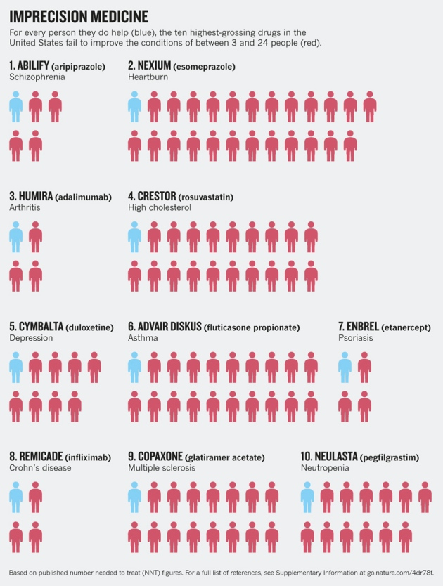
Medicine Today Is Imprecise
Top 20 drugs
80% non-responders
Wasted
1/3 health spending
$1 Trillion / year
Notes:
As you all know, medicine today is not very precise.
Patients often don’t respond to their treatments.
And overall there is a shocking amount of waste in healthcare spending, partly because we can’t distinguish what work/not work ahead of time.
http://www.nature.com/news/personalized-medicine-time-for-one-person-trials-1.17411
http://www.medscape.com/viewarticle/756262_2
http://www.nationalacademies.org/hmd/~/media/Files/Report%20Files/2012/Best-Care/BestCareReportBrief.pdf
http://www.theatlantic.com/health/archive/2012/09/how-the-us-health-care-system-wastes-750-billion-annually/262106/

Slide 4
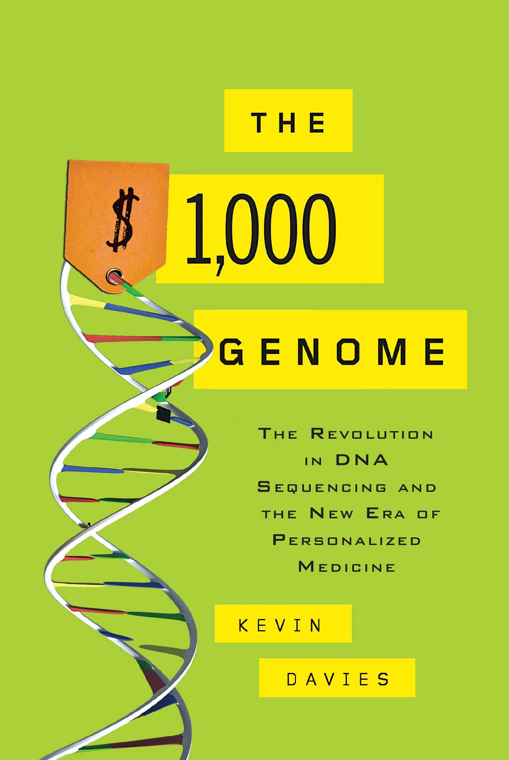
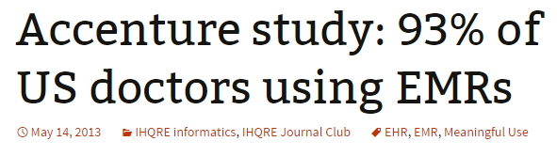
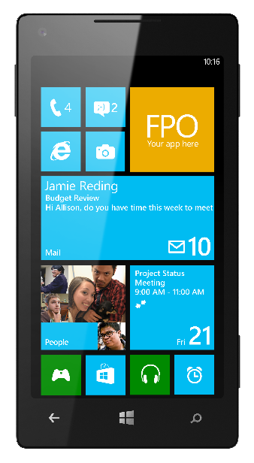
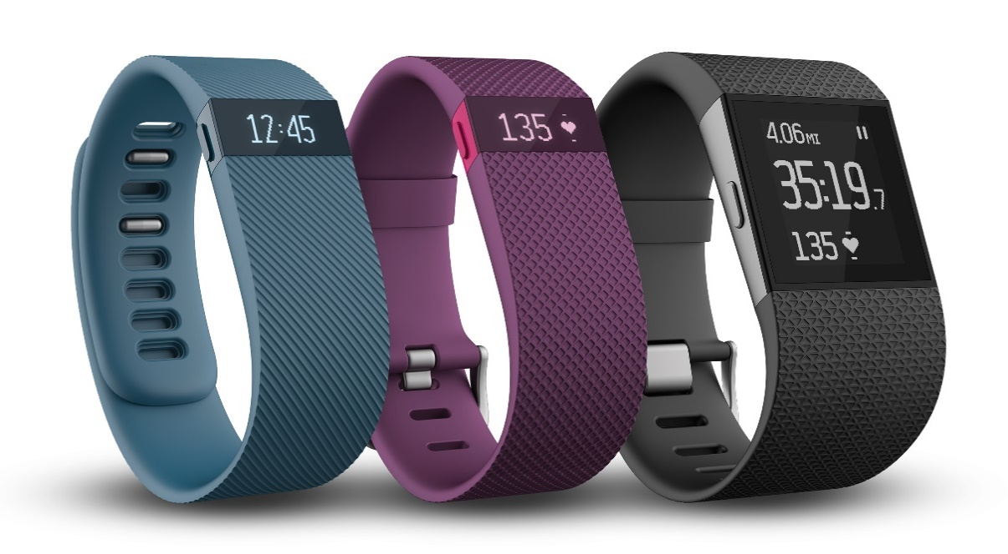
Disruption: Big Data
2009 − 2013: 40% → 93%
Notes:
The advent of big data promises a change for the good.
E.g., given tumor sequence, we’re literally staring at source code of cancer.
Similarly, EMRs and 24X7 health sensor data can help support precision healthcare.
http://www.commonwealthfund.org/~/media/files/publications/issue-brief/2014/may/1746_ryan_adoption_use_hlt_it_chcs_rb.pdf

Slide 5
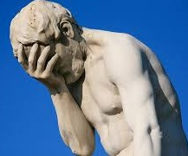
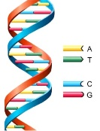
Why We Haven’t Solved Precision Medicine?
… ATTCGGATATTTAAGGC …
… ATTCGGGTATTTAAGCC …
… ATTCGGATATTTAAGGC …
… ATTCGGGTATTTAAGCC …
… ATTCGGATATTTAAGGC …
… ATTCGGGTATTTAAGCC …
High-Throughput Data
Discovery
Bottleneck #1: Knowledge
Bottleneck #2: Reasoning
AI is the key to overcome these bottlenecks
Notes:
However, big data also presents a grand challenge due to information overload.
There are simply too many pieces and we are not sure where to look.
AI can help by addressing two major bottlenecks in translating from big data to medical decision making.

Slide 6
Knowledge Bottleneck
Big data: Hard to interpret
E.g.: Tumor mutations
Rich knowledge: Hard to curate
E.g.: PubMed, clinical trials, EMRs
Wanted: Machine reading
Notes:
The first is the knowledge bottleneck.
There is a lot of prior knowledge and structured info that can help interpret big data.
But they generally reside in text.
What we need is machine reading to automate curation.

Slide 7
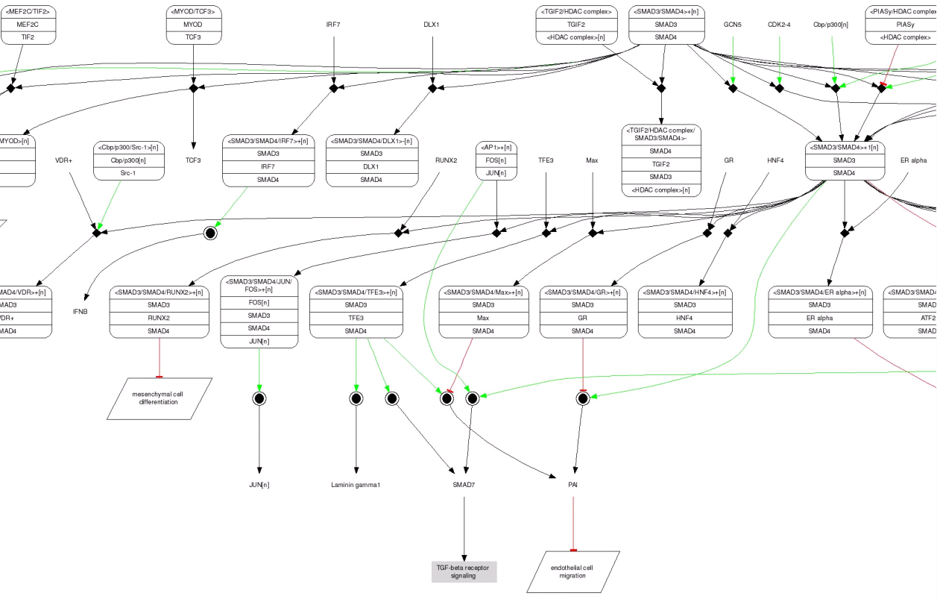
Machine Reading
PMID: 123
…
VDR+ binds to SMAD3 to form
…
Knowledge Base
PMID: 456
…
JUN expression is induced by SMAD3/4
…
……
Notes:
E.g., given text describing gene regulations, we want to automatically convert it into structured entries in a KB.
The resulting gene network can later be used to support querying and reasoning.

Slide 8
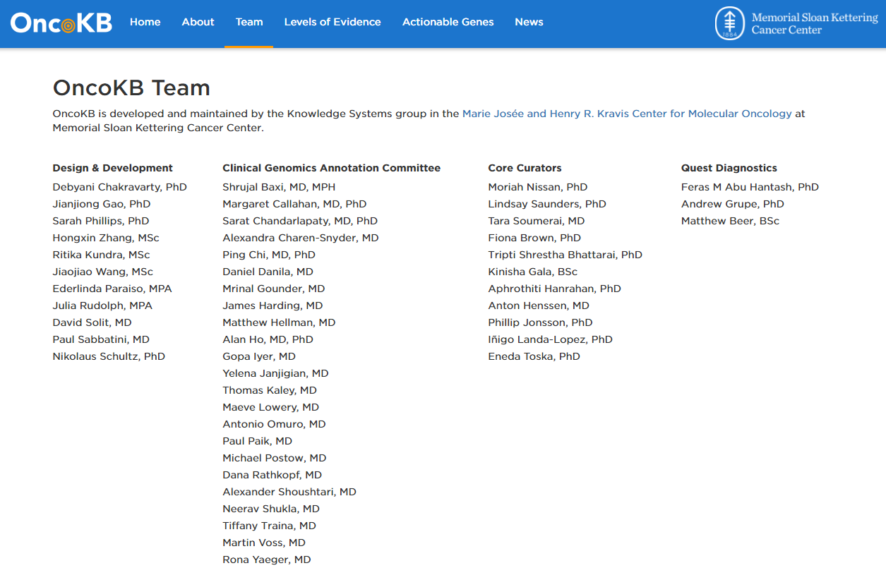
Notes:
Currently, such curation is generally done manually.
E.g., MSK has a large OncoKB team to curate actionable knowledge for molecular tumor board.
But the literature grows by 2 per min and thousands per day.
It’s very hard to catch up by hand.

Slide 9
Can we help increase curation speed by 100X?
Notes:
So one grand challenge is to develop MR to substantially improve curator productivity.

Slide 10
Reasoning Bottleneck
Small training data
Complex features
Rich knowledge
Wanted: Knowledge-rich machine learning
Notes:
Besides from know bottleneck, an even bigger challenge lies in integrating big data and rich knowledge to support optimal decision making.
From a ML point of view, the challenge is steep.
There are a lot of potentially relevant dimensions and interactions, but labeled examples are often hard to get.
What we need is to exploit the rich knowledge to enable effective learning from small training data.

Slide 11
Machine Learning
Output
<SMAD3, POS-REG, JUN>
?
“JUN expression is induced by SMAD3”
Input

Slide 12
Machine Learning
Output
Liver cancer in 1 year?
?
Patient 123: EMR
Input

Slide 13
Machine Learning
Output
Labeled Examples
Supervised Learning
Algorithm
<Input 1, Output 1>
Learned Model
<Input 2, Output 2>
……
<Input n, Output n>
Input

Slide 14
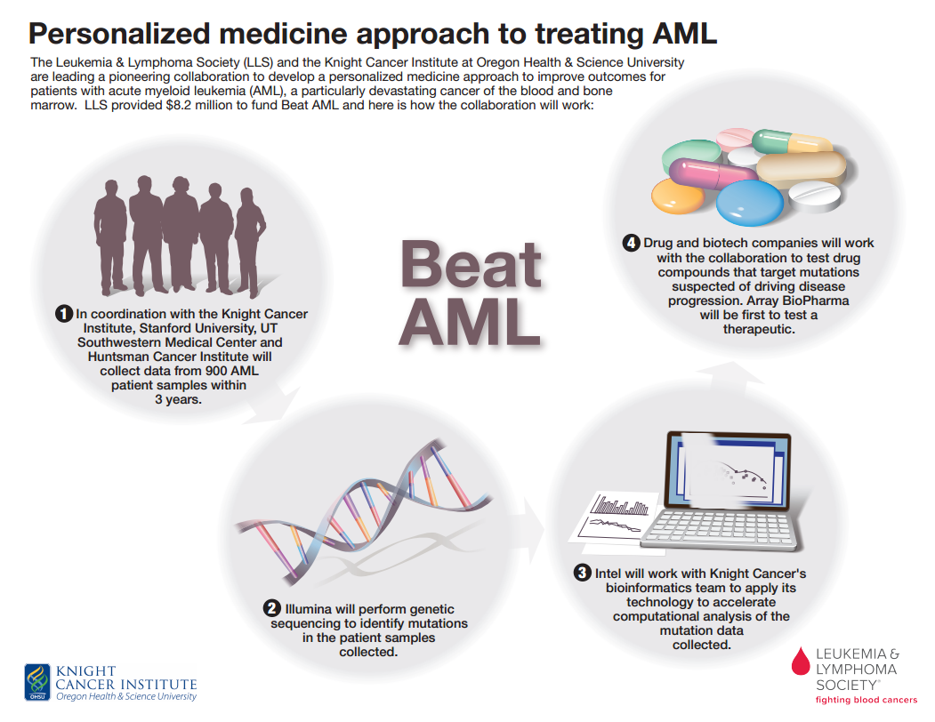
Example: Personalize Drug Combos
Targeted drugs: 149
Pairs: 11,026
Tested: 102 (in two years)
Unknown: 10,924
Notes:
For example, the Knight Cancer Institute wants to explore drug combos for AML.
In the pilot, they’re considering ~150 drugs, for which there are 11K pairs.
In the past two years, they only experimented for about 1% of the pairs.
So another grand challenge is to learn from these pairs and identify promising ones among the unknown.

Slide 15
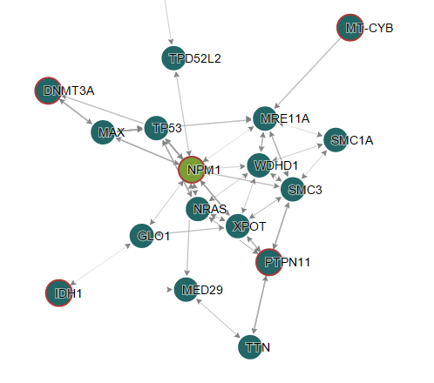
Knowledge-Rich Machine Learning
Drug 1
Knowledge Base
Drug 2
Notes:
Eg, given a drug combo candidate, we generally know quite a bit about their direct targets.
What we need is to estimate indirect effect thru gene network, which we know a lot from MR or manual curation.
Effectively, we’re using prior knowledge to constrain an OW complex feature space.

Slide 16
Example: Personalize Drug Combos
Targeted drugs: 149
Pairs: 11,026
Tested: 102 (in two years)
Unknown: 10,924
Can we find good combos in months, not centuries?
Notes:
For example, the Knight Cancer Institute wants to explore drug combos for AML.
In the pilot, they’re considering ~150 drugs, for which there are 11K pairs.
In the past two years, they only experimented for about 1% of the pairs.
So another grand challenge is to learn from these pairs and identify promising ones among the unknown.

Slide 17
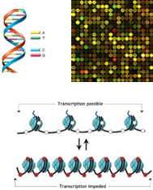

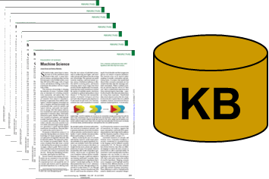
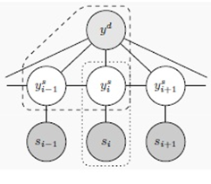
Project Hanover
Big Medical Data
Decision Support
Precision
Medicine
Machine
Reading
Knowledge-Rich ML
Notes:
At MSR, I’m leading Project Hanover, which focuses on MR and KR-ML for addressing the know/reason bottleneck in PM.

Slide 18
Challenge: Long Tail of Variations
TP53 inhibits BCL2.
Tumor suppressor P53 down-regulates the activity of BCL-2 proteins.
BCL2 transcription is suppressed by P53 expression.
The inhibition of B-cell CLL/Lymphoma 2 expression by TP53 …
……
negative regulation
532 inhibited, 252 inhibition, 218 inhibit, 207 blocked, 175 inhibits, 157 decreased, 156 reduced, 112 suppressed, 108 decrease, 86 inhibitor, 81 Inhibition, 68 inhibitors, 67 abolished, 66 suppress, 65 block, 63 prevented, 48 suppression, 47 blocks, 44 inhibiting, 42 loss, 39 impaired, 38 reduction, 32 down-regulated, 29 abrogated, 27 prevents, 27 attenuated, 26 repression, 26 decreases, 26 down-regulation, 25 diminished, 25 downregulated, 25 suppresses, 22 interfere, 21 absence, 21 repress ……
Notes:
In machine reading, a fundamental problem is that people are so creative at using different ways to say the same thing.
E.g., all these expressions essentially state that TP53 can negatively regulates BCL2.
In a small corpus of 1K abstracts, we already observe a long tail of variations, which need to be modeled in our ML sys.
Additionally, we need to model the bigger context as these phrases are often ambiguous.

Slide 19
Challenge: Complex Relations
Drug 1
Knowledge Base
Drug 2
Notes:
On the flip side, there are a lot of known relations to exploit, but we need to figure out an efficient way to encode and reason with them.

Slide 20
Deep Learning
Key idea: distributed representation
Non-linear dimension reduction
Automate feature learning
Notes:
Increasingly, deep learning has emerged as a powerful tool for tackling these challenges.
Its magic stems from learning a distributed representation from raw input features, which can compress a lot of structured info into a continuous representation.
It also eliminates the need for hand-engineering features as in traditional ML apps.

Slide 21
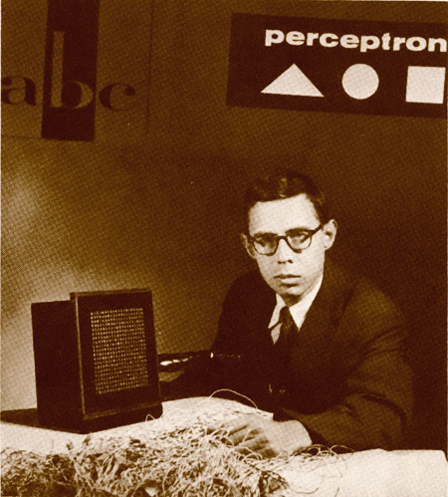
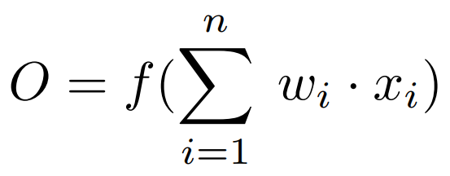


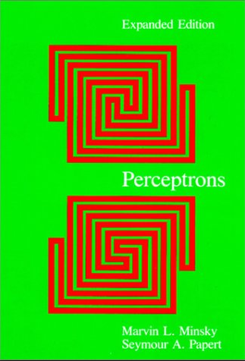



Neural Unit
First Wave
Output
Perceptron
[Rosenblatt, 1957]
Source: Arvin Calspan Advanced Technology Center; Hecht-Nielsen, R. Neurocomputing (Reading, Mass.: Addison-Wesley, 1990)
Can not represent complex functions such as XOR
[Minsky & Papert, 1969]
Input Layer
Notes:
The basis for DL is an artificial neuron.
The input is a real vector, the output is a function of the weighted sum of the input dimensions.
This formulation was first conceived in 1940s, inspired by some properties of real neurons.
In 1957, Frank Rosenblatt proposed the perceptron algorithm, which can be used to learn the weights.
This caused a lot of excitement at the time, but the wave died down after Minsky and Papert pointed out that such a unit can’t represent complex functions that can’t be separated by a hyperplane.

Slide 22
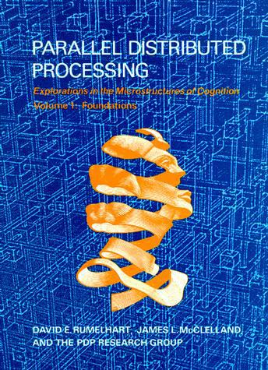
Neural Network
Second Wave
Output
Backpropagation
[Rummelhart, Hinton, Williams, 1986]
Hidden Layer
Gradient diffusion or explosion:
Can not learn more than a few layers
Input Layer
Notes:
However, if we introduce a hidden layer, it can represent a lot more things, including passing the litmus test of XOR.
In late 1980s, researchers rediscovered the backprop alg for learning such a network, which is essentially gradient descent w/ the gradient computed using the chain rule from calculus 101.
This led to the second wave of excitement, but it eventually died down because people soon learned about its limitations.
To represent a very complex function, a shallow network might require exponentially many hidden units.
A deep network has much better representation power, but the vanilla gradient descent doesn’t work as gradient can increase or decrease exponentially in the number of layers.

Slide 23
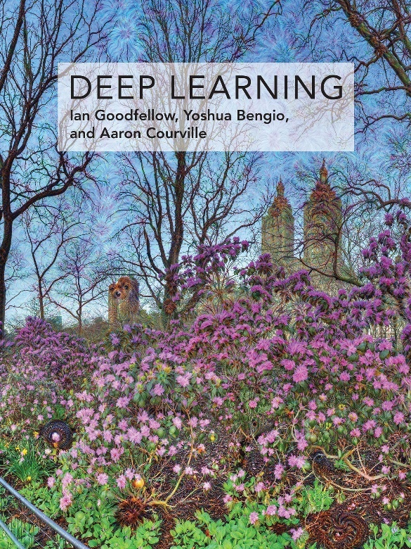
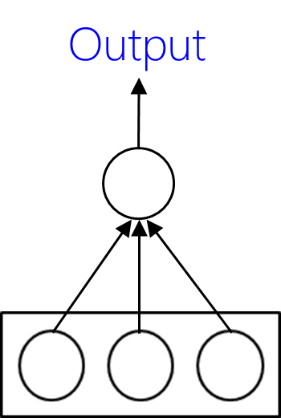
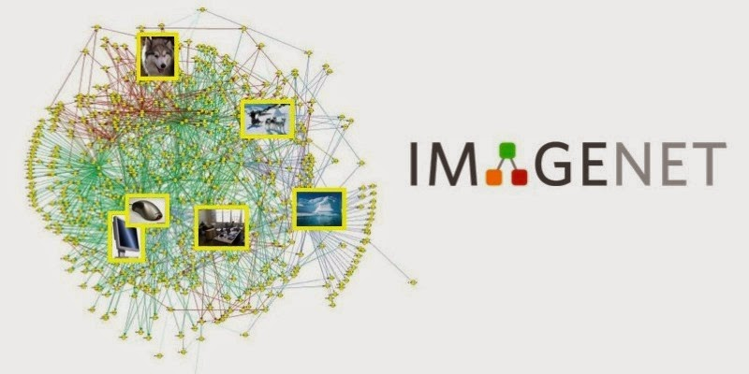
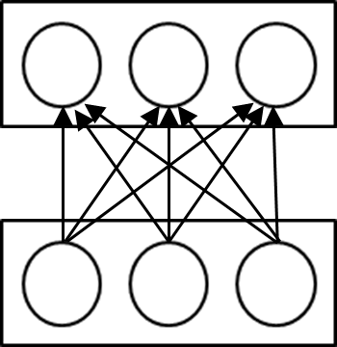
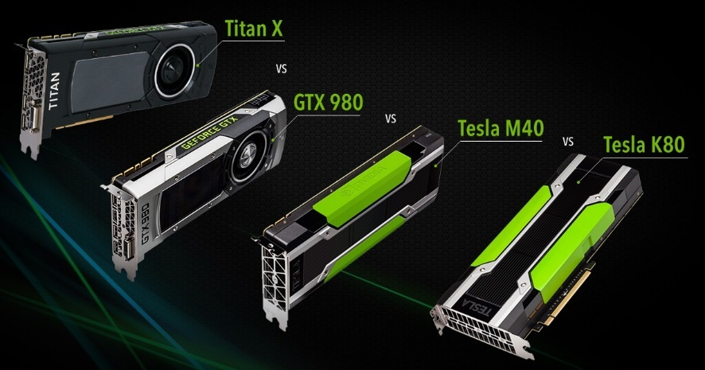
Deep Learning
Third Wave
SGD, ReLU, dropout, …
[Hinton, LeCun, Bengio, Schmidhuber, Hochreiter, …]
Many
Hidden Layers
…..
Big labeled data
Input Layer
Fast computation
Notes:
Fast forward to mid-2000s, the persistent push by a few die-hard researchers finally paid off.
A confluence of three things unlocks the potential of deep neural networks.
The internet makes available a large amount of labeled data.
The Moore’s law makes computer fast enough to process them.
Several algorithmic advances combine to enable much more effective learning, including addressing the gradient problem.

Slide 24
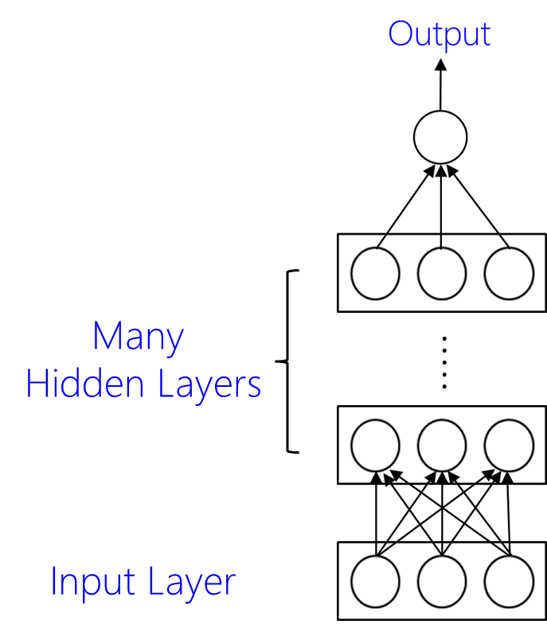
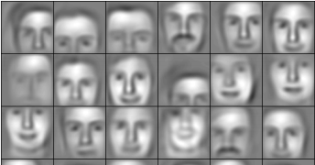
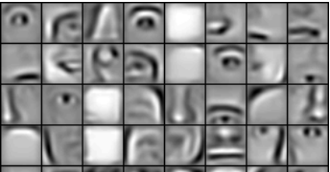
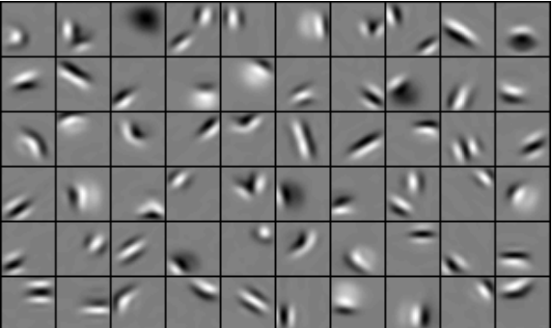
Promise: Representation Learning
Object Models
Object Parts
Edges
Face Images
Notes:
As we mentioned earlier, an important advantage of deep learning is automatically learning meaningful distributed representation.
E.g., from face images, a deep network can learn to detect edges in lower layers, object parts in intermediate layers, and object modeling at upper layers. These learned vectors then offer powerful features for end prediction tasks.

Slide 25
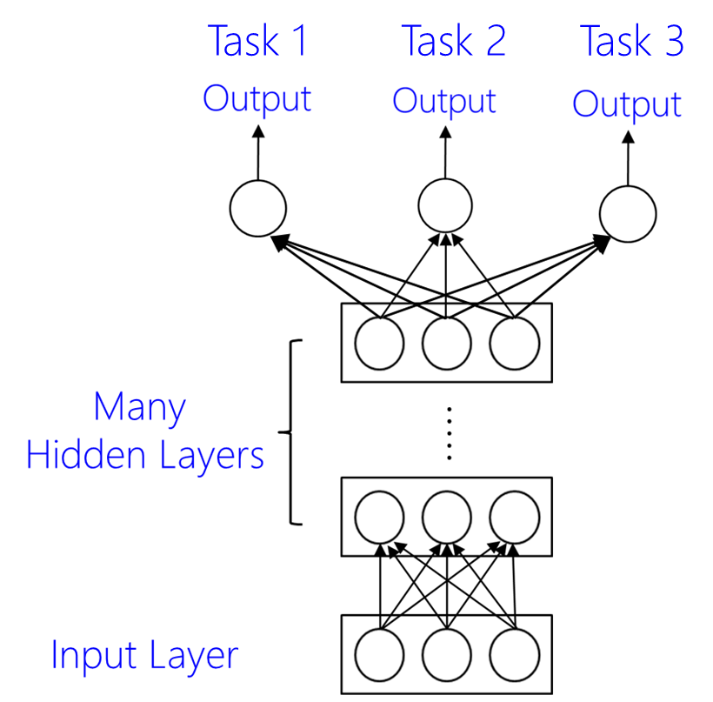
Promise: Multi-Task Learning
E.g.: Medical image understanding
v.s. ImageNet
Notes:
It also makes transfer learning super easy, by simply sharing the hidden layers.
E.g., recent work on medical image understanding typically initializes w/ a deep network trained on ImageNet.
Tumors look very differently from cats and dogs. But they can still reuse the lower layers of edge detectors etc.

Slide 26
Annotation Bottleneck
Deep learning requires many labeled examples
Hire experts to label: Not scalable
Crowdsource: Lack domain expertise
Notes:
Deep learning has dominated speech recognition, object recognition, machine translation.
Their commonality is that there are a large amount of labeled data such as Switchboard, ImageNet, Europarl proceedings.
For biomedicine, the challenge is that there is a vast space of entities and relations, and it’s not so easy to obtain labeled examples.
E.g., ImageNet was created by crowdsourcing, but it’s very hard to apply it to biomedicine, as average Turkers can’t understand PubMed papers or read CT scans.

Slide 27
Learning with Indirect Supervision
Unsupervised learning
Statistical relational learning
Situated learning
Distant supervision
Incidental learning
Grounded learning
Notes:
On the other hand, because biomedicine is such a high-value domain, many related structured resources are available, such as ontology and manually-curated KBs.
In ML, there are a lot of ideas for exploiting such indirect supervision.

Slide 28
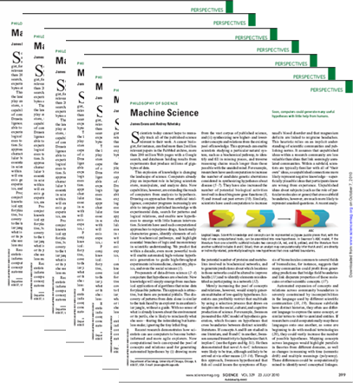
Grounded Learning
?
Distant Supervision
Notes:
A particular potent framework is grounded learning.
The idea is to view the direct labels as latent variables, and uncover them using readily available contextual info.

Slide 29







Project Hanover: Grounded Learning
PSB 2015
Genetic Regulations
Molecular Tumor Board
TACL 2017
Open Science
2018
2017
(Under review)
Clinical Trial Matching
PSB 2018
(Under review)
Notes:
This has been a focus in our research, especially in machine reading.
Initially, we have done quite a bit of work in extracting gene regulations.
More recently, we begin extracting actionable knowledge for molecular tumor board, such as drug sensitivity and resistance.
We also start applying this powerful tool to facilitating public data access and annotation for open science, and to understanding eligibility criteria in clinical trials and patient info in EMRs.

Slide 30
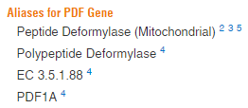

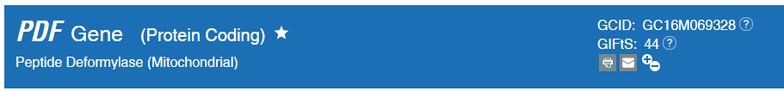
Entity Linking (a.k.a. Normalization)
In eubacteria and eukaryotic organelles the product of this gene, peptide deformylase (PDF), removes the formyl group from the initiating methionine of nascent peptides. …… The discovery that a natural inhibitor of PDF, actinonin, acts as an antimicrobial agent in some bacteria has spurred intensive research into the design of bacterial-specific PDF inhibitors. …… In humans, PDF function may therefore be restricted to rapidly growing cells.
Notes:
Let me start w/ a relatively simple task of identifying entities such as gene, drug, diseases.
As you well know, their names can be very ambiguous.
PDF can refer to a gene, not portable document format.

Slide 31
Entity Linking
The discovery that a natural inhibitor of PDF, actinonin, acts as an antimicrobial agent
Does “PDF” refer to a gene here?
Notes:
This can be abstracted into a classification task of determining whether a mention refers to a given entity type.

Slide 32
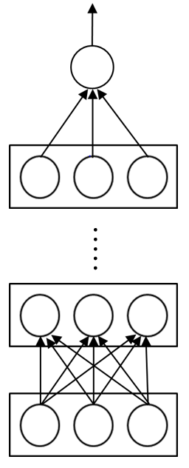
Entity Linking
Does “PDF” refer to a gene here?
Deep Neural Network
Word Embedding
a natural inhibitor of <CANDIDATE> , actinonin , acts
Contextual words
The discovery that a natural inhibitor of PDF, actinonin, acts as an antimicrobial agent
Notes:
The standard way to approach it is by inspecting the words in context. Words like inhibitors hint at a gene reference.
However, there is a long tail of possible words and short phrases, with most appearing for very few times in a particular domain.
So we adopted a DL approach.
First, we represent each word by a vector using the so-called 1-hot encoding, namely, it’s a long vector with each dimension indicating the presence of a word using 1 or 0.
This becomes the input vector in a deep NN, such as a convolutional NN.
The dimension reduction naturally handles the sparsity issue.
Furthermore, we can apply word embedding trained on large domains such as PubMed to smaller domains such as clinical trials.

Slide 33
Entity Linking: Grounded Learning
Distant supervision: UMLS ontologies
Positive examples: Mentions matching lexicon
Reduce noise: Filter short mentions
Negative examples: Random noun phrases
Wang et al. “Distant supervision for entity linking in precision medicine”, PSB-18, under review.
Notes:
The organic supervision derives from entity ontologies in UMLS, such as HUGO for human genes and MeSH for diseases.
Positive examples are mentions that match an entity reference, and negative examples are sampled from random noun phrases.
Essentially, we are trying to learn about how the contexts differ e.g., between a gene mention and a document format.
False negatives are possible, but they are rare since a NP can be anything, most of which are not of the given entity type.
By definition, there are false positives. But the hope is that there are enough true positives for learning relevant distinguishing features.
We can further reduce the noise with domain knowledge. E.g., a longer matched mention is more likely to be true positive.

Slide 34
Entity Linking: Grounded Learning
Deep learning dominates feature-engineered
Transfer learning: PMC → Clinical trials, EMRs
Grounded learning substantially outperforms cTAKES etc.
Wang et al. “Distant supervision for entity linking in precision medicine”, PSB-18, under review.
Notes:
We found that deep learning dominates standard feature-engineered classifiers.
It also enables effective transfer learning, which means that a reader training on PMC already performs quite well in specialized domains such as trials and EMRs.
Noise reduction further improved accuracy, and grounded learning substantially outperformed standard tools such as cTAKES.

Slide 35
Relation Extraction
The deletion mutation on exon-19 of EGFR gene was present in 16 patients, while the L858E point mutation on exon-21 was noted in 10.
All patients were treated with gefitinib and showed a partial response.
Gefitinib can treat tumors w. L858E mutation in EGFR gene
Notes:
Given co-occurring entity mentions, a more advanced task is to determine if the text mentions certain relation among them.
E.g., given these two sentences, we should infer that gefitinib can be a candidate for treating tumors w/ certain EGFR mutations.
This can be also be framed as a classification task.

Slide 36
Relation Extraction: Grounded Learning
Distant supervision: Manually curated databases
Positive examples: Co-occurring w. known relations
Reduce noise: Minimal span
Negative examples: Random co-occurring tuples
Peng et al. “Cross-Sentence N-ary Relation Extraction with Graph LSTM”, TACL-17.
Notes:
There are several manually curated KBs, such as CIVIC and GDKD.
Positive examples can be chosen as co-occurring triples that have a known relation such as drug sensitivity.
Negative examples can be sampled from random drug-gene-mutation w/o any known relations.
As in entity linking, there are ways to further reduce noise by filtering positive examples.

Slide 37
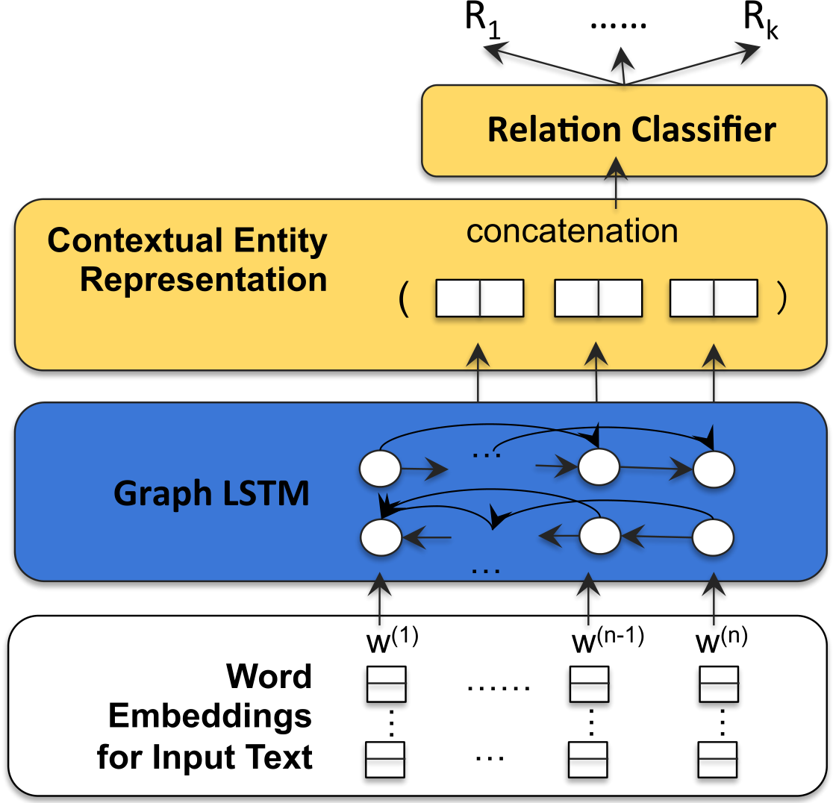
Graph LSTM
Notes:
Here, we use a graph LSTM, which is no longer limited to a fixed window of context, but can encompass whole sentences or paragraphs where the candidate tuples co-occur.

Slide 38
Recurrent Neural Network
Contextual Hidden Representation
……
Word Embedding
W₁
W₂
……
W_{N}
Notes:
Some of you might be familiar w/ RNN, which is similar to HMM, except that the hidden states are not discrete classes, but real vectors.

Slide 39
Recurrent Neural Network
Recurrent Unit
……
W₁
W₂
……
W_{N}
Notes:
The recurrent unit is no long a multinomial, but a NN.

Slide 40
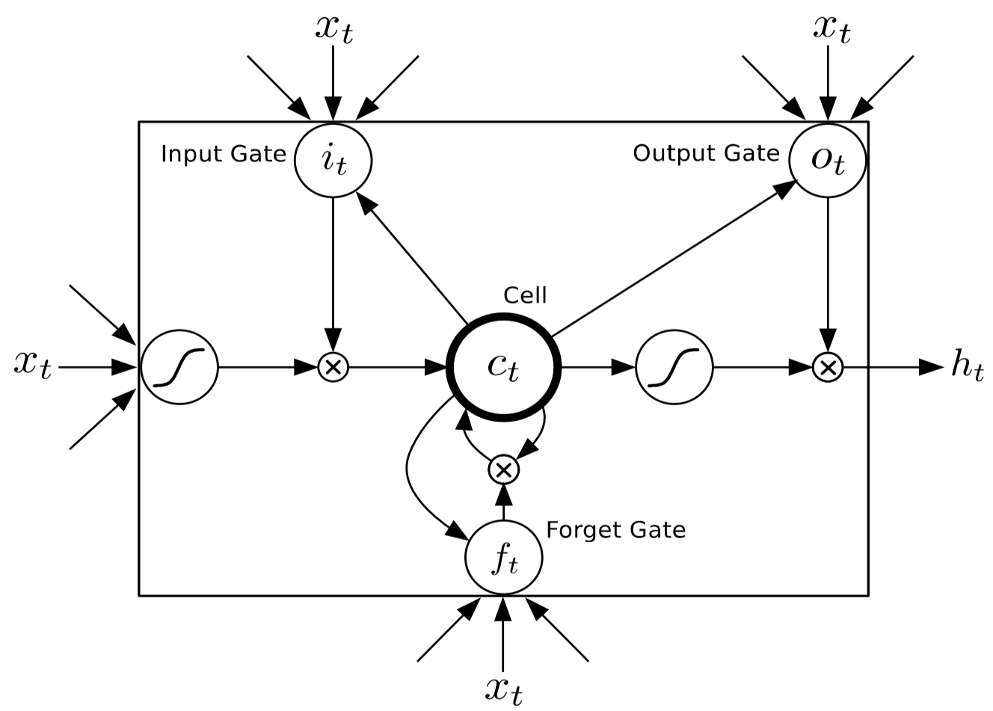
Long Short-Term Memory (LSTM)
Notes:
However, a standard feedforward unit will suffer from the gradient diffusion/explosion issue as we mentioned earlier.
Instead, it’s replaced w/ a LSTM unit.
The intuition is to introduce gates so that the memory cells can propagate a constant gradient arbitrarily long, until the forget gate decides to stop it.

Slide 41
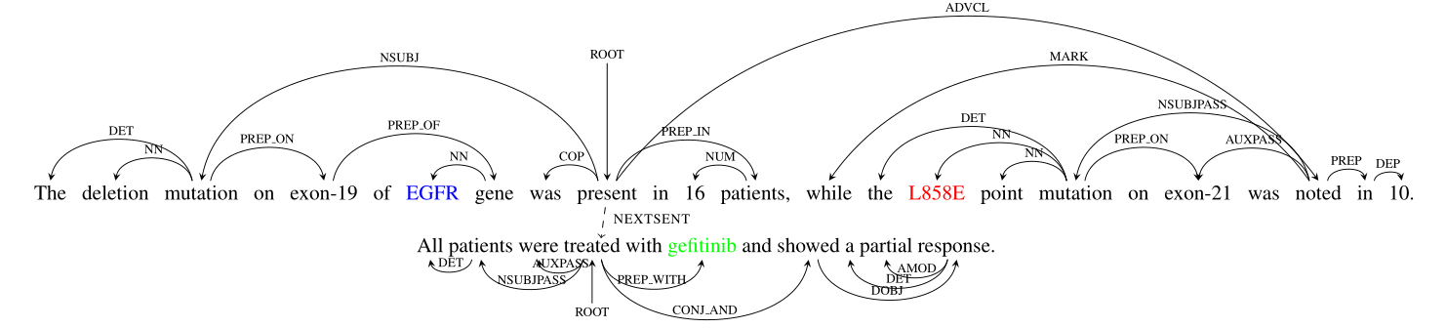
Why Graph?
Exploit rich linguistic structures
Notes:
Previously, LSTM is primarily used in a chain, which only explicitly models word adjacency.
There are many long-ranged dependencies, such as syntax, coreference, discourse, which requires a graph not a chain.
So we propose one of the first graph-LSTM approaches.
This requires adapting the gates and changing the backpropagation algorithm, which I won’t go into details.

Slide 42
Relation Extraction: Grounded Learning
Deep learning dominates feature-engineered
Multi-task learning improves accuracy
Cross-sentence triples extraction yield
Grounded learning: 70 X manual curation
Peng et al. “Cross-Sentence N-ary Relation Extraction with Graph LSTM”, TACL-17.
Notes:
We found that the deep learning approach similar dominates feature-engineered classifier.
And multi-task learning with related relations helps.
We’re also the first to consider cross-sentence extraction, which tripled the yield compared to single sentences.
Overall, grounded learning produces almost two orders of magnitude compared to the organic supervision from manual curation.

Slide 43
Knowledge Base Embedding
Distant Supervision:
Higher score for known relations
Score
Toutanova et al., “Representing Text for Joint Embedding of Text and Knowledge Bases”, EMNLP-15.
Toutanova et al., “Compositional Learning of Embeddings for Relation Paths in Knowledge Bases and Text”, ACL-16.
TP53
NEG-REG
BCL2
Notes:
Previously, we learned from a small hand-curated KB to curate a much larger KB.
But they are explicitly stated facts in the text.
To reason about implicit facts from known ones, we can again adopt a neural network approach.
Essentially, we fixed a scoring function and learned embedding for entities and relations so that those w/ known relations score higher.
Note that we’re not deciding over a particular mention in text, but rather reasoning whether this relation can hold given everything else we know. The result could be a novel fact not stated in any text.

Slide 44
Knowledge Base Embedding
Reasoning: Efficient
Recall on held-out: + 20 points
Learned features for other predictions
Toutanova et al., “Representing Text for Joint Embedding of Text and Knowledge Bases”, EMNLP-15.
Toutanova et al., “Compositional Learning of Embeddings for Relation Paths in Knowledge Bases and Text”, ACL-16.
Notes:
Compared to other traditional reasoning methods, the advantage is that it’s super efficient, essentially just matrix ops.
Experiments show that we can correctly infer a lot more held-out facts, and the learned embedding can be used as features for other prediction tasks.

Slide 45
Example: Personalize Drug Combos
Targeted drugs: 149
Pairs: 11,026
Tested: 102 (in two years)
Unknown: 10,924
Notes:
For example, the Knight Cancer Institute wants to explore drug combos for AML.
In the pilot, they’re considering ~150 drugs, for which there are 11K pairs.
In the past two years, they only experimented for about 1% of the pairs.
So another grand challenge is to learn from these pairs and identify promising ones among the unknown.

Slide 46

Personalize Drug Combinations
Patient: Transcriptome
Drug: Gene targets
Gene embedding $$ key features
Notes:
We used the embedding learned from our machine-read gene network as key features, and combined them with expression levels and drug targets.

Slide 47
Learning Interpretable Model
Notes:
We can interrogate our learned model for hints about potential mechanisms.

Slide 48
Learning Interpretable Model
Hanover: BCL2 + MEK
Impending trial on
Venetoclax / Trametinib
Notes:
One thing that immediately jumps out is BCL2 & MAPK are a favorable target combo.
Our collaborators informed us that there is actually an impending trial on a drug combo that inhibits BCL2 and MEK pathways, respectively.
So this gives us some hope that our model indeed learns something meaningful for AML.

Slide 49
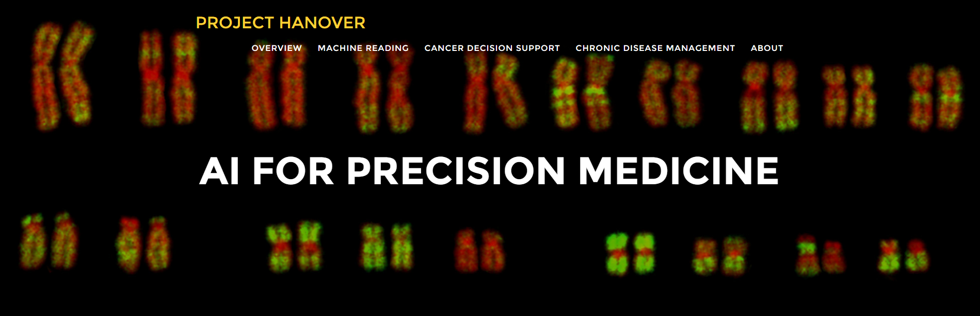

Knowledge
Machine Reading
Reasoning
Knowledge-Rich ML
E.g., PubMed, clinical trials, EMRs
E.g., personalize drug combinations
http://hanover.azurewebsites.net
Notes:
As a recap, in Project Hanover, we’re tackling the know/reason bottlenecks by developing methods for machine reading and know-rich ML, using grounded learning and increasingly DNN.
We have an Azure website w/ publicly available resources.

Slide 50
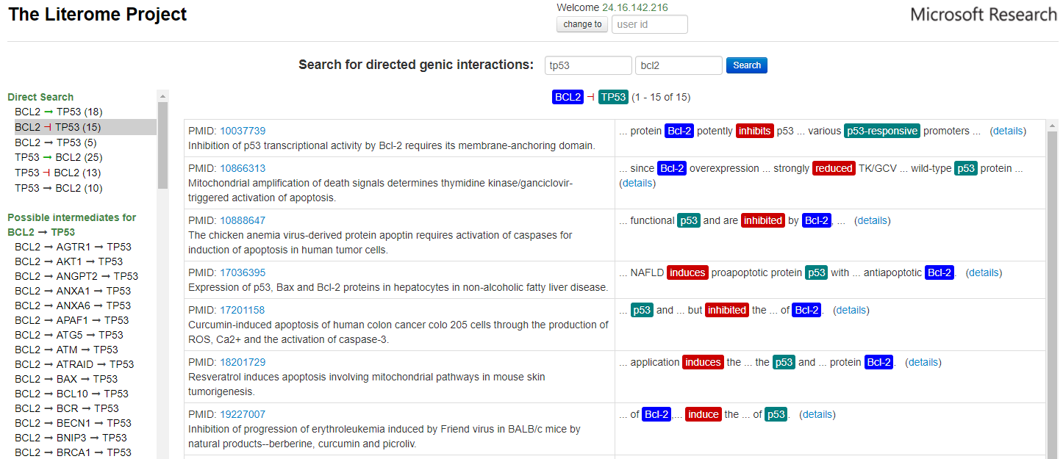

Poon et al. “Literome: PubMed-scale genomic knowledge base in the cloud”, Bioinformatics-14.
Notes:
E.g., our gene networks are available at Literome.

Slide 51
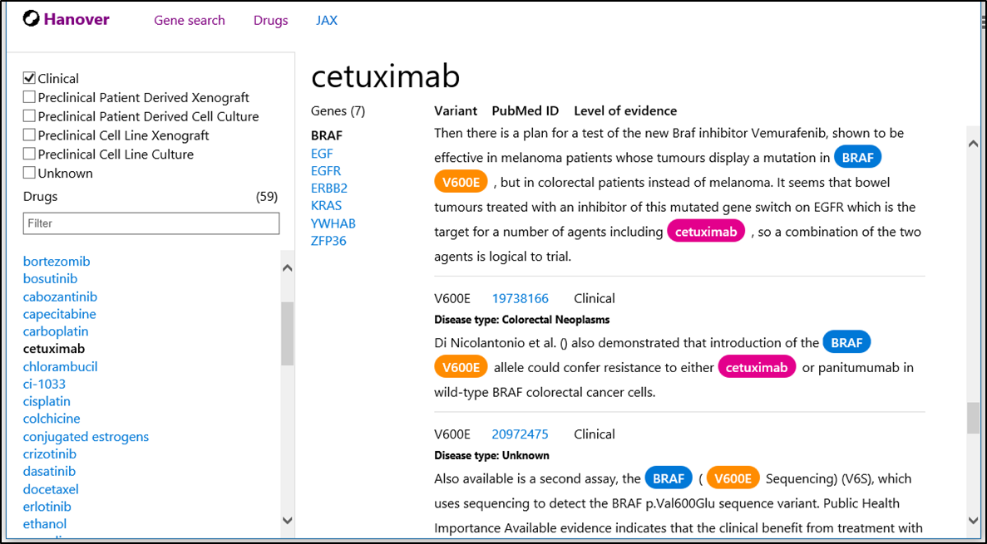
Notes:
And here is a sneak peek of our Hanover KB for molecular tumor board, with machine-read drug-gene-mutation interactions.

Slide 52
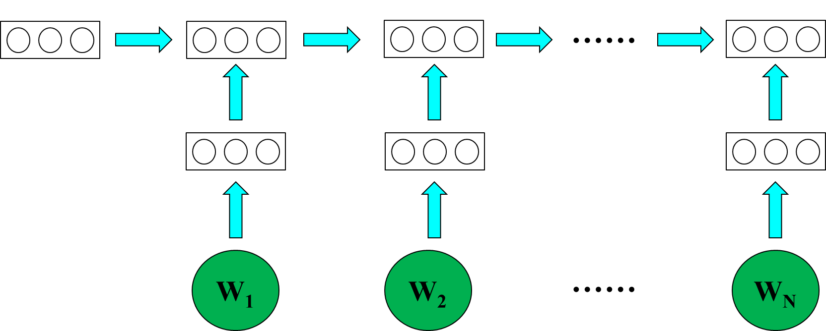
New: Chronic Disease Modeling
LSTM
Disease Onset
Complications
Subtypes
EMR
Notes:
Most recently, we start thinking about general precision healthcare, with some nascent attempts in predicting future disease onsets and complications, which could be potentially applicable for cancer early detection.

Slide 53
EDRN Opportunities
Literature: Prior knowledge on biomarkers
EMR: Patient information
Clinical trial: Structured eligibility criteria
Big data mining: Omics, EMRs, images
Mechanism discovery: Serial biomarker
Notes:
I’ll end with some preliminary brainstorming with Ziding on applying our MR results and DL methods to cancer early detection.
These are more like seedling questions to promote discussions.

Slide 54
Collaborators
Knight: Brian Drucker, Jeff Tyner
Chicago: Andrey Rzhetsky
Wisconsin: Mark Craven
Microsoft Research: Chris Quirk, Kristina Toutanova, Scott Yih, Bill Bolosky, David Heckerman, Lucy Vanderwende, Ravi Pandya
Interns: Maxim Grechkin, Ankur Parikh, Victoria Lin, Sheng Wang, Stephen Mayhew, Daniel Fried, Violet Peng, Hao Cheng, Hai Wang

