Slide 1

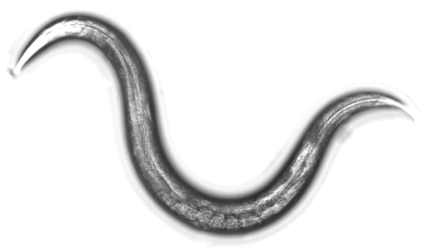

[N-NOSE: Nematode-NOSE]
1st cancer screening technology
using nematode olfaction
Yohei Matsunaga, Takaaki Hirotsu
HIROTSU BIO SCIENCE Inc.
Notes:
Thank you for giving us this kind of great opportunity to present our research. In this presentation, we’d like to talk about cancer screening technology using nematode olfaction. We call, this method, is N-NOSE meaning Nematode NOSE

Slide 2

present state & future of cancer in the world
Cancer is a leading cause of death worldwide,
accounting for 8.7 million deaths in 2015. (WHO)
In 2030, people in developing countries become wealthy with the average life span extended, so it is expected that annual cancer deaths will rise to 13 million.
The global economic impact of premature death and disability from cancer is around $ 900 billion (\ 100 trillion). (OECD 2013)
Notes:
First, let me explain a little bit background of cancer thing. As you known, cancer is a leading cause of death worldwide. In a future, number of cancer death is expected to reach over 13 million. It is also expected global economic loss by caner.

Slide 3
cancer mortality can be reduced
if cases are detected and treated earlier
5 year survival rate
 | Stomach |  | Colon | Rectal
Stage | (%) | Stage | (%) | (%)
IA | 93.4 | 0 | 94.8 | 92.9
IB | 87.0 | I | 90.6 | 89.3
II | 68.3 | II | 83.6 | 76.4
IIIA | 50.1 | IIIa | 76.1 | 64.7
IIIB | 30.8 | IIIb | 62.1 | 47.1
IV | 16.6 | IV | 14.3 | 11.1
Early stage
Late stage
Japanese Gastric Cancer Association ,
Japanese Society for Cancer of the Colon and Rectum
Notes:
Here is 5 year survival rate in gastric and intestinal cancers. In early stage of caner, the survival rate is around 90%. But if it goes to late stage, each survival rate gets worse, less than 50%. So detection and treatment in early stage of caner is one of effective way to decrease in caner death.

Slide 4
An ideal process of cancer screening
1st Screening
2nd Screening
Detailed Exam
Check
presence of cancer
Specify type of cancer
Diagnostic imaging
Tissue diagnosis
Low cost
Easy
Painless
Comprehensive
Comprehensive
Specify cancer type
Observation of cancer tissue
Definitive
Diagnosis
New tumor marker under development
(ctDNA, miRNA etc)
Image Inspections
（CT, MRI, Endoscope,
Ultrasonic echo）
We don’t have
good 1st screening test
5 major cancer test
PET-CT
Existing tumor marker
Required for all tests：high-accuracy・early detection
Notes:
This is an ideal process of cancer screening. In the first screening, checking of presence or absence of caner is important step. In the 2nd screening, specification of cancer type, and then the doctor’s diagnosis through image inspections, observation of caner tissue, and so on. 1st screening test needs low cost, easy and high accuracy. Now, we don’t have good 1st screening test. As a result, the cancer checkup rate hasn’t been improved, meaning it’s still difficult to detect early stage of cancer.

Slide 5
Development of 1st cancer screening test
It is necessary to provide all the following features
Low costs
High accuracy
Convenient
Painless(non-invasive)
Comprehensive
Notes:
So development of a new 1st screening test with low cost, high accuracy, convenient, Painless, comprehensive is required.

Slide 6
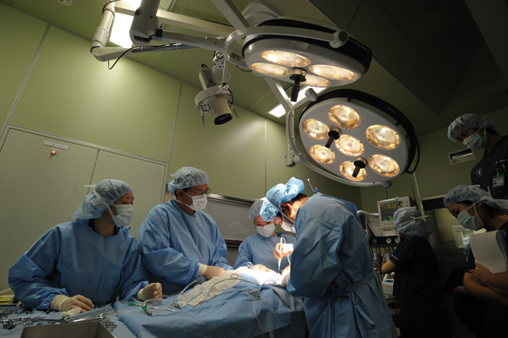
Cancer odors
It has been reported that
Patients of cancer have specific odorants
Notes:
To develop a new caner screening test, we focused on caner odors. Since, It has been reported that patients of caner have specific odorants in clinical sites.

Slide 7
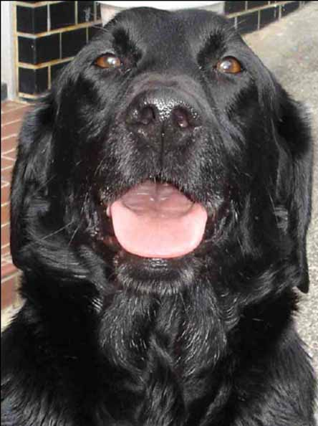
Sensor for cancer odors
Artificial odor sensor, But,,,,
・High costs
・Identification of specific odors
To cover these points
Development of Biological methods
ie) Dog has GOOD olfaction, But,,,
・Training is required…
・Its accuracy depends on
dog’s concentration and individual differences.
・examination (5-10 sample/day). High costs
Notes:
To detect the odor, artificial odor sensor is a good choice. But, it would be high cost and needed to identify specific odors. To cover these points, biological methods are developed. For example, Dog has good olfaction and can detect early stage cancer. However, training is required to detect cancer, and accuracy depends on dog’s concentration and individual differences. In addition, dogs can examine a few samples / days and it would be high cost.

Slide 8
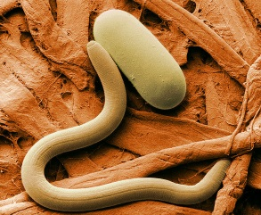
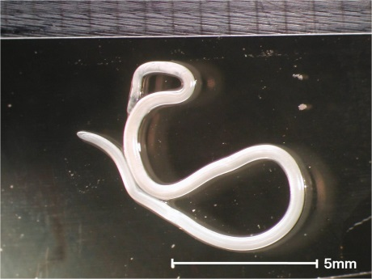
Nematode
・Parasitic, Free-living
・The total number of
species is about 1 million?
Anisakis larvae attached to
early-stage of gastric caner
(Sonoda et al., 2014)
Handling is Risky!
Anisakis
Notes:
So we focus on nematode as biological methods. Since, it has been reported that anisakis larvae attached to early stage of gastric caner. But anisakis is a parasitic worms and handling is risky. I don’t want to handle so much.

Slide 9

C. elegans
A small model organism (1mm)
Free-living
Handling and culture are very easy!
1) We can easily grow C. elegans at low cost
Meal: E. coli on agar plate.
It takes about 4 days to go to next generation.
Hermaphrodites: lay eggs (100-300) without mating.
2) C. elegans has a good olfactory system
Olfactory responses can be easily measured by locomotion in small field. (9cm dish etc…)
Let me show later
Notes:
Then, we focused on C. elegans. This worm is free-living and very small. And handling and culture are very easy. For example, the worms eat E. coli on agar plate, and it takes about 4 days to go to next generation. And the worm are hermaphrodites so mating is not required to maintain. In addition, the worm have good olfactory system. And olfactory responses can be easily measured by locomotion in small field. Let me show later.

Slide 10
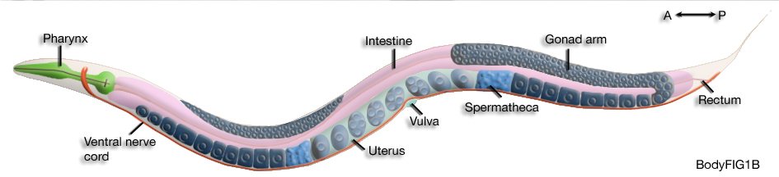

Olfactory neurons in C. elegans
Head region
olfactory neurons
in C. elegans
ADL
AWA
AWB
Odor
AWC
ASH
worm does not have eyes
Olfactory neurons have important function
to check environmental conditions
Notes:
This figure shows olfactory neurons in C. elegans. Worm has all olfactory neuron in head region. In contrast, worm does not have eyes. So, olfactory neruons have very important function to check environmental condition, .

Slide 11
Number of olfactory receptors
Human | Dog | Mouse | Drosophila | C. elegans
400 | 800 | 1100 | 60
1200
C. elegans may have GOOD nose!
Notes:
This table shows number of olfactory receptors in these animals. Compared to these animals, worms has big number of receptor genes. So, worms may have good nose.

Slide 12
C. elegans shows locomotion to odors
attraction
Start
●
●
odor
Nonanone
●
●
chemotaxis index
Isoamyl
alcohol
Benz
aldehyde
Pyrazine
Attraction
(A)
Avoidance
(B)
avoidance
N(A)-N(B)
attractant
repellant
chemotaxis index =
all
Notes:
Here is method. Basically, worms shows locomotion to odors. Using this response, we can evaluate the function of odor. For example, worms are put on the center of agar plate. And odor is put in these points. After an hour, number of worms are counted in each region a and b, and calculate chemotaxis index using this formula. If worms senses an attractant, chemotaxis index shows a positive, In contrast, chemotaxis index show a negative when worms senses a repellant.

Slide 13
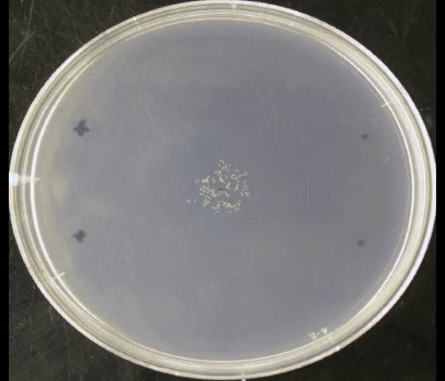
locomotion to an attractant
Attractant
Notes:
Here is a movie of worms locomotion to attractant. White dots are worms on agar plate. During a hour, most animal reached to attraction region.

Slide 14

Question
Can C. elegans detect cancer odors from human samples?
Urine！
Collection of urine is very easy, painless!
Oh, NO,,,,
C. elegans did not show good response to urine,,,
Notes:
Then, here is question, Can worms detect cancer odors from human sample?? There are some human sample such as blood, tissue, and urine. Among them, we focus on urine because collection of urine is very easy, and painless. Then we used urine for our assay. But, worms did not show good response to urine.

Slide 15
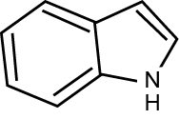

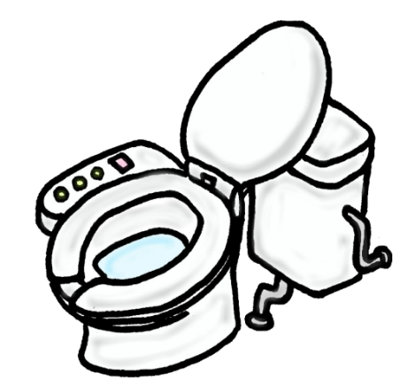

Olfactory preference changes depending on odor concentrations
Indole
Low concentration
(dilution: less than or equal to 1/10000)
High concentration
(dilution: more than or equal to
1/10)
Good smell like jasmine
Bad smell like feces
Notes:
But, we did not give up. Because, we have an idea, which is olfactory preference changes depending on odor concentration. For example indole. Low concentration of indole smell like jasmine. This is good smell. In contrast, high concentration of indole smells like bad.

Slide 16
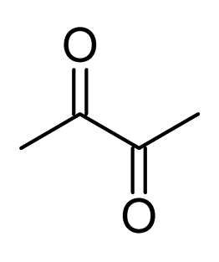
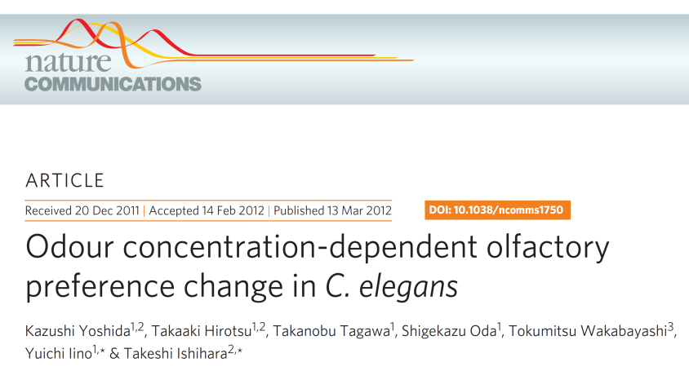
Olfactory preference changes in C. elegans
high concentration
Diacetyl
low concentration
dislike
like
attraction
Chemotaxis index
Diacetyl
concentration
avoidance
Yoshida, Hirotsu, Nature Communications, 2012
Notes:
Worms also show preference change depending on odor concentration. Basically, worms like diacetyl Flavor. However, worms don’t like high concentration of diacetyl.

Slide 17
Urine contains
high concentration of cancer odors??
We try to use diluted urine sample for
chemotaxis assay!
Notes:
So, we think urine contains high concentration of caner odor. So we try to use diluted urine sample for chemotaxis assay.

Slide 18
C. elegans is attracted to diluted urine sample
from cancer patients
attraction
chemotaxis index
Stage | 1 | 2 | 3 | 4
Stomach | 5 | 7 | 0 | 1
Colorectal | 1 | 4 | 0 | 1
Pancreatic | 0 | 0 | 1 | 0
avoidance
Control participants
Cancer patients
Hirotsu et al, PLoS ONE, 2015
Notes:
This graph shows a result of chemotaxis assay using diluted urine sample. To urine of control paricipants, worms show avoidance behavior. In contrast, to urine of cancer patients, worm show attraction. In this assay, we use urine from early stage of caner, indicating that it is possible worm can detect early stage of caner.

Slide 19
C. elegans detects cancer smells using their olfactory neruons
attraction
*
AWC ablated
chemotaxis index
AWB ablated
*
Urine form
Cancer patient
Urine from
Healthy person
avoidance
AWC: sense attractive odorants
AWB: sense repellents
Hirotsu et al, PLoS ONE, 2015
Notes:
Next we address neural mechanism for detection of cancer smell. In the worm, AWC neuron sense attractive odorants. Normally, worm show attraction to urine form caner patient. In contrast, ablation of AWC neuron caused a defect in attraction to urine form cancer patient. Then AWB neuron is reported to sense repellant. Worms show avoidance to urine from healthy parson. In contrast, ablation of AWB caused a defect in the avoidance. These results suggest that worms detect smells from urine using their olfactory neurons

Slide 20
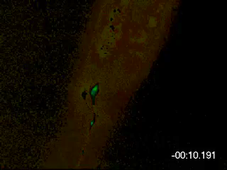
AWC olfactory neurons strongly respond to urine from cancer patients
Calcium imaging
＝visualization of neural activity by measuring Ca2+ concentration.
AWC olfactory neuron
inactivation
activation
Hirotsu et al, PLoS ONE, 2015
Notes:
This movie shows the neural response in AWC neuron to urine from cancer patient. An arrow indicates cell body of AWC neuron. Green indicates inactivation and red indicate activation of the neuron. Normally, AWC neuron show green, But after stimulation by urine form caner patient, AWC shows activation. This result suggested that worms detect caner odor using AWC neurons.

Slide 21
Accuracy of N-NOSE (Nematode Nose)
242 urine samples (Cancer = 24, Control = 218)
Cancer patients
Stage | 0 | 1 | 2 | 3 | 4 | total
Esophageal | 1 | 0 | 0 | 0 | 0 | 1
Stomach | - | 4 | 0 | 0 | 1 | 5
Colorectal | 2 | 1 | 2 | 4 | 1 | 10
Pancreatic | - | 0 | 0 | 0 | 1 | 1
Bile duct | - | 1 | 0 | 0 | 0 | 1
Prostate | - | 1 | 0 | 0 | 0 | 1
Breast | 0 | 2 | 3 | 0 | 0 | 5
total | 3 | 9 | 5 | 4 | 3 | 24
Hirotsu et al, PLoS ONE, 2015
Notes:
Next, we evaluate accuracy of N-NOSE using 242 urine samples. Here we use 7 types of caners. Half of early stage.

Slide 22
N-NOSE shows high accuracy
Cancer (24)
Control (218)
Sensitivity (23=95.8%)
attraction
Specificity (207=95.0%)
Chemotaxis index
avoidance
Hirotsu et al, PLoS ONE, 2015
Notes:
This figure shows result of assay. Worms show attraction to urine from cancer patient and sensitivity was over 90 %. In contrast, worms show avoidance and specificity was also. over 90%

Slide 23
The sensitivity of N-NOSE is superior to
other existing tumour markers
Comparison of sensitivity and specificity
in same participants (n=242)
 | Sensitivity (%) | Specificity (%)
N-NOSE | 95.8 | 95.0
CEA | 25.0 | 96.3
Anti-p53 antibody | 16.2 | 86.2
Urine diacetylspermine | 16.7 | 95.4
Hirotsu et al, PLoS ONE, 2015
Notes:
Then next we compared sensitivity and specificity between N=NOSE and tumor markers in same participants. Compared to CEA, anti – 53, diacetyl spermine, N-NOSE shows good score. This result suggest that N-NOSE would be a good marker for cancer detection.

Slide 24
Following factors did not affect N-NOSE results.
Sex, age of participants
Other diseases including diabetes
Most physical complaints
Type of medicine
Pregnancy
Hirotsu et al, PLoS ONE, 2015
Notes:
We also check effect form following background such as sex, age, other disease diabeties. But, these following factors did not affect N-NOSE results.

Slide 25
The advantages of N-NOSE
①Painless
②Convenient
③Rapid
④Low costs
⑤Comprehensive
⑥Detection of early cancer
⑦High accuracy
Notes:
Here is a advantages of N-NOSE. Painless convenient, rapid low cost comprehensive detection of early caner, high accuracy

Slide 26
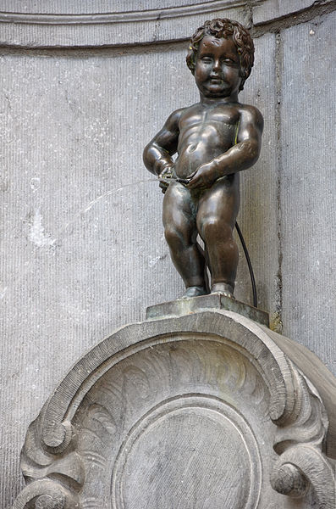
Painless
urine sample: painless
Small volume of urine is required！
Notes:
In painless: because N-NOSE use urine and only small volume of urine is required.

Slide 27
Convenient
Urine can be collected at the same time in general health examinations.
Compared to dogs,,,,,In Nematode,
training is not required!
handling is very easy!
Notes:
In convenient, urine can be collected at the same time in general health examination. And Compared to dog, training is not required since worms have innate sensing to caner odor. And handling is very easy.

Slide 28
Rapid
Test time: It takes about 1 hour.
Notes:
In rapid, it takes an hour in the test.

Slide 29
Low costs
・Material cost is about a few $ /test
・Low cost for establishment of manual N-NOSE.
Special laboratory is not needed.
N-NOSE can be introduced all over the world
Notes:
In low cost, materials cost is about a few dollars/test. And low cost for establishment of manual N-NOSE and special equipment is not required.

Slide 30
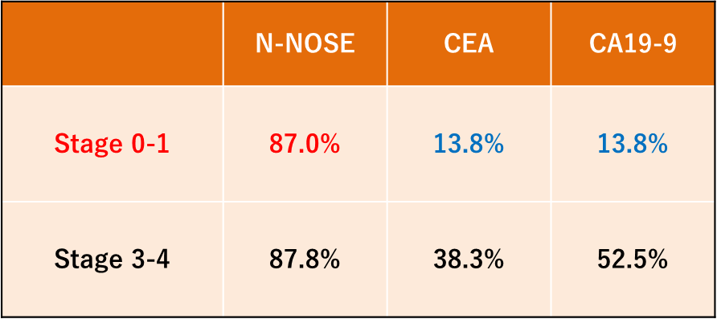
High sensitivity for early stage of cancer
Notes:
In sensitivity for early stage of cancer. This table shows the sensitivity of N-NOSE and tumor markers in each stages. Both categories, N-NOSE show good score, compared with tumor markers.

Slide 31
Comprehensive
・Now, N-NOSE can detect 15 types of cancer.
・N-NOSE would be suitable for a screening for multiple cancers.
Colorectal
Prostate
Pancreatic
Breast
Uterine
Lung
Liver
Stomach
Bile duct
Bladder
Cecal
Esophageal
Pharyngeal
GIST
Mediastinum
Notes:
In comprehensive, Now N-NOSe can detect 15 types of caner. It means N-NOSE would be suitable for a screening for multiple cancers.

Slide 32
N-NOSE would be a good Choice for
1st Cancer screening
1st Cancer screening
Next examinations
Only collect urine.
Low cost and High accuracy
CT inspection
PET examination
Mammography
MRI
Echo (Ultrasonic examination）
Biochemical examination
Endoscopy
Detailed
examination
positive
N-NOSE
negative
Effective for various type of cancer
as first screening test
N-NOSE regularly
Notes:
So, N-NOSE would be a good choice for 1st caner screening test. We can take next examination when you get N-NOSE positive.

Slide 33
Practical use of N-NOSE
・Screening test of cancers (2020)
・Identification of cancer types (2022)
・Monitor of cancer recurrence (2020) practical
as 1st screening
as 2st screening
Notes:
We have following idea for practical use of N-NOSE. Screening test of cancer as 1st screening. Identification of caner types as 2nd screening. And monitor of caner recurrence. りかーれんす

Slide 34
Can N-NOSE identify cancer types?
YES!
Notes:
Here is most frequently asked question. Can N-NOSE identify cancer types?? Now we can say yes

Slide 35
An idea for identification of cancer types
It has been reported…cancers have specific odors
There are receptors for each cancer odors in worms
Creation of receptor-knockout worms
which cannot respond to a specific cancer odor
attraction
chemotaxis index
avoidance
Stomach
lung
Breast
Pancreatic
Colorectal
Notes:
It has been reported cancers have specific odors. So we think there are receptors for each cancer odors in worms. In worms, gene disruption is very easy, so we type to create receptor-knockout worms can not respond to a specific caner odor. If we can get worm does not respond urine form pancreatic cancer patient, we can use the worms as 2nd screening test and address mechanisms deeply.

Slide 36
Candidate receptors for cancer odors
Knockout of A receptor gene
Knockout of B receptor gene
chemotaxis index
lung
colon
Breast
Pancreatic
lung
colon
Breast
Pancreatic
肺癌
Notes:
Now From our screening, we’ve obtained 2 candidate. A candidate show the defect in the response to urine form lung and pancreatic cancer. On the other hand, another candidate show the defect in the response to urine from Brest caner. Using the candidates, we will address underlying mechanism.

Slide 37
Surgery evaluation, Monitor of cancer recurrence
Before surgery
After surgery
Follow-up
(3-6month)
41 cancer patients
Cancer recurrence
3 patients
Positive
N-NOSE positive
All patients
Negative
Surgery
N-NOSE negative
29 patients
(70.7%)
Notes:
We also think that N-NOSE would be good choice for surgery evaluation and monitor of caner recurrence. Here is a preliminary data, Before surgery, N-NOSE showed positive in 41 cancer patients. After surgery, 29 patient show negative. Then during follow-up, cancer recurrence occurred in 3 patients, In 3 patients show N-NOSE positive. These result suggest that N-NOSE have potential to use for surgery evaluation and monitor of cancer recurrence
Maybe, 30% still have cancer we guess. In this assay, we use urine from stage 1-2 stage caner. 30% show positive but value become decrease compared to before surgery in each person. In this evaluation, we need to use other cut off value.

Slide 38
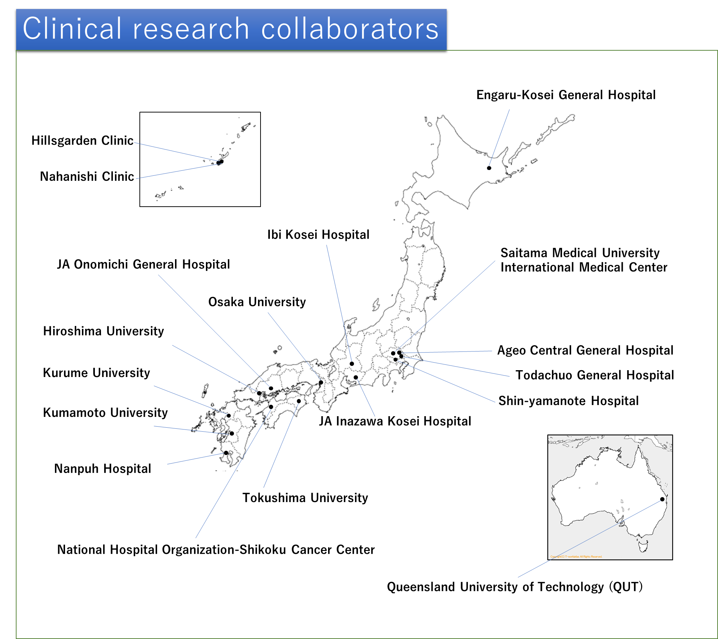
Notes:
Now, we have 17 clinical research collaborators in Japan and Australia.

Slide 39
Recent results of clinical research
N-NOSE results of Japanese samples（Dec., 2018）
 | Positive / Number of cases | Sensitivity
Cancer patients | 996 / 1158 | 86.0%
 | Negative / Number of cases | Specificity
Healthy control | 339 / 362 | 93.6%
Detailed results are under article submission
Notes:
This is one of latest result of clinical research. We have analyzed over 300 caner patient and 1000healthy participants. N-NOSE still showed high sensitivity and specificity.

Slide 40
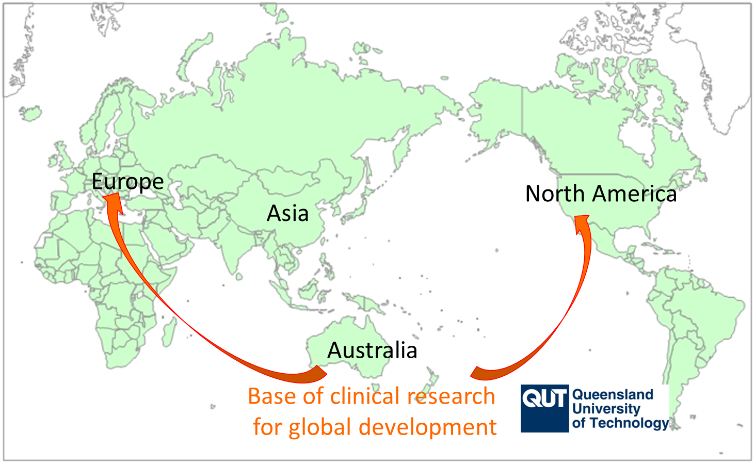
Global expansion of N-NOSE
IP：We have exclusive license of a basic patent in the world
applied for about 10 peripheral patents
We need to verify if there is no racial differences in N-NOSE
Hirotsu Bio Australia is established in QLD (Australia)
to analyze the Western patients
We will start expand a global business (ex. U.S., Europe)
We have already signed a collaborative research
with QUT and started clinical research
Notes:
We also need to verify if there is no racial differences in N-NOSE. We established a company in Australia. and we have already signed collaborative research with Queensland University of technology and started clinical research.

Slide 41
Results of N-NOSE (Australian people)
Cancer
Healthy
Sensitivity = 91.0% (61/67) Specificity = 90.9 % (20/22)
Notes:
Here is a preliminary data from Australian people. This result showed sensitivity and specificity is around 90%, meaning result of N-NOSE may not have racial differences.

Slide 42
R & D Schedule in Japan
R & D Stage
Practical application
2017
2018
2019
2020
2021
Clinical research (increase number of medical cases）
Each type of cancer 75～100 samples
Healthy people ～1000 samples
Multi-Screening
Monitoring for cancer prevention
Development of automation machine with collaborator
(Capital alliance with MIRACA group etc.)
Analysis of mechanism
Odor of cancer
Receptor
Specify
type of cancer
①pancreatic cancer
Notes:
This is R&D schedule in Japan. We will continue to do clinical research and analysis of mechanism until 2020. In addition, we’ve been developing automation machine for high –through put. For automation, we have collaborator in Japan.

Slide 43
Thank you for your attention!!
We’re looking for
research collaborator in US.
Contact :
http://hbio.jp/
hirotsu@hbio.jp
Notes:
Thank you for your attention!

Slide 44
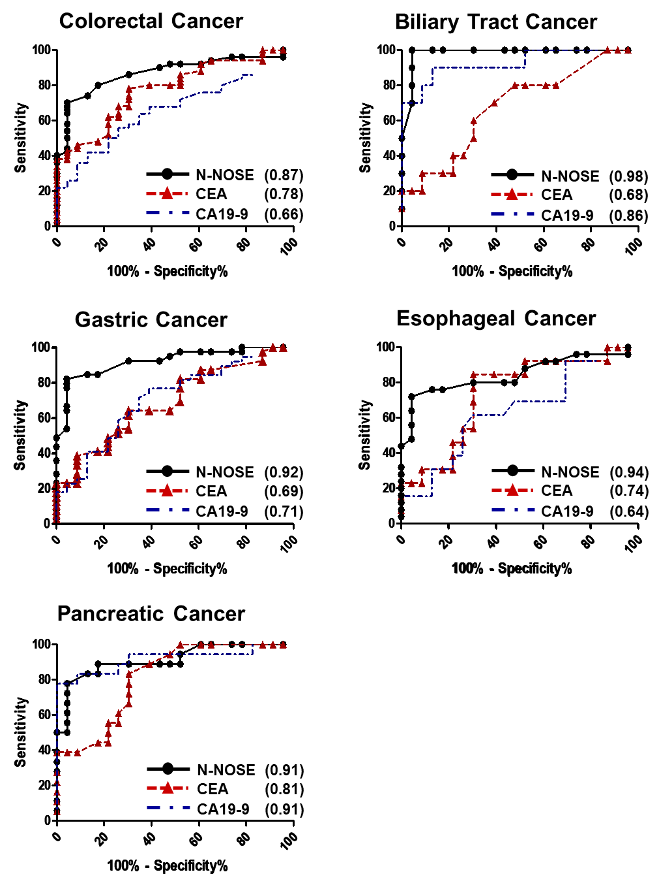

Slide 46
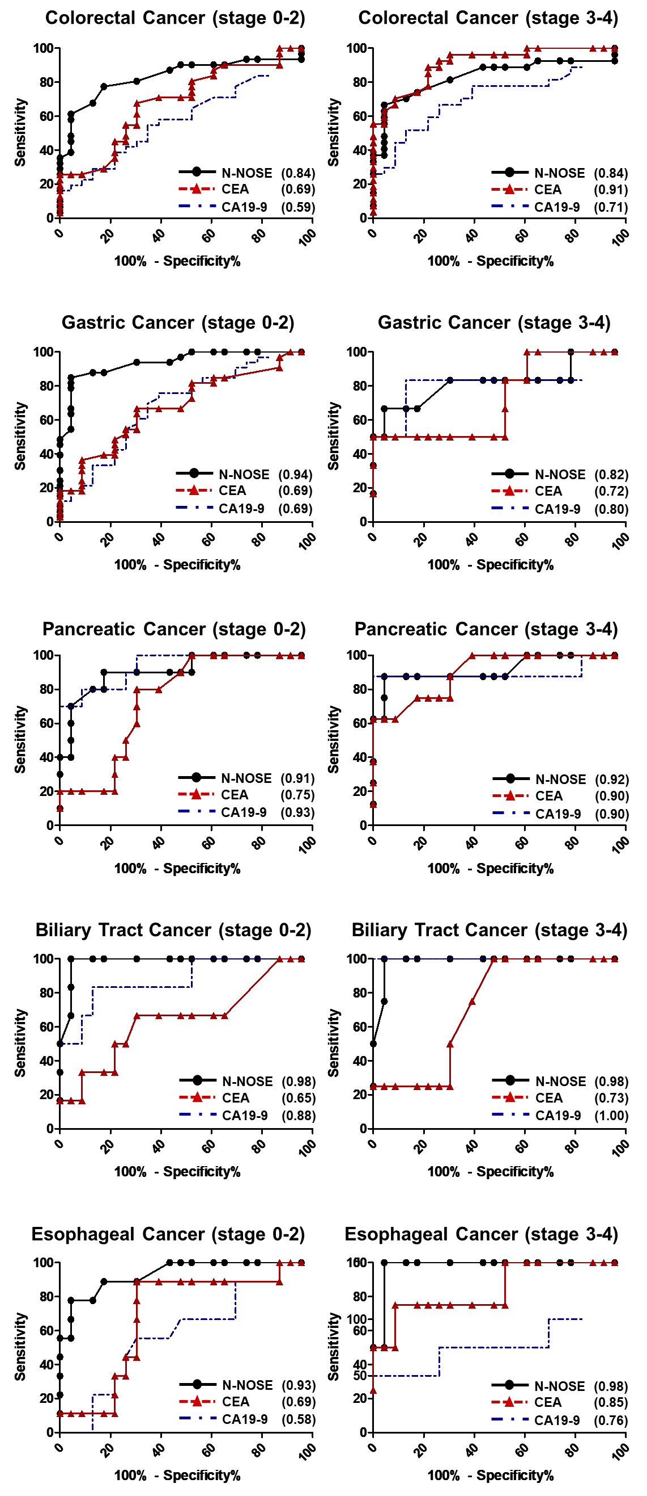

Slide 47
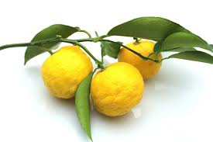
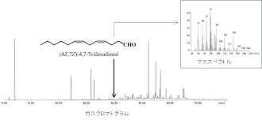
Yuzu (Citron)
Containing more than 400 volatiles
Ex) limonene (60%) etc
*small amount of volatile
*It can not detect GC.
(detected by human nose)
*important function for
yuzu flavor
yuzunone
Retention time (GC)
Small amount of volatile is important!!

Slide 48
locomotion to an attractant
Attractant

Slide 49

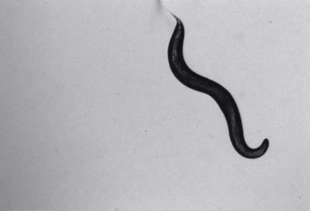
Behavior of C. elegans
Moving while drawing sine curves
Locomotion is,,,
elegant!?

Slide 50
Number of olfactory neurons
Human | Dog | Mouse | Drosophila | C. elegans
5 million | A few hundred million | 10 million | 1300
10
C. elegans can be easily addressed
for the underlying neural mechanism

Slide 51
Olfactory receptor
Olfactory receptor in C. elegans
＝7 transmembrane G-protein coupled receptor (GPCR)
（similar to mammals）
Cell membrane

Slide 52
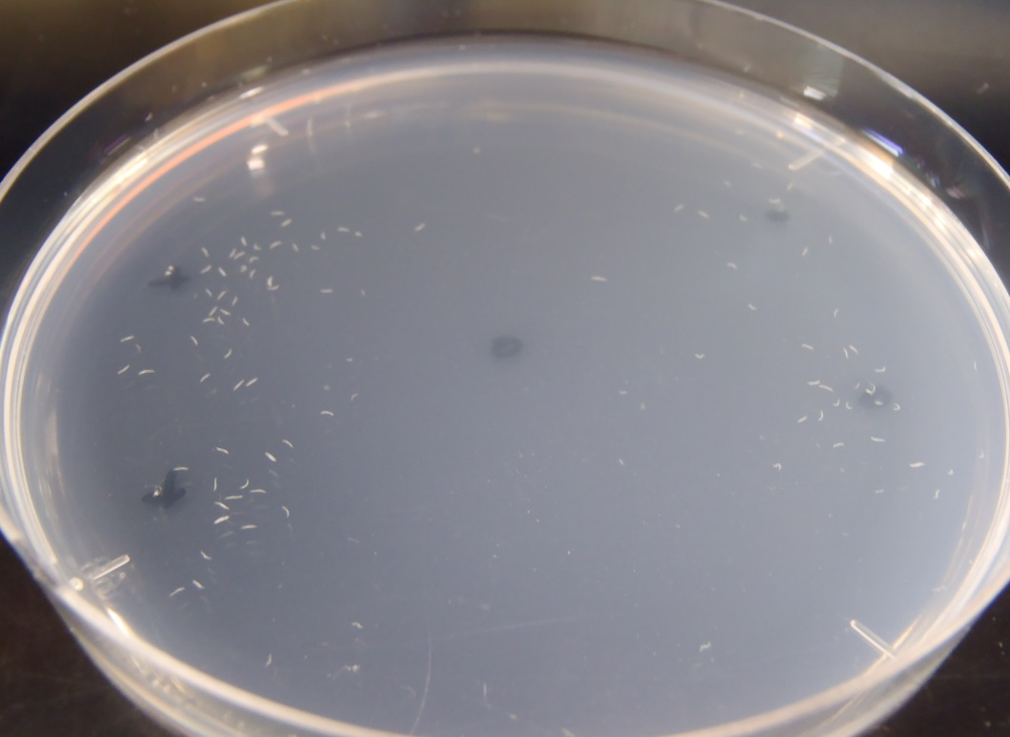
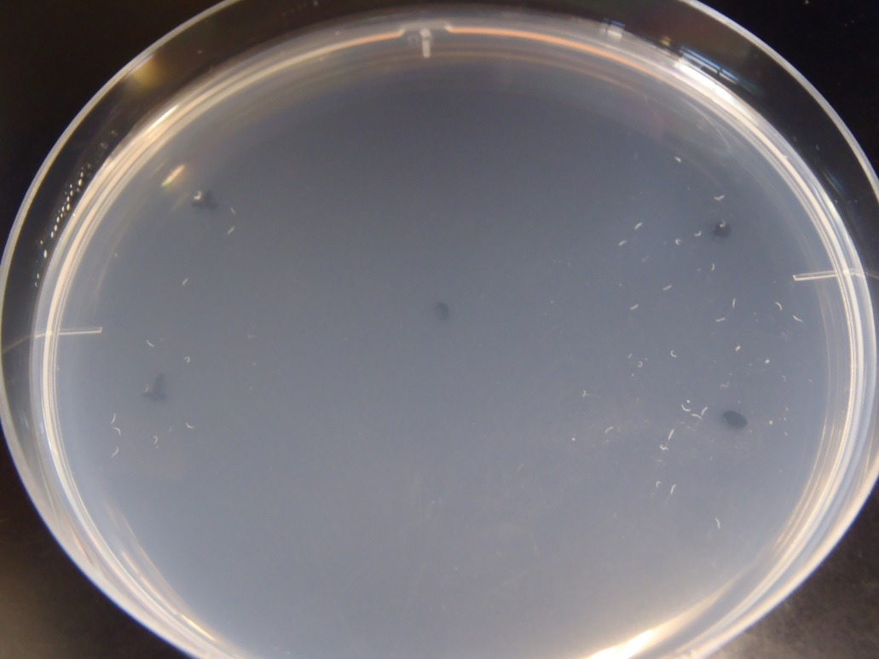
Attractant
Repellent

