Slide 1
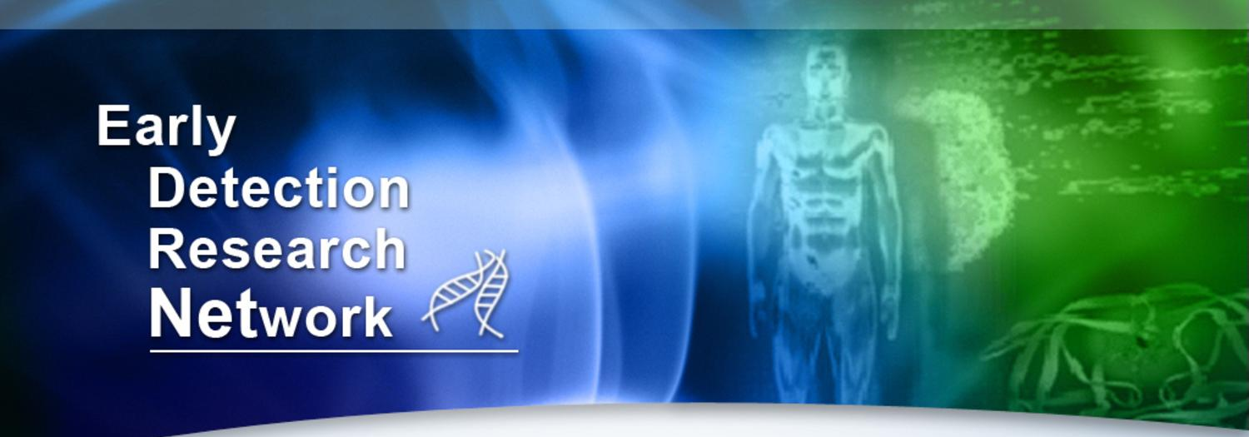
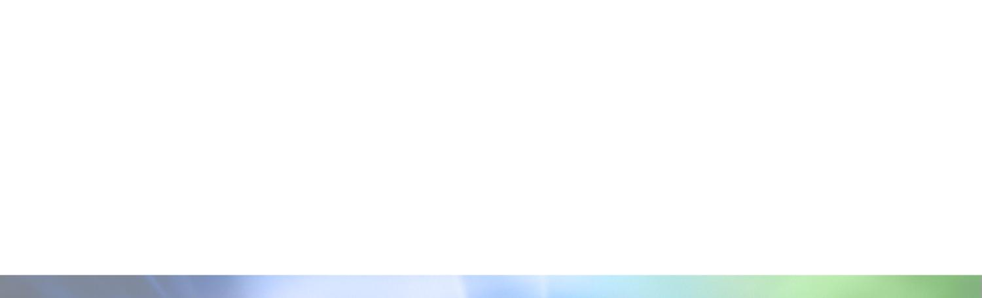
State-of-the-EDRN
Sudhir Srivastava
34th EDRN Steering Committee Meeting, March 18-20, 2019
Nashville, TN

Slide 2
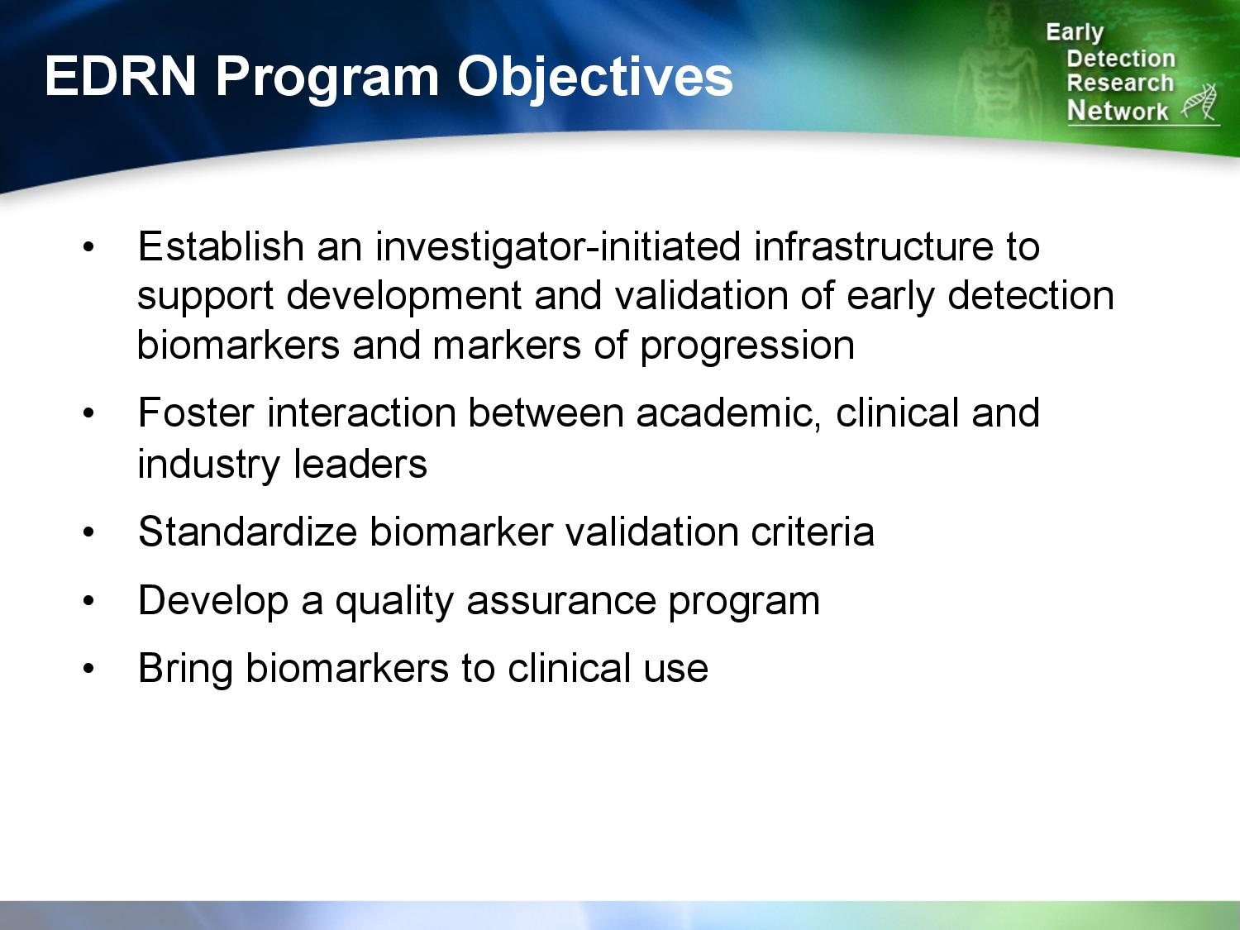

Slide 3
Organization of EDRN
Discovery
An “infrastructure” for supporting collaborative research on molecular, genetic and other biomarkers in human cancer detection and risk assessment.
Biomarker
Development
Laboratories
Biomarker
Development
Laboratories
Assay Development
Clinical Epidemiology &
Validation Centers
Validation
Network Consulting
Team
Chair: Larry Norton
Steering Committee
Chair: Joshua LaBaer
Co-Chair: Arul Chinnaiyan
Data Management & Coordinating Center
Director: Ziding Feng
Notes:
3
EDRN is a investigator-driven consortium of more than 200 investigators and 40 laboratories. It is structured around four major scientific components: BDL, BRL, CEVC, and DMCC. The Steering Committee is the major oversight committee, comprised of the Principal Investigators. DMCC provides logistics support and conduct research in statistical methodologies and manage and analyze data for the consortium. In collaboration the JPL, our Informatics Center, they help develop informatics infrastructures.

Slide 4
Scientific Advances
Scientific Advances: Technology, Approaches and Resources
Scientific Advances: Organ-specific Research
Resources
Partnerships
New Frontiers

Slide 5
Scientific Advances: Technology
High-resolution melt chip array platform developed for analysis of methylated DNA markers (University of Pittsburgh)
NAPA (Nucleic Acid Programable Array) for Glycomic Biology (ASU)
Antibody-free SRM Assays: Ovary and Prostate (PNNL, CPDR and NCI Investigators)
Radio-Phomic features extraction for small nodules/lesions with unknown clinical significance (Moffitt)
Deep Learning Approaches to Classify Lesions into low- or high-risk groups (Moffitt, Vanderbilt)
CancerSeek: A multi-analyte Diagnostic Assay for PanCancer detection

Slide 6
Scientific Advances: Breast and Ovarian Cancers
NAPPA technology to study immune response to autoantigens and their post translational modifications for early detection
Circulating plasma biomarkers of breast cancer using PDX models
Retrospective and prospective collection of 2D- and 3D-mammography images and blood samples to develop combined image features and circulating blood biomarkers for breast cancer
Phase 3 validation of blood-based biomarkers for ER+ breast cancer
Risk models for prediction of breast cancer
PapSeek test for early detection of OC Elucidation of the clonal relationship between high-grade serous OC (HGSOC) and its presumed precursor lesion, serous tubal intraepithelial carcinoma (STIC)
Phase 2 and 3 validation of auto-antibodies (AAbs) as early detection biomarkers for serous ovarian cancer (SOC)
Proteomic, Genomic, and Longitudinal Pathways to Ovarian Cancer Biomarker Discovery
Uterine Lavage tDNA and circulating protein BMs for early detection of OC. 8-site collaborative study under FHCRC IRB review. Patient accrual is anticipated to commence in July 2019.

Slide 7
Highlights: Breast Cancer - Highlights
Retrospective and prospective collection of 2D- and 3D-mammography images and blood samples to develop combined image features and circulating blood biomarkers for breast cancer. The Duke BDL/Moffitt CVC collaboration is actively accruing 3D-mammography images and fresh blood samples from cases and controls (BI-RADS 4); blood samples are being analyzed for the detection of Cancer-Associated Macrophage-Like (CAML) cells and other biomarkers, including CA125 and a number of TAAbs associated with TNBC
Circulating plasma biomarkers of breast cancer using PDX models to be used in conjunction with mammography (±ultrasound) to improve sensitivity and specificity during screening.
5,124 uniquely human peptides were identified in the plasma of breast cancer-bearing PDX mice, mapping to ~1,247 human proteins
Phase 2: Biomarker candidates are being tested in EDRN Breast Reference Set samples using Accurate Inclusion Mass Screening (AIMS), a new method developed for confident identification of human specific peptides

Slide 8
Highlights: Breast Cancer
Phase 2 and 3 validation of auto-antibodies (AAbs) as early detection biomarkers for serous ovarian cancer (SOC): Two collaborative studies (MDACC, ASU, FHCRC) have assembled a cohort of 950 samples (250 OC cases, 200 benign pelvic mass controls and 500 healthy controls) to determine the SEN, SPE and PPV of TAAbs to TP53 and other auto-antigens (MUC16, MSLN, IGFBP2 and ITGB8) to detect OC. Preliminary data using 3 different assays for TP53 AAbs indicate a SEN of 13.2%-21.6% at a SPE of 97.6% – 98%.
Proteomic, Genomic, and Longitudinal Pathways to Ovarian Cancer Biomarker Discovery (MGH BDL). Longitudinal pre-diagnostic case-control plasma samples from two screening studies (CGN and GOG-0199) analyzed by mass-spec/transcriptomics and iMRM of top 50 candidates, and by O-link discovery of 1,008 protein Proximity Elongation Assays (PEAs).
iMRM with 15 protein candidates: (HE4, SPINT1, TIMP1, IGFBP1, IGFBP2 + 10 novel BMs)
SEN=23%-38% at SPE=95%
O-link with 23 protein candidates: (MUC16, HE4, SPINT1, FR-alpha, KRT19 + 18 novel BMs)
SEN=38%-53% at SPE=95%
Uterine Lavage tDNA and circulating protein BMs for early detection of OC. The clinical protocol for the 8-site collaborative study has been developed and is currently under FHCRC IRB review. Patient accrual is anticipated to commence in July 2019.

Slide 9

Highlights: Breast Cancer Imaging
Wavelet expansion feature predicts breast cancer risk
Typical mammogram is decomposed with a wavelet expansion yielding a multiresolution view/level
The resulting levels capture detail at different spatial scales are significantly associated with 22% to 39% increase in breast cancer risk
Notes:
During conceptualization and implementation of the program, EDRN set out several key objectives: to establish an investigator-initiated infrastructure that would foster interaction among stakeholders; to standardize biomarker validation criteria; and, of course, ultimately bring biomarkers to clinical use.

Slide 10
Scientific Advances: Colon and GI Cancers
Protein and glycomic plasma markers for early detection of adenoma and colon cancer*
high-density antibody microarray with a 5 protein/glycomics panel
Phase 3 validation of early detection biomarkers for colorectal cancer
CancerSEEK: For detecting a variety of cancers
Pancreatic Cysts: Markers to detect whether or not cysts are likely to become cancerous
Swallowable Esophageal Sampling Balloon for the detection of esophageal cancer

Slide 11
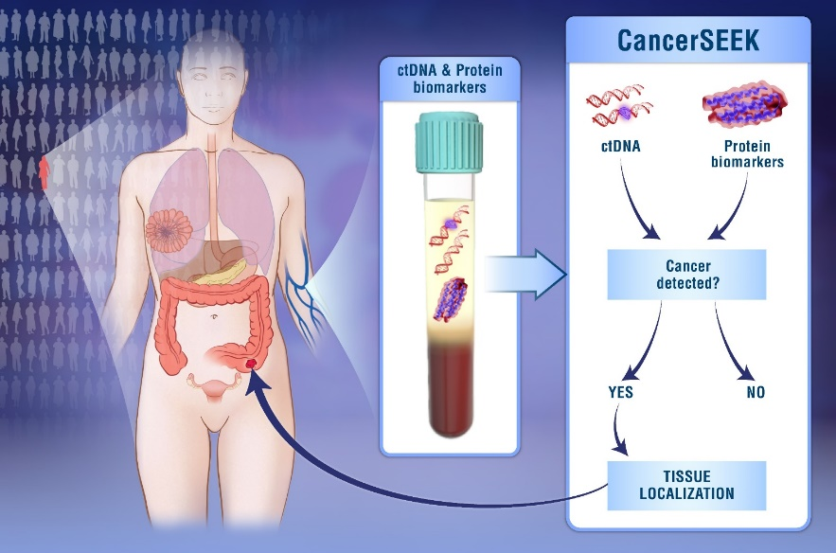
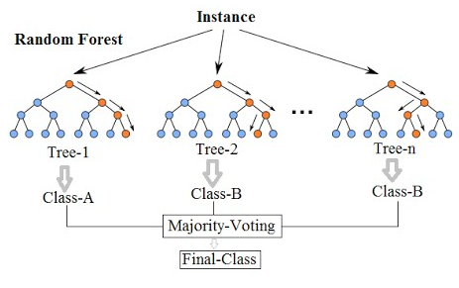
Highlight: Colon and GI Cancers
1. CancerSEEK*:
Single blood test that screens for eight common cancers
ovary, liver, stomach, pancreas, esophagus, colorectum, lung, or breast
16 genes, 61 amplicons, 8 protein markers
Sensitivity 69-98%, Specificity 98%
Site of Origin determination
Machine Learning (Random Forest) N=626
ctDNA data (gene level)
Protein data
Gender
Top Prediction was correct in a median of 63% of the cases. (p < 10-47 one-sided binomial test)
Top 2 Prediction identified the site in a median of 83% of the cases. (p < 10-77 one-sided binomial test)
* Cohen et al., Science, 2018
Notes:
Trees and Forests. The random forest starts with a standard machine learning technique called a “decision tree” which, in ensemble terms, corresponds to our weak learner. In a decision tree, an input is entered at the top and as it traverses down the tree the data gets bucketed into smaller and smaller sets.
Why is it called random then?
Say our dataset has 1,000 rows and 30 columns. There are two levels of randomness in this algorithm:
At row level: Each of these decision trees gets a random sample of the training data (say 10%) i.e. each of these trees will be trained independently on 100 randomly chosen rows out of 1,000 rows of data. Keep in mind that each of these decision trees is getting trained on 100 randomly chosen rows from the dataset i.e they are different from each other in terms of predictions.
At column level: The second level of randomness is introduced at the column level. Not all the columns are passed into training each of the decision trees. Say we want only 10% of columns to be sent to each tree. This means a randomly selected 3 column will be sent to each tree. So for the first decision tree, may be column C1, C2 and C4 were chosen. The next DT will have C4, C5, C10 as chosen columns and so on.

Slide 12
Highlight: Colon and GI Cancers
JASSS Balloon
2. Identifying DNA methylation biomarkers for non-endoscopic detection of Barrett’s esophagus**
Methylated DNA Biomarker Panel: mVIM and mCCNA1
Swallowable Esophageal Sampling Balloon
92% Specificity, 90% Sensitivity for Non-Dysplastic Barrett’s Detection
Joe/Amitabh/Sandy’s Swallowable Sampling Balloon
mVIM
mCCNA1
AUC: 0.91
N=36 controls 50 cases
AUC: 0.92
N=36 controls 50 cases
** Moinava et al., Sci.Transl. Med. 2018

Slide 13







Highlight: Pancreatic Cancer
NCI EDRN: Pancreatic Cyst Biomarker Validation Study
Telomerase
Glucose
DNA Methylation Markers
PancreaSeq
Amphiregulin
Gastricsin
Glycoproteins
Das-1
Data Management Coordinating Center
Cathepsin E
Pancreatic Cyst Biomarker Alliance

Slide 14
Promising Pancreatic Cyst Biomarkers
Assay (Pancreatic Cyst Biomarker Alliance Investigator) | Mucinous vs. Non-Mucinous Cysts
 | Sensitivity | Specificity
DNA Sequencing: KRAS, GNAS, VHL, CTNNB1, TP53, PIK3CA & PTEN (Aatur Singhi) | 86% | 100%
Protein expression: MUC5AC:WGA, MUC5AC:BGH & endorepellin (Brian Haab) | 92% | 94%
Amphiregulin expression & glucometer glucose (Walter Park) | 100% | 72%
Protease activity: Gastricsin & Cathepsin E (Charles Craik) | 93% | 100%
Assay (Pancreatic Cyst Biomarker Alliance Investigator) | Presence vs. Absence of Advanced Neoplasia
 | Sensitivity | Specificity
DNA Sequencing: KRAS, GNAS, VHL, CTNNB1, TP53, PIK3CA & PTEN (Aatur Singhi) | 88% | 100%
DNA Methylation: SOX17, FOXE1, PTCHD2, SLIT2, EYA4 & SFRP1(Michael Goggins) | 84% | 89%
Protein expression: Das-1 (Koushik Das) | 91% | 96%
Protein activity: Telomerase (Michael Goggins) | 74% | 93%
Notes:
So, among the areas of pathology that in my opinion there is room for improvement. One, our preparation and interpretation of solid versus cystic lesions is antiquated and needs to keep up with the changing times, changing technologies and changing clinical needs.
Two, which I think is fairly simple, an agreement in nomenclature and terminology – where all potential stakeholders are included in the discussion with clearly defined diagnostic categories that trigger specific clinical decisions. Do we really need a malignant category and 2 neoplastic categories?
And Three, as pathologists continue to ask more and more tissue from our gastroenterology colleagues, I think its also important for pathology to try to do more with what they are given. Technologic advancements in pathology should mirror those in gastroenterology. We shouldn’t put the onus on you and keep asking for more and more tissue, but try to meet you half way by improving our technology as you do yours.

Slide 15
Scientific Advances: Lung and Upper-Aerodigestive Cancers
High-resolution melt chip array platform developed for analysis of methylated DNA markers
A six gene panel of methylated genes has been determined for early detection of lung cancer
Validation of imaging, RNA signature, and protein biomarkers for lung cancer in IPNs.
Established a 1200 patient IPN imaging repository with clinical annotation.
Used radiomic and deep learning approaches to reclassify IPNs into low or high risk groups.
A RNA gene expression classifier from peripheral blood mononuclear cells (Pax gene tubes) can help distinguish benign from malignant
miRNA biomarker panel in sputum for early detection of lung cancer in CT-identified nodules are being sequence (whole-genome) using Illumina HiSeq to illustrate difference in progressor vs. non-progressor nodules
Notes:
During conceptualization and implementation of the program, EDRN set out several key objectives: to establish an investigator-initiated infrastructure that would foster interaction among stakeholders; to standardize biomarker validation criteria; and, of course, ultimately bring biomarkers to clinical use.

Slide 16
Highlight: Lung Cancer
Using the clinical information, imagining, and tissue repositories from DECAMP, verification of mRNA and miRNA signatures in nasal epithelium that distinguishes benign vs. malignant pulmonary nodules were performed and progressing well
A joint international clinical trial between NYU and Clinica Las Condes in Santiago, Chile is in full progress. Several markers are being validated including SMRP (soluble mesothelin-related protein)

Slide 17
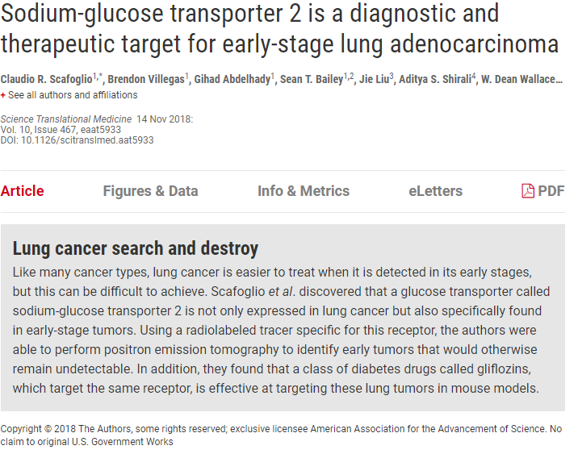
Highlight: Sodium-glucose transporter 2 is a diagnostic and therapeutic target for early-stage lung adenocarcinoma

Slide 18
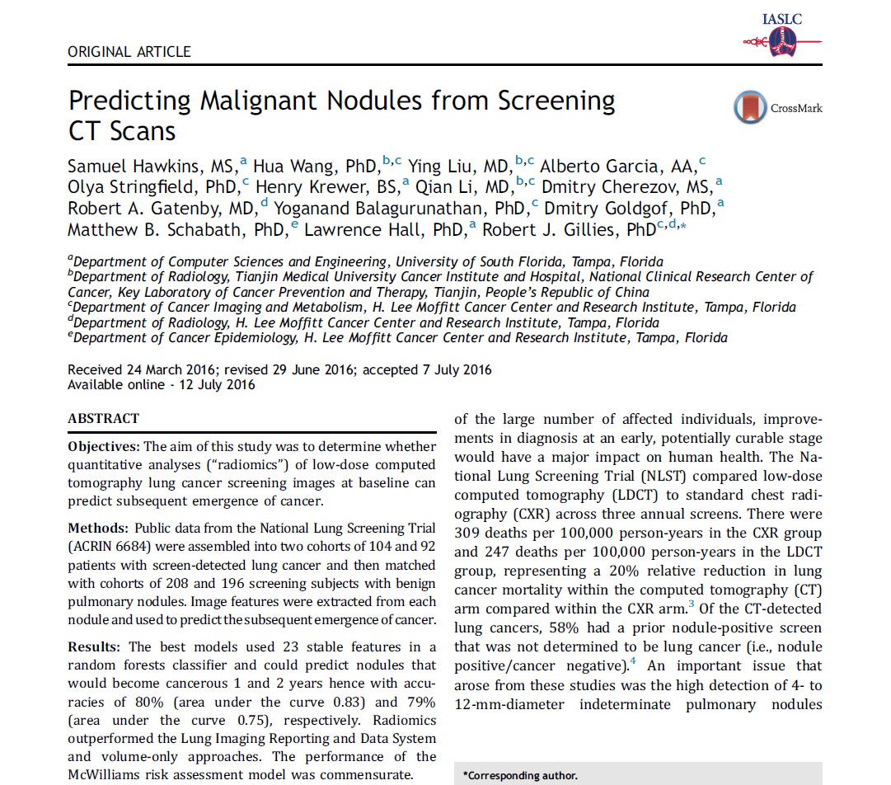
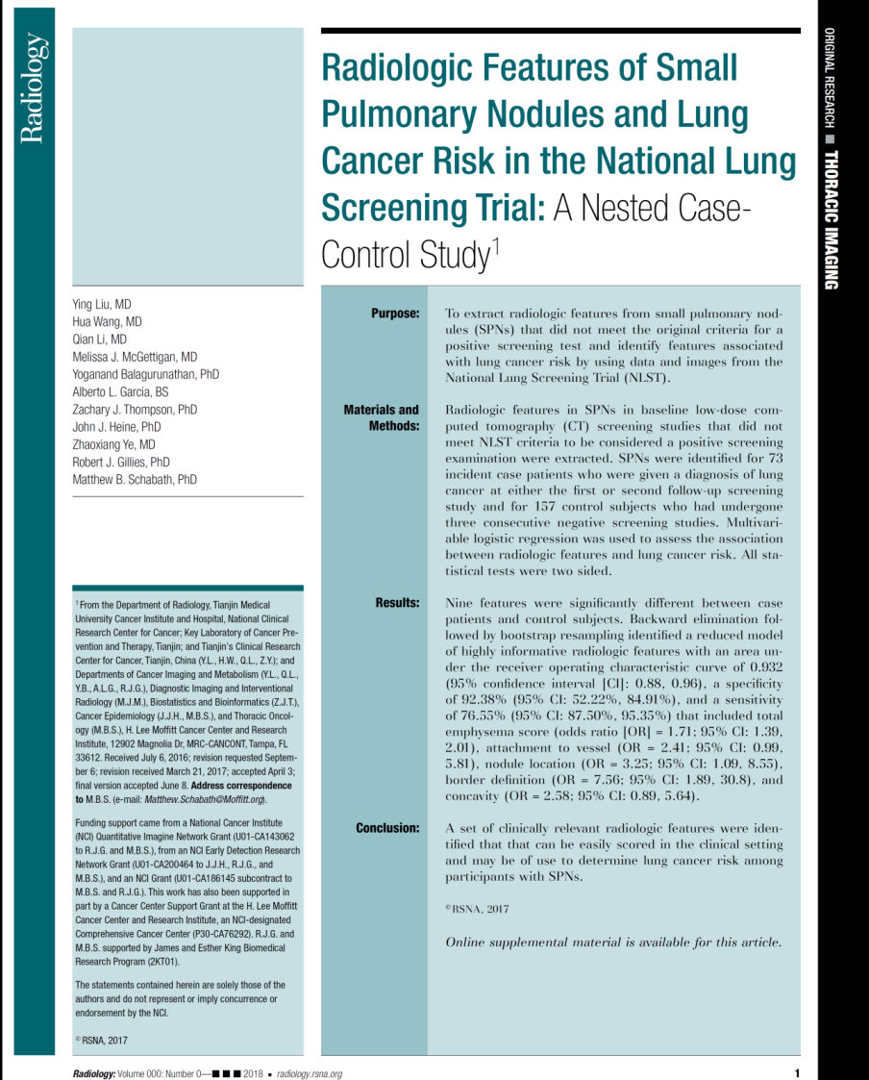
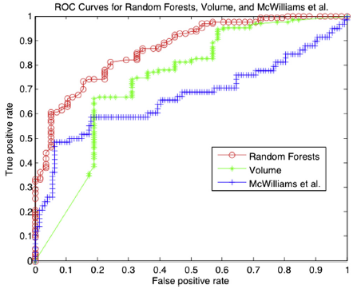
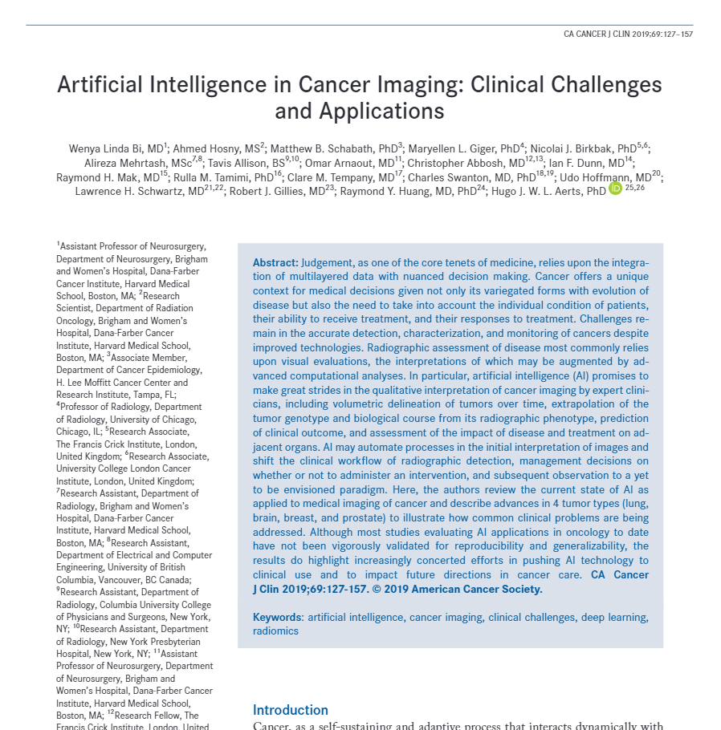
Highlights - Lung Cancer Imaging
Established image/biospecimen repository on ~3,100 lung cancer screening patients and ~2,600 incidental pulmonary nodule patients
Developed new 1) imaging pipelines to automate image curation and radiomic feature extraction and 2) analytical pipelines to identify the most informative models/features that are stable and reproducible
Applied machine learning, neural networks, and deep learning approaches to improve/validate radiomic features for risk prediction, diagnostic discrimination, and prediction of nodule/cancer behavior
Mapping radiomic features to genomic/biological underpinnings
18 publications, 3 under review, 5 in progress. A few highlights:
Radiomics outperformed Lung Imaging Reporting and Data System and volume-only approaches
A radiomic model of 5 features is
highly predictive of lung cancer risk (AUROC=0.94)
1.00
0.75
High-profile review in CA CANCER J CLIN on artificial intelligence in Cancer Imaging
Sensitivity
0.50
Demographics Only
Area under ROC curve = 0.613
0.25
Features Only
Area under ROC curve = 0.928
Features and Demographics
Area under ROC curve = 0.936
0.00
0.00
0.25
0.50
0.75
1.00
1 - Specificity
Notes:
During conceptualization and implementation of the program, EDRN set out several key objectives: to establish an investigator-initiated infrastructure that would foster interaction among stakeholders; to standardize biomarker validation criteria; and, of course, ultimately bring biomarkers to clinical use.

Slide 19
Scientific Advances: Prostate Cancer
Targeted proteomic approach to biomarker discovery
PRISM-SRM successfully develop for predictive biomarkers for aggressive prostate disease
Heath disparity shown among African and White Americans in pace of disease progression associated with deletion site on 3q13.31 which is mapped to the LSAMP gene locus
Potential glycosylated biomarkers assayed
Developed a post-DRE, whole urine-based targeted RNAseq assay for PCa early detection
Highly correlated to current clinically validated assay assessing T2:ERG and PCA3 (MiPS)
NGS platform allows for evolution of content

Slide 20
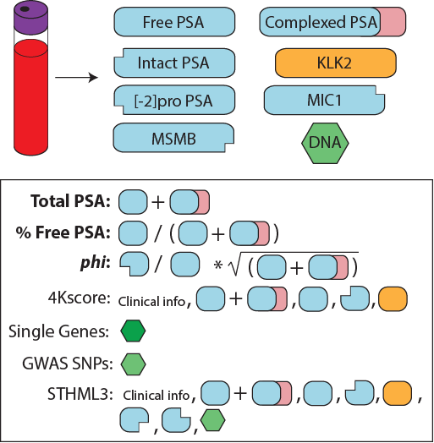
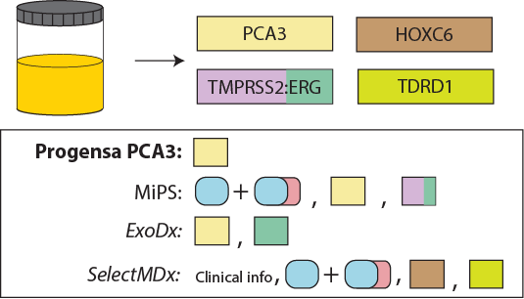
Highlight: ?Prostate cancer early detection tests on the horizon
None specifically use markers of aggressive prostate cancer
Notes:
Numerous early detection assays for prostate cancer. None specifically use markers of aggressive prostate cancer

Slide 21
Research Highlights
Highlight: LncRNA as Potential Biomarkers
Established MiPS-NGS assay
Discovered/characterized novel lncRNA biomarkers (PCAT14, ARLNC1, and THOR)
Identified CDK12 a biomarker for sensitivity to immune checkpoint inhibitors
Wu, Cieslik, Robinson et al, Cell 2018

Slide 22
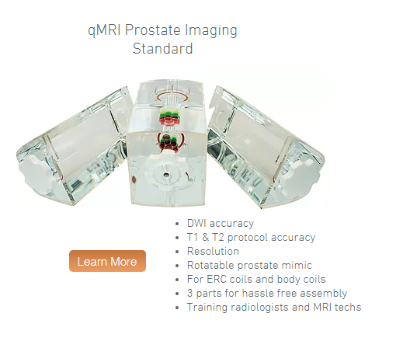
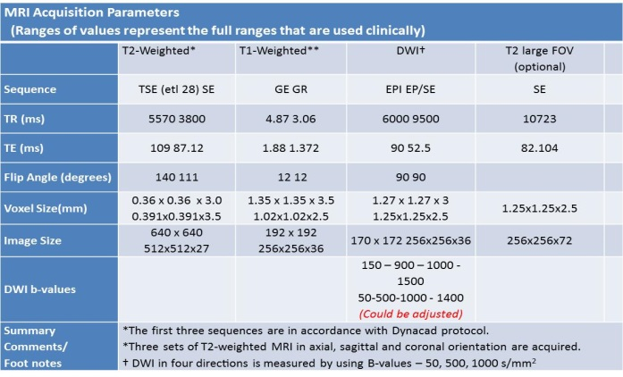
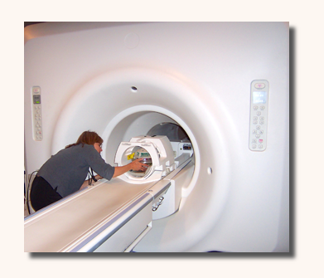
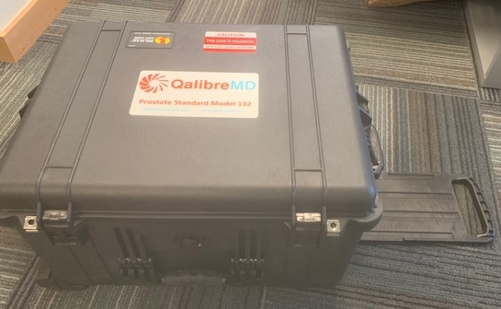
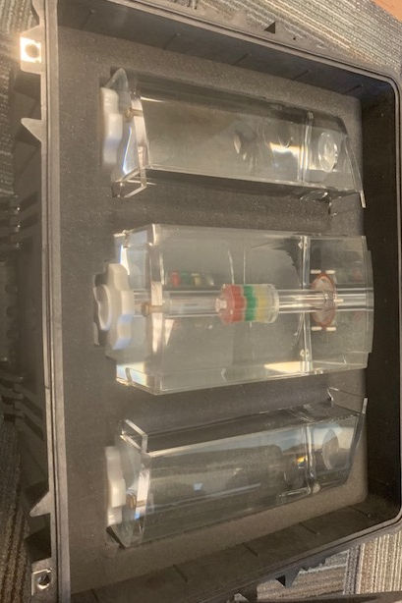
Highlight: Prostate Cancer Imaging
Phantom Study
1. Deploy a quantitative phantom to study the DWI variability in a scanner and across three participating sites.
During the next year, we will scan this phantom a minimum of 3 times at Moffitt, Michigan, U Miami using a Siemens Skyra 3.0 T system with a 32-channel phased array Body Coil
Progress:
We converged on the scanner parameters obtained from three centers.
Set aside funding was released in Oct 2018.
Physical phantom received 3/12/2019
Notes:
During conceptualization and implementation of the program, EDRN set out several key objectives: to establish an investigator-initiated infrastructure that would foster interaction among stakeholders; to standardize biomarker validation criteria; and, of course, ultimately bring biomarkers to clinical use.

Slide 23
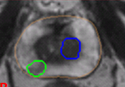
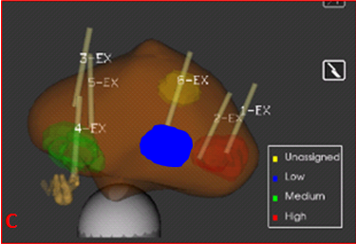
Highlight: Prostate Cancer Imaging
Evaluate Prostate Biopsy System & Radiomics
Aim 1:Evaluate US TRUS Biopsy System
Obtain needle tracks for the targeted biopsy system
Aim 2:Radiomics at the biopsy location
Obtain radiomic characterization around the region of the biopsy.
Aim 3: Statistical Analysis
Ability of targeted biopsy to find clinically significant cancers compared to core biopsy.
Evaluate variability of TRUS biopsy system.
Progress:
We started our discussion with Research groups at DynaCAD Uronav to obtain digital map (Dicom RT) of the needle locations.
Preliminary 2D maps and locations has been exchanged. Pending institutional NDA agreement and/or server purchase, full disclosure will be obtained.
Currently they provide rendered image with biopsy locations.
Notes:
During conceptualization and implementation of the program, EDRN set out several key objectives: to establish an investigator-initiated infrastructure that would foster interaction among stakeholders; to standardize biomarker validation criteria; and, of course, ultimately bring biomarkers to clinical use.

Slide 24
Scientific Advances: Resources
High-Risk Cohort for Pancreatic Cancer (Gloria Peterson, Mayo)
Prostate Active Surveillance Study (PASS) Cohort with Canary Foundation
EDRN-DOD Collaboration on The Detection of Early Lung Cancer Among Military Personnel-1 (Nodule Cohort)
EDRN-DOD Collaboration on The Detection of Early Lung Cancer Among Military Personnel-2 (Screening Cohort)
Pancreatic Cancer Biomarker Hybridoma Cell Lines (Lustgarten)
New Onset of Diabetes (NOD) Cohort for Pancreatic Cancer; collaboration with NCORP, PanCAN
NCI-JPL Informatic resources, tools and data science
NCI-NIST QA program on measurements and reference samples
NCI-PNNL Mass Spectrometry Infrastructure

Slide 25


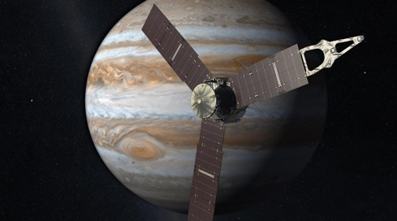
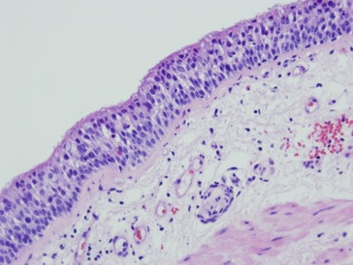

NCI/JPL Data Science Collaboration: Crossing Disciplines
Development of an advanced Knowledge System to capture, process, share and support reproducible analysis for biomarker research
Working with three key programs in cancer research (~100 investigators)
Genomics, Proteomics, Imaging, etc data types of data
NASA-NCI partnership, leveraging informatics and data science technologies from planetary and Earth science
Reproducible, Big Data Systems for exploring the universe
Software and data science methodology transfer
Notes:
An interagency agreement was formed between NCI and JPL allowing us to leverage the systems already developed in planetary and earth science to create an advanced knowledge system to capture and share biomarker data for EDRN

Slide 26
Integration of multiple computational pipelines for data integration on cloud and locally hosted
“LabCAS”
Integrated Knowledge
Database
Instrument
Publish Data Sets with
Common Data Elements
Biomarkers
Sequencer
Laboratory Data Repository
Science Data Processing Algorithm
Image Data
Pathology Data
Genomics Data
Instrument
Publish Data Sets with
Common Data Elements
Protocols
Sites
Laboratory Data Repository
Imaging
Science Data Processing Algorithm
Instrument
Publish Data Sets with
Common Data Elements
Other Resources
NCI Imaging
Data
caBio
Other
Resources
Laboratory Data Repository
Pathology
Science Data Processing Algorithm
Scalable computing, common data elements, computational methods
Notes:
Here’s an example of creating data pipelines. This is something that is being developed with the EDRN and MCL programs, but the notion is towards enabling more and more data integration and interactivity with analytical tools

Slide 27
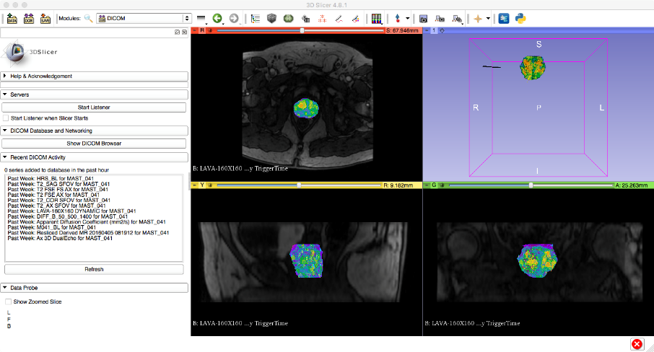
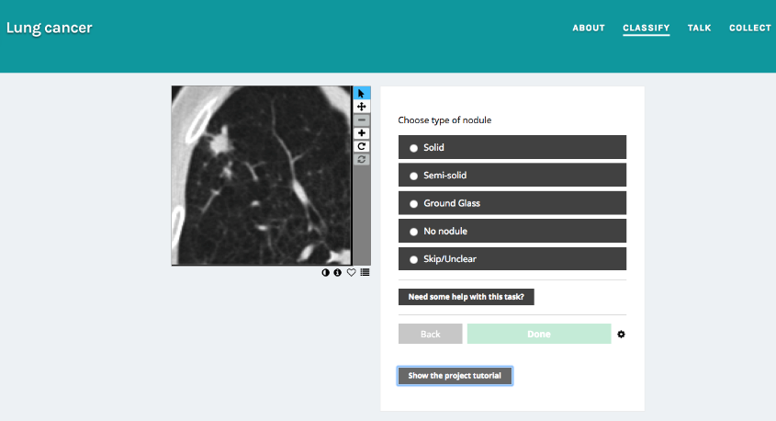
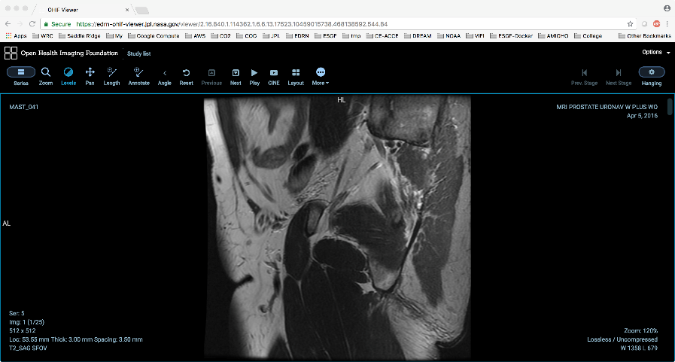
Analytical Methods and Tools to Integrate Diverse Data
Apply machine learning and deep learning methods and libraries into data pipelines and data commons
Plug-in many open-source viewers and analytical tools (client and server side)
caMicroscope
OHIF DICOM Viewer
3D Slicer
Crowd sourcing analysis
Image archive for multi-site studies for EDRN and MCL programs
Scale on the cloud
Notes:
It is important that the focus remains on the development of the ECOSYSTEM and not a specific tool. Those will come and go and can be plugged in as they become available to meet specific consortium needs!

Slide 28
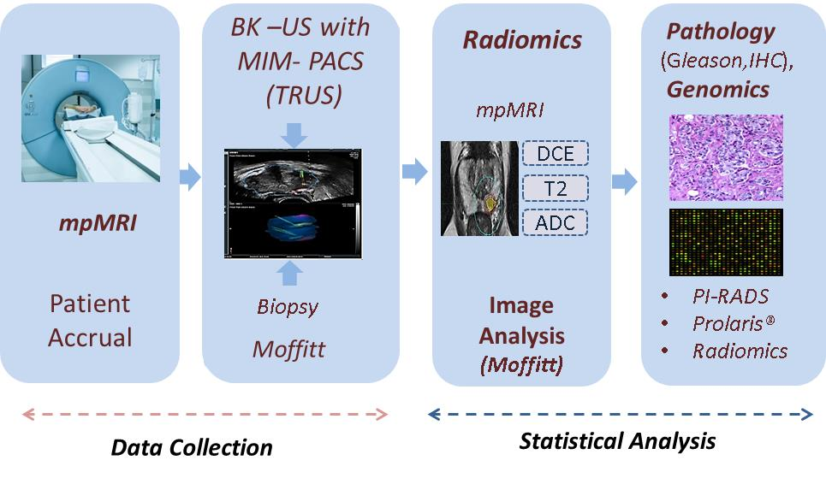
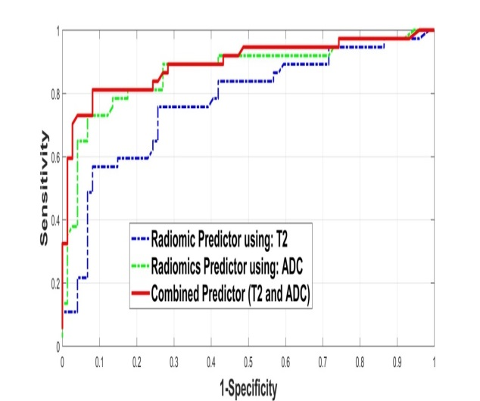
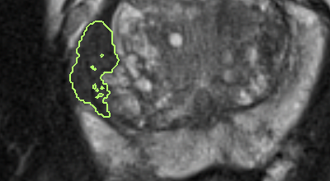
Highlights: Prostate Cancer Imaging
* Goal is to find regions in the prostate biopsy to obtain risk assessment for the patients.
Combined radiomic Predcitor (T2, ADC) is ~0.84
(Sample size: ~54 Patients).
Features
(T1, ADC,DCE)
Redundancy Reduction
Discriminator
Analysis
ROI
Notes:
During conceptualization and implementation of the program, EDRN set out several key objectives: to establish an investigator-initiated infrastructure that would foster interaction among stakeholders; to standardize biomarker validation criteria; and, of course, ultimately bring biomarkers to clinical use.

Slide 29
EDRN-DOD Collaboration on The Detection of Early
Lung Cancer Among Military Personnel-1 (Nodule Cohort)

Slide 30
EDRN-DOD Collaboration on The Detection of Early Lung Cancer Among Military Personnel-2 (Screening Cohort)

Slide 31
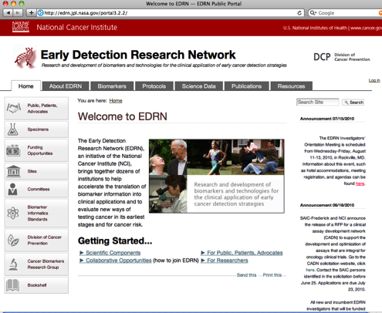
Various Portals: Dissemination and Access to Biomarker Data
Gateway to information
Integration of internal and external information
Access to research data and analytical tools
Google-like search
Multi-level Security
http://cancer.gov/edrn
http://mcl.jpl.nasa.gov

Slide 32
Research Partnerships with Federal and Not-for-Profit Entities
Federal Partnerships
- National Institute of Standards and Technology (NIST)
- Jet Propulsion Laboratory, NASA
- Pacific Northwest National Laboratory (PNNL)
- Center for Prostate Disease Research (CPDR), Department of Defense
International Partnerships
- Japan Agency for Medical Research and Development (AMED)
- Chinese Academy of Medical Sciences China EDRN (Beijing and Shanghai)
- Clínica Las Condes/Universidad de Chile, Chile (Mesothelioma project)
Foundations
- Lustgarten Foundation
- Kenner Family Research Fund
- Pancreatic Cancer Action Network (PanCAN)
- Canary Foundation

Slide 33



JOINT STATEMENT ISSUED ON 30TH SEPTEMBER 2014
Honorable Prime Minister of India Shri Narendra Modi and President Barack Obama agreed in principle to initiate cooperative activities to increase capacity in “Translational cancer research”, including by developing collaborative programs for and with India's upcoming National Cancer Institute- India, AIIMS, New Delhi

Slide 34
EDRN Serves as HUB to Many Sister Programs (Spokes)
MCL
Alliance
US EDRN-Japan
Programs
Early Detection Research Network (EDRN)
Molecular and Cellular Characterization of Screen-Detected Lesions (MCL)
Alliance of Glycobiologists for Cancer
Exosome-Derived Analytes for Cancer
Consortium for Imaging and Biomarkers (CIB)
Liquid Biopsy for Early Cancer Assessment
Consortium on Translational Research for Liver Cancer
Pancreatic Cancer Detection Consortium (PCDC)
Chronic Pancreatitis, Diabetes and Pancreatic Cancer (CPDPC)
Pre-Cancer Atlas (PCA)
Inert Agency Agreements (IAA)
National Institute of Standards and Technology (NIST)
Pacific Northwest National Laboratory (PNNL)
Center for Prostate Disease Research (CPDR)
Exosome-Derived Analytes
NIST
EDRN
CIB
CPDR
US EDRN-Chile
PNNL
Liquid biopsy
US EDRN-China
JPL
CTRLC
PCDC
PCA
CPDPC

Slide 35
It’s a Village: The Cancer Biomarkers Partners
Private Enterprises
Patient Advocacy Groups
Academia
CBRG
Federal Agencies and International Partners
(Other NCI Programs, NIST, CPDR, JPL, FDA)

